Slide 1
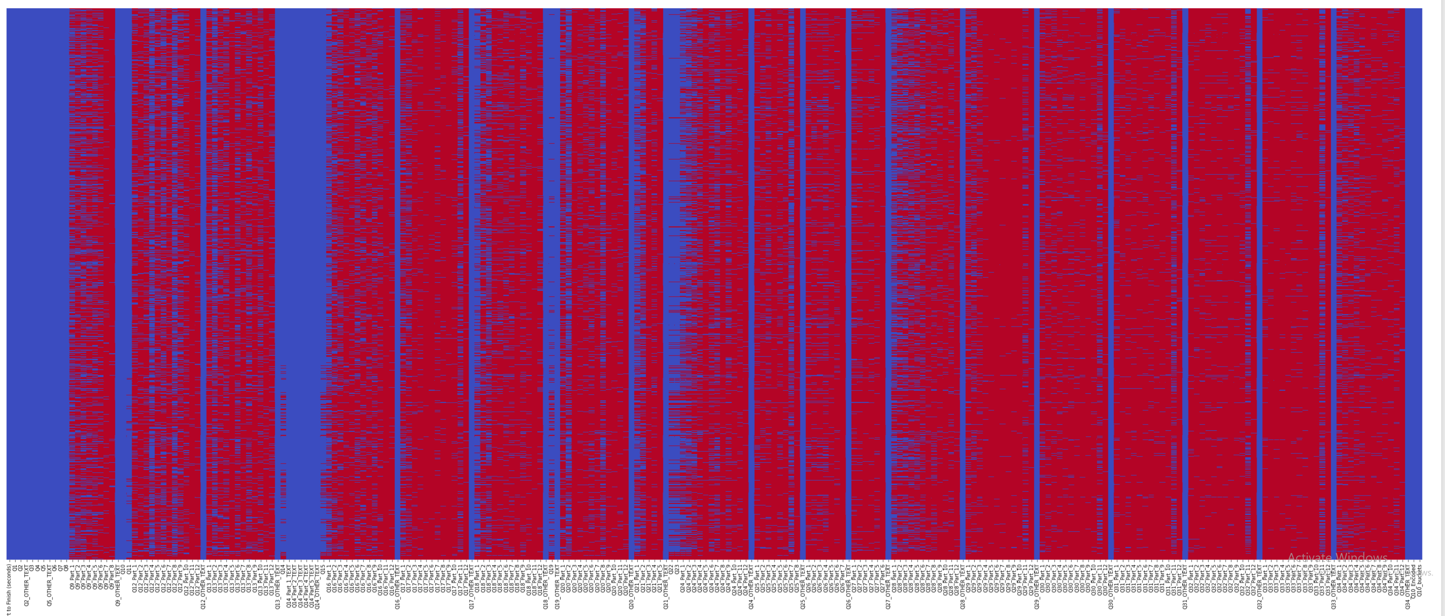
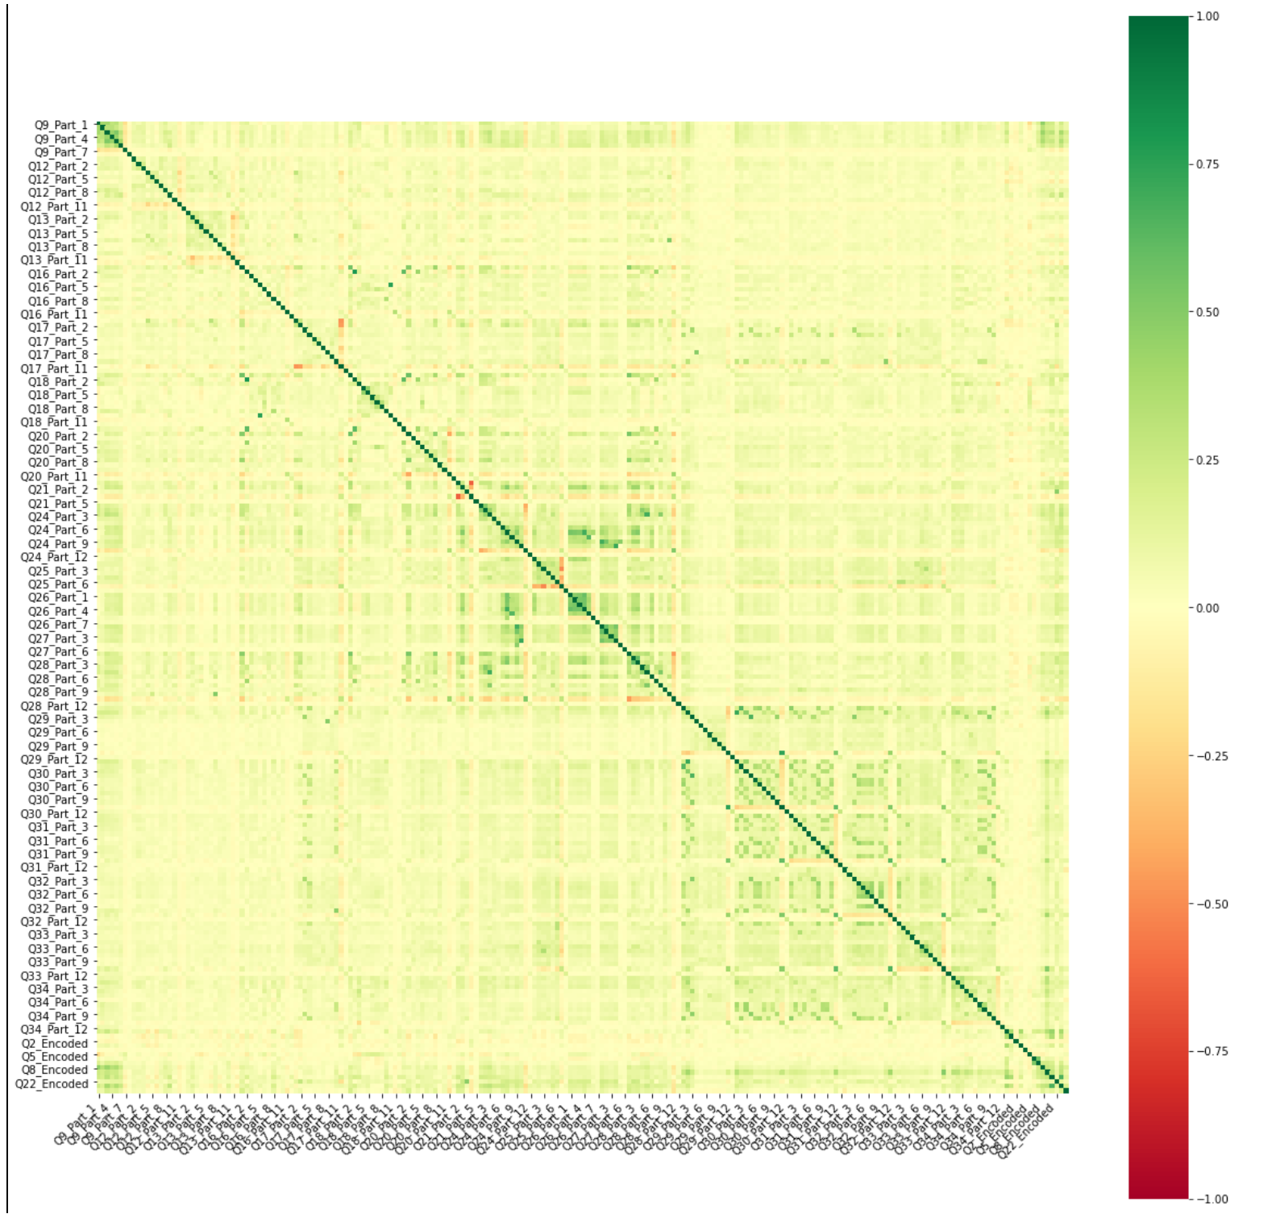
Data Cleaning
Initially we got a significant amount of missing data
After cleaning and filling in missing value we achieved the following correlation plot
Significant amount of time was spent cleaning the data.
Different methods were used to deal with missing data such as: replacing missing values with mode where column null value < 20%
Any column with null value less than 2% the corresponding rows were dropped

Slide 2
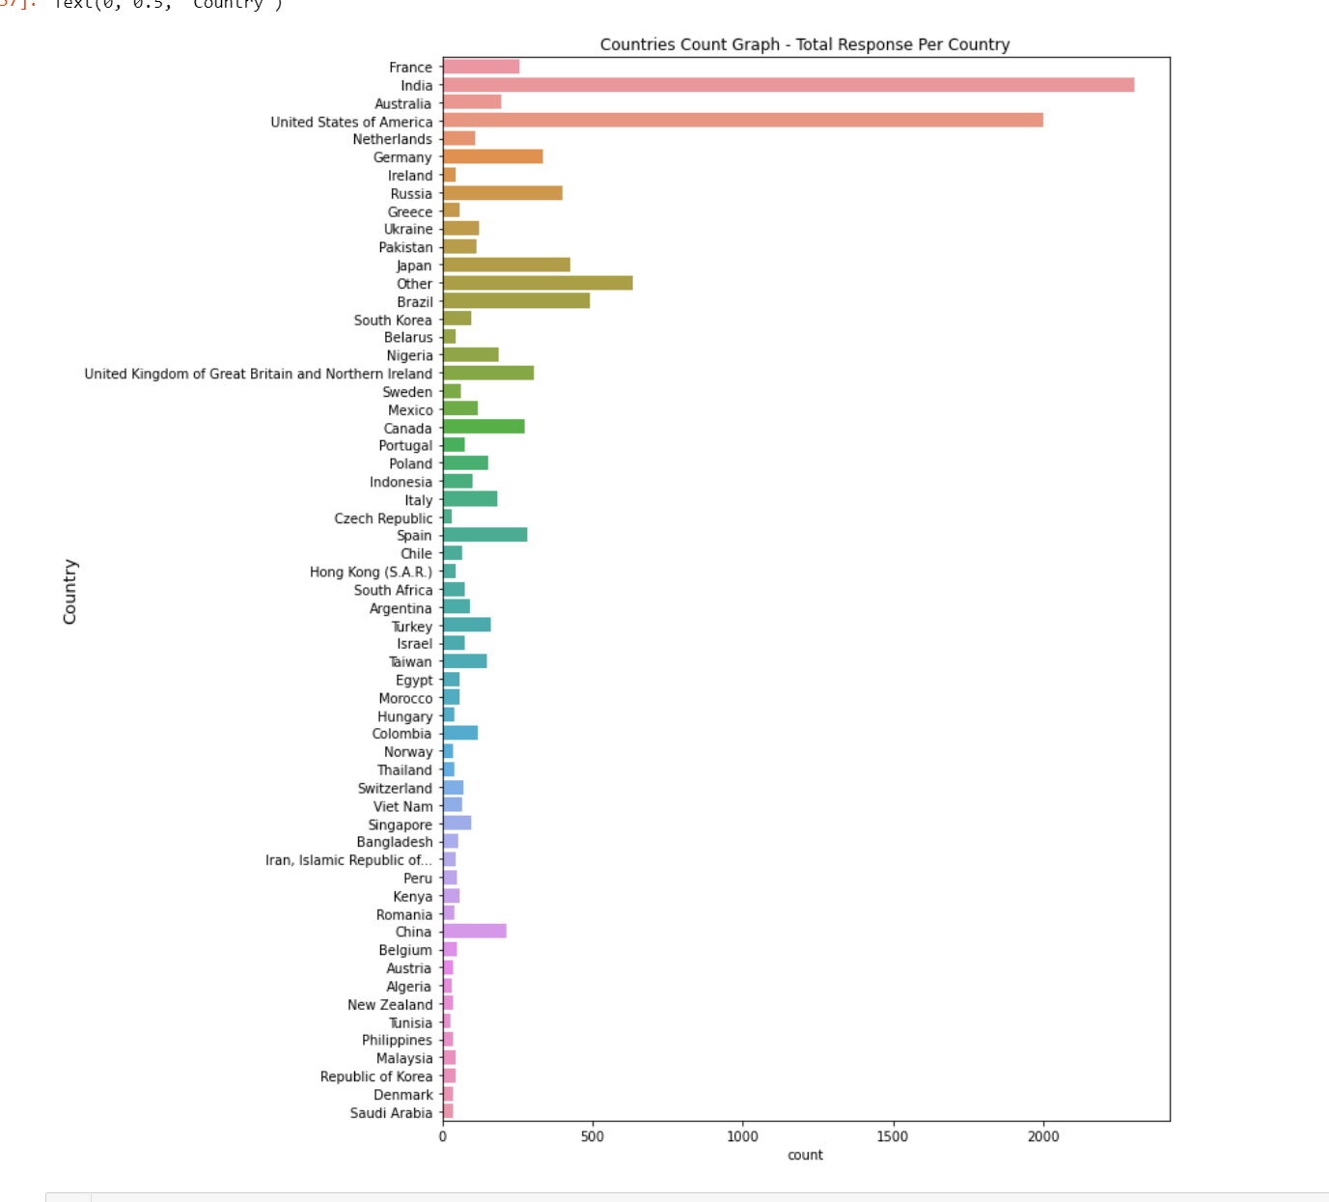
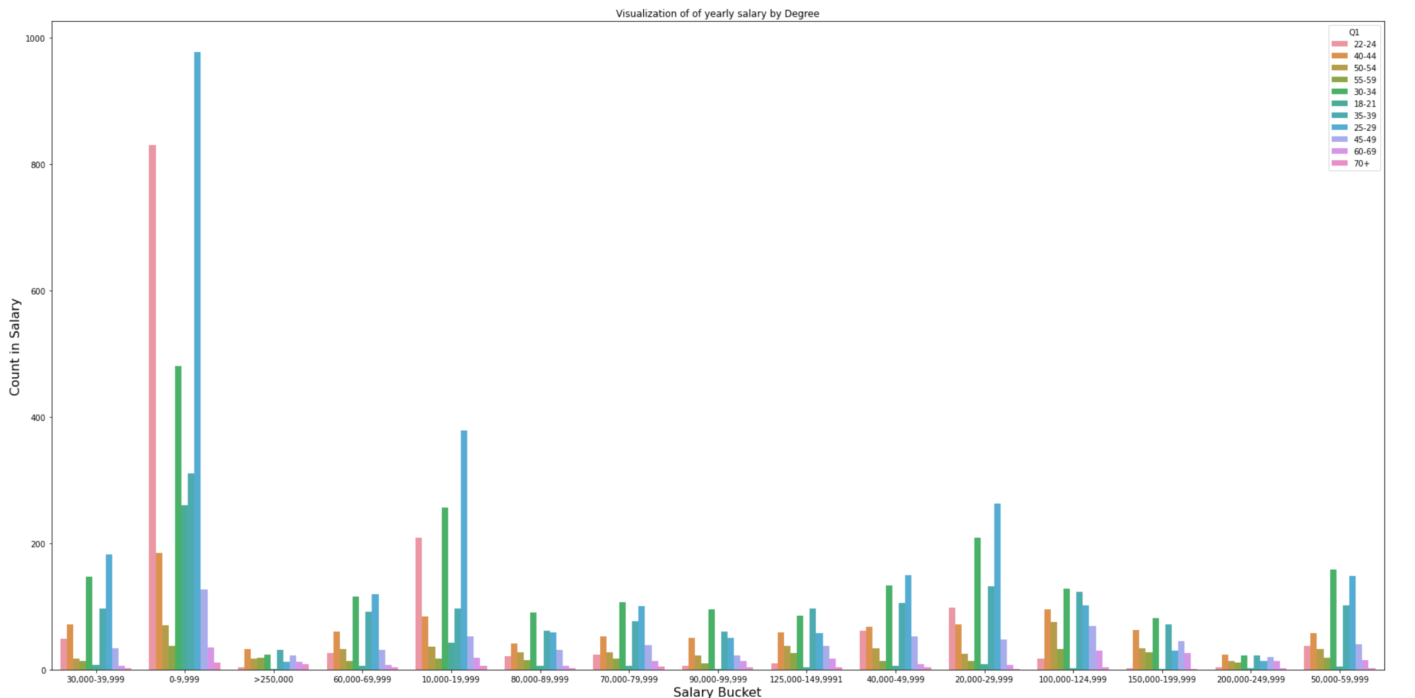
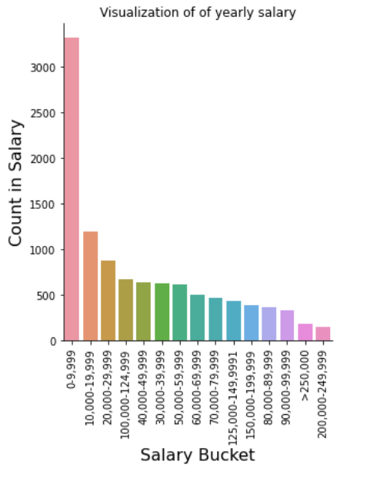
Exploratory Data Analysis
Visualization of Yearly Salary by Age
Count plot of Salary Buckets
These are the Feature importance showing top 15 features
Count plot of country

Slide 3
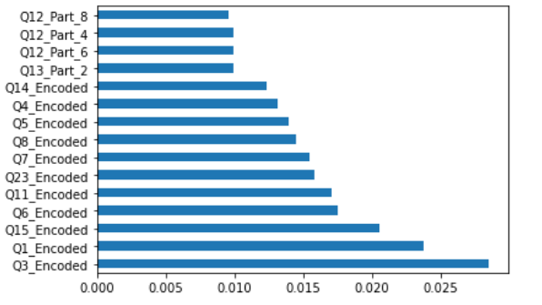
Feature Selection
Feature Importance Ranking
For Feature selection we used 4 methods.
1st was correlation map however due high number of features we were not able to interpret properly.
2nd Recursive Feature Elimination was used to clean the features and pick the features which were robust. This narrowed down our features from 216 to 107
3rd We also used Feature ranking to see the features with higher importance.
4th Chi-Squared test was also used for feature selection process.
Features from method 3 and 4 were compared to feaures in method 2. Since Method 3 and 4 had almost similar features in top 107 as features . Features from RCE were used for our model

Slide 4
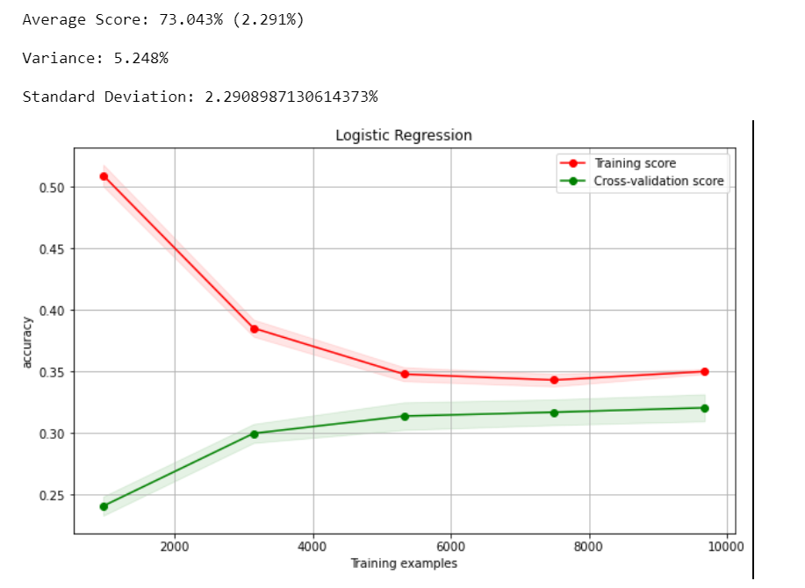
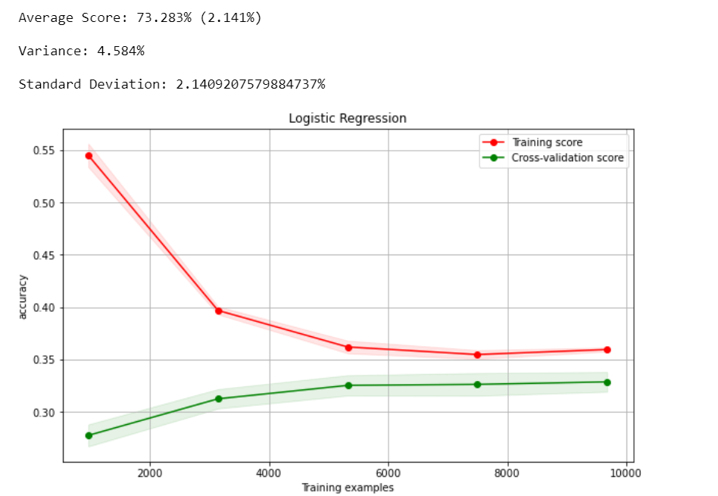
Model Implementation
Looking at the learning curve we can see that the model have very close accuracy. However in our scenario we noticed the accuracy was about 73% which was the result of underfitting.
This could also be due not having training data or features.
Additionally our data set had a lot gaps which were replaced and filled with label encoding, and data cleaning techniques. This could cause some irreducible error in the data.
To improve the accuracy of the data we used grid search technique to find the best values for our hyper parameters.
So the final result were
C=0.01 and solver = liblinear.
We also sed L1 regularization penalty for this

Slide 5
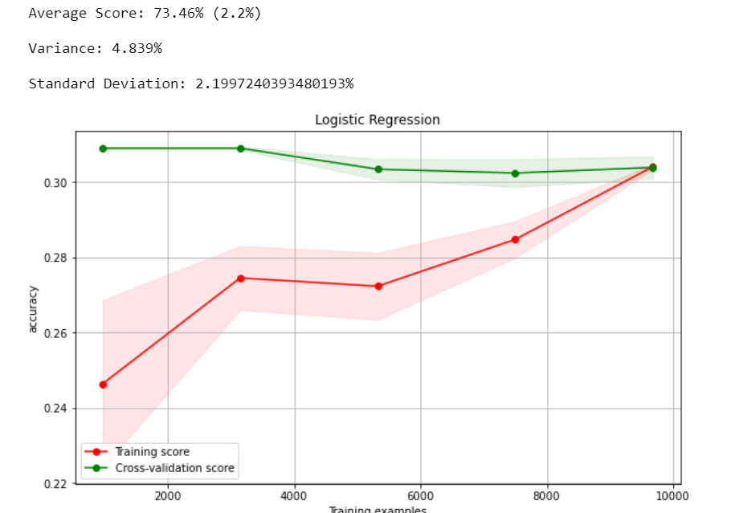
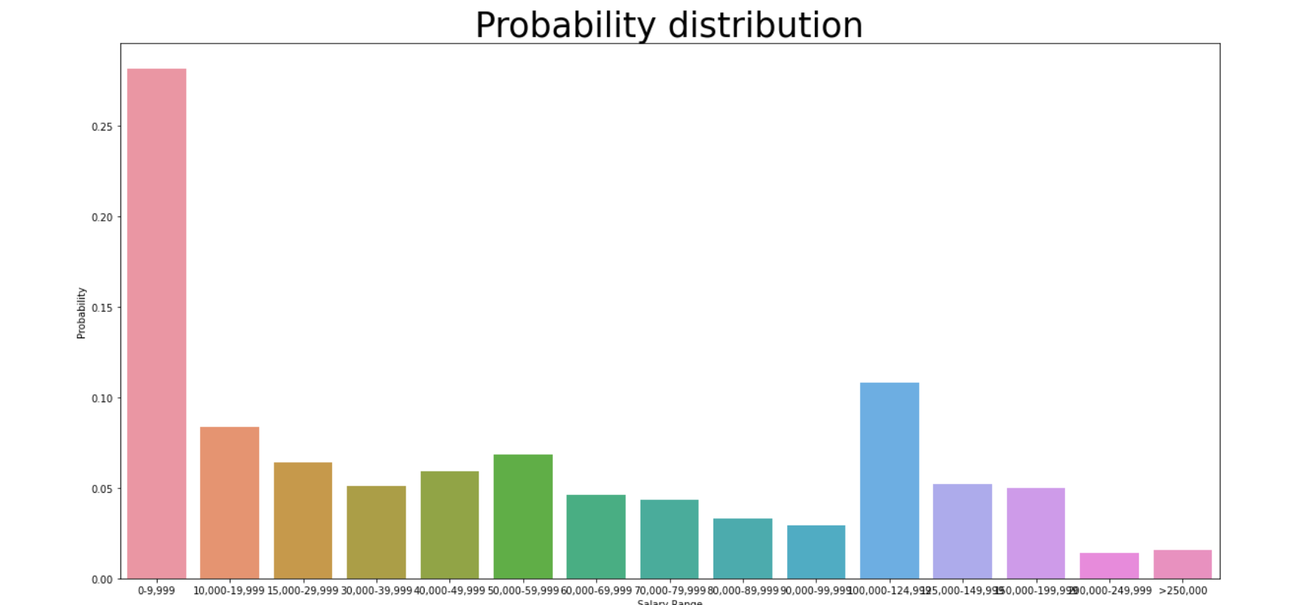
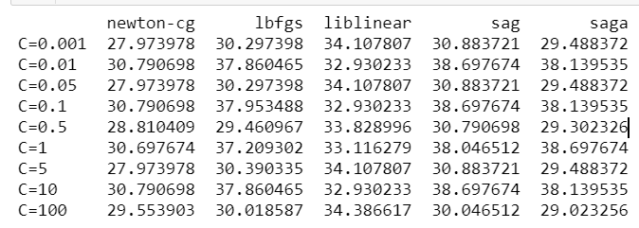
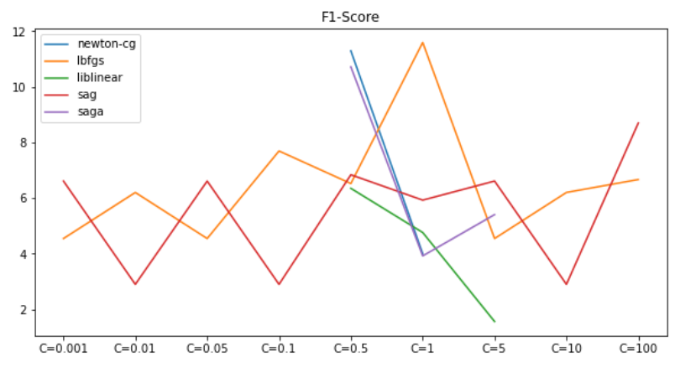
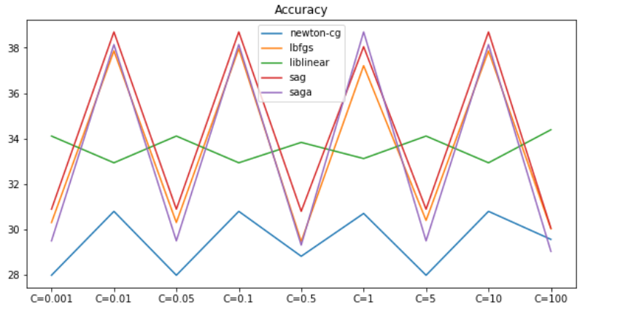
Model Tuning and Discussion
Model Prediction probability graph
Model using the Optimized Hyper Parameters
The model still has issue predicting. Since the gap between the training and testing decreased it can be said that the model may not be underfitting however, the model is overfitting. As we have high bias in test set and 0 variance

