Slide 1


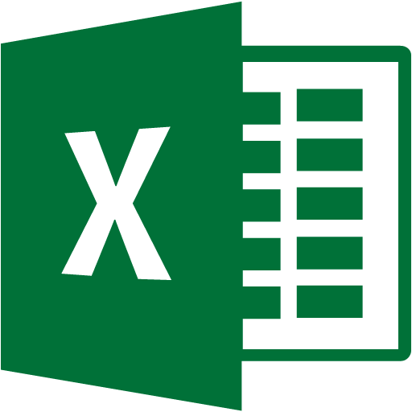



“Tonadoes loss” Cloud System Architecture
Azure Machine Learning &
Azure Web Apps
Data
Consumers
Data
Model
ML Web Services
(REST API Services)
API
ML Studio
(Web IDE)
Excel
Cloud storage
CSV Data
Manage
Workspace:
Experiments
Datasets
Trained models
Notebooks
Access settings
Web App
API
Web Site
Azure ML Gallery
(community)
Data
Modeling
Web App
Clients

