Slide 1
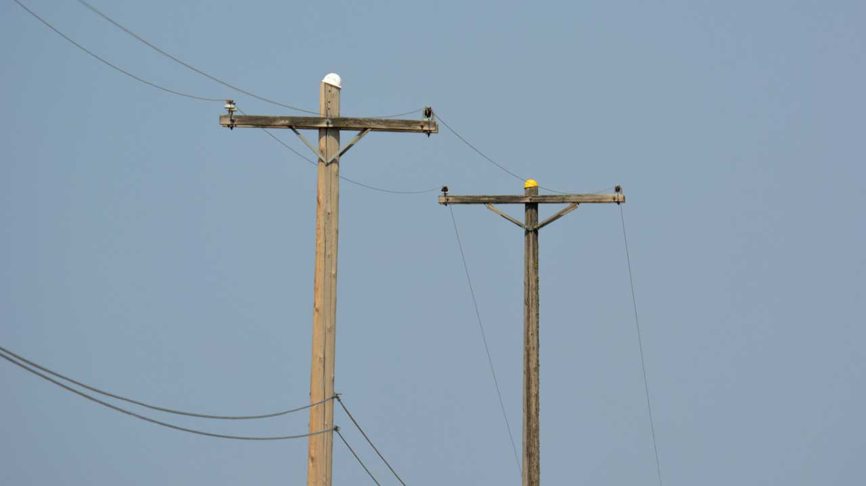
Discovering Wooden Poles using Object Detection
Τ.Α. Geoforce P.C.
https://tageoforce.com
Athens, 2019
Notes:
Good evening and thank you for your invitation @ your offices.
We are going to present to you our proposal “Discovering Wooden Poles using Object Detection”
[click]

Slide 2
Agenda
Introduction
Current status
Project proposal & main objective
Working packages
Advantages & disadvantages
Methodology
Excepted results
Validation
Deliverables
T.A. GEOFORCE
Notes:
Agenda
Introduction, where we are going to say few things about T.A. Geoforce
Current status, where we will present all the input data that you have shared with us
Project proposal & main objective, our proposal for this project and what is the main purpose of it.
Working packages, a minimal presentation of the Work packages for the first initial stage of the project
Few things about advantages and disadvantages (risks, etc…)
The methodology that we following in out AI projects
Excepted results, how the model’s results are visualized and what we expect to see
Few things about the validation of the data
Deliverables of the project.
[click]

Slide 3
Introduction
T.A. Geoforce is a company specialized in:
Big Data analytics,
AI services,
Spatial Intelligence solutions
It follows three (3) basic principles:
Openness
Interoperability
Sharing
T.A. GEOFORCE
Notes:
Introduction
T.A. Geoforce is a pioneer company specialized @ innovating ideas in data-analytics.
The main sections that we are working are:
Big Data analytics
AI services (such us Deep Learning, Machine Learning, Predictive Analytic Services)
Spatial Intelligence solutions (GIS, BIM)
Our company is founded on three principles and these are:
Openness, where most of our work is published under Open license.
Interoperability, where the data and services that we develop are follow international standards
Sharing, working with our clients we share the knowledge where we create together.
[click]

Slide 4
Current status
- There are around 6 million wooden poles installed on the land area of Greece.
- The client wants to discover the exact location of these wooden poles, using innovation techniques.
- The wooden poles are having 6 meters height and the length of the cable from the main switch is known.
T.A. GEOFORCE
Notes:
Current status
As you have said to us – in the previous meeting we had – there are about 6 million wooden poles installed, that create your national on land telecommunication cable network.
The lack of knowing where exactly is the location of these wooden poles, creates a lot of issues, like maintain and expand the current network, calculate the services cost, evaluate the current network work load.
The characteristics of these wooden poles are:
6 meters height
The length of the cable from the main switch.
[click]

Slide 5
Project proposal & main objective
T.A. Geoforce can provide an innovative way to discover wooden poles using earth-observation imagery.
It will be developed an Artificial Intelligence solution, where using deep learning techniques will be created an automate process of wooden poles identification.
The objectives of this project are:
To be delivered a point dataset of the wooden poles. (as completed as possible)
To be created new knowledge of discovering objects using earth observation imagery.
T.A. GEOFORCE
Notes:
We – T.A. Geoforce – can provide you innovative solution for discovering wooden poles using earth-observation imagery.
Our experience makes us continuously evolve together with our clients, providing to them AI solutions using best practices, state of art techniques and cutting-edge technologies.
Our proposal is to develop an AI solution where the discovering automatically wooden poles using Deep Learning techniques.
The objectives of this project are:
First, deliver a point dataset with the wooden poles of your network.
Secondly, create new knowledge which will give added value your data and systems.
[click]

Slide 6
Working packages
Developing technical specifications
Management & coordination
Implementation architecture
Collecting datasets
Developing experiments & models
Evaluation
Dissemination
Working members
T.A. Geoforce
Client
T0
T1
T2
T3
Report
T4
Specifications
Report
Report &
Final Deliverable
WP1
WP2
WP3
WP5
WP7
WP4
WP6
T.A. GEOFORCE
Notes:
We propose the first initial stage of this project can take place with a test area:
small enough for not creating a big cluster for processing
Large enough that will have the data that it needs for create a good model.
Working together, we can split the whole project into 7 working packages
Developing technical specifications, where together we will work on technical specifications on the project, so the deliverables will be evaluated by the criteria which will be specified.
The management and coordination of the project, where our team will lead this part.
We will design the architecture of the implementation so the project will be easily scalable and reproducible.
Search and collect data from different data sources so we can have a sucessfull model.
Developing the experiments with special data preparation techniques, using all the necessary ml algorithms and evaluating the models that will be created
Evaluation, we will create a reliable evaluation mechanism as it will be described in the specification technical document.
Finally, dissemination and exploitation where together will be work on sharing the new knowledge that will be created.
The chart below shows the 4 periods, in which at the end of each period you will have a report with the status of the project and at the end the final deliverables.
The periods are showing relatively how much human/working-hours/difficult each stage is.
[click]

Slide 7
Advantages & disadvantages
New knowledge will be created
Faster than the traditional implementation
Easy to be re-executed (partial/ total)
New imagery can be used to monitor the status of the poles
Challenging project
Bleeding cutting-edge technologies
Risk of many False - Positives
In-situ validation difficulties
T.A. GEOFORCE
Notes:
Advantages and disadvantages for this project are:
Advantages:
The most important is that new knowledge will be created so, it will be used in other use cases in-house. This will also will be give points of experience in your work.
If we were trying to send groups of people outside it would take longer –the traditional way- it would take many months for this project to be completed. So our way is a faster way to get the results.
We can re-execute partial the project in areas where we have problem or re-execute the whole project for updating the data, using a more reliable model, or having better imagery in the future.
Finally, it can unlock new services like monitor your telecommunication network in special occasions like strong winds, lightings, tsunamis etc.
Also, follow AI solutions than working with the traditional way has and some risks like:
It is a challenging project because the poles are very thick, and we might have many errors.
We use bleeding cutting edge technologies which need specialized deep knowledge of what you are doing.
Risk of many false –positives as we said, it might recognize poles that are used in other networks or are shadows etc….
The validation of this dataset is also challenging, cause it will be needed to group of people go outside and take in-situ measurements.
[click]

Slide 8
Methodology
Business Understanding
Deployment
Data Understanding
Evaluation
Data Preparation
Modeling
T.A. GEOFORCE
Notes:
T.A. Geoforce is following all the best practices that have been created for data science project that developing AI.
First, we start with the Business Understanding, something that it is very important for us, cause knowing the problems of our client, we can ask the right questions the data.
Second, is the Data understanding, which is a back – forward procedure, cause if the data does not exist, we can not create the added value product for the client.
Third, data preparation a very difficult procedure, we our experienced data scientists handle the datasets by detecting and correcting (or removing) corrupt or inaccurate records from a record set, apply statistics methods and ingesting data into the ml algorithms.
Modeling, the process which data are ingested inside the ml algorithm creating a model that will be evaluated.
If the evaluation is over the threshold what we have set we can go to production bt deploying and using the model.
That will lead to a new needs for the client, which will lead to new stage of business understanding …..
Now, we can see a demo…..
[click]

Slide 9
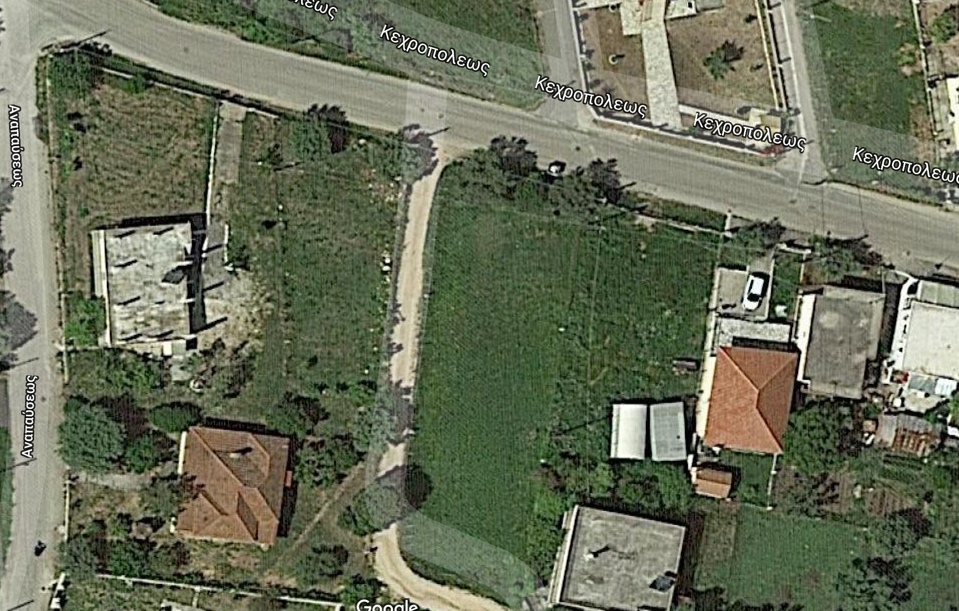




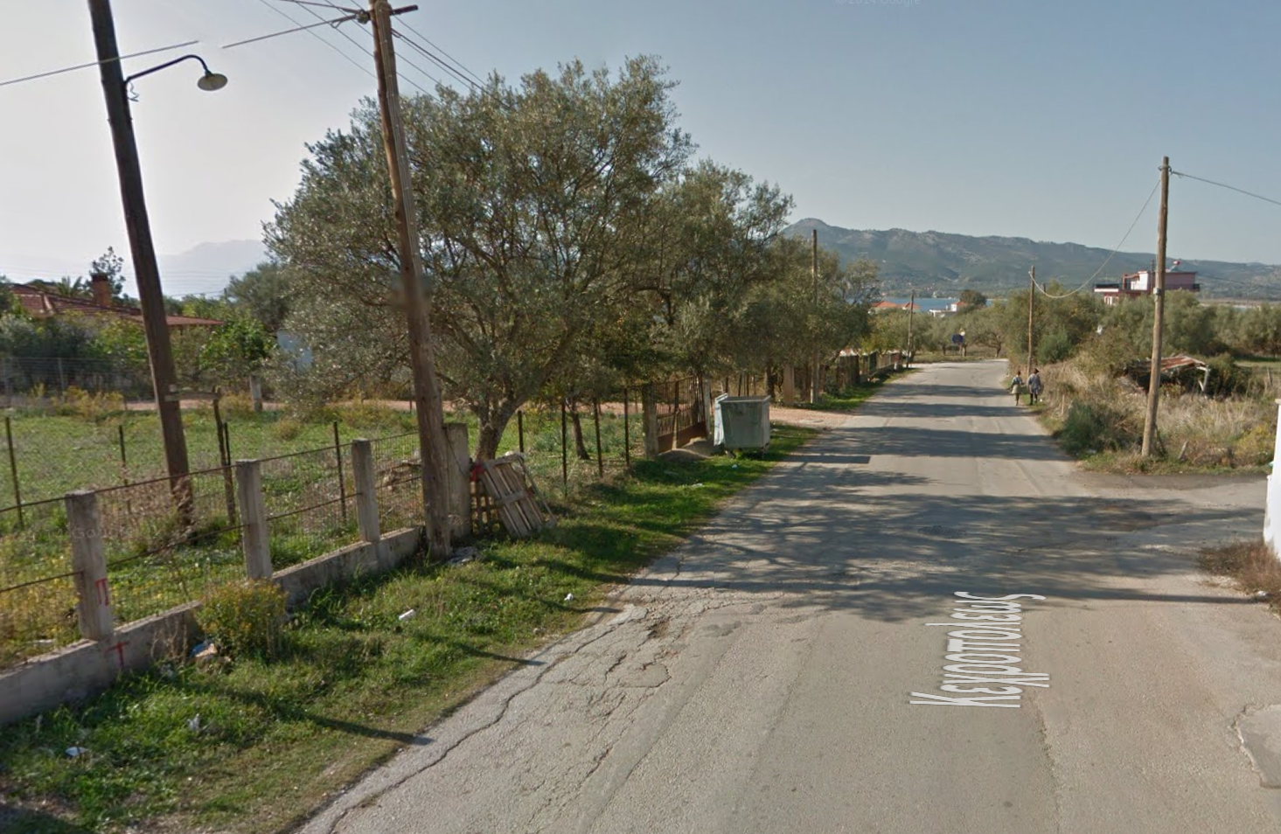
Excepted results
True Positives
False Positives
False Negatives
T.A. GEOFORCE
Notes:
So, how the result will appear after the model is applied to the datasets.
It will appear points where it will be:
The green ones true positives where there is detected a wooden pole correct.
The red ones, where there is wooden pole but it was not detected.
The false negatives where there is no wooden pole, but there is one.
We can see and in the street view how it is appeared.
[click]

Slide 10
Validation
Post extraction phase
It can be created a web GIS application with the scope of validating the poles positions by the employees.
Characteristics:
The web application will be secure using the authorization services of the client.
There will be at least 2 layers (basemap and a WFS-T layer of wooden poles)
The employees of the client will validate the poles by set a property to T or F, using a popup widget.
T.A. GEOFORCE
Notes:
After the creation of the dataset - for validation reasons - we propose to be developed a WebGIS application where client’s employee will be login in and using the map will validate the network from the area that are familiar.
For the poles that will validate they will do click on the pole on the map, a popup window will appear where they can edit the property of the validation. If there is true a pole, they will set it to True else to False.
[click]

Slide 11
Deliverables
After the validation:
1. geojson point file will be delivered with metadata (INSPIRE).
2. Reports, source code and models will be delivered as repository.
3. Dissemination & exploitation activities (in-house seminars, conferences).
T.A. GEOFORCE
Notes:
The deliverables of the project will be a geojson file of the point geometry of the wooden pole, plus some properties like the propability, the municipality etc…. The geometry will be in EPSG:2100 (EGSA ‘87) projection system. The write metadata will be created for that file, that will be compliment with the INSPIRE directive (EN ISO 19115 and EN ISO 19119).
Also, the reports, source code, experiments, models will be delivered as a repository folder, which can be used for future projects.
Finally, working together with the client it will be created all the necessary dissemination and exploitation activities like in-house seminars of the project to the data team, data scientists team, data architects of the clients, plus presentations to conferences.
[click]

Slide 12
Thank you
&
Questions
Source code: https://github.com/TA-Geoforce/Wooden-Poles-Object-Detection
T.A. GEOFORCE
Notes:
Thank you so much.
Questions.
And the everything you can find out here
https://github.com/TA-Geoforce/Wooden-Poles-Object-Detection

