Slide 1
EC8204 BLOCKCHAIN AND CYBER SECURITY · GROUP PROJECT
GROUP 41 · INDEX NUMBERS
MiniChain
EG/2021/4754 Rathnayaka I.G.T.A
EG/2021/4706 Peiris P R S
PROJECT NAME
MiniChain – Cryptocurrency Transaction System with Attack Lab
DOMAIN
Blockchain & Cyber Security (Cryptocurrency · FinTech)
APPLICATION
A from-scratch blockchain for signed coin transfers with proof-of-work mining, a peer-to-peer network and an attack lab that demonstrates – and defends against – forgery, double spending, replay, tampering and 51% attacks.
3 MIN VIDEO
https://youtu.be/AgEqoAu_OqE
MiniChain · EC8204 · Group 41 · EG/2021/4754 · EG/2021/4706
1 / 6
Notes:
0:00–0:20 Hello, we are Group 41, registration numbers EG/2021/4754 and EG/2021/4706. Our project is MiniChain, a cryptocurrency transaction system with an attack lab. The domain is blockchain and cyber security. The application: a from-scratch blockchain where users send signed payments, miners secure them with proof-of-work, and an attack lab shows how forgery, double spending, tampering and 51 percent attacks are stopped, or where they succeed.

Slide 2
PROBLEM → SOLUTION
The problem: trusting a middleman with the ledger
The problem
Blockchain solution
✕ One party keeps the ledger
✕ History can be quietly edited
✕ Payments can be forged or replayed
✕ The same coin can be spent twice
✕ Everyone must trust the operator
✓ Signed transactions (ECDSA)
✓ Hash-linked, tamper-evident blocks
✓ Proof-of-work consensus
✓ Nonce + balance stop replay and double spend
✓ Anyone can verify every coin
→
MiniChain · EC8204 · Group 41 · EG/2021/4754 · EG/2021/4706
2 / 6
Notes:
0:20–0:50 Today, a bank or payment company keeps the ledger, so we must trust it. History can be edited, payments can be forged, and the same money can be spent twice. A blockchain removes the middleman: every payment is signed by its owner, grouped into blocks that are linked by hashes, and secured by proof-of-work, so anyone can verify every coin.

Slide 3
IMPLEMENTATION
How MiniChain works
1 Wallet
2 Sign
3 Validate
4 Mine
5 Chain
secp256k1 key pair
address = hash of public key
ECDSA signature
nonce (anti-replay) + fee
signature ✓
balance ✓ nonce ✓
Merkle root of payments
proof-of-work
reward + fees to miner
hash links to previous block
most cumulative work wins
›
›
›
›
Built from scratch in Node.js · zero dependencies · fees & mining reward · 3-node peer-to-peer network with fork resolution · live web dashboard
MiniChain · EC8204 · Group 41 · EG/2021/4754 · EG/2021/4706
3 / 6
Notes:
0:50–1:25 A wallet has a secp256k1 key pair; the address is a hash of the public key. It signs each payment with ECDSA, including a nonce and a fee. Nodes validate the signature, balance and nonce, then miners put pending payments into a block with a Merkle root and search for a nonce so the hash starts with zeros: that is proof-of-work. The miner earns a reward plus fees. Every block stores the previous block's hash, and three peers gossip blocks and pick the chain with the most work. It is all built from scratch in Node.js with no dependencies.

Slide 4
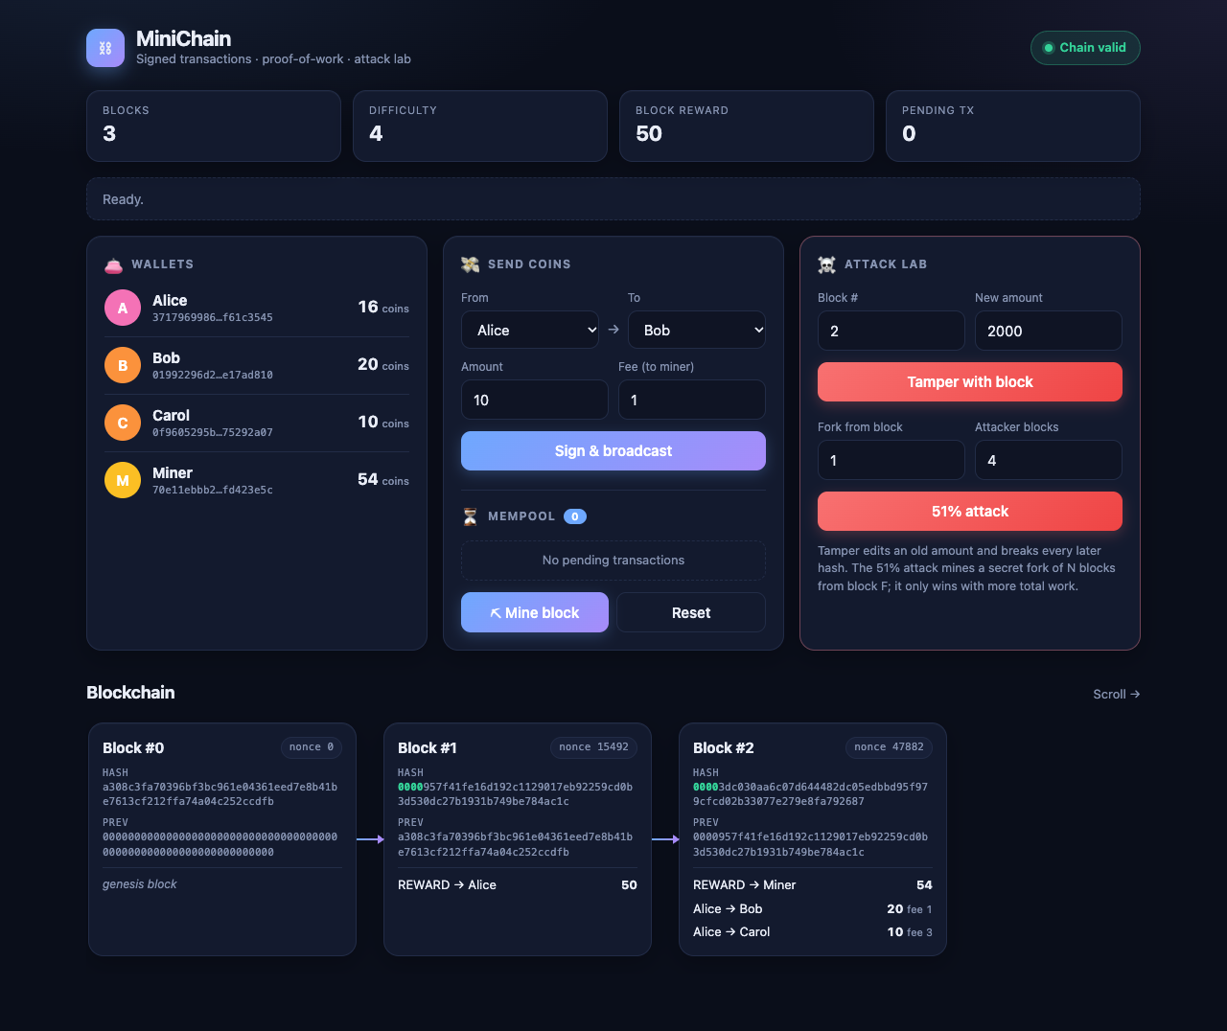
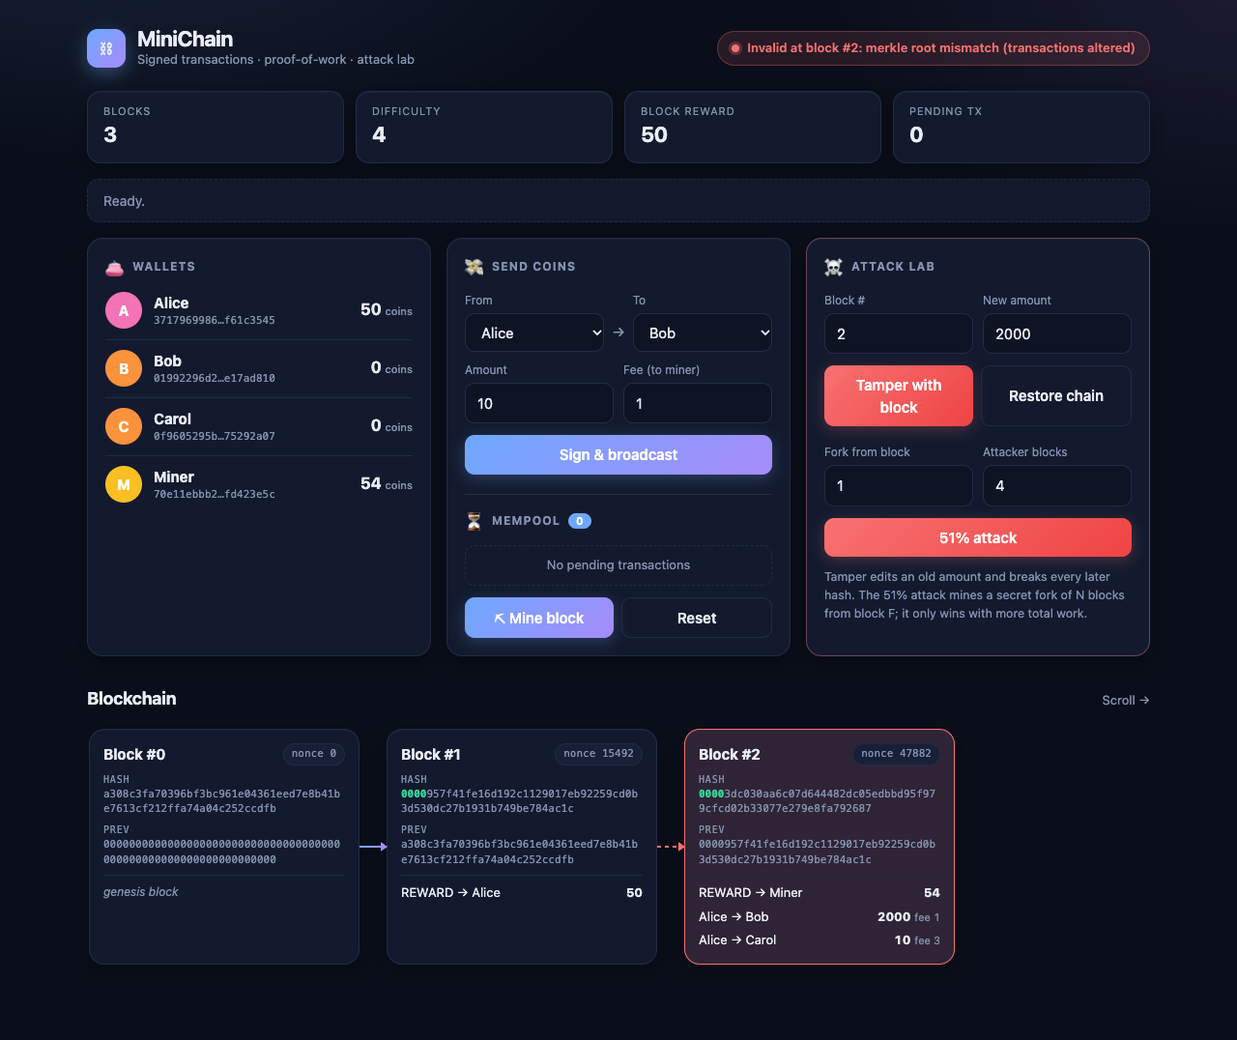
DEMO
Live demo: send, mine, tamper
Signed payments mined into block #2: chain valid
Block #2 edited: chain invalid at block #2
MiniChain · EC8204 · Group 41 · EG/2021/4754 · EG/2021/4706
4 / 6
Notes:
1:25–2:10 This is the live dashboard. Alice sends coins to Bob and Carol; the payments wait in the mempool, then a miner seals them into block 2 and earns the reward plus fees. The chain is valid. Now the attack lab edits Alice's payment inside block 2 from 20 coins to 2000. The Merkle root no longer matches, so the dashboard flags the chain invalid at exactly block 2, and the link to the next block turns red.

Slide 5
RESULTS
Attack lab: results and mitigation
Forged sender
Rejected
key must hash to the sender address
Double spend
Rejected
nonce already used / balance spent
Replay
Rejected
nonce already consumed
Tamper with old block
Detected at block #
Merkle root / hash / link breaks
51%: small attacker
Rejected
fork has less cumulative work
51%: majority attacker
SUCCEEDS
history rewritten (the PoW limit)
How to defend against a 51% attack
Wait for confirmations
Raise the difficulty
Add checkpoints
Use proof-of-stake
Treat a payment as final only after about 6 blocks are built on top of it.
A higher hash rate makes it far more expensive to out-mine honest miners.
Nodes refuse to reorganise the chain past a block everyone has agreed on.
Attackers risk their own staked coins if they try to rewrite history.
MiniChain · EC8204 · Group 41 · EG/2021/4754 · EG/2021/4706
5 / 6
Notes:
2:10–2:40 We attacked our own chain. A forged sender, a double spend, a replayed payment and a tampered block are all rejected. Even a small 51 percent attacker fails because their fork has less work. But a majority attacker succeeds and rewrites history: this is the inherent limit of proof-of-work. To defend: wait for about six confirmations before treating a payment as final, raise the difficulty, add checkpoints so nodes will not reorganise past agreed blocks, or move to a consensus with finality such as proof of stake.

Slide 6
WRAP-UP
Conclusion
✓ Tamper-evident ledger with signed, replay-proof payments
✓ Proof-of-work consensus with fork resolution
✓ Working 3-node peer-to-peer network with fees
✓ Attacks demonstrated, including where the design breaks (51%)
Thank you
Group 41
Rathnayaka I.G.T.A
EG/2021/4754
Peiris P R S
EG/2021/4706
GitHub: TA-rathnayaka/minichain
Video: youtu.be/AgEqoAu_OqE
Limits & future work
Dynamic difficulty · authenticated peers · disk persistence · checkpoints / PoS finality
MiniChain · EC8204 · Group 41 · EG/2021/4754 · EG/2021/4706
6 / 6
Notes:
2:40–3:00 In conclusion: MiniChain gives a tamper-evident ledger with signed, replay-proof payments, proof-of-work consensus and a working peer-to-peer network, and it shows honestly where the design breaks: a majority attacker. Future work is dynamic difficulty, authenticated peers, disk persistence and checkpoints. Thank you. The source code is on GitHub and the full video is on YouTube.

