Slide 1
PROJECT-I · REVIEW 3 · BCSE497J
Verifying Machine Unlearning in
Privacy-Preserving AI Systems
A Multi-Metric Framework — implementation progress & interim results
Kanishka Mohankumar 23BDS1007
Vignesh Venkatesan 23BDS1056
Brijesh T A 23BDS1122
Guide: [name]
Notes:
Open: we're presenting implementation progress, interim results, and the changes made in response to Review 2 feedback.

Slide 2
AGENDA
What we'll cover
1
Response to Review 2 feedback — the GAN
2
What we built: one framework, two workflows
3
Verification signals & the GAN reconstruction signal
4
Interim results — failure matrices & reconstructions
5
Analysis, challenges & individual contributions
6
Path to Review 4
Notes:
One line: we open with the panel's own feedback to show we listened.

Slide 3
FOLLOW-UP
Response to Review 2 feedback
“Incorporate a GAN for the image-based datasets.”
What we did
Signal sets
Added a GAN-based reconstruction attack as a new IMAGE-only verification signal — behind the same interface as our other signals.
Tabular workflow
MIA · LiRA
Image workflow
MIA · LiRA · GAN reconstruction
“The multi-metric framework gaining a metric — not a bolt-on.”
Notes:
Spend a full minute here — this is the follow-up mark. The GAN is a verification signal, image-only, behind the same interface.

Slide 4
ARCHITECTURE
One framework, two workflows
Same harness, same interfaces, same scoring — only the signal set differs.
Tabular workflow
Image workflow
Dataset: Purchase-100
Model: MLP
Signals: MIA · LiRA
Dataset: Fashion-MNIST · CIFAR-10
Model: SmallCNN
Signals: MIA · LiRA · GAN reconstruction
The GAN signal is image-only — nothing to reconstruct in tabular data — so it lives in the image workflow and nowhere else.
Notes:
The only difference between the workflows is the signal list. Enforced by a registry, so the codebase never forks.

Slide 5
METHODOLOGY
The core measurement loop
1
2
3
4
5
›
›
›
›
Split
Anchors
Unlearn
Audit
Score
Retain / Forget / Test
Original vs Gold (answer key)
honest / lazy / forging
signals run BLIND
verdict vs ground truth
We play all three parties — owner, provider, auditor — so we always know the right answer and can grade the auditor. The auditor never reads ground truth (enforced in code).
Notes:
Gold is the answer key a real auditor never has; we use it only to score. If the auditor read it the audit would be circular.

Slide 6
PROGRESS · ~50%
What we implemented this cycle
Harness + single-source-of-truth data split
MLP (tabular) + SmallCNN (image) models
✓
✓
Fine-tune unlearning — honest / lazy / forging
Three verification signals: MIA, LiRA, GAN
✓
✓
DCGAN prior for the image workflow
Failure-matrix driver + AUC / TPR@low-FPR scoring
✓
✓
Five test suites green (spine, training, unlearn, verify, gan)
Real results on Purchase-100 and Fashion-MNIST
✓
✓
Notes:
This is the half-implementation Review 3 expects. Remaining methods/signals are designed against frozen interfaces for Review 4.

Slide 7
SIGNALS
Three independent verification signals
Aggregate MIA
Per-example LiRA
GAN reconstruction
Population level
Individual records
Image-only (NEW)
Is the model still confident on the forget set vs held-out test? Cheap; but an average can hide an exposed tail.
Shadow models give an OUT distribution per record; the target's confidence is scored against it. Catches the tail MIA misses.
Invert a DCGAN to reconstruct a query image; score the model's confidence on it. The Review-2 feedback signal.
Notes:
LiRA carries thesis claim #1 (per-example beats aggregate). GAN is the image-native signal from the feedback.

Slide 8
HOW IT WORKS
The GAN reconstruction signal
Train a DCGAN — on retain images → a manifold G(z) of realistic images
1
A model that memorised a record stays confident on its reconstruction; one that never saw it does not.
Invert the GAN — optimise z so G(z) matches a forgotten image → reconstruction
2
Score — the target model's confidence on that reconstruction
Reuses the same confidence measure as MIA → directly comparable in the matrix. (cf. arXiv 2405.20272)
3
Notes:
Frame it as an honest reconstruction attack. It reuses MIA's confidence machinery, so it sits in the same matrix.

Slide 9
INTERIM RESULTS
Results — the memorisation signal (Purchase-100)
Model
Forget
Test
Residual
+0.226
Gold
0.771
0.771
+0.000
Original
0.997
0.793
+0.226
forget-set memorisation of the Original above the Gold model — the gap the auditor must detect and a forger must hide.
FT-honest
0.757
0.659
−0.013
FT-lazy
0.958
0.756
+0.187
FT-forging
0.997
0.793
+0.226
Only Gold forgets AND keeps utility. Plain accuracy misleads: the forging model looks BETTER on test than the honest one.
Notes:
The +0.226 gap proves the setup works. Accuracy rewards the cheater — the strongest motivation for real signals.

Slide 10
INTERIM RESULTS
Failure matrix — Purchase-100 (tabular)
Aggregate MIA
LiRA
Forgotten (~0.5)
Gold (forgotten)
0.51
0.51
Borderline
Original (before)
0.69
0.74
Still remembered
Fine-tune honest
0.56
0.57
Fine-tune lazy
0.66
0.70
Fine-tune forging
0.69
0.74
Cells = AUC, mean over 3 seeds (std ≤ 0.01; higher = still identifiable). Gold is clean; forging equals the Original exactly; LiRA is stronger than aggregate MIA.
Notes:
Gold clean, forging = original, LiRA > MIA. Per-example evidence beats the average — thesis claim #1.

Slide 11
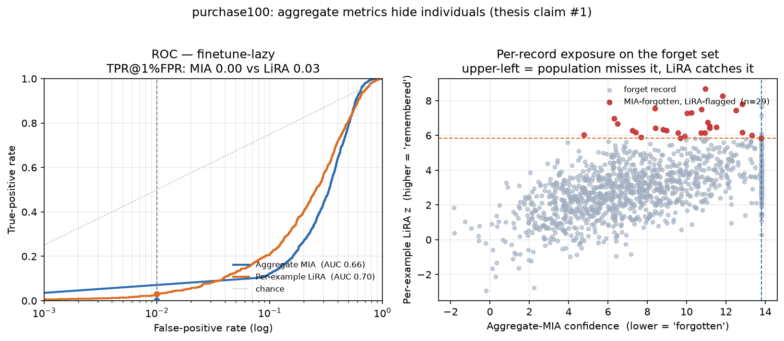
INTERIM RESULTS
Per-example beats aggregate — the proof
Lazy (“claimed unlearned”) provider: aggregate MIA calls records forgotten, yet per-example LiRA still flags 29 of them. Left: log-scale ROC (harm lives in the low-FPR tail). Right: per-record exposure — each dot upper-left is a record the average misses.

Slide 12
INTERIM RESULTS
Failure matrix — Fashion-MNIST (image)
MIA
LiRA
GAN recon.
Gold (forgotten)
0.50
0.50
0.53
Original (before)
0.55
0.60
0.54
Fine-tune honest
0.53
0.55
0.55
Fine-tune lazy
0.54
0.58
0.53
Fine-tune forging
0.55
0.60
0.54
Memorisation gap +0.115 (overfitting regime; mean over 3 seeds). Ordering honest < lazy < forging ≈ original holds; LiRA again strongest.
GAN column ≈ 0.5 for every model incl. Gold — no clean separation. A first calibration (removing per-class difficulty) confirms this; full calibration is Review-4 work.
Notes:
Say the GAN caveat out loud — the column reads high even for Gold. Prototype, not a finished discriminator.

Slide 13
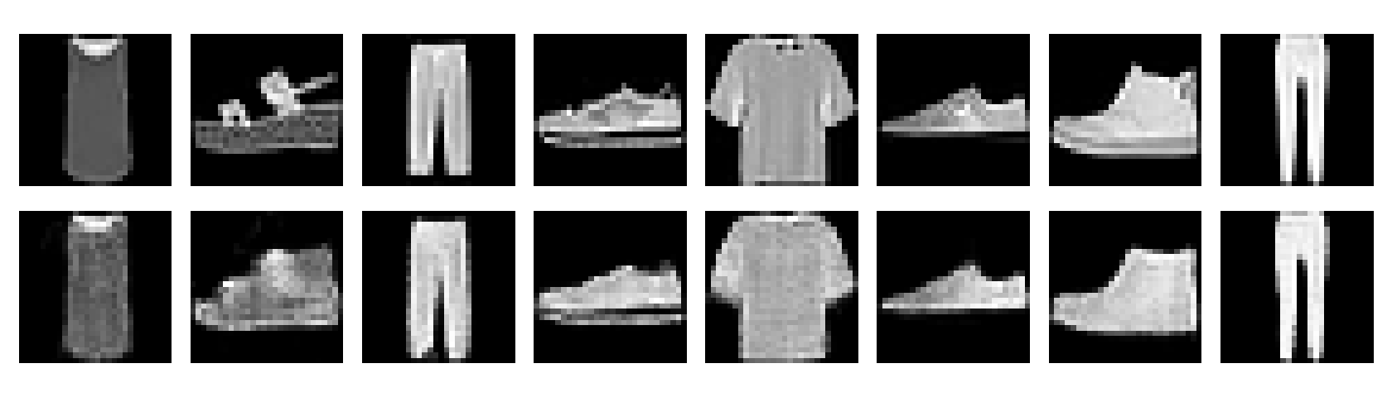
INTERIM RESULTS
GAN reconstruction of forgotten images
Top: true forgotten Fashion-MNIST items. Bottom: DCGAN reconstructions.
The generator reconstructs data the model was asked to forget — the visual basis of the reconstruction attack.
Notes:
This is the strong GAN deliverable regardless of the AUC — recognisable reconstructions of forgotten items.

Slide 14
WHAT IT MEANS
Analysis & honest findings
LiRA > aggregate MIA
Accuracy rewards the cheater
per-example evidence detects residual influence the average misses
the forging model looks better on test than the honest one
Memorisation regime
GAN signal = working prototype
signals exist only when a model memorises; a generalised model leaks nothing
produces reconstructions but not yet a clean discriminator — R4 calibration
Notes:
State the GAN caveat proactively — it shows you understand your own method. The regime point shows methodological maturity.

Slide 15
PROBLEM-SOLVING
Challenges solved & refinements
Device-safety bug — a test helper built tensors on CPU while the model was on GPU → made helpers device-aware
1
LiRA cost — shadows were retrained per model → train once and reuse across all models (~5× faster)
2
No signal on images — generalised CNNs leak nothing → discovered the overfitting-regime requirement + added a memorisation diagnostic
3
Notes:
Evidence of real engineering and refinement, not smooth sailing.

Slide 16
TEAM
Individual contributions
Kanishka Mohankumar
Vignesh Venkatesan
Brijesh T A
Person A — Training & Unlearning
Person B — Verification & GAN
Person C — Harness & Rigour
Models, training loop, anchor models, fine-tune unlearning (3 honesty levels)
MIA, LiRA, DCGAN + GAN reconstruction signal; owns the thesis
Config/seeds, single-source split, scoring, failure-matrix driver, methodology
Notes:
Each member states their own line — the panel grades individually.

Slide 17
PATH TO REVIEW 4
What comes next
NegGrad, Fisher & SISA unlearning methods
Backdoor-trigger and weight/posterior-distance signals
CIFAR-10 at scale
Extend runs: more seeds and larger forget sets
Finish calibrating the GAN signal (first calibration done)
Streamlit dashboard + the full failure matrix
AI-tool disclosure
AI assistance (Claude) was used for design guidance, code scaffolding, and debugging. All decisions, understanding, interpretation, and validation are our own — as this review and Q&A demonstrate.
Notes:
Say the AI-disclosure sentence out loud — the guidelines require it.

Slide 18
Thank you
Unlearning claimed is not unlearning verified.
Questions welcome
Notes:
Hand to Q&A — use the drill sheet; each member defends their own area.

