Slide 1
Shared Clarity.
For ground-engineering delivery.
[Presentation title] · [Audience] · [Date]

Slide 2

[Presentation title]
[Subtitle or date]

Slide 3
AGENDA
What we will cover.
01
The problem we keep seeing
02
How TACEDGE structures the workflow
03
What a pilot looks like
04
Evidence from live work
05
Next steps and decision point

Slide 4
01
[Section title]

Slide 5
[SECTION]
One clear message per slide.
Lead with the outcome. Support it with two or three short sentences at most. If the slide needs a paragraph, it needs a document instead.

Slide 6
[SECTION]
Two-column content.
Before TACEDGE
With TACEDGE
Field records arrive fragmented
Hours of data entry and chasing
Reports rebuilt from fragments
Captured once at the workface
Live picture for the PM
Confirmed report released to the engineer

Slide 7
[SECTION]
Three supporting points.
Field usability
Evidence integrity
QA visibility
Simple crew controls, offline-first capture, large touch targets.
Photos, tests and measurements attach to the work item as it happens.
Exceptions surface for judgement. Everything else flows through.

Slide 8
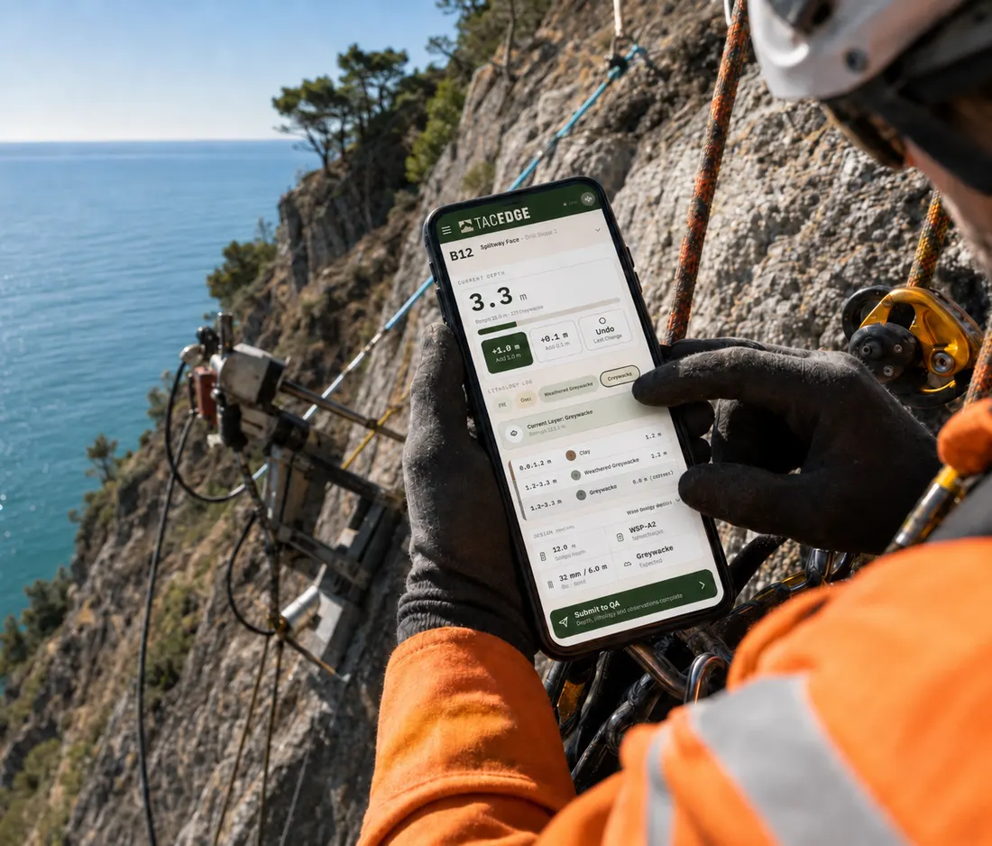
[SECTION]
Full-width image.
Caption: place, activity, year. [Replace with your image]

Slide 9
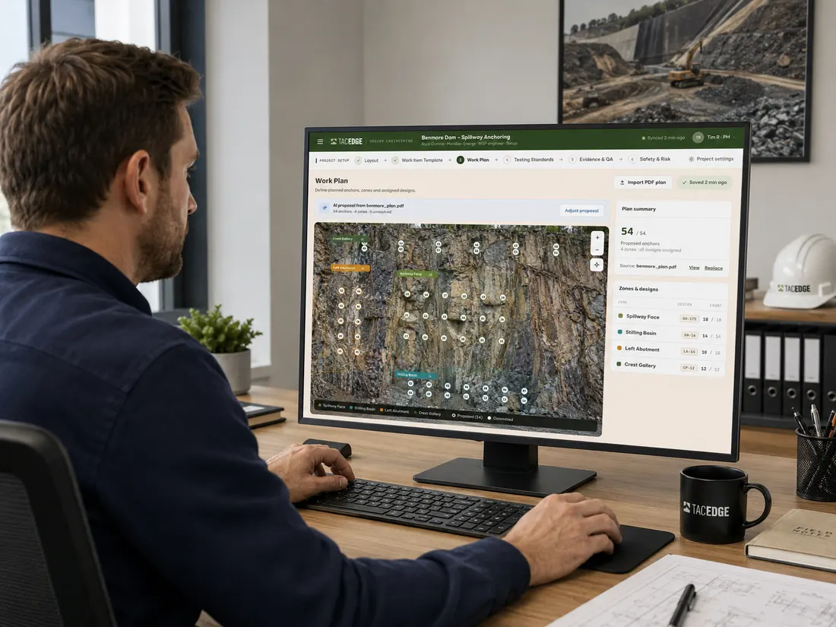
[SECTION]
Image and text.
Say one thing about the image.
Set the project up once
Capture the work where it happens
Give the engineer a confirmed report

Slide 10
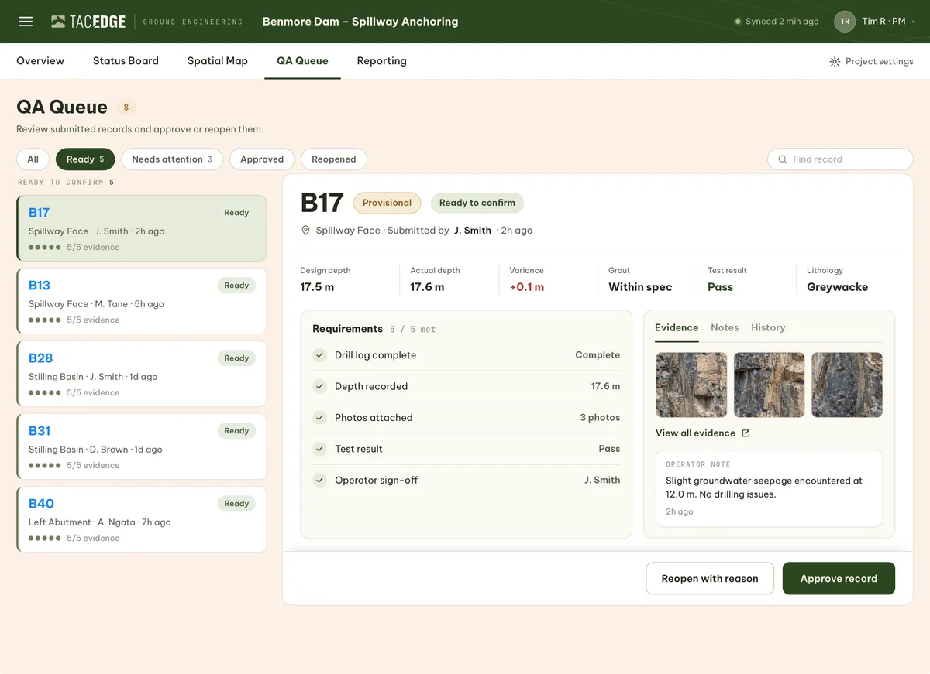
PRODUCT
Real screens only.
TACEDGE QA queue · [replace with the screen relevant to your story]

Slide 11
THE PROBLEM
Field data becomes project overhead.
THE CURRENT WAY
WITH TACEDGE
Paper, forms, apps, calls and photos
PMs compile instead of assuring
Engineers receive reconstructed reports
One shared system from setup to release
Live, structured field data
A confirmed report the engineer can trust

Slide 12
THE WORKFLOW
Configure. Capture. Confirm.
1
Configure
2
Capture
3
Confirm
Set the project up once.
Record the work where it happens.
Verify and release.
→
→
Release is the outcome of Confirm. It is never a fourth stage.

Slide 13
[SECTION]
Process flow.
Configured
→
Captured
→
Submitted
→
Confirmed
One arrow style. Single-word stage labels. Forest fill marks the terminal-positive stage only.

Slide 14
[SECTION]
Key numbers.
[12]
[0]
[15 min]
records confirmed per shift
re-keying steps
from capture to PM visibility
Numbers must be evidenced. Source note: [source, date]

Slide 15
[SECTION]
Comparison.
 | Current way | With TACEDGE
Capture | Paper and re-keying | Once, at the workface
Visibility | End of week | Live
Report | Rebuilt by the PM | Released from confirmed records

Slide 16
[VOICE OF THE CUSTOMER]
“[Short, verifiable quote from a named role. Two sentences at most.]”
[Name or role] · [Organisation] · [Date]

Slide 17
[SECTION]
Timeline.
Week 0
Weeks 1–4
Week 5
Week 6
Configure
Capture on live work
Review evidence
Decision point

Slide 18
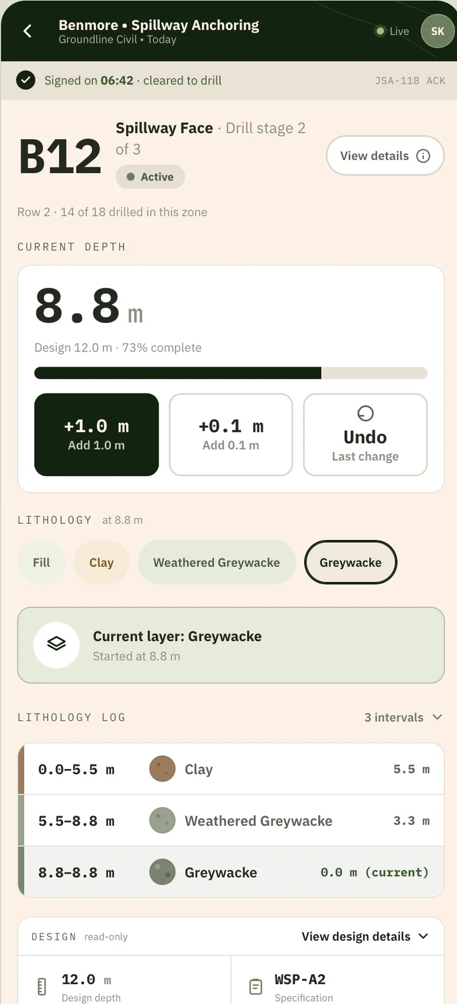
CASE STUDY
[Project name]: what the evidence showed.
CONTEXT
[Work type, location, crew size.]
WHAT WE DID
[Configured the workflow, captured live work, confirmed the record.]
RESULT
[Evidenced outcome with numbers where possible.]

Slide 19
NEXT STEPS
A small validation, not a broad rollout.
1
Choose one workflow
2
Configure it together
3
Validate it on live work
4
Decide from evidence

Slide 20
See TACEDGE on your project.
Bring a current project or reporting problem. In 15 minutes, we'll show how TACEDGE would structure the workflow.
[Name] · [Role] · [Phone]
info@tacedge.co.nz · tacedge.co.nz · New Zealand

Slide 21
APPENDIX
[Supporting detail]

Slide 22
APPENDIX A
[Supporting detail].
Item | Detail | Source
[Item] | [Detail] | [Source, date]
[Item] | [Detail] | [Source, date]
[Item] | [Detail] | [Source, date]
Appendix slides carry the detail so the main deck stays light.

