Slide 1
Data Warehouse QA
Summary and findings
Xiaorui Zhang
3-17-23
Notes:
Hello! Today I will be briefly summarizing the QA process that we used for the data warehouse

Slide 2
Method
Lessons learned
qa
Q&a
Notes:
I’ll go over the methods used, lessons learned, and then stop for discussion

Slide 3






Goal:
Final product is representative of raw data
Cleaning and Transformations
Raw data on SQL server
Raw data
Notes:
So the ultimate goal of the data warehouse and any ETL process is to take the raw data and turn it into a useful end product that is representative of the raw data, and this is a multi-step process.

Slide 4
Method
Check raw row counts
Check distinct key counts
Ex: Member_ID, Claim_ID
Check important combinations
Ex: Distinct member_id – enroll_month_year combinations
Spot-check individual values
Notes:
The tools we use during this process are row counting, key counting, and spot-checks of individual values. We use spot-checks rather than checking all data because checking every single value is extremely time-prohibitive and plus you have a team of statisticians, we may as well use our statistical powers to decrease processing time.

Slide 5
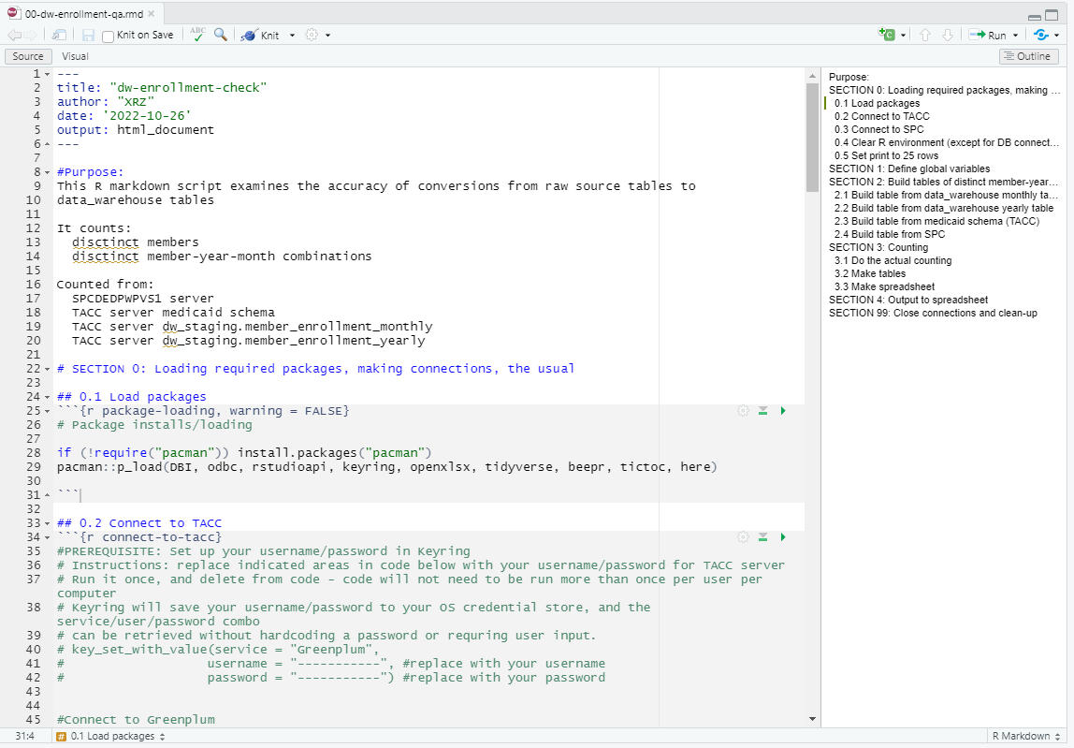
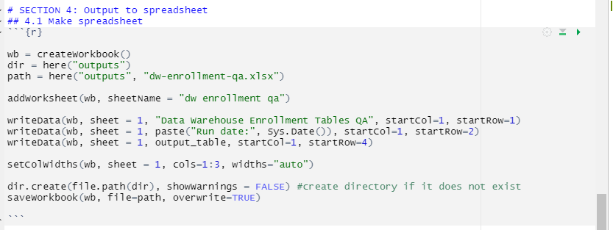
code
What’s being counted and runtime
Code has sections
Written in R markdown because:
Can talk to both Greenplum and local SQL server in the same script
Can export data to excel
**Note that Python can do this too
Export directly to .xlsx with formatting
Notes:
This is what some of the code looks like. I’m not going to spend too much time on technical details, but some of the advantages of the code that I’ve written are that there’s a lot of plain English in it – even a layman should be able to read this code and be able to figure out what it’s doing. The code is broken down into sections, so you can jump to the section you need right away. It’s also written in R so it can talk to both our SQL servers and export to Excel – this is not something that is easy to do in either SQL alone or SAS alone, those two languages are more one trick ponies whereas both R and Python are more flexible tools.

Slide 6
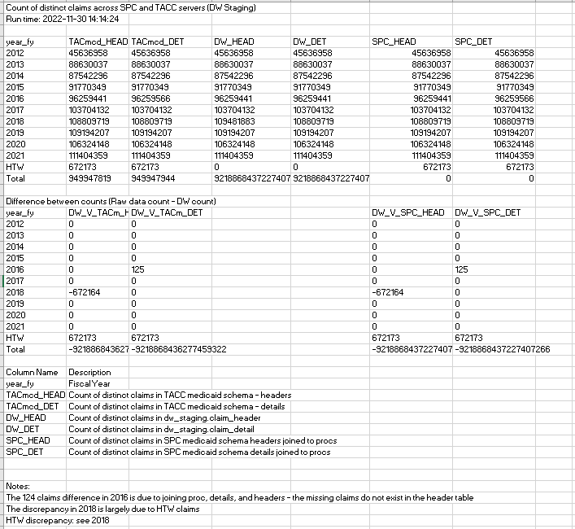
OUTPUT: COUNTING
What’s being counted and runtime
Raw numbers
Differences (highlight discrepancies)
Explanation of columns
Notes (explain discrepancies)
Notes:
Here’s what some of the output for count checking looks like. Once again, I have designed the output with the idea in mind that someone else might have to look at this in the future. The key that’s being counted is listed at the top followed by raw numbers, differences between numbers, explanations of columns, and notes as I figure out why the discrepancies happen.

Slide 7
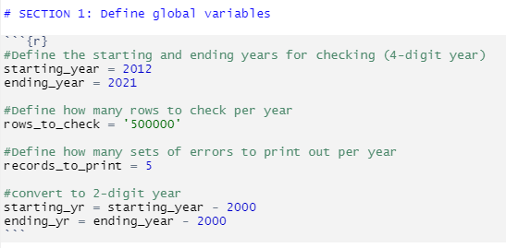
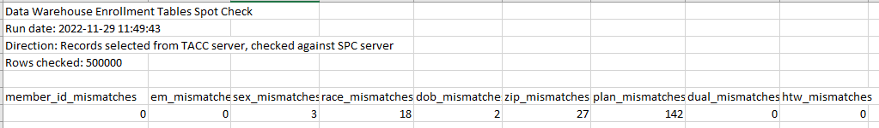
OUTPUT: spot checks
Adaptable code: can number of rows to check, number of mismatches to print
Summary of mismatches
Notes:
When I wrote the code for spot checks, I made sure to make it adaptable, so you can adjust the number of rows to check and number of mismatches to print. The output gives you a summary of mismatches, so you can wee here that we’ve checked 500,000 rows and there are… 3 sex mismatches, 18 race mismatches, and so on.

Slide 8
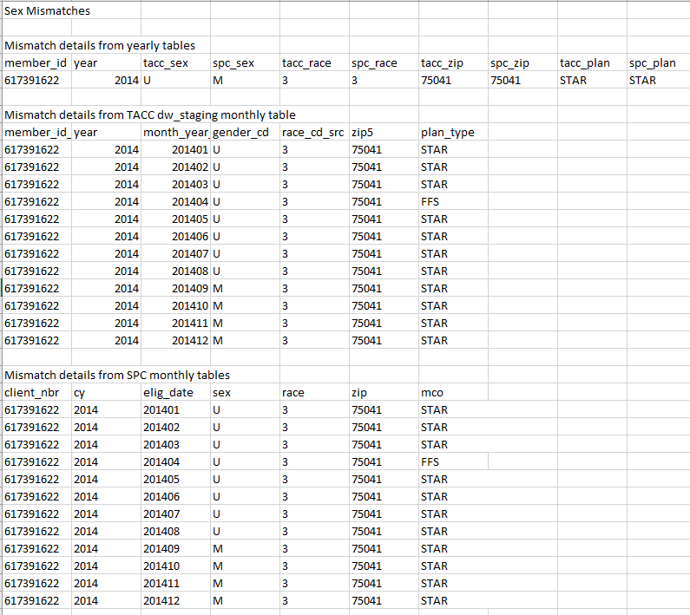
OUTPUT: spot checks
Print out mismatch
Print out raw data that generated mismatch
Notes:
The output will also show you the exact mismatch and the raw data that generated it, so you can judge for yourself what you think the “correct” value should have been. In this case, the mismatch happened because TACC took the most frequent value, which is U, and the table that I built on the SPC side excluded unknowns when there was better information. This change has already been approved for the data_warehouse and it will be addressed in the next update.

Slide 9
This method is cyclical
Make a table
QA
Identify a problem
…repeat until no errors are zero or below acceptable threshold
Notes:
The tools we use during this process are row counting, key counting, and spot-checks of individual values. We use spot-checks rather than checking all data because checking every single value is extremely time-prohibitive and plus you have a team of statisticians, we may as well use our statistical powers to decrease processing time.

Slide 10
Lessons learned
DOCUMENT EVERYTHING
At least 2 people
Mistakes exist on every level
Build code to last
Notes:
So…. LESSONS LEARNED. These are the 4 primary lessons that I’ve taken away from this process.

Slide 11
Lessons learned
DOCUMENT EVERYTHING
Nobody likes documentation, but everyone needs documentation
EXPLAIN RATIONALE : Figuring out WHY something needs to happen takes way more time than actually making it happen
Once created, no need to explain the same thing over and over again to different people
If someone leaves the project, their work can be continued
Great way to spot logical inconsistencies and identify patterns
At least 2 people
Mistakes exist on every level
Build code to last
Notes:
ONE: DOCUMENT EVERYTHING. If you didn’t document it, you didn’t do it. Creating documentation is extremely time-intensive up front, but the larger and more complex the project, the more time it saves.

Slide 12
Lessons learned
DOCUMENT EVERYTHING
At least 2 people
2 pairs of eyes = more mistakes caught
Separating QA from coding incentivizes both people to do their jobs properly
It’s hard to see mistakes in your own code
Forces you to write code people can actually read
This means that code can be maintained by more than 1 person
Mistakes exist on every level
Build code to last
Notes:
You need at least two people.

Slide 13
Lessons learned
DOCUMENT EVERYTHING
At least 2 people
Mistakes exist on every level
We found errors in data loading from .csv to SQL tables
We found errors in data loading into data_warehouse
We found errors in how variables are reinterpreted
Bottom line: Because errors can be introduced at every step
Decrease number of steps: KISS
QA needs to happen at every step
Build code to last

Slide 14
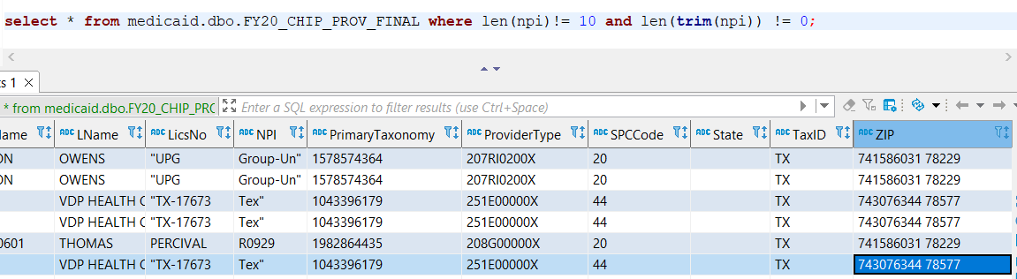
Lessons learned
These values are field-shifted!

Slide 15
Lessons learned
DOCUMENT EVERYTHING
At least 2 people
Mistakes exist on every level
Build code to last
Write code as if you’re going to have to run it again
Write code as if SOMEONE ELSE will have to run it next time
Minimize cases where you have to manually do anything – anything that CAN be automated SHOULD be automated
EXTREMELY CLEAR TABLE AND VARIABLE NAMES
Any part of code where someone might not understand why you chose to write it that way requires a comment explaining rationale

Slide 16
DISCUSSION

Slide 17
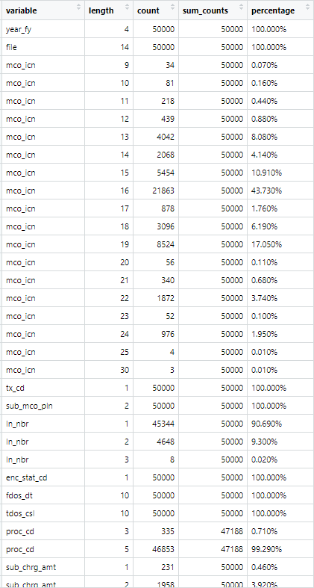
Data validity
We didn’t do this in a systematic manner for DW but I did also take a look at lengths of incoming data to get an idea of what the valid range is supposed to be

