Slide 1
Data Warehouse QA
Summary and findings
Xiaorui Zhang
3-17-23

Slide 2
Method
Check raw row counts
Check distinct key counts
Spot-check individual values

Slide 3
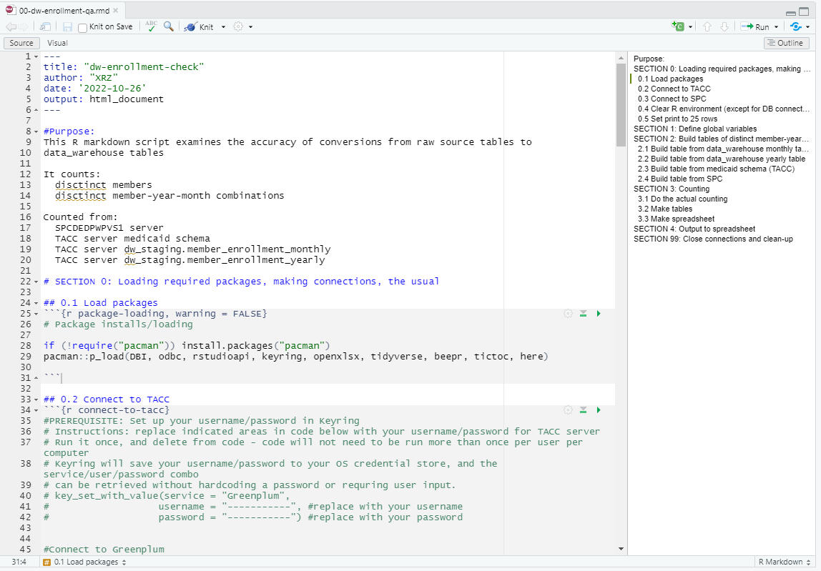
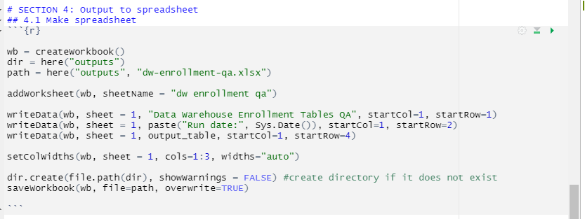
code
What’s being counted and runtime
Code has sections
Written in R markdown because:
Can talk to both Greenplum and local SQL server in the same script
Can export data to excel
Note that Python can do this too
Export directly to .xlsx with formatting

Slide 4
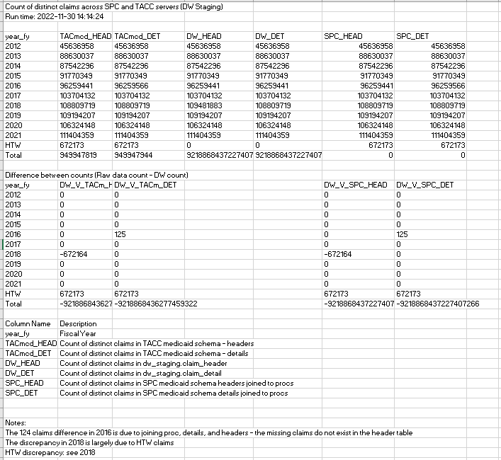
OUTPUT: COUNTING
What’s being counted and runtime
Raw numbers
Differences (highlight discrepancies)
Explanation of columns
Notes (explain discrepancies)

Slide 5
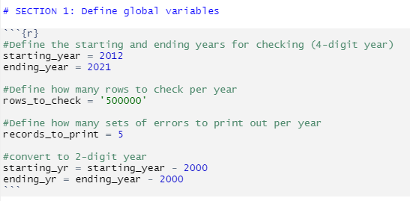
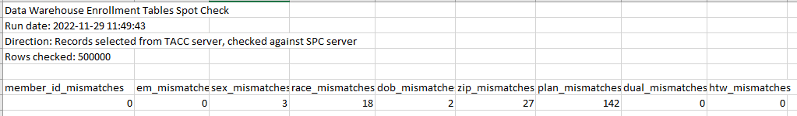
OUTPUT: spot checks
Adaptable code: can number of rows to check, number of mismatches to print
Summary of mismatches

Slide 6
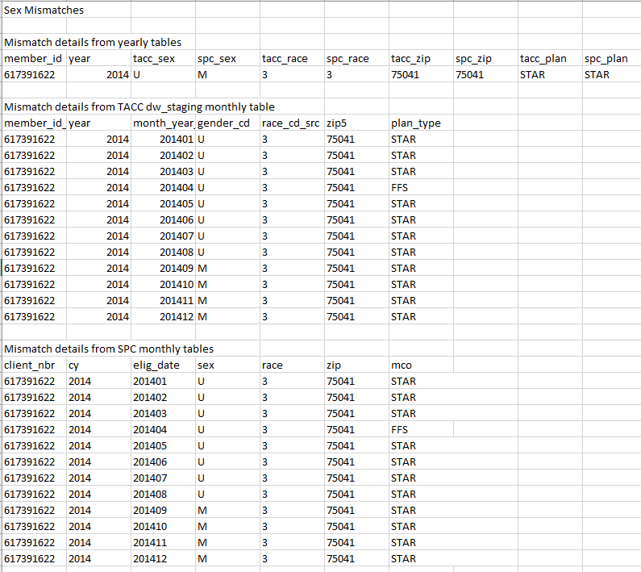
OUTPUT: spot checks
Print out mismatch
Print out raw data that generated mismatch

Slide 7
Lessons learned
DOCUMENT EVERYTHING
At least 2 people
Mistakes exist on every level

Slide 8
Lessons learned
DOCUMENT EVERYTHING
Nobody likes documentation, but everyone needs documentation
Figuring out WHY something needs to happen takes way more time than actually making it happen
No need to explain the same thing over and over again to different people
If someone leaves the project, their work can be continued
At least 2 people
Mistakes exist on every level

Slide 9
Lessons learned
DOCUMENT EVERYTHING
At least 2 people
2 pairs of eyes = more mistakes caught
Separating QA from coding
Mistakes exist on every level

Slide 10
Lessons learned
DOCUMENT EVERYTHING
Nobody likes documentation, but everyone needs documentation
Figuring out WHY something needs to happen takes way more time than actually making it happen
No need to explain the same thing over and over again to different people
If someone leaves the project, their work can be continued
At least 2 people
Mistakes exist on every level

Slide 11
Lessons learned
DOCUMENT EVERYTHING
Nobody likes documentation, but everyone needs documentation
Figuring out WHY something needs to happen takes way more time than actually making it happen
No need to explain the same thing over and over again to different people
If someone leaves the project, their work can be continued
At least 2 people
Mistakes exist on every level

Slide 12
Lessons learned
DOCUMENT EVERYTHING
Nobody likes documentation, but everyone needs documentation
Figuring out WHY something needs to happen takes way more time than actually making it happen
No need to explain the same thing over and over again to different people
If someone leaves the project, their work can be continued
At least 2 people
Mistakes exist on every level

