Slide 1

Data warehouse : Interim report
Why we built* it, and why you should use it
*technically it was already built we just made it more reliable and useful
Notes:
Hi everyone. Today, Joe and I are going to be talking to you about the Data_warehouse: why we refreshed it, and why you should use it.

Slide 2
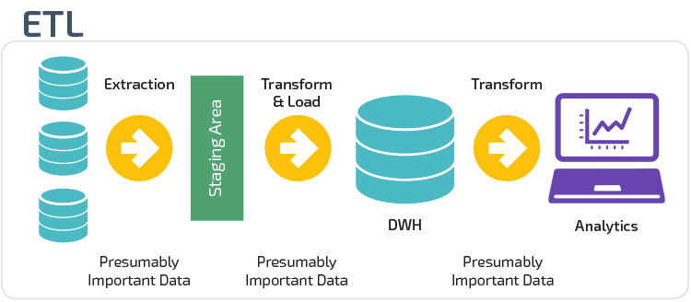
What is the Point of a Data Warehouse
Notes:
What is a data warehouse? The purpose of a data warehouse is to take raw data and store it in a structured, defined way through an extraction, transformation, and loading (or ETL) process. Data from disparate sources are unified, cleaned, and distilled into a data structure that streamlines reporting and also decreases the depth of knowledge that is required to extract meaningful data from a database.

Slide 3


WHAT is OUR DATA WAREHOUSE
SPCDEPWPVS1
TACC
ERS
Explorys
HTW
Homes
Medicaid
Optum
TDCJ
& others…
Data_warehouse
Medicaid
Medicare
Optum
Truven
Unique to server
Unique to server
Austin
Houston
For access, contact either Xiaorui or Isrrael
Notes:
OUR data warehouse is housed at the Texas Advanced Computing Center, or TACC, which is home to the Greenplum postgresSQL server. While it doesn’t have all of the data sources that are housed on the local SQL server, the primary advantage of Greenplum is that it uses massively parallel processing and distributed architecture to be able to handle extremely large data loads. What this means in practical terms is that the data on the local SQL server, which by necessity is split up into yearly tables, can now be combined into aggregate tables and still retain very fast query speeds.

Slide 4
What is the DATA WAREHOUSE
Medicaid
Data_warehouse
Truven
Combined tables
Unified variable names!
Cleaned enrollment data
Fields trimmed of white spaces and converted to proper type
Data corrections
Removal of useless data
Optum
Revamp in progress…
Medicare
Notes:
Beyond that though, Joe and I followed up on the work of David Walling, Will Coughlin and the rest of the programming team to revamp the data_warehouse. Some of its key benefits are combined tables… unified variable names… cleaned enrollment data… and more.

Slide 5


WHAT’S IT GOING TO DO FOR ME?
Combined Tables
Raw data
Data_warehouse
CHIP_RX_FY19
Search in one single table!
Adapting code to another data source does not require changing variable names
Search multiple tables
Variable names are slightly different in each table
Pharmacy_claims
CHIP_RX_FY20
FFS_RX_FY19
FFS_RX_FY20
MCO_RX_FY19
MCO_RX_FY20
Notes:
So what’s it going to do for me? Aren’t the raw tables good enough? Well, ease of use is one huge advantage. If you wanted information from Medicaid pharmacy claims for 2 fiscal years, you would have to query data from 6 different tables, adjust the variable names each time, and aggregate the results. With the data warehouse, you would only have to write ONE query.

Slide 6
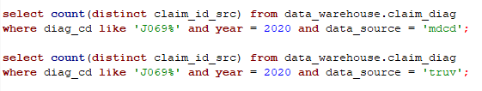
WHAT’S IT GOING TO DO FOR ME?
Unified variable names
Query time: ~ 35 seconds
Equivalent
Query time: also ~ 35 seconds
Notes:
Additionally, adapting code between data sources is as easy as adding a where statement, since the variable names remain the same. If you’re wondering if this additional where statement slows down querying… it doesn’t, because each data source is housed in its own partition. You can also just query the partition directly – the back end processes are essentially the same, so there’s no performance difference.

Slide 7
WHAT’S IT GOING TO DO FOR ME?
Cleaned enrollment data
Raw data
Data_warehouse
member_id | year | sex | race | zip | plan_type
12345 | 2015 | F | 1 | 75954 | FFS
12345 | 2015 | F | 1 | 75935 | STAR
12345 | 2015 | F | 1 | 75935 | STAR
12345 | 2015 | F | 3 | 75935 | STAR
12345 | 2015 | F | 3 | 75935 | STAR
12345 | 2015 | M | 3 | 75935 | STAR
12345 | 2015 | M | 3 | 75935 | STAR
12345 | 2015 | M | 1 | 75961 | STAR
12345 | 2015 | M | 1 | 75961 | STAR
12345 | 2015 | M | 1 | 75961 | STAR
12345 | 2015 | M | 1 | 75961 | STAR
12345 | 2015 | M | 1 | 75961 | STAR
member_id | year | sex | race | zip | plan_type
12345 | 2015 | M | 1 | 75935 | STAR
Enrollment tables have been cleaned using
Most prevalent value for that year
If tie, then use most recent value
CHIP
Star Kids
STAR+PLUS
Star Health
STAR
MMP
FFS
Medicaid plan types have been assigned using hierarchy:
Data is messy and disagrees with itself
*CHIP PERINATAL LOGIC NOT YET ADDED
Notes:
Another thing we’ve done is clean up the yearly enrollment tables. Those of you working with the data know that member demographic information comes to us in a monthly format, and sometimes a member will have more than one date of birth or their sex or race will flip flop between months. The data_warehouse yearly enrollment table does all the hard work of cleaning up these tables so that you don’t have to. We use the most prevalent value for that year OR if there is a tie, then the most recent value. For Medicaid in particular, plan types have also been assigned using this hierarchy.

Slide 8
WHAT’S IT GOING TO DO FOR ME?
Data Corrections
Raw data
Data_warehouse
claim_id | header_dos | details_dos
4931859419 | 2020-05-22 | 1900-01-01
34624572451 | 2020-05-22 | [blank or missing]
claim_id | header_dos | details_dos
4931859419 | 2020-05-22 | 2020-05-22
34624572451 | 2020-05-22 | 2020-05-22
Data sometimes has clearly incorrect or out of range information…
Replaced with better information
Also fixed: Removed data that doesn’t map properly! Removed leading/trailing whitespaces!
Notes:
We’ve also taken the initiative to correct some out of range, blank, or missing dates, replacing them with better information where available. Additionally, we’ve also removed keys that are clearly erroneous like member IDs that are all 0, and trimmed fields of leading or trailing white spaces.

Slide 9

WHAT’S IT GOING TO DO FOR ME?
Universal Cleaning Logic
Without DW:
Code is manually cleaned for each project
Inefficient
Leads to inconsistencies in cleaning logic
With DW:
Cleaning happens during ETL process
Consistent set of rules that can be refined over time
Notes:
These changes allow us to impose a set of UNIVERSAL CLEANING LOGIC. Currently, each project cleans its data manually, which is inefficient and leads to inconsistencies. Using the data warehouse, the cleaning is part of the ETL process, and results in a consistent set of rules that can be refined over time.

Slide 10
But how can I trust it?
Count of distinct claim IDs (msclmid) in data_warehouse and Truven schema on TACC server
Run time: 2023-01-13 15:52:02
year | dw_ccaes | dw_ccaeo | dw_mdcrs | dw_mdcro | truv_ccaes | truv_ccaeo | truv_mdcrs | truv_mdcro
2011 | 16054327 | 141177517 | 8907513 | 53671929 | 16054327 | 141177517 | 8907513 | 53671929
2012 | 15821442 | 141446271 | 8110827 | 45848871 | 15821442 | 141446271 | 8110827 | 45848871
2013 | 11613471 | 116117967 | 7118655 | 39462168 | 11613471 | 116117967 | 7118655 | 39462168
2014 | 12754200 | 123539857 | 6658248 | 38422882 | 12754200 | 123539857 | 6658248 | 38422882
2015 | 7012925 | 32975148 | 4089671 | 18402426 | 7012925 | 32975148 | 4089671 | 18402426
2016 | 7225729 | 36474303 | 3849138 | 18332458 | 7225729 | 36474303 | 3849138 | 18332458
2017 | 6715083 | 37535115 | 2959578 | 16275643 | 6715083 | 37535115 | 2959578 | 16275643
2018 | 7498614 | 50220108 | 1993135 | 12651429 | 7498614 | 50220108 | 1993135 | 12651429
2019 | 6912682 | 43887419 | 1966294 | 13362344 | 6912682 | 43887419 | 1966294 | 13362344
2020 | 6885963 | 46324960 | 3091594 | 17636955 | 6885963 | 46324960 | 3091594 | 17636955
2021 | 6502128 | 43595228 | 3264925 | 16446561 | 6512965 | 43595978 | 3265064 | 16446722
Difference between Truven schema and data_warehouse (Truven - DW):
year | ccaes_diff | ccaeo_diff | mdcrs_diff | mdcro_diff
2011 | 0 | 0 | 0 | 0
2012 | 0 | 0 | 0 | 0
2013 | 0 | 0 | 0 | 0
2014 | 0 | 0 | 0 | 0
2015 | 0 | 0 | 0 | 0
2016 | 0 | 0 | 0 | 0
2017 | 0 | 0 | 0 | 0
2018 | 0 | 0 | 0 | 0
2019 | 0 | 0 | 0 | 0
2020 | 0 | 0 | 0 | 0
2021 | 10837 | 750 | 139 | 161
Note: The difference in claim id count in 2021 is because some claims have enrolids that exist in the s and o tables that do not map to any enrolid in the a or t tables
The reason that this discrepancy ONLY exists in 2021 is likely because for 2020 and earlier, Will created entries in dim_uth_member_id to accomodate them
Extensive QA-ing has been performed
Row counting
Key counting
Field value comparisons (random sampling)
Discrepancies have been investigated
Notes:
Now… I have heard from more than one person that the “RAW DATA IS ALWAYS THE MOST RELIABLE” so Joe and I worked really hard to make sure that the information in the data_warehouse accurately reflects what is in the raw data.
We performed row counting, key counting – which is the join keys like member IDs or claim IDs, and did random sampling to make sure the individual values within each field matched the raw data and matched across servers. Any discrepancies we found were investigated, and the discrepancy rates brought down below 0.1%, and in many cases, to exactly zero. I personally investigated a lot of discrepancies and the ones remaining are largely due to messiness in the source data. But, of course, if you spot an issue, bring it to our attention and we will address it in the next update.

Slide 11
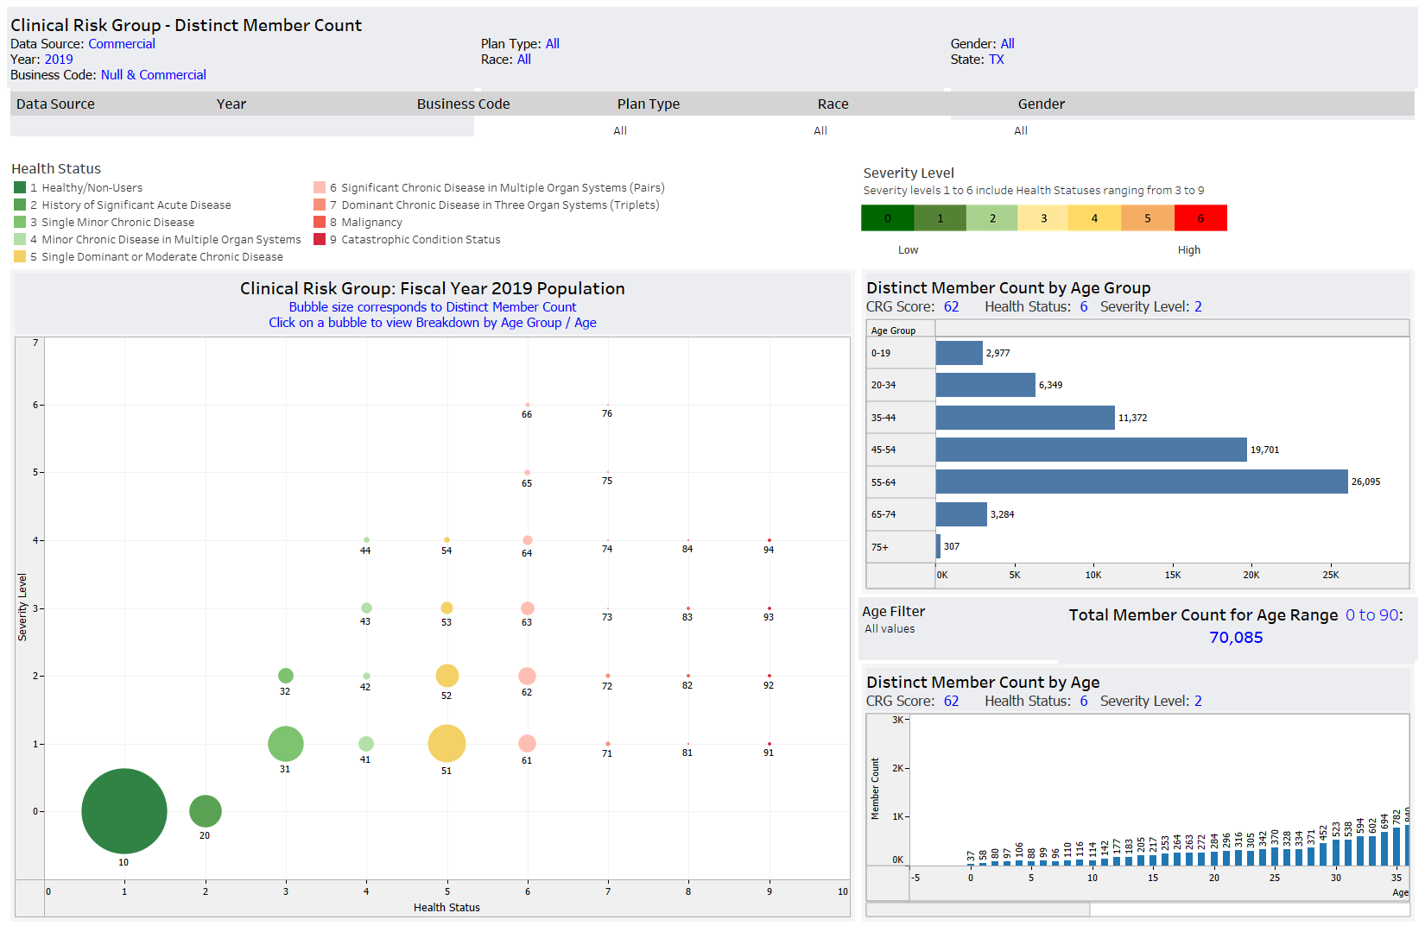
WHAT’S IT GOING TO DO FOR ME? Further enhancements
Conditions
Clinical Risk Groups
Admission Episodes
COVID Severity
Tableau
…
PostGIS
Apache Madlib
Notes:
List enhancements …. Lead into Dashboard stuff

Slide 12
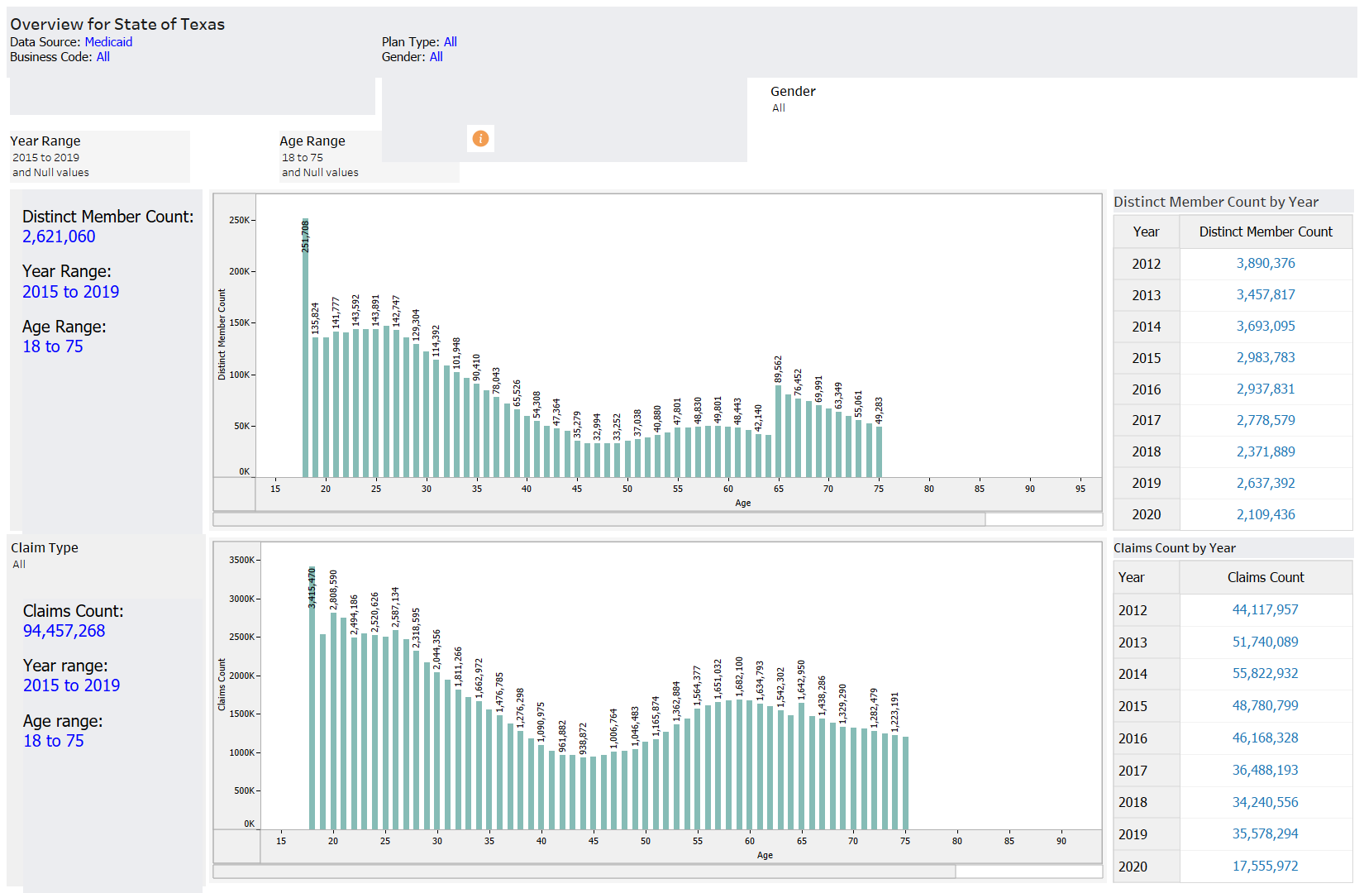
Notes:
Joe:
An example:
Give some props to Madhuri + Programmers helping make it
Why the dashboard was created: Provide summary statistics about common queries

Slide 13

Limitations + Considerations Joe is a poor salesman
Not all the data is on there
Not every variable is on there
Making changes can be time consuming
What’s your use case?
Notes:
As I said at the beginning, the purpose of the data warehouse is to provide very fast analytics on huge amounts of data
The big assumption here is that all your data is in one place
For 5-agency, Medicaid is on the data warehouse
Not every variable is on there
Replicating every variable would defeat the point of a data warehouse
It is a bespoke system, meaning updating the code requires a lot of intervention

Slide 14
When Might you not want to use it? Research and Analytics Have Different Business Requirements
some data Registries
🏥👩‍⚕️➡️
🔒🏫🗄️🔒➡️
📈🤓📝
Notes:
Joe:
The data warehouse is de-identified
Many registry studies involve linking IDENTIFIED data to semi-identifiable data in claims, like Medicare
We have the private data from Medicare, hidden from most everyone
That data, at the moment, can’t go into the data warehouse
The way things are set up, you may need to do some backwards walking to get there

Slide 15
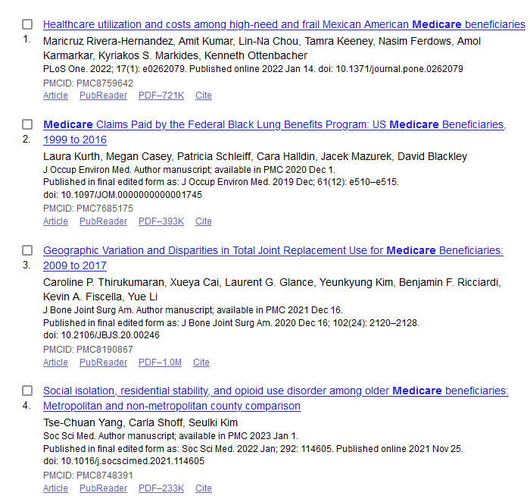
When Might you not want to use it? Research and Analytics Have Different Business Requirements
Some databases are Common languages in research
Notes:
Joe:
Some administrative database products can be considered common languages across institutions
While it isn’t standard practice, ideally all studies should provide code and specifications of variables used
So that their code is reproducible – This is more the case in some RCT’s I’m not as sure about health services
That was mentioned in a previous meeting but there is some legislation about data sharing
There are people who spend years working strictly on Medicare claims
Incorporating their expertise into an analysis, which may involve variables outside the scope of standard analytics
Are you studying someone in Medicare on a 2 year grant? Well, you may want to speak their common language and not give added work of having to explain your derivations

Slide 16
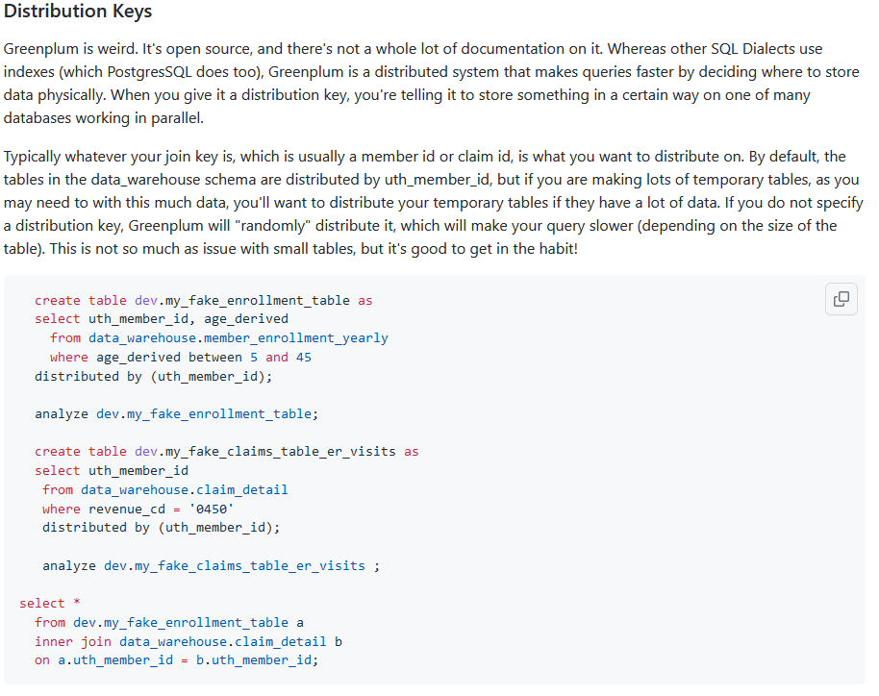
What do you need to know before using it Things aren’t fast on their own
Read our docs!
Read the other docs linked to on our docs!
Ask questions.
Notes:
Greenplum runs on Postgres
Both of which have quirks
So, regardless of your SQL experience, if you do whatever you do in another dialect or system, you may be disappointed
Read documentation

Slide 17
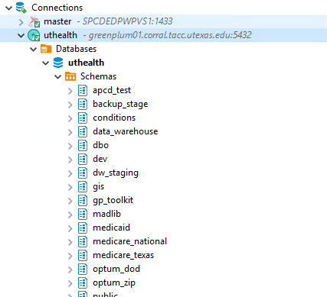
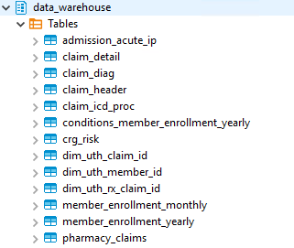
Usage notes
Done!
Revamp in progress…
Medicaid
Truven
Optum
Medicare
Notes:
Now we’ve tried to make data_warehouse easy to use but here are some areas that might trip a newcomer up. The data_warehouse is located in its own schema, and these are the tables in that schema. Remember how I said this was an interim update? Two things: ONLY MEDICAID AND TRUVEN have been refreshed and QA’d. Optum and Medicare are still in progress. The refresh focused on the highest utility tables, so the claims tables, the enrollment tables, and pharmacy claims are all done. Admissions, conditions, and CRG have not yet been refreshed.

Slide 18
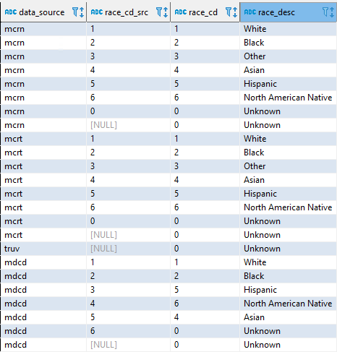
Usage notes
Race has been recoded
reference_tables.ref_race
New IDs generated just for DW
(you don’t have to use them)
These are the IDs that you know and love
Notes:
Two last things so you don’t get tripped up… the data_warehouse generates some new ID numbers because we squished four data sources into one table. You don’t have to pay attention to them, you can just use these columns to work with the IDs that you know and love.
Additionally, because races are coded differently in every data source, the data_warehouse has recoded the race column. The reference table is located under schema reference_tables in table ref_race.

Slide 19

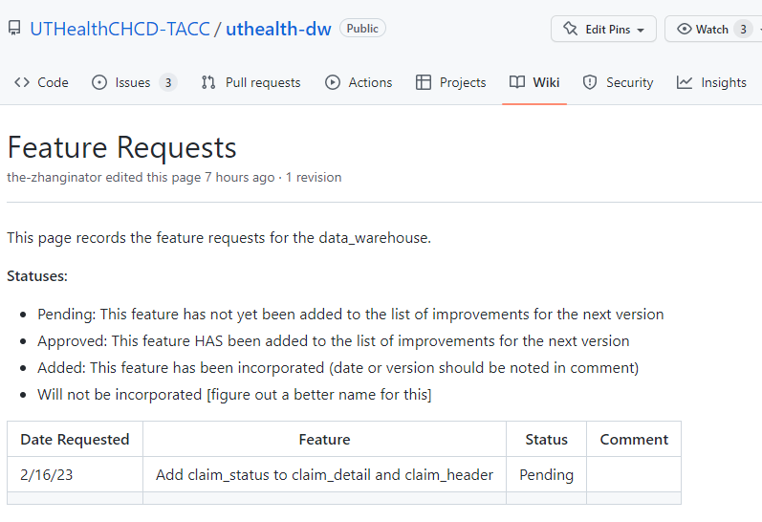

Feature requests and contact
https://github.com/UTHealthCHCD-TACC/uthealth-dw/wiki/Feature-Requests
Contact:
Xiaorui Zhang
Message on Teams or
xiaorui.zhang@uth.tmc.edu
Isrrael Perez
Message on Teams or
isrrael.perez@uth.tmc.edu
(NOT JOE W. – HE HAS ABANDONED US)
Notes:
The last thing I want to talk about is that there is a Feature Requests page! If, during a project, you encounter a column that seems important but is missing from DW, please just message me and I will add it to the feature requests list. We’ll talk it over and decide whether to incorporate it based on utility and feasibility, and approved feature requests will move into production. Questions and concerns should be sent to Xiaorui and Isrrael – NOT JOE, for he has abandoned us. To join the Biostats team. Joe, we already miss you.

Slide 20
resources
Data_warehouse Wiki (LOTS of good information here)
https://github.com/UTHealthCHCD-TACC/uthealth-dw/wiki
Guides on how to connect to DW from SAS! R! Python!
More tips and tricks!
Feature requests list: check to see if features have already been requested!
https://github.com/UTHealthCHCD-TACC/uthealth-dw/wiki/Feature-Requests
More information about Greenplum:
https://greenplum.org/greenplum-101/

