Slide 1
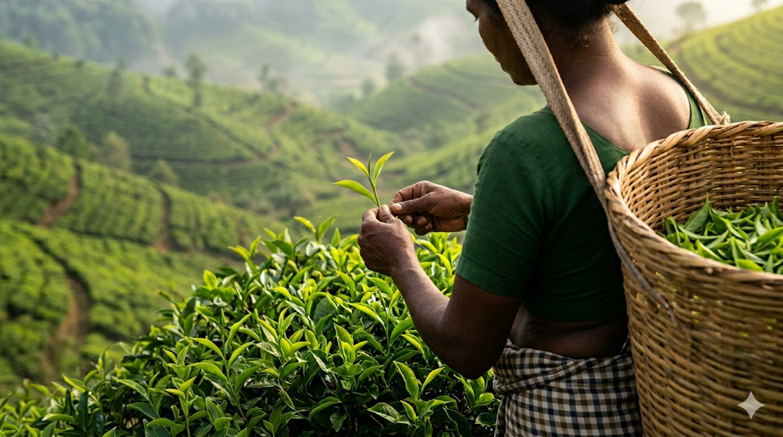


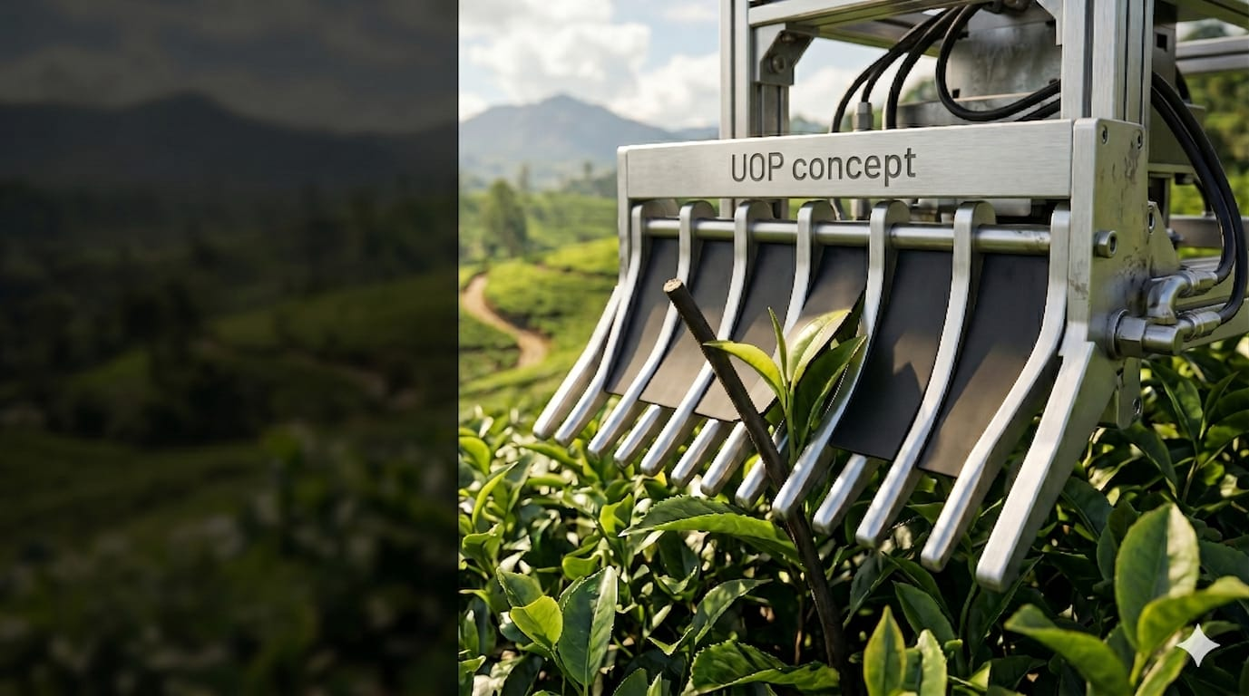
Adaptive Design for
Precision Tea Harvesting
Evaluation of Existing Systems &
Development of Improvement Recommendations
ME325 — Mechanical Engineering Group Project
Group Members Theekshana Dilhara [E/21/097] Yugan Sachithra [E/21/099] Keshani Kaushalya [E/21/218]
Supervised by
Dr. Elan Sivakumar
🍃 Tea Harvesting Research

Slide 2
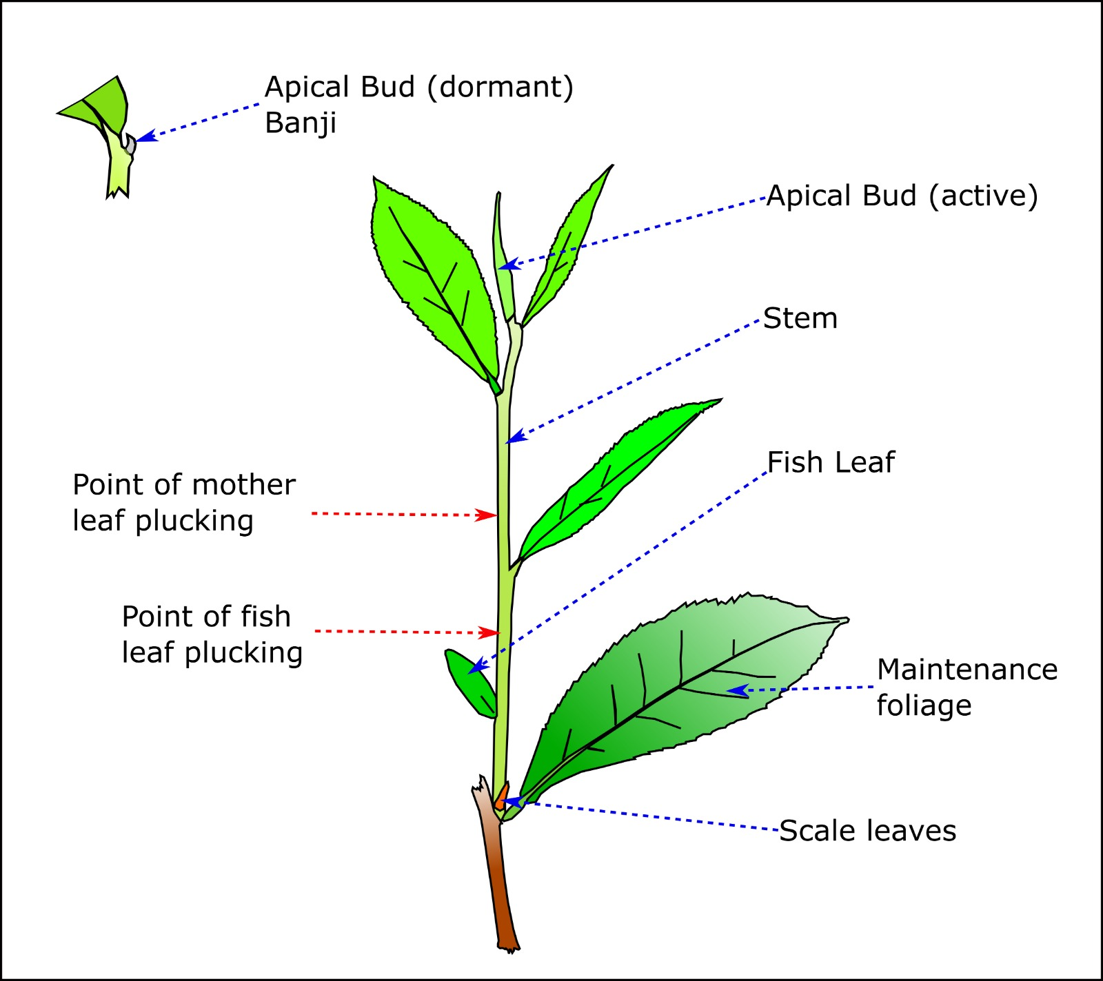
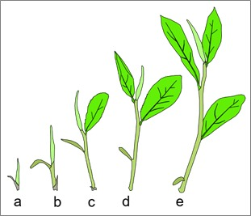
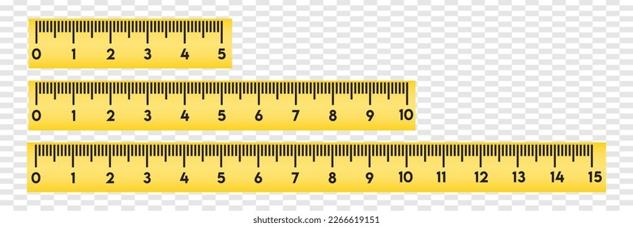

TEA SHOOT BIOLOGY & PLUCKING SCIENCE
01
Understanding tea shoot anatomy is essential to designing a selective harvesting mechanism.
🌱 Shoot Growth Stages (a → e)
🍃 Key Plucking Facts
• Pluckable shoot = Apical Bud + 2–3 tender leaves
• Arimbu = immature shoot — must NOT be harvested
• Banji = dormant bud — not ideal for plucking
• Maintenance foliage must be preserved for photosynthesis
• Fish leaf marks the lower boundary of plucking zone

Slide 3
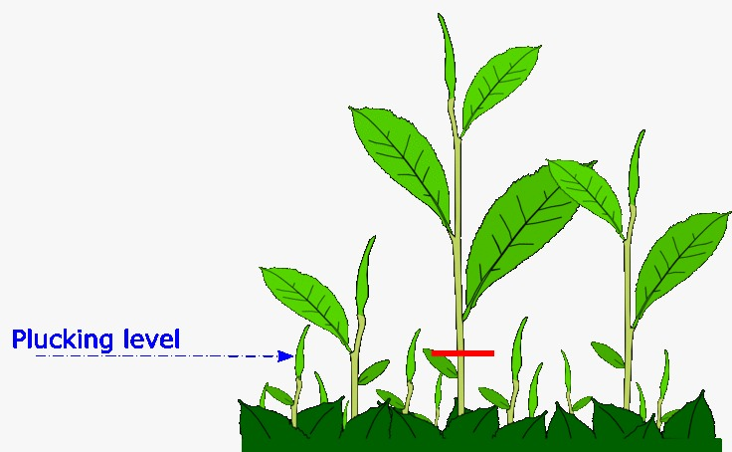
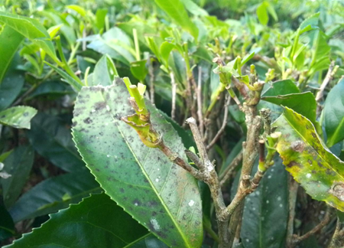
THE PROBLEM & AIM
02
📌 PROBLEM: Labour shortages and rising costs are forcing tea estates to adopt mechanical harvesting — but current machines damage leaves, lack selectivity, and fail on steep Sri Lankan terrain.
❌ WHY CURRENT MACHINES FAIL
✅ PROPOSED APPROACH
Selective harvesting — targets only pluckable shoots
Evaluates stem rigidity, bending angles & node count
Computer vision and sensors to detect buds in real time
Adaptable cutting height for uneven terrain
Reduced leaf damage & improved tea quality
Data-driven design validated through FEA & simulation
VS
Machines cannot detect precise plucking level
Cannot distinguish Arimbu / banji shoots
35–40% yield loss; heavy leaf damage
🎯 AIM: Conduct a systematic comparative analysis of tea plucking harvesters and propose practical design improvements for Sri Lankan plantation conditions.

Slide 4
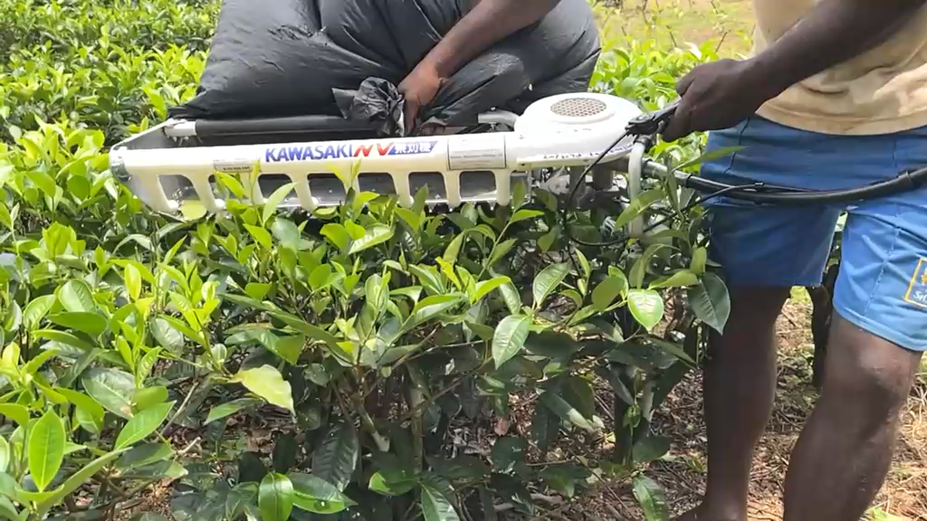

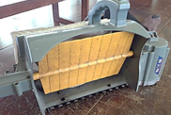
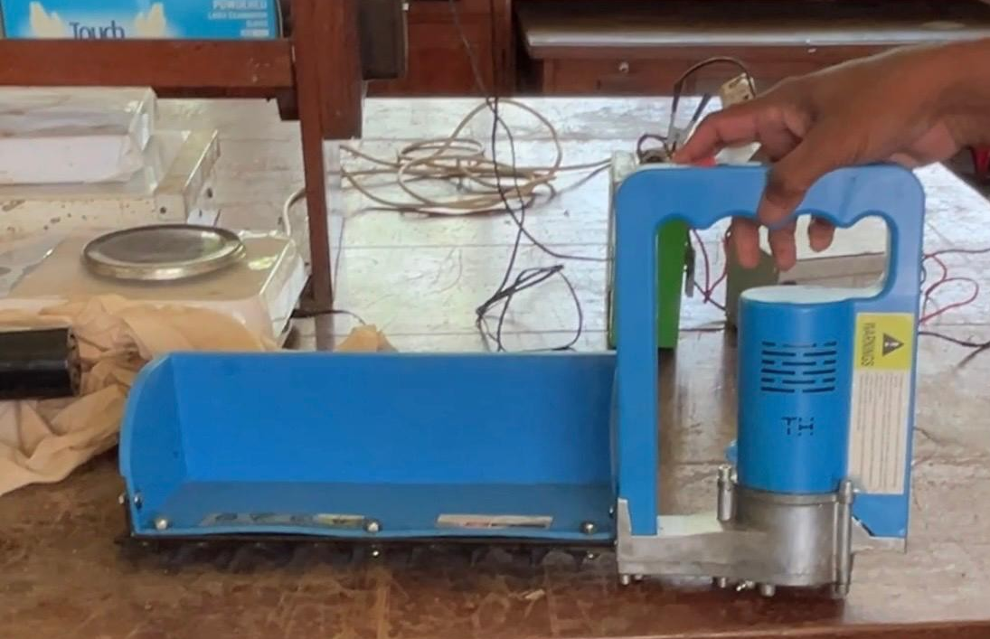
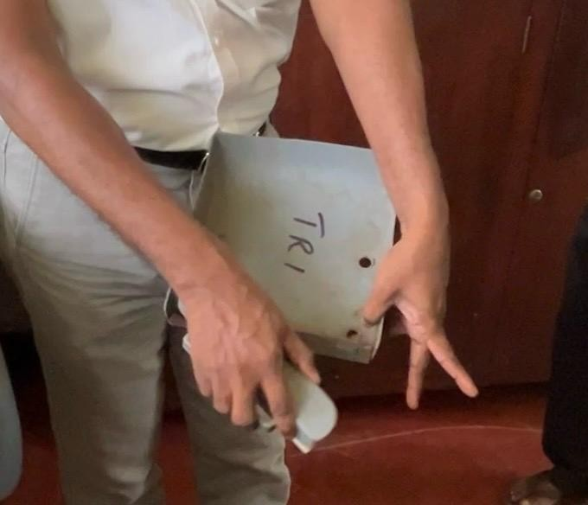
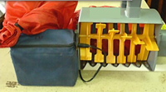
COMPARATIVE ANALYSIS OF TEA PLUCKING MACHINES
03
Field study informed by Tea Research Institute of Sri Lanka (TRI), Rathnapura
Criterion | Kawasaki Petrol Operated Harvester | Kawasaki Impeller | Battery Harvester | TRI Shear Plucker | Static Teeth
Power Source | Petrol | Battery ✅ | Battery ✅ | Human | Battery ✅
Daily Output | 0.7–1.0 ac/day (15× faster) | < NV60H (10× faster) | 30+ kg/hr (similar speed) | 4.3 kg/hr (2× faster) | Very low
Leaf Quality | Poor — many broken leaves | Poor — fans bruise leaves | Moderate < 10% coarse | Good — close to manual | Very poor — teeth jam
Selectivity | None | None | Low | Partial | None
Sri Lanka Terrain | Hilly (partly) | Hilly (partly) | Any land | Any land | Not tested
SL Pluck Cycle | 14–16 days ✅ | 14–16 days ✅ | 14–16 days ✅ | 7 days ✅ | Not suitable
Overall Rating | 🟢🟢🟢⚪⚪ 3 / 5 | 🟡🟡⚪⚪⚪ 2 / 5 | 🟢🟢🟢⚪⚪ 3 / 5 | 🟢🟢🟢🟢⚪ 4 / 5 | 🔴⚪⚪⚪⚪ 1 / 5
Operation of the currently using machine

Slide 5
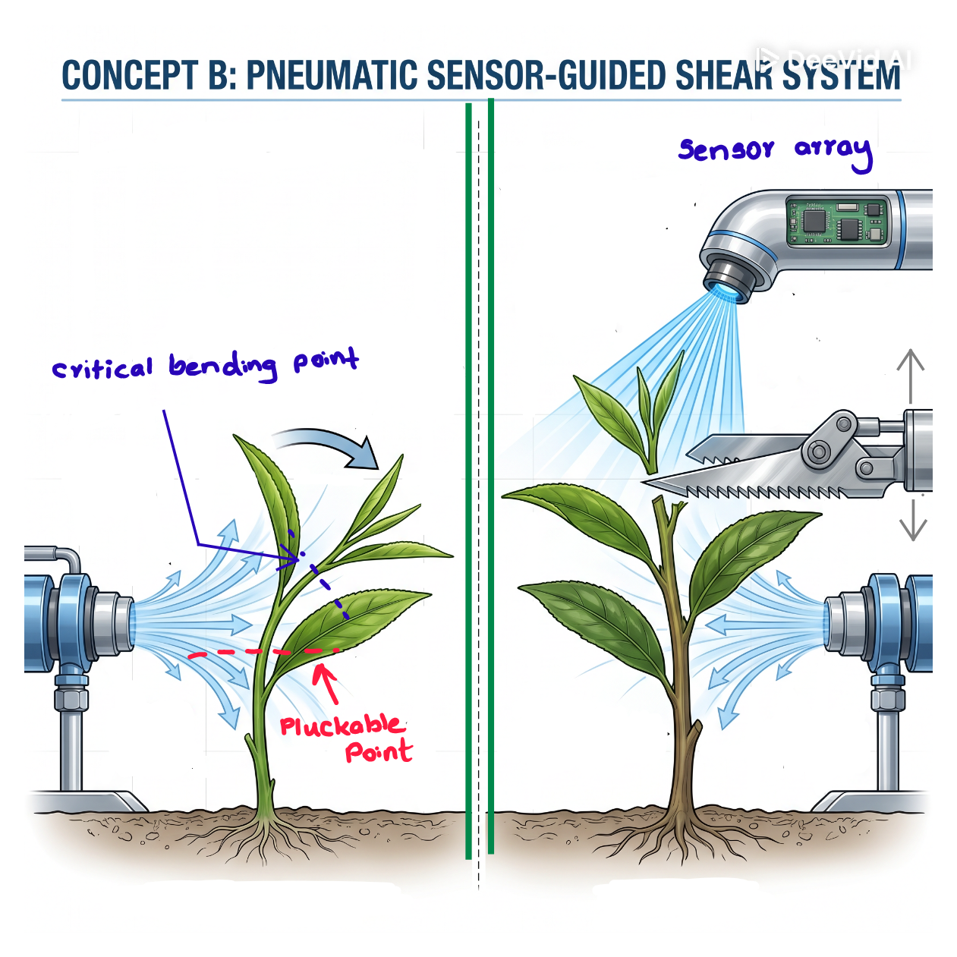
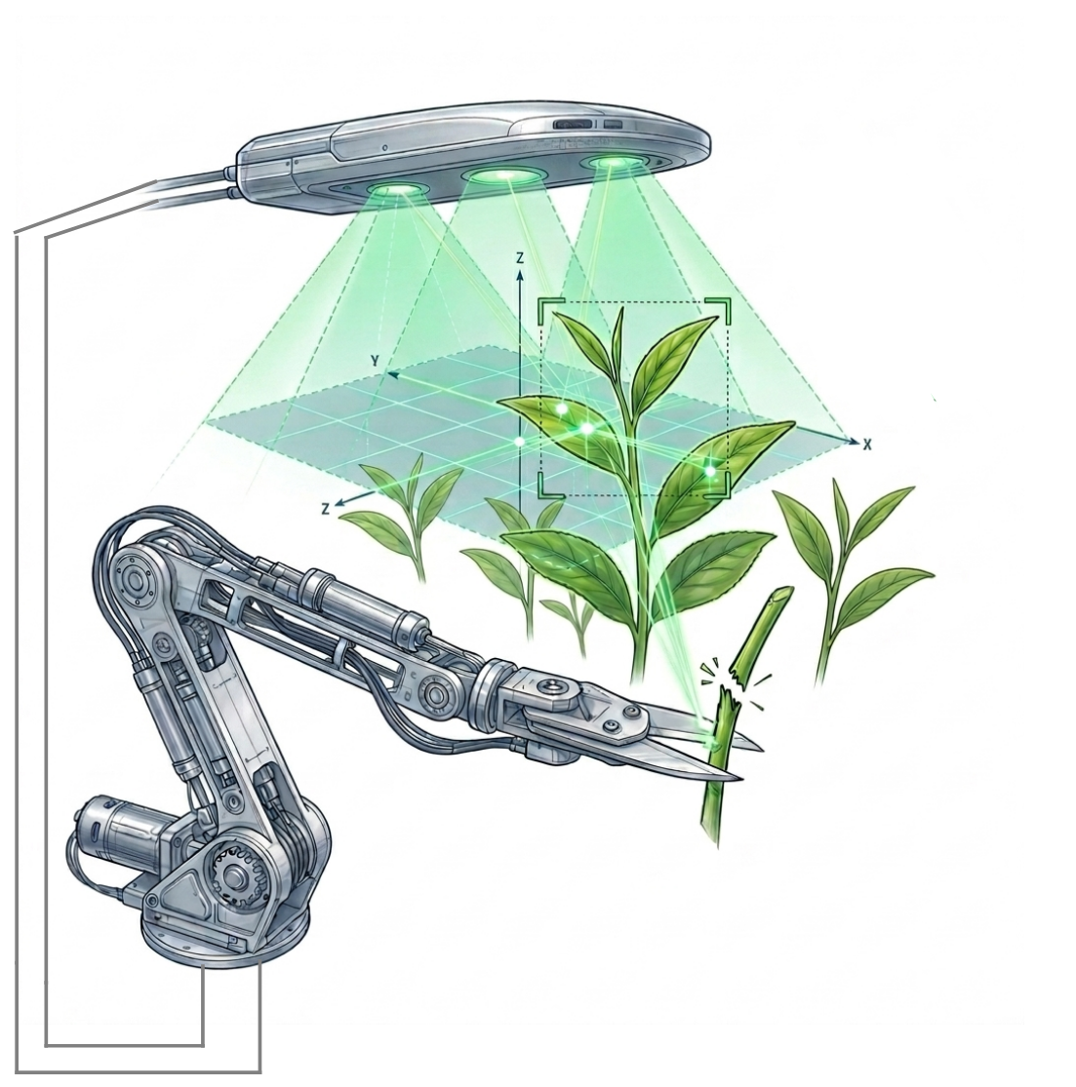
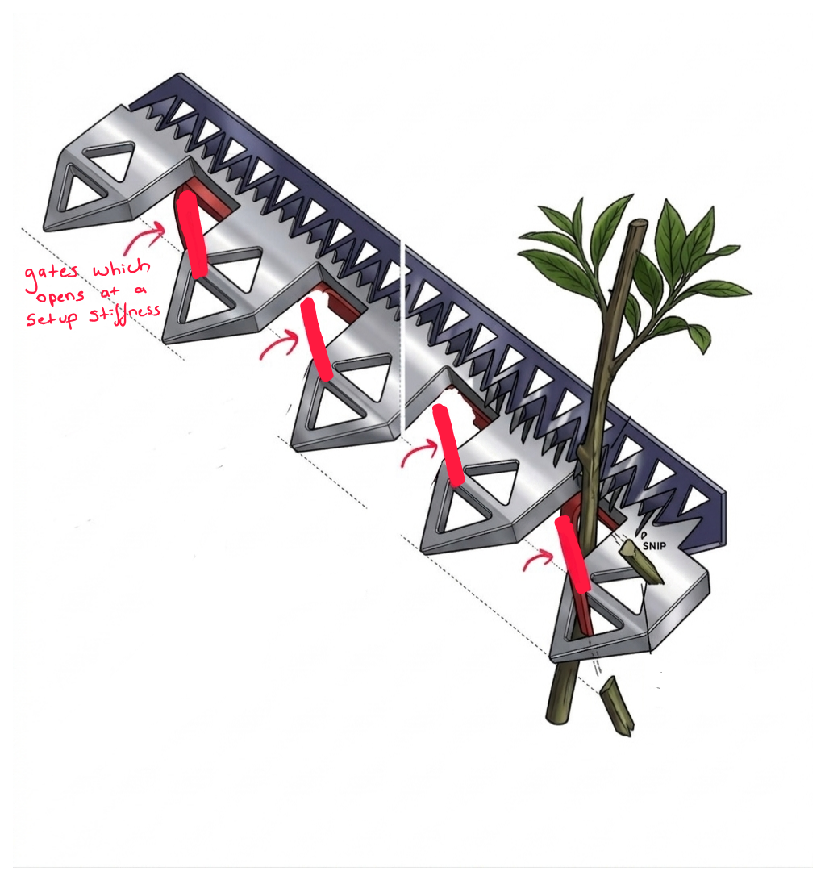
ENGINEERING DESIGN & METHODOLOGY
04
🤖 Concept C: Stiffness Based Selection Gate
📡 Concept A: Sensor-Guided Bending Shear
🔬 Concept B: Optical Micro-Shear System
Exploits stem flexural rigidity. Deflector bends mature stems to 80° yield point. Sensor array detects bud position → dynamically adjustable blade targets the exact internode.
Front facing camera scans canopy, identifies the topmost bud, and counts leaf nodes. If node count ≥ 3, a localized micro-shear severs the specific stem without collateral damage.
A mechanical comb attachment uses flexible strips to sort shoots by stem stiffness. Flexible immature shoots bend safely underneath the gates, while rigid mature stems push the gates open to reach the cutting blades.
SOFTWARE TOOLS:
SolidWorks 2024 · Ansys FEA · MATLAB / Python · GitHub

Slide 6
PROJECT TIMELINE — 4 MILESTONES
05

Slide 7
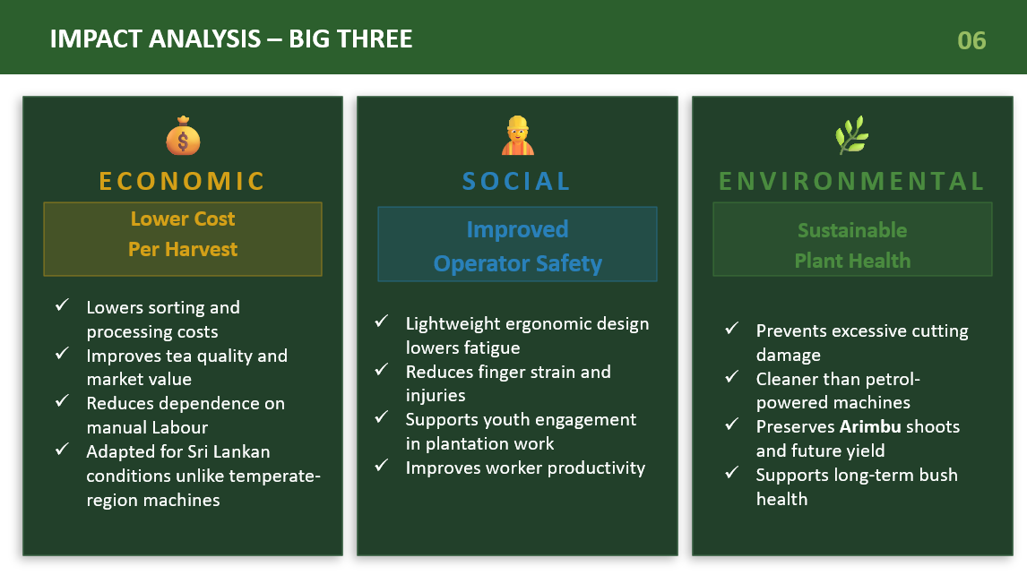
Ready for the Next Generation of Tea Harvesters? Let’s innovate, Efficient & Quality-Oriented Solutions

