Slide 1
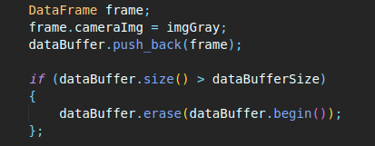
MP.1 DATA BUFFER
Implement a vector for dataBuffer objects whose size does not exceed a limit (e.g. 2 elements). This can be achieved by pushing in new elements on one end and removing elements on the other end.

Slide 2
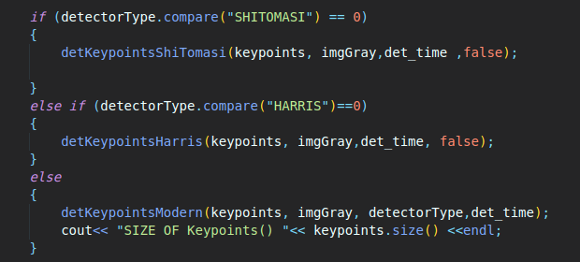
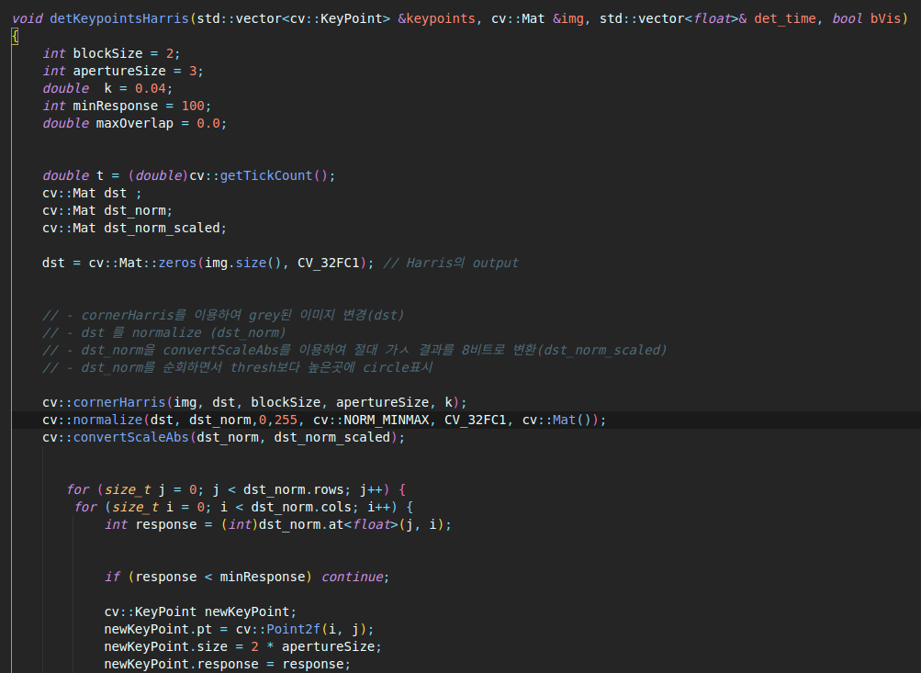
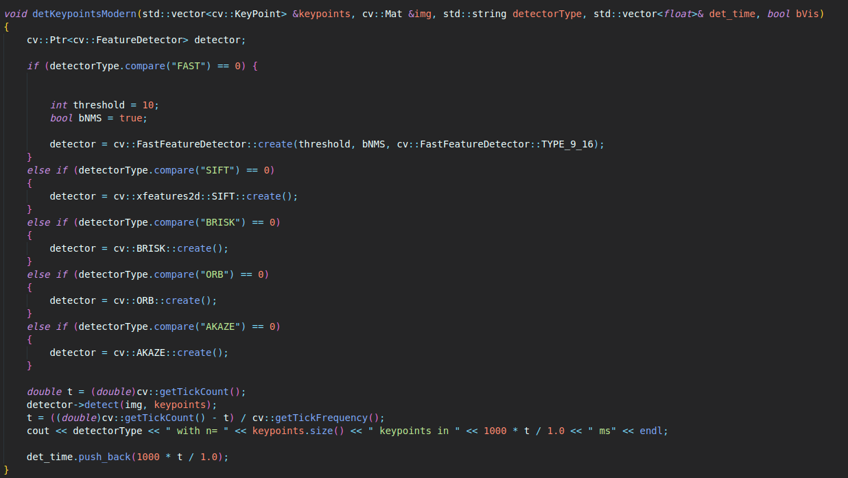
MP.2 Keypoint Detection
Implement detectors HARRIS, FAST, BRISK, ORB, AKAZE, and SIFT and make them selectable by setting a string accordingly.

Slide 3
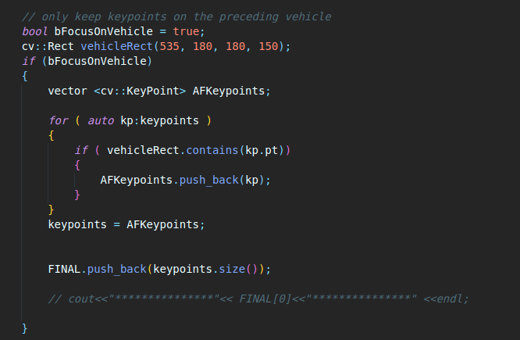
MP.3 Keypoint Removal
Remove all keypoints outside of a pre-defined rectangle and only use the keypoints within the rectangle for further processing.

Slide 4
MP.4 Keypoint Descriptors
Implement a vector for dataBuffer objects whose size does not exceed a limit (e.g. 2 elements). This can be achieved by pushing in new elements on one end and removing elements on the other end.

Slide 5
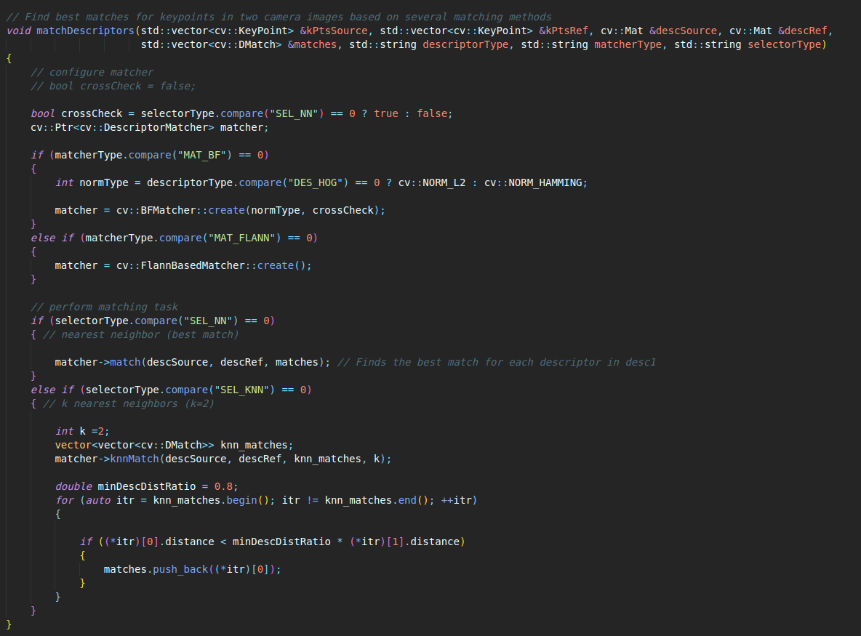
MP.5 Descriptor Matching
Implement FLANN matching as well as k-nearest neighbor selection. Both methods must be selectable using the respective strings in the main function.

Slide 6
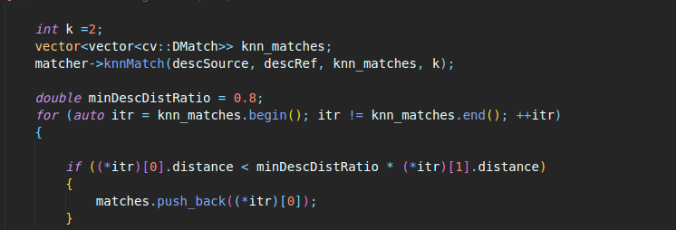
MP.6 Descriptor Distance Ratio
Use the K-Nearest-Neighbor matching to implement the descriptor distance ratio test, which looks at the ratio of best vs. second-best match to decide whether to keep an associated pair of keypoints.

Slide 7
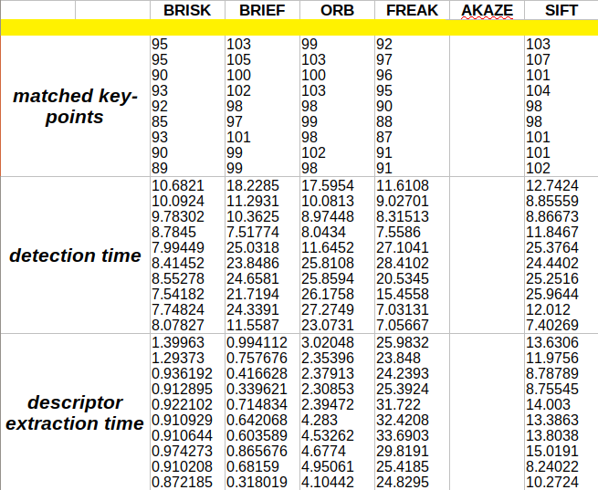
MP.7 & MP.8 & MP.9
1. SHI-TOMASI

Slide 8
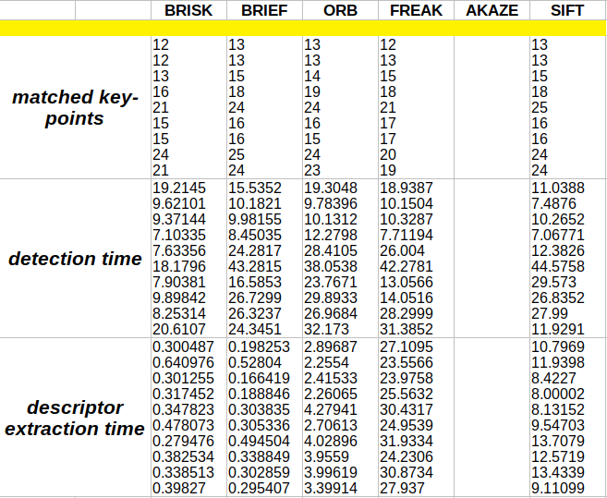
MP.7 & MP.8 & MP.9
2. HARRIS

Slide 9
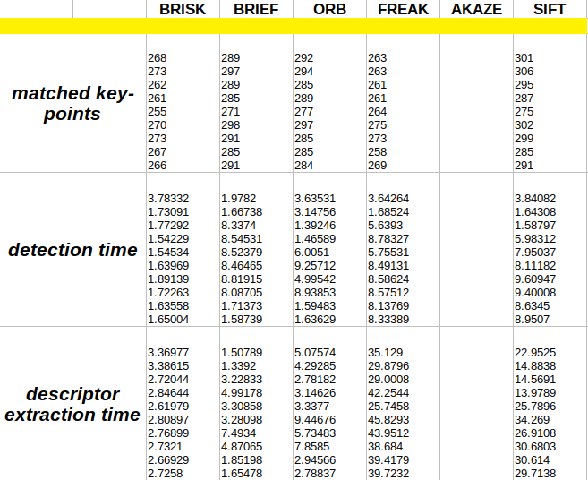
MP.7 & MP.8 & MP.9
3. FAST

Slide 10
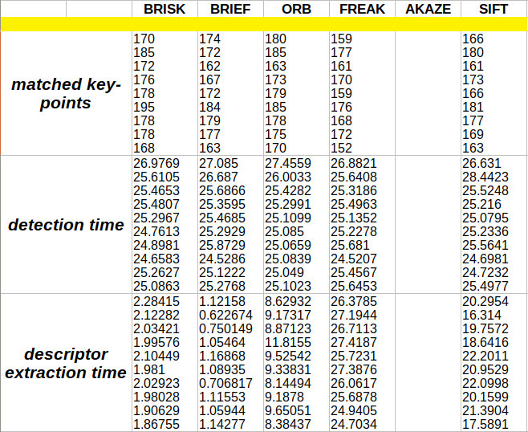
MP.7 & MP.8 & MP.9
4. BRISK

Slide 11
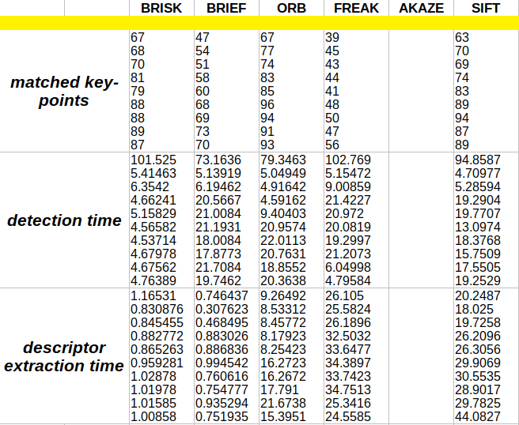
MP.7 & MP.8 & MP.9
5. ORB

Slide 12
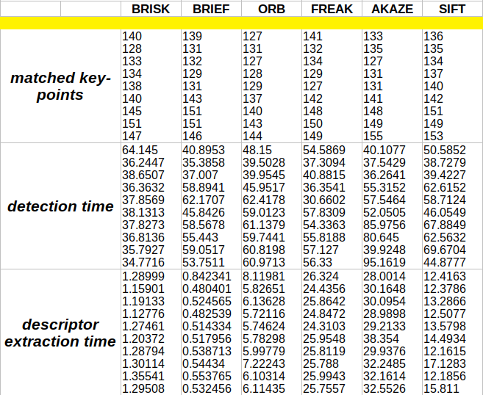
MP.7 & MP.8 & MP.9
6. AKAZE

Slide 13
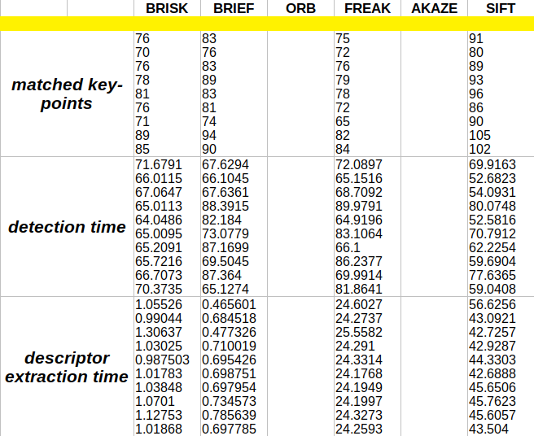
MP.7 & MP.8 & MP.9
7. SIFT

Slide 14
Conclusion
TOP 3 combinations
1. FAST + BRIEF (BEST RUN TIME)
2. ORB +ORB (ROBUST IN SCALE CHANGE)
3. SHI-TOMASI + BRISK (BEST MATCH)

