Slide 1
Final Project

Slide 2
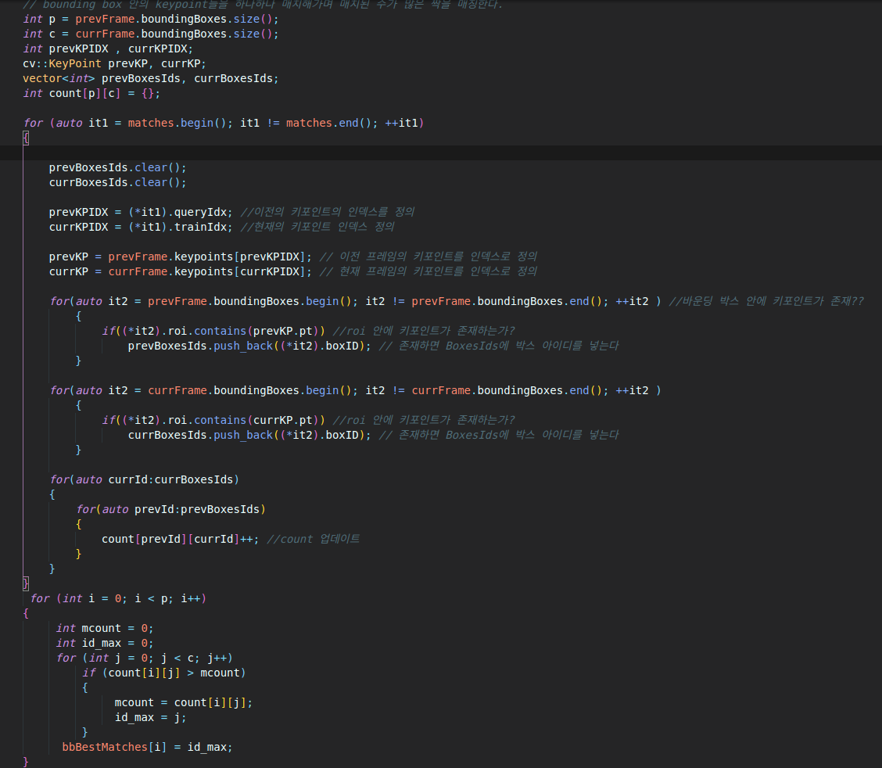
FP.1 Match 3D Objects
Implement the method "matchBoundingBoxes", which takes as input both the previous and the current data frames and provides as output the ids of the matched regions of interest (i.e. the boxID property). Matches must be the ones with the highest number of keypoint correspondences.

Slide 3
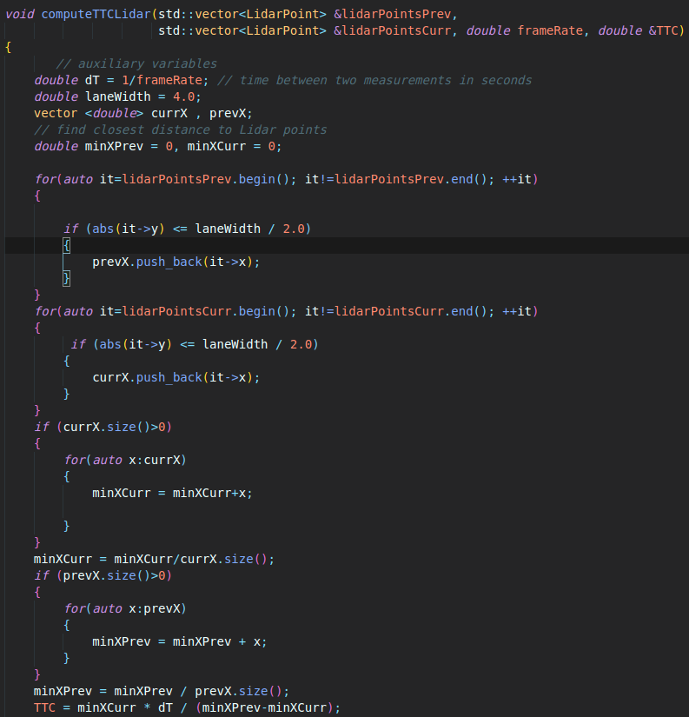
FP.2 Compute Lidar-based TTC
Compute the time-to-collision in second for all matched 3D objects using only Lidar measurements from the matched bounding boxes between current and previous frame.

Slide 4
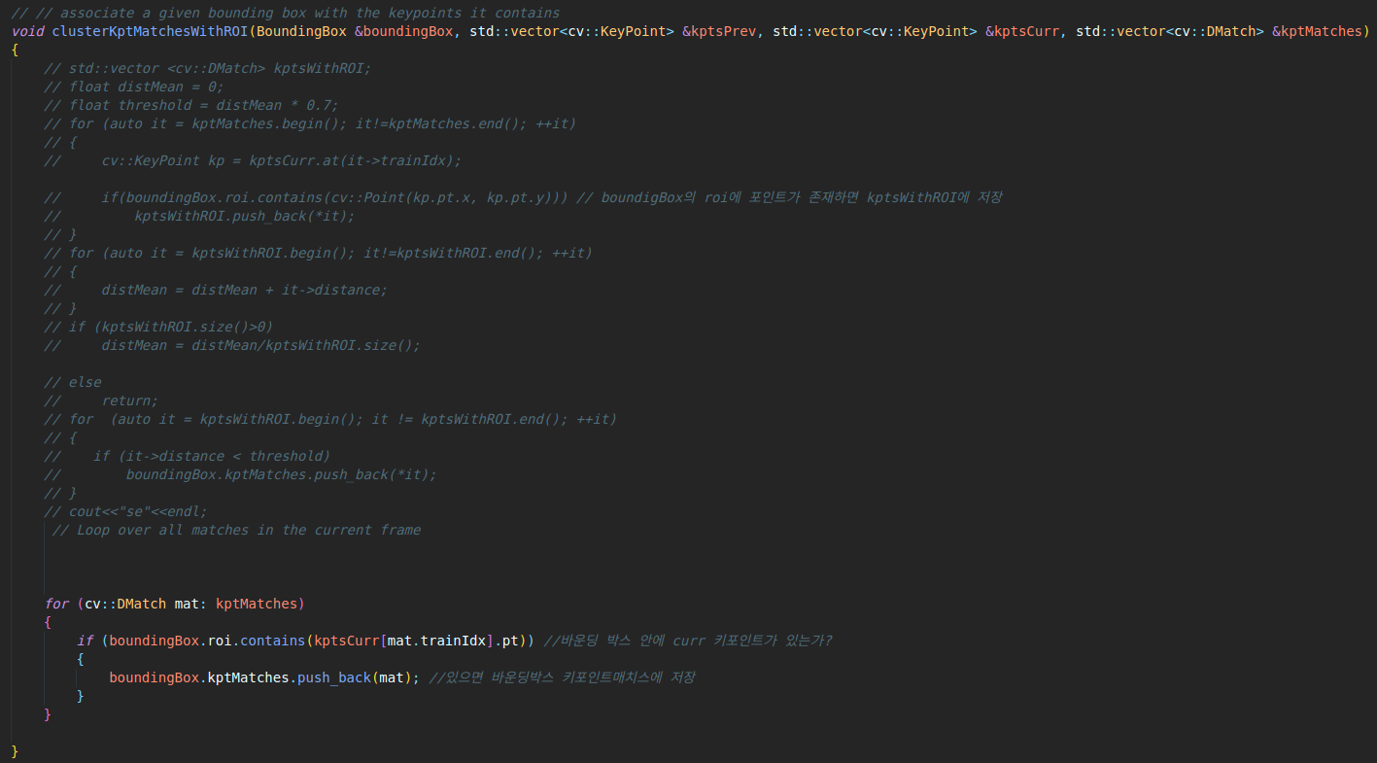
FP.3 Associate Keypoint Correspondences with Bounding Boxes
Prepare the TTC computation based on camera measurements by associating keypoint correspondences to the bounding boxes which enclose them. All matches which satisfy this condition must be added to a vector in the respective bounding box.

Slide 5
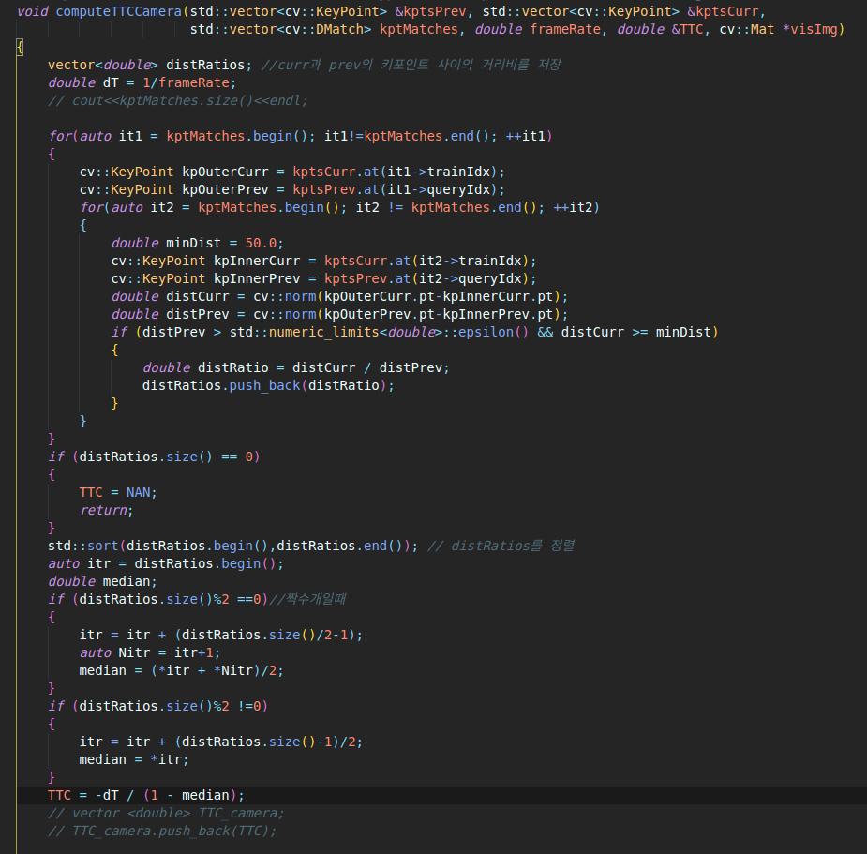
FP.4 Compute Camera-based TTC
Compute the time-to-collision in second for all matched 3D objects using only keypoint correspondences from the matched bounding boxes between current and previous frame.

Slide 6
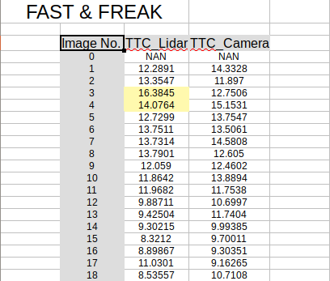
FP.5 Performance Evaluation 1
Find examples where the TTC estimate of the Lidar sensor does not seem plausible. Describe your observations and provide a sound argumentation why you think this happened.
As you can see, there are two irregular TTC time in Lidar. You can calculate TTC by this formular.
TTC = minXCurr *dT / (minXPrev-minXCurr)
If (minXPrev-minXCurr) decrease, TTC become bigger. And minXPrev may influenced by point cloud outliers.

Slide 7
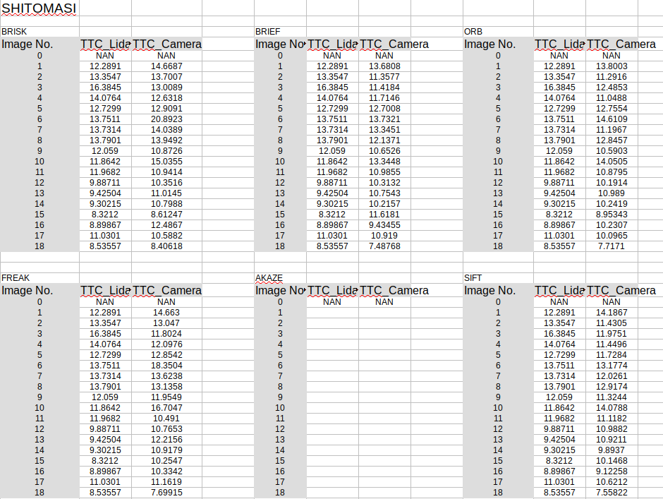
FP.6 Performance Evaluation 2
Run several detector / descriptor combinations and look at the differences in TTC estimation. Find out which methods perform best and also include several examples where camera-based TTC estimation is way off. As with Lidar, describe your observations again and also look into potential reasons.

Slide 8
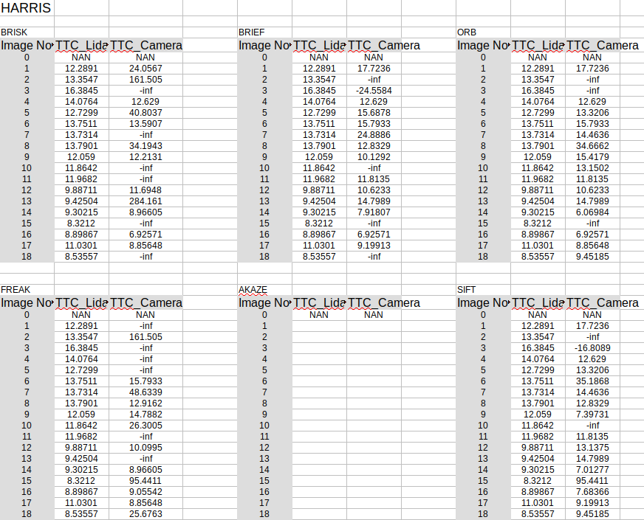
FP.6 Performance Evaluation 2
Run several detector / descriptor combinations and look at the differences in TTC estimation. Find out which methods perform best and also include several examples where camera-based TTC estimation is way off. As with Lidar, describe your observations again and also look into potential reasons.

Slide 9
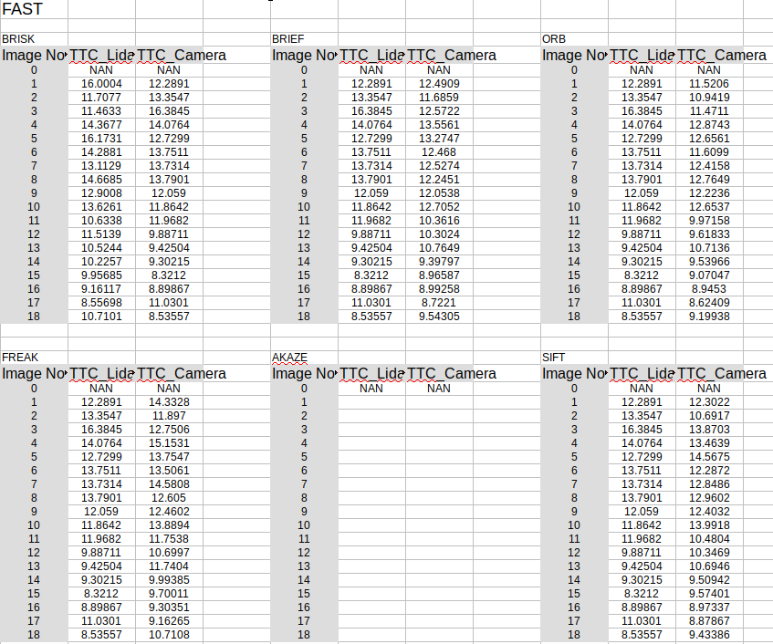
FP.6 Performance Evaluation 2
Run several detector / descriptor combinations and look at the differences in TTC estimation. Find out which methods perform best and also include several examples where camera-based TTC estimation is way off. As with Lidar, describe your observations again and also look into potential reasons.

Slide 10
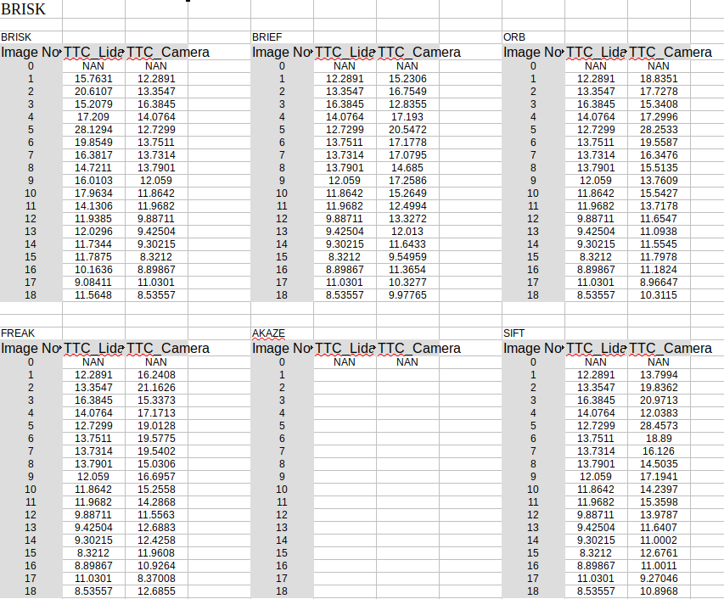
FP.6 Performance Evaluation 2
Run several detector / descriptor combinations and look at the differences in TTC estimation. Find out which methods perform best and also include several examples where camera-based TTC estimation is way off. As with Lidar, describe your observations again and also look into potential reasons.

Slide 11
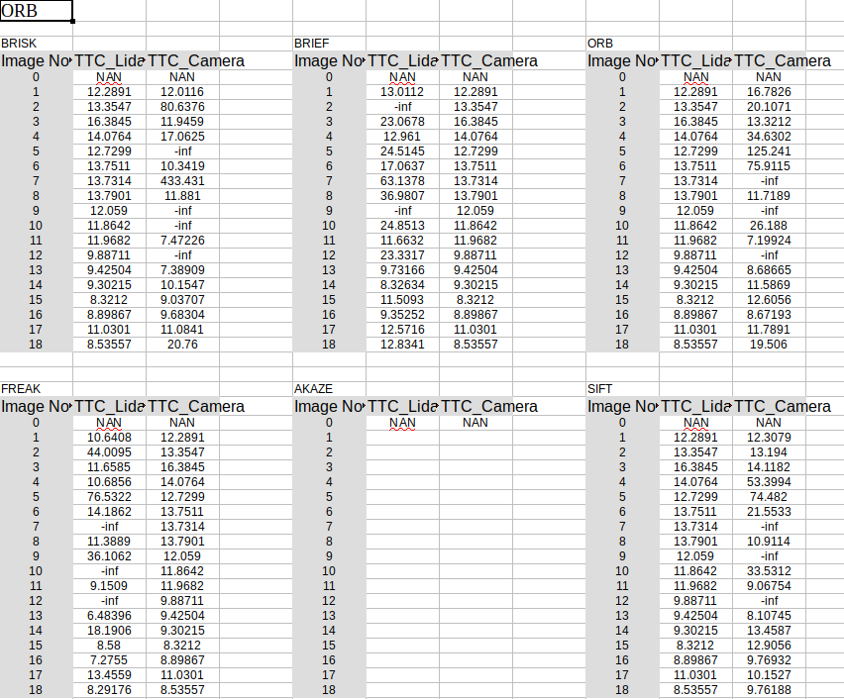
FP.6 Performance Evaluation 2
Run several detector / descriptor combinations and look at the differences in TTC estimation. Find out which methods perform best and also include several examples where camera-based TTC estimation is way off. As with Lidar, describe your observations again and also look into potential reasons.

Slide 12
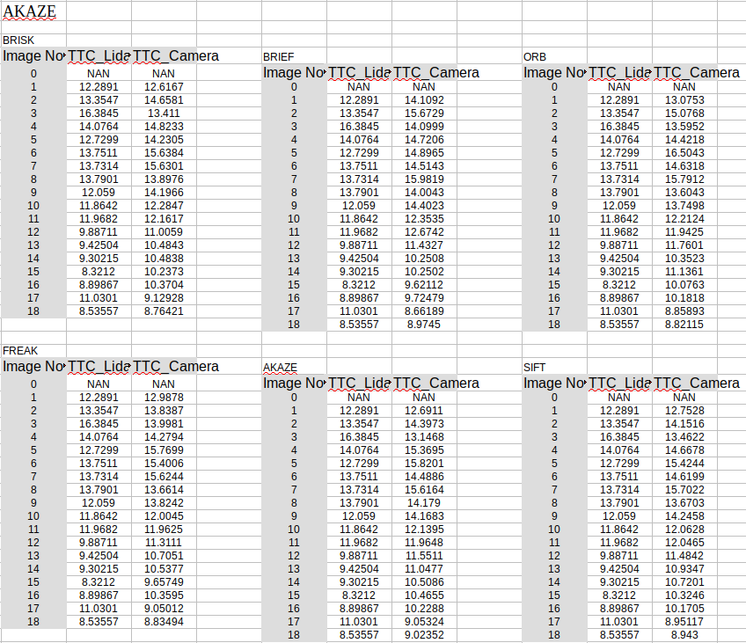
FP.6 Performance Evaluation 2
Run several detector / descriptor combinations and look at the differences in TTC estimation. Find out which methods perform best and also include several examples where camera-based TTC estimation is way off. As with Lidar, describe your observations again and also look into potential reasons.

Slide 13
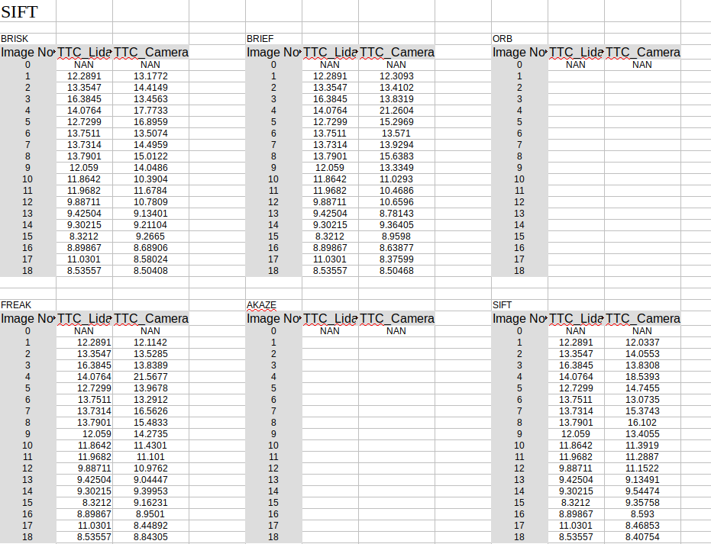
FP.6 Performance Evaluation 2
Run several detector / descriptor combinations and look at the differences in TTC estimation. Find out which methods perform best and also include several examples where camera-based TTC estimation is way off. As with Lidar, describe your observations again and also look into potential reasons.

Slide 14
Conclusion
Best Combination
Mid-term project
Final Project
1. FAST + BRIEF (BEST RUN TIME)
2. ORB +ORB (ROBUST IN SCALE CHANGE)
3. SHI-TOMASI + BRISK (BEST MATCH)
1. FAST + BRIEF (BEST RUN TIME)
2. SHI-TOMASI + BRIEF (BEST ACCURACY)
3. SHI-TOMASI + BRISK (BEST MATCH)

