Slide 1

Internship Presentation
Md. Noor Uddin
Registration no : 2017831027
Performed at : LEADs Corporation Ltd.

Slide 2
Table Of Contents
Internship Objective
About LEADs
Customers & Partners
What Did I Learn
Tasks Breakdown
What Did I Learn
Conclusion

Slide 3
Internship Objective
Internship, a professional learning opportunity which provides students with relevant, hands-on work that is connected to their area of study or career interest.
Internships are supervised, structured learning experiences which introduces the student to the company, its culture, and proposed assignments.
assists students in setting and achieving learning objectives,career path.

Slide 4
About LEADs
LEADS is involved in designing, developing, implementing and maintaining business application software for both domestic and overseas markets.
LEADS provide Core Banking Solution (BankUltimus) for the Banking industry for both local and global market.
Furthermore, LEADS provides complete life cycle of software development services including system analysis, use case development, system architecture & design, system integration, native, web API development, UI/UX design, database design and administration, functional and system­­­­ testing, quality assurance and project management.

Slide 5
Project I have Worked On
Core Banking Solution (CBS) branded as “BankUltimus” provides integrated solutions for Retail, SME and Corporate banking as well as has features supporting Trade Finance, Loan management system and many more. It is an enterprise banking solution that enables Banks to provide full range of banking services and content to Customer Information File (CIF), Know Your Customer (KYC) & Transaction Profile (TP) according to Central Bank compliance efficiently and reliably.
I have worked on “UltimusNex” project which is a newer edition of BankUltimus being developed using new technologies and maintaining guidelines from Bangladesh Bank.

Slide 6
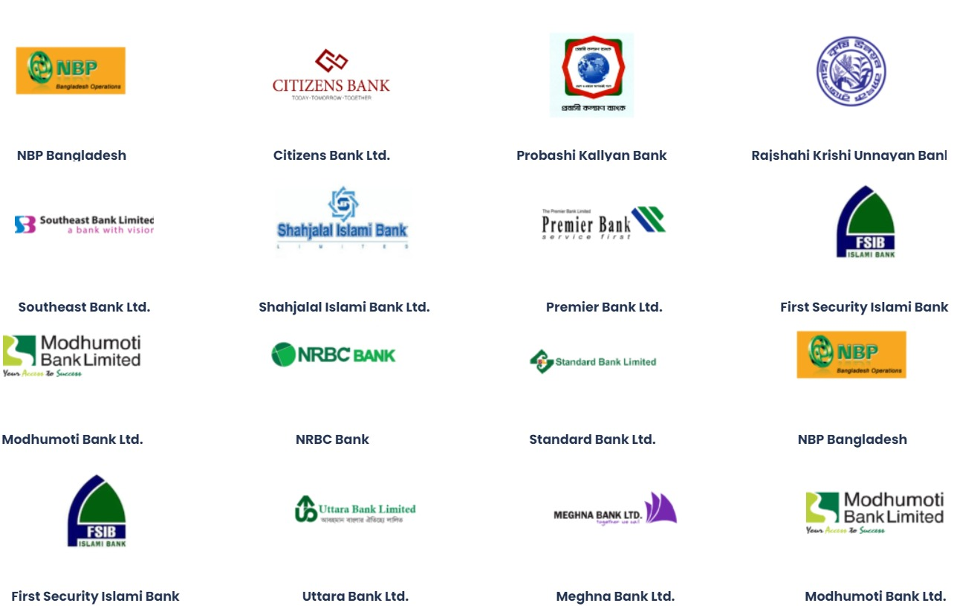
Customers

Slide 7


Partners

Slide 8
What Did I Learn
There are two aspects of my learning -
Technical - which includes various technologies and tools.
Non technical - which includes interpersonal skills.

Slide 9
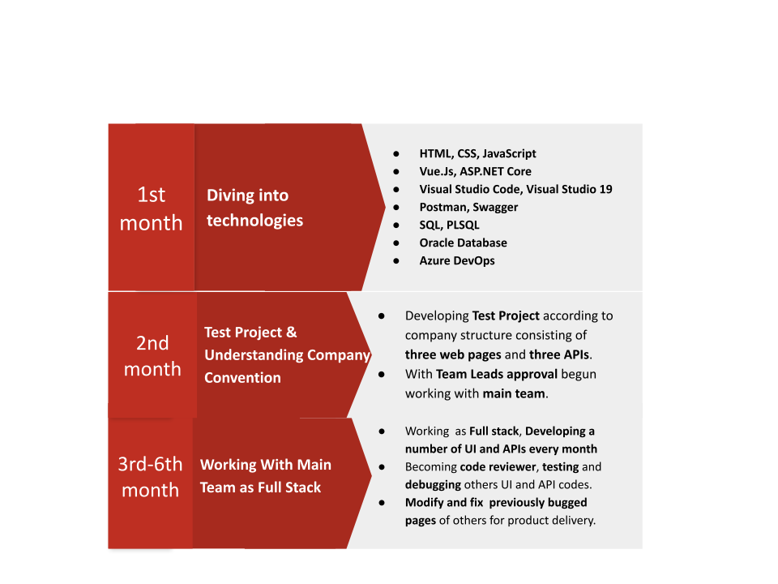
Technical learning

Slide 10
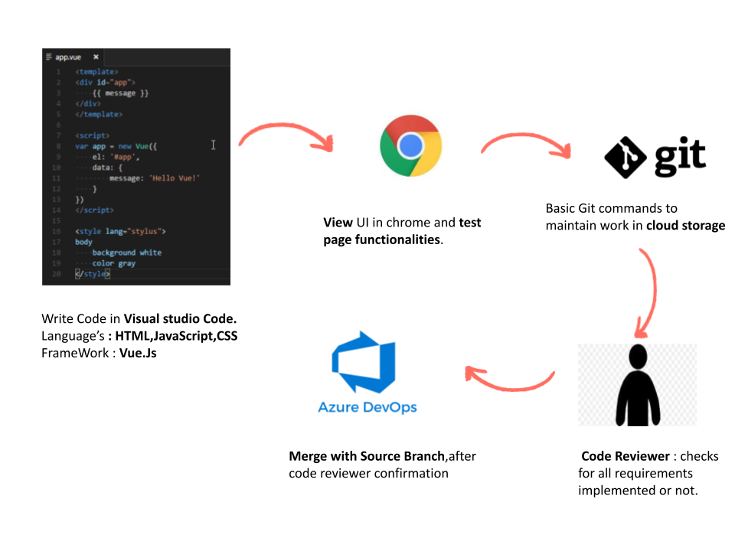
Task Breakdown
As Front end developer :

Slide 11
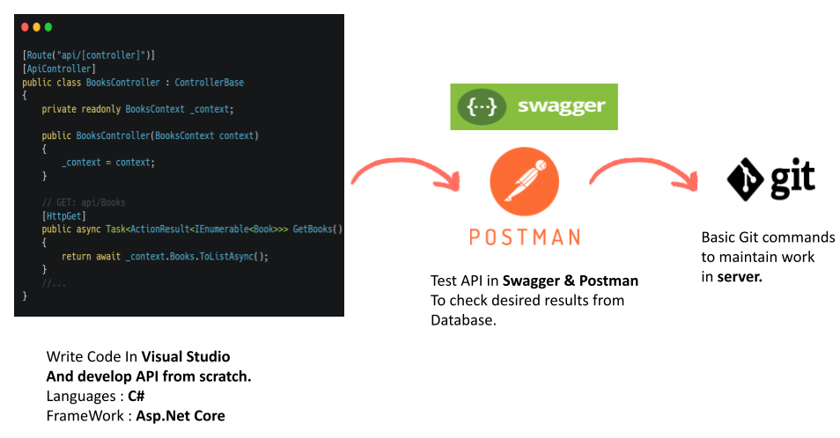
Task BreakDown
As Back end Developer:

Slide 12
Non Technical Learning
Multi tasking
Time management
No bullying and blaming
Appreciate success, do not discourage failure
Quality over quantity

Slide 13
Conclusion
This internship has been an excellent and rewarding experience.
It was a great opportunity to gain and enhance personal and professional skills.
These valuable skills have boosted me and my future career on a higher level for which I am grateful.
My sincere gratitude and appreciation to my Department,my Honorable teachers.
Thank You…

