Slide 1
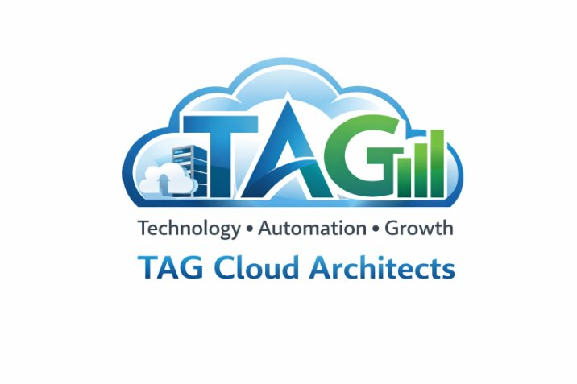
TAG Cloud Architects
AWS Cloud Architecture Capstone Project
The Scalable Solution
Notes:
Our team name TAG Cloud Architects formed from the first initials of the team members TAG, Terica Alexia Godpower, but beyond that the name shows a structure and intentional approach to cloud architecture and is aligned with the industry best practices.
T.A.G. represents Technology Automation and Growth; this directly follows the key principles of the AWS Well Architected Framework.
Technology- it is our goal to show Reliability and Security, This ensures we focus on building a resilient, highly available and secure cloud infrastructure
Automation this is where we focus on the Operational Excellence and performance Efficiency. This is a what to emphasize the use of cloud native functions such as auto scaling, monitoring and self healing systems that have the ability to improve efficiency and cut the manual input.
Growth this shows Performance Efficiency and Cost Optimization showing the solution can scale dynamically to meet increasing demand and maintain performance while controlling cost.
As the cloud architects it is our main goal is not only to solve the clients problem but to design a solution that is scalable, secure, cost-effective and aligned with the cloud architecture standards. This is a prideful name that illuminates the mindset and the value that we aim to provide to this project

Slide 2
Team Members
Team Lead / Integration / Quality Control
TS
AH
GO
Requirements Lead
Gaps Lead
Terica Shepard
Alexia Hinton
Godspower Oseratin Ogunseri
Project Manager Coordinate team progress set deadlines Validate formatting is without error Brief all concerns to the Clien (professor)
Review and determine all requirements Organize Functional Non-Functional Technical Ensure all items are addressed
Build the Gaps Document Identify Missing requirements Validate Assumptions Risks Prepare Questions for the client
Notes:
Terica Shepard, Alexia Hinton, Godspower Oseratin Ogunseri

Slide 3
Project Objective
Design a scalable, secure, and cost-efficient AWS solution
to support XYZ University student records system.
Plan, design, build, and deploy the web app
Support growth and optimize costs

Slide 4
Requirements Gathering Process
-Analyze problem statement
-Identify functional, non-functional, and technical requirements
-Identify gaps
-Conduct client meeting
-Update final requirements

Slide 5
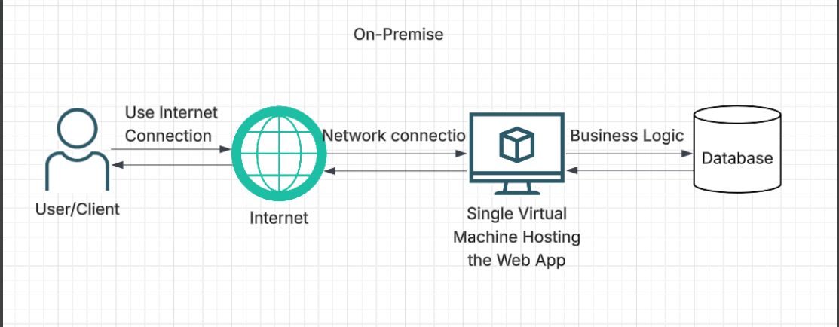
Current System

Slide 6
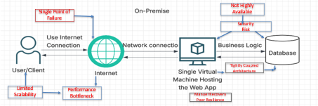
System Current State
Single Virtual Machine creates a single point of failure
No High availability for web tier
Limited ability to scale during peak admission
Performance bottleneck from combined application processing
Increased security and operational risk
Increased security and operational risk

Slide 7
Thank You
Questions????

Slide 8


Identify
Functional Requirements
Non-Functional Requirements
Technical Requirements
Gaps Identified

Slide 9
Functional Requirements
View
FR-01 The system should allow to view student instantly
Add
FR-02 New records must be saved and seen with no error
Modify
FR-03 The changes can be seen at the time of the update throughout the system
Delete
FR-04 The records that are hidden or removed will not impact other datas

Slide 10

Non-Functional Requirements
High availability
Minimizes downtime with multiple instances and database replicas
Scalability and Performance
Must support an average of 2000 users per day and handle load spikes smoothly & automatically
Security
Protection against data breaches and tampering
Cost efficiency
We'll take advantage of the Cloud infrastructure to use only what we need, resulting in reduced cost

Slide 11
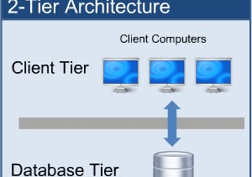
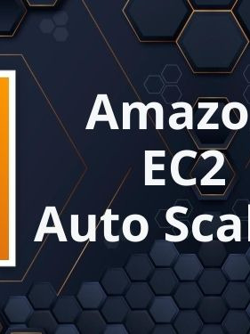
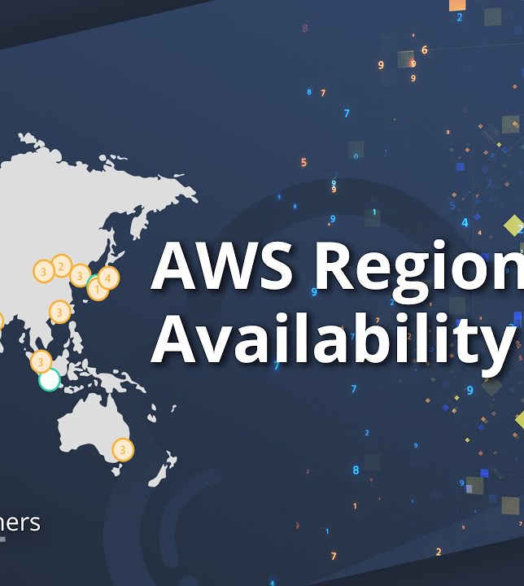


Technical Requirements
Using AWS US East (N. Virginia) region
Load balancer
Single point of entry distributes load against a pool of resources
Two-tier architecture
This will enhance performance & security and eliminate single points of failure
Auto scaling
This will help meet demand during spikes
Self-healing
Cloud resources will have health monitoring and unhealthy resources can be automatically remedied
This Photo by Unknown Author is licensed under CC BY-NC-ND

Slide 12
Technical Requirements
Using AWS US East (N. Virginia) region
Load balancer
Two-tier architecture
Auto scaling
Self-healing

Slide 13

Gaps Identified
Database type
Authentication method
Security compliance
Backup strategy
Budget constraints
This Photo by Unknown Author is licensed under CC BY-SA-NC

Slide 14
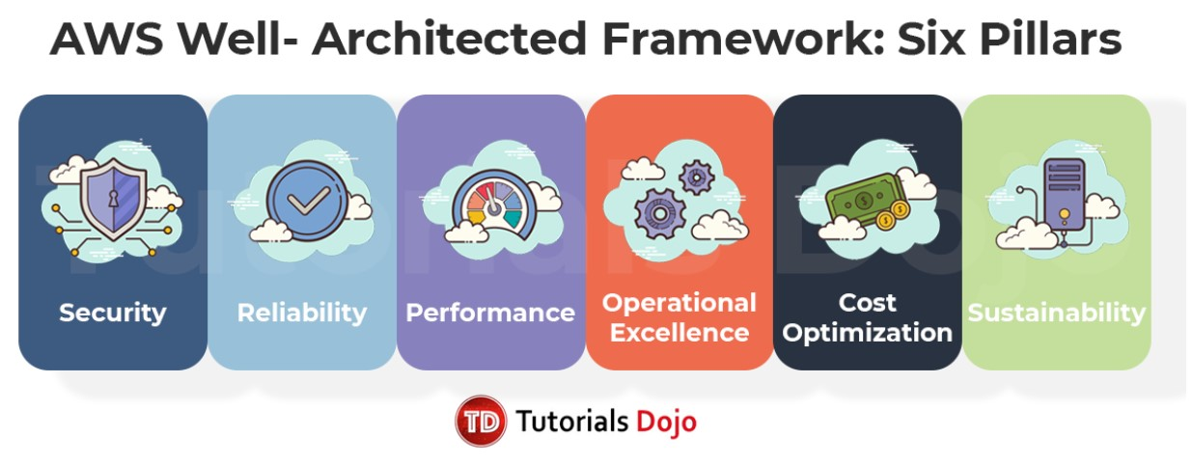
AWS Well-Architected Alignment
Reliability: Availability
Performance Efficiency: Performance & Scaling
Security: Data protection
Cost Optimization: Cost control

