Slide 1
WP1: Data integration
Summer RAINET meeting
Barcelona, July 2-3, 2015

Slide 2
Data integration : goals
Identify all the data required for the study
Determine their location (public DB) and how to get them
Identify the important information in each source
Build an analysis environment able to :
  Integrate all the data
  Allow to query any kind of relation/association between them
  Allow to easily develop the future analysis
  Associate the future analysis result to data to ensure reproducibility and durability
  Allow easy share of results/information

Slide 3
Data Integration : identification
Proteins
- Protein definitions from Uniprot
- Protein cross-reference IDs
- Protein isoforms
- Protein domains
Gene Ontology
- Gene Ontology definition
- Gene ontology protein annotations
Kegg Pathway
- KEGG pathway definition
- Kegg Pathway protein annotations
Reactome pathway
- Reactome pathway definition
- Reactome pathway protein annotations
Interactome
- Detected protein interactions
- Partition of graph using OCG
- Functionnal annotation of partition modules

Slide 4
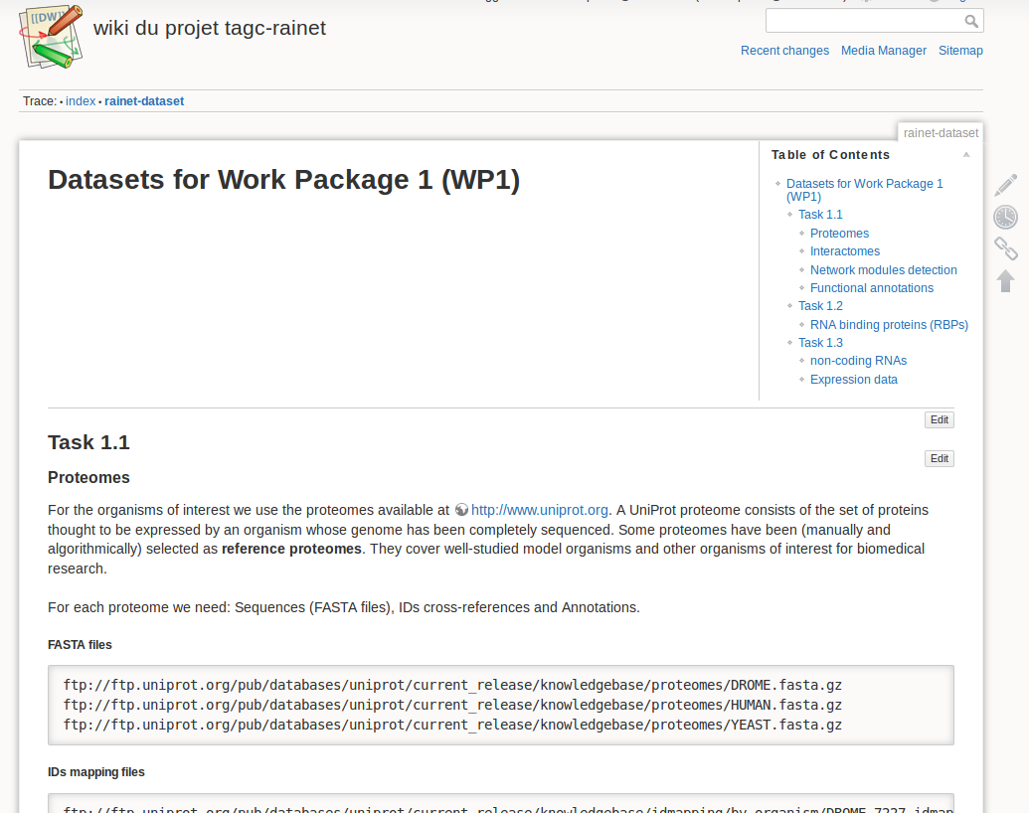
Data Integration : location and obtaining

Slide 5
Data Integration : location and obtaining
Proteins
- Protein definitions (Uniprot, 68561)
- Protein cross-reference Ids (Ensembl, 4315642)
- Protein isoforms (Uniprot, 38750)
- Protein domains (PFAM, 14881 ; SMART, 1274)
Gene Ontology
- Gene Ontology definition (GeneOntology, 43251)
- Gene ontology protein annotations (GeneOntology, 369769)
Kegg Pathway
- KEGG pathway definition (KEGG, 295)
- Kegg Pathway protein annotations (KEGG, 24825)
Reactome pathway
- Reactome pathway definition (Reactome, 23306)
- Reactome pathway protein annotations (Reactome, 316475)
Interactome
- Existing interactions (iMex compliant DB like DIP, IntAct, MINT...)
- Partition of graph using OCG (Brun group)
- Functionnal annotation of partition modules (Brun group)

Slide 6
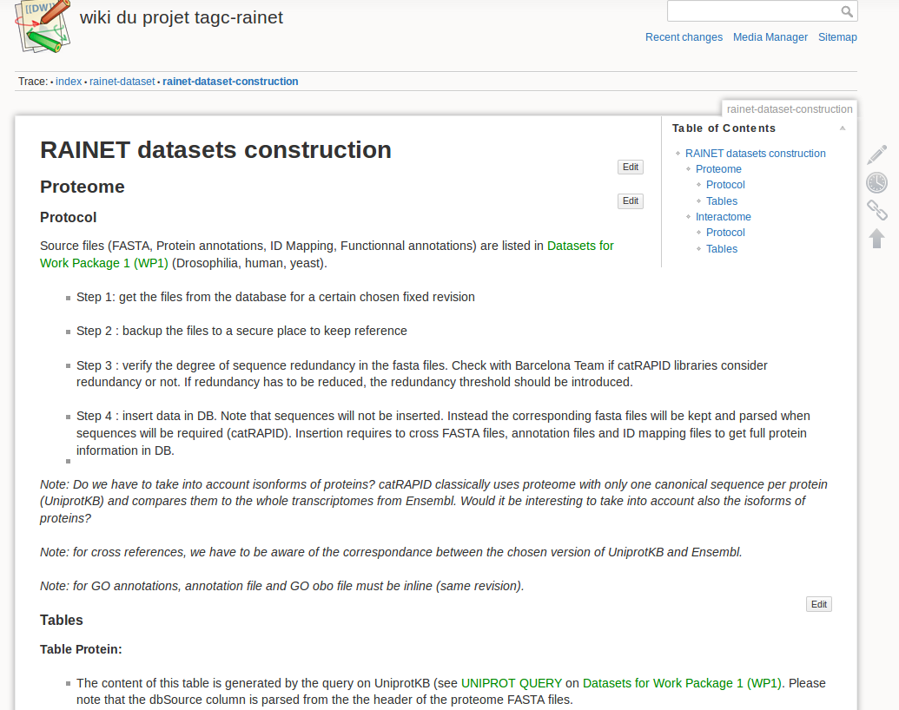
Data Integration : location and obtaining

Slide 7
Data integration : goals
Identify all the data required for the study
Determine their location (public DB) and how to get them
Identify the important information in each source
Build an analysis environment able to :
  Integrate all the data
  Allow to query any kind of relation/association between them
  Allow to easily develop/execute the future analysis
  Associate the future analysis result to data to ensure reproducibility and durability
  Allow easy share of results/information

Slide 8
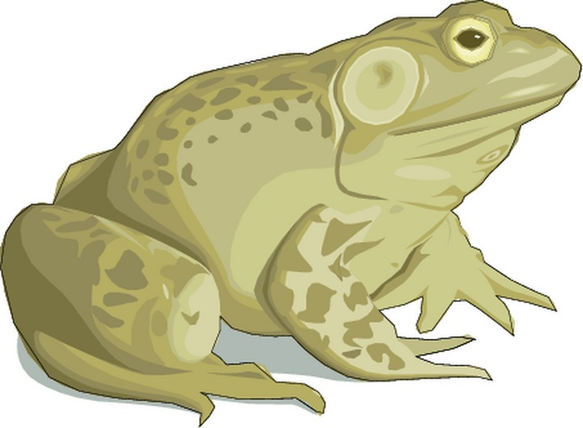


Data integration : constructing environment
Rainet2Toad
Total Omic Analysis of Data
A fully Object-Oriented Python software with complete ORM database integration

Slide 9
Data integration : constructing environment
Rainet2Toad
Total Omic Analysis of Data
A fully Object-Oriented Python software with complete ORM database integration
Object-Oriented : easy to develop, easy to maintain, easy to evolve, robust model
Python : language commonly known by bioinformaticians, strong bio-libraries
Database (SQLite) : powerful query with SQL, data association, durability,
                reproducibility, easy to share (single file) and to restore
ORM (SQLAlchemy) : easy DB management, easy DB query, easy object management

Slide 10
Data integration : code with standard development
Code uses standard design patterns
- Factory
- Singleton
- Strategy
Code uses standard error management
- Raising/catching of exceptions
- Multi-level logging protocol
Code uses standard documentation
- Internal code documentation
- Doxygene API documentation
Code deployment is automated
- ant task used to deploy code on server
- ant task used to deploy/uncompress data on server
Execution is done through easy-to-use command line
- Command are similar to tools like samtools
- Documented through python standards
Rainet2Toad

Slide 11
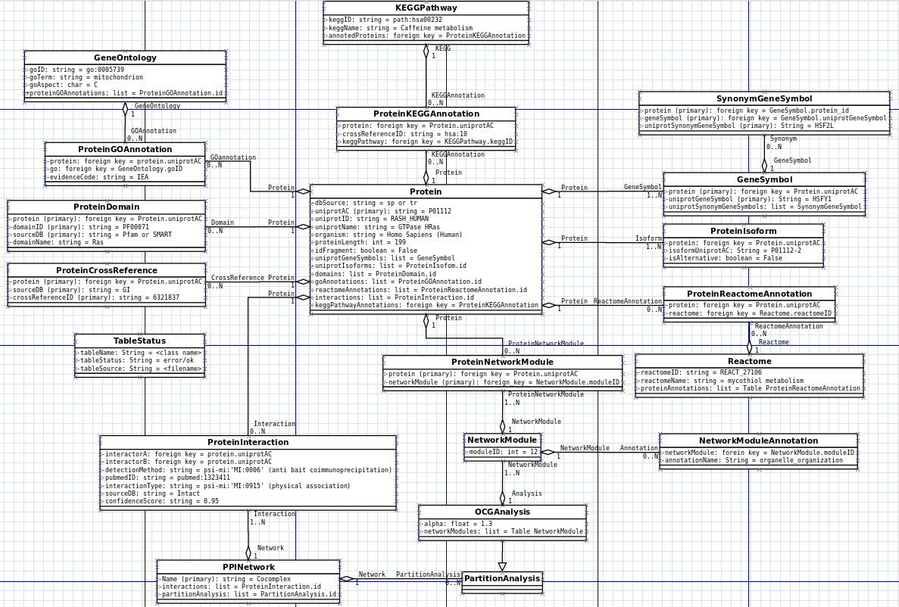
Data integration : class model
Rainet2Toad

Slide 12
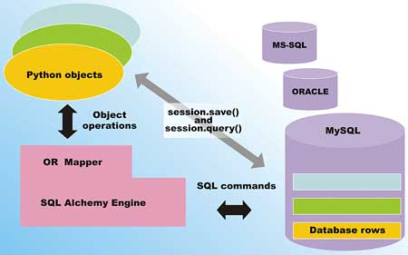
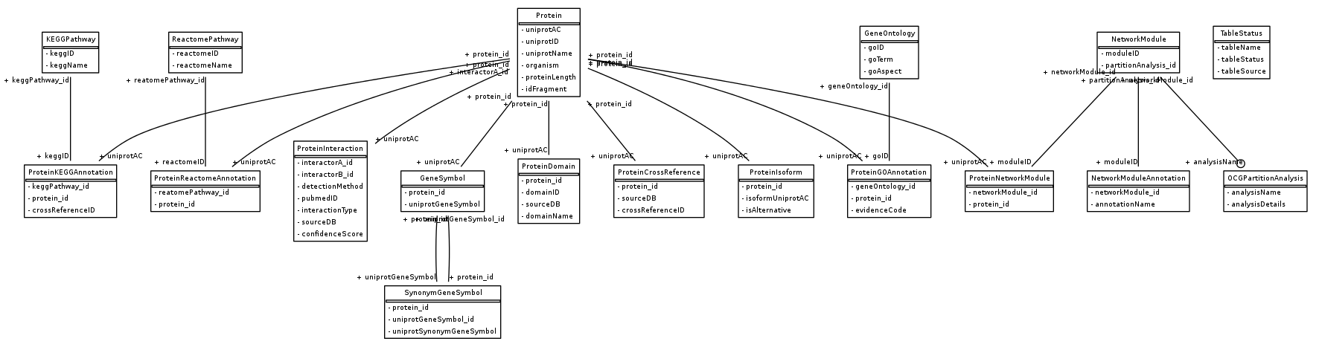
Data integration : ORM and database tables
Rainet2Toad
SQLite

Slide 13
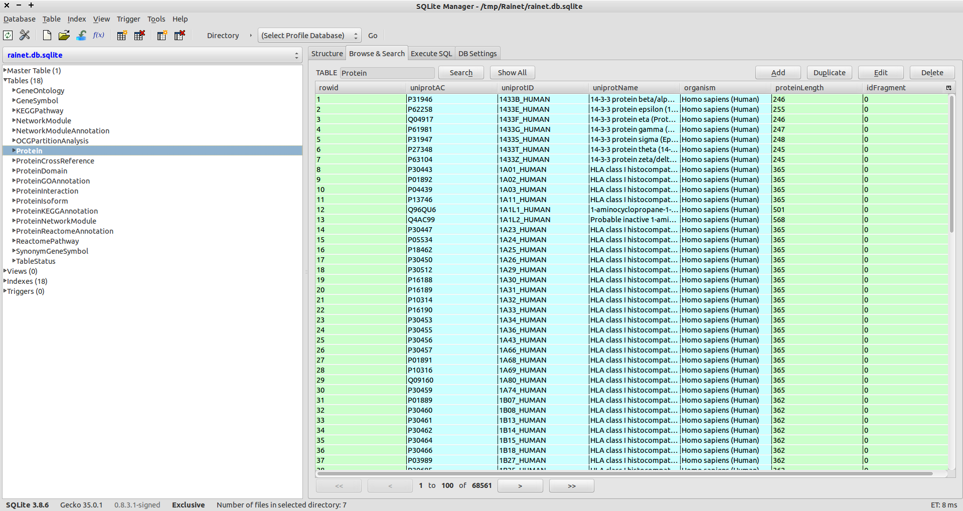
Data integration : easy to use DB Firefox plugin
Rainet2Toad

Slide 14
Data integration : next tasks
Rainet2Toad
Build interactome
- Retrieve the correct set of interactions
- Insert it to DB
Analyse interactome
- Build partition of graph
- Build functionnal annotations of partition modules
Develop first analysis

