Slide 1
Relief Dashboard
Real time disaster relief logistics coordination
Flutter and Firebase application connecting field volunteers and coordinators

Slide 2
THE PROBLEM
Relief coordination is fragmented and manual
When a disaster strikes, such as a flood, earthquake, or humanitarian crisis, relief operations are often coordinated through phone calls, group chats, paper forms, and spreadsheets passed between field workers and coordinators.
▪ No real time visibility. Coordinators cannot see what supplies exist, where, or in what quantity.
▪ Slow, error prone request handling. Volunteers cannot easily report community needs, and coordinators cannot see requests as they arrive.
▪ Misallocated resources. Stock is sent to the wrong location, or critical needs go unmet while other areas are over supplied.
▪ No prioritization. Without urgency tracking, life threatening requests can sit in the same queue as low priority ones.

Slide 3
THE PROBLEM
Who it affects
Field Volunteers
Coordinators and Admins
Affected Communities
Need a fast way to report needs and locations without technical overhead.
Responsible for inventory, allocation, and making sure aid reaches the right place in time.
Wait longer or receive less effective aid when coordination breaks down.

Slide 4
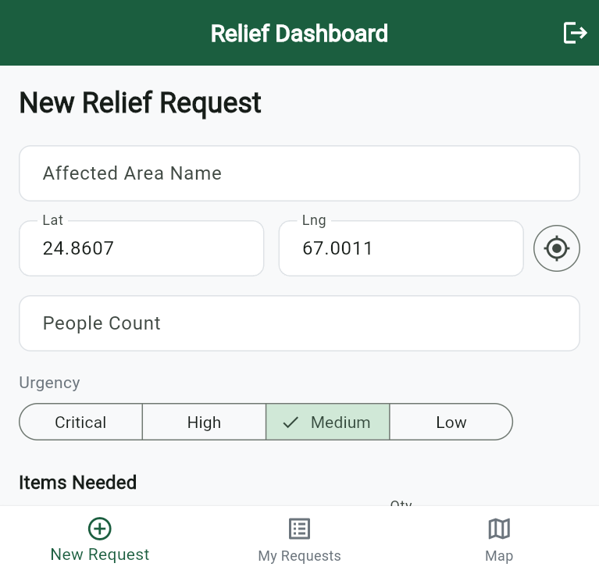
THE SOLUTION
A shared, live system of record
Relief Dashboard is a role based, real time logistics application that connects field volunteers directly to coordinators.
▪ Volunteers submit requests with location, photo evidence, urgency level, and needed items directly from the field.
▪ Coordinators act in real time, checking inventory across warehouses and allocating stock with one tap.
▪ Both roles share a live map view of requests and warehouses for full geographic context.
New relief request form

Slide 5
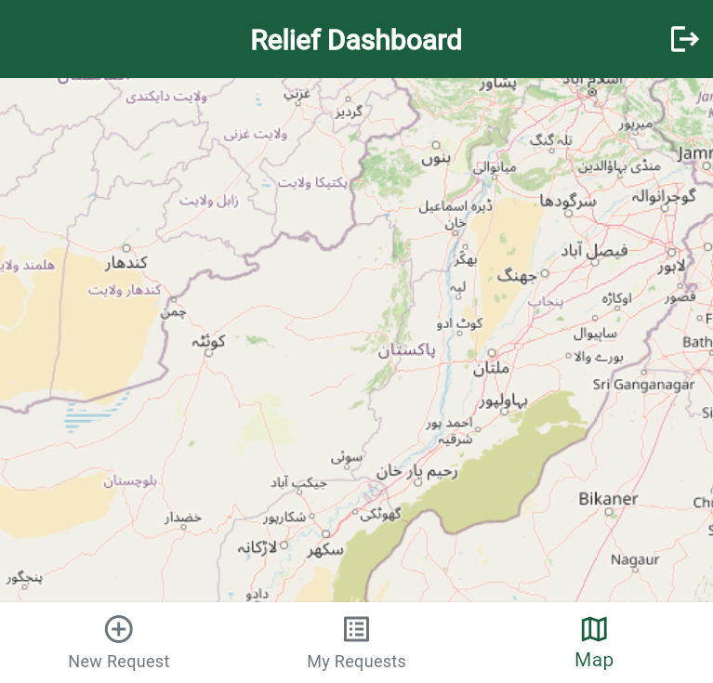
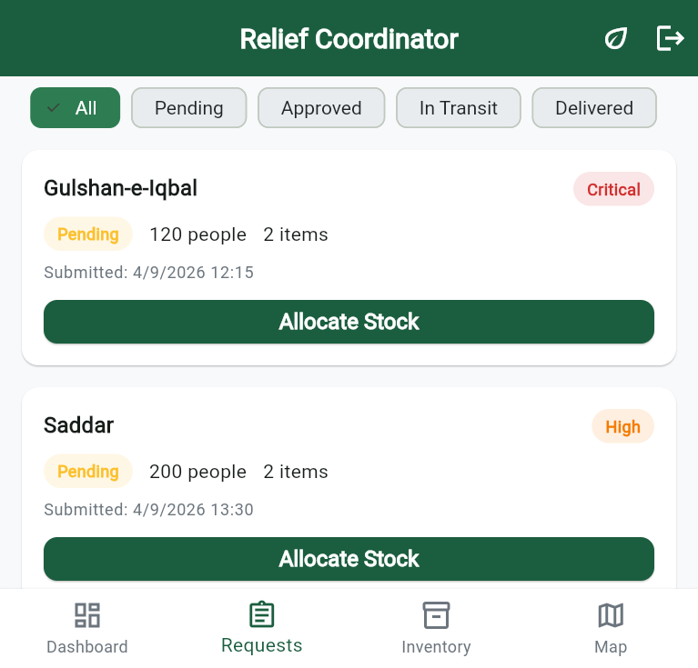
THE SOLUTION
Who it serves
Field Volunteer role
Coordinator / Admin role
A lightweight, mobile friendly flow for reporting needs from the field.
A full operations dashboard for managing warehouses, inventory, requests, and allocation decisions.
Volunteer map view
Admin requests screen

Slide 6
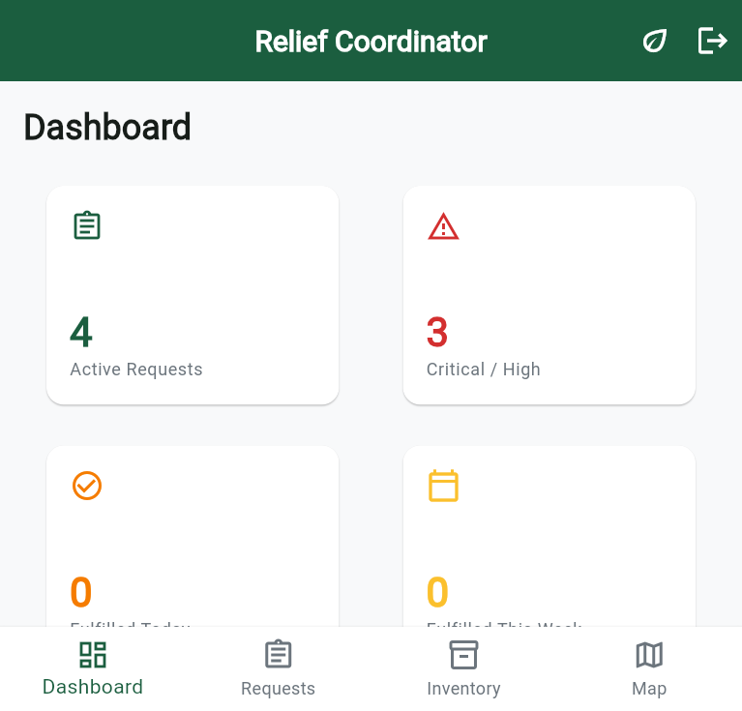
THE IMPACT
What this changes for relief operations
▪ Faster response times. Requests move from submission to allocation in a live pipeline instead of chat threads or paperwork.
▪ Better resource allocation. Coordinators always see current inventory and allocate stock against real, verified requests.
▪ Prioritized triage. Urgency levels such as critical and high surface the most urgent needs first.
▪ Transparency for everyone. Volunteers track the real time status of the requests they submitted.
▪ Data driven oversight. An analytics dashboard gives coordinators an at a glance view of active requests and status distribution.
Admin analytics dashboard

Slide 7
THE TECHNOLOGY
Built on Flutter and Firebase
Layer | Technology
App framework | Flutter (Dart), Material 3 UI
Backend and database | Firebase Cloud Firestore, real time streams
Authentication | Firebase Authentication, role based access
File storage | Firebase Storage for request photos
Maps | flutter_map with OpenStreetMap tiles, latlong2
Analytics and charts | fl_chart
State management | provider
Device features | geolocator for location, image_picker for photo capture
Architecture highlights
▪ Role based access control enforced in the UI and in Firestore security rules.
▪ Real time data sync via Firestore streams, with no manual refresh needed.
▪ Cross platform from a single Dart codebase, covering web, Android, iOS, and desktop.

Slide 8
WHAT WE ACTUALLY BUILT
End to end functionality across both roles
▪ Authentication and onboarding: sign up with role selection, secure login, and an auth gate that routes users to the correct experience.
▪ Field Volunteer flow: new request form, "My Requests" screen with real time status tracking, and a map view of submitted requests.
▪ Coordinator / Admin flow: analytics dashboard, filterable requests screen with one tap stock allocation, inventory management, and an interactive map.
▪ Shared infrastructure: data models for users, requests, inventory, and warehouses; a Firestore service layer; reusable UI components; an app wide Material 3 theme.
▪ Demo ready: seeded demo accounts and sample data across Food, Water, Medicine, Shelter, and Clothing for live walkthroughs.

Slide 9
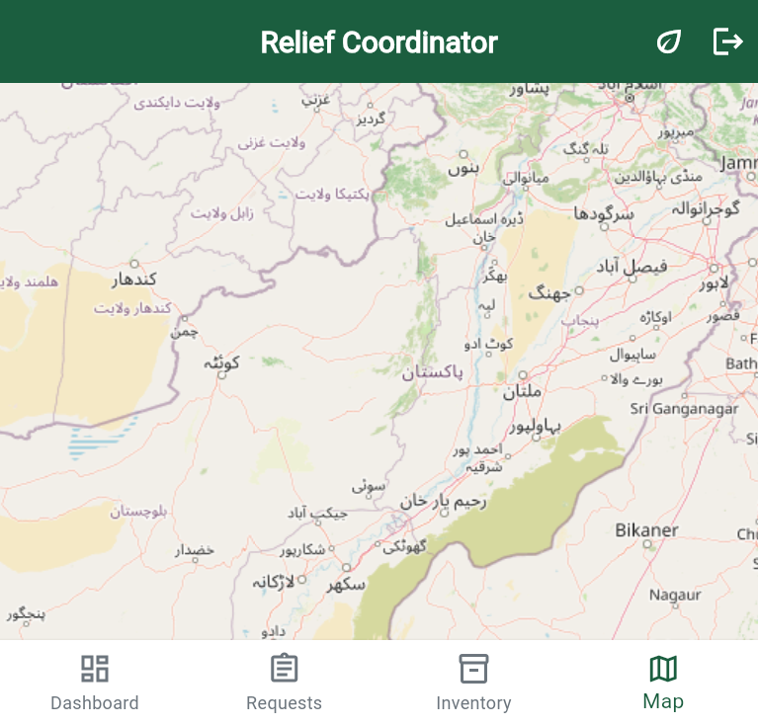
PRODUCT WALKTHROUGH
Screenshots
Admin dashboard
Admin map
New request form
Volunteer map

Slide 10
Current Status
Fully functional end to end prototype covering both user roles, running on web and mobile from a single Flutter codebase, backed by live Firebase services.
Thank you. Questions welcome.

