Slide 1
Text-to-speech Synthesis
Speaker: Tu, Tao
<r07922022@ntu.edu.tw>

Slide 2
Outline
Introduction
Traditional methods
End-to-end text-to-speech model
Coding time

Slide 3
Outline
Introduction
Traditional methods
End-to-end text-to-speech model
Coding time

Slide 4



Introduction
Task
Input: text
Output: speech
Text
Speech

Slide 5
Introduction
Applications
voice assistant
reading machines
eyes-free applications
etc.

Slide 6
Outline
Introduction
Traditional methods
End-to-end text-to-speech model
Coding time

Slide 7
Traditional methods
Formant synthesizer (1970s)
Front-end: phoneme
Back-end: vocal tract model using formants
text -> phonemes -> formants & other parameters -> speech
Notes:
https://vocaroo.com/i/s1c4c6XQmzIa

Slide 8
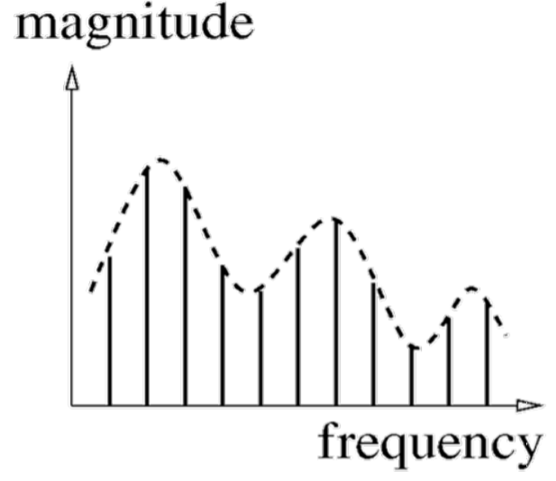
Traditional methods
Formant synthesizer (1970s)
What are formants?
F1
F2
F3
spectrum of a voiced sound

Slide 9
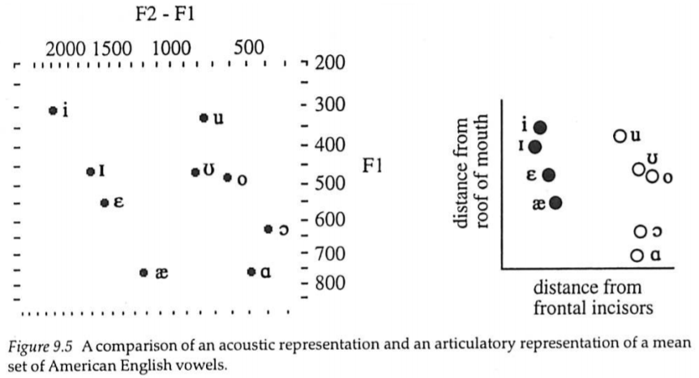
Traditional methods
Formant synthesizer (1970s)
Vowels & formants
“The sounds of the world’s languages “
Peter Ladefoged and Ian Maddieson
Notes:
frontal incisors: 額門切牙 (門牙+下面兩顆)

Slide 10
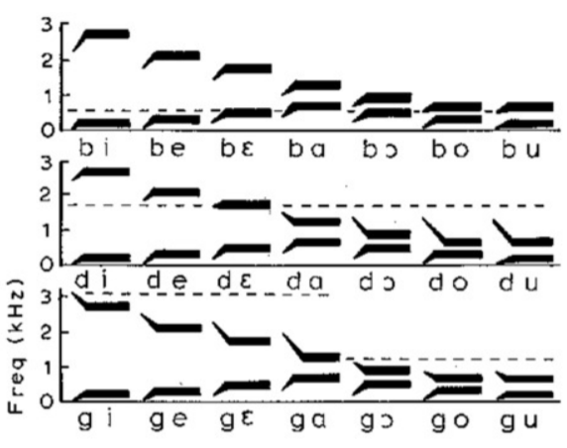
Traditional methods
Formant synthesizer (1970s)
Consonants & formants
Delattre, P. C., A. M. Liberman and F. S. Cooper (1955) Acoustic Loci and Transitional Cues for Consonants. JASA vol. 27, no. 4. 769-773.
Notes:
F2 transition

Slide 11
Traditional methods
Unit selection speech synthesis (1990s)
A large scale database containing pre-recorded speech
about 100 hours
hard to maintain
Concatenate proper segments to output desired speech
The synthesized speech will be unnatural at concatenation points
Overall, the output speech is natural and limited by the recorded speech
Notes:
https://www.cs.cmu.edu/~awb/festival_demos/sounds/sbs1.wav

Slide 12
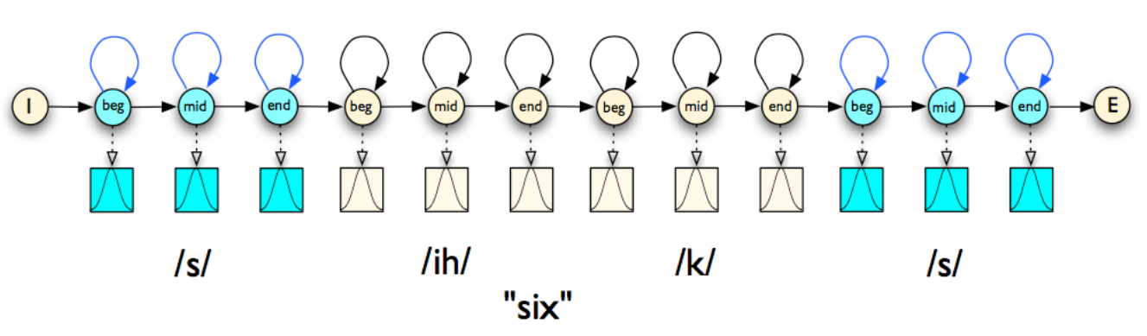
Traditional methods
HMM-based speech synthesizer (2000s)
HMM generates acoustic features (f0, mel spectrogram, ...)
Vocoder generates waveform based on these acoustic features
Only need to save model parameters
Speech
Vocoder
Text
HMM
Notes:
http://www.sp.nitech.ac.jp/~tokuda/HTS_demo/vocoder_demo/data.mcep.syn.wav

Slide 13
Outline
Introduction
Traditional methods
End-to-end text-to-speech model
Coding time

Slide 14
Tacotron
Overview
Proposed by Yuxuan Wang et al. (google, 2017)
Neural text-to-speech synthesizer
seq2seq w/ attention: text -> spectrogram
Griffin-Lim vocoder: spectrogram -> waveform
Tacotron series

Slide 15
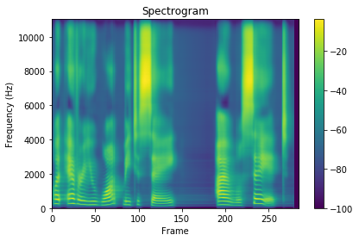
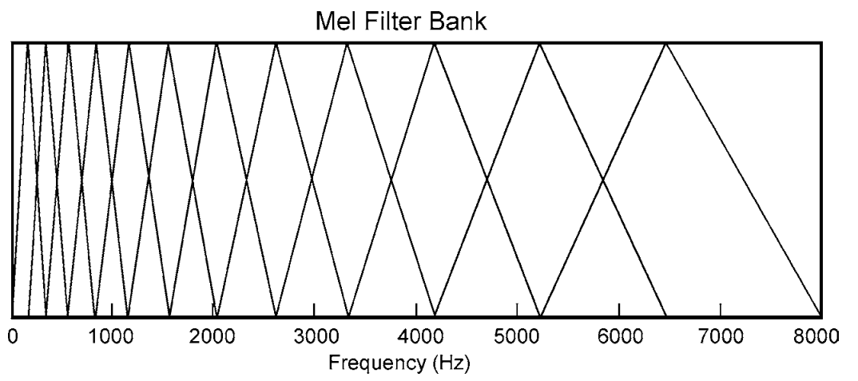
Tacotron
Spectrogram
spectrogram
a visual representation of the spectrum of
frequencies of a signal as it varies with time
mel-spectrogram
spectrogram in mel-scale
Librosa does these for us

Slide 16
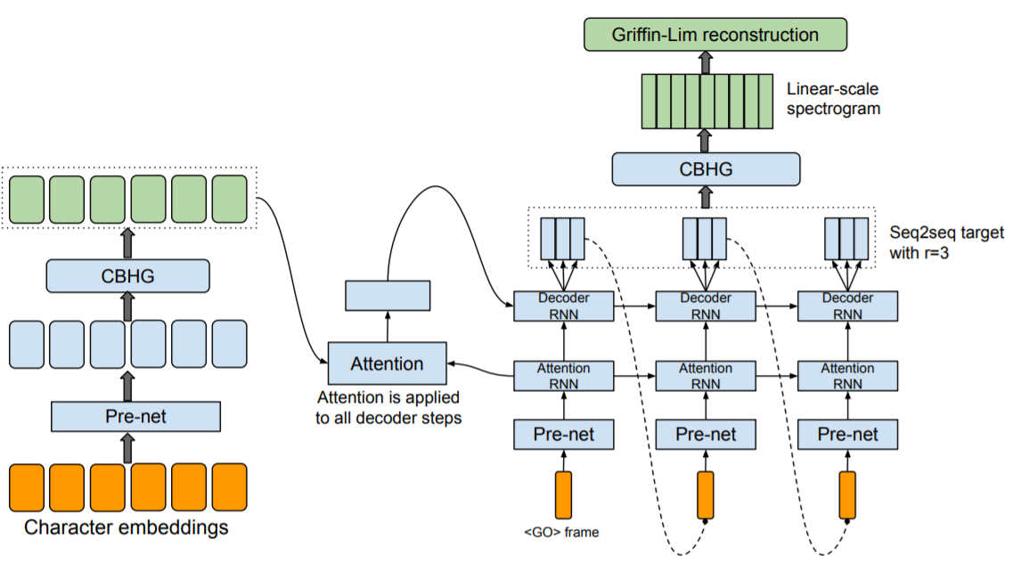
Tacotron
Modules
Encoder
Prenet
CBHG
Decoder
Prenet
GRU
CBHG
Decoder
Encoder

Slide 17
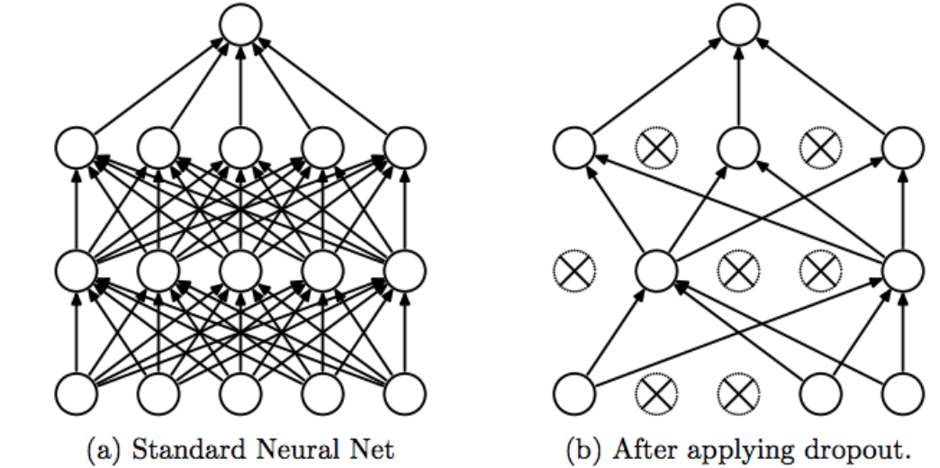
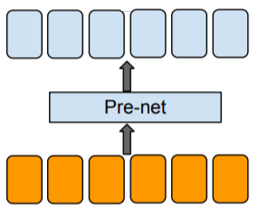
Tacotron
Prenet
linear layer (w/ ReLU)
dropout (dropout rate 0.5)
avoid overfitting

Slide 18
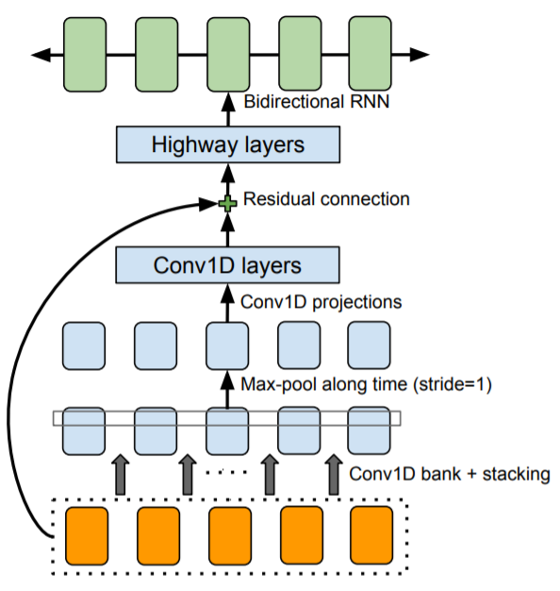
Tacotron
CBHG
conv1d bank
K sets of conv1d filters (kernel size from 1 to K)
the convolution outputs are stacked
max-pool
increase local invariances (along time)
conv1d projection
to match hidden dimension

Slide 19
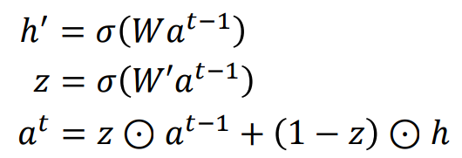
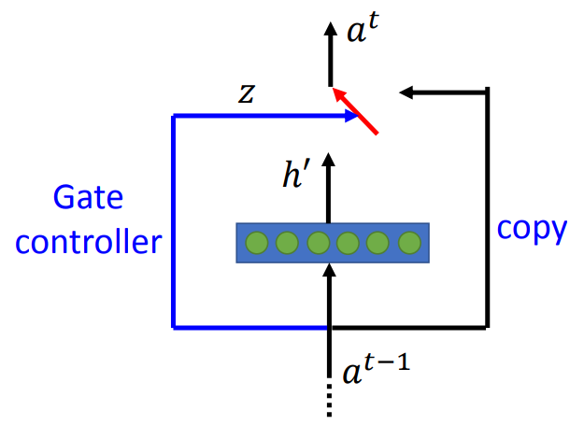
Tacotron
CBHG
highway network

Slide 20
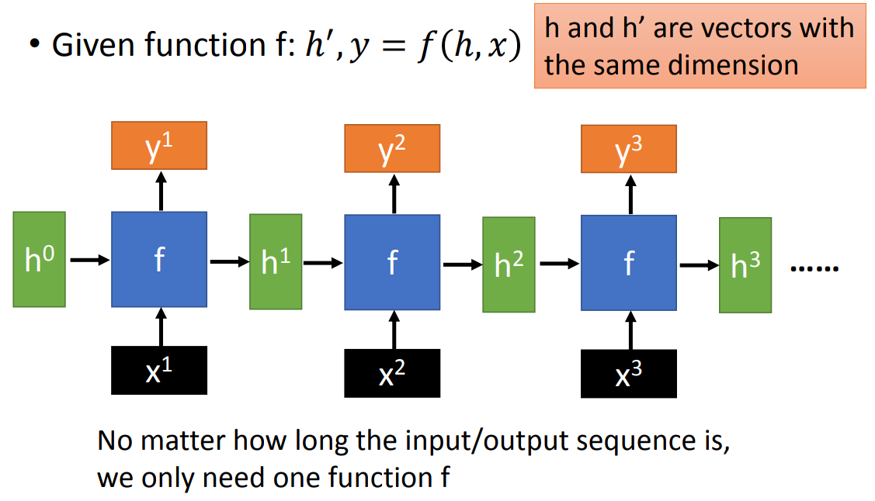
Tacotron
CBHG
GRU
recurrent neural network

Slide 21
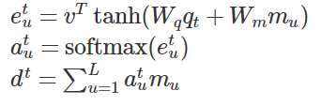
Tacotron
m_1
m_2
m_u
q_t
Attention
Content-based tanh attention
q_t: query generated by decoder at time t
m_u: u-th memory entry generated by encoder
softmax over u
d_t: context vector
e_1^t
e_2^t
e_u^t
softmax
0.99 0.01 ... 0.00

Slide 22
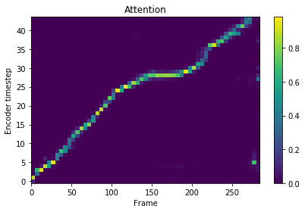
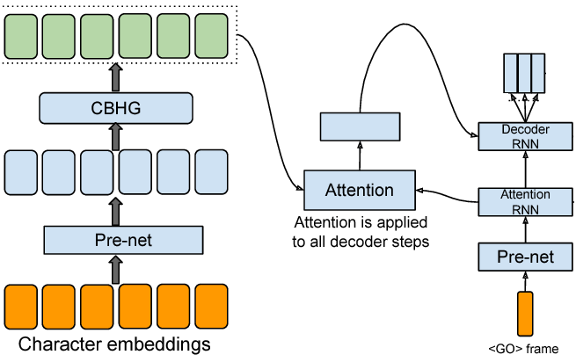
Tacotron
Attention
0.99 0.01 0.00 …. 0.00 0.00

Slide 23
Tacotron
Quick summary

Slide 24
Tacotron
Training
Loss function
L1-norm between real and predicted spectrograms
L1-norm between real and predicted mel spectrograms
Both in log scale
Teacher forcing
Notes:
Maybe focus on low-frequency band

Slide 25
Tacotron
Truly End-to-end
Concatenate a Wavenet vocoder to convert mel spectrograms to waveforms
Tacotron2
compact Tacotron
wavenet

Slide 26
Outline
Introduction
Traditional methods
End-to-end text-to-speech model
Coding time

Slide 27
Coding time
Repositories
Pytorch
Tacotron (ttaoREtw) (pytorch)
Tacotron (r9y9) (pytorch)
Tacotron2 (BogiHsu) (pytorch)
Tacotron2 (nvidia) (pytorch)
Tensorflow
Tacotron (keithito) (tensorflow)
Tacotron2 (Rayhane Mama) (tensorflow)

Slide 28
Coding time
src/module.py
Tacotron
Encoder
Prenet
CBHG (K=16)
MelDecoder
Prenet
3 GRUs (attention RNN x 1, Decoder RNN x 2)
BahdanauAttn (attention)
Postnet
CBHG (K=8)

Slide 29
Coding time
Run on Colab
https://colab.research.google.com/drive/1Cr4BC9zNayEHy8fyqH2wG-uhnhEs7jwk

Slide 30
References
Introduction to Digital Speech Processing lectured by Prof. Lin-shan Lee (數位語音處理概論)
Lectures from Prof. Hung-yi Lee
Text-to-speech synthesis slides from Prof. Yamagishi Junichi
Tacotron: Towards End-to-End Speech Synthesis
Wavenet: A Generative Model for Raw Audio
Neural Machine Translation by Jointly Learning to Align and Translate
Highway Networks
“The sounds of the world’s languages “ Peter Ladefoged and Ian Maddieson
Delattre, P. C., A. M. Liberman and F. S. Cooper (1955) Acoustic Loci and Transitional Cues for Consonants. JASA vol. 27, no. 4. 769-773.
LiROSA: a python package for music and audio analysis
Google Colab

