Slide 1
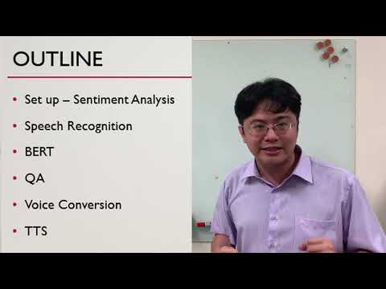

Slide 2
Pytorch Tutorial
Wu Yuan Kuei, 吳元魁

Slide 3

What is pytorch?
It’s a Python based scientific computing package.
It is supported by a large tech company, Facebook.
Use graphs to represent the flow of data and operations.
It is well documented.
Notes:
pytorch簡介 https://ppt.cc/fzfJax
static, dynamic graph: https://ppt.cc/fyzLzx

Slide 4

Why pytorch?
Notes:
pytorch簡介 https://ppt.cc/fzfJax
static, dynamic graph: https://ppt.cc/fyzLzx

Slide 5
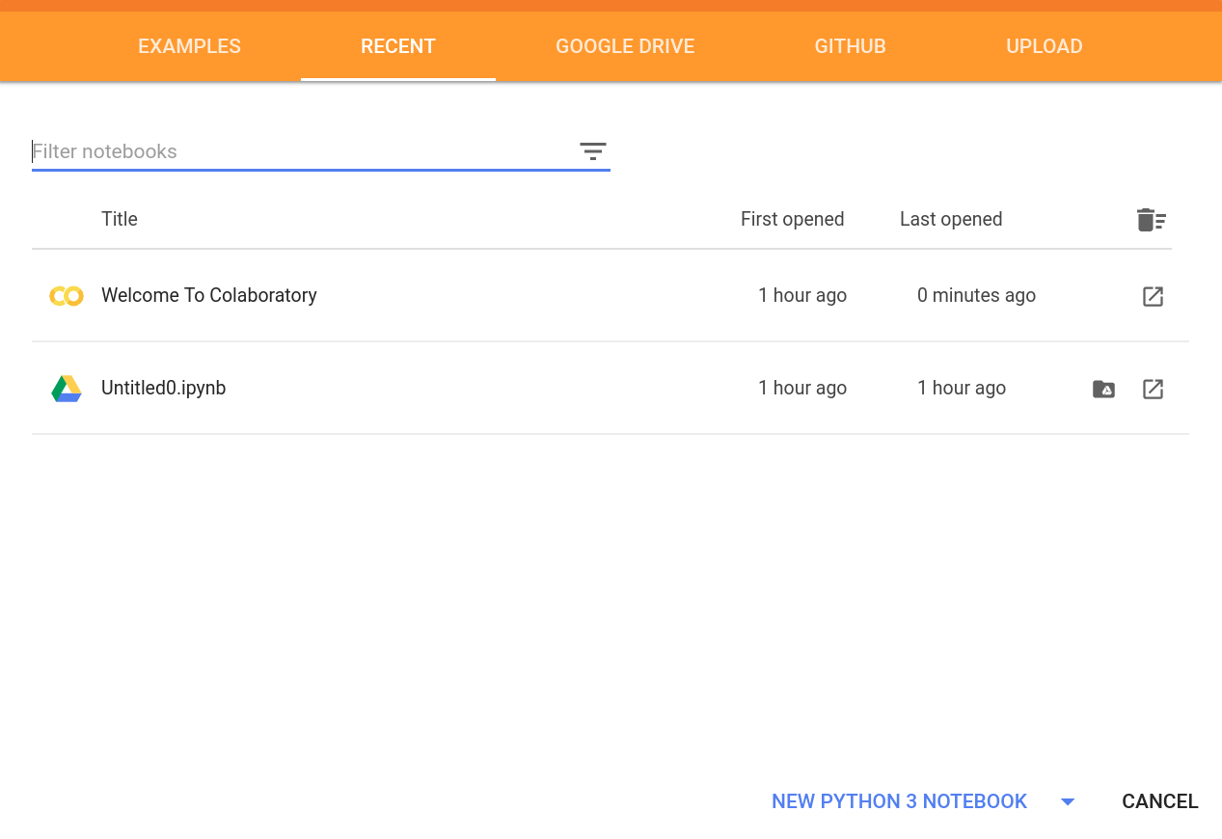
Colab

Slide 6
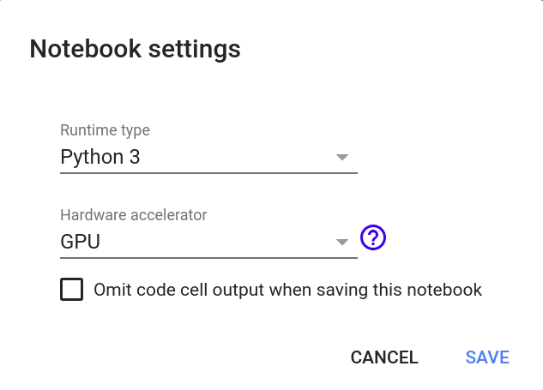
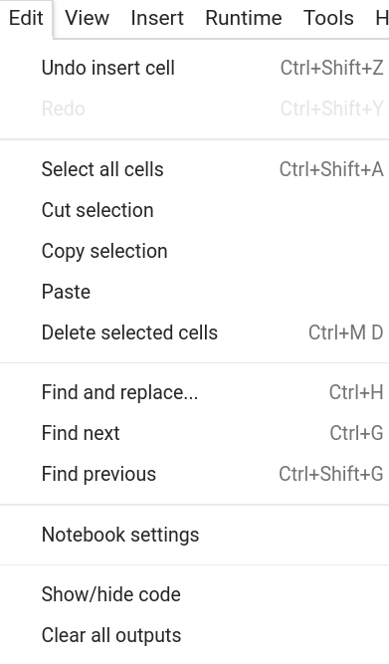
Colab edit

Slide 7
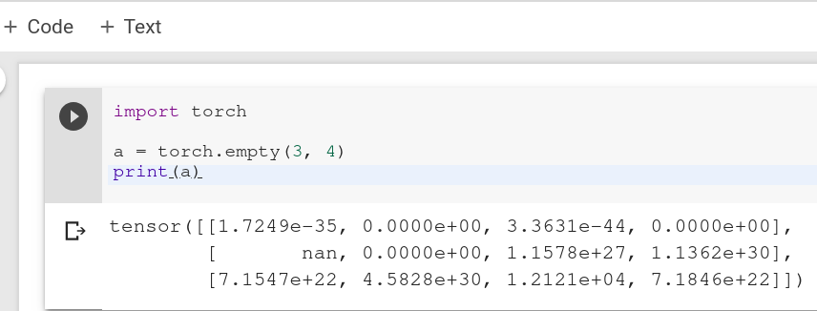
Colab

Slide 8
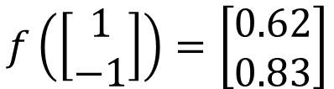
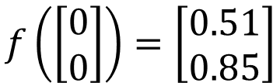
Neural Network (神經網路)
1
0.73
2
0.72
3
0.51
0
-2
-1
-1
1
0
-2
-1
0.5
-2
0.12
-1
0.85
0
1
-1
4
0
0
2
This is a function.
Input vector, output vector
Notes:
For example, if we modify “1” to “2”, then we have another function

Slide 9
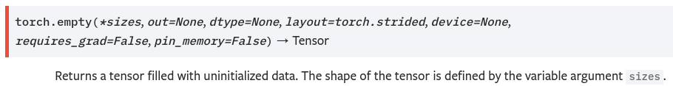
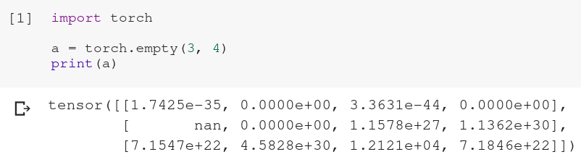
Tensor

Slide 10
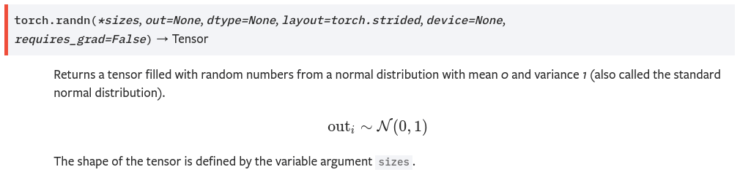
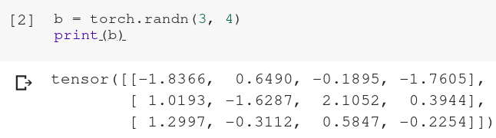
Tensor

Slide 11
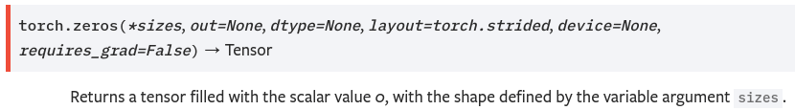
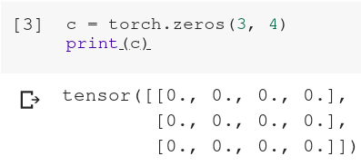
Tensor

Slide 12

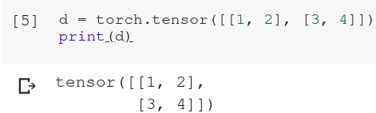
Tensor

Slide 13
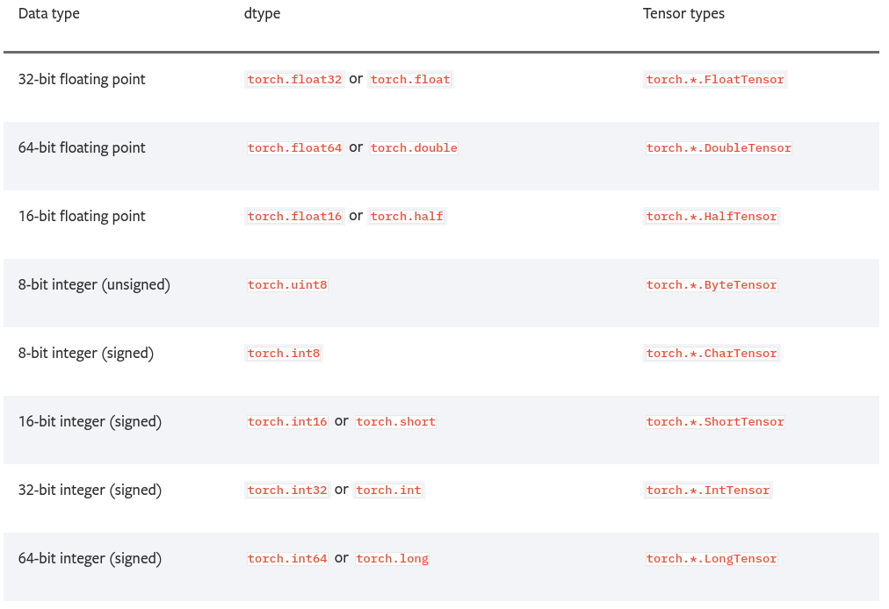
Tensor dtype

Slide 14
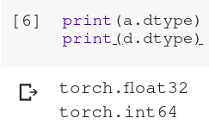
Tensor dtype

Slide 15
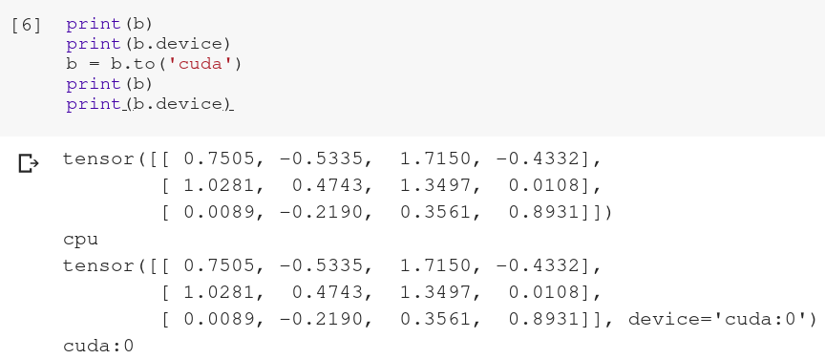
Tensor device

Slide 16
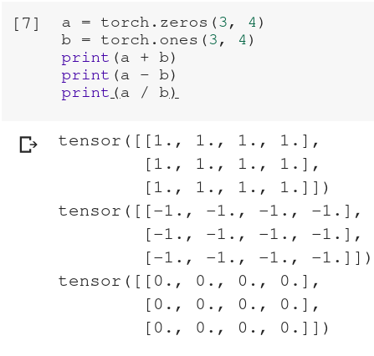
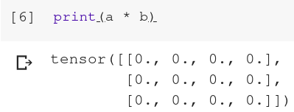
Tensor operations

Slide 17
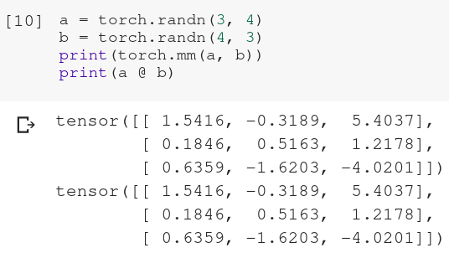
Tensor operations

Slide 18
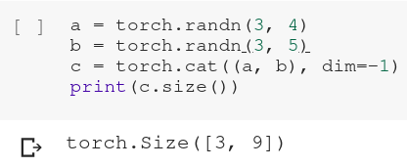
Tensor operations

Slide 19
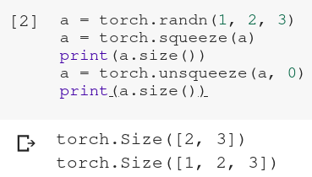
Tensor operations

Slide 20
Tensor operations
Notes:
解釋三圍tensor

Slide 21
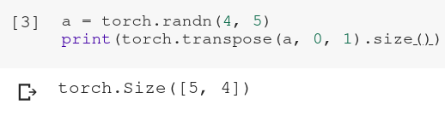
Tensor operations

Slide 22
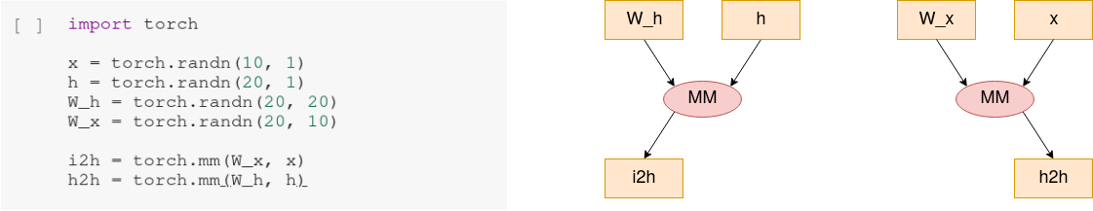
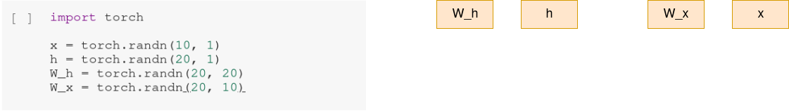
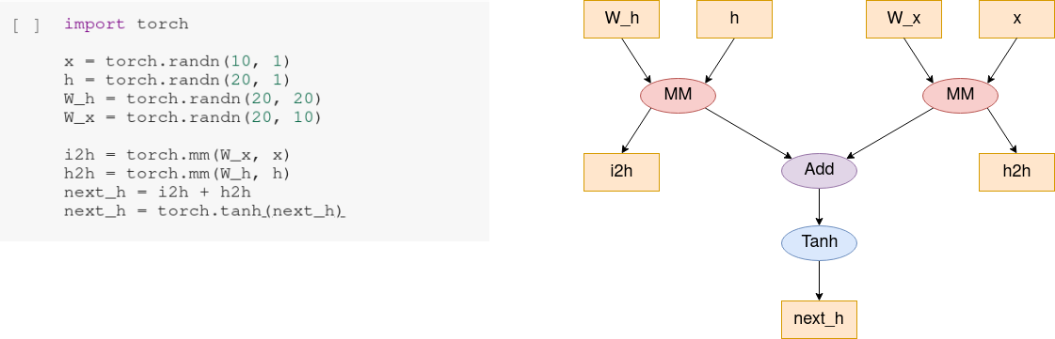
Dynamic graph

Slide 23
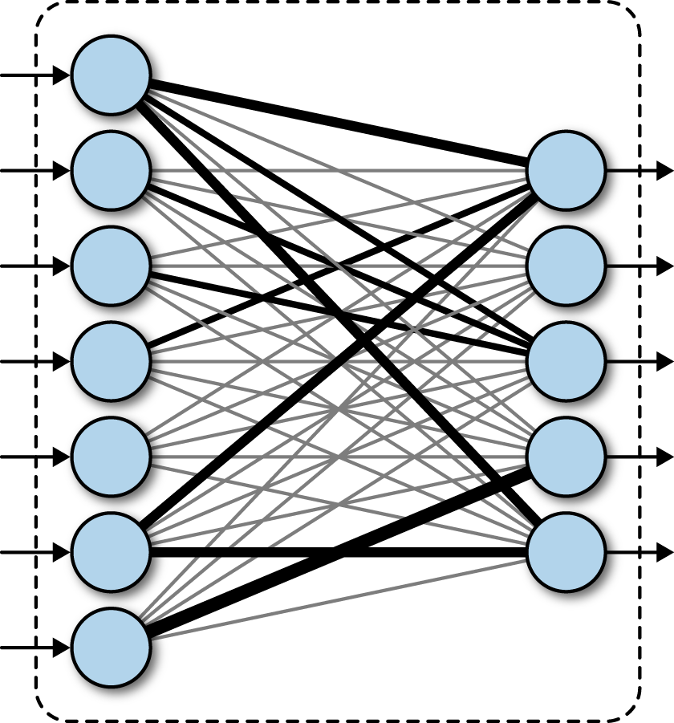
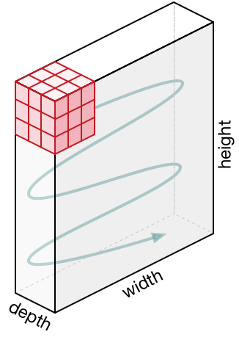
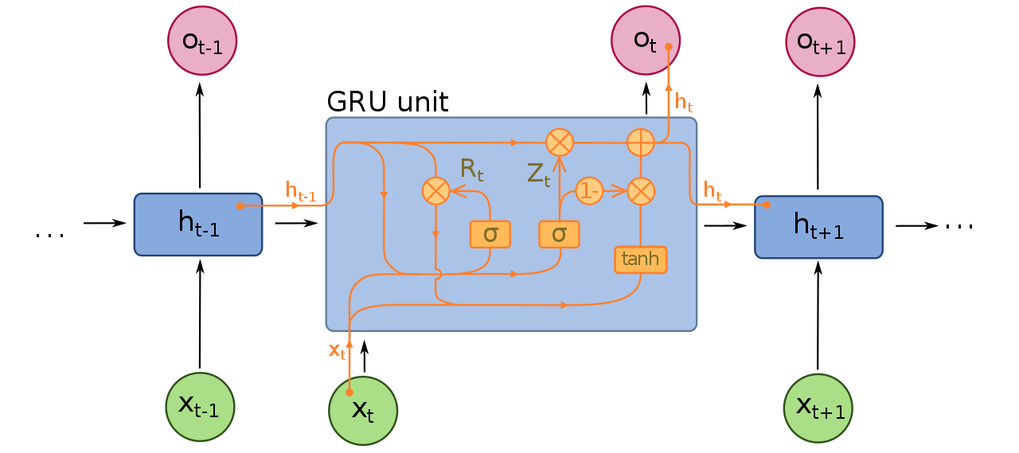
Neural Network
fully connected layer CNN RNN

Slide 24
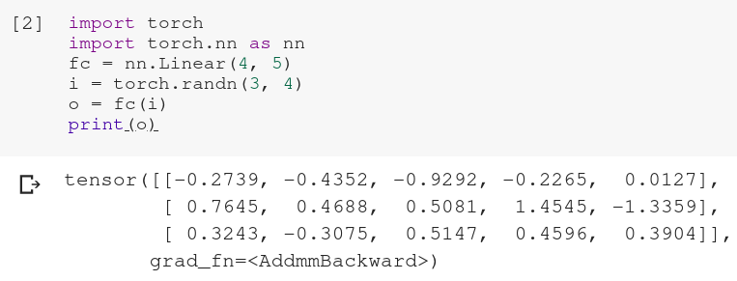
Neural Network (Fully Connected Layer)
Notes:
Linear 為啥不用 torch.mm

Slide 25
Neural Network (Convolutional Layer)
padding, stride dilation

Slide 26
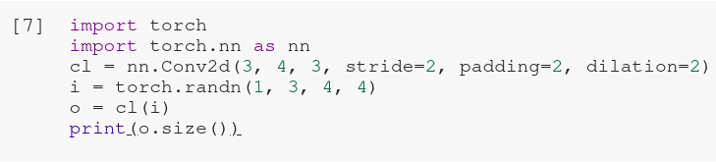

Neural Network (Convolutional Layer)

Slide 27
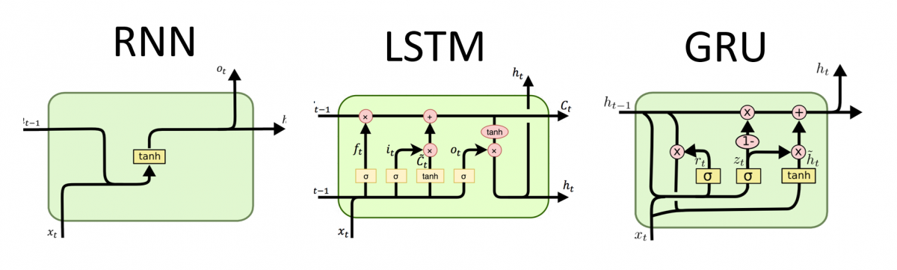
Neural Network (Recurrent Neural Network)

Slide 28
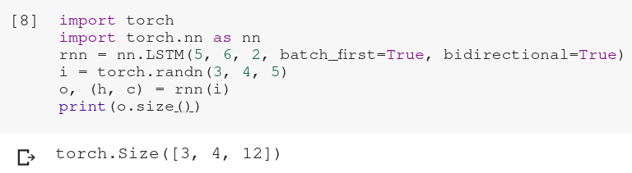
Neural Network(Recurrent Neural Network)

Slide 29
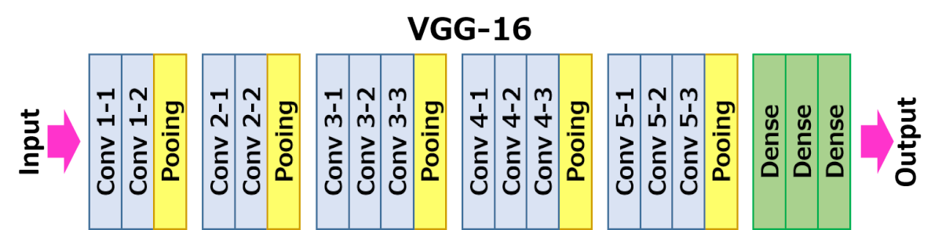
Neural Network (Deep Neural Network)

Slide 30
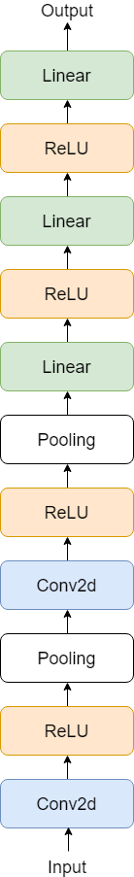
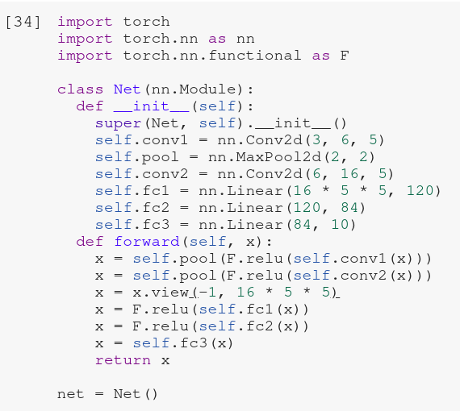
Neural Network (pytorch implementation)

Slide 31
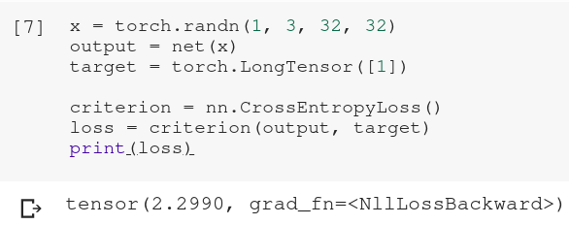
Loss function

Slide 32
Optimizer
上課影片連結：https://www.youtube.com/watch?v=yKKNr-QKz2Q

Slide 33
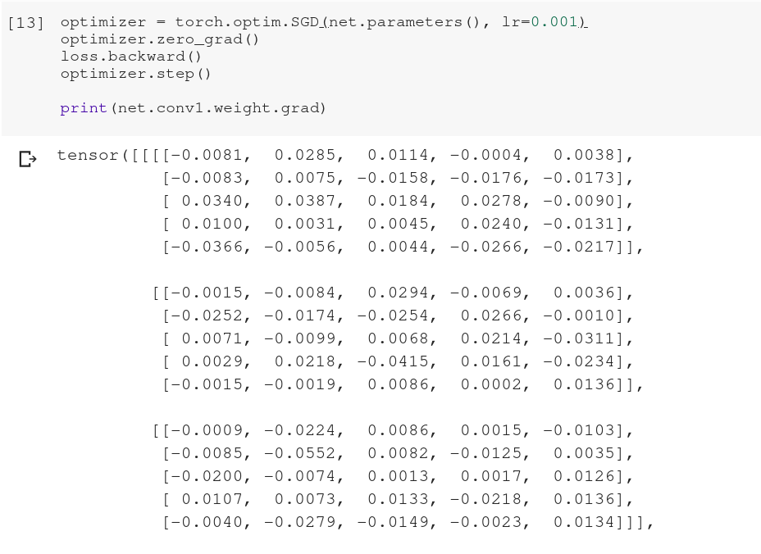
Update weight

Slide 34
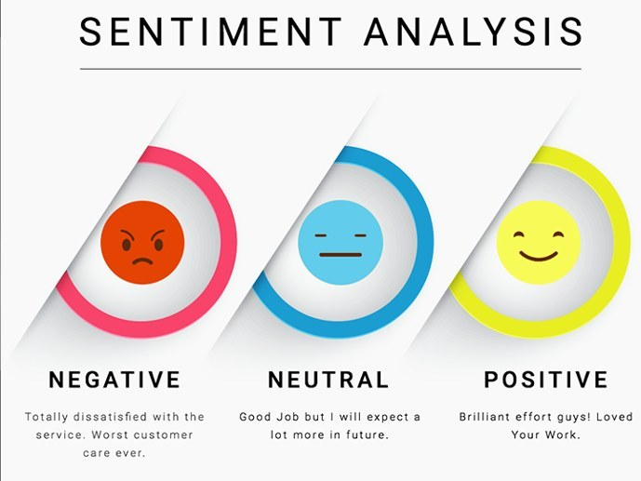
Sentiment Analysis

Slide 35
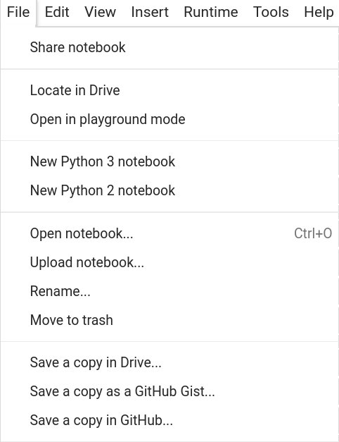
Sentiment Analysis
link: https://colab.research.google.com/drive/1nXAan22xjA_PaI2RZnfdG4NAog9Q0Xzk

