Slide 1



性能測定結果_クラウド
View in Power BI
Last data refresh:
2019/02/20 10:56:42 Tokyo Standard Time
Downloaded at:
2019/02/20 11:01:58 Tokyo Standard Time

Slide 2
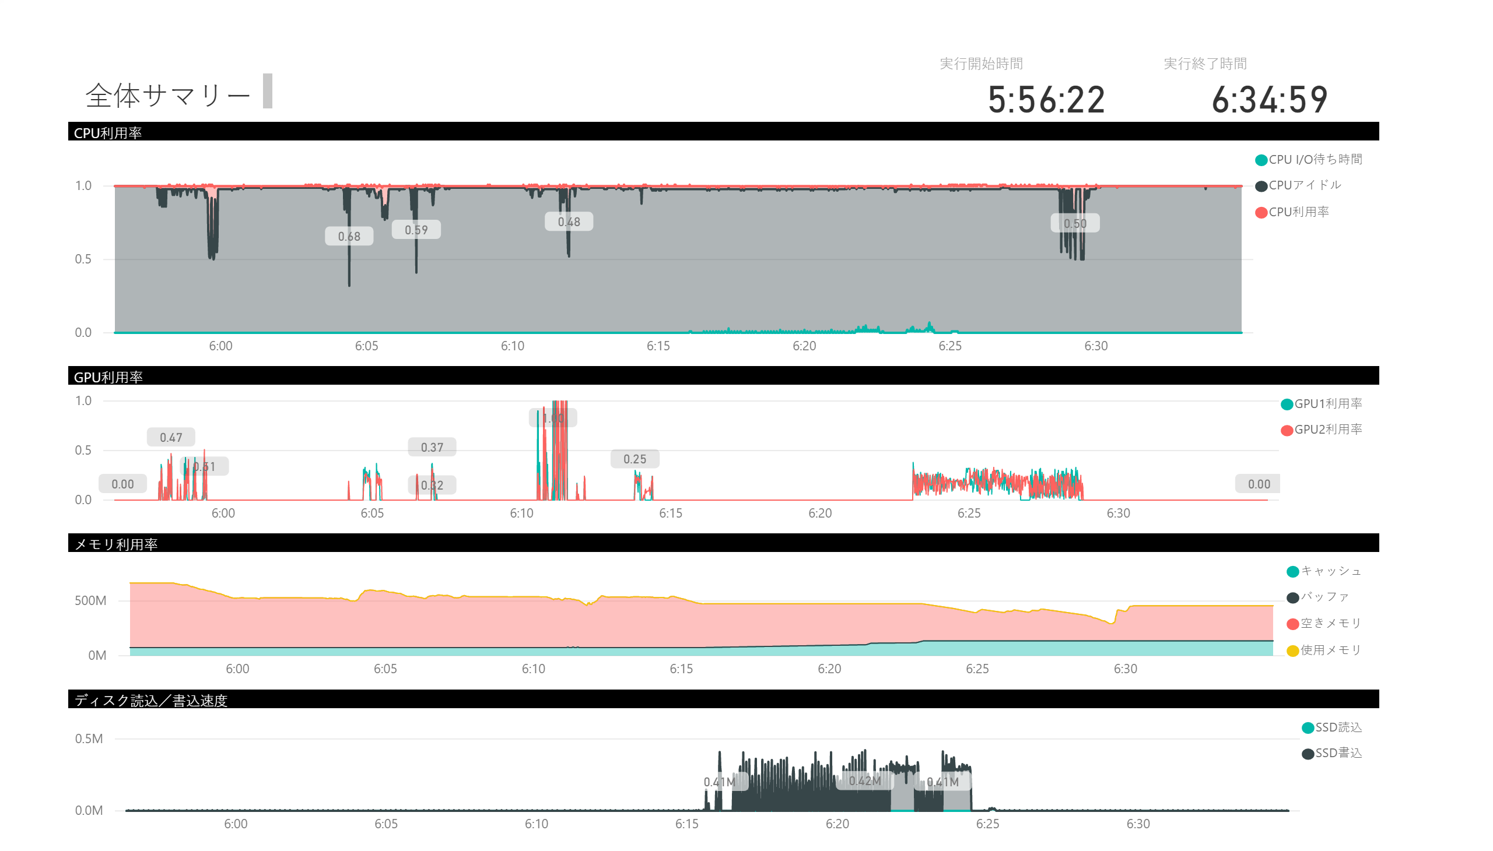

Slide 3
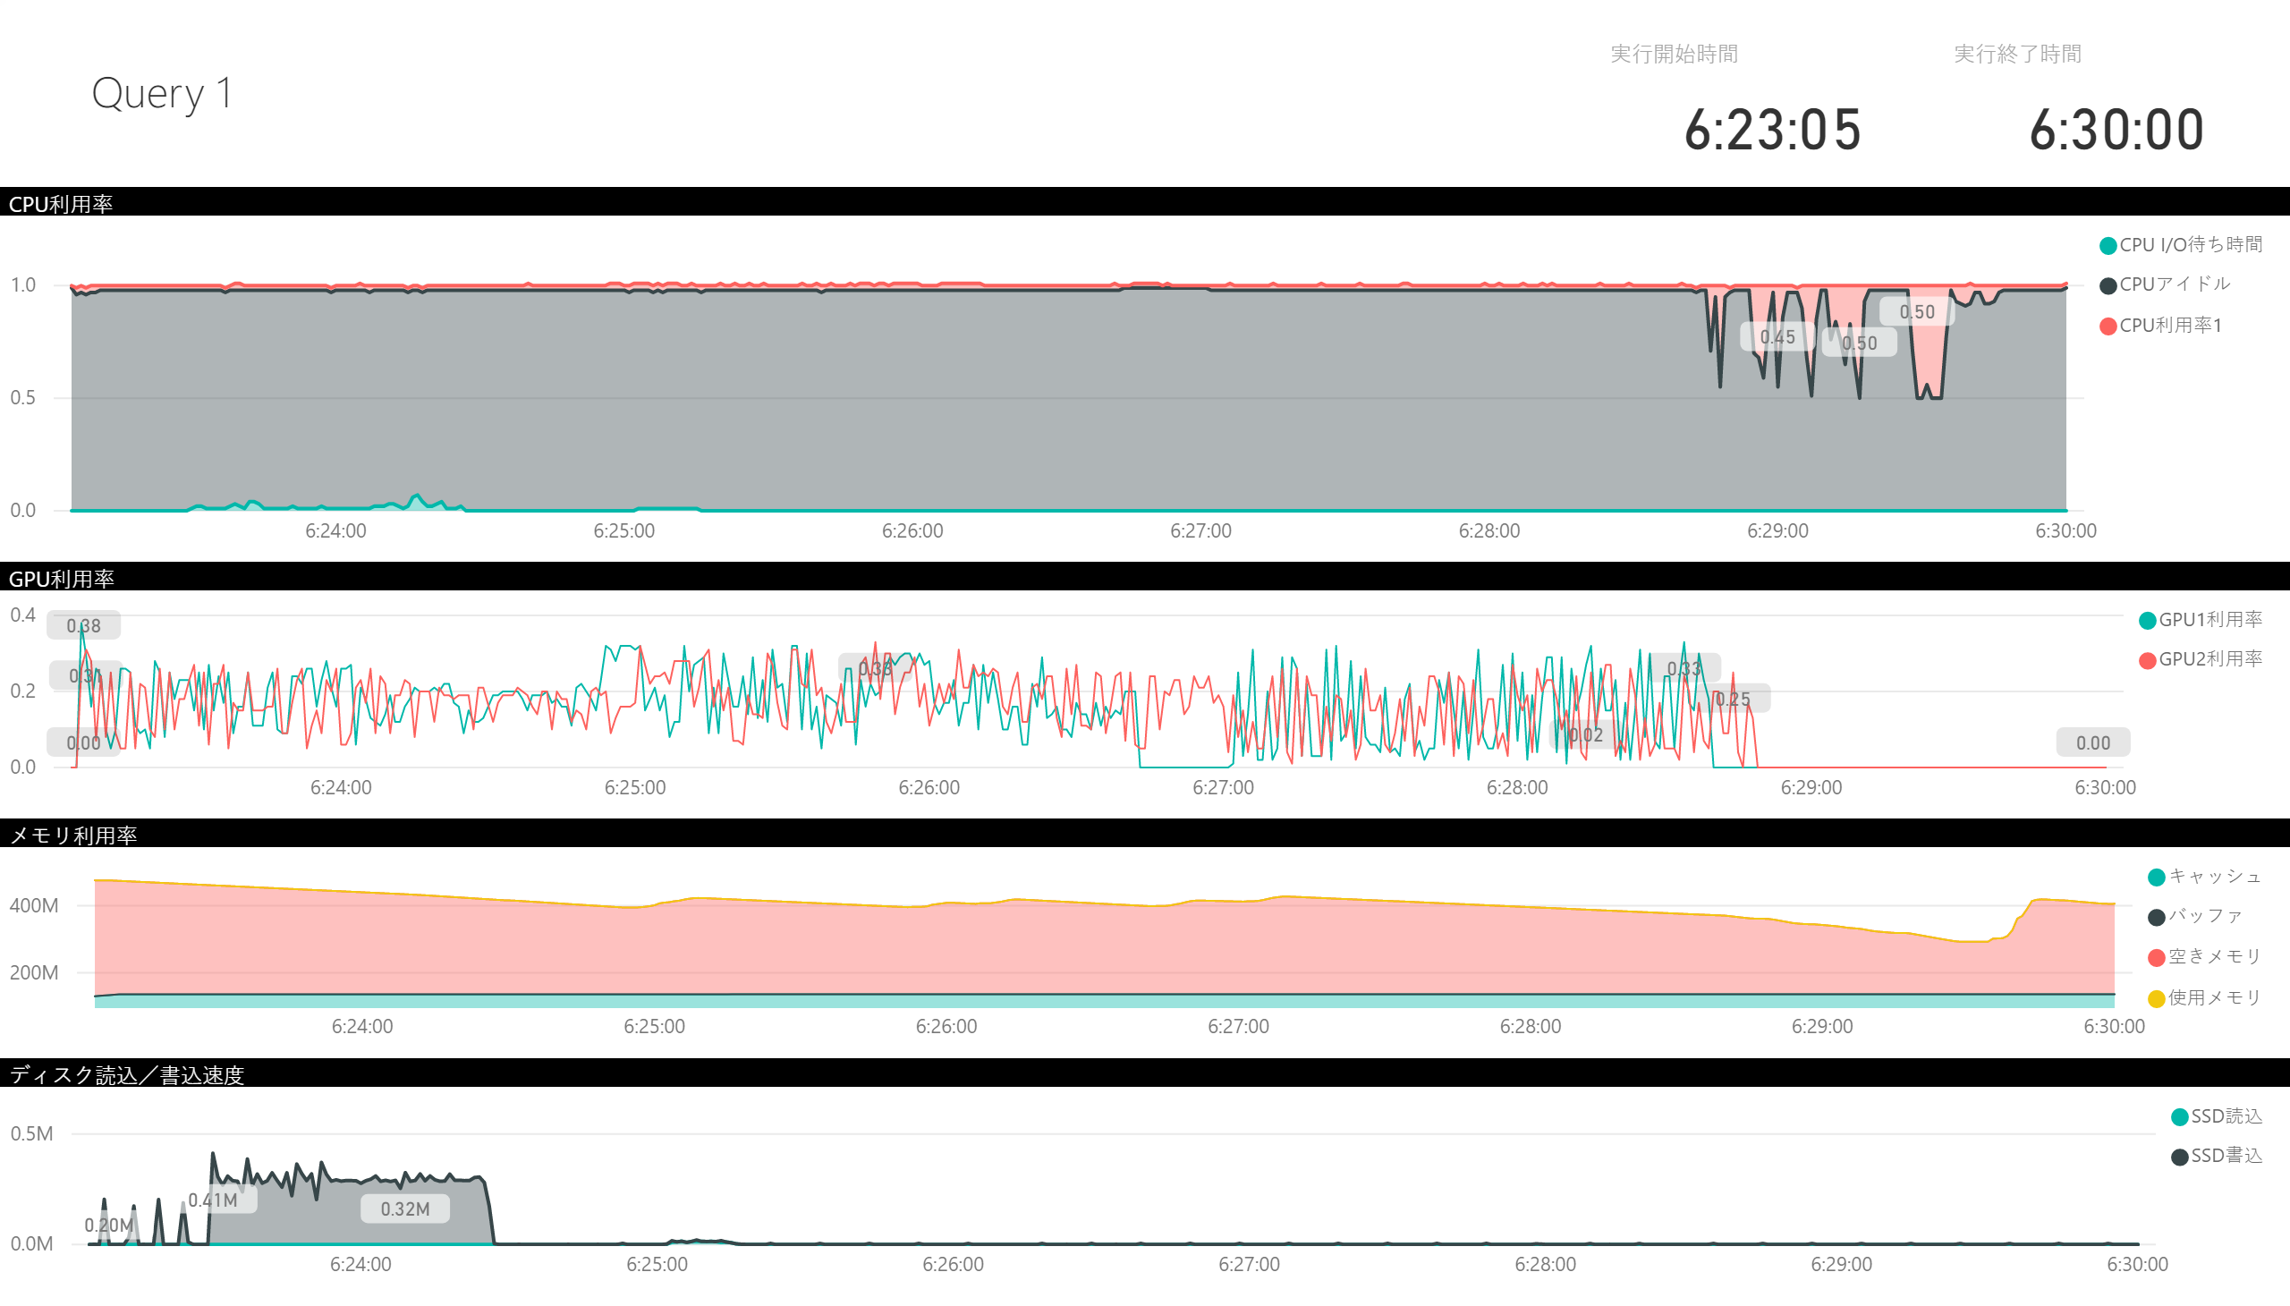

Slide 4
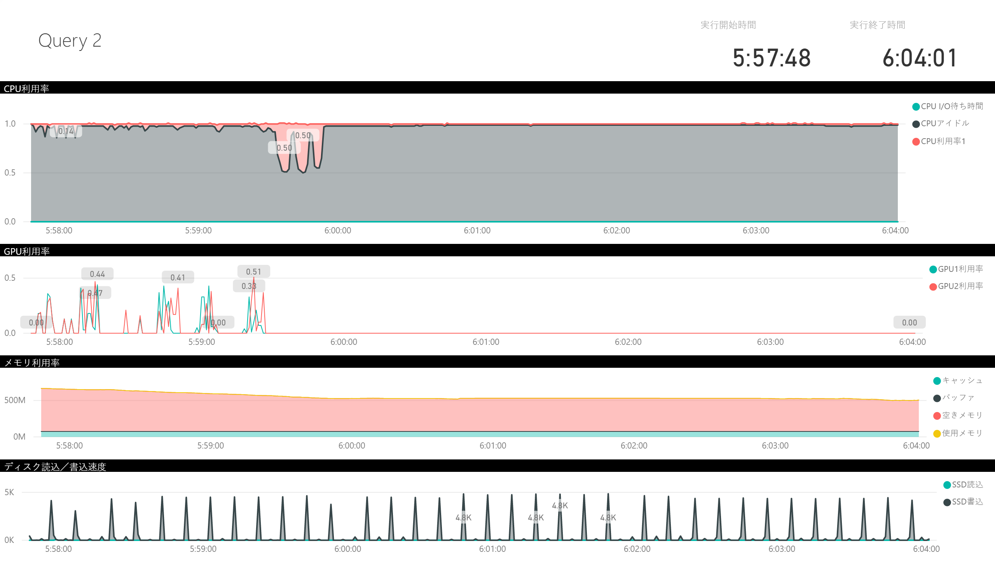

Slide 5
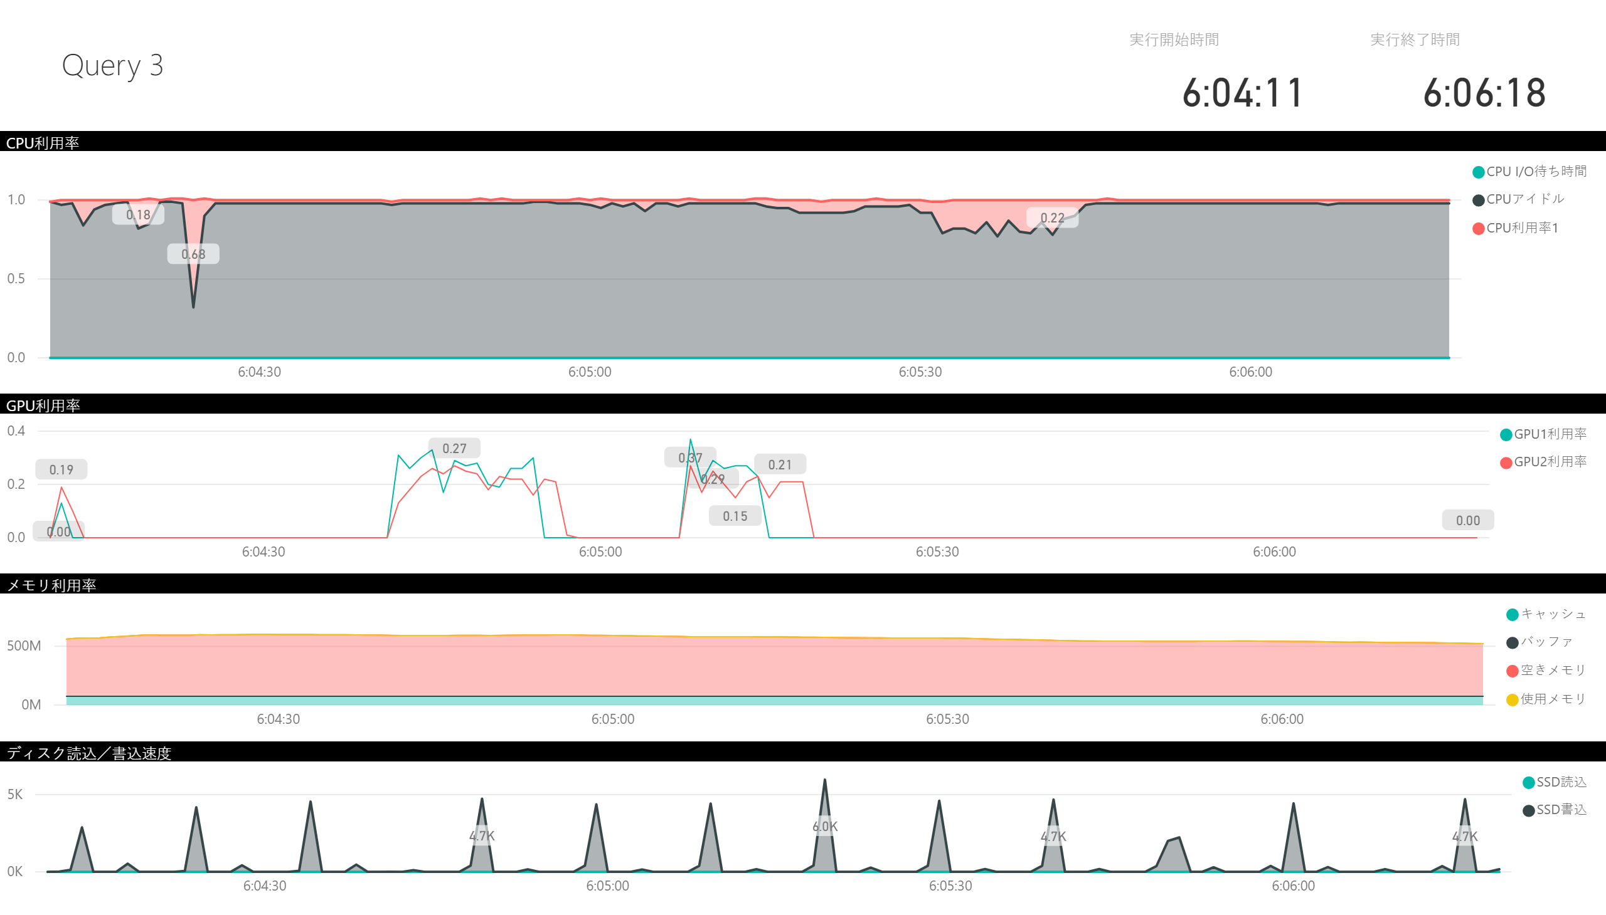

Slide 6
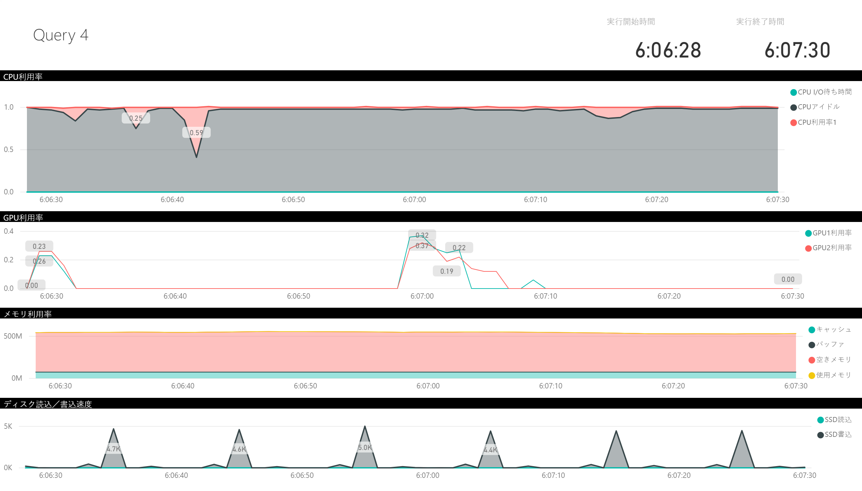

Slide 7
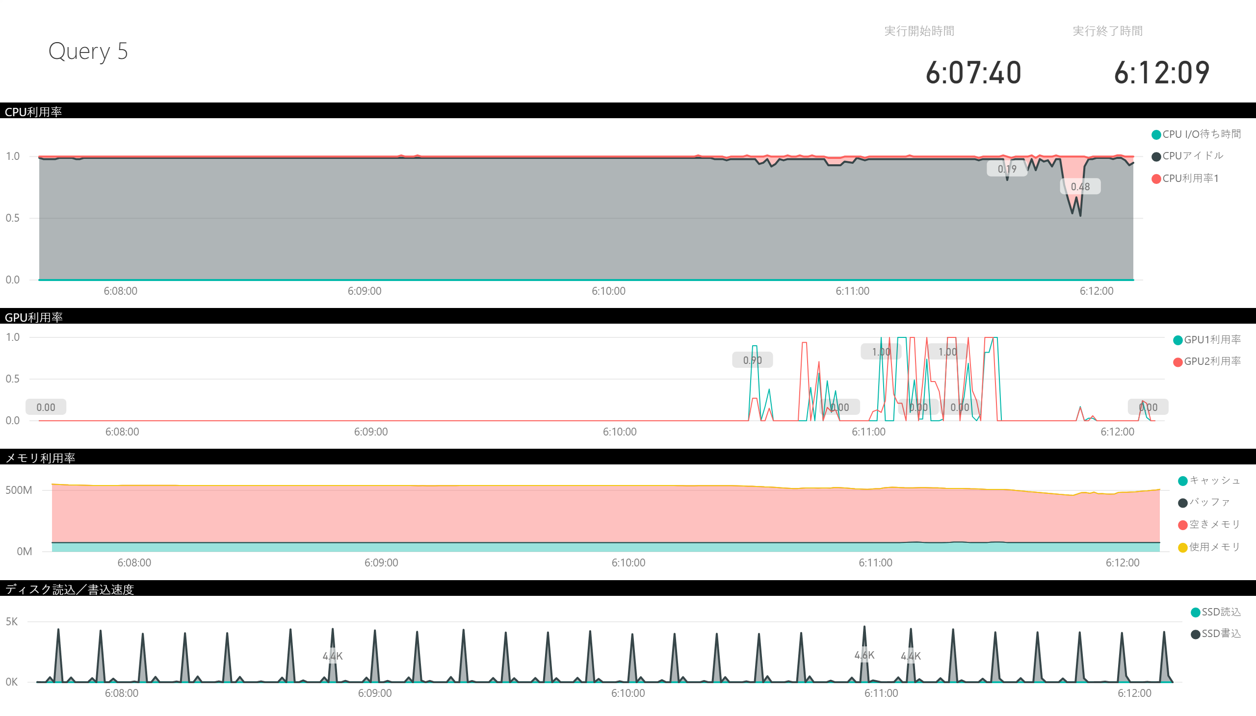

Slide 8
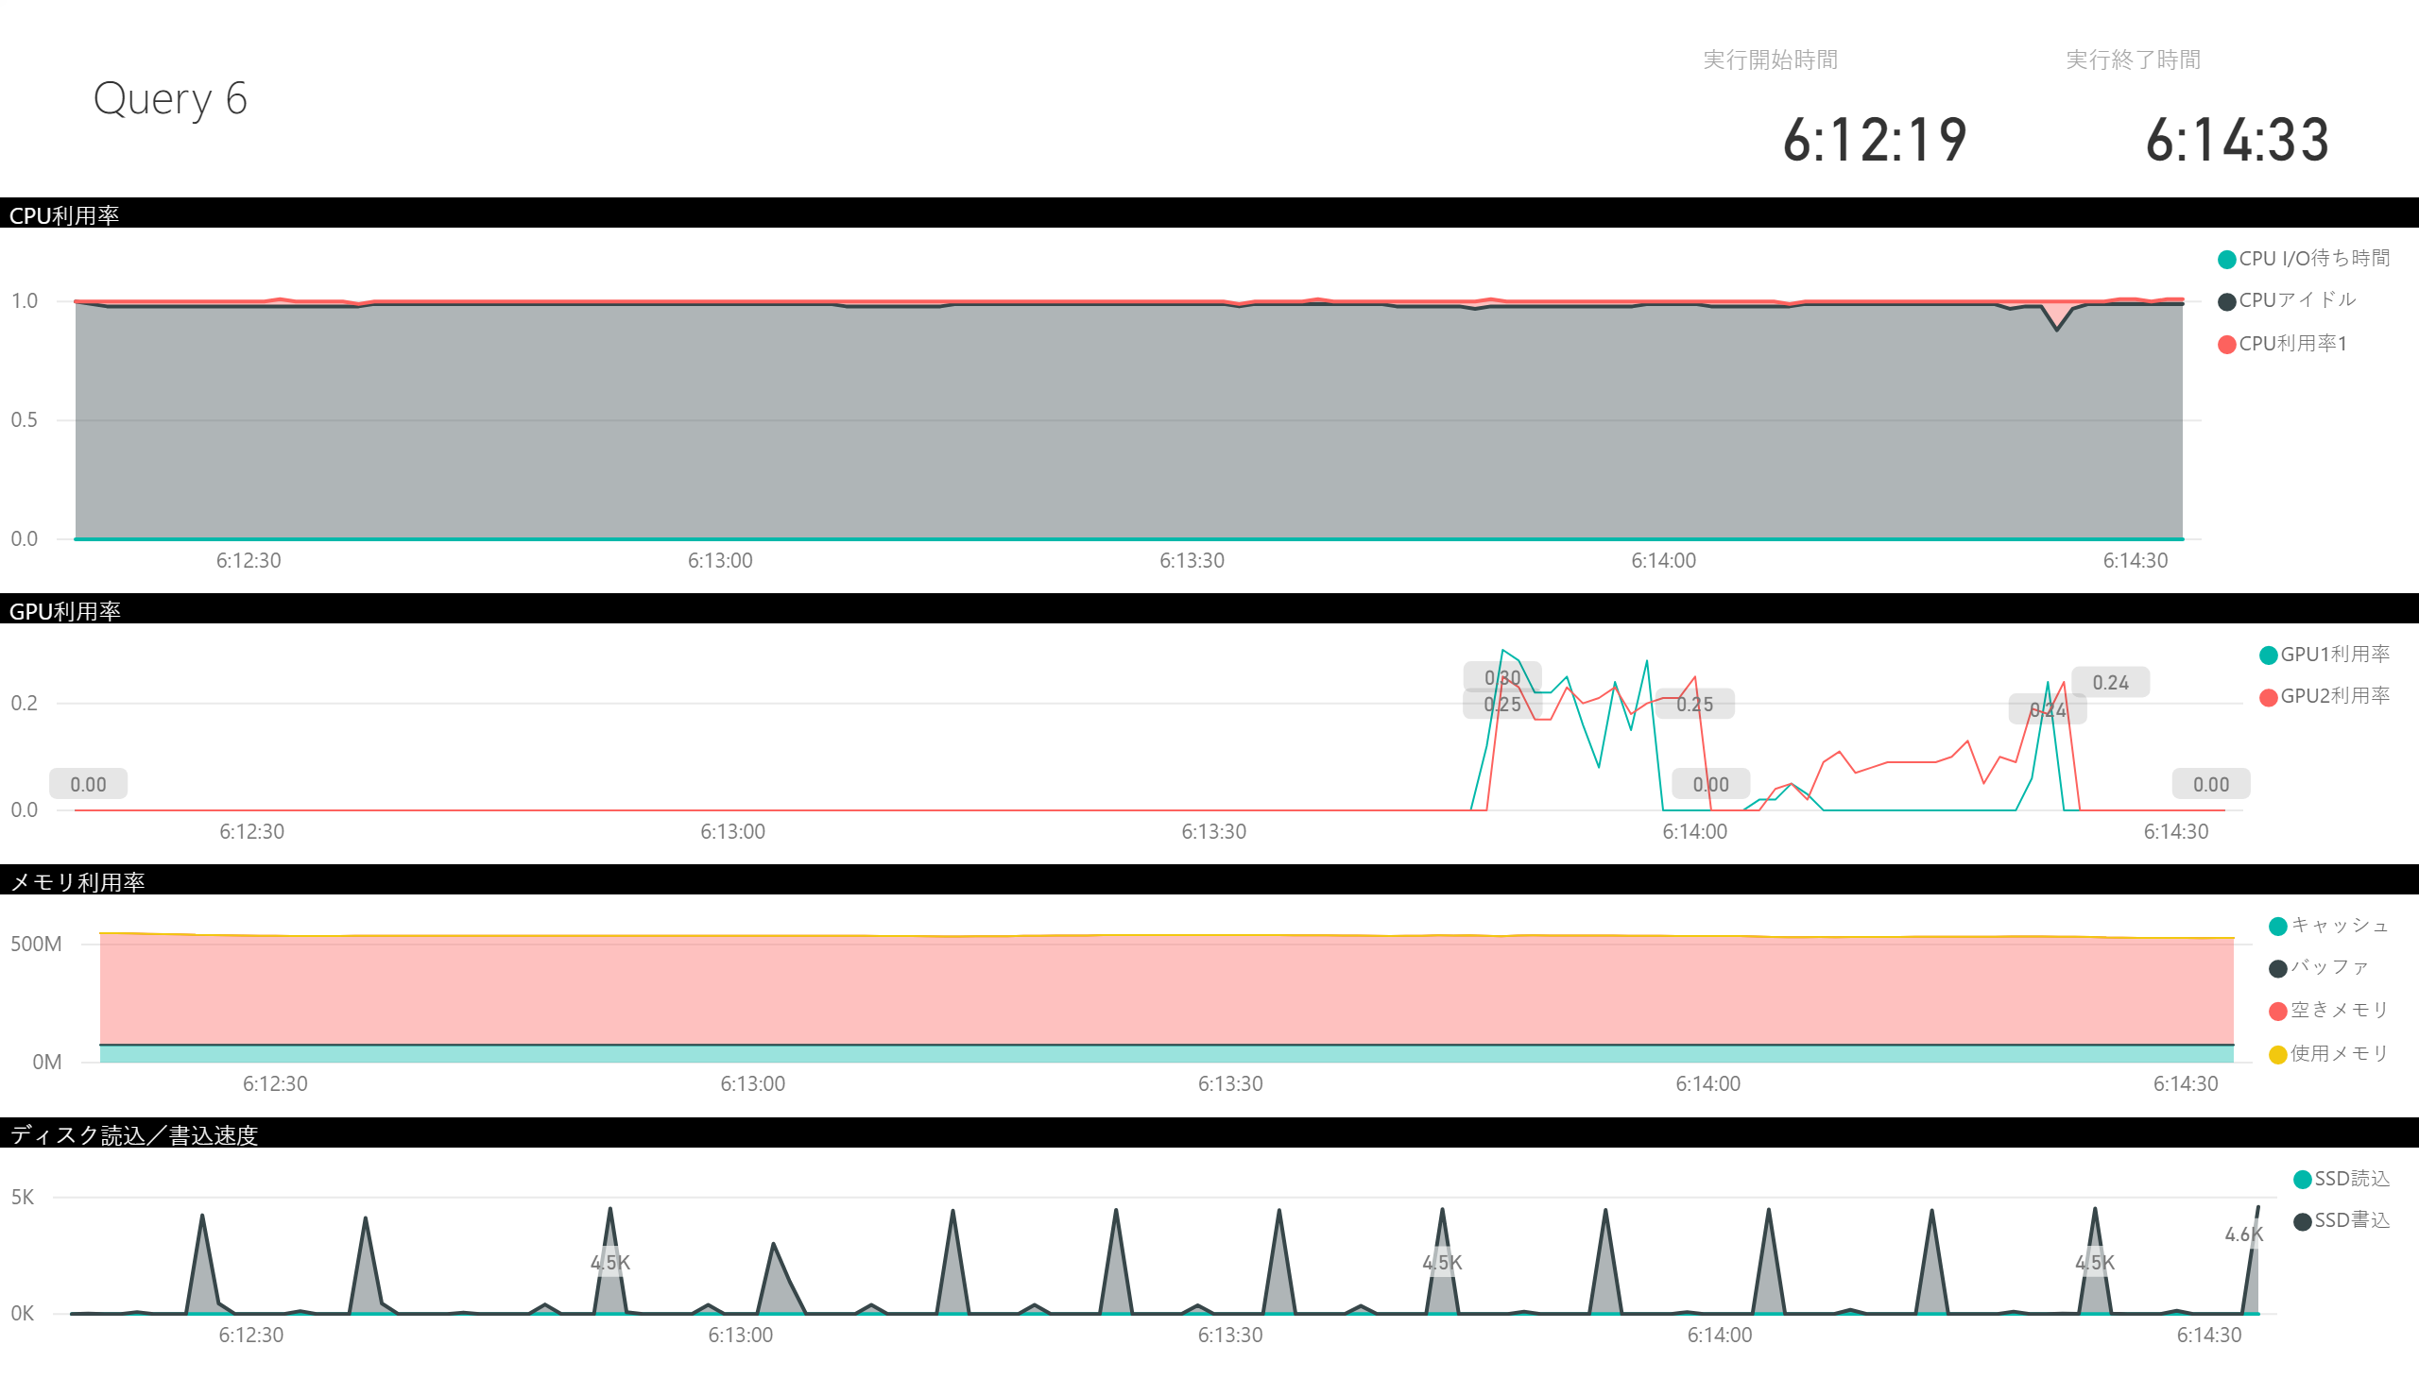

Slide 9
