Slide 1
Issues & Challenges
A Study on Cloud Computing Security
Thanjida Akhter
201691489

Slide 2
contents
Introduction
Cloud computing architecture
Issues
Challenges
Conclusion
Reference

Slide 3
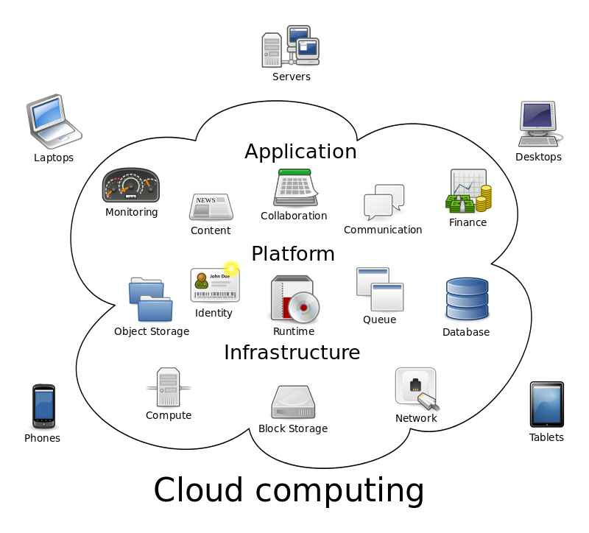
Cloud Computing
Notes:
It is an internet based computing where all the shared resources ,software and information are provided to the computers and devices on demand.
cloud computing: is the delivery of computing services—servers, storage, databases, networking, software, analytics, and more—over the Internet (“the cloud”)
web 2.0:-Web 2.0 offers many interactive software choices, many of which have become household names.
Here are some examples of Web 2.0((free web-based email, online banking, project management tools, word processing, spread sheeting, consignment and flea market trading (e.g. eBay), price shopping for consumer goods, digital photo processing, news feeds, online radio, video hosting, geometrics and mapping services, car anti theft tracking and GPS, home security surveillance, dating and relationships services, psychology and medical counseling, headhunting and executive job, searching, sports team organizing, photo gallery services, music and file sharing, computer virus scanning, computer hardware testing, private investigator, confidential search services, wedding planning, logo design and graphic arts services)))

Slide 4
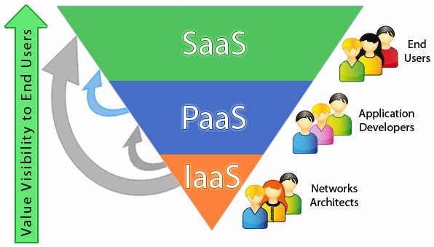
Cloud service models
Infrastructure-as-a-service (IaaS)
Platform as a service (PaaS)
Software as a service (SaaS)
Cloud Computing Stack
Notes:
Infrastructure as a Service (IaaS) :
-- vendors offer computing power and storage space on demand.
Platform as a Service (PaaS) :
--It provides a platform in the cloud, upon which applications can be developed and executed.
Software as a Service (SaaS):
--It offers renting application functionality from a service provider rather than buying, installing and running software by the user.

Slide 5
Deployments/ Types of clouds
Private cloud
The cloud is managed by a single business or organization.
2. Public cloud
The cloud infrastructure is owned and managed by a large Cloud Service Provider (CSP).
3. Community cloud
The cloud is managed by several organizations and community that has the same interest.
4. Hybrid cloud
The cloud infrastructure is composed of two or more of the above models
Notes:
Types of cloud deployments: public, private, hybrid
Not all clouds are the same. There are three different ways to deploy cloud computing resources: public cloud, private cloud, and hybrid cloud.
Public cloud
Public clouds are owned and operated by a third-party cloud service provider, which deliver their computing resources like servers and storage over the Internet. Microsoft Azure is an example of a public cloud. With a public cloud, all hardware, software, and other supporting infrastructure is owned and managed by the cloud provider. You access these services and manage your account using a web browser.
Private cloud
A private cloud refers to cloud computing resources used exclusively by a single business or organization. A private cloud can be physically located on the company’s on-site datacenter. Some companies also pay third-party service providers to host their private cloud. A private cloud is one in which the services and infrastructure are maintained on a private network.
Hybrid cloud
Hybrid clouds combine public and private clouds, bound together by technology that allows data and applications to be shared between them. By allowing data and applications to move between private and public clouds, hybrid cloud gives businesses greater flexibility and more deployment options.

Slide 6
issues
Privileged access
Data location
Data segregation
Data availability
Regulatory compliance
Recovery
Investigative Support
Long-term viability
Notes:
Privileged access: Who has specialized/privileged access to data? Who decides about the hiring and management of such administrators?
Data location: Does the cloud vendor allow for any control over the location of data?
Data segregation: Is encryption available at all stages, and were these encryption schemes designed and tested by experienced professionals?
Data availability: Can the cloud vendor move their entire client’s data onto a different environment should the existing environment become compromised or unavailable?
Regulatory compliance: Is the cloud vendor willing to undergo external audits and/or security certifications?
Recovery: What happens to data in the case of a disaster, and does the vendor offer complete restoration, and, if so, how long does that process take?
Investigative Support: Does the vendor have the ability to investigate any inappropriate or illegal activity?
Long-term viability: What happens to data if the cloud vendor goes out of business, is client’s data returned and in what format?

Slide 7
Challenges
Service Level Agreement
Authentication and Identity Management
Data Security and Protection
Trust Management
Access Control and Accounting
Notes:
Service →Level Agreement:
A Service level agreement is a part of a service contract between the consumer and provider that formally defines the level of service. It is used to identify and define the customer’s needs and to reduce areas of conflict like Services to be delivered Performance, Tracking and Reporting Problem Management Legal Compliance and Resolution of Disputes, Customer Duties and Responsibilities, Security IPR and Confidential Information Termination
Authentication and Identity Management
By using the cloud services, the user can access the information from various places over the internet.
Trust Management
Due to heterogeneity and diversity in cloud computing services, a fine grained access control polices should be enforced. Access control services should be flexible enough to capture dynamic, attribute- or credential-based access requirements
Data →Centric Security and Protection
number of customers can share, save and access the data over the cloud. So data from one customer must be properly segregated from that of another and it must be able to move securely from one location to another [6]. Cloud providers must implement the proper security measures to prevent data leaks or access by third unauthorized parties
Access Control and Accounting

Slide 8
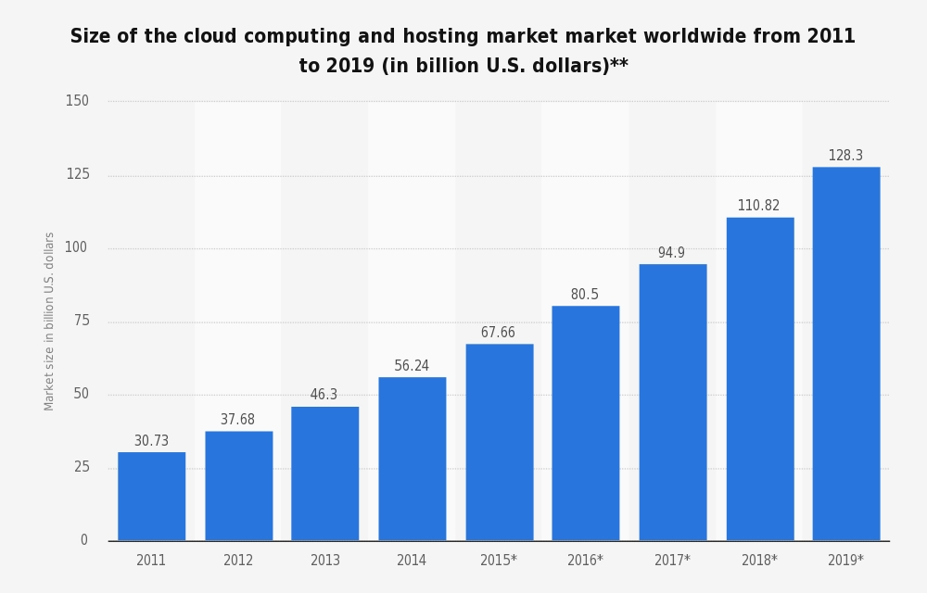
Conclusion

Slide 9
Reference
Popović, Krešimir, and Željko Hocenski. "Cloud computing security issues and challenges." MIPRO, 2010 proceedings of the 33rd international convention. IEEE, 2010.
So, Kuyoro. "Cloud computing security issues and challenges." International Journal of Computer Networks 3.5 (2011): 247-55.
Swapna, K., and Praveen Gupta. "Cloud Computing: Security Issues and Challenges." AADYA-National Journal of Management and Technology (NJMT) 3.2 (2015): 149-154.
Verma, Amandeep, and Sakshi Kaushal. "Cloud computing security issues and challenges: a survey." Advances in Computing and Communications (2011): 445-454.
https://azure.microsoft.com/en-ca/overview/what-is-cloud-computing/

Slide 10


