Slide 1

A Study on
Frequent pattern mining
Project Presentation
COMP 6901
Applied Algorithms
Zhi Yuan | 201170644
Thanjida Akhter | 201691489
Rabeya Akhter | 201793299

Slide 2
Contents
Abstract
Introduction
Motivation, Applications, Importance
Algorithm names
Basic Concepts
Algorithm Details
Time Complexity
Reference
Zhi Yuan:201170644

Slide 3
Abstract
Pattern mining algorithms can be applied on various types of data such as sub graphs, associations, indirect associations, trends, periodic patterns, sequential rules, lattices, sequential patterns, high-utility patterns, etc. Example like frequent pattern mining is that of finding relationships among the items or pattern in a database those products that are frequently purchased together by customers. This paper introduces a detailed analysis of the algorithms focusing on frequent pattern mining also try to find suitable algorithm base on time complexity
Zhi Yuan:201170644

Slide 4


What is data mining?
the use of sophisticated data analysis tools to discover previously unknown, valid patterns and relationships in large data sets
Data
Information
Zhi Yuan:201170644

Slide 5
Frequent Pattern?
Frequent Pattern: a pattern (a set of items, subsequences, substructures, etc.) that occurs frequently in a data set.
Databases: item(transaction), tree, graph, string, vectors,…
Patterns: itemset, tree, paths, cycles, graphs, geographs,…
Zhi Yuan:201170644

Slide 6
Motivation
Motivation: Finding inherent regularities in data
What products were often purchased together?
What are the subsequent purchases after buying a PC?
What kinds of DNA are sensitive to this new drug?
Zhi Yuan:201170644

Slide 7
Applications
Supermarket
Product placement
special promotions
Web search
which keywords often occur together in webpages?
Heath care
frequent sets of symptoms for a disease
DNA sequence
Zhi Yuan:201170644

Slide 8
Importance
Discloses an intrinsic and important property of data sets
Forms the foundation for many essential data mining tasks
Association, correlation, and causality analysis
Sequential, structural pattern
Pattern analysis in spatiotemporal, multimedia, time-series.
Classification: associative classification
Cluster analysis: frequent pattern-based clustering
Zhi Yuan:201170644
Notes:
Virtual Infrastructure: virtual machines, virtual storage disks, virtual networks or virtual data centers.

Slide 9
Some Algorithm names
Apriori
FP Growth
Eclat
SaM
PrefixSpan
Broglet’s FP-Growth
Goethals FP-Growth
Vertical data format approach
Zhi Yuan:201170644

Slide 10
Association Rule Mining
Given a set of transactions, find rules that will predict the occurrence of an item based on the occurrences of other items in the transaction
Tid | Items bought
10 | Beer, Nuts, Diaper
20 | Beer, Coffee, Diaper
30 | Beer, Diaper, Eggs
40 | Nuts, Eggs, Milk
50 | Nuts, Coffee, Diaper, Eggs, Milk
Example of Association
Rules
{Diaper} -> {Beer},
{Milk, Bread} -> {Eggs,Coke},
{Beer, Bread} -> {Milk},
Implication means co-occurrence
Zhi Yuan:201170644

Slide 11
Basic Concepts of Association Rule
Itemset
– A collection of one or more items• Example: {Milk, Bread, Diaper}
k-itemset
• An itemset that contains k items
Support count (s)
– Frequency of occurrence of an itemset
– E.g. s({Bread,Diaper}) = 3
Support
– Fraction of transactions that contain an
itemset
– E.g. s({Milk, Eggs}) = 2/5
Frequent Itemset
An itemset whose support is greater
than or equal to a minsup threshold
Tid | Items bought
10 | Beer, Nuts, Diaper
20 | Beer, Coffee, Diaper
30 | Beer, Diaper, Eggs
40 | Nuts, Eggs, Milk
50 | Nuts, Coffee, Diaper, Eggs, Milk
Customer
buys both
Customer
buys diaper
Customer
buys beer
Zhi Yuan:201170644

Slide 12
Basic Concepts of Association Rule
Find all the rules X → Y with minimum support and confidence threshold
– Support (s)
Fraction of transactions that contain both X and Y
– Confidence (c)
Measures how often items in Y appear in transactions that
contain X
Let minsup = 50%, minconf = 50%
Freq. Pat.: Beer:3, Nuts:3, Diaper:4, Eggs:3, {Beer, Diaper}:3
Association rules: (many more!)
Beer → Diaper (s-60%, c-100%)
Diaper → Beer (s-60%, c-75%)
Rules that satisfy both minsup and minconf are called strong rules
Tid | Items bought
10 | Beer, Nuts, Diaper
20 | Beer, Coffee, Diaper
30 | Beer, Diaper, Eggs
40 | Nuts, Eggs, Milk
50 | Nuts, Coffee, Diaper, Eggs, Milk
Zhi Yuan:201170644

Slide 13
Mining Association Rules
Two-step approach:
1. Frequent Itemset Generation
– Generate all itemsets whose support ≥ minsup
2. Rule Generation
– Generate high confidence rules from each frequent itemset, where each rule is a binary partitioning of a frequent itemset
Frequent itemset generation is still computationally expensive
Zhi Yuan:201170644

Slide 14
Three major approaches
A brief description of the three frequent pattern mining algorithms namely Apriori, Eclat and FP Growth
Apriori [Agrawal & Srikant 1994]
FP-growth [Han, Pei & Yin 2000]
Eclat[MJ Zaki, S Parthasarathy, M Ogihara, W Li - KDD, 1997]

Slide 15
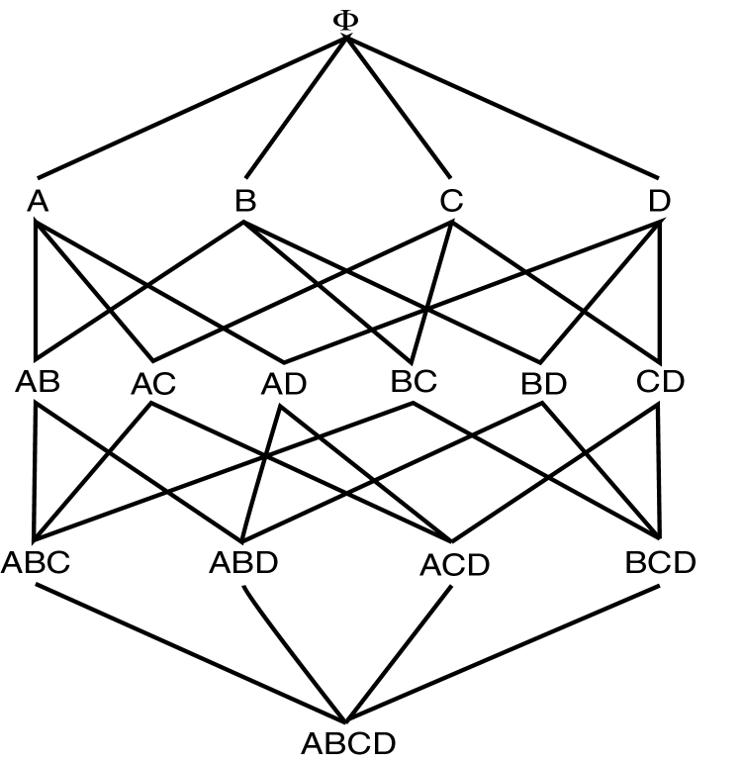
Apriori Algorithm
Apriori principle:
Self-joining (L*L)
Pruning(If there is any itemset which is infrequent, its superset should not be generated/tested)
Large Itemset Property
Thanjida Akhter:201691489

Slide 16
Pseudo-code
C_{k}: Candidate itemset of size k
L_{k} : frequent itemset of size k
L₁ = {frequent items};
for (k = 1; L_{k} !=∅; k++) do begin
C_{k+1} = candidates generated from L_{k};
for each transaction t in database do
increment the count of all candidates in C_{k+1} that are contained in t
L_{k+1} = candidates in C_{k+1} with min_support
end
return ∪_{k} L_{k};
Thanjida Akhter:201691489

Slide 17
Apriori: Example
Sup_{min} = 2
Itemset | sup
{A} | 2
{B} | 3
{C} | 3
{D} | 1
{E} | 3
Database
Itemset | sup
{A} | 2
{B} | 3
{C} | 3
{E} | 3
L₁
Tid | Items
10 | A, C, D
20 | B, C, E
30 | A, B, C, E
40 | B, E
C₁
1st scan
C₂
C₂
Itemset | sup
{A, B} | 1
{A, C} | 2
{A, E} | 1
{B, C} | 2
{B, E} | 3
{C, E} | 2
L₂
2nd scan
Itemset
{A, B}
{A, C}
{A, E}
{B, C}
{B, E}
{C, E}
Itemset | sup
{A, C} | 2
{B, C} | 2
{B, E} | 3
{C, E} | 2
C₃
Itemset
{B, C, E}
3rd scan
L₃
Itemset | sup
{B, C, E} | 2
Thanjida Akhter:201691489

Slide 18
Advantages & Disadvantages
Advantages:
Uses large itemset property
Easily parallelized
Easy to implement
Disadvantages:
Assumes transaction database is memory resident
Requires database scans
Thanjida Akhter:201691489

Slide 19
FP-growth
Use a compressed representation of the database using an FP-tree
Once an FP-tree has been constructed, it uses a recursive divide-and-conquer approach to mine the frequent itemsets

Slide 20
FP-tree construction
null
After reading TID=1:
A:1
B:1
After reading TID=2:
null
A:1
B:1
B:1
C:1
D:1
Thanjida Akhter:201691489

Slide 21
FP-Tree Construction
Transaction Database
null
A:7
B:3
B:5
C:3
C:1
D:1
Header table
D:1
C:3
E:1
D:1
E:1
D:1
E:1
D:1
Thanjida Akhter:201691489

Slide 22
FP-growth
Build conditional pattern base for E: P = {(A:1,C:1,D:1), (A:1,D:1), (B:1,C:1)}
Recursively apply FP-growth on P
null
A:7
B:3
B:5
C:3
C:1
D:1
C:3
D:1
D:1
E:1
D:1
E:1
E:1
D:1
Rabeya Akhter:201793299

Slide 23
FP-growth
Conditional tree for E:
Conditional Pattern base for E: P = {(A:1,C:1,D:1,E:1), (A:1,D:1,E:1), (B:1,C:1,E:1)}
Count for E is 3: {E} is frequent itemset
Recursively apply FP-growth on P
null
A:2
B:1
C:1
C:1
D:1
D:1
E:1
E:1
E:1
Rabeya Akhter:201793299

Slide 24
FP-growth
Conditional tree for D within conditional tree for E:
Conditional pattern base for D within conditional base for E: P = {(A:1,C:1,D:1), (A:1,D:1)}
Count for D is 2: {D,E} is frequent itemset
Recursively apply FP-growth on P
null
A:2
C:1
D:1
D:1
Rabeya Akhter:201793299

Slide 25
FP-growth
Conditional tree for C within D within E:
Conditional pattern base for C within D within E: P = {(A:1,C:1)}
Count for C is 1: {C,D,E} is NOT frequent itemset
null
A:1
C:1
Rabeya Akhter:201793299

Slide 26
FP-growth
Conditional tree for A within D within E:
Count for A is 2: {A,D,E} is frequent itemset
Next step:
Construct conditional tree C within conditional tree E
Continue until exploring conditional tree for A (which has only node A)
null
A:2
Rabeya Akhter:201793299

Slide 27
FP-growth
null
Conditional Pattern base for D: P = {(A:1,B:1,C:1), (A:1,B:1), (A:1,C:1), (A:1), (B:1,C:1)}
Recursively apply FP-growth on P
A:7
B:1
B:5
C:1
C:1
D:1
C:3
D:1
D:1
D:1
D:1
Rabeya Akhter:201793299

Slide 28
FP-growth
Frequent Itemsets found (with min sup = 2): AD, BD, CD, ACD, BCD, ABD
Rabeya Akhter:201793299

Slide 29
Challenges of Frequent Pattern Mining
Multiple scans of transaction database
Huge number of candidates
Tedious workload of support counting for candidates
Rabeya Akhter:201793299

Slide 30
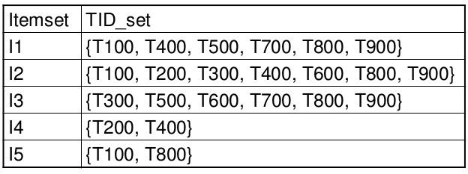
Vertical Layout
Rather than have
Transaction ID – list of items (Transactional)
We have
Item – List of transactions (TID-list)
Now to count itemset AB
Intersect TID-list of item A with TID-list of item B
All data for a particular item is available
Rabeya Akhter:201793299

Slide 31
Eclat Algorithm
Dynamically process each transaction online maintaining 2-itemset counts.
Transform
Partition L2 using 1-item prefix
Equivalence classes - {AB, AC, AD}, {BC, BD}, {CD}
Transform database to vertical form
Asynchronous Phase
For each equivalence class E
Compute frequent (E)
Rabeya Akhter:201793299

Slide 32
Frequent Itemset Generation
ECLAT: for each item, store a list of transaction ids (tids); vertical data layout
TID-list
Rabeya Akhter:201793299

Slide 33
Frequent Itemset Generation
Determine support of any k-itemset by intersecting tid-lists of two of its (k-1) subsets.
3 traversal approaches:
top-down, bottom-up and hybrid
Advantage: very fast support counting
Disadvantage: intermediate tid-lists may become too large for memory
∧
→
Rabeya Akhter:201793299

Slide 34
ECLAT: FP Mining with Vertical Data Format
Both Apriori and FP-growth use horizontal data format
Alternatively data can also be represented in vertical format
TID | List of item IDS
T100 | I1,I2,I5
T200 | I2,I4
T300 | I2,I3
T400 | I1,I2,I4
T500 | I1,I3
T600 | I2,I3
T700 | I1,I3
T800 | I1,I2,I3,I5
T900 | I1,I2,I3
itemset | TID_set
I1 | {T100,T400,T500,T700,T800,T900}
I2 | {T100,T200,T300,T400,T600,T800,T900}
I3 | {T300,T500,T600,T700,T800,T900}
I4 | {T200,T400}
I5 | {T100,T800}
Rabeya Akhter:201793299

Slide 35
ECLAT Algorithm by Example
Transform the horizontally formatted data to the vertical format by scanning the database once
The support count of an itemset is simply the length of the TID_set of the itemset
TID | List of item IDS
T100 | I1,I2,I5
T200 | I2,I4
T300 | I2,I3
T400 | I1,I2,I4
T500 | I1,I3
T600 | I2,I3
T700 | I1,I3
T800 | I1,I2,I3,I5
T900 | I1,I2,I3
itemset | TID_set
I1 | {T100,T400,T500,T700,T800,T900}
I2 | {T100,T200,T300,T400,T600,T800,T900}
I3 | {T300,T500,T600,T700,T800,T900}
I4 | {T200,T400}
I5 | {T100,T800}
Rabeya Akhter:201793299

Slide 36
ECLAT Algorithm by Example
min_sup=2
Frequent 2-itemsets in vertical format
Frequent 1-itemsets in vertical format
itemset | TID_set
I1 | {T100,T400,T500,T700,T800,T900}
I2 | {T100,T200,T300,T400,T600,T800,T900}
I3 | {T300,T500,T600,T700,T800,T900}
I4 | {T200,T400}
I5 | {T100,T800}
itemset | TID_set
{I1,I2} | {T100,T400,T800,T900}
{I1,I3} | {T500,T700,T800,T900}
{I1,I4} | {T400}
{I1,I5} | {T100,T800}
{I2,I3} | {T300,T600,T800,T900}
{I2,I4} | {T200,T400}
{I2,I5} | {T100,T800}
{I3,I5} | {T800}
The frequent k-itemsets can be used to construct the candidate (k+1)-itemsets based on the Apriori property
Rabeya Akhter:201793299

Slide 37
ECLAT Algorithm by Example
Frequent 3-itemsets in vertical format
itemset | TID_set
{I1,I2,I3} | {T800,T900}
{I1,I2,I5} | {T100,T800}
min_sup=2
This process repeats, with k incremented by 1 each time, until no frequent items or no candidate itemsets can be found
Properties of mining with vertical data format
Take the advantage of the Apriori property in the generation of candidate (k+1)-itemset from k-itemsets
No need to scan the database to find the support of (k+1) itemsets, for k>=1
The TID_set of each k-itemset carries the complete information required for counting such support
The TID-sets can be quite long, hence expensive to manipulate
Rabeya Akhter:201793299

Slide 38
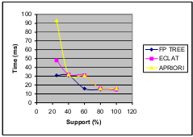
Comparison of Algorithms
Figure 1: Comparison of Apriori, Eclat and FP Growth algorithm on artificial dataset.
Rabeya Akhter:201793299

Slide 39
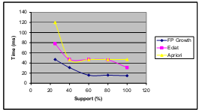
Comparison of Algorithms
Figure 2: Comparison of Apriori, Eclat and FP Growth algorithm on
artificial dataset when the number of transactions are made three times the original.
Rabeya Akhter:201793299

Slide 40
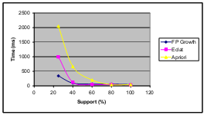
Comparison of Algorithms
Figure 3: Comparison of apriori, éclat and FP Growth algorithm on artificial dataset when the number of attributes are made three times the original.
Rabeya Akhter:201793299

Slide 41
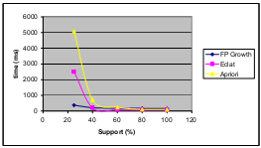
Comparison of Algorithms
Rabeya Akhter:201793299

Slide 42
Time Complexity
Apriori Algorithm: Scan database at every level of breadth first search. Apriori’s outer loops are bounded by the number of common prefixes.
Worst case: O(N ²)
FP Growth : Best case: O(N log N)
Worst case: O(N ² )
ECLAT : Worst case: O(k(k+1)
[K is the number of items]
Rabeya Akhter:201793299

Slide 43
CONCLUSION
FP Growth is the best among the three algorithms and is thus most scalable.
Eclat performs poorer than FP Growth and the Apriori performs the worst.
Rabeya Akhter:201793299

Slide 44
Reference
Charu C. Aggarwal, Jiawei Han, Aggarwal Charu C., Han, Jiawei. An Introduction to Frequent Pattern Mining, Springer International Publishing: Cham 2014.
Agrawal R, Imielinski T, Swami A (1993) Mining association rules between sets of items in large databases. In: Proceedings of the 1993 ACM-SIGMOD international conference on management of data (SIGMOD’93), Washington, DC, pp 207–216.
Agrawal R, Srikant R (1994) Fast algorithms for mining association rules. In: Proceedings of the 1994 international conference on very large data bases (VLDB’94), Santiago, Chile, pp 487–499.
R. Agarwal, C. C. Aggarwal, and V. V. V. Prasad. Depth-first Generation of Long Patterns, ACM KDD Conference, 2000: Also appears as IBM Research Report, RC, 21538, 1999.
E. Cohen. M. Datar, S. Fujiwara, A. Gionis, P. Indyk, R. Motwani, J. Ullman, and C. Yang. Finding Interesting Associations without Support Pruning, IEEE TKDE, 13(1), pp. 64–78, 2001.
R. Agrawal, and R. Srikant. Mining Sequential Patterns, ICDE Conference, 1995.
Jiawei Han , Jian Pei , Yiwen Yin, Mining frequent patterns without candidate generation, Proceedings of the 2000 ACM SIGMOD international conference on Management of data, p.1-12, May 15-18, 2000, Dallas, Texas, USA

Slide 45
Thank You

