Slide 1
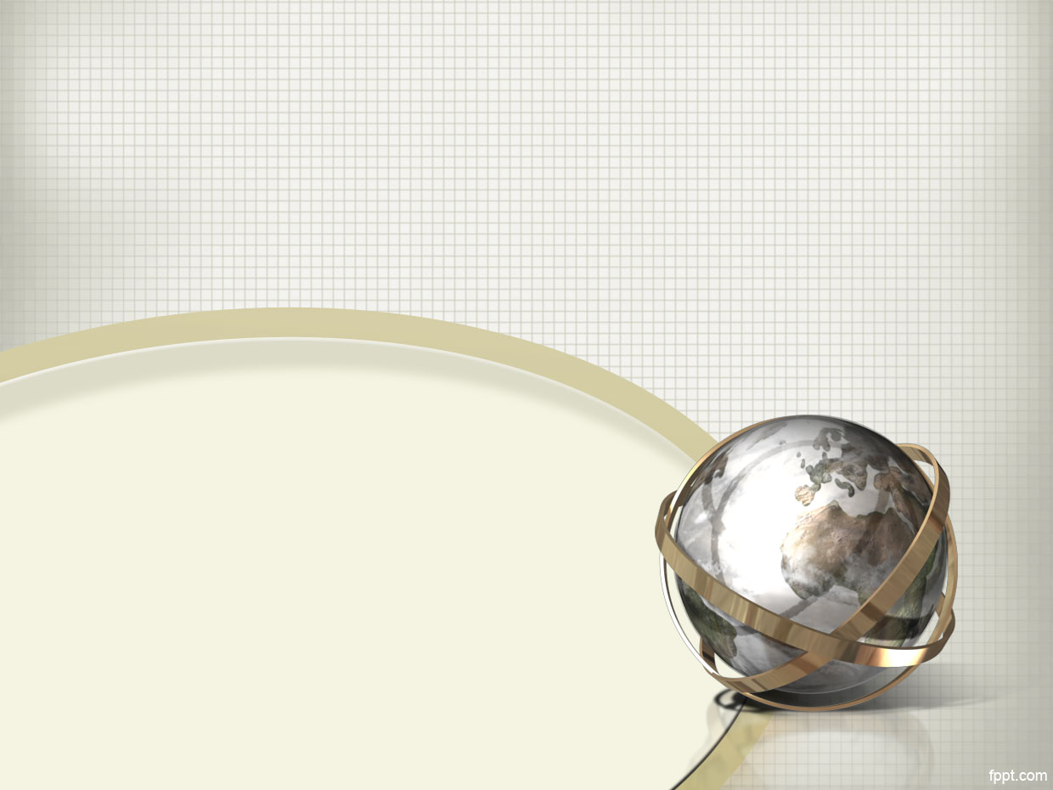

Course Title: Computer Graphics
Course Code : CSE421
Topic: Aliasing
Thanjida Akhter : 102-15-1030

Slide 2
What is Aliasing?
False frequencies created by poor sampling of an input signal.
Sampled
signal
Input
signal
Sampling Rate
Notes:
Green signal shows original, high frequency input.
This input signal is only sampled at around half it’s maximum frequency.
The output (red signal) is now only half the original frequency – a clear error!

Slide 3
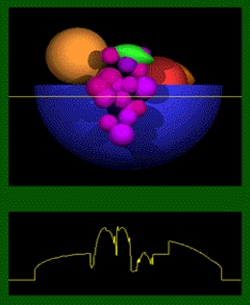
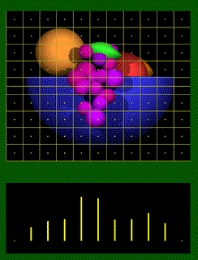
Example
Original
scene
Sampling at
Pixel centres
Sampled
signal
Continues
signal

Slide 4
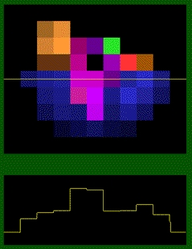
Example
Rendered image
Discrete signal

Slide 5
Effects of Aliasing
Artefacts are created by this poor sampling.
Manifested as an audible, unmusical “buzz” in aliased sound data.
Also creates problems for computer graphics when vectorial data is sampled and rasterised.
Notes:
Computer graphics can also be thought of as a signal composed of a specific set of frequencies.
As an interesting aside, the JPEG compression algorithm works by examining these frequencies and resampling them to create smaller files with minimal loss of data, in a similar fashion to the mp3 compression system commonly used for audio files.
Vectorial data = mathematical description of a graphical element. Can be scaled and manipulated with no loss of accuracy.
Rasterisation = converting this vectorial data into a fixed number of pixels for storage as a bitmap or output to a raster display such as a computer monitor.

Slide 6
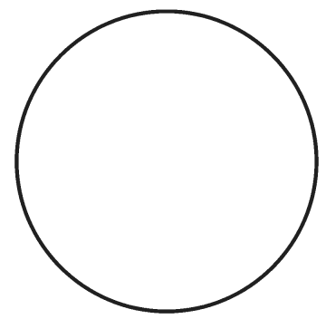
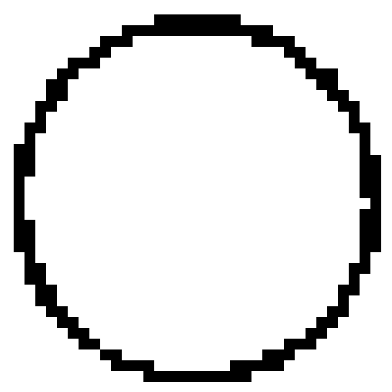
Effects of Aliasing in Graphics
Jagged effect in rasterised graphics:
Vector representation of a circle
Jagged edges due to aliasing
during the rasterisation process

Slide 7
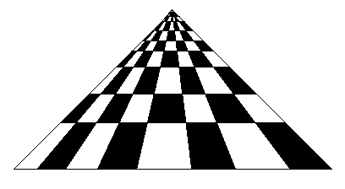
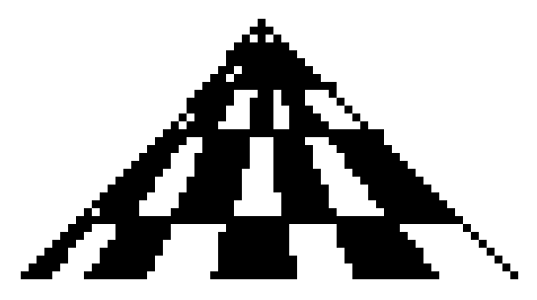
Effects of Aliasing in Graphics
Poor representation of fine detail:
Image representing a chessboard in 3D
Closeup of most distant squares

Slide 8
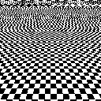
Aliasing in Graphics
A graphics example:
Notes:
This image shows aliasing occurring towards the top of the image. This is because the image is not being sampled (or rendered) at a high enough resolution. The result is a strange affect known as Moiré patterns which are not artefacts of the original sample.
In fact George Bush wore a tie on the 13th April which apparently produced Moiré patterns similar to above. This (according to American TV stylist Henry Roth) is covered in TV101, i.e. one of the first things you learn with TV. Sometimes its called strobing on TV but a more accurate term is Aliasing generating a Moiré pattern.*
*Source: Bush Tie Not Looking Good – Apr 14,2004, http://www.eonline.com/News/Items/0,1,13902,00.html, 2005
Image Source: Anti-aliasing - Wikipedia, the free encyclopedia, http://en.wikipedia.org/wiki/Anti_aliasing, 2005

Slide 9
Avoiding Aliasing?
The aliasing problem can be avoided when sampling audio by applying Nyquist’s Theorem.
Sampling should be done at TWICE the rate of the maximum frequency present in the original signal.
Antialiasing is sometimes called oversampling.
Applied to the signal seen earlier/
Notes:
Theorum proposed by Nyquist, 1928. Later proven by Shannon in 1949 and is more properly known as the Nyquist-Shannon formula.

Slide 10
Avoiding Aliasing?
Use of Nyquist’s theorem produces a mathematically identical output signal.
Sampled
signal
Input
signal
Sampling Rate (2x input frequency)
Notes:
Green signal shows original, high frequency input.
This input signal is sampled at twice its maximum frequency.
The output (red signal) now matches the original frequency!

Slide 11
Avoiding Aliasing?
In computer graphics, the resolution of the rasterised image replaces the sampling rate seen in the audio example.
To apply Nyquist would require the output device to have a resolution double that which is discernable to the human visual system.
Technology is not currently at this level, so alternatives must be sought.
Notes:
Resolution = number of pixels used to display the raster image.

Slide 12
Anti-Aliasing Techniques
Prefiltering: Lower the maximum frequency (filter out high frequencies)
Super Sampling: Raise the sampling frequency
Stochastic Sampling: Sample randomly instead of uniformly

Slide 13
Pre-filtering
Blur the images by some low-pass filters
Easy for 2D text, images, and 2D graphics
Difficult for 3D graphics (visibility is an issue since translucency is expensive)

Slide 14
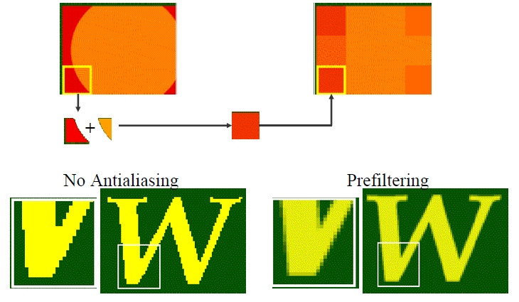
Pre-filtering example

Slide 15
Increasing Resolution
Physically increase the display resolution
-Not always possible
Perform Postfiltering / Supersampling
-Actual display is m*n, sample on a sm*sn virtual display
– Then “average” several (typically s*s ) virtual sub-pixels to yield one actual pixel
-Averaging
- unweighted (simple average)
-weighted (more importance to virtual sub-pixels closer to the center)

Slide 16
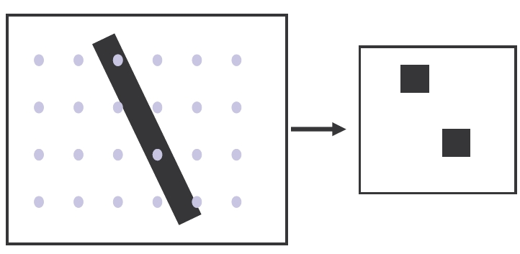
Averaging with supersampling

Slide 17
Stochastic Sampling
Sample at a random place within the pixel to determine its color (Jittering)
Pick a random point and keep it if its nearest neighbor is > r units away (Poisson Disk Sampling)
Often use stochastic sampling with supersampling
Reduces aliasing at the cost of added noise.

Slide 18
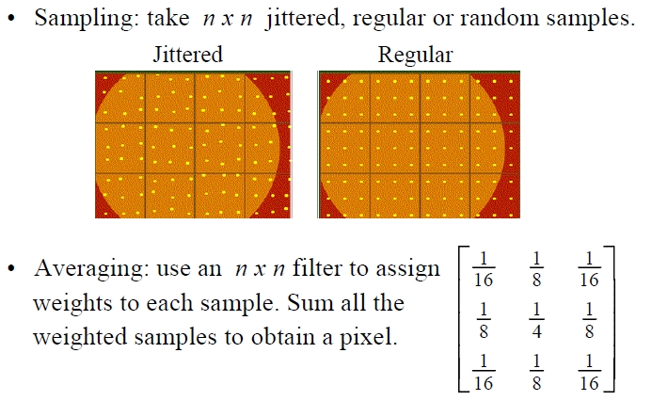
Stochastic Sampling

Slide 19
Thank You

