Slide 1
Tinker Board
tinker your way to the future
Thanjida Akhter
201691489

Slide 2
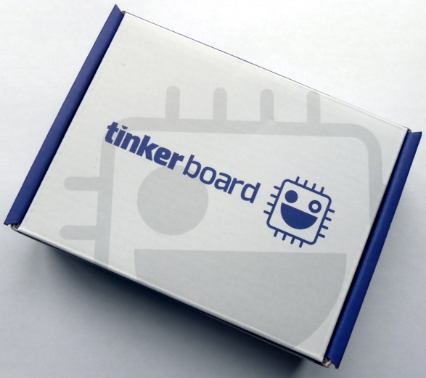
Agenda
History
Features & Functionality
Performance
Operating System
Reference

Slide 3
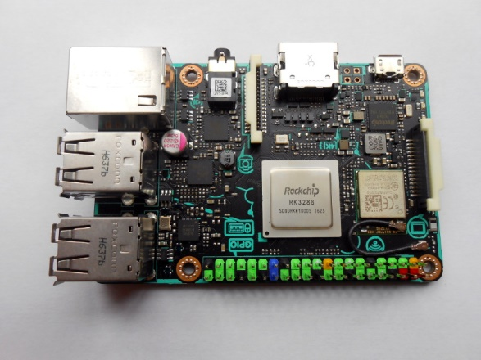
History
Release date : March 13, 2017
Launched : ASUS
Aim : Second-generation and later Raspberry Pi models

Slide 4
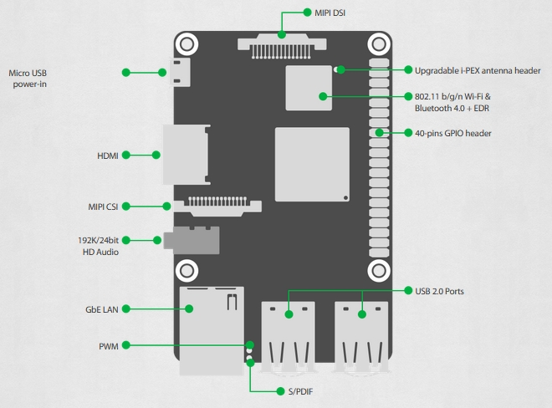
tinker Board
Tinker Board is a Single Board Computer (SBC) in an ultra-small form factor that offers class-leading performance while leveraging outstanding mechanical compatibility
Notes:
Tinker Board is a Single Board Computer (SBC) in an ultra-small form factor that offers class-leading performance while leveraging outstanding mechanical compatibility. The Tinker Board offers makers, IoT enthusiasts, hobbyists, PC DIY enthusiasts and others a reliable and extremely capable platform for building and tinkering ideas into reality.

Slide 5
Features & Functionality
CPU: Rockchip RK3288 - Quad core 1.8 GHz ARM Cortex-A17 (32-bit)
GPU: 600MHz Mali-T764 GPU
RAM: 2GB dual channel LPDDR3
Storage: Removable MicroSD slot ( supporting SD 3.0 )
Display Output: Full size HDMI 1.4
Audio port: 3.5 mm audio jack ( supporting line out and microphone in )
Audio Playback: 192k/24bit sample rate
GPIO: 40-pin header with 28 GPIO pins
Ethernet: Gigabit LAN ( not shared with USB bus )
Wireless: Bluetooth 4.0, 802.11 b/g/n Wi-Fi, with IPEX antenna header
USB: four USB 2.0 ports
Video input: MIPI-CSI camera
Video output: MIPI-DSI, compatible with the Raspberry Pi 7" display and others
Power input: Micro-USB
Operating System: TinkerOS is a Debian Linux derivative & Android 6.01

Slide 6
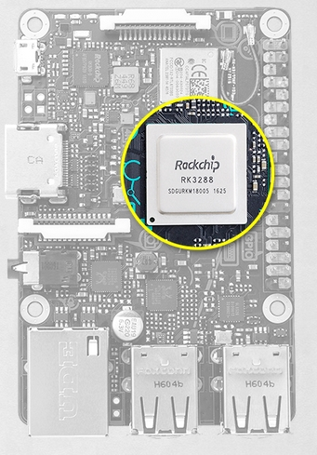
CPU Performance & Functionality
Powerful and modern quad-core ARM-based processor
Rockchip RK3288
2GB of LPDDR3 dual-channel memory
SD 3.0 interface that offers significantly faster read and write speeds to expandable microSD cards used for the OS, applications and file storage
Notes:
Class Leading Performance:
Using a powerful and modern quad-core ARM-based processor, the Rockchip RK3288, the Tinker Board offers significantly improved performance versus other popular SBC boards. Realizing the growing demands of different builds and projects, the Tinker Board features 2GB of LPDDR3 dual-channel memory. Tinker Board is also equipped with an SD 3.0 interface that offers significantly faster read and write speeds to expandable microSD cards used for the OS, applications and file storage.

Slide 7
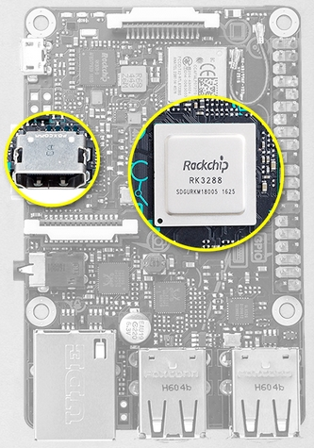
GPU Performance & Functionality
Supports next-generation graphics and GPU Compute API's
Powered by an ARM-based Mali™-T764 GPU
GPU and fixed function processors allow for a wide range of uses
High-quality media playback
Gaming
Computer vision
Gesture recognition
Image stabilization and processing
Computational photography
Notes:
Robust GPU Performance & Functionality:
Featuring a powerful but energy-efficient design, the Tinker Board supports next-generation graphics and GPU Compute API's. Powered by an ARM-based Mali™-T764 GPU, the Tinker Board's GPU and fixed function processors allow for a wide range of uses, including high-quality media playback, gaming, computer vision, gesture recognition, image stabilization and processing, as well as computational photography and more. Multimedia enthusiasts will appreciate the fixed-function H.264 and H.265 playback support, including playback of HD and UHD video*.
*HD & UHD video playback at 30 fps is currently only possible via the Rockchip video player, which is limited to support under TinkerOS. Currently, third-party video players and applications may not offer hardware acceleration and may likewise offer limited playback performance and/or stability. Please refer to the FAQs for more information.

Slide 8
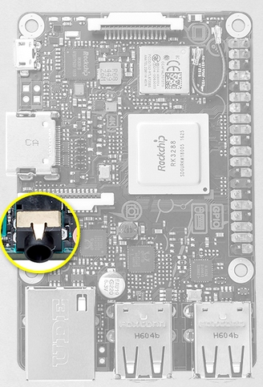
HD Audio Quality
HD codec that supports up to 192kHz/24-bit audio
The audio jack can support both audio output and a microphone in, without an extension module.
Notes:
HD Audio Quality:
Further improving on key areas found lacking on many SBC boards, Tinker Board is equipped with an HD codec that supports up to 192kHz/24-bit audio. The audio jack can support both audio output and a microphone in, without an extension module.

Slide 9
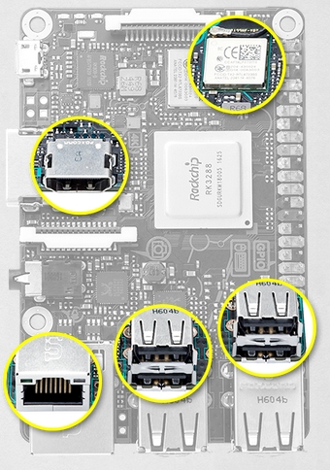
I/o Connectivity
40-pin GPIO interface
Two HD MIPI connections
HD displays
HD cameras
Gbit LAN connectivity
Superior throughput
Perfect for network centric
LAN storage applications.
LAN port receives dedicated
Bus resource
Ethernet performance throughout
Wi-Fi and Bluetooth controller are shielded with metal cover, ensuring minimal interference and improved radio performance
Full-size HDMI output for connection
TVs
Monitors
HDMI-enabled displays
Four USB 2.0 ports
Notes:
Maker-Friendly, with IoT Connectivity
Tinker Board features standard maker and hobbyist connectivity options, including a 40-pin GPIO interface. Additionally, it also equipped with two HD MIPI connections, allowing for HD displays and HD cameras. The Tinker Board also features Gbit LAN connectivity, offering superior throughput, perfect for network centric and LAN storage applications. Moreover, the LAN port on the Tinker Board receives dedicated bus resource, ensuring consistent Ethernet performance throughout. The integrated Wi-Fi and Bluetooth controller are shielded with metal cover, ensuring minimal interference and improved radio performance. There is also IPEX antenna header for upgrades. Rounding out its connection options, Tinker Board also features a full-size HDMI output for connection to TVs, monitors and other HDMI-enabled displays, as well as four USB 2.0 ports for extensive peripheral and accessory connectivity.

Slide 10
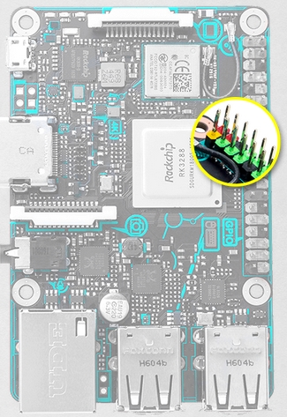
DIY Design
Visibility and clarity of the color-coded GPIO header that allows for quick and easy recognition of respective pin headers.
The PCB dimensions and topology are also in line with the standard SBC boards
Wide range of chassis
Physical accessories
The PCB also features silk-screening with connection header and location callouts, for improved connection clarity
MIPI headers also feature contrasting colored pull tabs
Heat sink, which helps improve heat dissipation under heavy loading or in hot ambient environments
Notes:
Enhanced DIY Design
Careful consideration went into the design and development of the Tinker Board to provide a superior end user experience for first-time builders or experienced hobbyists. Makers will appreciate the improved visibility and clarity of the color-coded GPIO header that allows for quick and easy recognition of respective pin headers. The PCB dimensions and topology of the Tinker Board are also in line with the standard SBC boards, allowing support for a wide range of chassis and physical accessories. The PCB also features silk-screening with connection header and location callouts, for improved connection clarity. Onboard MIPI headers also feature contrasting colored pull tabs. Finally, the Tinker Board also includes a heatsink, which helps improve heat dissipation under heavy loading or in hot ambient environments.

Slide 11
Performance

Slide 12
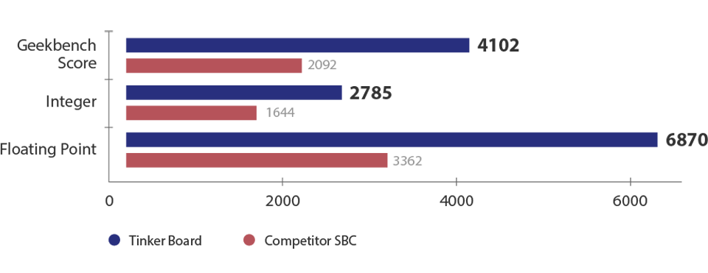
CPU Performance
Enhance multithread application performance.
It operates at frequencies of up to 1.8GHz
Improving performance across all applications.
Increase in CPU core count, along with an increase in processor frequency, helps to enable significantly faster performance in a wide range of applications, extending and enhancing project capabilities.
As a result, typical PC tasks are faster and more responsive.
Notes:
CPU Performance
Tinker Board features an ARM-based RK3288 SoC and is equipped with 4 cores to enhance multithread application performance. It operates at frequencies of up to 1.8GHz, improving performance across all applications. This increase in CPU core count, along with an increase in processor frequency, helps to enable significantly faster performance in a wide range of applications, extending and enhancing project capabilities. As a result, typical PC tasks are faster and more responsive.

Slide 13
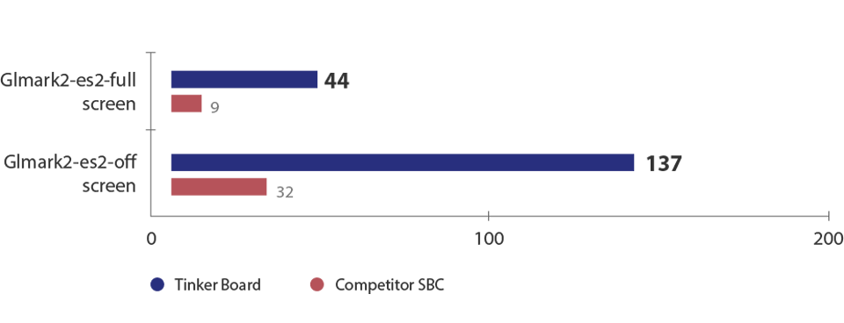
GPU Performance
GPU is based on the Mali™-T764 GPU
It offers up 16 cores and a 600MHz clock speed.
Notes:
GPU Performance
Tinker Board's GPU is based on the Mali™-T764 GPU. It offers up 16 cores and a 600MHz clock speed. When compared to competitor SBC GPU, Tinker Board offers better GPU computing and GPU acceleration performance.

Slide 14
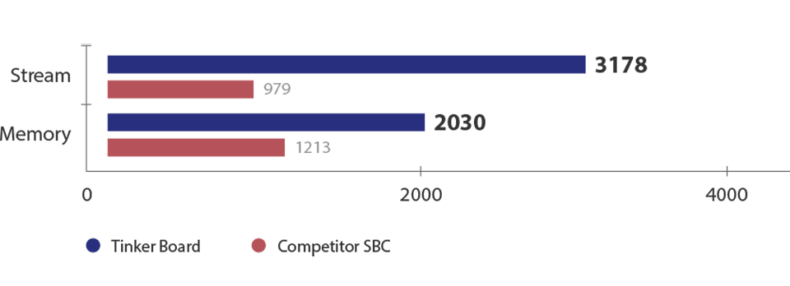
Stream and Memory Performance
Dual-channel DDR3 which delivers better memory bandwidth versus competitor devices that offer only a single-channel DDR2.
Notes:
Stream and Memory Performance
Tinker Board offers dual-channel DDR3 which delivers better memory bandwidth versus competitor devices that offer only a single-channel DDR2.

Slide 15
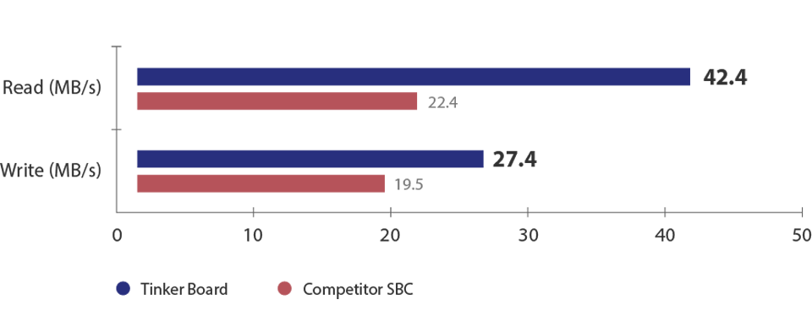
SD Card Read/Write Speed
SD 3.0 specification support, allowing for microSD card compatibility and significantly faster performance
Faster SD Card performance makes it a preferred solution for everyday computing or for application installation, file access and backup.
Read speeds: up to 89% faster
Write speeds: up to 40% faster
Notes:
SD Card Read/Write Speed
Tinker Board features SD 3.0 specification support, allowing for microSD card compatibility and significantly faster performance. Faster SD Card performance makes it a preferred solution for everyday computing or for application installation, file access and backup. ．Read speeds: up to 89% faster ．Write speeds: up to 40% faster

Slide 16
Network/Audio Specifications
Specification | Wi-Fi | Audio Format / Sample Rate | Audio Function
Tinker Board | 802.11 b/g/n with upgradable IPEX antenna | Play: 24bit/192KHz, Record: 24bit/96KHz | Audio output, Microphone input
Competitor SBC | 802.11 b/g/n | 16bit/48KHz | Audio output only

Slide 17
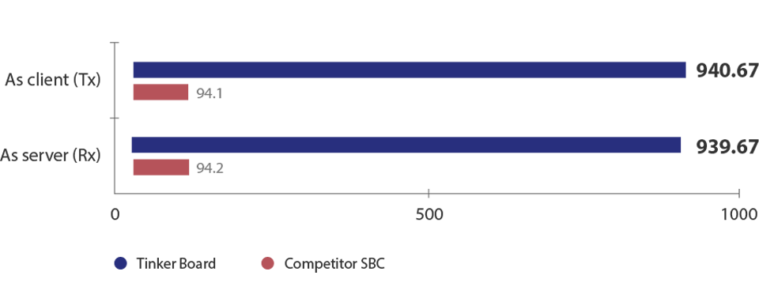
Networks Performance
Gigabit Ethernet, which offers significantly improved throughput versus competitor SBC that are equipped with 10/100 Ethernet.
Transfer/Receive speeds

Slide 18
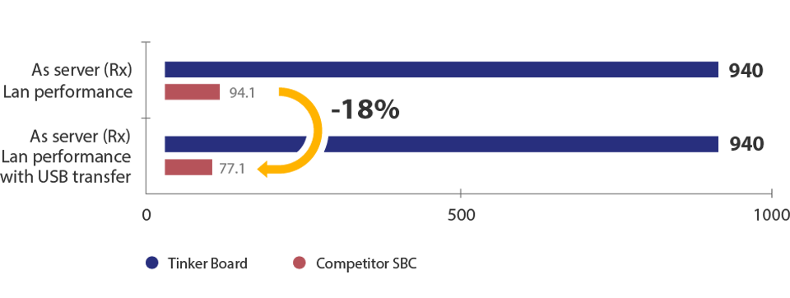
LAN performance with USB transfer
Controller and non-shared bus design ensure superior packet delivery and reception
LAN performance remains the same on the Tinker Board during USB transfers versus LAN performance of competitor SBC which experience up to an 18% drop during USB transfer.

Slide 19
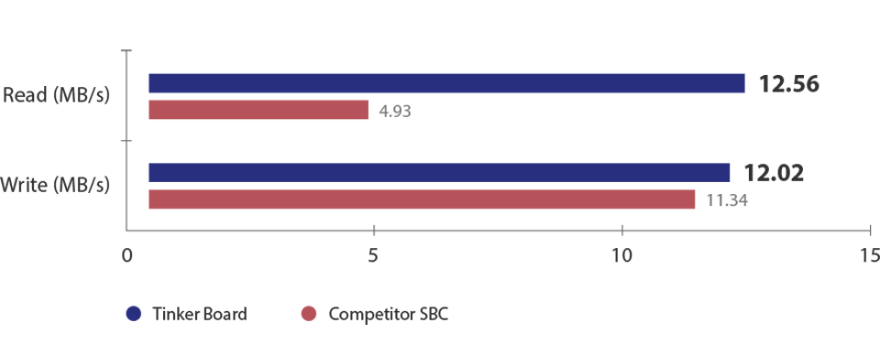
USB Speed
Tinker Board offers superior read and write performance with external storage drives, allowing quicker read and write speeds.
This improves workflow, copying, backups and overall file usage
Read speeds: up to 154% faster
Write speeds: up to 6% faster

Slide 20
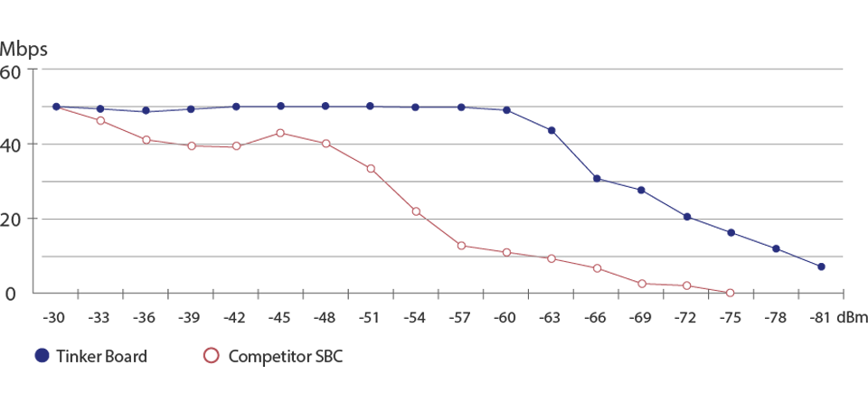
Wi-Fi Performance
Tinker Board Wi-Fi performance is more robust than what is available in most competitor devices, allowing for improved signal reception
Location: OctoScope platform Target AP: ASUS RT-AC66U (Broadcom) | Standard: b/g/n mixed Channel: 6 Bandwidth: 20MHz Security: none

Slide 21
Operating System
Linux
Windows
Android 6.01

Slide 22
Reference
https://www.asus.com/ca-en/Single-Board-Computer/Tinker-Board/
https://en.wikipedia.org/wiki/Asus_Tinker_Board
http://hackaday.com/2017/02/15/review-the-asus-tinker-board/

Slide 23


