Slide 1

Department of Computer Science & Engineering Course Title: Theory of computing Course Code: CSE221 Thanjida Akhter(102-15-1030)

Slide 2
Topic Enumerators or Enumerations or Enum

Slide 3
Turing Machine: A Turing machine is a kind of state machine. At any time the machine is in any one of a finite number of states.

Slide 4
Enumerators: >>> An enumerator is a variant of a TM with an attached printer or an output tape. >>>Some people use the term recursively enumerable language for languages recognized by enumerators.

Slide 5
Example:

Slide 6
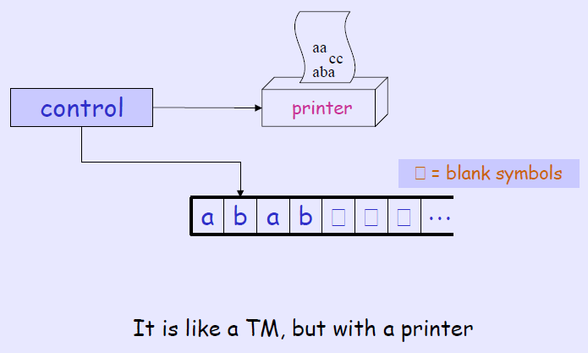
>>>Whenever the TM wants to print something, I sends the string to the printer
>>>If the enumerator does not halt, it may print an infinite list of strings

Slide 7
schematic of an Enumerator >An enumerator starts with a blank input tape >>If the enumerator does not halt it may print an infinite list of strings >>>The language recognized by the enumerator is the collection of strings that it eventually prints out.

Slide 8
Do you know ???

Slide 9
Theorem: Let L be a language, 1.If L is enumerated by some enumerator, there is a TM that recognizes L. 2.If L is recognized by some TM, there is an enumerator that enumerates L.

Slide 10
Implementation of ENUM: 1. E-mail 2. Voice Mail 3. Fax Machines 4. Telephone 5. Web homepage

Slide 11
What ENUM does not do: 1. Each one of these services can be handled by separate contracts between customer and service provider, e.g. phone, mobile, email, . . . 2. ENUM is not about telecom bypass. 3.ENUM does not change the Numbering Plan.

Slide 12
END

