Slide 1
Machine Learning for Osteoarthritis(OA)
Classification and Metabolic Marker Identification
Thanjida Akhter
M.Sc. Candidate
Supervisor: Dr. Ting Hu

Slide 2
Abstract
Machine Learning explores the study and construction of algorithms that can learn from and make predictions on data and analyze feature importance. Osteoarthritis (OA) is a heterogeneous disease with various pathogenic factors and a most common form of arthritis. OA has significant metabolic background. If we can find the Important metabolites, then we can predict the disease. Three Machine Learning algorithms were used in this project to detect the most important metabolites related to OA, including Random Forest, Gradient Boosting Machine (GBM) and K-Nearest Neighbors (k-NN). Twenty metabolites were identified as the most relevant to the disease of OA by all three algorithms

Slide 3
CONTENTS
Introduction
Methods
Result
Conclusion
Future work
Discussion

Slide 4

Machine Learning
Unsupervised learning
Supervised learning
Classification
Regression
Notes:
Statistical techniques to give computer systems the ability to "learn" with data, without being explicitly programmed
optimize classification of samples or features, also develop models that can be used to predict behavior or properties of systems
Supervised--example inputs and their desired outputs
Classification=process of mapping input data to a discrete output
Regression=process of mapping input data to a continuous output variable

Slide 5
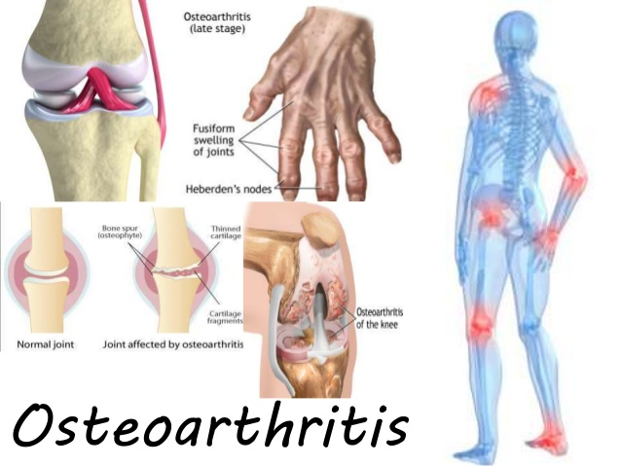
Notes:
Osteoarthritis (OA) is a heterogeneous disease
OA is the most common form of arthritis
affecting about 10% of the world's population aged 60 years or older
joint pain and disability
hypertension, type-2 diabetes and dyslipidemia
joint replacement for end-stage disease

Slide 6
Metabolic
Metabolism
Metabolite
Notes:
metabolism- The process maintain the living state of a cell or an organism
Metabolic -connection from the metabolism of a living organism
Metabolite - a substance that is a product of metabolic action.

Slide 7
Application Platform
Algorithms
Library
Data analysis
METHODS

Slide 8



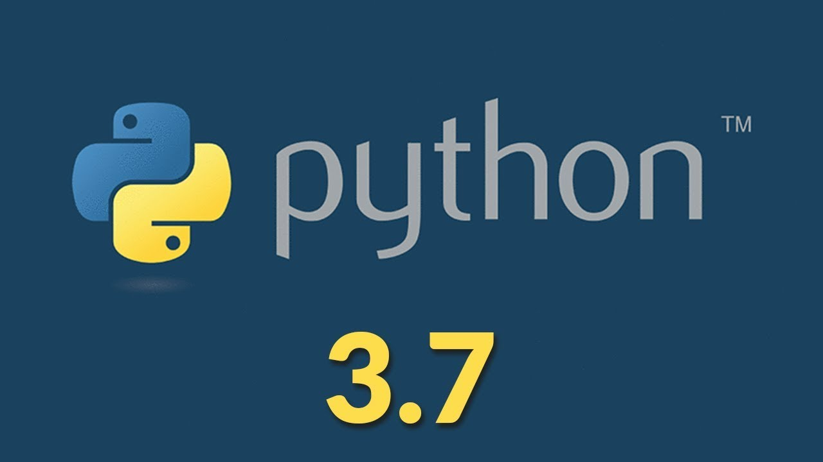
Application Platform

Slide 9
algorithms
Random Forest
Gradient Boosting Machine (GBM)
K-Nearest Neighbors(k-NN)

Slide 10




Library
Notes:
SK-. It features various classification, regression and clustering algorithms including support vector machines, random forests, gradient boosting, k- means and DBSCAN, and is designed to interoperate with the Python numerical and scientific libraries NumPy and SciPy
Panda-data manipulation and analysis
Numpy-adding support for large, multi-dimensional arrays and matrices
matplotlib numerical mathematics extension NumPy It provides plots into applications

Slide 11
Data analysis
A
B
C
D

Slide 12
Accuracy of algorithms
Metabolites from each algorithms
Most Important metabolites
RESULT

Slide 13
Accuracy of algorithms
 | Algorithms Name | Train Accuracy (%) | Test Accuracy (%)
1 | Random Forest | 100% | 89.00%
 | Gradient Boosting | 100% | 92.10%
 | KNN Model | 92.86% | 86.60%
2 | Random Forest | 100% | 89.04%
 | Gradient Boosting | 100% | 91.78%
 | KNN Model | 87.63% | 83.22%
3 | Random Forest | 98.97% | 91.78%
 | Gradient Boosting | 100% | 90.07%
 | KNN Model | 92.78% | 85.62%
4 | Random Forest | 100% | 88.36%
 | Gradient Boosting | 100% | 89.04%
 | KNN Model | 88.66% | 81.16%

Slide 14
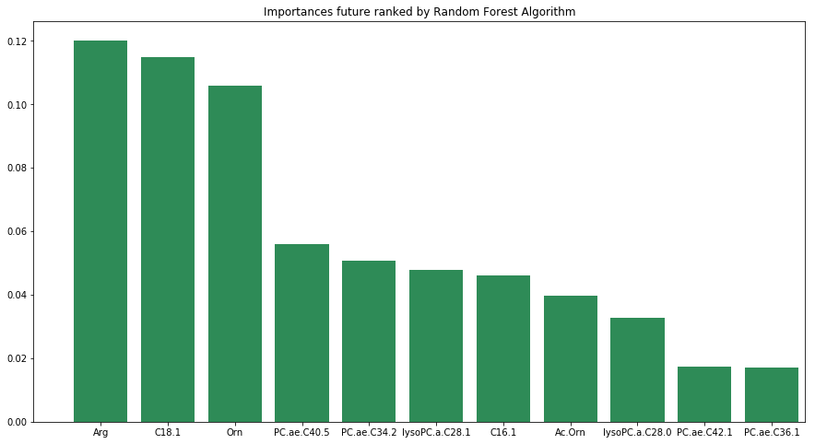
Important metabolites ranked by
Random Forest

Slide 15
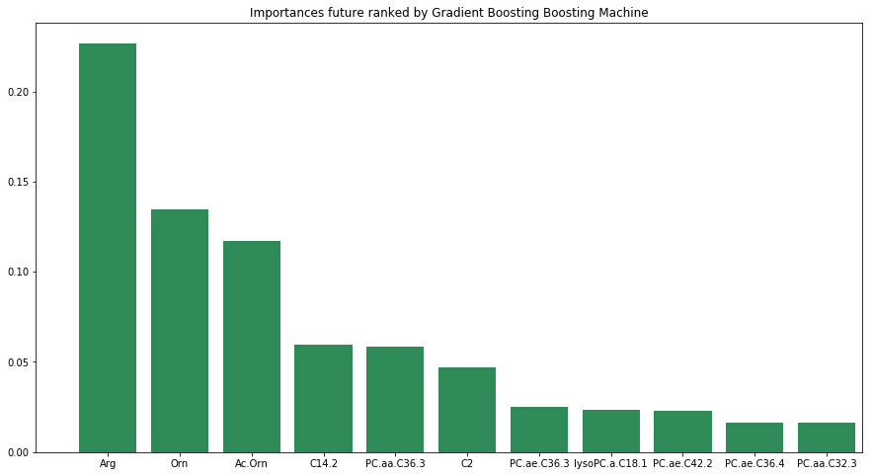
Important metabolites ranked by GBM

Slide 16
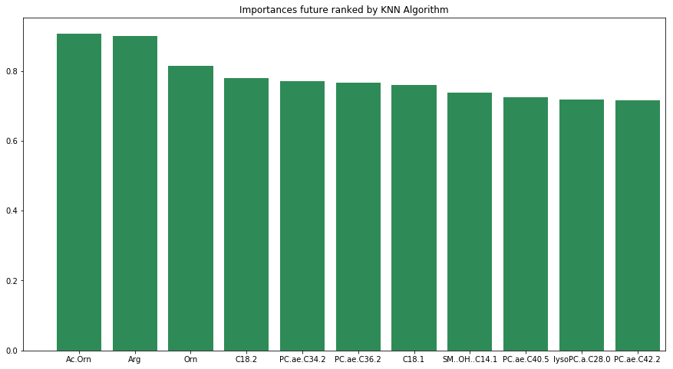
Important metabolites ranked by KNN

Slide 17
All Important metabolites
 | Random Forest | GBM | K-NN
1 | Arg | Arg | Ac. Orn
2 | C18.1 | Orn | Arg
3 | Orn | Ac. Orn | Orn
4 | PC.ae.C40.5 | PC.aa.C36.3 | C18.2
5 | PC.ae.C34.2 | C14.2 | PC.ae.C34.2
6 | lysoPC.a.C28.1 | C2 | PC.ae.C36.2
7 | C16.1 | PC.ae.C36.3 | C18.1
8 | Ac. Orn | lysoPC.a.C18.1 | SM..OH.C14.1
9 | lysoPC.a.C28.0 | PC.ae.C42.2 | PC.ae.C40.5
10 | PC.ae.C42.1 | C16.1 | lysoPC.a.C28.0
11 | PC.ae.C36.1 | PC.ae.C36.1 | PC.ae.C42.2

Slide 18
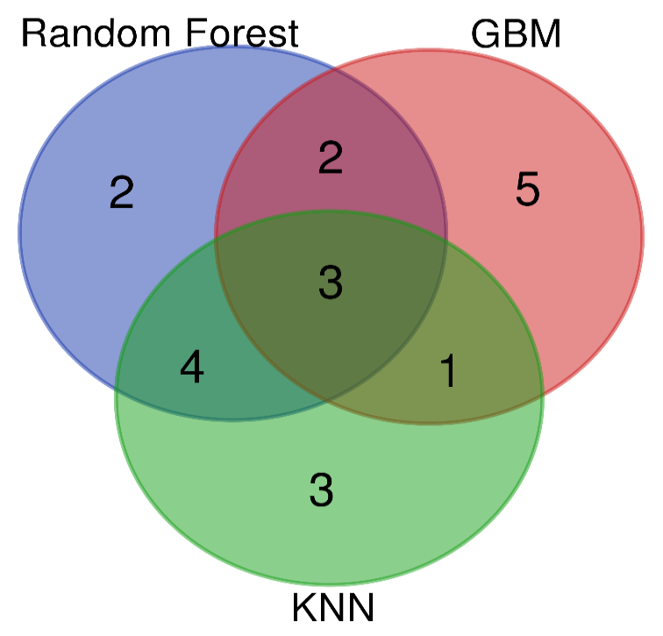
DISCUSSION

Slide 19
DISCUSSION
CONCLUSION
Algorithms Name | Total | Metabolites
Random Forest, GBM &KNN | 3 | Orn, Arg, Ac.Orn
Random Forest & GBM | 2 | C16.1, PC.ae.C36.1
Random Forest & KNN | 4 | lysoPC.a.C28.0, C18.1, PC.ae.C40.5, PC.ae.C34.2
GBM & KNN | 1 | PC.ae.C42.2
Random Forest | 2 | lysoPC.a.C28.1, PC.ae.C42.1
GBM | 5 | lysoPC.a.C18.1, C2, C14.2, PC.ae.C36.3, PC.aa.C36.3
KNN | 3 | PC.ae.C36.2, C18.2, SM..OH..C14.1

Slide 20
FUTURE WORK

Slide 21

thanks for your attention

