Slide 1
Integrated Class Routine Information and Management System
Thanjida Akhter
ID: 102-15-1030
Dr. Syed Akhter Hossain
Professor and Head
Department of CSE
Daffodil International University
Sunday 11 May, 2014

Slide 2
Agenda
Introduction
Objectives
Routine Management System
Features
Tools Used to Develop
ER Diagram
Use Case Model
System Overview
Conclusion
Future Work
References

Slide 3
Introduction
Integrated Class Routine Information and Management System is
an interactive online management system to manage Routine Information System
a way to share timely updates of a routine
a way to get full Routine or some defined part of a routine

Slide 4
Objectives
Upload, update and create Routine on the web
Search a Routine based on department, course code, semester, classroom, teacher initial, level, term and day.
Book a room Temporarily
Find Updated Routine at any time

Slide 5
Routine Management System
Most essential part of an educational system
Everything proceeds depending on it

Slide 6
Features
Upload CSV file of a Routine to create a routine on the web
Search a routine full or partial
Book a room temporarily
Print a defined routine
Manage Classroom, Department, Teacher and Course
Manage User and their authorization

Slide 7
Tools used to develop
Asp. Net Mvc3 architecture
MSSQL
CSS
HTML Razor Syntax
Java Script
Ajax

Slide 8
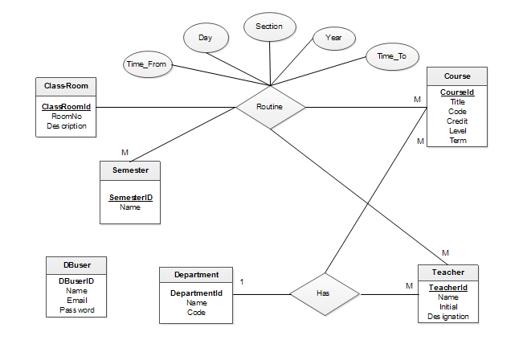
ER Diagram

Slide 9
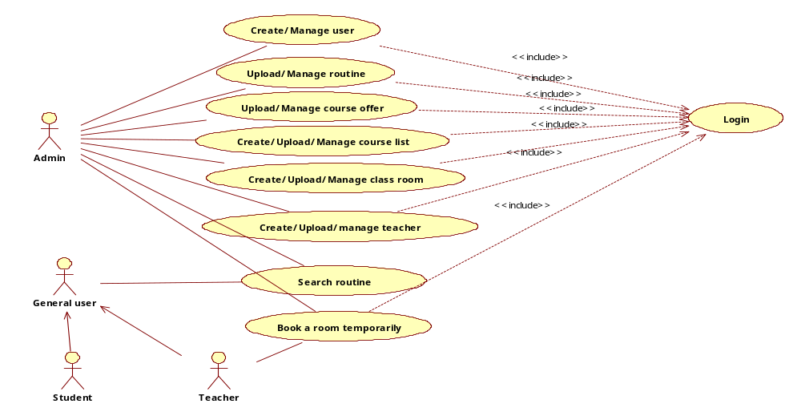
Use Case Model

Slide 10
System Overview

Slide 11


Slide 12
Conclusion
Integrated Class Routine Information and Management System has been designed to give all sorts of flexibility to all kinds of user those who are related to Routine Management.
It has been designed to share the timely updates of a routine more easily and effectively.
With these teachers can also control make up classes more easily then ever.
We hope that Integrated Class Routine Information and Management System will be a helpful website for all administrative persons, teachers and students in case of getting all the essential information about a semester’s routine.

Slide 13
Future Scope
There are many scopes for this project in the future. Some of them are
In the future this project will be integrated with the University’s Social web System.
MySql database will be used as the back end database.
In addition of this system a Mobile application will be developed for only search option.
Enhancing the capability and usability
Upgrade functionality according to user feedback
Applying genetic algorithm to generate routine automatically

Slide 14
References
[1] Microsoft Developer network. library. [Online]. Available: http://msdn.microsoft.com/library
[Las Modified: 18 April 2014, 02:47pm]
[2] stackoverflow.asp.net.mvc[Online]. Available:http://stackoverflow.com/questions/tagged/asp.net-mvc
[Las Modified: 14 April 2014, 01:47am]
[3] codeproject.C#.[Online]. Available http://www.codeproject.com/?cat=3
[Las Modified: 17 April 2014, 12:47pm]
[4] codeproject..NET.[Online]. Available http://www.codeproject.com/?cat=24
[Las Modified: 26April 2014, 10:10am]
[5]Microsoft.ASP.NET. Membership and Authorization.[Online]
Available:http://www.asp.net/mvc/tutorials/mvc-music-store/mvc-music-store-part-7
[Las Modified: 20April 2014, 9:10pm]
[6] codeplex. ASP.NET MVC3 Site Template.[Online]. Available:http://mvc3sitetemplate.codeplex.com/[Las Modified: 28April 2014, 12:10am]

Slide 15
Thank You

