Slide 1


Department of Computer Science & Engineering Course Title : Statistics Course Code : MAT223

Slide 2
Presented by Thanjida Akhter ID:102-15-1030

Slide 3
Topic How can uses statistics in CSE

Slide 4
What is statistics? Statistics: The science of collecting, organizing, presenting, analyzing and interpreting data to assist in making more effective decisions. Or Statistics is a collection of numerical information

Slide 5
What is the importance of statistics to computer science? Computer sciences also deals with organization and interpretation of numerical facts. In fact most of the principles of computer sciences are based on concepts of statistics.

Slide 6




Statistical analysis is used in web search engine:

Slide 7
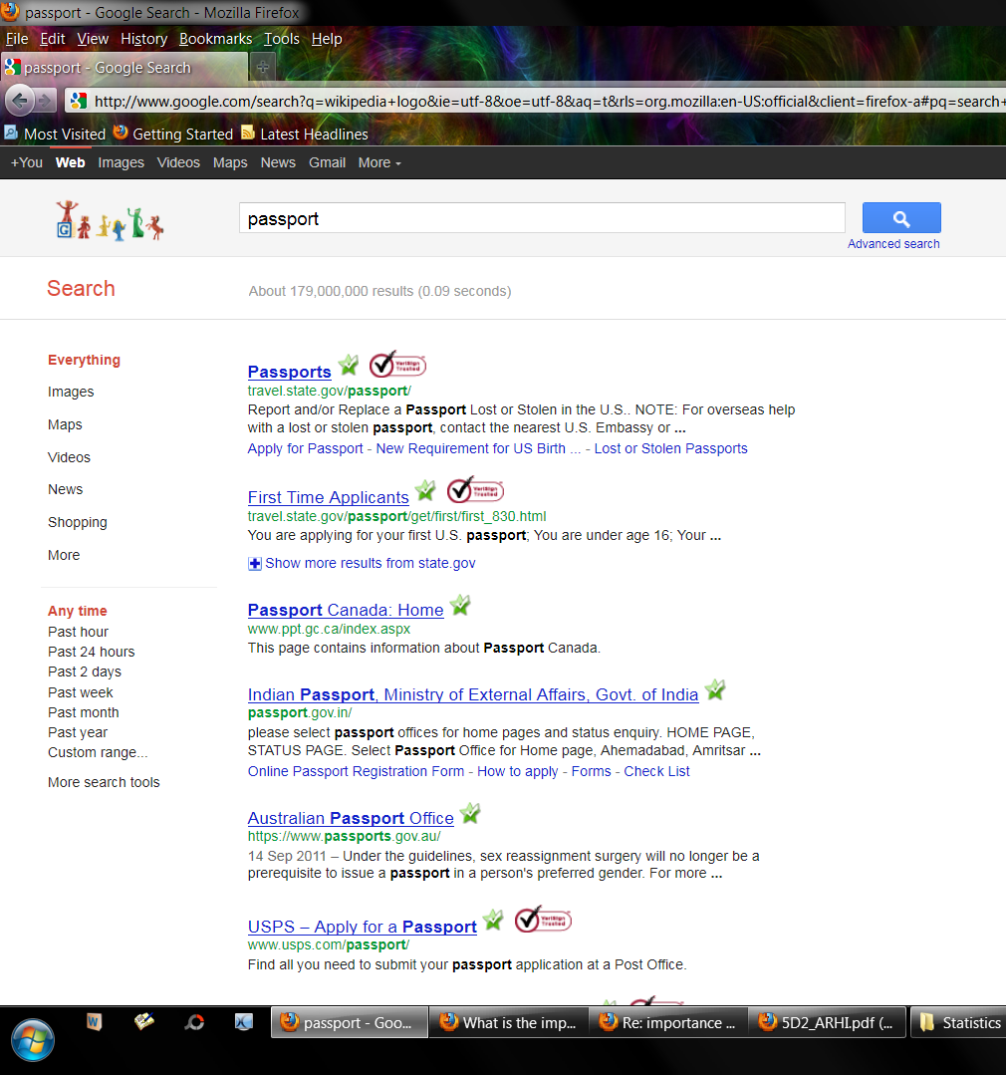
Example:

Slide 8

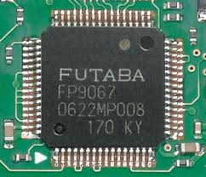
IC & CHIP 1.To determine the average life span of a chip 2.To determine the failure rate of a chip 3.To determine the overall reliability of an equipment

Slide 9

Artificial Intelligence:

Slide 10


Statistical data: 1.Antiivirus programs for heuristic analysis. 2.IP traffic routing. 3.Routing policy determining.

Slide 11
END

