Slide 1


Course Title: Communication Engineering
Course Code : CSE411
Topic : Wi-Fi
Thanjida Akhter : 102-15-1030

Slide 2
What is Wi-Fi
Short for wireless fidelity
The standard for wireless local area networks (WLANs)
Or
IEEE 802.11 Standard
By Greg Goldman

Slide 3
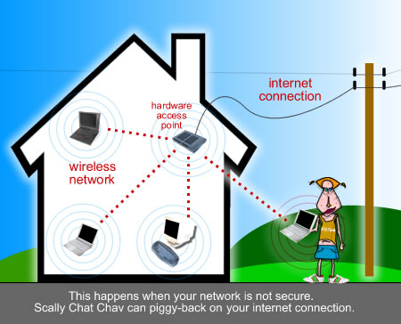
How connect
Connect computers anywhere in your home or office without the need for wires. The computers connect to the network using radio signals, and computers can be up to 100 feet or so apart.

Slide 4
Wi-Fi Alliance
Non-profit standards organization.
Global organization that created the Wi-Fi brand name.
Formerly the Wireless Ethernet Compatibility Alliance.

Slide 5


Wi-Fi Certification
The Wi-Fi CERTIFIED logo from the Wi-Fi Alliance.
Rigorous interoperability testing requirements.
Certifies the interoperability of 802.11 products from the many different vendors.

Slide 6
What is the goal of 802.11 standard ?
Develop a Medium Access Control (MAC) and Physical Layer (PHY)
Specification for wireless connectivity for fixed, portable and moving stations within a local area.

Slide 7
802.11 sub-standards(amendments )
802.11 MAC (Media Access Control) ratified 1999
802.11b PHY 2.4 GHz (max 11 Mbps) ratified 1999
802.11a PHY 5.0 GHz (max 54 Mbps) ratified 1999
802.11g PHY 2.0 GHz (max 54 Mbps) ratified 2003
802.11i Security draft number XXX
802.11e QoS, Multimedia draft number XXX
802.11h European regulations for 5GHz draft number XXX
802.11h Japan regulations for 5GHz draft number XXX

Slide 8
802.11 Station Types
No transition
BSS transition
ESS Transition Mobility

Slide 9
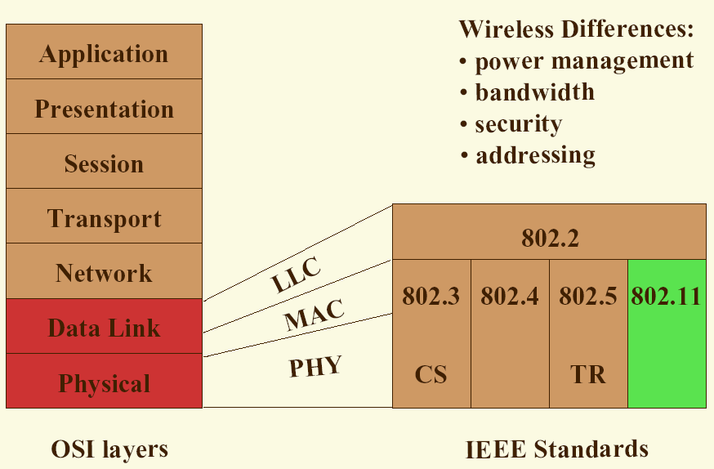
Context with OSI layers

Slide 10
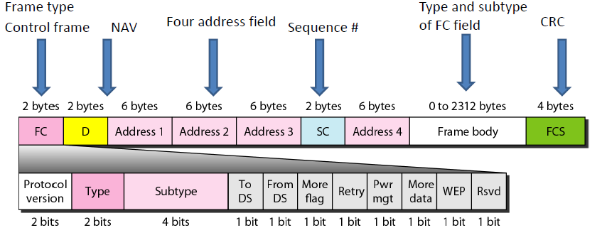
Standard 802.11 frame format

Slide 11
Frames types and subtypes
Three types of frames:
1.Control
(ACK, RTS, CTS, Power Save …)
2.Management
(Beacon, Probe Request, Probe Response,
Association request, Association response …)
3.Data
(Data, Null Data, Data_CF_Ack , ….)

Slide 12
802.11 MAC Infrastructure Model
BSS2
Stations (STA)
any wireless device
Access Point (AP)
connects BSS to DS
controls access by STA’s
Basic Service Set (BSS)
a region controlled by an AP
mobility is supported within a single BSS
Extended Service Set (ESS)
a set of BSS’s forming a virtual BSS
mobility is supported between BSS’s in an ESS
Distribution Service (DS)
connection between BSS’s
ESS1
DS
AP2
AP3
STA1
AP1
STA3
BSS3
BSS1
STA2

Slide 13
Ad hoc network models
Ad Hoc Model includes:
Stations (STA)
any wireless device
act as distributed AP
Independent Basic Service Set (IBSS)
BSS forming a self contained network
no AP and no connection to the DS
STA1
STA3
STA2
BSS

Slide 14
Two types of access to air
DCF (distributed coordination function):
Uses CSMA/CA for Access Method
Can’t use CSMA/CD for three reason:
–Costly equipments
–Hidden Station
–Signal Fading –distance
PCF (point coordination function) means ONE point coordinator (BOSS) who will allowed you to speak (like in Bluetooth)

Slide 15
Summary of required features and difficulties vs 802.11 features
Features
High speed operation (PHY only)
Fair access (DCF, PCF)
Time-bounded access (PCF)
Flexible configuration (BSS, IBSS)
Security (WEP)
Mobility support (ESS)
Low power (PS)
Difficulties
Hidden terminals (RTS/CTS)
Capture (CSMA/CA, ACK)
Noise and interference (ACK, frag)
Limited spectrum (licencing, PHYs)

Slide 16
Why do we need 11A/11B/11G ?
11A: 5.0 GHz , OFDM modulation
Rates from 6 to 56 Mbps , on market from 2002
Advantages of 5.0 GHz PHY:
Less devices on the market (no microwave, no blue tooth …)
8 not-overlapped channels
11B: 2.4 GHz , CCK modulation
Rates from 1 to 11Mbps , on market from 1999
Advantages of 2.4 GHz PHY:
Low frequency, better wall penetration, less sensitive to multipath
3 not-overlapped channels
11G: 2.4 GHz, CCK+OFDM modulation
Rates from 6 to 56 Mbps, on market from 2003 and most popular today

Slide 17
Advantages
Freedom – You can work from any location that you can get a signal.
Setup Cost – No cabling required.
Flexibility – Quick and easy to setup in temp or permanent space.
Scalable – Can be expanded with growth.
Mobile Access – Can access the network on the move.

Slide 18
Disadvantages
Speed – Slower than cable.
Range – Affected by various medium.
-Travels best through open space.
-Reduced by walls, glass, water, etc
Security – Greater exposure to risks.
-Unauthorized access.
-Compromising data.
-Denial of service.

Slide 19
Thank You

