Slide 1
MACHINE LEARNING x E-COMMERCE
711K
Pricing
Strategy Recommender
Products Analysed
94%
A Two-Stage ML Pipeline for Supply-Side Pricing Intelligence
Model Accuracy
300+
Categories
Takwa Bennjima & Yahya Mabrouk - AY 2026 / 2027

Slide 2
01 - THE SPARK
Why AI in E-Commerce?
Our starting point: e-commerce is drowning in data, yet most sellers price by gut feeling.
$6T+
ML
DATA
E-Commerce Explosion
AI as the Differentiator
Data-Driven Opportunity
Global e-commerce surpassed $6 trillion in 2024. Competition is intense -- pricing decisions are make-or-break.
ML models can process millions of product signals simultaneously -- something no human analyst can replicate.
Platforms like AliExpress expose rich structured data: prices, ratings, sales, discounts -- a goldmine for ML.
-> We asked: can ML tell sellers not just WHAT to price, but HOW to price?

Slide 3
02 - THE DATA
The Dataset That Inspired Everything
We did not start with a model in mind. We found the AliExpress dataset first -- and the data told us what to build.
711,168
What the Data Revealed
Raw product listings
> Massive variance in pricing across similar products
300+
Product categories
> Sellers cluster into natural behavioural groups
84%
Products with discounts
> Rating & discount patterns strongly predict sales
16
Engineered features
> No existing tool helps sellers choose a strategy
-> The gaps in the data defined our research question.

Slide 4
03 - THE PROBLEM
The Pricing Strategy Gap
55%
No
0
of products underperform
clear strategic guide
dedicated tools for sellers
Despite competitive prices, most AliExpress listings fail to generate meaningful sales volume.
Pricing tools focus on consumer-side demand. Supply-side strategy recommendations simply do not exist.
Sellers cannot tell which pricing approach -- heavy discount vs premium -- works best in their category.
Research Question:
"What pricing strategies do sellers adopt -- and which performs best per product category?"

Slide 5
04 - THE SOLUTION
A Two-Stage ML Pipeline
STAGE 1 - UNSUPERVISED
STAGE 2 - SUPERVISED
K-Means Clustering
Random Forest Classifier
No labels existed -- we used clustering to discover natural pricing archetypes in the data.
Cluster labels become training targets -- model learns to predict strategy for new products.
->
+ K=3 (Elbow + Silhouette methods)
+ 3 candidate models compared
+ Silhouette Score: 0.31
+ 5-fold cross-validation
+ 711,168 products clustered
+ Bayesian hyperparameter tuning
+ Identified 3 pricing personalities
+ 16 engineered features
Cluster labels from Stage 1 are the supervised targets for Stage 2 -- no manual labelling needed.

Slide 6
05 - CLUSTERING RESULTS
3 Pricing Strategy Archetypes
A
B
C
WINNING STRATEGY
AVOID
NEEDS FIX
Smart Discounter
Overpriced Low Performer
Underperformer
Avg Sold
131 units
Avg Sold
7 units
Avg Sold
2 units
Avg Price
46 SAR
Avg Price
1,252 SAR
Avg Price
94 SAR
Rating
4.77 / 5
Rating
1.32 / 5
Rating
0.70 / 5
Share
36.7%
Share
8.2%
Share
55.1%
K-Means - K=3 - Silhouette Score = 0.31 - 711,168 products

Slide 7
06 - MODEL EVALUATION
Metrics, Models & Why We Care
Model Comparison
Why These Metrics?
Model
Accuracy
F1
Accuracy
Logistic Regression
91.71%
91.76%
Overall correctness -- easy to communicate to stakeholders.
F1 Score
XGBoost
93.77%
93.79%
Balances precision & recall -- critical when classes are imbalanced.
Random Forest (Tuned)
94.17%
94.19%
[OK]
AUC-ROC
Measures ranking ability across all thresholds -- more rigorous than accuracy.
5-Fold Cross-Validation
Mean F1 = 93.28% Std = 0.12% -> Stable
Confusion Matrix
Shows which classes are confused -- guides targeted improvements.

Slide 8
07 - KEY FINDINGS
What the Data Reveals
01
02
03
Smart Discounter wins everywhere
Rating is the #1 success driver
18x sales gap between strategies
Wins in 99.3% of all 300+ categories -- the strategy is universal, not category-specific.
Feature importance = 34%. High rating (4.5+) is the single strongest predictor of success.
Smart Discounter averages 131 units sold vs 7 for Overpriced and 2 for Underperformer.
04
05
06
Discounting is the norm
Category barely matters
Free shipping = competitive edge
84% of products are discounted. 50% discount is the most popular tier -- psychological pricing.
category_id has only 2% feature importance -- same strategy works across electronics, fashion, beauty.
Only 30% offer free shipping -- a clear, underutilised differentiation opportunity.

Slide 9
08 - THE PRODUCT
Pricing Strategy Recommender App
INPUT -- What the seller provides
OUTPUT -- What the seller receives
1. Product Category
> Predicted strategy + confidence score
2. Current Price (SAR)
> Recommended discount range (25-50%)
->
3. Customer Rating (0-5)
> Radar chart vs ideal Smart Discounter
4. Shipping: Free or Paid
> 3-step personalised action plan
> Category insights + avg units sold
Built with Streamlit - Model serialised with joblib - Deployable in one command

Slide 10
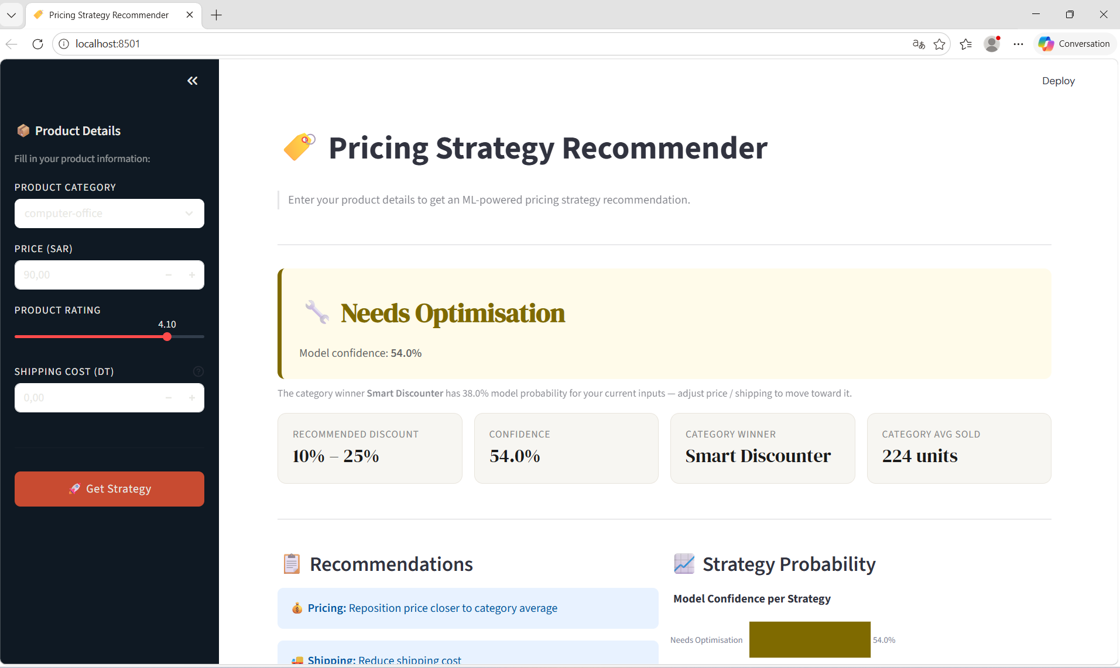
09 - CONCLUSION & Q&A PREP
Takeaways & Anticipated Questions
94.17%
Model Accuracy
93.28%
CV Mean F1
0.12%
CV Std (Stable)
18x
Sales Gap
Smart Discounter wins 99.3% of categories - Rating #1 driver (34%) - 18x more sales

Slide 11
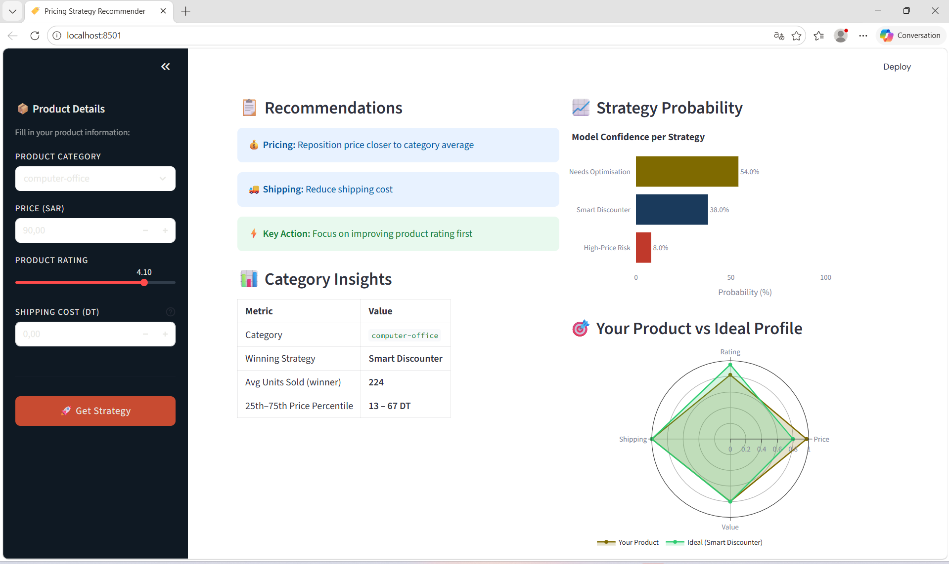

Slide 12
