Slide 1
MACHINE LEARNING X E-COMMERCE
711K
AliExpress Pricing
Products
Strategy Recommender
300+
Categories
A Two-Stage ML Pipeline for Supply-Side Pricing Intelligence
94%
Accuracy
Academic Year : 2025 / 2026
Takwa Bennjima & Yahya Mabrouk

Slide 2
01 — PROBLEM STATEMENT
The Pricing Strategy Gap
🛒
📉
❓
Customer decision bias
55% Underperform
No Clear Guide
Most pricing tools focus on what customers pay, but fail to provide sellers with actionable strategies.
More than half of all AliExpress products fail to sell effectively despite competitive prices.
Sellers can’t tell which pricing approach increases sales in their category.
Research Question:
"What pricing strategies do sellers adopt, and which strategy performs best per product category?"

Slide 3
02 — DATASET & APPROACH
Supply-Side Analysis at Scale
711,168
Two-Stage ML Pipeline
Products after cleaning
Stage 1 · UNSUPERVISED
300+
K-Means Clustering
Product categories
Discover pricing archetypes
84%
Products with discounts
Stage 2 · SUPERVISED
Random Forest
16
Predict best strategy per product
Engineered features

Slide 4
03 — CLUSTERING RESULTS
3 Pricing Strategy Archetypes
K-Means (K=3, Silhouette Score = 0.31) · 711,168 products clustered
🏆
📉
🔧
Smart Discounter
Overpriced
Low Performer
Underperformer
Avg Sold
131 units
Avg Sold
7 units
Avg Sold
2 units
Avg Price
46 SAR
Avg Price
1,252 SAR
Avg Price
94 SAR
Rating
4.77 / 5
Rating
1.32 / 5
Rating
0.70 / 5
Share
36.7%
Share
8.2%
Share
55.1%
WINNING STRATEGY
AVOID
NEEDS FIX

Slide 5
04 — MODEL PERFORMANCE
Classification Results
Model
Accuracy
F1 Score
Logistic Regression
91.71%
91.76%
Random Forest (Tuned)
94.17%
94.19%
✓ SELECTED
XGBoost
93.77%
93.79%
5-Fold Cross Validation:
Mean F1 = 93.28% · Std = 0.12% → Model is STABLE ✅

Slide 6
05 — KEY FINDINGS
What the Data Reveals
01
Smart Discounter wins everywhere
04
18x sales gap between strategies
Wins in 99.3% of all 300+ categories — strategy is universal, not category-specific.
Smart Discounter averages 131 units sold vs 7 for Overpriced Low Performer and 2 for Underperformer.
02
Rating is the #1 success driver
05
Category barely matters
Feature importance = 34%. High rating (4.5+) is the single strongest predictor of strategy success.
category_id has only 2% feature importance — same strategy works across electronics, fashion, beauty.
03
Discounting is the norm
06
Free shipping = competitive edge
84% of products are discounted. 50% discount is the most popular tier — psychological pricing effect.
Only 30% of products offer free shipping — a clear opportunity for differentiation.

Slide 7
06 — CONCLUSION & DEPLOYMENT
From Data to Actionable Strategy
🏷️ Streamlit App
94.17%
93.28%
Pricing Strategy Recommender
Model Accuracy
CV Mean F1
→ Input: Category + Price + Rating + Shipping
→ ML prediction with confidence score
→ Recommended discount range (25–50%)
0.12%
300+
→ Radar chart vs ideal Smart Discounter
→ 3-step personalized action plan
CV Std (Stable)
Categories Covered
→ Category insights + avg units sold
Smart Discounter wins in 99.3% of categories · Rating #1 driver · 18x more sales than Overpriced

Slide 8
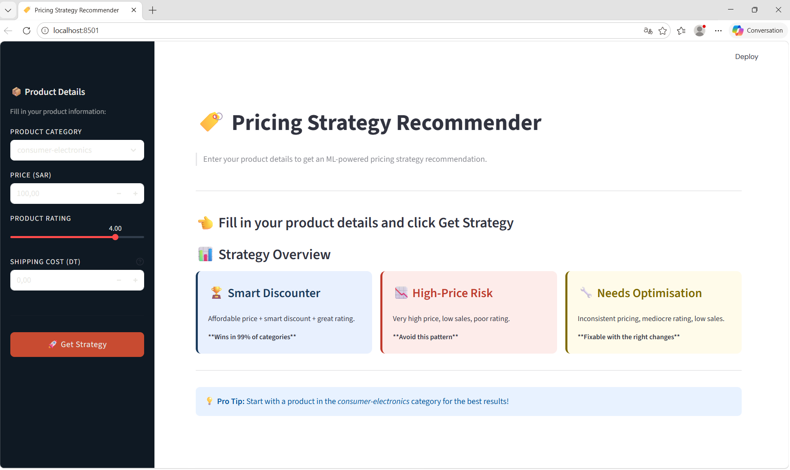

Slide 9
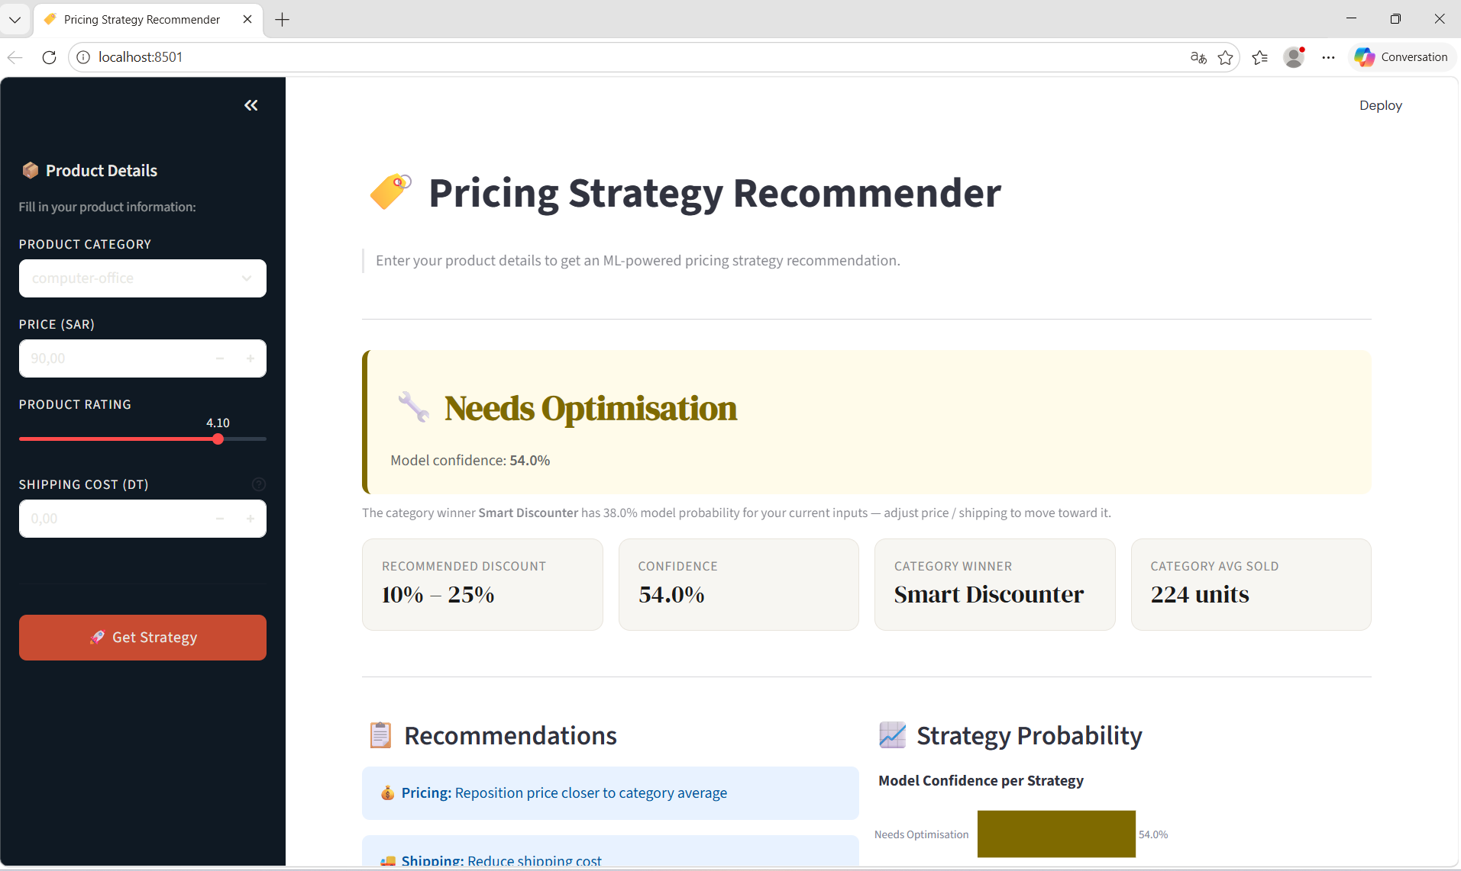

Slide 10
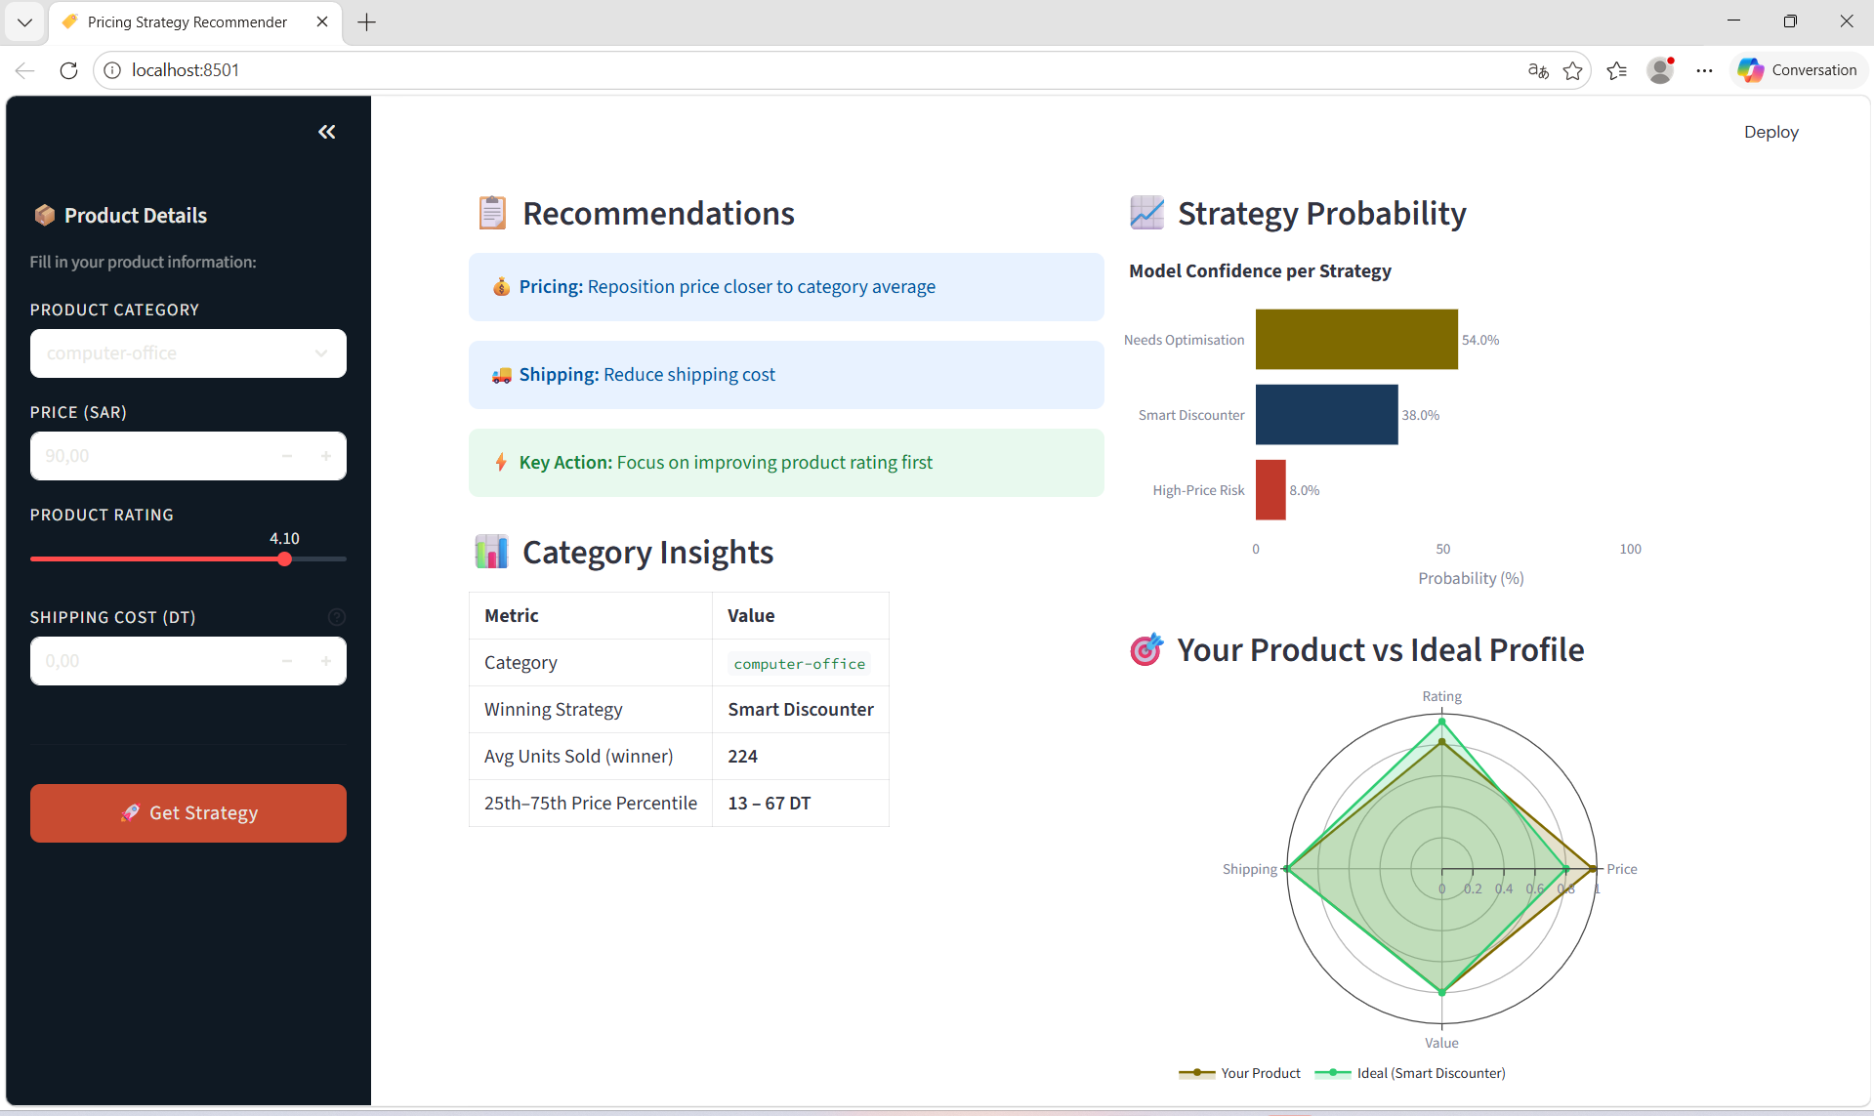

Slide 11
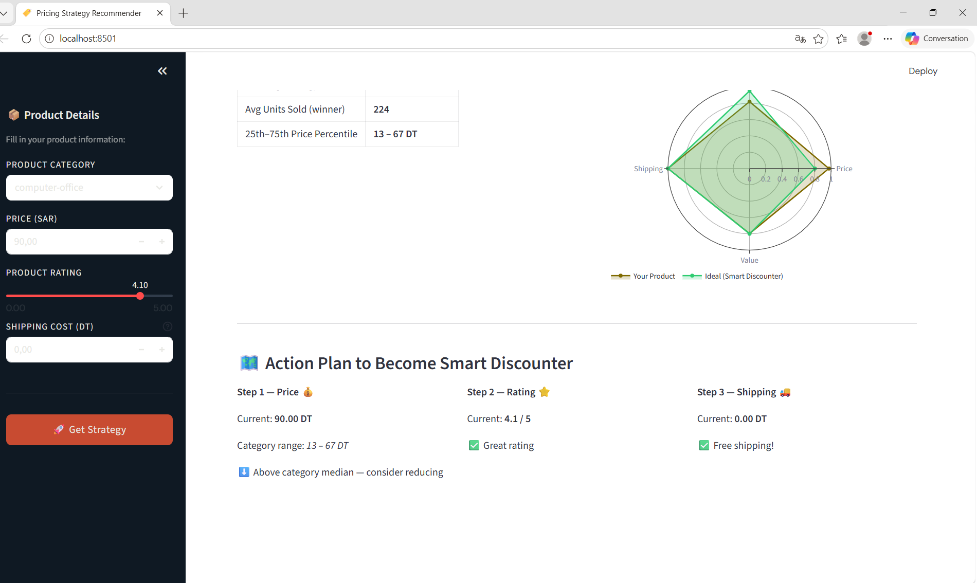

Slide 12
THANKS FOR YOUR ATTENTION

