Slide 1
Advanced Concepts in Machine Learning for Energy
Time: April 7, 9, 11, 14, 15, 1:00 pm - 5:30 pm (in-person students)
April 7 to 25, 2025 (distance students)
Location: GERB 315 and Zoom

Slide 2
Lecture | Topic | Quiz
1 | Neural network fundamentals and continuous optimization
2 | Image classification, object detection, and pixel segmentation | #1
3 | Autoencoder, autodecoder, and generative adversarial network (GAN) | #2
4 | Attention mechanism, transformers (GPT) and reinforcement learning | #3
5 | Final project Q&A, advanced topics review | #4

Slide 3
Lecture 2
Digital images (1:00-1:30 pm)
Simple neural network and lab intro (1:30-2:00 pm)
Lab 2a (2:00-2:30 pm)
CNN, augmentation
Lab 2b
Transfer learning (2:30-3:00 pm)
lab 2c (3:00-4:00 pm)

Slide 4
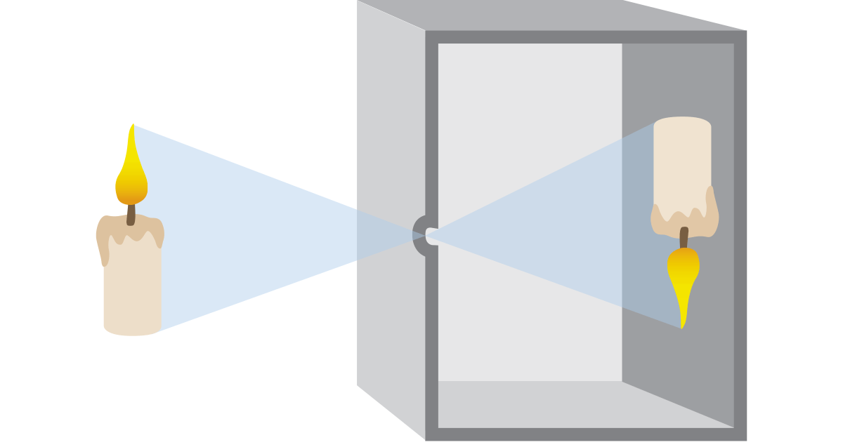
Pinhole principle

Slide 5
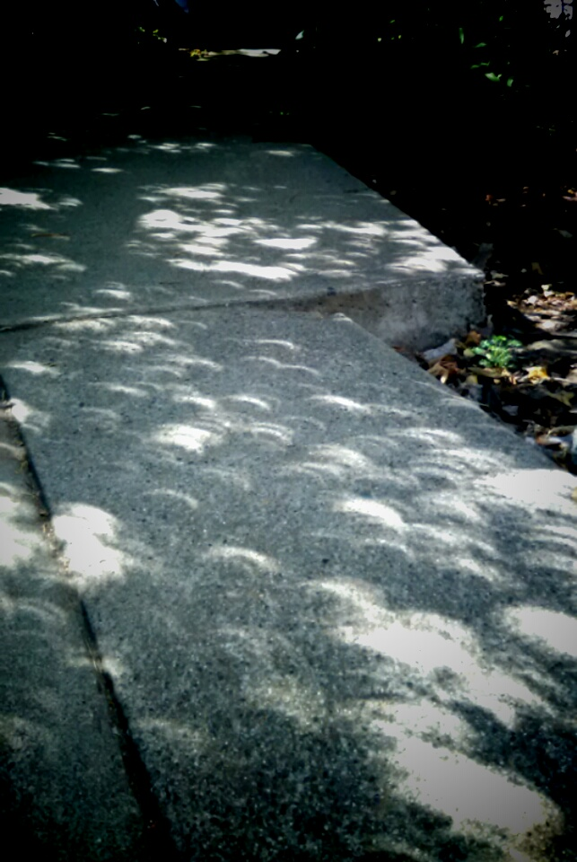
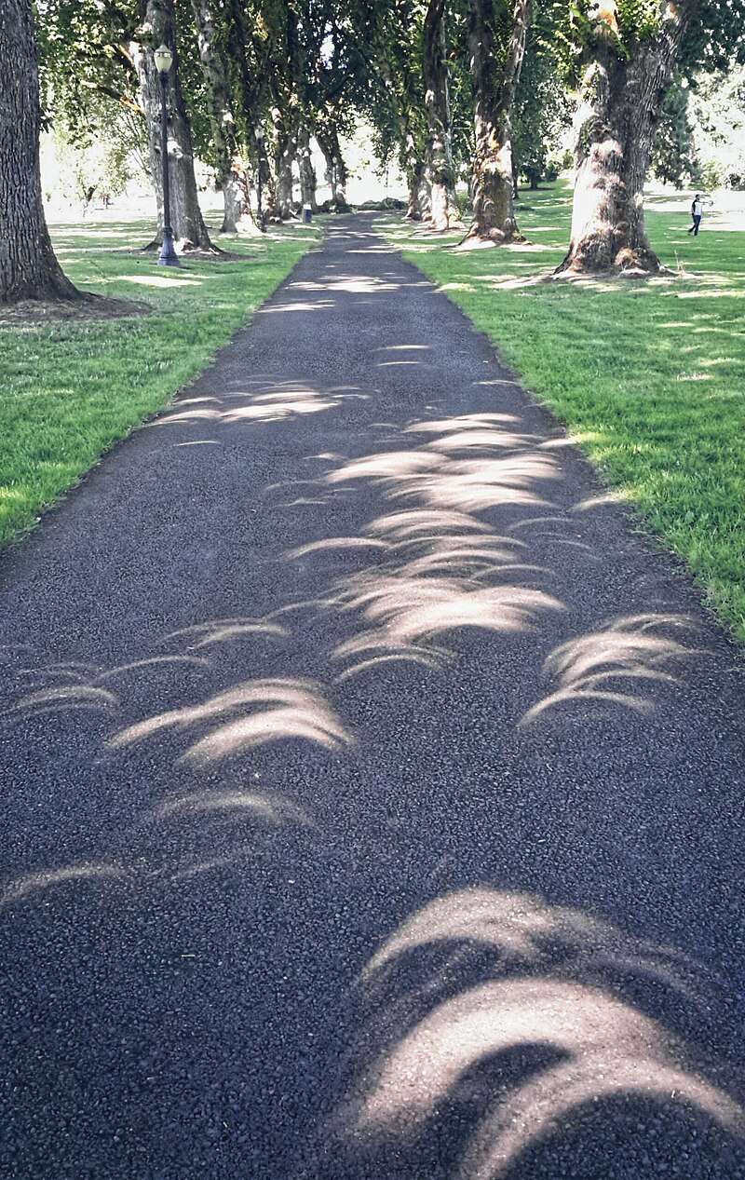

Slide 6
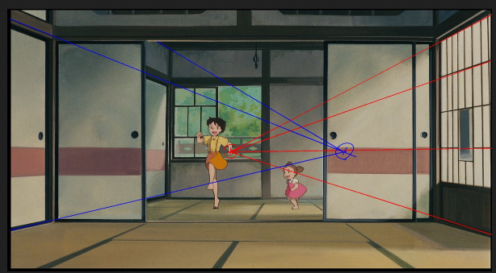

Slide 7
Vision
Pigment cup eyes
Pinhole eyes
Compound eyes

Slide 8
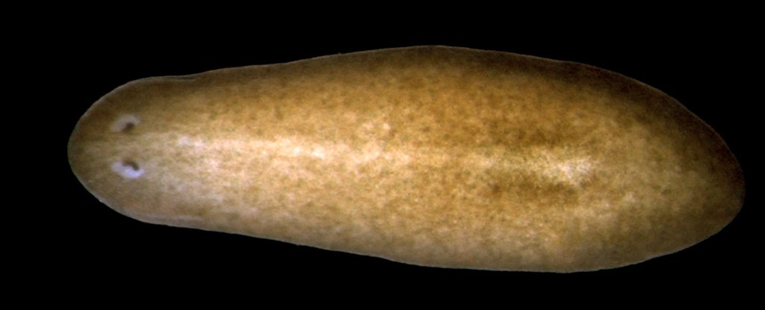
Flatworms
Shettigar, N., Joshi, A., Dalmeida, R., Gopalkrishna, R., Chakravarthy, A., Patnaik, S., ... & Gulyani, A. (2017). Hierarchies in light sensing and dynamic interactions between ocular and extraocular sensory networks in a flatworm. Science advances, 3(7), e1603025.

Slide 9
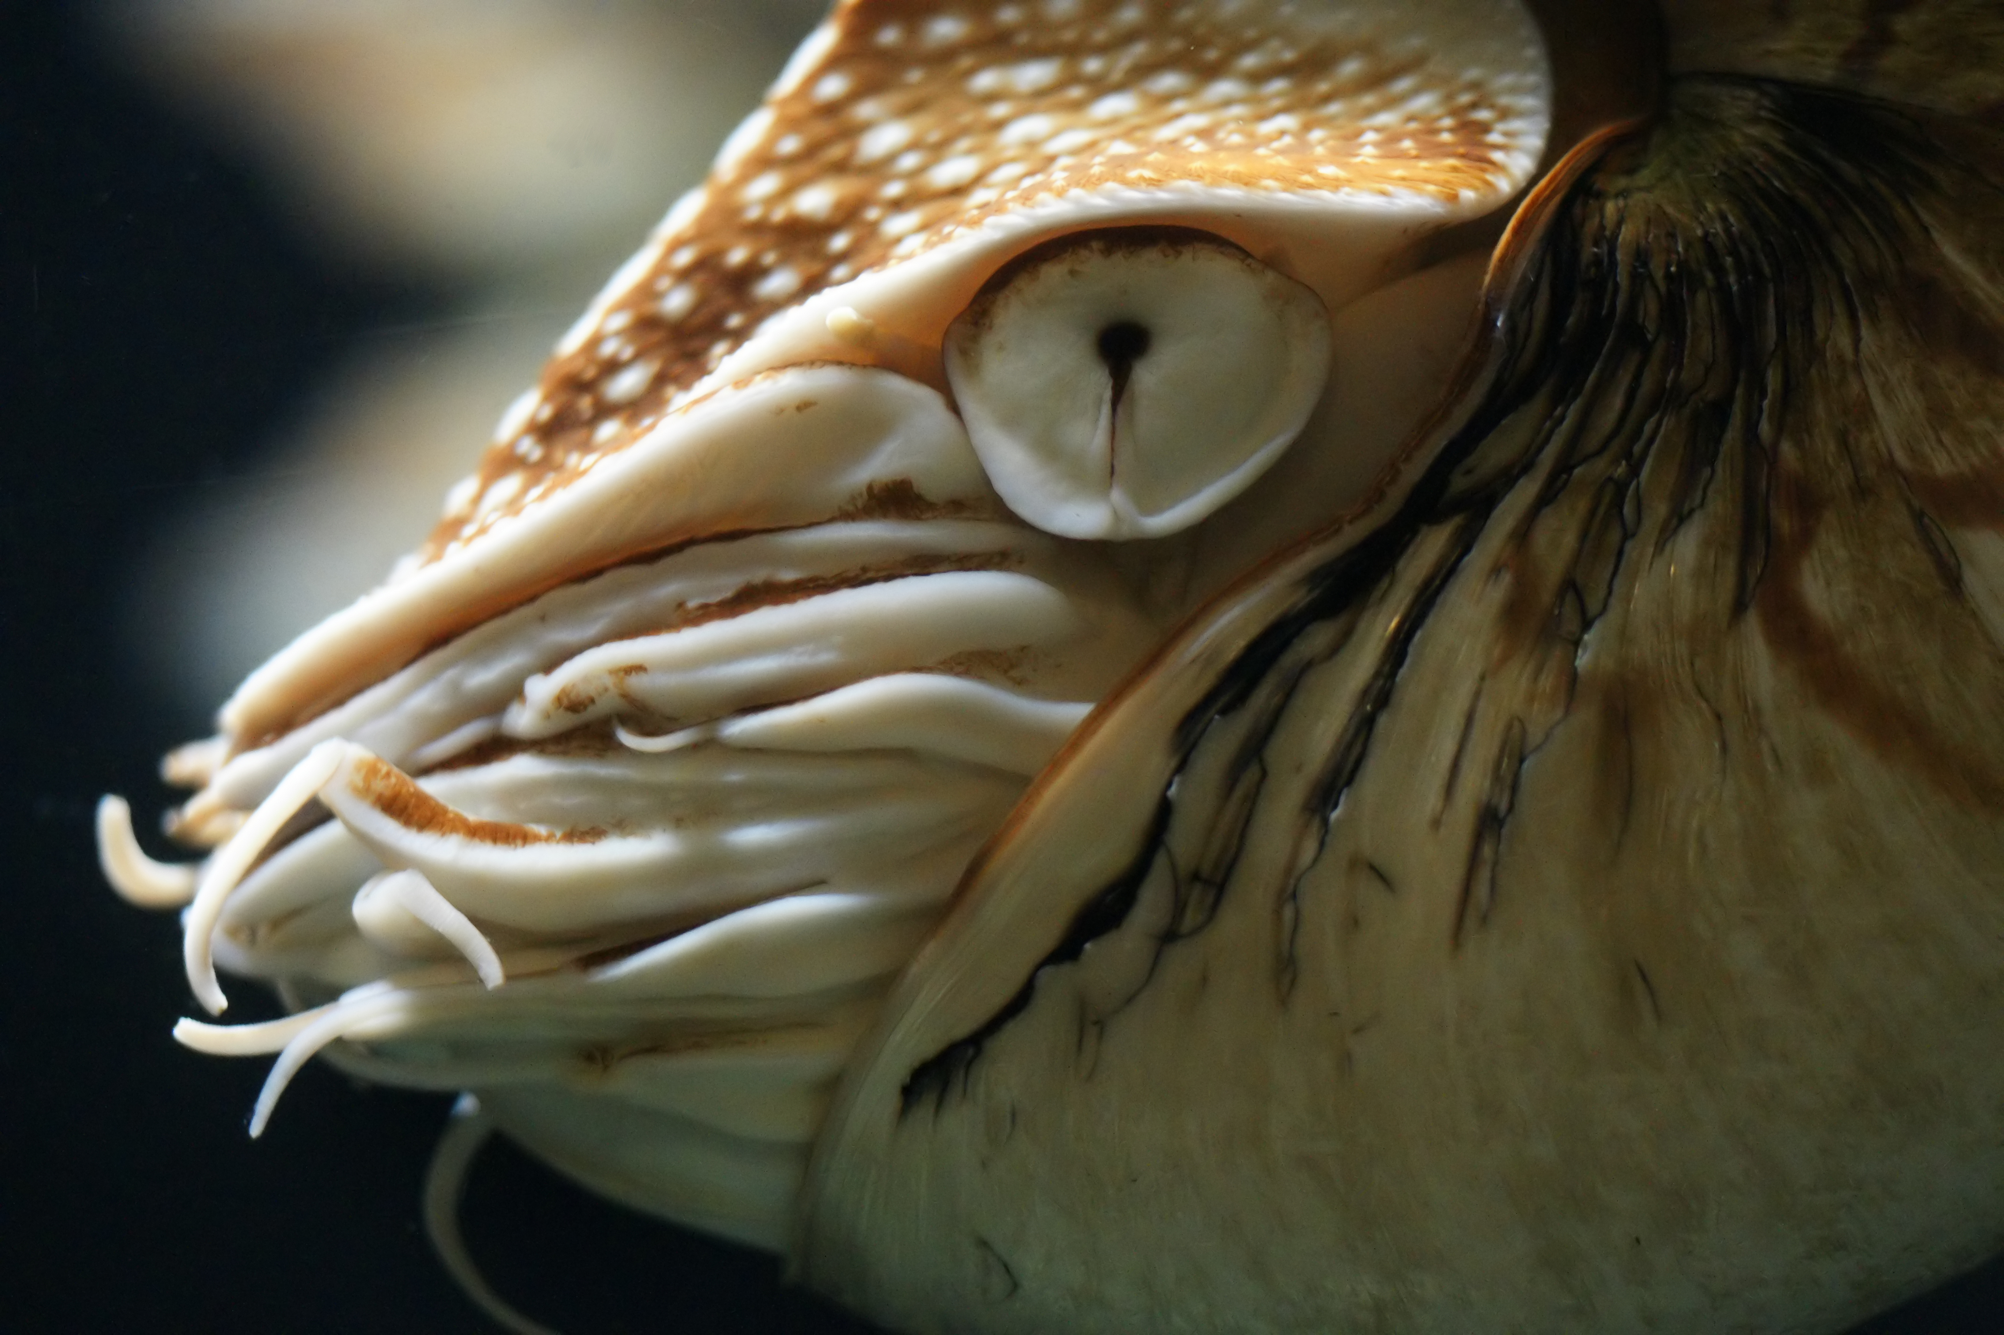
Nautilus

Slide 10
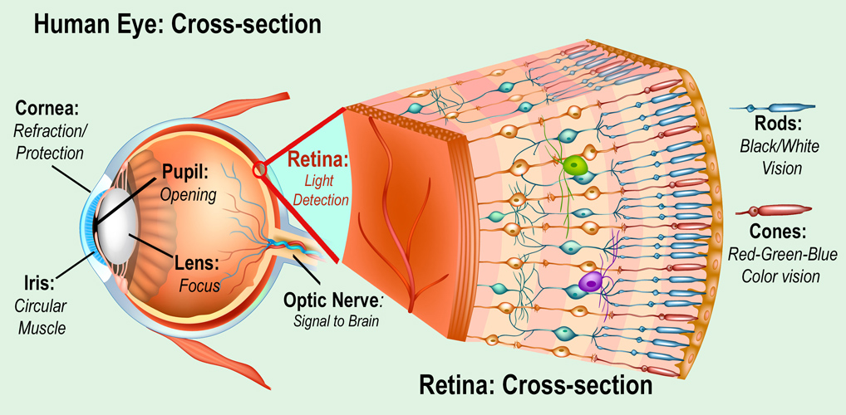
NASA

Slide 11
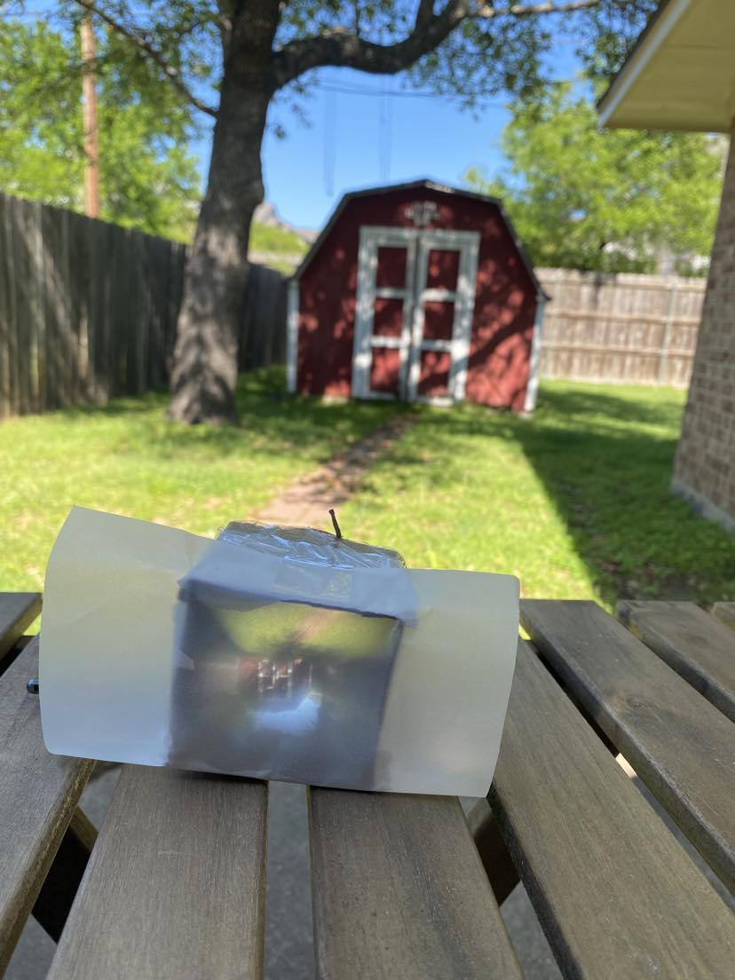
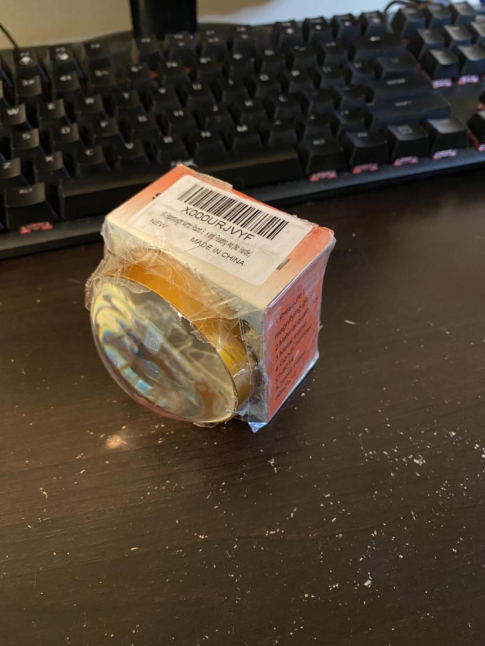

Slide 12
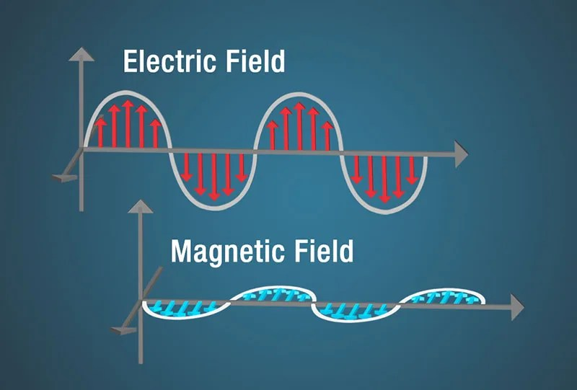
Light
Electromagnetic wave
The particle-like nature of light is observed by detectors used in digital cameras—individual photons liberate electrons that are used for the detection and storage of the image data
https://science.nasa.gov/ems/02_anatomy/

Slide 13
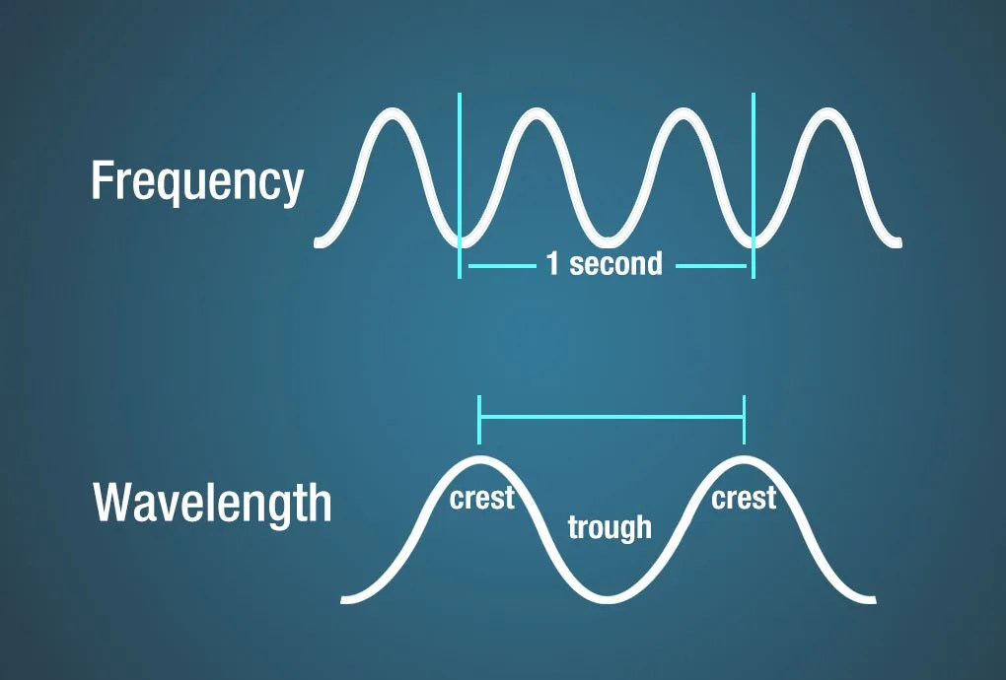

Slide 14
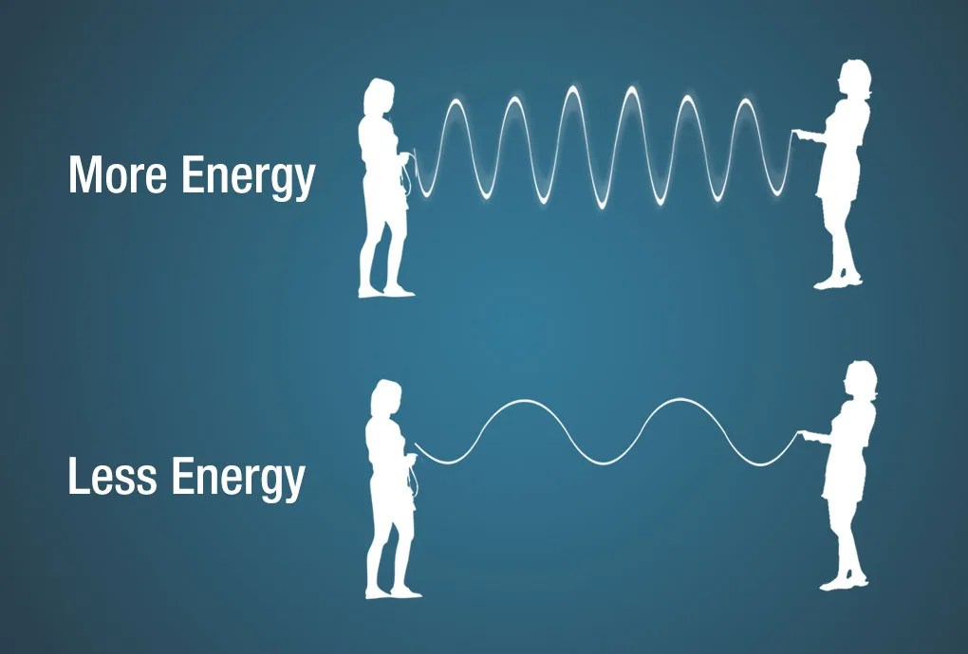

Slide 15
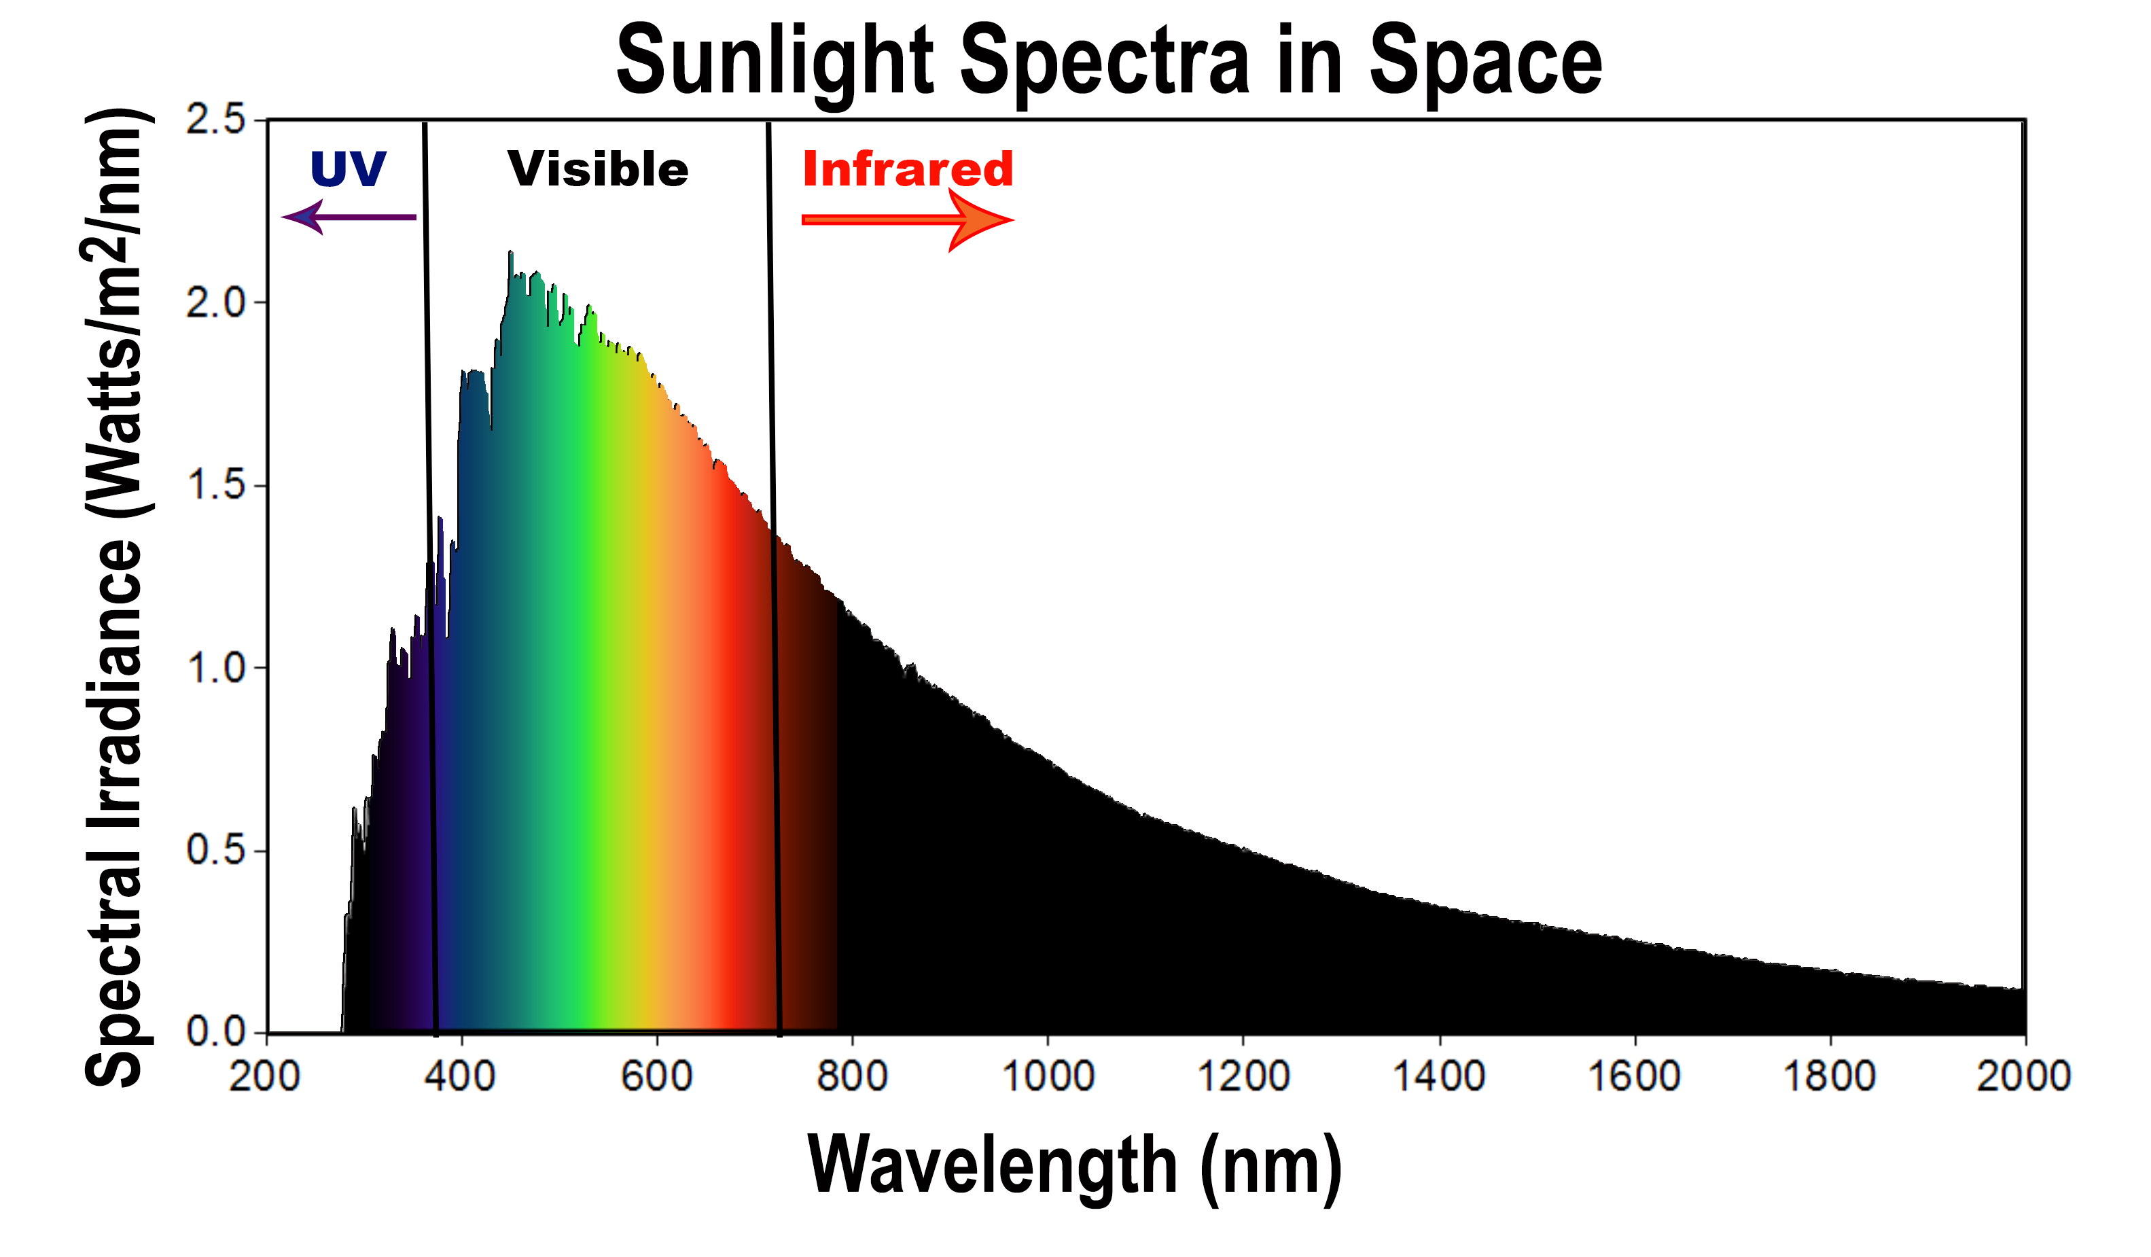

Slide 16
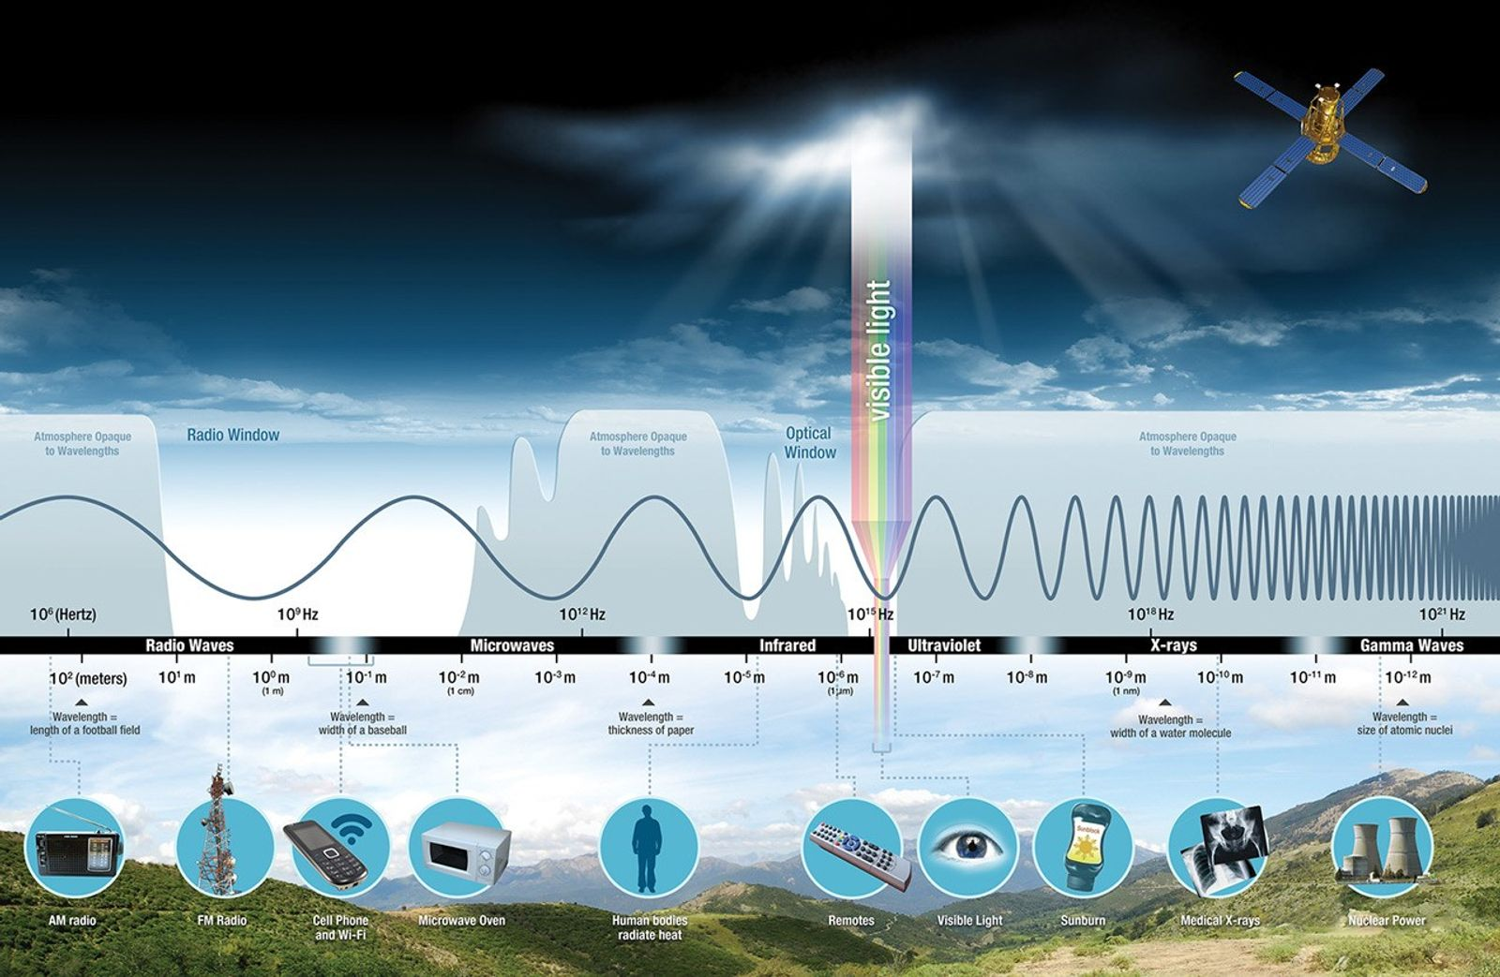

Slide 17
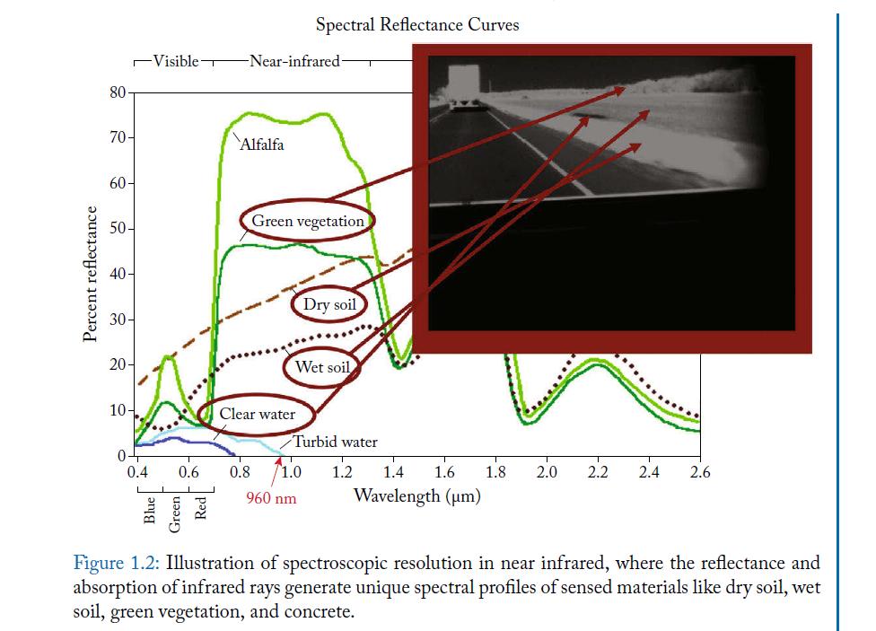
Teutsch, M., Sappa, A. D., & Hammoud, R. I. (2021). Computer vision in the infrared spectrum: challenges and approaches.

Slide 18
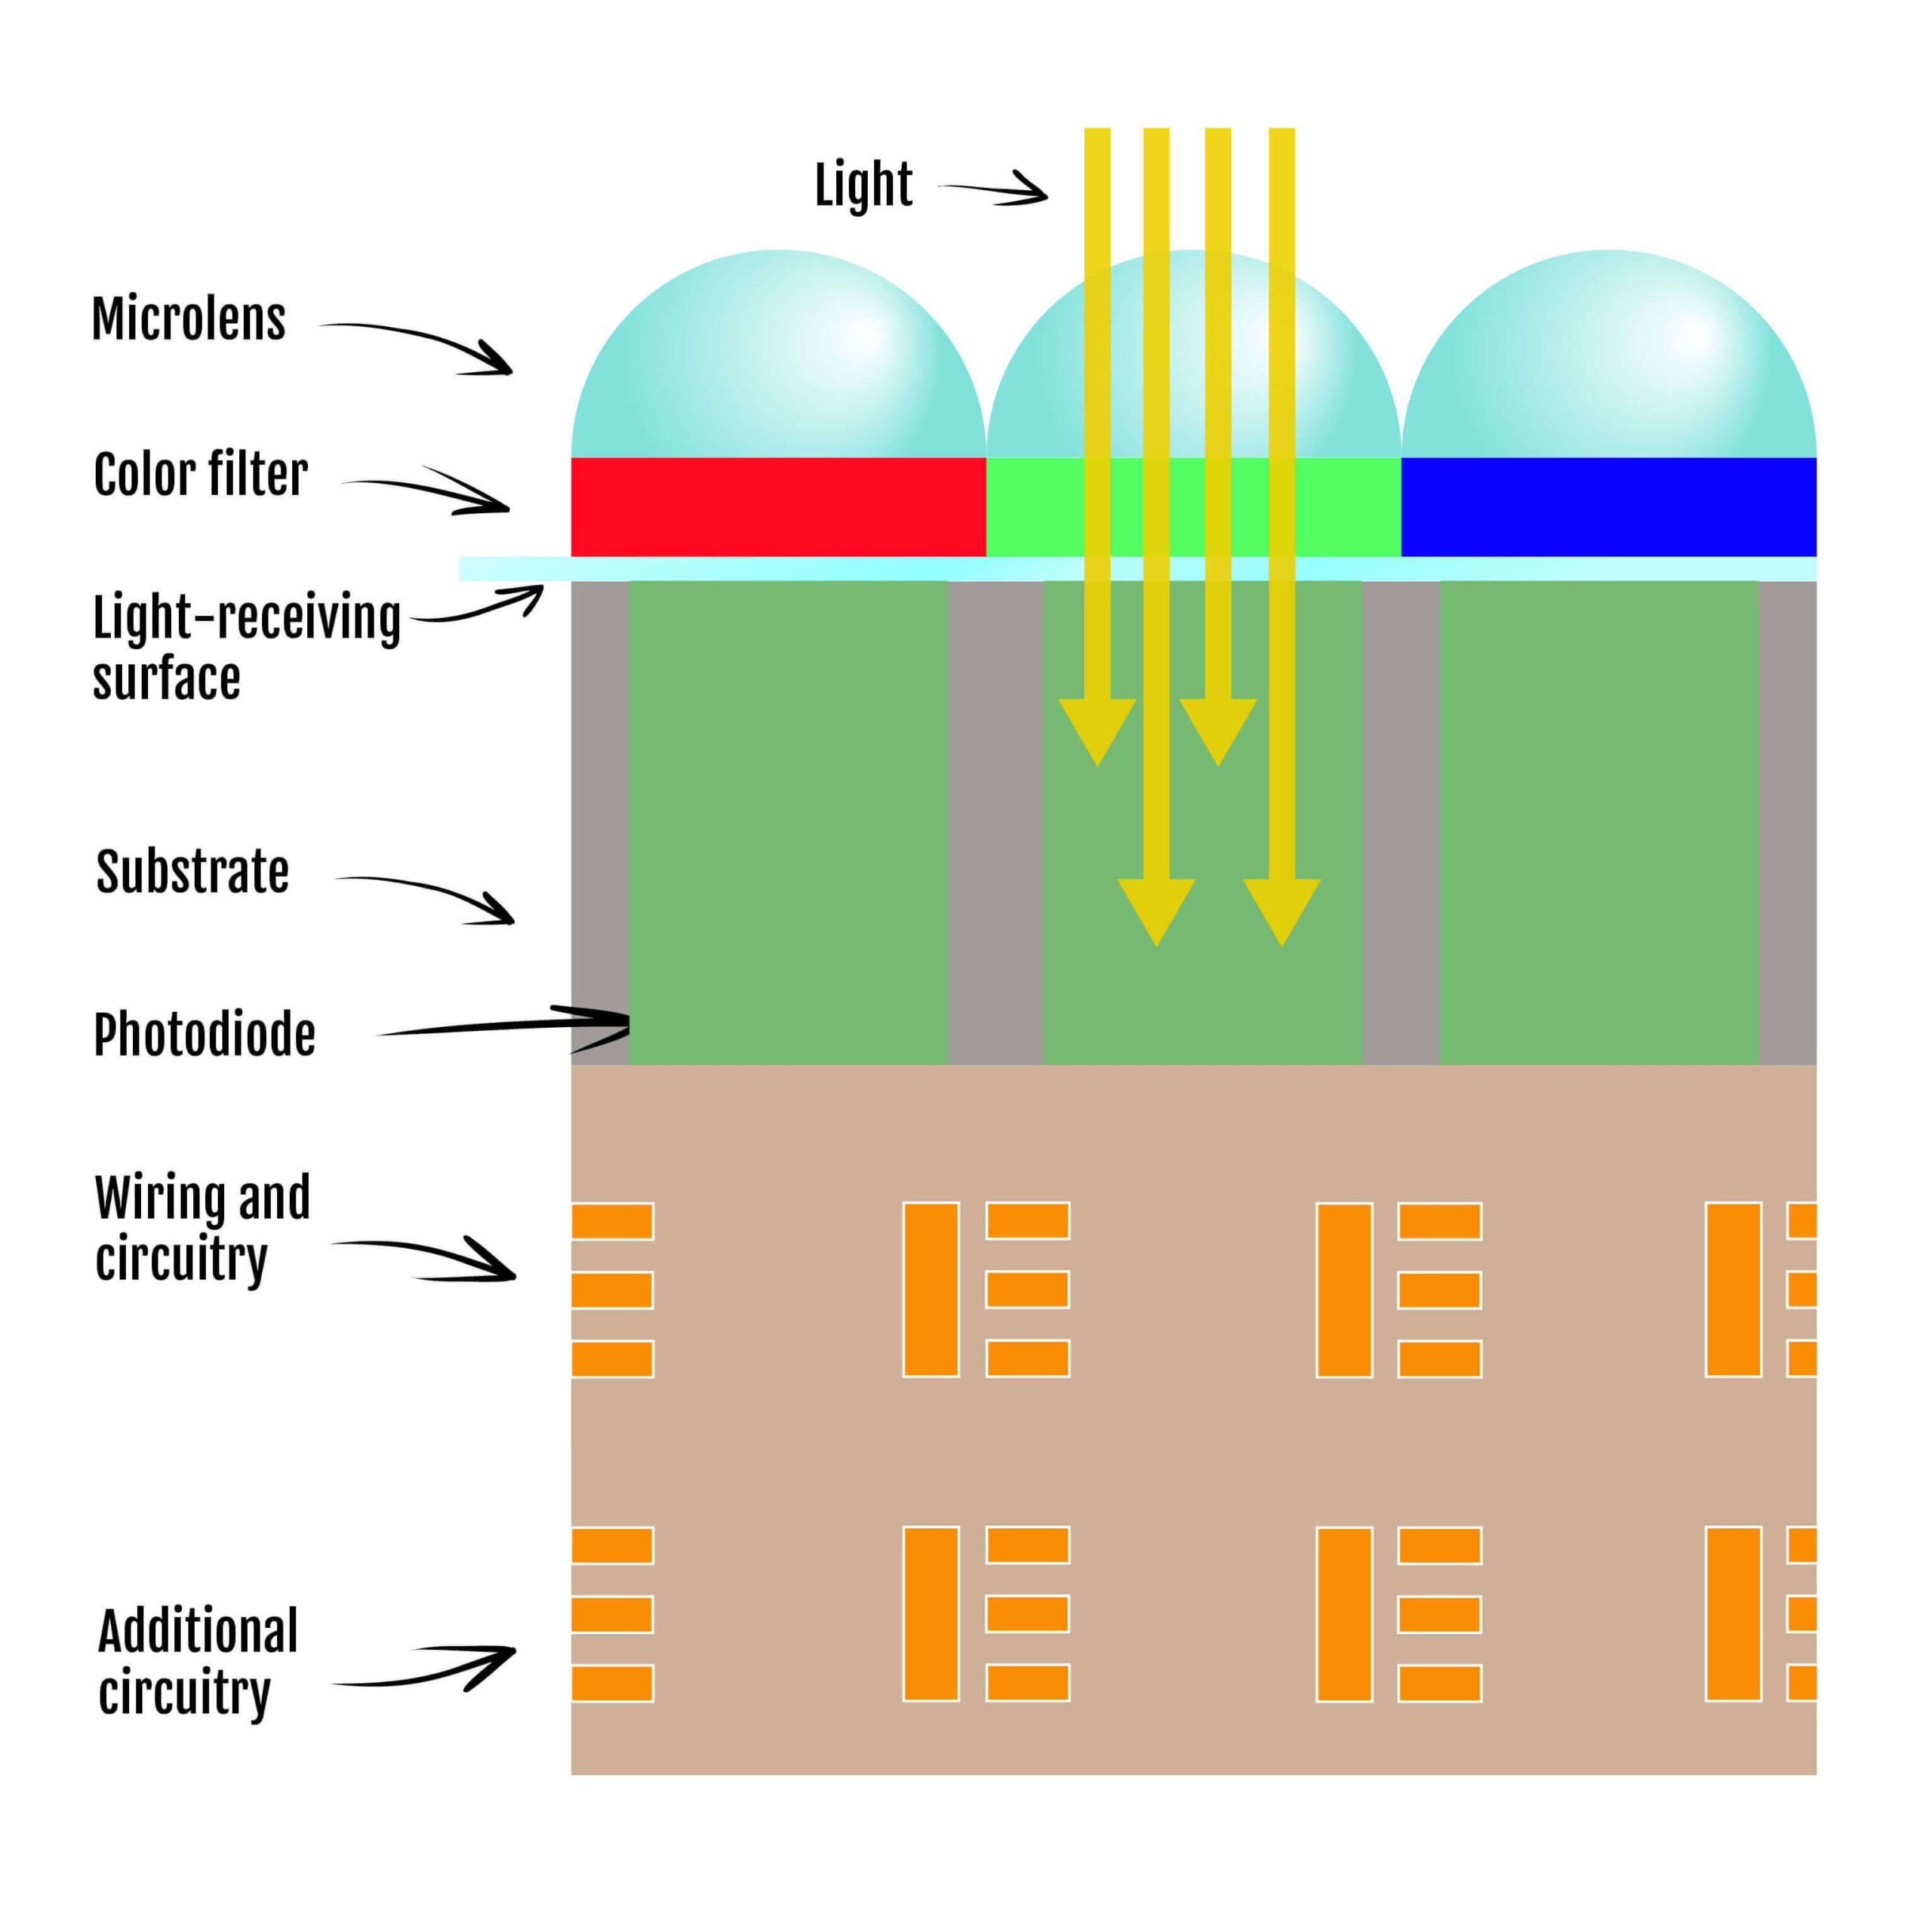

Slide 19
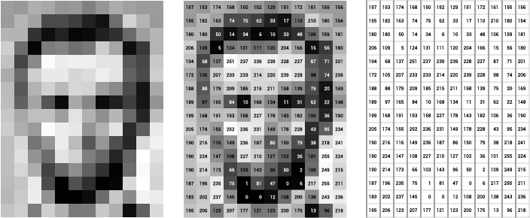
Grey scale

Slide 20
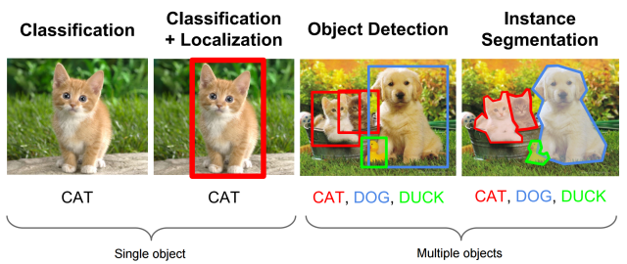
Image processing tasks

Slide 21
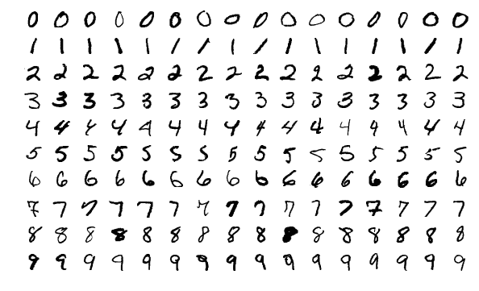
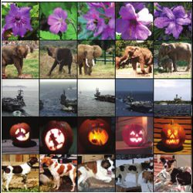
Dataset | Model
MNIST database (60,000 images) ImageNet (1.2 M images for 1000 classes) … | VGG 16 (19) series ResNet (50, 101, 150) …

Slide 22
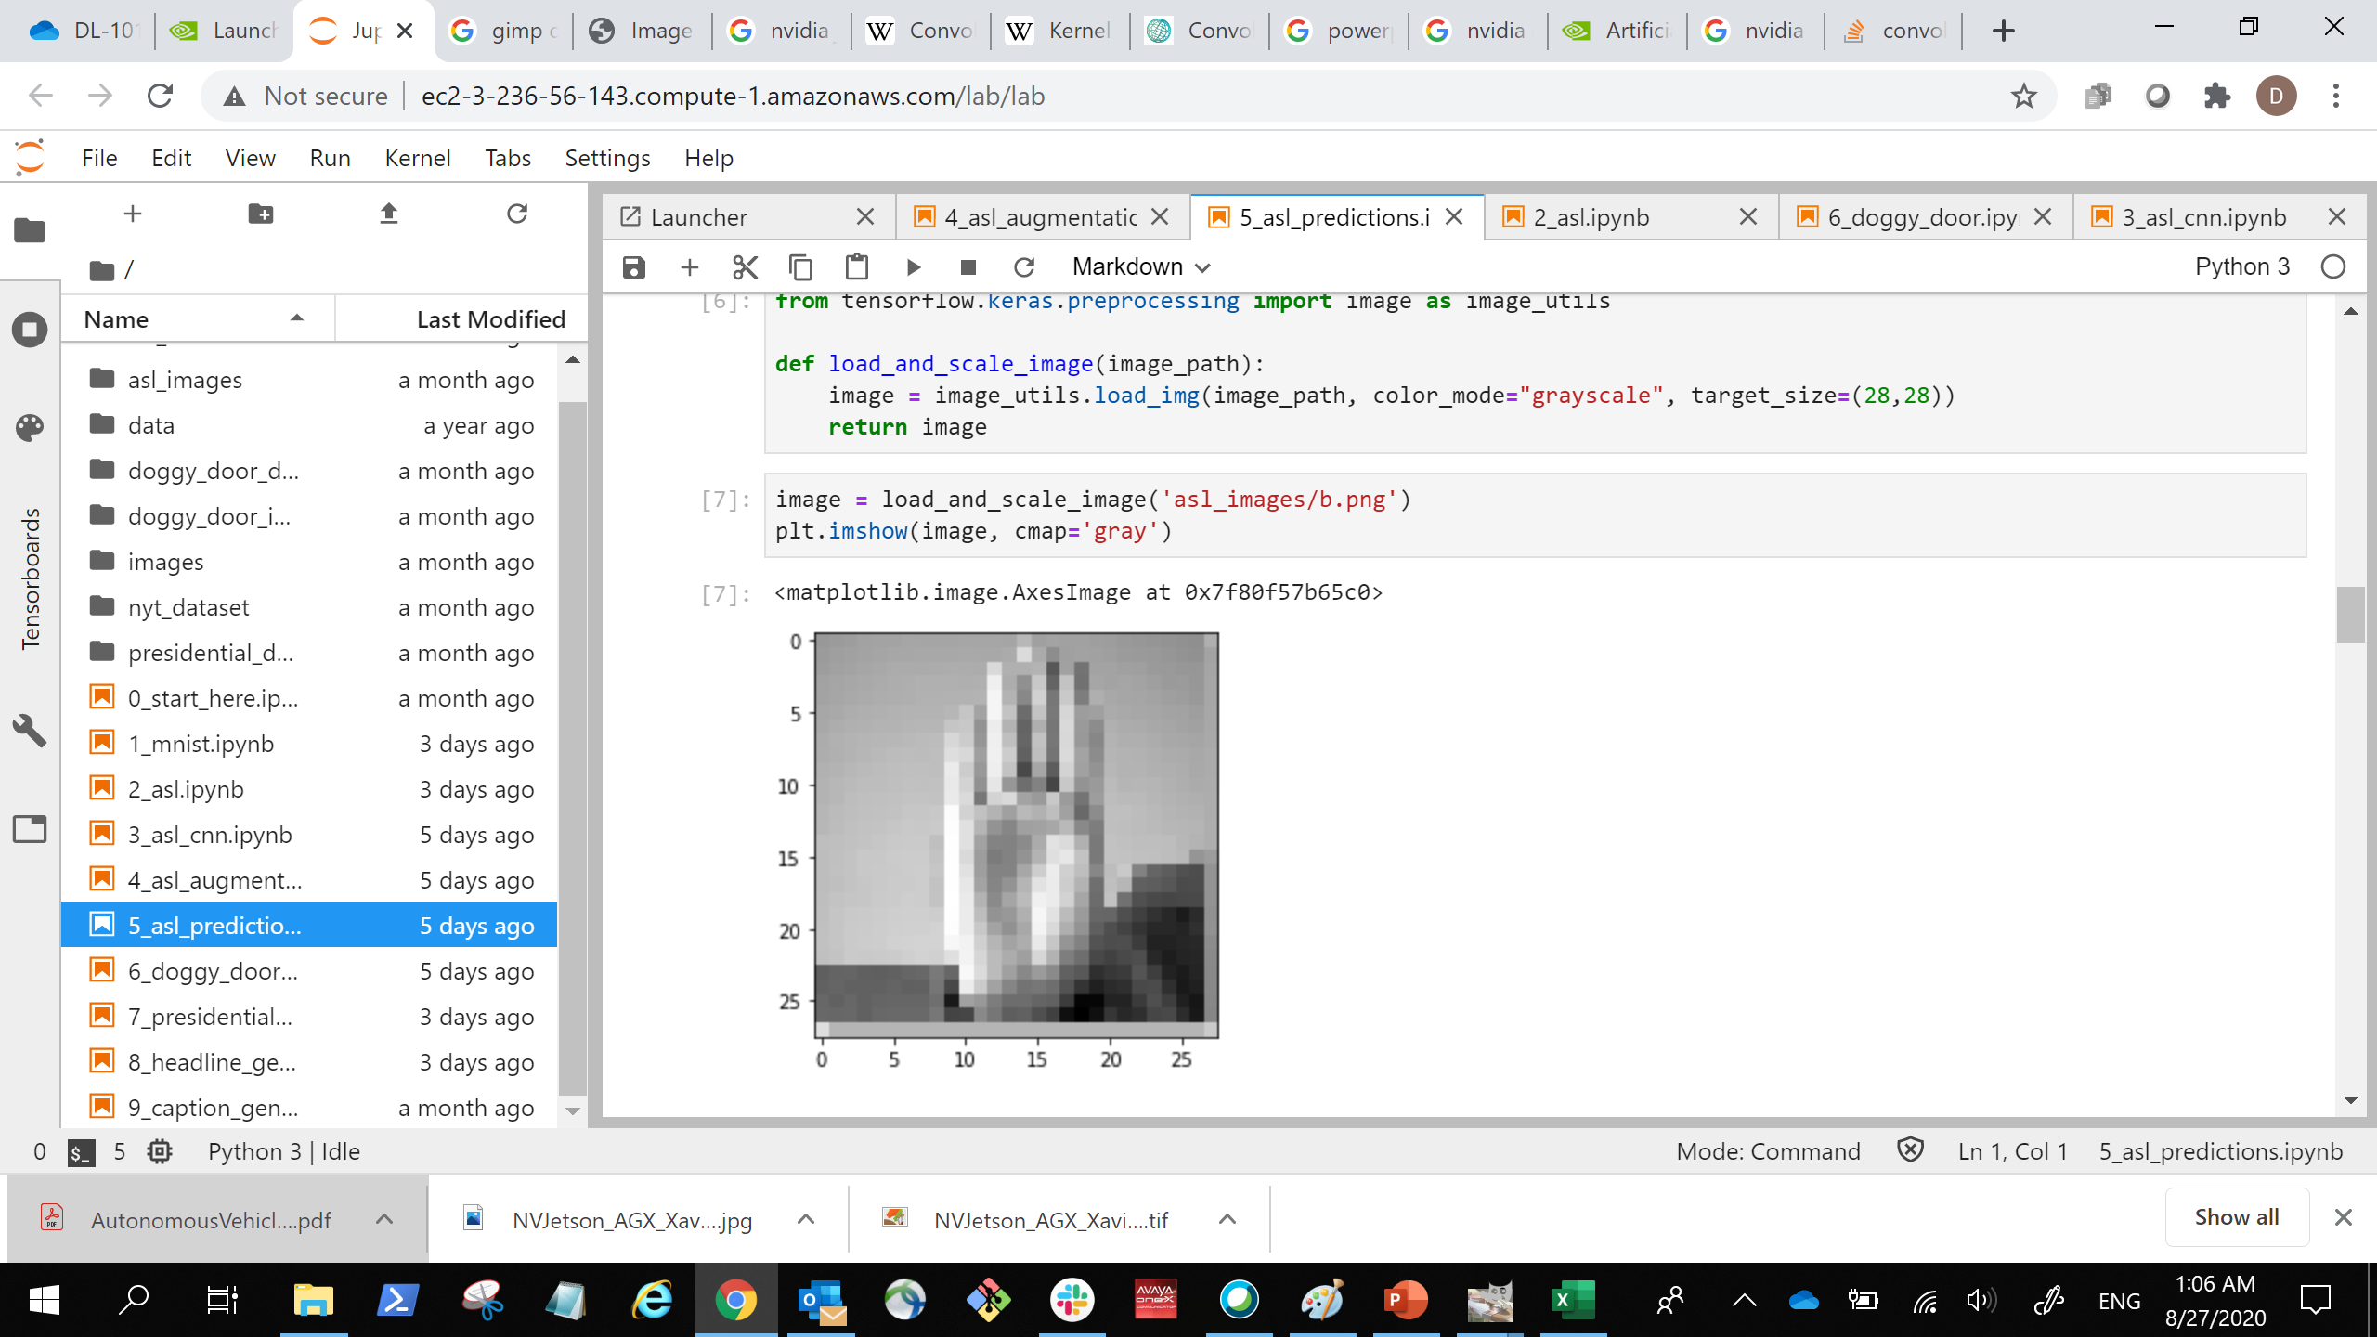
Simple neural net
… …
… …
… …
Flatten
… …
(784)
Dense
(512)
Dense
(512)
Dense
(28, 28, 1)
Image Input
(24)
Output Prediction

Slide 23
Lab 2a
Final project example lab
Problem description
Code detail explanation
Results summary

Slide 24
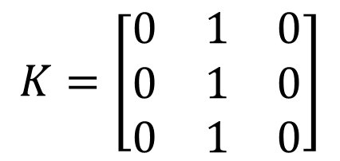
Convolution Computation
7 | 7 | 7 | 7 | 5
7 | 7 | 7 | 5 | 5
7 | 7 | 5 | 5 | 5
7 | 5 | 5 | 5 | 5
5 | 5 | 5 | 5 | 5
7 | 7 | 7 | 7 | 5
7 | 7 | 7 | 5 | 5
7 | 7 | 5 | 5 | 5
7 | 5 | 5 | 5 | 5
5 | 5 | 5 | 5 | 5
7 | 7 | 7 | 7 | 5
7 | 7 | 7 | 5 | 5
7 | 7 | 5 | 5 | 5
7 | 5 | 5 | 5 | 5
5 | 5 | 5 | 5 | 5
$$K=\left[\begin{matrix}0 & 1 & 0 \\ 0 & 1 & 0 \\ 0 & 1 & 0\end{matrix}\right]$$
0 | 0 | 0 | 0 | 0
0 | 21 | 19 | 17 | 0
0 | 19 | 17 | 15 | 0
0 | 17 | 15 | 15 | 0
0 | 0 | 0 | 0 | 0
Kernel at position 1
Kernel at position 2
Kernel at position n

Slide 25
More than one dimension
Kernel size: 3x3x4
0 | 0 | 0 | 0 | 0
0 | 21 | 19 | 17 | 0
0 | 19 | 17 | 15 | 0
0 | 17 | 15 | 15 | 0
0 | 0 | 0 | 0 | 0
0 | 0 | 0 | 0 | 0
0 | 21 | 19 | 17 | 0
0 | 19 | 17 | 15 | 0
0 | 17 | 15 | 15 | 0
0 | 0 | 0 | 0 | 0
Kernel size: 3x3x4

Slide 26
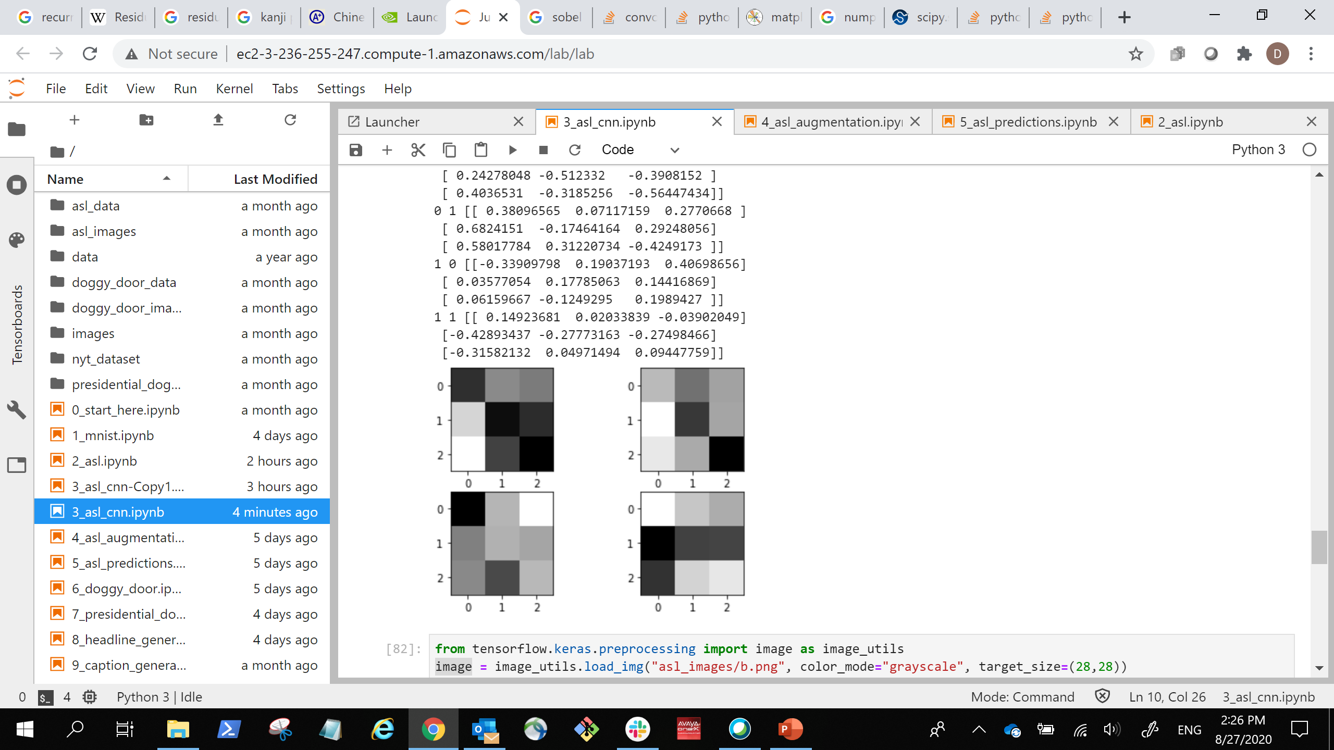
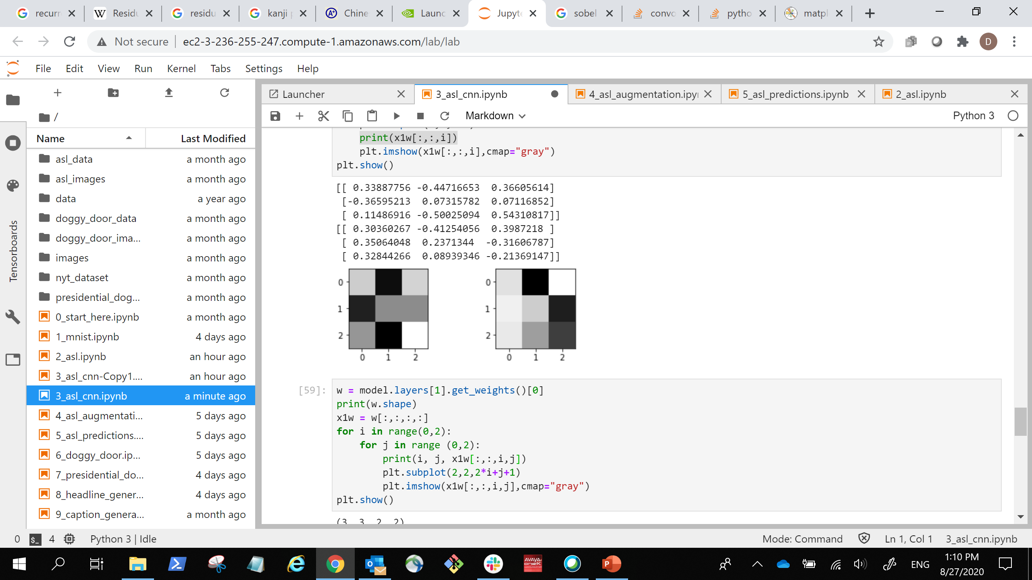
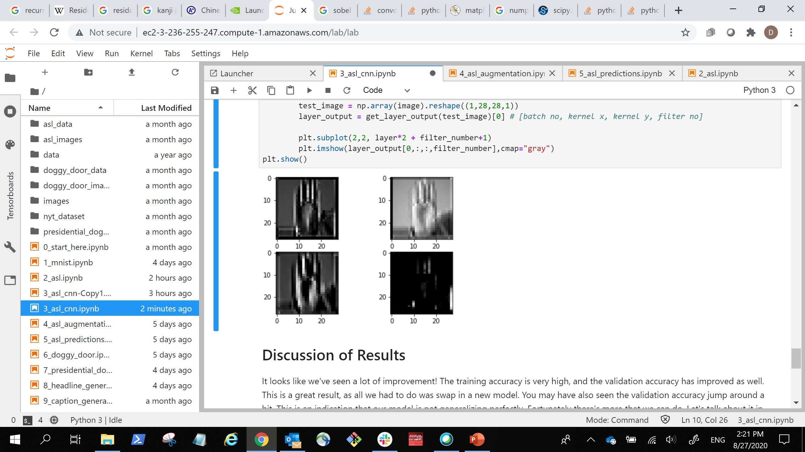
Simple neural net
… …
… …
(28, 28, 2)
Stacked Images
(28, 28, 2)
Stacked Images
(3, 3, 1, 2)
Kernels
(3, 3, 2, 2)
Kernels
(512)
Dense
(512)
Dense
(28, 28, 1)
Image Input
(1568)
Flattened Image
Vector
(24)
Output Prediction

Slide 27
CNN dimensions

Slide 28
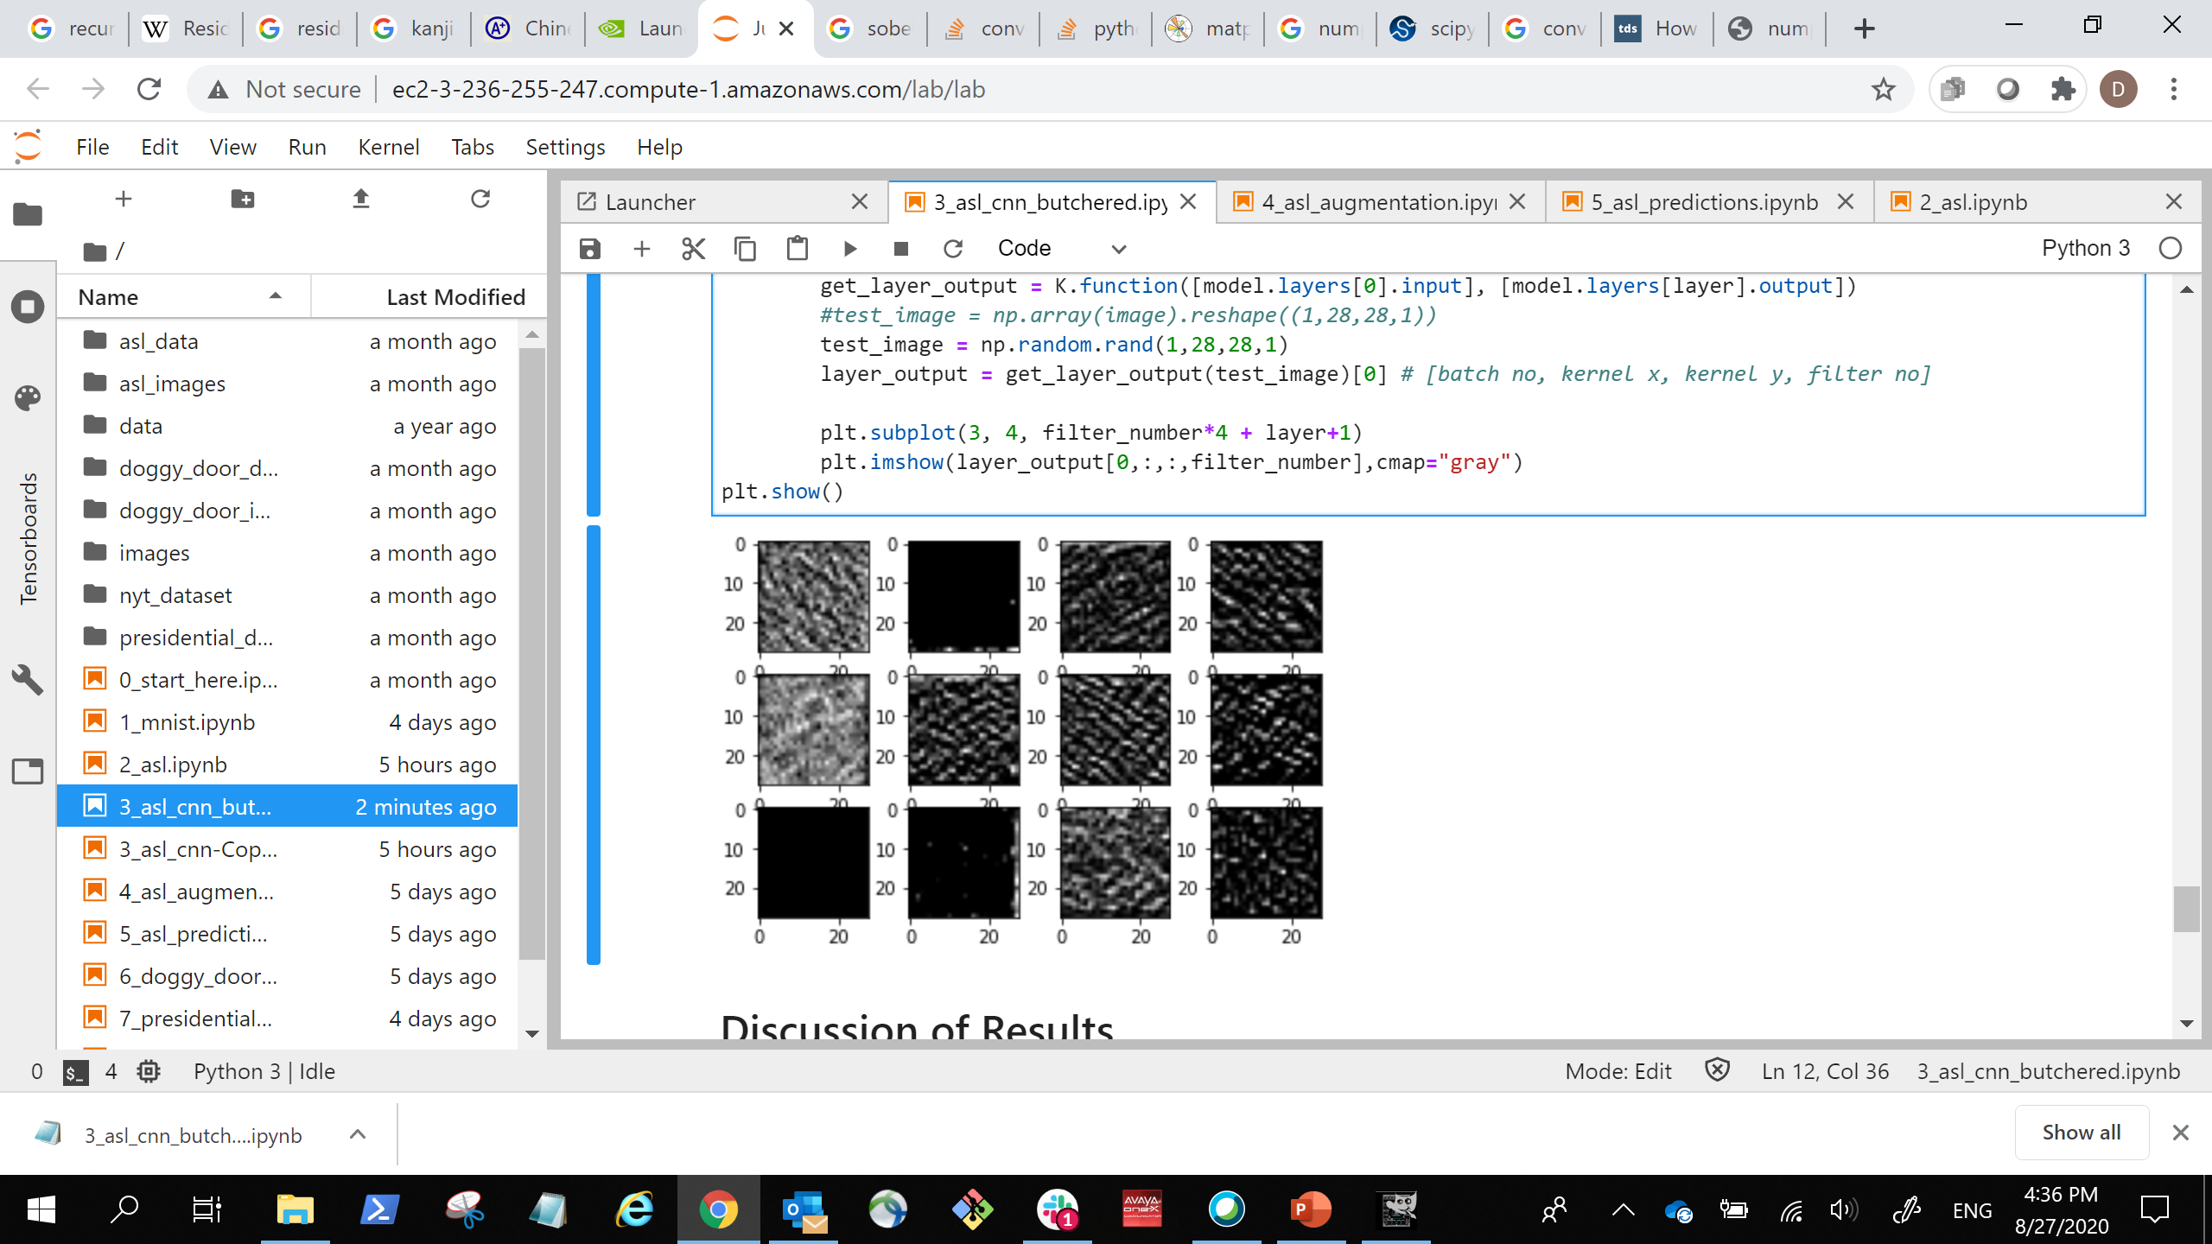
Neural Network Perception
Input
Convolution
Convolution
Convolution
Convolution
Dense
Dense
Output
Edges
Textures
Objects

Slide 29
Max pooling
110 | 255 | 153 | 67
12 | 89 | 88 | 43
10 | 15 | 50 | 55
23 | 9 | 49 | 23
255 | 153
23 | 55

Slide 30
Transfer Learning
Input
Convolution
Max Pooling
Convolution
Dropout
Max Pooling
Convolution
Max Pooling
Dense
Dense
Output
More Specialized
More Generalized

Slide 31
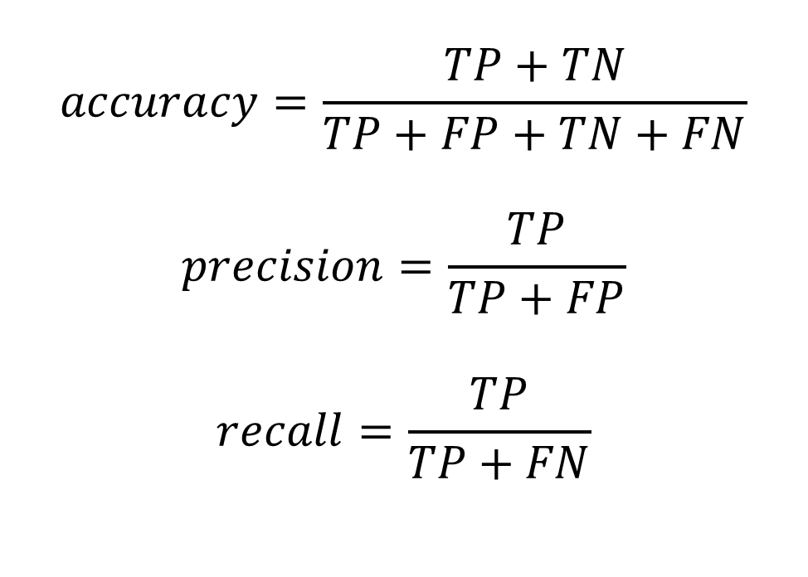
Prediction\Ground Truth | Positive | Negative
Positive | TP | FP
Negative | FN | TN
$$accuracy=\frac{TP+TN}{TP+FP+TN+FN}$$
$$precision=\frac{TP}{TP+FP}$$
$$recall=\frac{TP}{TP+FN}$$

Slide 32
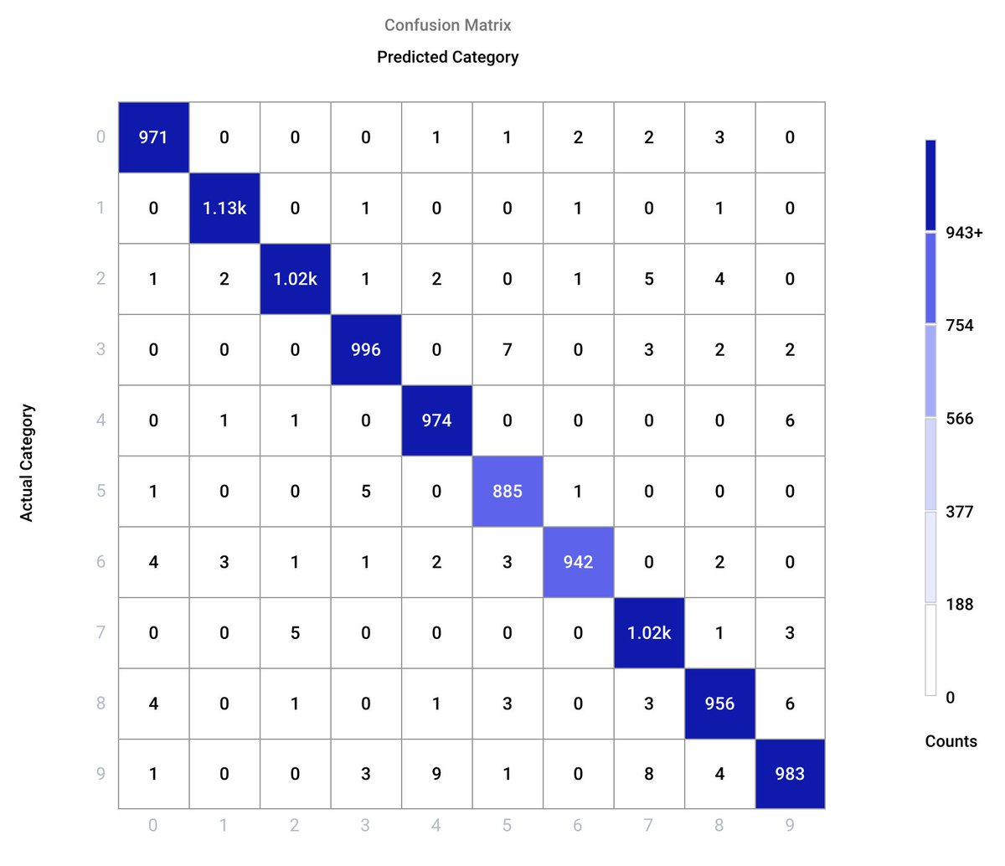

Slide 33

Image augmentation
Horizontal Flip
Vertical Flip

Slide 34



Image augmentation
Rotation
Zoom
Brightness
…
90⁰
135⁰
45⁰
0⁰
180⁰
315⁰
225⁰
270⁰

Slide 35
Established datasets
COCO
ImageNet
VOC
TorchVision dataset
Tensorflow dataset
…

Slide 36

Transfer learning
… …
… …
(28, 28, 2)
Stacked Images
(28, 28, 2)
Stacked Images
(3, 3, 1, 2)
Kernels
(3, 3, 2, 2)
Kernels
(512)
Dense
(512)
Dense
(28, 28, 1)
Image Input
(1568)
Flattened Image
Vector
(24)
Output Prediction

Slide 37
Transfer learning
… …
(28, 28, 2)
Stacked Images
(28, 28, 2)
Stacked Images
(3, 3, 1, 2)
Kernels
(3, 3, 2, 2)
Kernels
(512)
Dense
(28, 28, 1)
Image Input
(1568)
Flattened Image
Vector
(2)
Output Prediction

Slide 38
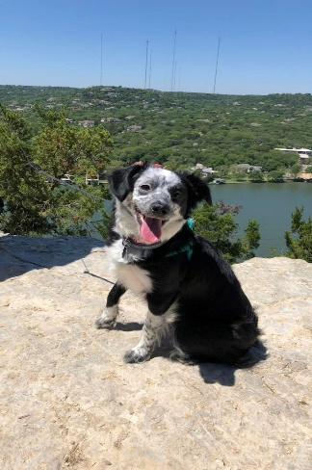
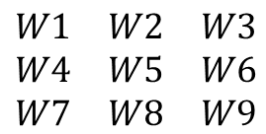
Resnet
$$\begin{matrix}W1 & W2 & W3 \\ W4 & W5 & W6 \\ W7 & W8 & W9\end{matrix}$$
Kernel =
y
…
…
Input
Convolution layer
Output

