Slide 1
Advanced Concepts in Machine Learning for Energy
Time: April 7, 9, 11, 14, 15, 1:00 pm - 5:30 pm (in-person students)
April 7 to 25, 2025 (distance students)
Location: GERB 315 and Zoom

Slide 2
Lecture | Topic | Quiz
1 | Neural network fundamentals and continuous optimization
2 | Image classification, object detection, and pixel segmentation | #1
3 | Autoencoder, autodecoder, and generative adversarial network (GAN) | #2
4 | Attention mechanism, transformers (GPT) | #3
5 | Final project Q&A, advanced topics review | #4

Slide 3
Lecture 3
Object detection and segmentation (1:00-1:30 pm)
Lab 2 Unet, lab 2d (MaskRCNN) (1:30-2:00 pm)
Object tracking (2:00-2:30 pm)
Lab 3a (2:30-3:00 pm)
Encoder-decoder structure (3:00-3:10 pm)
Lab 3b(3:10-3:40 pm)
Anomaly Detection using Autoencoders (3:40-4:00 pm)
Lab 3c (4:00-4:30 pm)
GAN(4:30-5:30 pm)
Lab 3d (5:00-5:30 pm)

Slide 4
Object detection
Identifying and localizing objects in an image
Output format:
Bounding boxes
Points
Application
Autonomous driving
Surveillance systems
Medical imaging analysis
Augmented reality

Slide 5
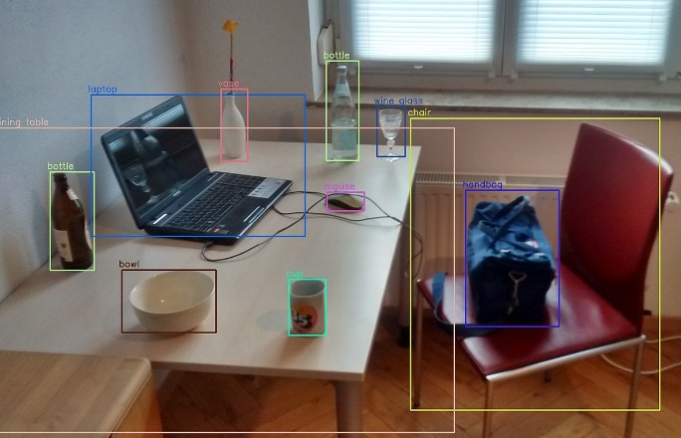
Dataset | Model
COCO (300K image in 80 classes) Open Images (9M images in 600 classes) … | YOLO series RCNN series Retina Net …

Slide 6


You Only Look Once (YOLO) Architecture
Prediction in each anchor box
X
Y
Width
Height
Confidence
Class 1 Probability
Class n Probability
…
x grid x grid x anchor box
RGB Input
CONV
MAX POOLING
CONV
Output
13✕13✕a✕(5+n)
...

Slide 7
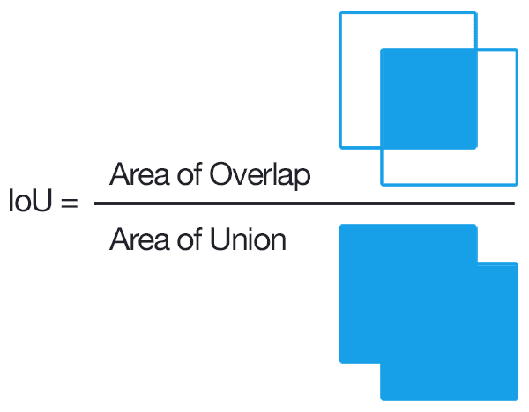
Object detection metric
True Positive (TP): IoU ≥ 50%
False Positive (FP): IoU < 50%
Ground Truth
Prediction
No True Negative (TN)
False Negative (FN): IoU = 0

Slide 8
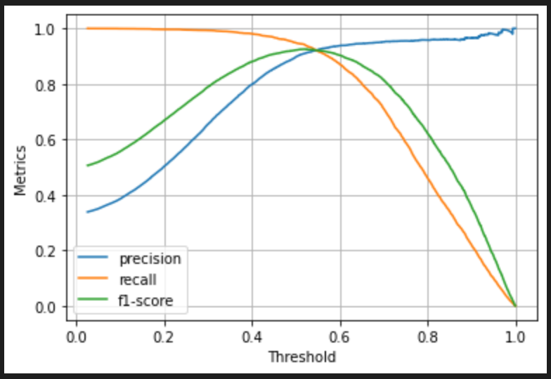
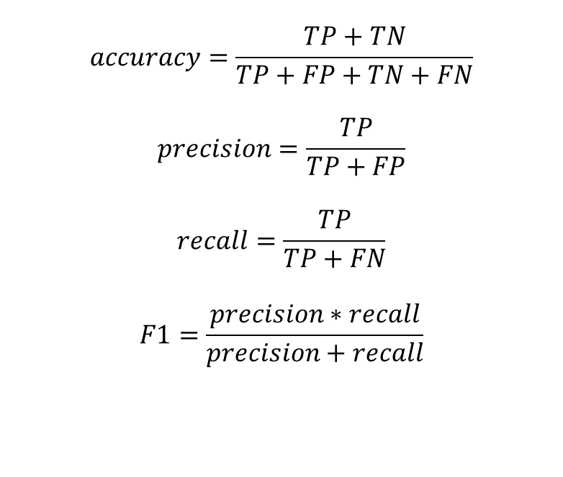
Prediction\Ground Truth | Positive | Negative
Positive | TP | FP
Negative | FN | TN
$$accuracy=\frac{TP+TN}{TP+FP+TN+FN}$$
$$precision=\frac{TP}{TP+FP}$$
$$recall=\frac{TP}{TP+FN}$$
$$F1=\frac{precision∗recall}{precision+recall}$$

Slide 9
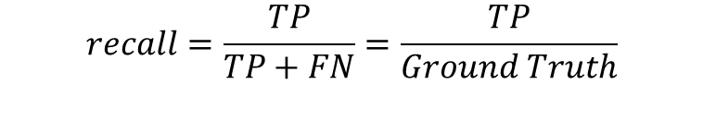

mAP
Mean average precision (mAP)
$$precision=\frac{TP}{TP+FP}=\frac{TP}{Predictions}$$
1
The best model
(AP = 100%)
Somewhat good model
$$recall=\frac{TP}{TP+FN}=\frac{TP}{Ground Truth}$$
Average Precision (AP)
precision
Not so good model
The worst model
(AP = 0%)
0
recall
0
1

Slide 10
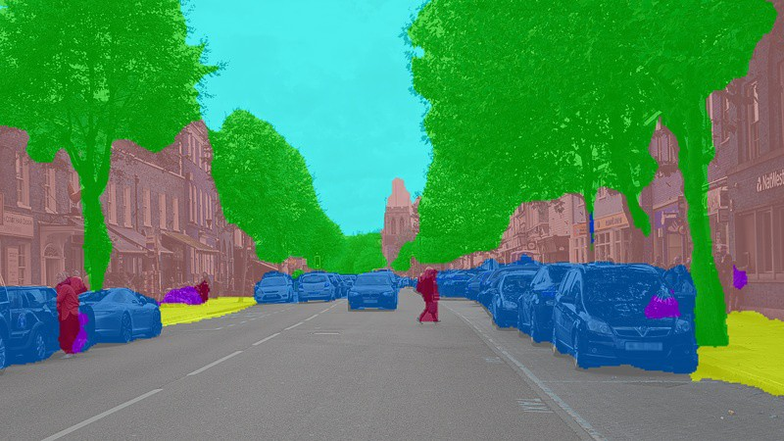
Dataset | Model
ADE20k (150 classes) COCO … | UNet SegNet …

Slide 11
Segmentation
Input
Encoder
Bottleneck
Decoder
Output

Slide 12
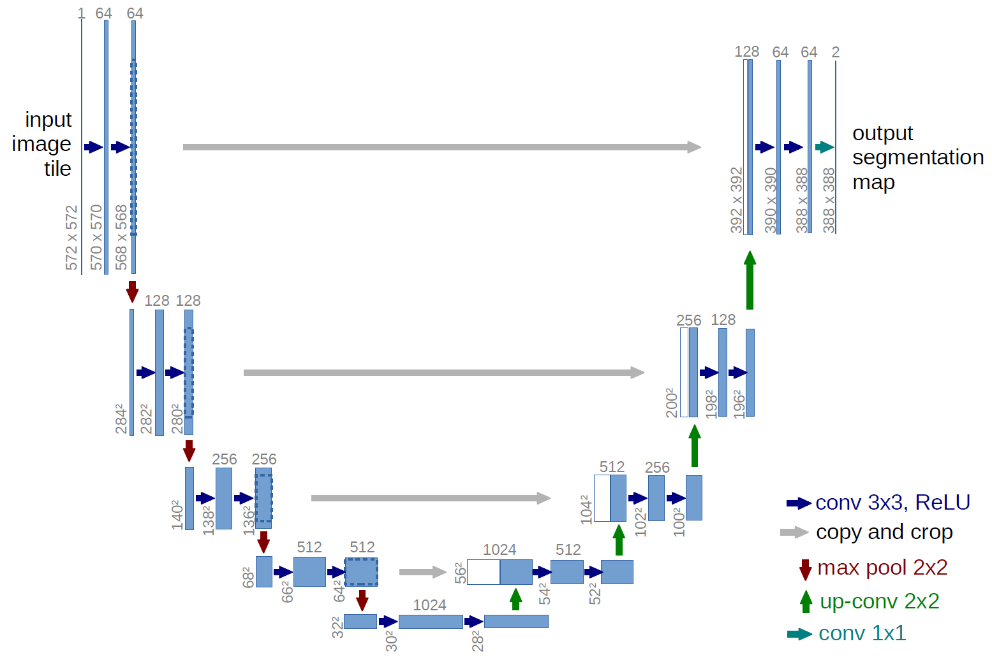

Slide 13
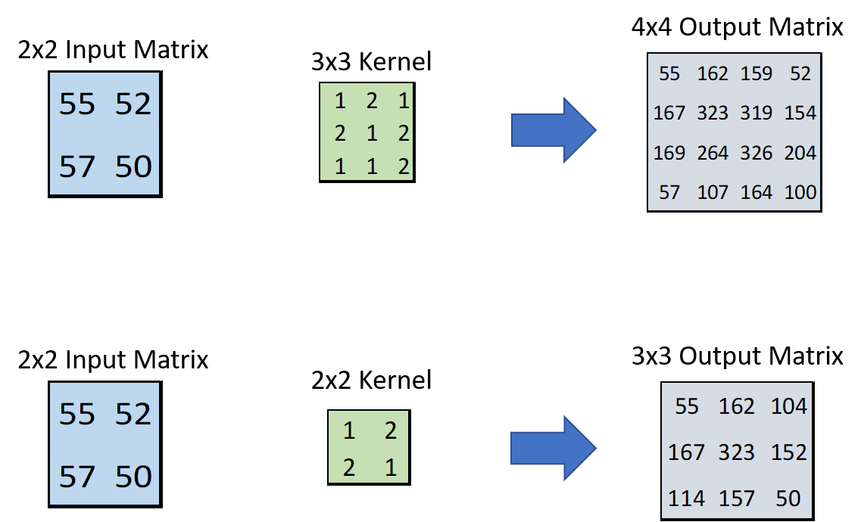

Slide 14


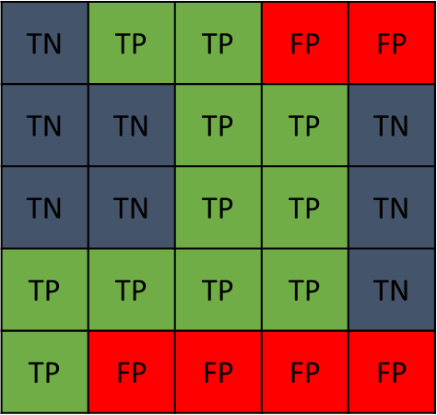
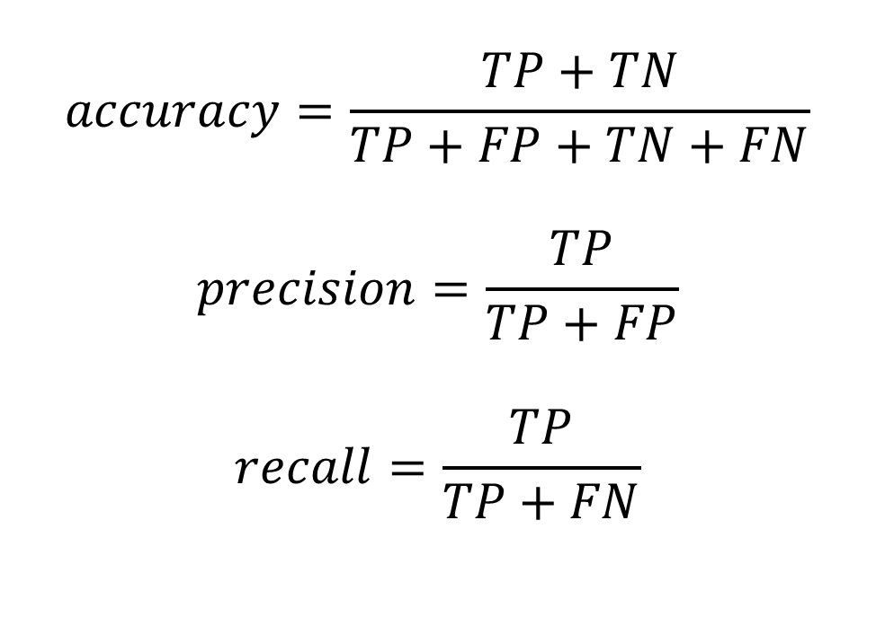
Pixel segmentation metric
$$accuracy=\frac{TP+TN}{TP+FP+TN+FN}$$
$$precision=\frac{TP}{TP+FP}$$
$$recall=\frac{TP}{TP+FN}$$
Ground truth
Prediction

Slide 15
Mask RCNN: a combination of object detection and segmentation
RPN
Feature maps
Class probabilities
Bounding boxes
Binary masks

Slide 16
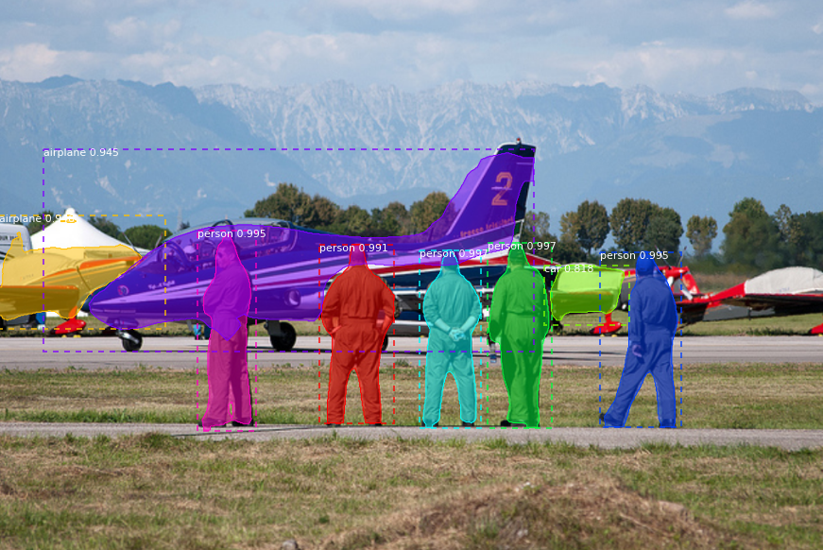
Mask-RCNN output

Slide 17
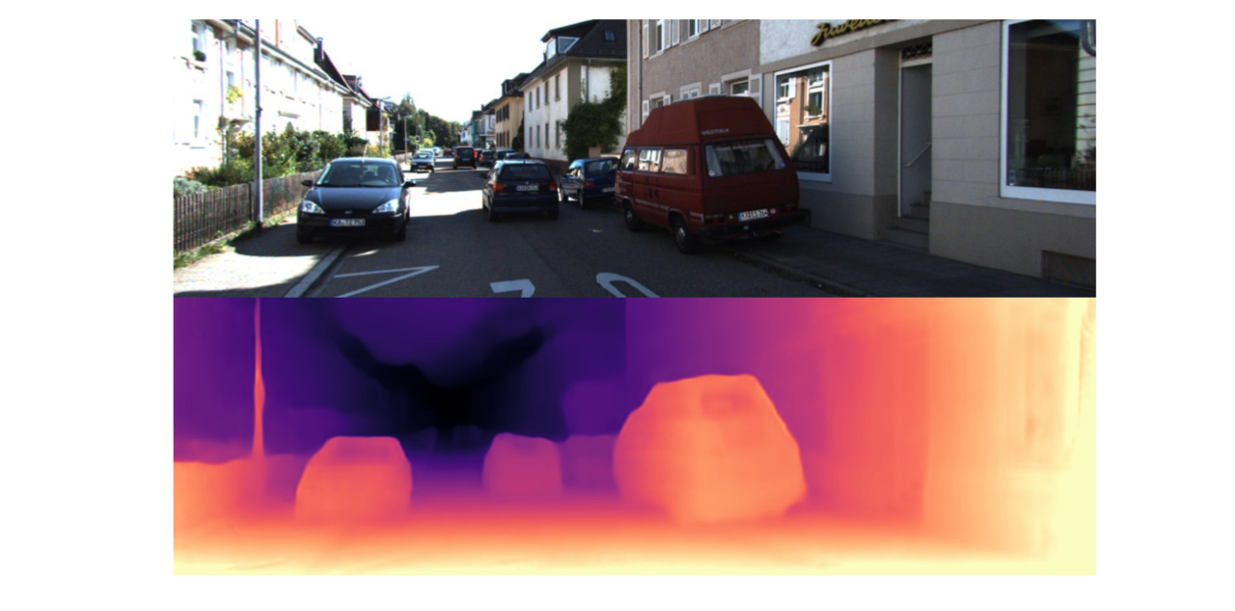

Slide 20
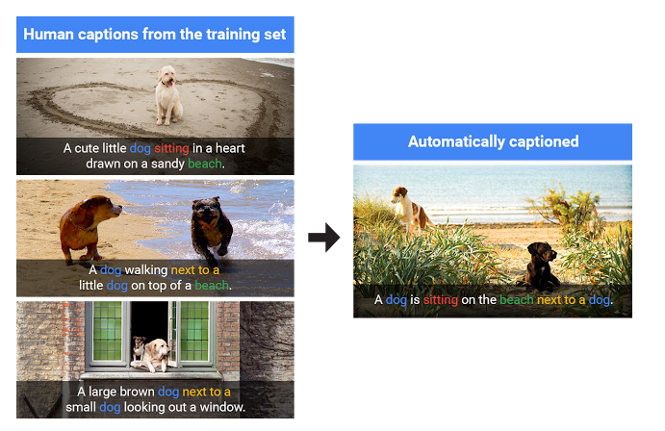

Slide 21
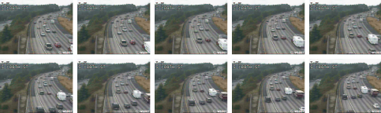
Video processing tasks
Object tracking
Video stabilization
Video enhancement
Video compression
Video to text
Recommendation

Slide 23
Object tracking
Object Detection (YOLO)
Object Association (Hungarian Association Algorithm)
Kalman filter

Slide 24
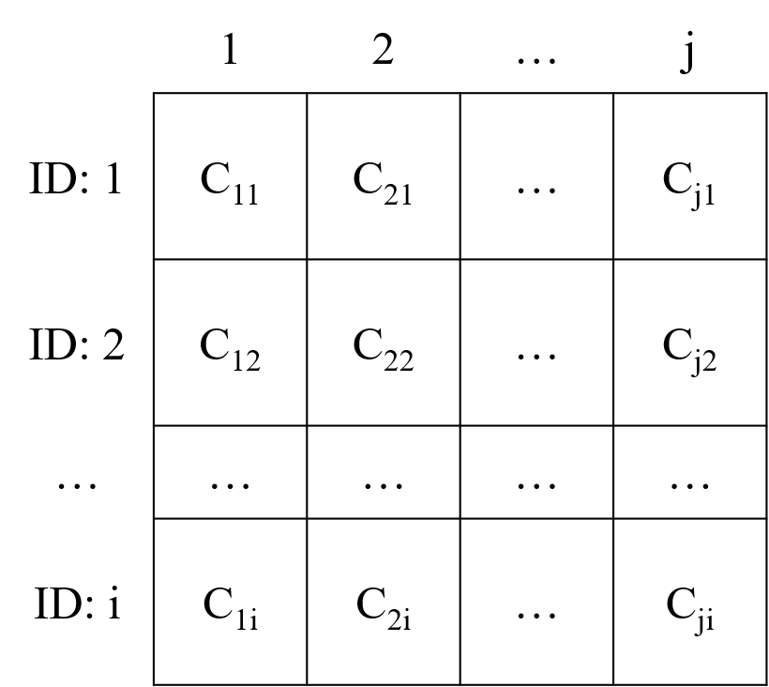
Hungarian algorithm
Row Reduction
Column Reduction
Zero Coverage
Iterative Refinement (if needed)
Finding the Optimal Assignment

Slide 25
Autoencoders
-.3
-.3
.6
.6
Encoder
Decoder

Slide 26
CNN Segmentation
Input
Encoder
Bottleneck
Decoder
Output

Slide 27
CNN Auto-encoder-decoder
Input
Encoder
Bottleneck
Decoder
Output

Slide 28
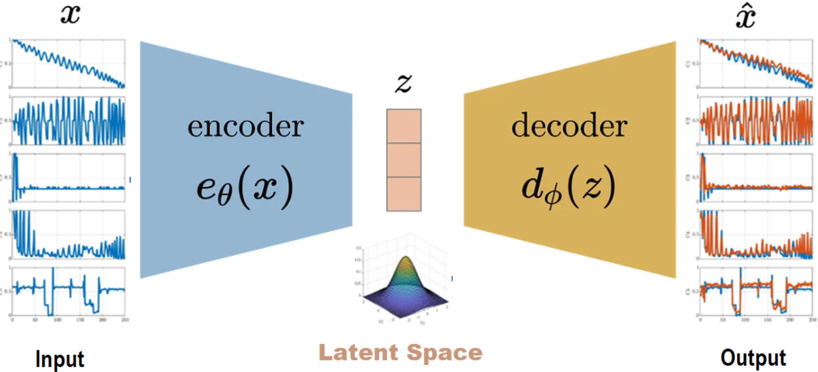

Slide 29
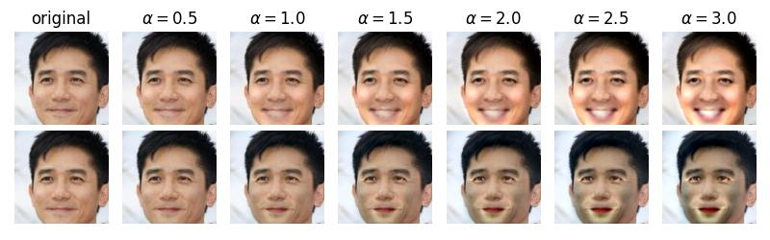

Slide 30
Applications
Data compression
Image search
Topic modeling
Image coloring
Translation
Generative AI
Anomaly detection

Slide 31
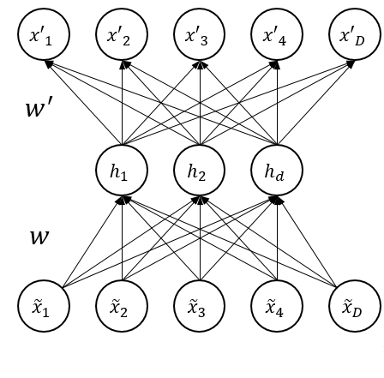
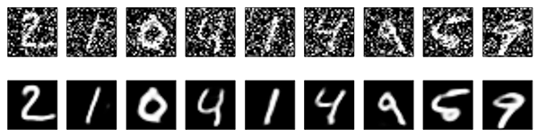
AUTOENCODER FLAVORS

Slide 32


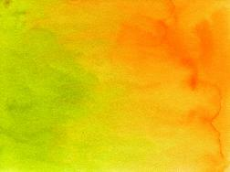



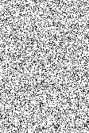





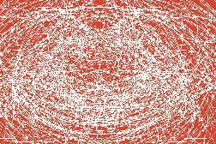
Generative Adversarial Networks (GANs)
Prediction
Real Images
Discriminator
Real
Fake
Generator
Noise
Fake Images
$$\min_{G}{\max_{D}\left(D,G\right)=\log\left(D\left(x\right)\right)+log⁡(1−D(G(z)))}$$

Slide 33
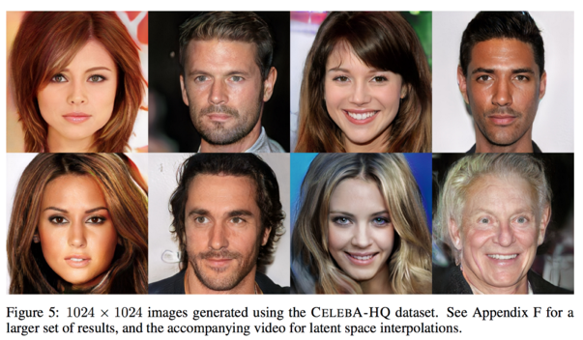
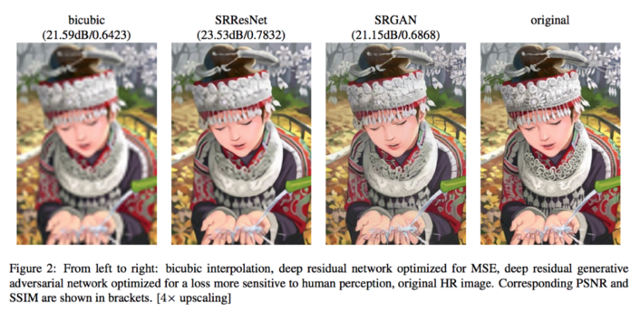
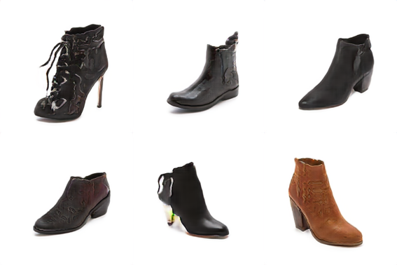
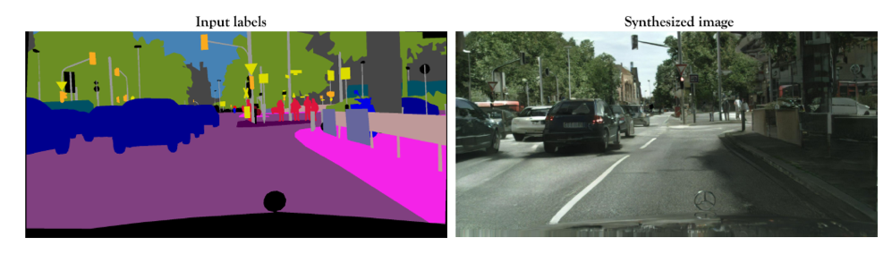
GAN APPLICATIONS
pix2pixHD

Slide 34
TRAINING THE GAN
STEP 1
Input
Journal Entry
Output
Journal Entry
duration | %%%%
src_bytes | %%%%
service | %%%%
flag | %%%%
src_bytes | %%%%
. . .
dst_host_srv_rerror_rate | %%%%
Generate Fake Sample
duration | #####
src_bytes | #####
service | #####
flag | #####
src_bytes | ####
. . .
dst_host_srv_rerror_rate | ####
Generator
Meaningless Output

Slide 35
TRAINING THE GAN
duration | #####
src_bytes | #####
service | #####
flag | #####
src_bytes | ####
. . .
dst_host_srv_rerror_rate | ####
STEP 2
Generator Output
Tune Discriminator Weights
Discriminator
0
Output
Score
-
1
duration | 0
src_bytes | 215
service | http (1)
flag | SF (1)
src_bytes | 215
. . .
dst_host_srv_rerror_rate | 0
Real Data Sample
Error

Slide 36
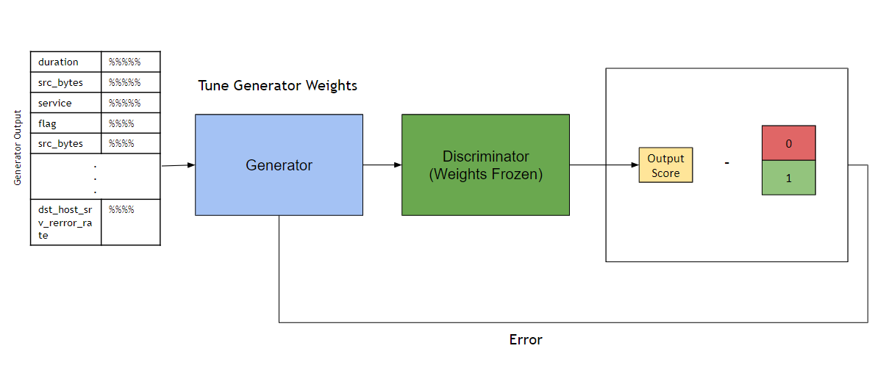
TRAINING THE GAN
STEP 3

Slide 37
TRAINING THE GAN
BACK TO STEP 1
Input
Journal Entry
Output
Journal Entry
duration | %%%%
src_bytes | %%%%
service | %%%%
flag | %%%%
src_bytes | %%%%
. . .
dst_host_srv_rerror_rate | %%%%
Generate Fake Sample
duration | 0
src_bytes | 215
service | http (1)
flag | SF (1)
src_bytes | 215
. . .
dst_host_srv_rerror_rate | 0
Generator
Meaningful Output

Slide 38

ANOMALY DETECTION
Input Test Point
duration | 0
src_bytes | 215
service | http (1)
flag | SF (1)
src_bytes | 215
. . .
dst_host_srv_rerror_rate | 0
Discriminator
Normal
P = 0.95

Slide 39
ANOMALY DETECTION
Input Test point
duration | 99999
src_bytes | 3239862
service | 5454
flag | SF (1)
src_bytes | 215
. . .
dst_host_srv_rerror_rate | 0
Discriminator
Anomaly
P = 0.33

