Slide 1
Advanced Concepts in Machine Learning for Energy
Time: April 7, 9, 11, 14, 15, 1:00 pm - 5:30 pm (in-person students)
April 7 to 25, 2025 (distance students)
Location: GERB 315 and Zoom

Slide 2
Lecture | Topic | Quiz
1 | Neural network fundamentals and continuous optimization
2 | Image classification, object detection, and pixel segmentation | #1
3 | Autoencoder, autodecoder, and generative adversarial network (GAN) | #2
4 | Attention mechanism, generative pretrained transformers (GPT) | #3
5 | Final project Q&A, advanced topics review | #4

Slide 3
Lecture 4
Word tokenization & lab 4a (1:00-2:00 pm)
Word embedding & lab 4b word2vec (2:00-3:00 pm)
Text classification & Lab 4b text classification (3:00-3:30 pm)
Attention & Lab 4c 1st half(3:30-4:00 pm)
Transformer & Lab 4c 2nd half (4:30-5:00 pm)
Lab 4e BLEU (5:00-5:30 pm)

Slide 4
Ambiguity
The fisherman went to the bank. He deposited some money.
The fisherman went to the bank. He caught a lot of fish there.

Slide 5
Language corpus is massive
English vocabulary: 30-40k
Wikipedia: 2.9 billion words (English)

Slide 6
NLP tasks
Dialogue
Text summarization
Machine translation
Information extraction
Sentiment analysis
…

Slide 7
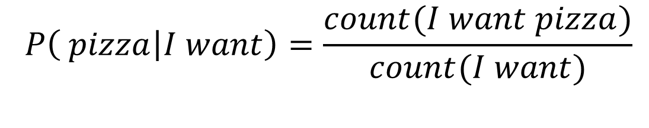
Estimating the probabilities
Sequence: “I want pizza”
Probabilistic model of a sequence of words
Vocabulary V
$$P\left(I want pizza\right)=P\left(I\right)∗P\left(want | I\right)∗P(pizza|I want)$$
$$P\left( pizza | I want\right)=\frac{count(I want pizza)}{count(I want)}$$

Slide 8

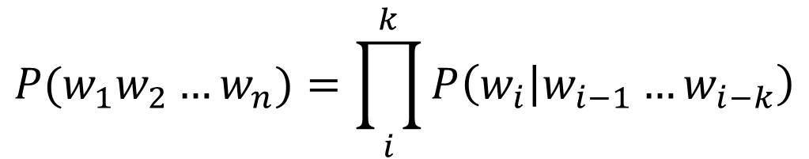



Markov chain
Consider only the last k words from the context
k gram
$$P(w_{1}w_{2}…w_{n})=\prod_{i}^{k}{P\left(w_{i} | w_{i−1}…w_{i−k}\right)}$$

Slide 9
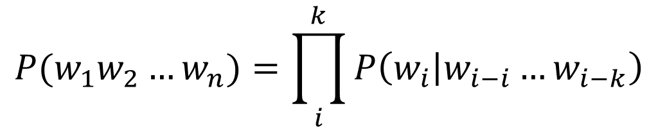
N-gram
Unigram
Bigram
Trigram, 4-gram, etc
Larger N, better accuracy
$$P(w_{1}w_{2}…w_{n})=\prod_{i}^{k}{P\left(w_{i} | w_{i−i}…w_{i−k}\right)}$$

Slide 10
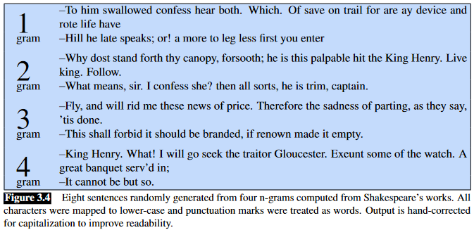



Slide 11
Metrics
Perplexity
Bilingual Evaluation Understudy (BLEU) score
Reasoning
…

Slide 12

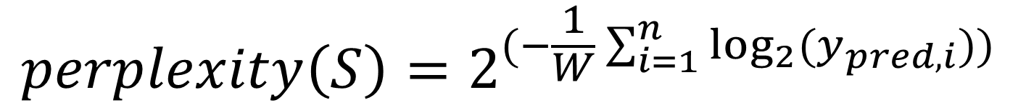
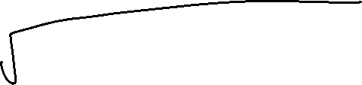

Perplexity
For each word i, the positive prediction is y_pred
W is the total number of words in the test corpus S
Minimizing perplexity = maximizing probability
$$perplexity\left(S\right)=2^{(−\frac{1}{W}\sum_{i=1}^{n}{\log_{2}⁡(y_{pred,i})) }}$$

Slide 13
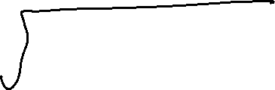

Slide 14

Pros and cons of perlexity
Pros:
Fast to compute, eliminate ”bad” models that can’t perform well in expensive real-world testing
Model’s uncertainty/information density is useful information
Statistically robust (not easily influenced by a single outlier sentence in the dataset)
Cons:
Not good for final evaluation: measures model’s confidence, not accuracy
Not fair comparison across models trained on different datasets
Can reward models trained on toxic or outdated dataset

Slide 15
Why did not work
Small dataset
Word embeddings
Training data: Google News
Test data: Shakespeare
P (affray | voice doth us) = 0 → P (test set) = 0

Slide 16

Tokenization
“I want pizza”
“我想要披萨”
“ピザが欲しいです”
“Eu quero pizza”
“أريد بيتزا ”
“मुझे पिज़्ज़ा चाहिए”
“Quiero pizza”
“피자가 먹고 싶어요”

Slide 17
ASCII and UTF encoding
“p”->01110000
https://www.unicode.org/charts
https://www.cogsci.ed.ac.uk/~richard/utf-8.cgi?input=pizza&mode=char
https://tiktokenizer.vercel.app/

Slide 18
Word embedding
Bag of words
TF-IDF
Word2Vec: Skip-gram and Negative Sampling
…

Slide 19
Basic Bag-of-Words (BOW)
corpus = [
"Red Bull drops hint on F1 engine.",
"Honda exits F1, leaving F1 partner Red Bull.",
"Hamilton eyes record eighth F1 title.",
"Aston Martin announces sponsor."
]

Slide 20
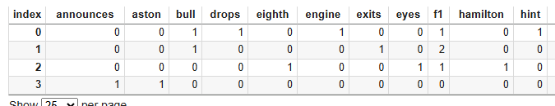




Count vectorizer
Doc 0 vs Doc 1: 0.47809144373375745
Doc 0 vs Doc 2: 0.15430334996209194
Doc 0 vs Doc 3: 0.0

Slide 21
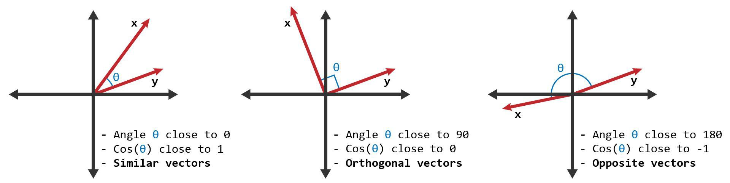
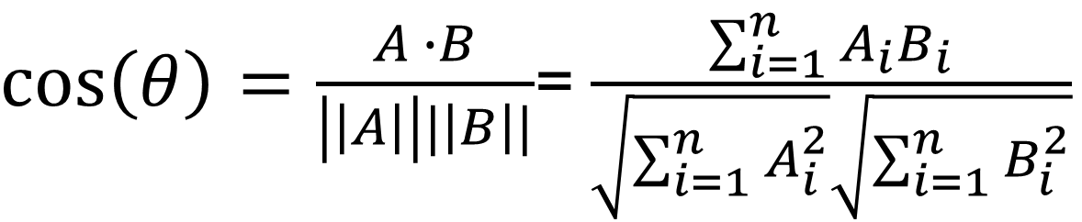
Cosine similarity
Vector A and B
Range from -1 to 1 -> not similar to similar
$\cos\left(θ\right)=\frac{A ∙B}{\left|\left|A\right|\right||\left|B\right||}$= $\frac{\sum_{i=1}^{n}{A_{i}B_{i}}}{\sqrt{\sum_{i=1}^{n}{A_{i}^{2}}}\sqrt{\sum_{i=1}^{n}{B_{i}^{2}}}}$

Slide 22


Cosine similarity
Vector A and B
Range from -1 to 1 -> not similar to similar
$\cos\left(θ\right)=\frac{A ∙B}{\left|\left|A\right|\right||\left|B\right||}$= $\frac{\sum_{i=1}^{n}{A_{i}B_{i}}}{\sqrt{\sum_{i=1}^{n}{A_{i}^{2}}}\sqrt{\sum_{i=1}^{n}{B_{i}^{2}}}}$

Slide 23
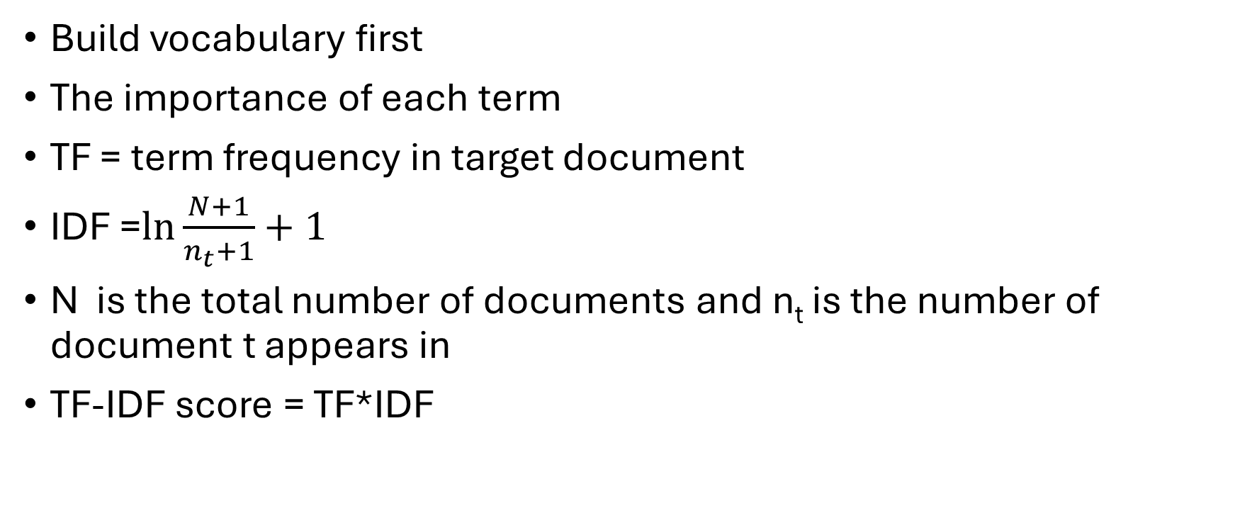
Term Frequency-Inverse Document Frequency (TF-IDF)
Build vocabulary first
The importance of each term
TF = term frequency in target document
IDF =$\ln{\frac{N+1}{n_{t}+1}+1}$
N is the total number of documents and n_{t} is the number of document t appears in
TF-IDF score = TF*IDF

Slide 24
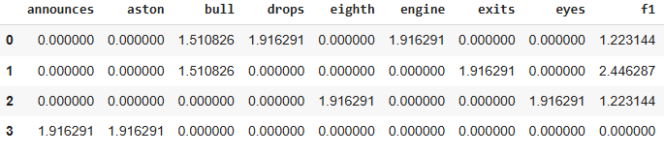
Little search engine
Lab 4a
Cosine similarity

Slide 25












Word2Vec

Slide 26












Slide 27
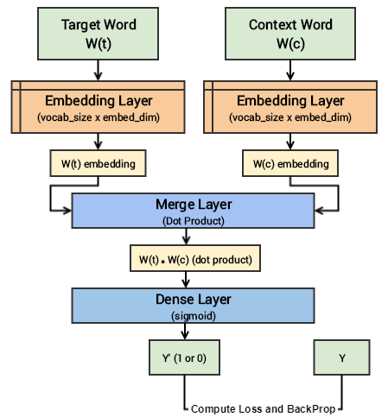


Slide 28
Lab 4b word2vec
Cosine similarity
https://projector.tensorflow.org/

Slide 29
Text classification
Rule-based
“Good, great, awesome, extraordinary”-> positive
“casino, weed, loss” -> negative
Bayesian
Logistic
Support vector machine
KNN

Slide 30
Prediction\Ground Truth | Positive | Negative
Positive | TP | FP
Negative | FN | TN
$$accuracy=\frac{TP+TN}{TP+FP+TN+FN}$$
$$precision=\frac{TP}{TP+FP}$$
$$recall=\frac{TP}{TP+FN}$$

Slide 31
Lab 4b text classification
The whole document is vectorized as one vector
How many parameters in the model?
FIXME

Slide 32
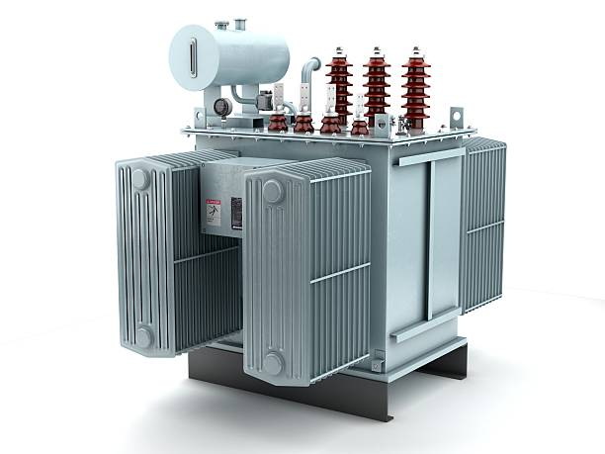
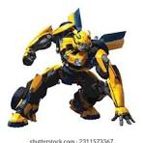
Transformer
GPT: Generative Pre-trained Transformer
Vision Transformer: DETR
Attention mechanism

Slide 33
CV and NLP
CNN: CV->NLP
LSTM: CV->NLP
RNN: CV->NLP
Transformer: NLP->CV

Slide 34
Sequence models
Recurrent Neural Networks (RNNs)
Long short-term memory (LSTM)
Gated recurrent units (GRUs)
Markov chains

Slide 35












Slide 36
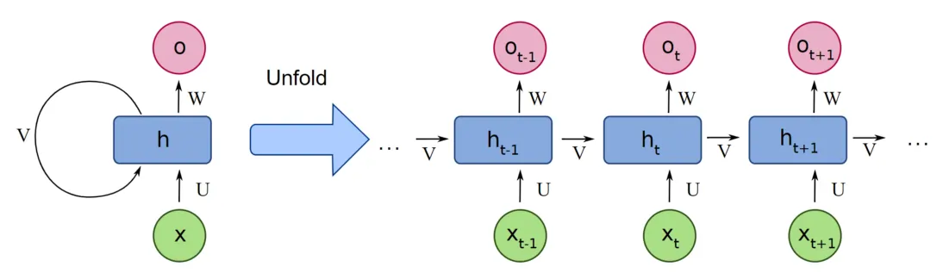





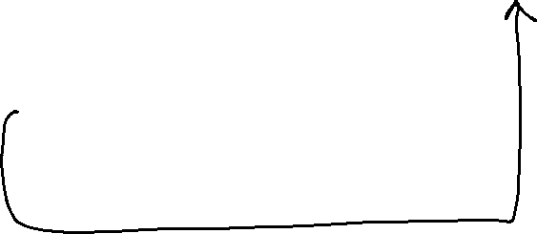
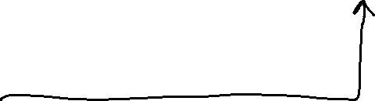

RNN

Slide 37


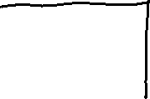



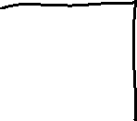







Attention

Slide 38
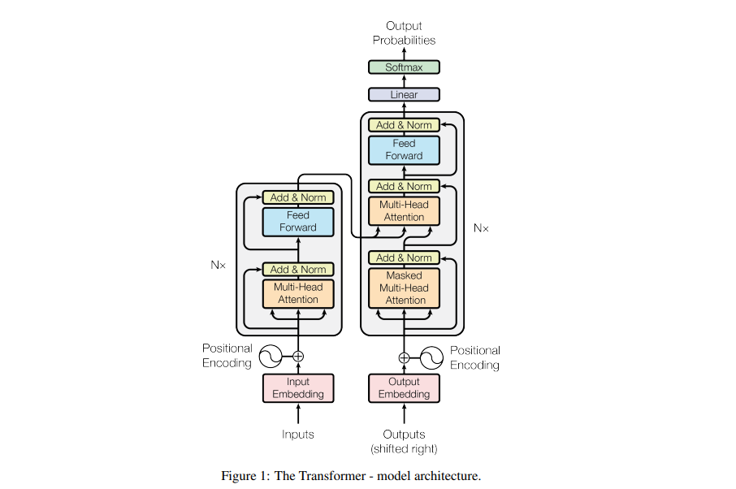









Vaswani, A. (2017). Attention is all you need. Advances in Neural Information Processing Systems.

Slide 39
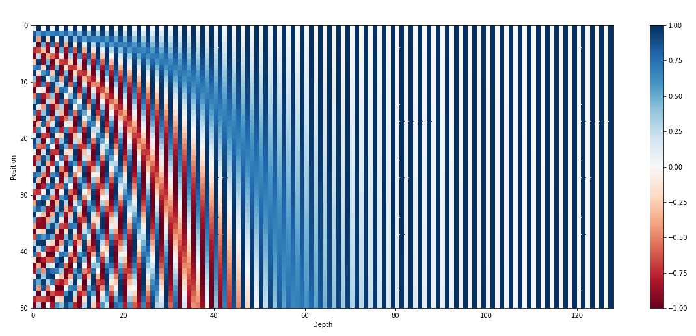




Slide 40

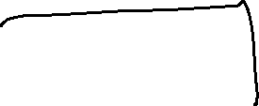















Slide 41
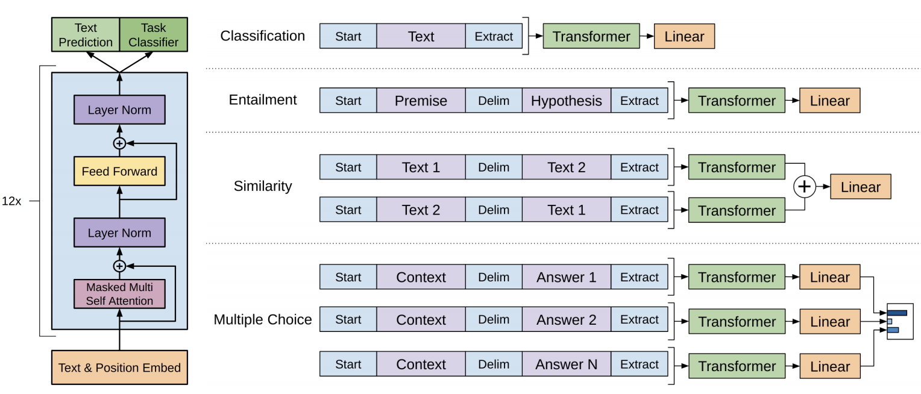


Generative Pre-trained Transformer
Decoder only

Slide 42
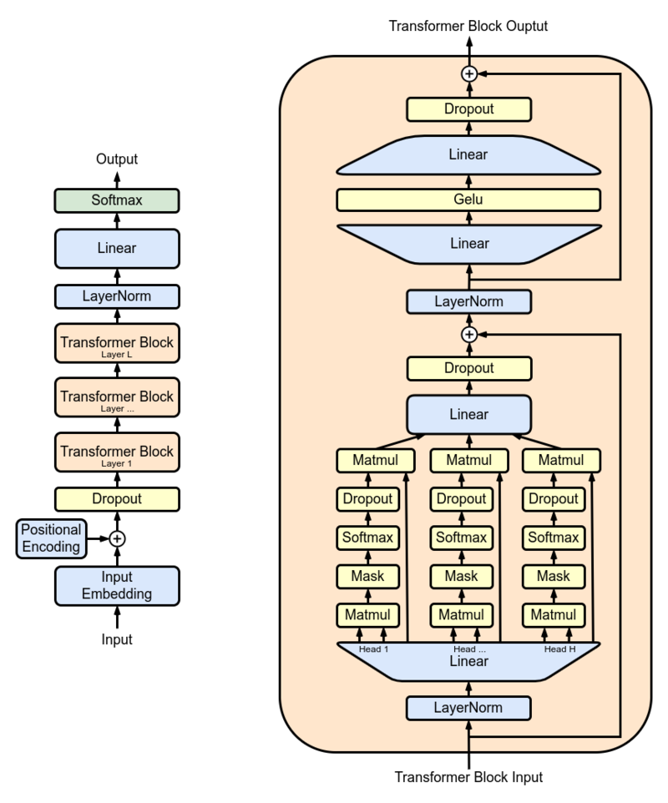

Slide 43
GPT 3
Parameters 175 B
Dataset 45T
96 attention heads
2048 token size
Learn from their chief scientist: https://www.youtube.com/watch?v=kCc8FmEb1nY

Slide 44
Why GPT bad at math
https://tiktokenizer.vercel.app/
Example:
456789*0.002359*0.0065688*266

Slide 45
More metrics
Bilingual Evaluation Understudy (BLEU)
Story Cloze
https://cs.rochester.edu/nlp/rocstories/
GSM8K
https://github.com/openai/grade-school-math

Slide 46

BLEU
Candidate: I want pizza
Candidate: I want fired rice
$$precision=\frac{\# overlapping words}{\# candidate words}=\frac{2}{3}$$
$$recall=\frac{\# overlapping words}{\# reference words}=\frac{2}{4}$$

Slide 47

N-gram BLEU
2-gram BLEU
Candidate: [“I want”, “want pizza”]
Candidate: [ “I want”, “want fired”, “fried rice”]
3-gram BELU
$$BLEU=\prod_{i=1}^{N}{p_{i}}$$

Slide 48

N-gram BLEU
Candidate: I want
Candidate: I want fired rice
$$brivety penalty(BP)=\left\{\begin{aligned}1 if c>r \\ e^{1−\frac{r}{c}} if c≤r\end{aligned}\right.$$
$$BLEU=BP∗\prod_{i=1}^{N}{p_{i}}$$

