Slide 1
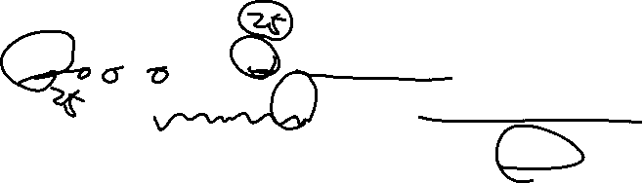
Advanced Concepts in Machine Learning for Energy
Time: April 7, 9, 11, 14, 15, 1:00 pm - 5:30 pm (in-person students)
April 7 to 25, 2025 (distance students)
Location: GERB 315 and Zoom

Slide 2
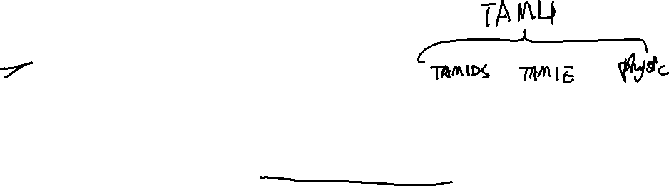
Instructor
Yalong Pi
Associate Research Scientist
Texas A&M Institute of Data Science
Address: Office 221C, John R. Blocker Building
Email: piyalong@tamu.edu

Slide 3
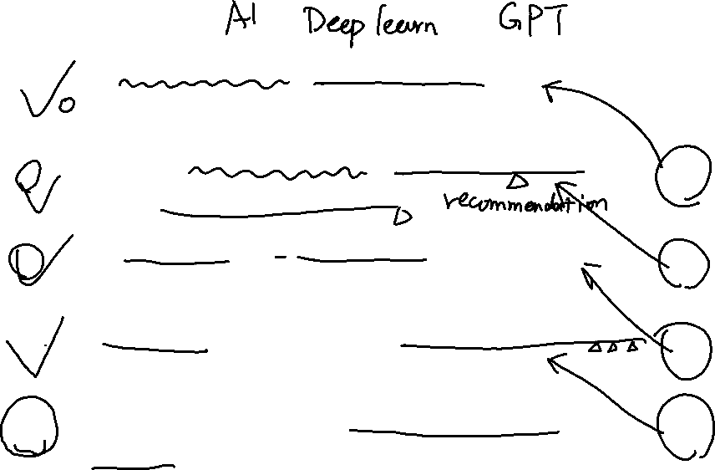


Lecture | Topic | Quiz
1 | Neural network fundamentals and continuous optimization
2 | Image classification, object detection, and pixel segmentation | #1
3 | Autoencoder, autodecoder, and generative adversarial network (GAN) | #2
4 | Attention mechanism, transformers (GPT) and reinforcement learning | #3
5 | Final project Q&A, advanced topics review | #4

Slide 4


Course materials
Canvas (quiz and final project submission)
Dataset: https://www.kaggle.com/datasets/piyalong/dataset-for-icpe-639
Code: https://github.com/TAMIDSpiyalong/Advanced-Concepts-in-Machine-Learning-for-Energy
Howdy (syllabus and grade)

Slide 5





TensorFlow | Google
Theano | University of Montréal, 2009
Keras | François Chollet, 2015 (now at Google)
Torch | Facebook
Caffe | Berkeley Vision and Learning Center (BVLC), 2013

Slide 6

Four quizzes and one final project
In-class quiz (10 points each)
Some calculation
Use quiz.ipynb on Github
Emphasis on fundamentals, no code test
Final project (60 points)
Track 1
Track 2
Due April 15&25
Total open book

Slide 7




Lecture 1
Intro (1:00-1:30 pm)
Break (1:30-1:40 pm)
Neural network optimization 1 (1:40-2:40 pm)
Break (2:53-3:00 pm)
Neural network optimization 2 (2:40-3:40 pm)
Break (3:23-3:50 pm)
Excel machine learning (3:50-4:30 pm)
Break (4:30- 4:40 pm)
Computing fundamentals and HPRC set up (4:40-5:30 pm)

Slide 8

















O₁
w₁₁
x₁
w₂₁
y
w₂₂
O₂
w₁₂
$$y_{pred}=x_{1}∗w_{11}∗w_{21}+x_{1}∗w_{12}∗w_{22}$$
x | y_{gt}
1 | 10
2 | 20
5 | 30

Slide 9
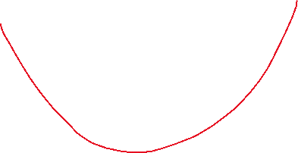









O₁
w₁₁
x₁
w₂₁
y
w₂₂
O₂
w₁₂
$$y_{pred}=x_{1}∗w_{11}∗w_{21}+x_{1}∗w_{12}∗w_{22}$$
$loss=(y_{true}−y_{pred}$)²
x | y_{gt}
1 | 10
2 | 20
5 | 30

Slide 10






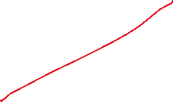





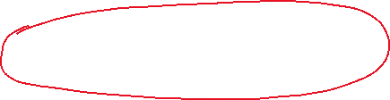













x | y_{gt}
1 | 10
2 | 20
5 | 30
$$y_{pred}=x_{1}∗w_{11}∗w_{21}+x_{1}∗w_{12}∗w_{22}$$

Slide 11
















O₁
w₁₁
x₁
w₂₁
y
w₂₂
O₂
w₁₂
$$y_{pred}=x_{1}∗w_{11}∗w_{21}+x_{1}∗w_{12}∗w_{22}$$
$loss=(y_{true}−y_{pred}$)²
x | y_{gt}
1 | 10
2 | 20
5 | 30
$$new \vec{w}=old \vec{w}−\frac{∂\vec{loss}}{∂\vec{w}}∗LR$$

Slide 12
x | y_{gt}
1 | 10
2 | 20
5 | 30
$$new \vec{w}=old \vec{w}−\frac{∂\vec{loss}}{∂\vec{w}}∗LR$$

Slide 13




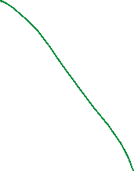





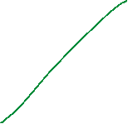



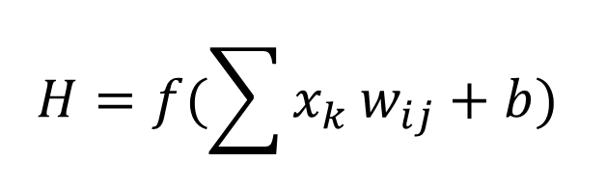











H₁
H
W₂₁
W₁₁
For each neuron H:
x₁
H₂
W₂₂
W₁₂
$$H=f(\sum{x_{k}}w_{ij}+b)$$
y₁
x₂
y₂
W_{ij}
H_{k}

Slide 14























H₁
H
W₂₁
W₁₁
For each neuron H:
x₁
H₂
W₂₂
W₁₂
$$H=f(\sum{x_{k}}w_{ij}+b)$$
y₁
x₂
y₂
f is the activation function
w_{ij} is the weight
b is the bias
A DNN has millions of weights and biases
W_{ij}
H_{k}

Slide 15
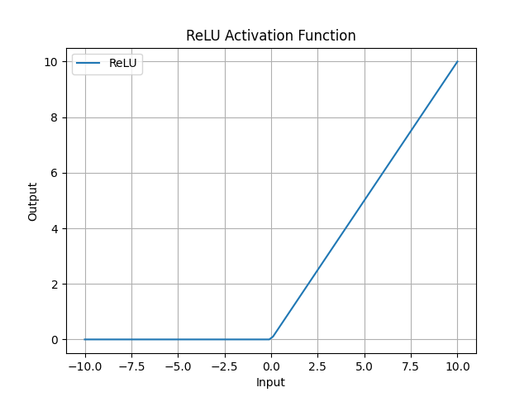


Slide 16
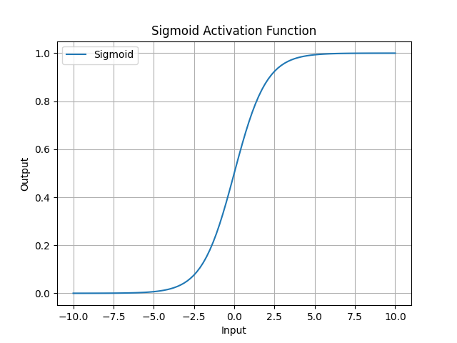





Slide 17





























Output types
Regression
Classification
Feature extraction
Combination

Slide 18
Regression loss
Mean absolute error
Mean square error
$$MAE=\frac{1}{n}|y_{pred}−y_{true}|$$
$$MSE=\frac{1}{n}{\left(y_{pred}−y_{true}\right)}^{2}$$

Slide 19















H₁
H
W₂₁
W₁₁
x₁
H₂
W₂₂
W₁₂
y₁
x₂
y₂
W_{ij}
H_{k}

Slide 20
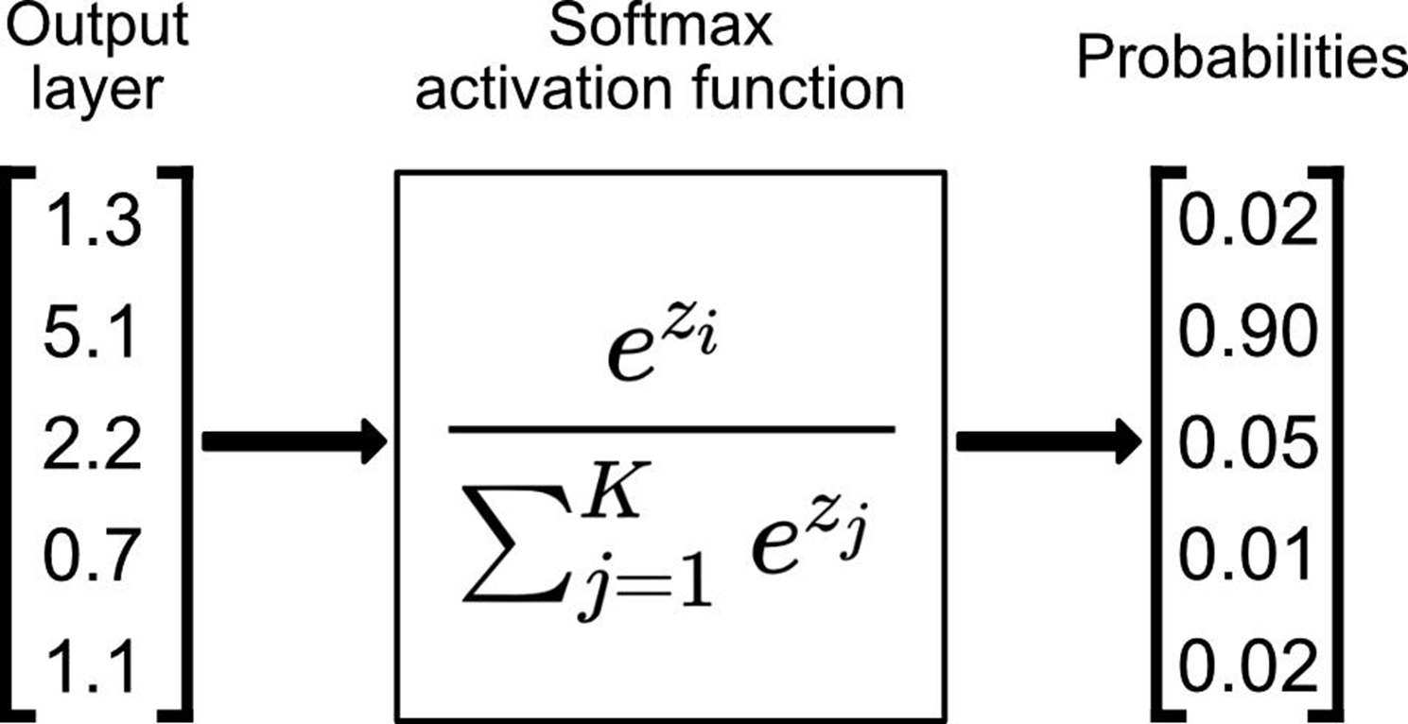













Softmax for y_pred

Slide 21
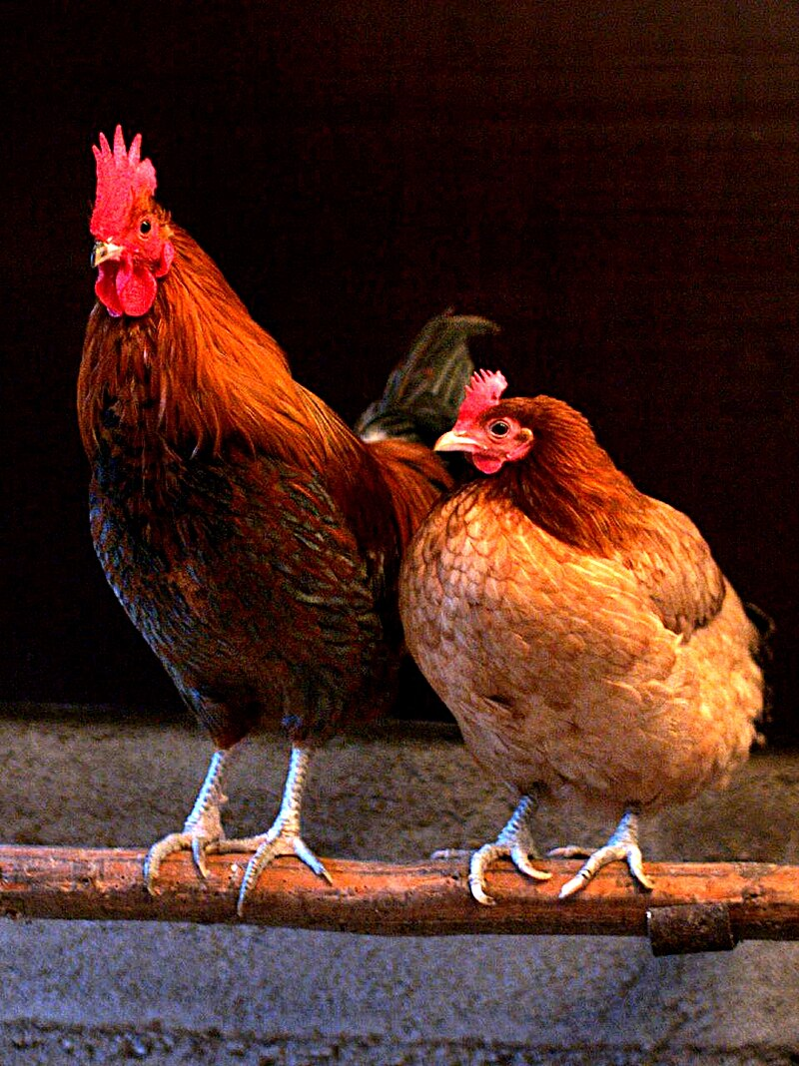
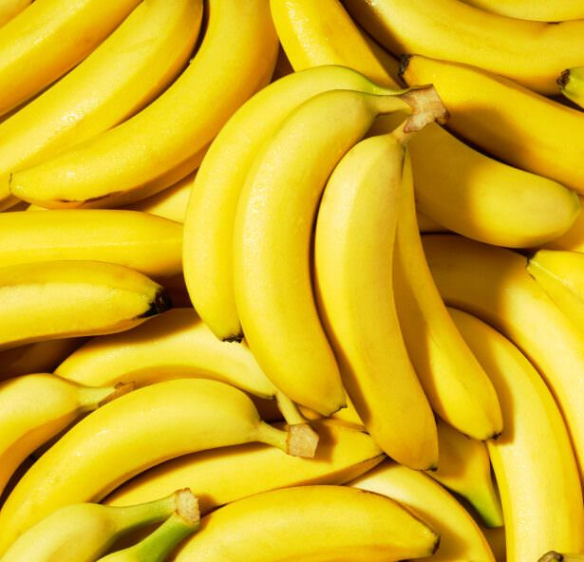













One hot encoding for y_true
$$\left[\begin{matrix}1 \\ 0 \\ 0\end{matrix}\right]$$
Chicken
Banana
Dog
$$\left[\begin{matrix}0 \\ 1 \\ 0\end{matrix}\right]$$

Slide 22
H₁
H
W₂₁
W₁₁
x₁
H₂
W₂₂
W₁₂
y₁
x₂
y₂
W_{ij}
H_{k}

Slide 23
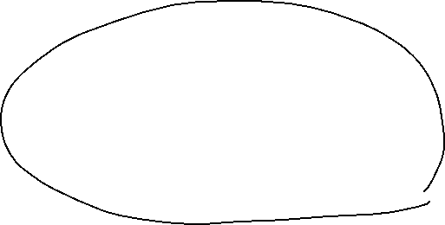

Cross entropy loss for classification
Binary cross entropy
After softmax
Multi class entropy
After softmax
$$BCE=−\sum{y_{true}∗\log\left(y_{pred}\right)+\left(1−y_{true}\right)∗log⁡(1−y_{pred})}$$
$$CE=−\sum{y_{true}∗\log\left(y_{pred}\right)}$$

Slide 24
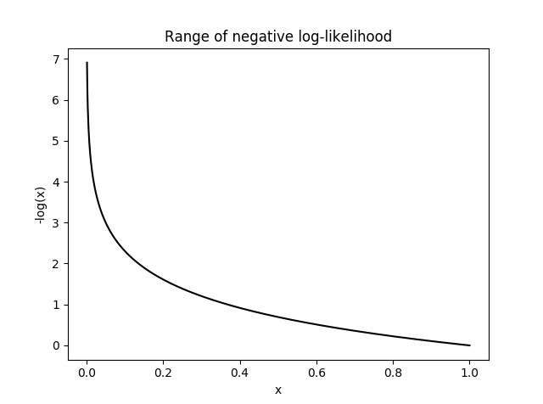




Slide 25
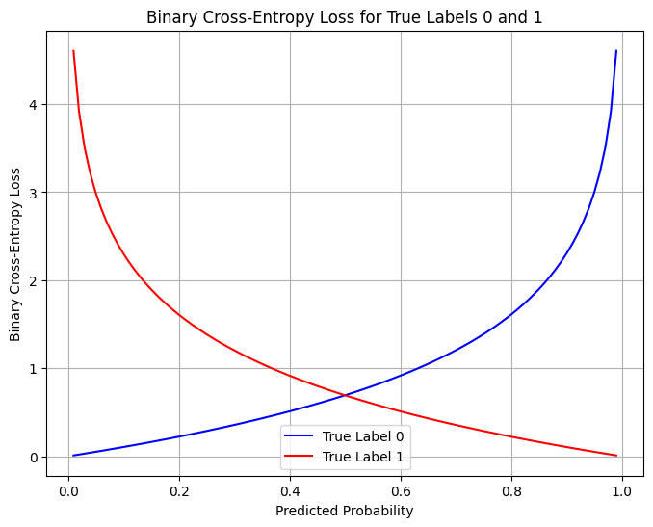



Slide 26




Feature extraction
H₁
F
W₂₁
W₁₁
x₁
H₂
W₂₂
F
W₁₂
y₁
x₂
F
y₂
F
W_{ij}
H_{k}
F

Slide 27








Combination
H₁
H
W₂₁
W₁₁
x₁
H₂
W₂₂
W₁₂
y₁
x₂
$$loss=MSE+CE$$
y₂
W_{ij}
H_{k}

Slide 28



Weight update
H₁
H
W₂₁
W₁₁
x₁
H₂
W₂₂
W₁₂
Learn
Fit
Train
Back propagation
y_{1_true}
y₁
x₂
$$loss$$
y₂
y_{2_true}
W_{ij}
H_{k}
$$new \vec{w}=old \vec{w}−∇∗LR$$

Slide 29

Use the model
H₁
H
W₂₁
W₁₁
x₁
H₂
W₂₂
W₁₂
Forward pass
Inference
Test
Validation
Deployment
y₁
x₂
y₂
W_{ij}
H_{k}
$$NN\left(X\right)=Y$$

Slide 30
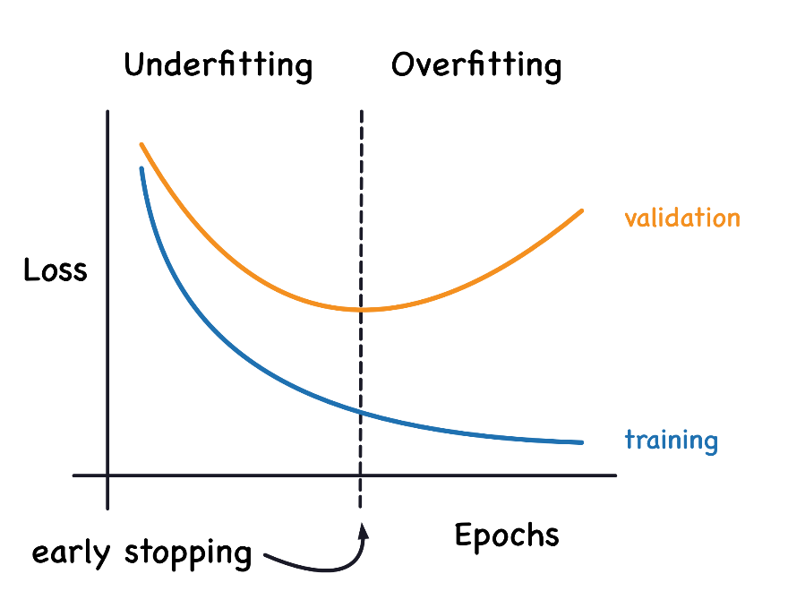







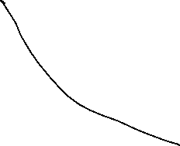












Slide 31
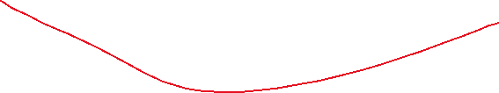
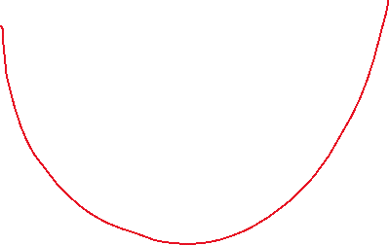

Slide 32
Metrics
Regression
MAE
MSE
Classification
Area under ROC
Confusion matrix
Recall
Precision
F1
Accuracy
Mix

Slide 33
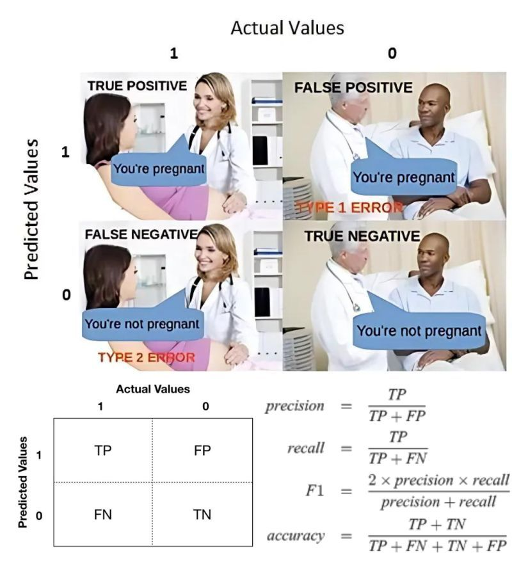







Slide 34
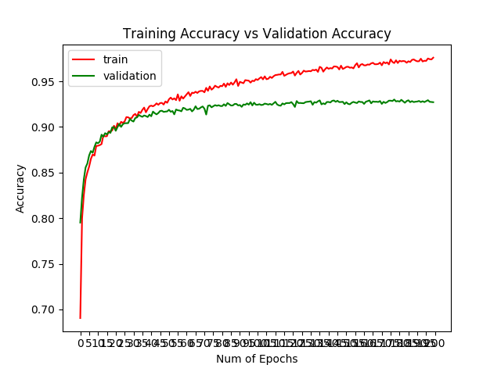



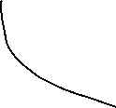

Slide 35
Excel machine learning
Partial derivatives
Chain rule/back propagation
https://github.com/TAMIDSpiyalong/Advanced-Concepts-in-Machine-Learning-for-Energy/blob/main/Lecure%201/Excel_Machine_Learning.pdf
Chapter 5
Chapter 7

Slide 36
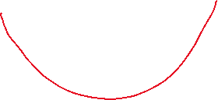
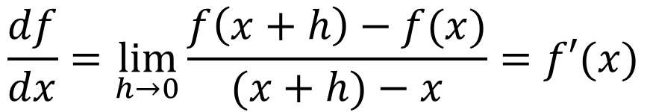
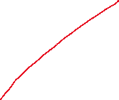
Derivative/slope for f(x)
“Mathematics for machine learning”, Chapter 5
Quiz
$$\frac{df}{dx}=\lim_{h→0}{\frac{f\left(x+h\right)−f(x)}{(x+h)−x}}=f′(x)$$

Slide 37
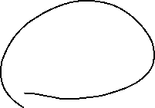








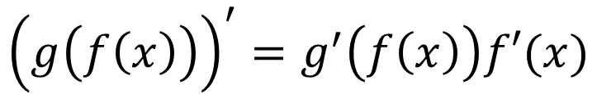
Differentiation Rules
$${(x^{n}) }^{′}=nx^{n−1}$$
Power rule
Chain rule
Constant rule
…
$${\left(g\left(f\left(x\right)\right)\right)}^{′}=g^{′}\left(f\left(x\right)\right)f′(x)$$
$$c^{′}=0$$

Slide 38

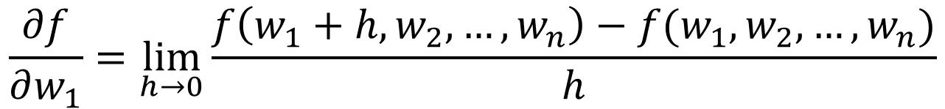
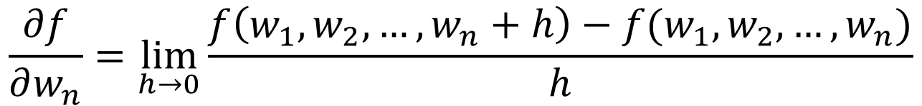
Partial derivatives
For example: f(x)=f(w₁,w₂,…,w_{n})
$$\frac{∂f}{∂w_{1}}=\lim_{h→0}{\frac{f\left(w_{1}+h,w_{2},…,w_{n}\right)−f(w_{1},w_{2},…,w_{n})}{h}}$$
$$…$$
$$\frac{∂f}{∂w_{n}}=\lim_{h→0}{\frac{f\left(w_{1},w_{2},…,w_{n}+h\right)−f(w_{1},w_{2},…,w_{n})}{h}}$$

Slide 39




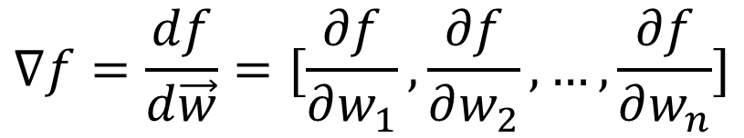









Gradient
For example: f(x)=f(w₁,w₂,…,w_{n})
Quiz
$$∇f=\frac{df}{d\vec{w}}=[\frac{∂f}{∂w_{1}},\frac{∂f}{∂w_{2}},…,\frac{∂f}{∂w_{n}}]$$

Slide 40




O₁
w₁₁
x₁
w₂₁
y
w₂₂
O₂
w₁₂
x | y_{gt}
1 | 10
2 | 20
5 | 30

Slide 41
O₁
w₁₁
x₁
w₂₁
y
w₂₂
O₂
w₁₂
x | y_{gt}
1 | 10
2 | 20
5 | 30

Slide 42
O₁
w₁₁
x₁
w₂₁
y
w₂₂
O₂
w₁₂
x | y_{gt}
1 | 10
2 | 20
5 | 30

Slide 43








O₁
w₁₁
x₁
w₂₁
y
w₂₂
O₂
w₁₂

Slide 44
Homework
See PDF
Try the Excel
Currently, there is no activation function. Could you add some?
Plot the prediction and results

Slide 45
Computing
Binary
Logic gates
Transistor
Half adder
HPRC set up

Slide 46
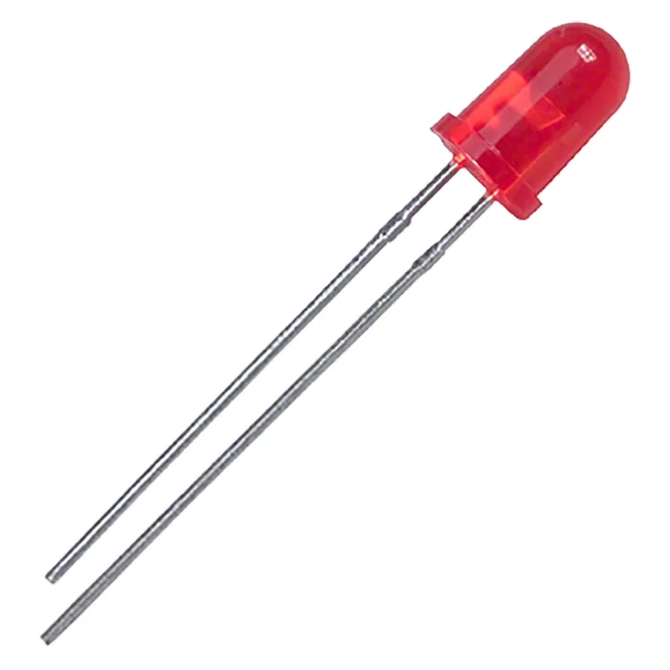













Binary
High voltage = 1 (on); Low voltage = 0 (off)
Reliable
ASCII (e.g., 01100001->”a”; 01110000->”p”)
2⁸
Clock at 1 Hz
t | 1 | 2 | 3 | 4 | 5 | 6 | 7 | 8 | 9 | 10 | 11 | 12 | 13 | 14 | 15 | 16 | 17 | 18 | 19 | 20 | …
s | 0 | 1 | 1 | 0 | 0 | 0 | 0 | 1 | 0 | 1 | 1 | 1 | 0 | 0 | 0 | 0

Slide 47







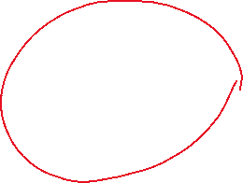



Binary to decimal
Binary
Decimal
$$d_{n−1}…d_{2}d_{1}d_{0}$$
$$d_{0}∗2^{0}+d_{1}∗2^{1}+…+d_{n−1}∗2^{n−1}$$

Slide 48
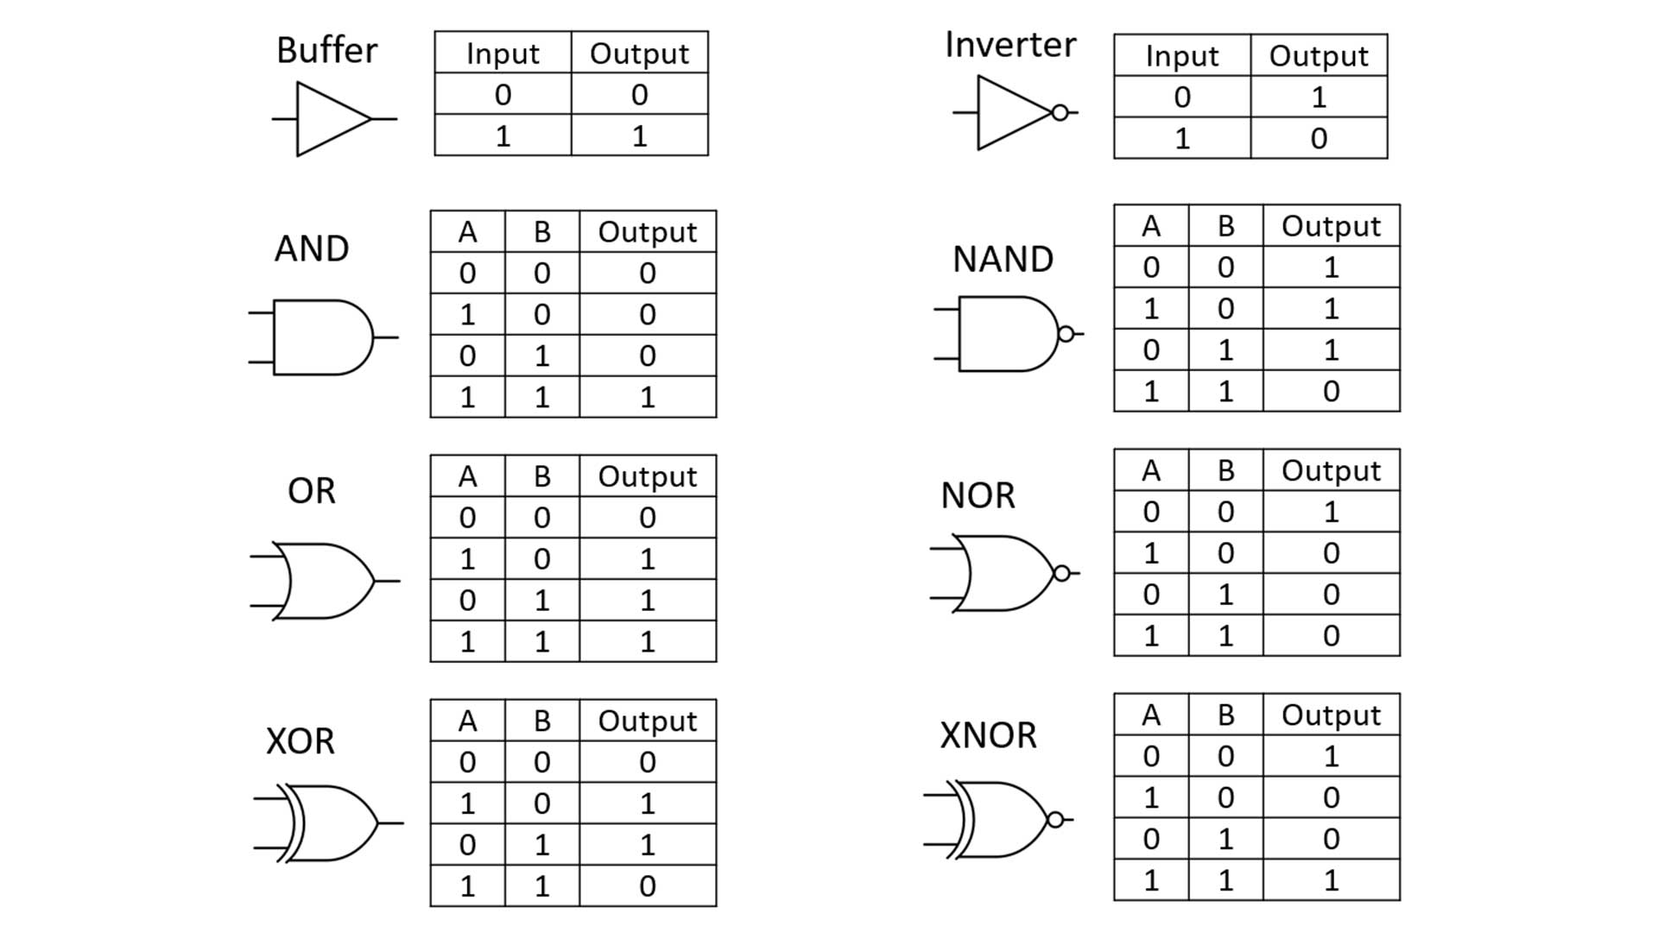


















Slide 49
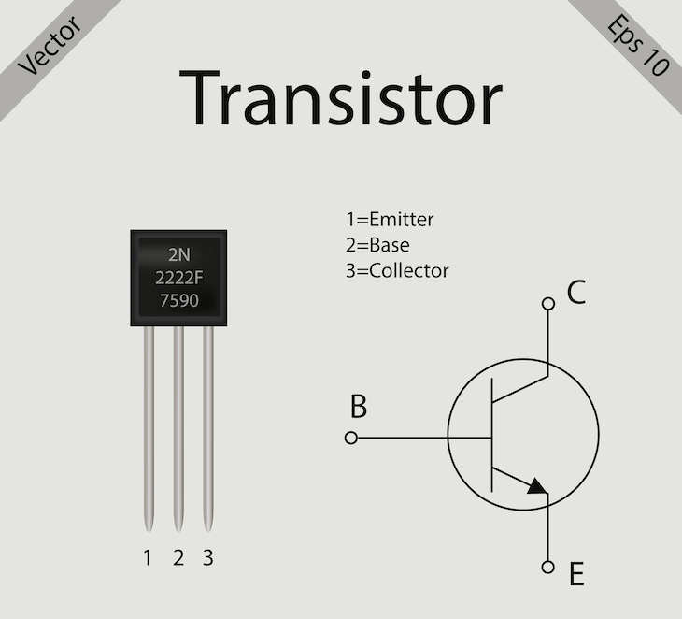










Slide 50
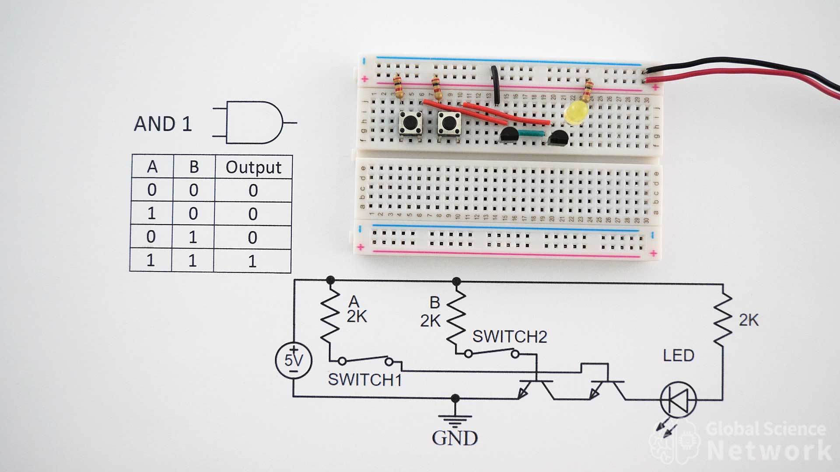


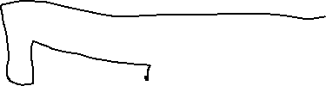










Slide 51
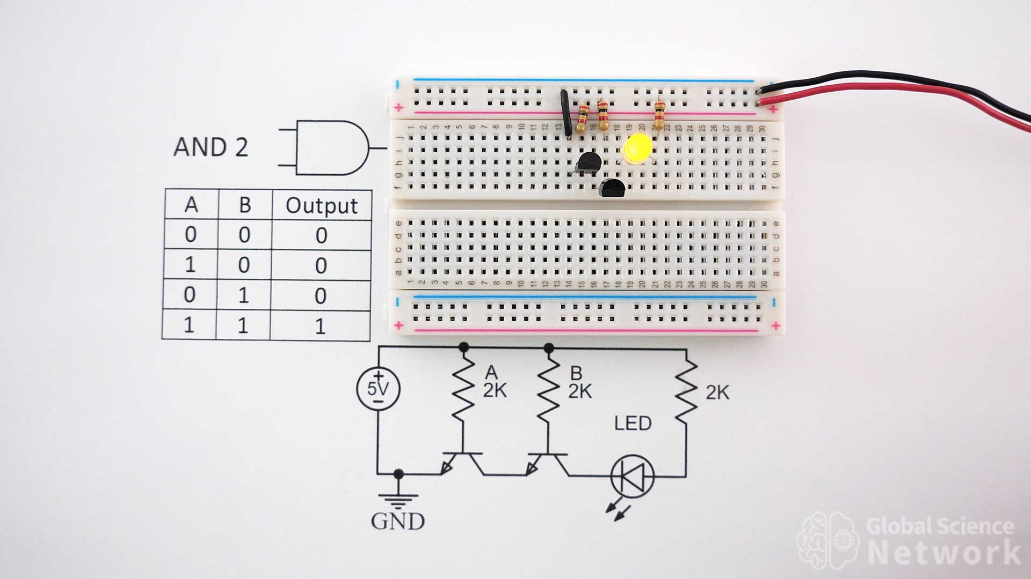







Slide 52
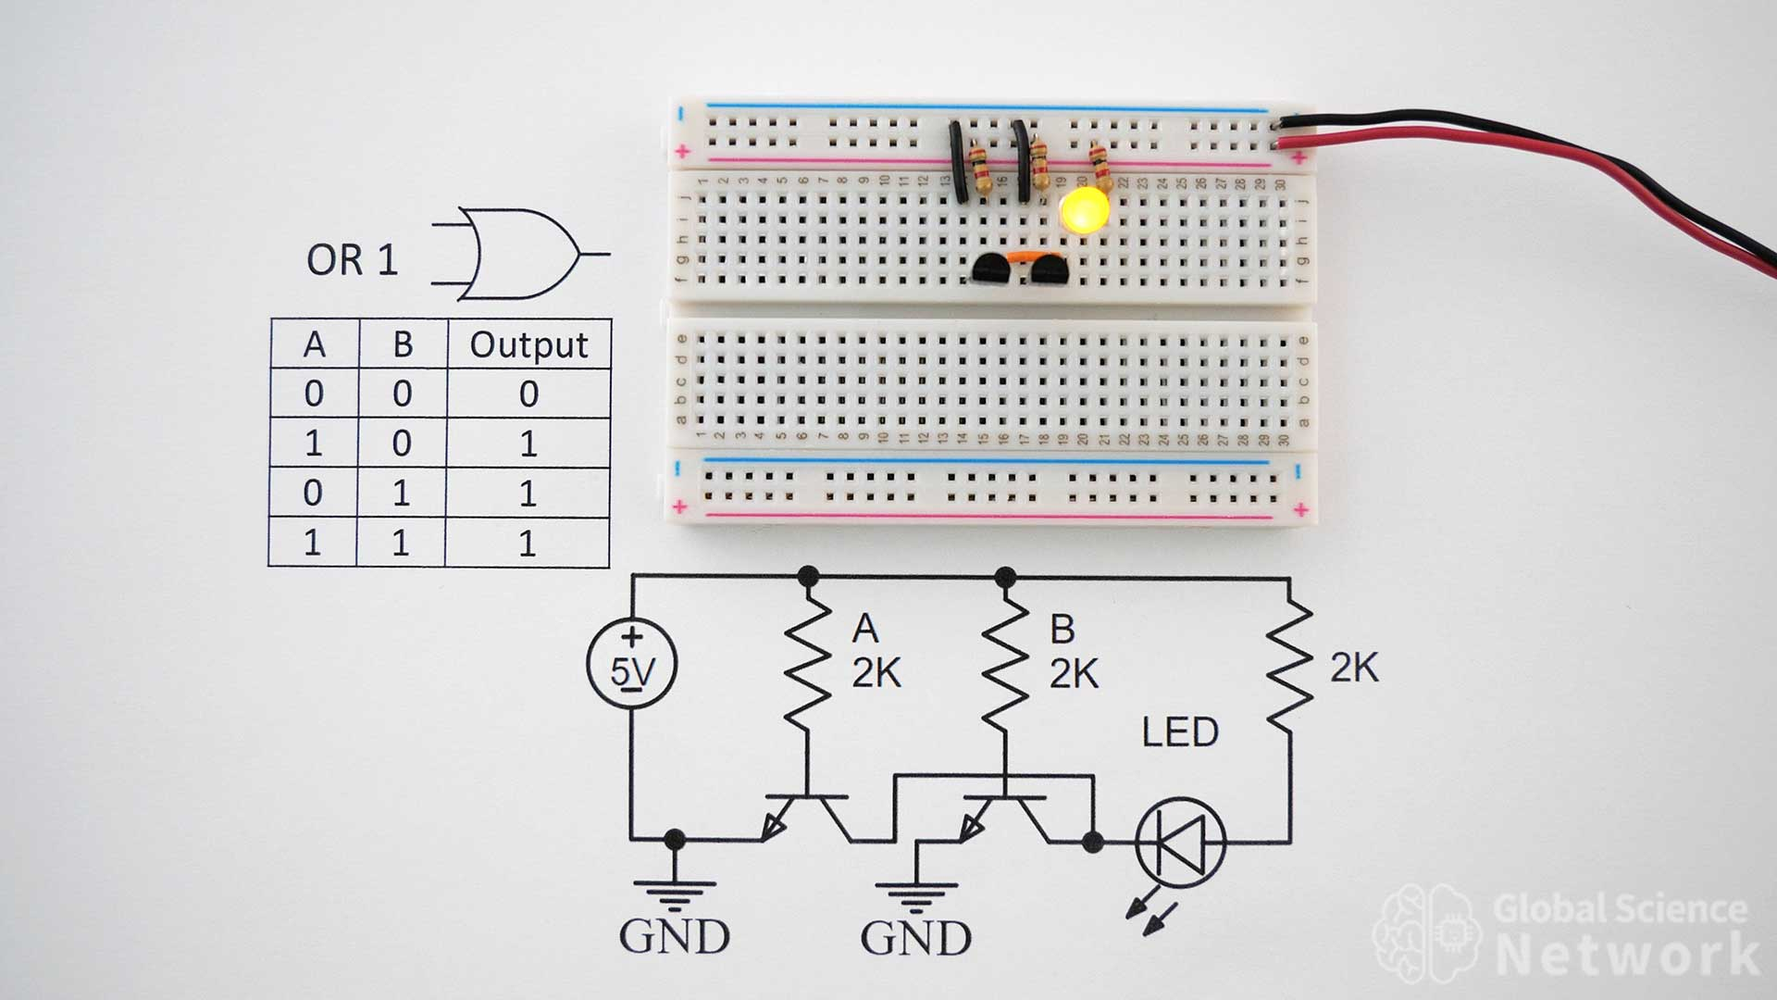

AND gate

Slide 53
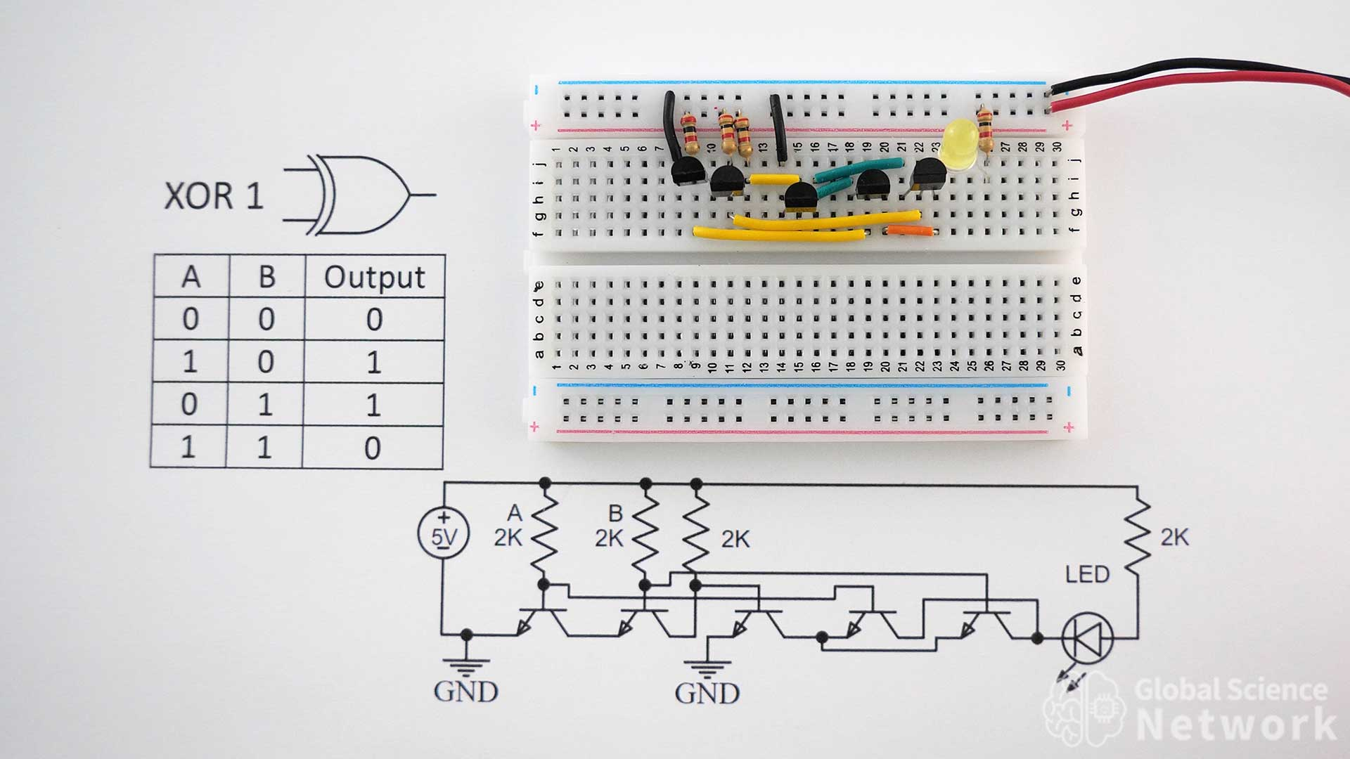


Slide 54
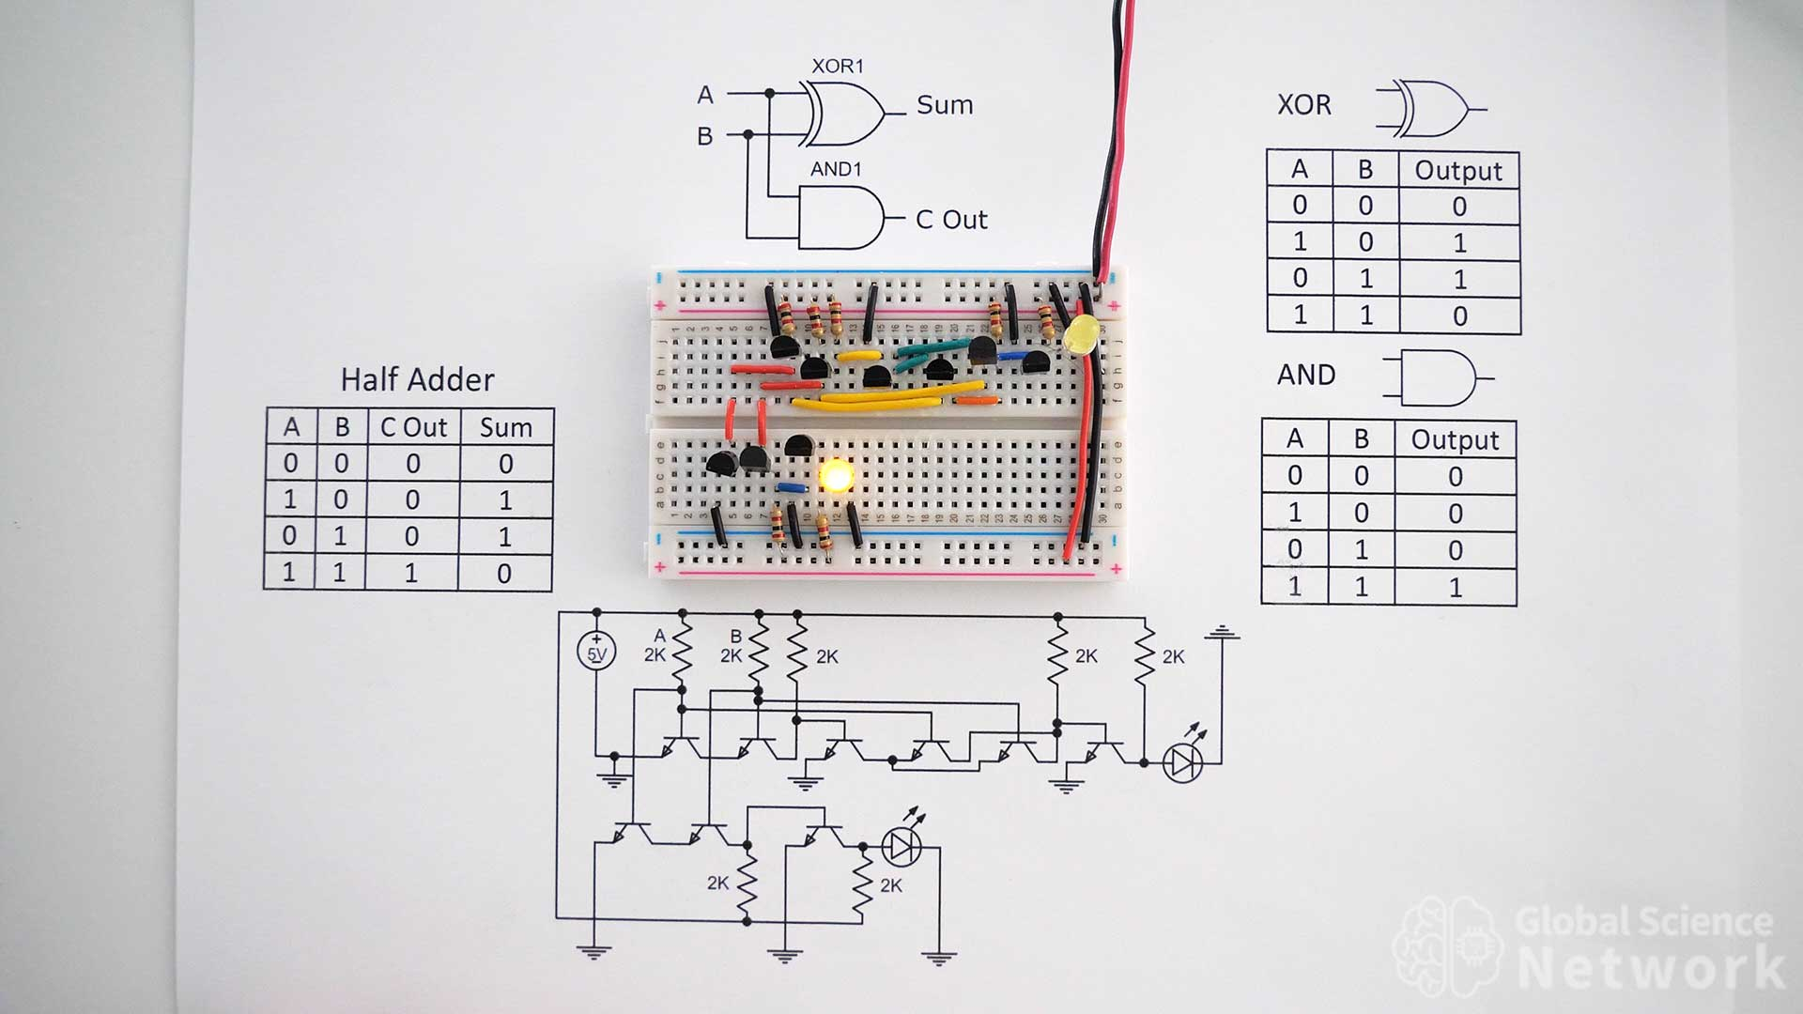

Slide 55
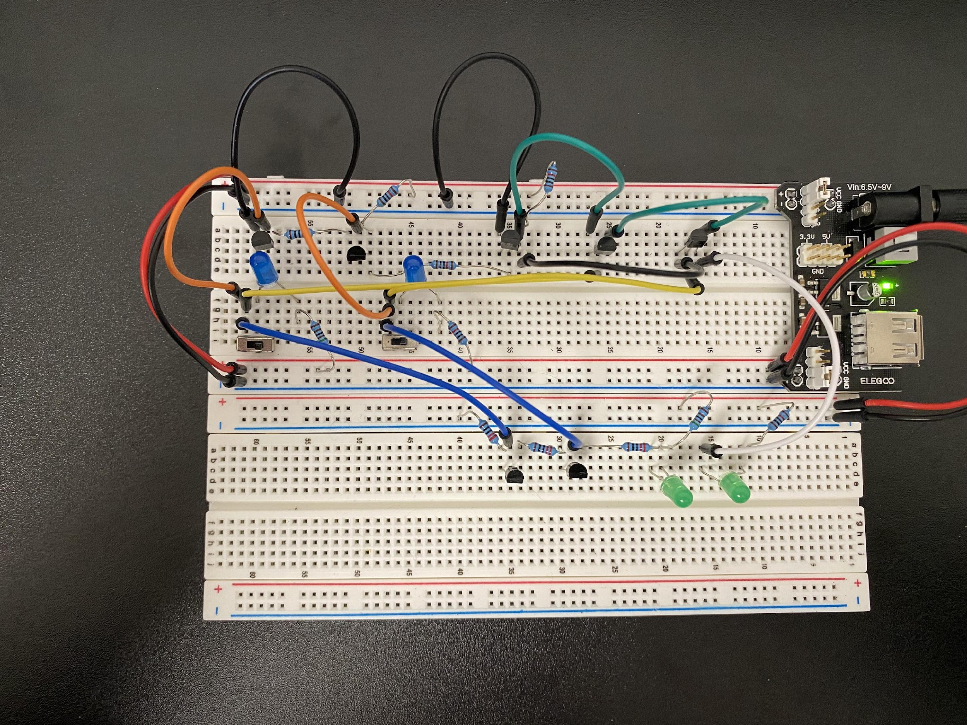




0+0=00

Slide 56
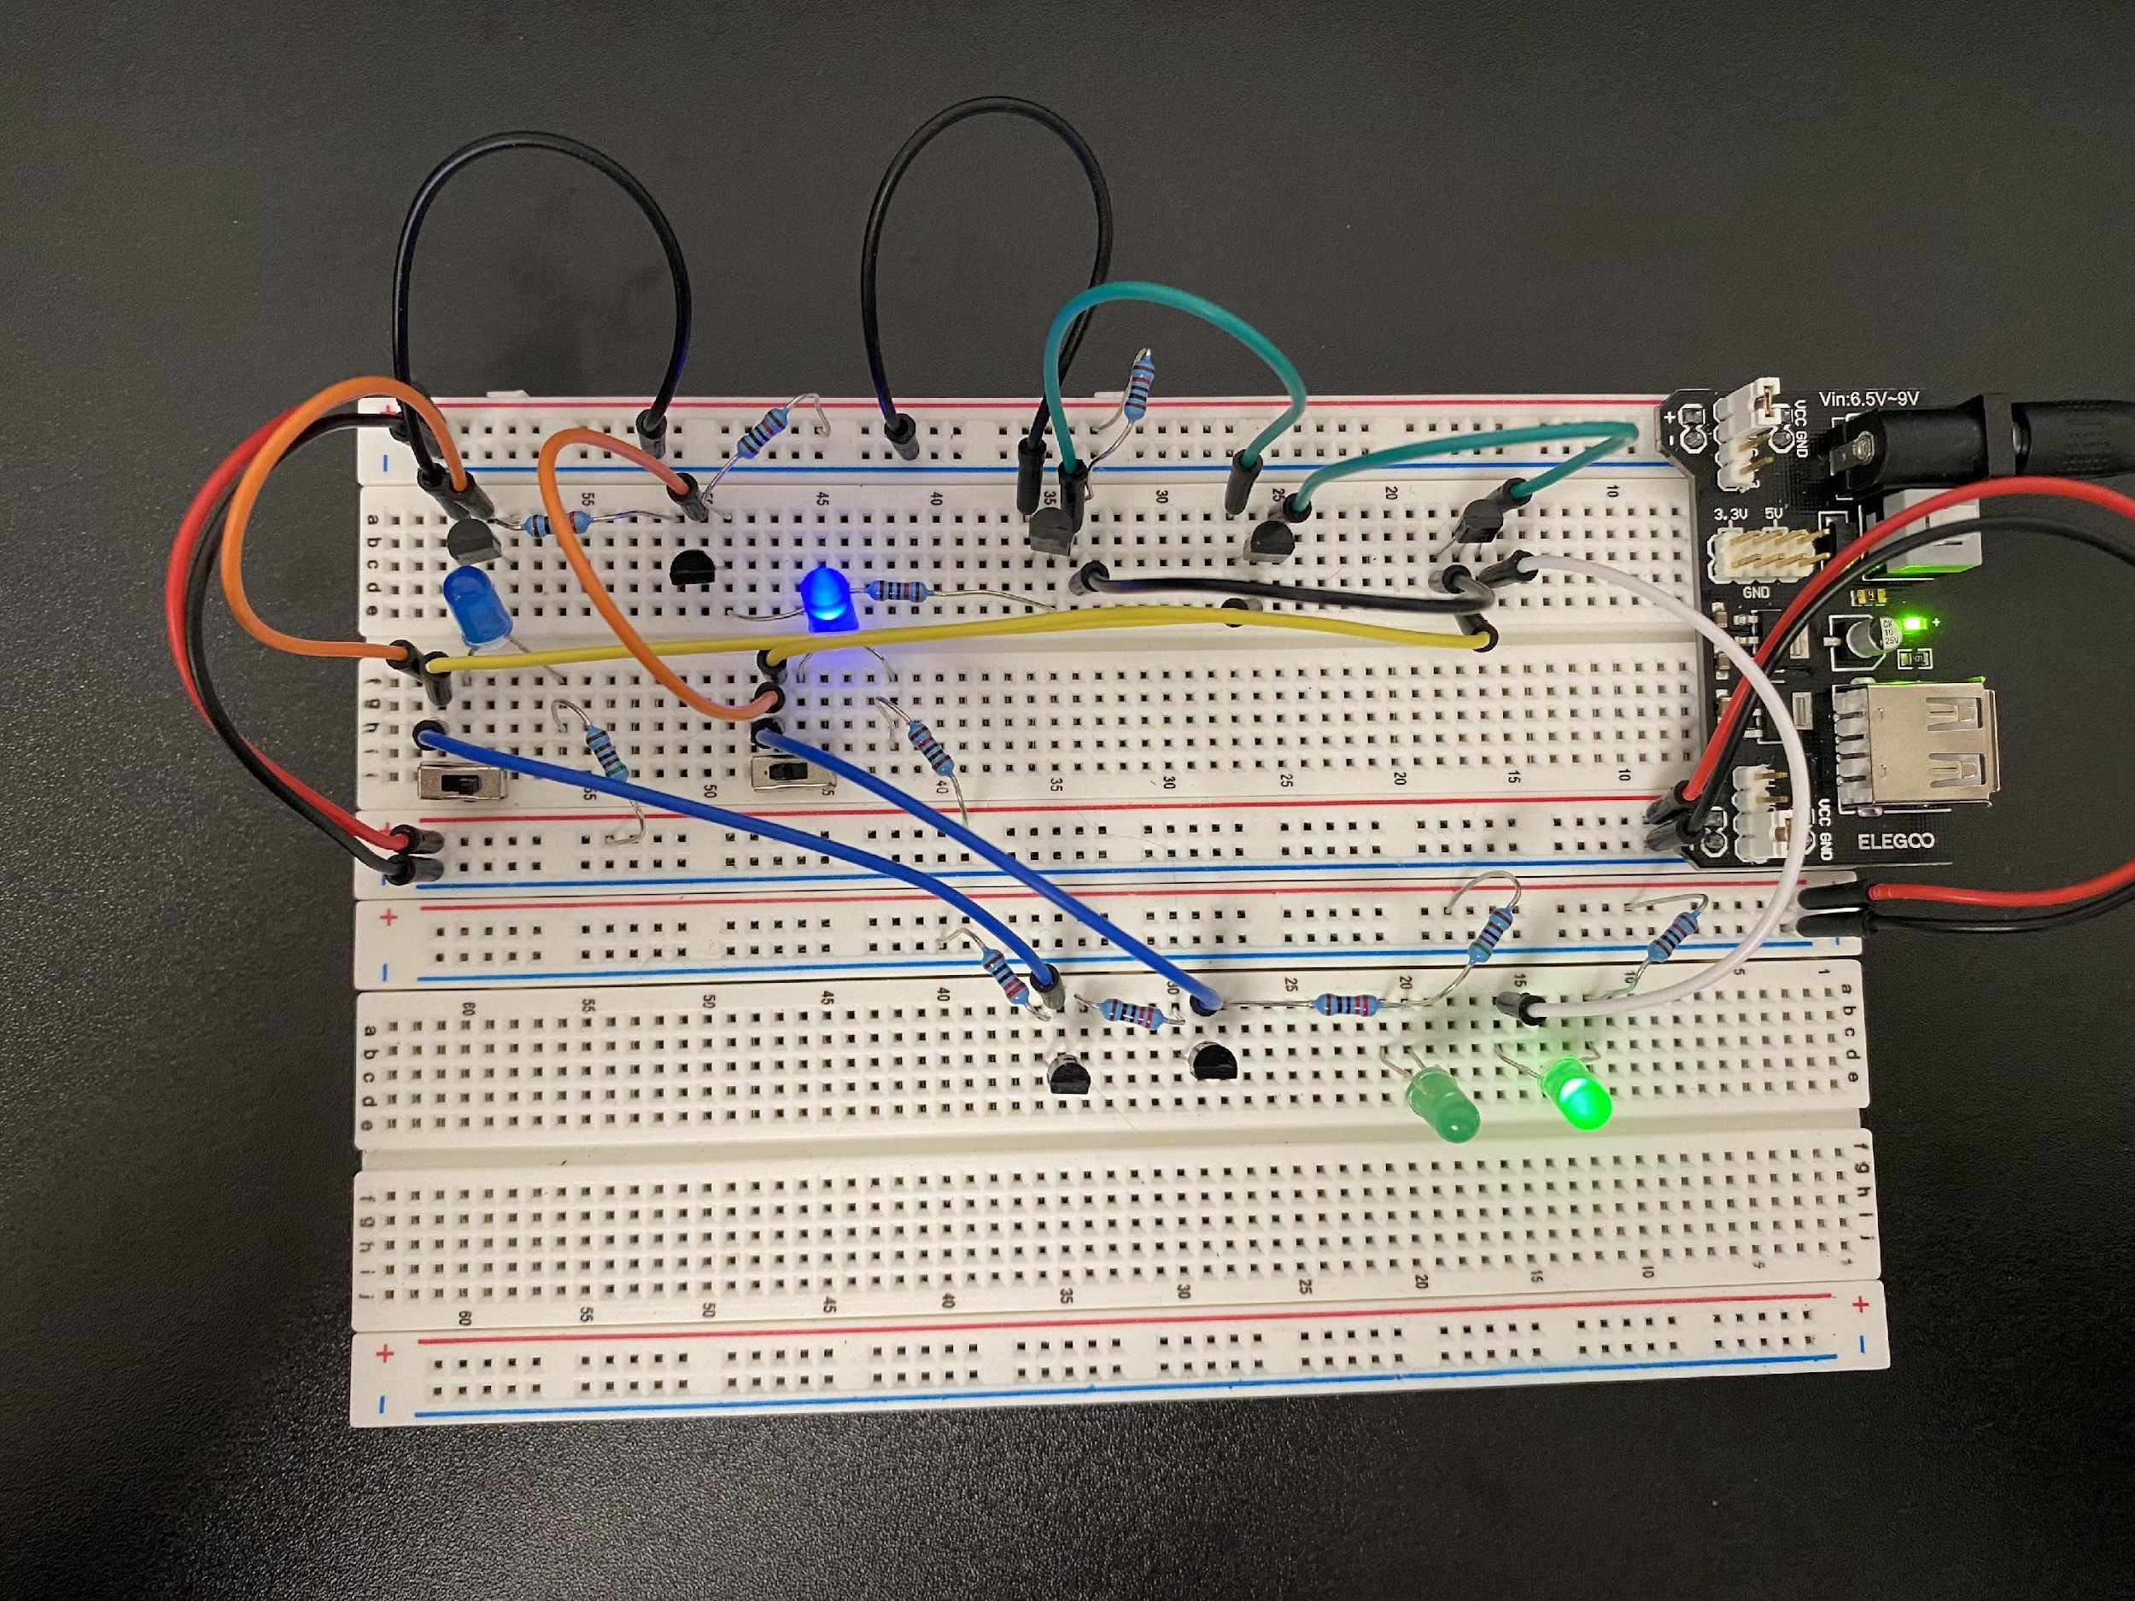
0+1=01

Slide 57
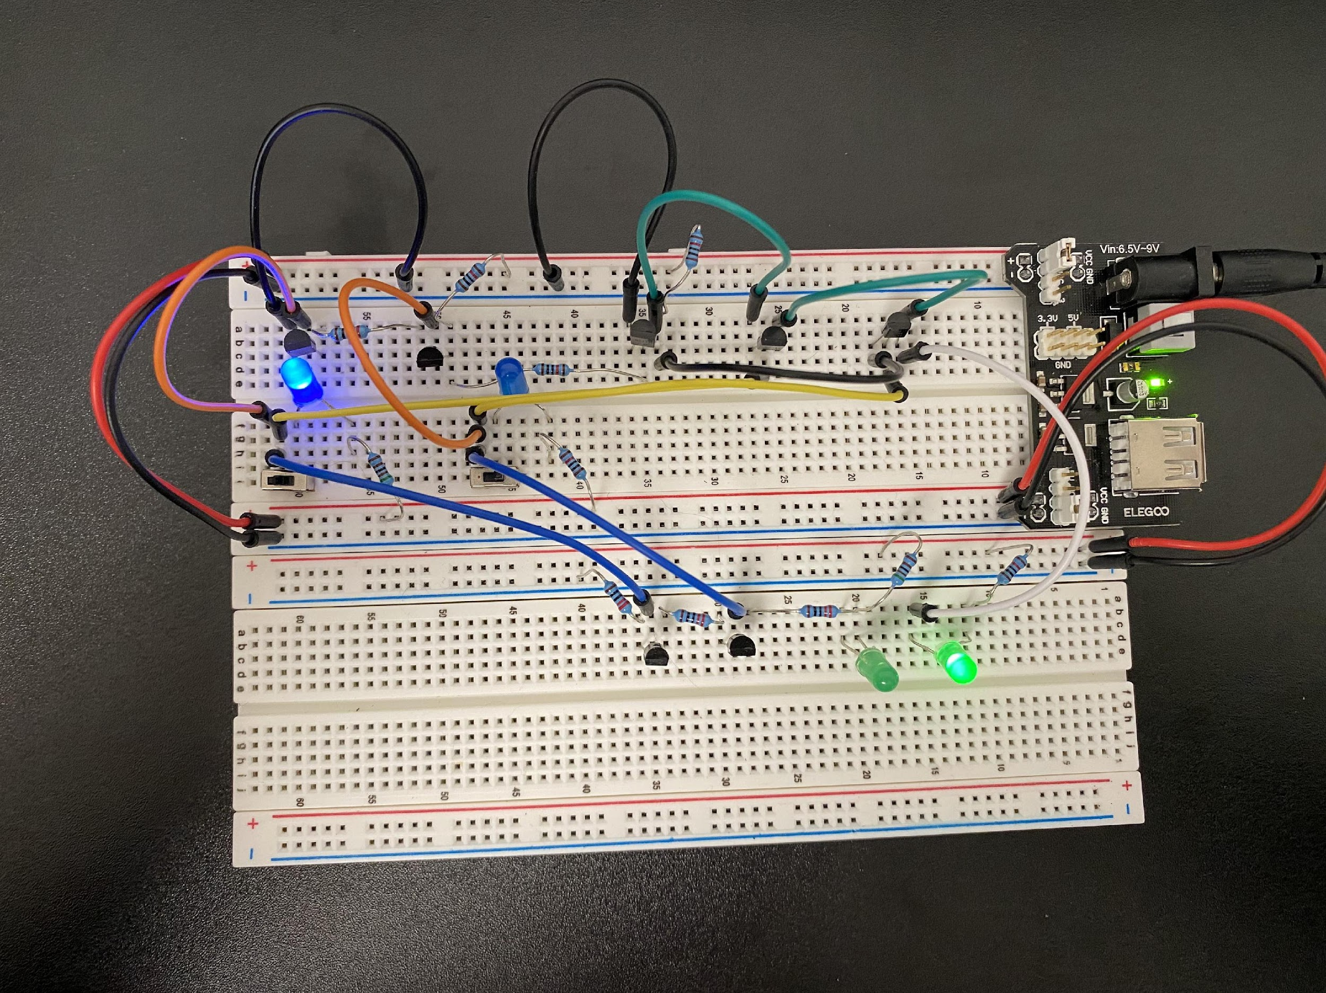
1+0=01

Slide 58
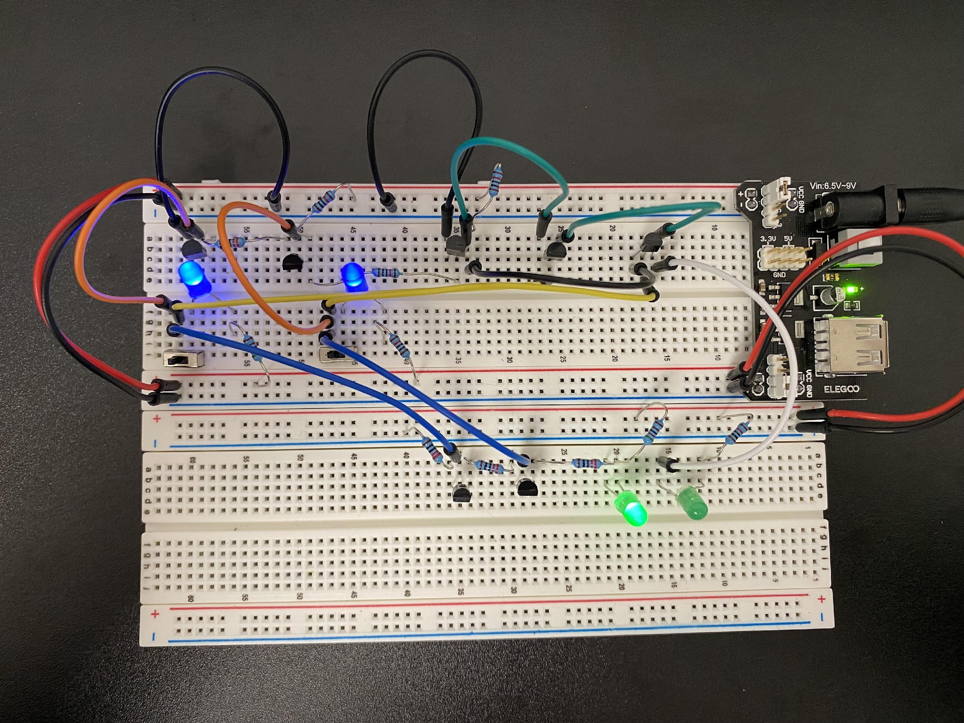




1+1=10

Slide 59
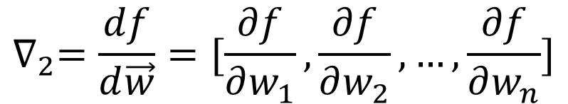
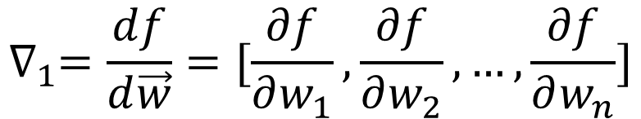
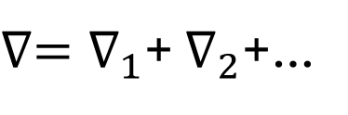
Batch
$$∇_{1}=\frac{df}{d\vec{w}}=[\frac{∂f}{∂w_{1}},\frac{∂f}{∂w_{2}},…,\frac{∂f}{∂w_{n}}]$$
Data pair 1
Data pair 2
…
Batch gradient
$$∇_{2}=\frac{df}{d\vec{w}}=[\frac{∂f}{∂w_{1}},\frac{∂f}{∂w_{2}},…,\frac{∂f}{∂w_{n}}]$$
…
$∇=∇_{1}$+ $∇_{2}$+…

Slide 60
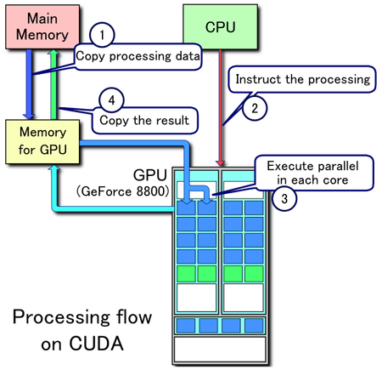













Slide 61



Slide 62

HPRC Resources
HPRC libraries and Google Co-lab do not have the same versions of TensorFlow and PyTorch
Large language models need GPUs (lecture 4)
GRACE
Get a sense of the AI hardware
Energy hungry

Slide 63
HPRC
https://hprc.tamu.edu/apply/
NetID: piyalong
Phone: 9792559203
Research Description: I am taking the 2025 ICPE 642. HPRC resources are required by the instructor to conduct energy-related research.
Apply for a basic account 5000 computing hours

Slide 64


