Slide 1
Advanced Concepts in Machine Learning for Energy
Time: March 26, 27, 30, April 1, 3
1:00 pm - 5:30 pm (in-person students)
(10 more days for distance students)
Location: GERB 315 and Zoom

Slide 2
Instructor
Yalong Pi
Associate Research Scientist
Texas A&M Institute of Data Science
Address: Office 221C, John R. Blocker Building
Email: piyalong@tamu.edu

Slide 3
Lecture | Topic | Quiz
1 | Neural network fundamentals and continuous optimization
2 | Image classification, object detection, and pixel segmentation | #1
3 | Autoencoder, autodecoder, and generative adversarial network (GAN) | #2
4 | Attention mechanism, transformers (GPT) and reinforcement learning | #3
5 | Final project Q&A, advanced topics review | #4

Slide 4
Course materials
Canvas (quiz and final project submission)
Dataset: https://www.kaggle.com/datasets/piyalong/dataset-for-icpe-639
Code: https://github.com/TAMIDSpiyalong/Advanced-Concepts-in-Machine-Learning-for-Energy
Howdy (syllabus and grade)

Slide 5
Four Quizzes and One Final Project
In-class quiz (10 points each)
Some calculation robust to AI
Use quiz.ipynb on GitHub
Emphasis on fundamentals, no code test
Final project (60 points)
Track 1
Track 2
Due April 5 (April 15 for remote students)
Total open book, including AI

Slide 6

Final Project
https://github.com/TAMIDSpiyalong/Advanced-Concepts-in-Machine-Learning-for-Energy/tree/main/Final%20Project

Slide 7
Lecture 1
Intro (1:00-1:30 pm)
Break
Neural network optimization 1 (1:40-2:40 pm)
Break
Neural network optimization 2 (2:40-3:40 pm)
Break
Excel machine learning (3:50-4:30 pm)
Break
Computing fundamentals and HPRC set up (4:40-5:30 pm)

Slide 8
Neural network optimization
Simplest example
Gradient
Weight update
Loss function
Metric

Slide 9
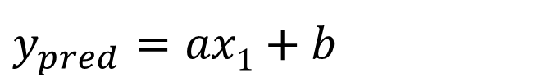
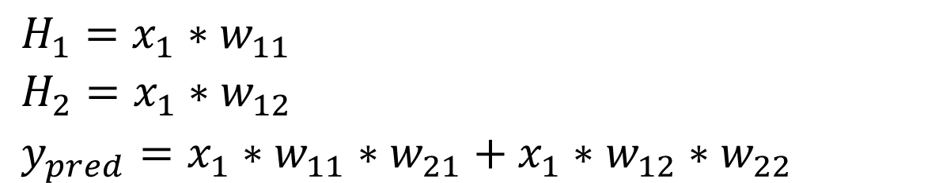
y
$y_{pred}$ $=ax1+b$
H₁
30
w₁₁
w₂₁
x₁
y
20
w₂₂
w₁₂
H₂
10
0
1
2
5
x
$H_{1}=x_{1}∗w_{11}$
$H_{2}=x_{1}∗w_{12}$
$y_{pred}=x_{1}∗w_{11}∗w_{21}+x_{1}∗w_{12}∗w_{22}$
x | y
1 | 10
2 | 20
5 | 30

Slide 10
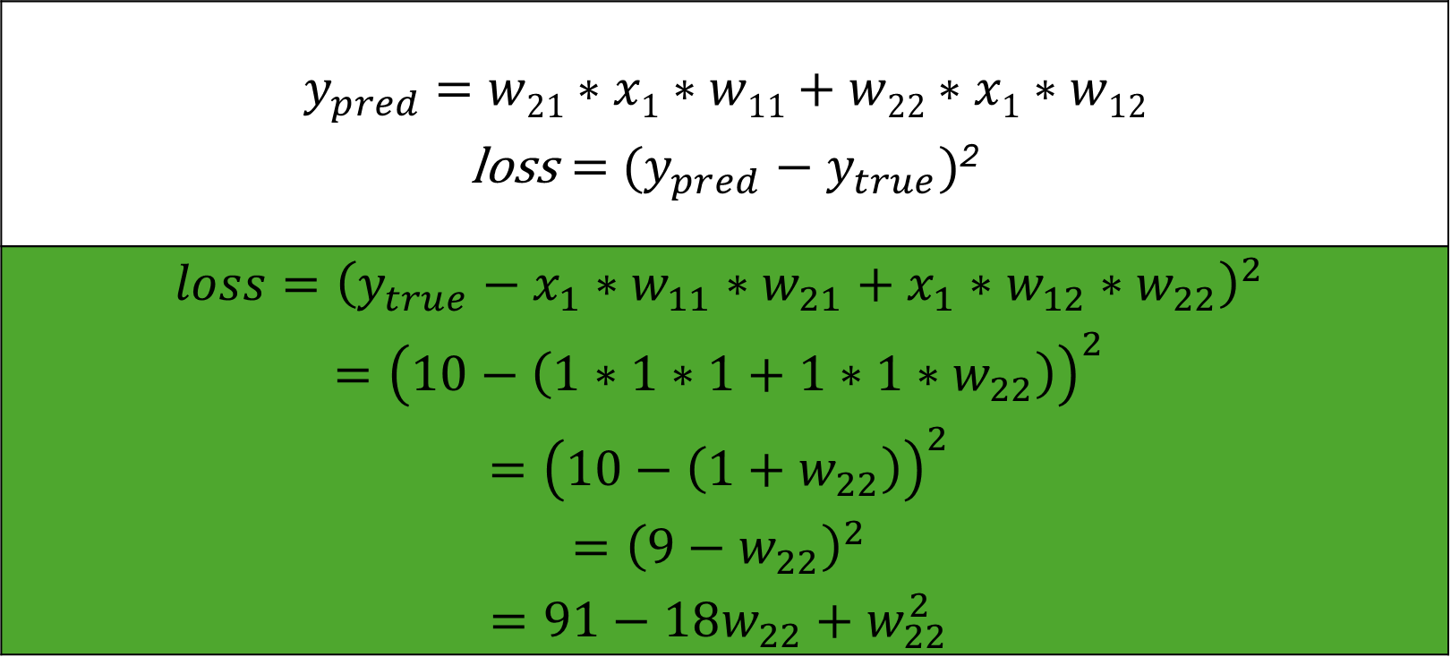
$y_{pred}$ $=w21∗x1∗w11+w22∗x1∗w12$ $\text{loss}={ (y_{pred}−y}_{true})$²
$$loss={\left(y_{true}−x_{1}∗w_{11}∗w_{21}+x_{1}∗w_{12}∗w_{22}\right)}^{2}$$ $$={\left(10−\left(1∗1∗1+1∗1∗w_{22}\right)\right)}^{2}$$ $$={\left(10−\left({1+w}_{22}\right)\right)}^{2}$$ $$={\left(9−w_{22}\right)}^{2}$$ $$=91−18w_{22}+w_{22}^{2}$$
x | y
1 | 10
2 | 20
5 | 30

Slide 11
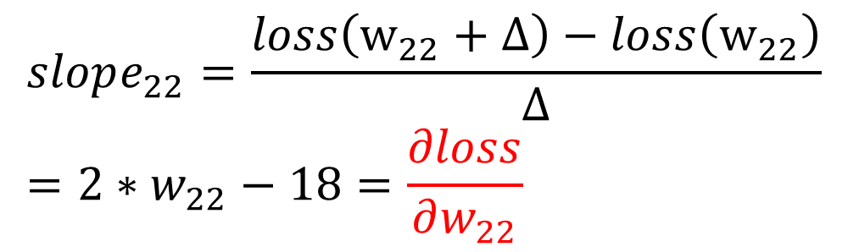
H₁
Loss
w₁₁
w₂₁
x₁
y
w₂₂
w₁₂
H₂
Slope: -
Slope: +
0
9
w₂₂
$$loss=91−18w_{22}+w_{22}^{2}$$
x | y
1 | 10
2 | 20
5 | 30
$$slope_{22}=\frac{loss\left(w_{22}+Δ\right)−loss\left(w_{22}\right)}{Δ}=2∗w_{22}−18=\frac{∂loss}{∂w_{22}}$$

Slide 12
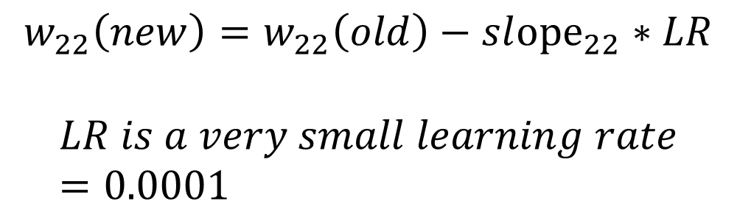
H₁
Loss
w₁₁
w₂₁
x₁
y
w₂₂
w₁₂
H₂
Slope: -
Slope: +
0
9
w₂₂
x | y
1 | 10
2 | 20
5 | 30
$$w_{22}\left(new\right)=w_{22}\left(old\right)−sl{ope}_{22}∗LR$$
$$LR is a very small learning rate=0.0001$$

Slide 13
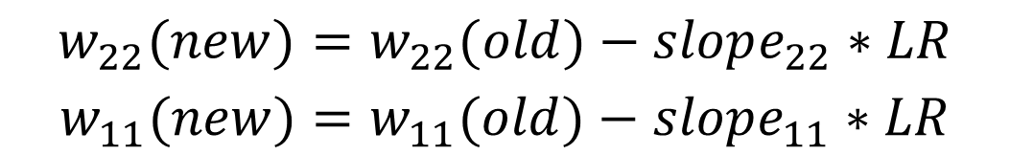
H₁
Loss
w₁₁
w₂₁
x₁
y
w₂₂
w₁₂
H₂
0
w₂₂
w₁₁
$$w_{22}(new)=w_{22}(old)−slope_{22}∗LR$$
$$w_{11}(new)=w_{11}(old)−slope_{11}∗LR$$
x | y
1 | 10
2 | 20
5 | 30

Slide 14

$$w_{22}(new)=w_{22}(old)−slope_{22}∗LR$$
$$w_{11}(new)=w_{11}(old)−slope_{11}∗LR$$
$$w_{12}(new)=w_{12}(old)−slope_{12}∗LR$$
$$w_{21}(new)=w_{21}(old)−slope_{21}∗LR$$
Loss
H₁
w₁₁
w₂₁
x₁
y
w₂₂
w₁₂
H₂
0
w₂₂
w₁₁

Slide 15
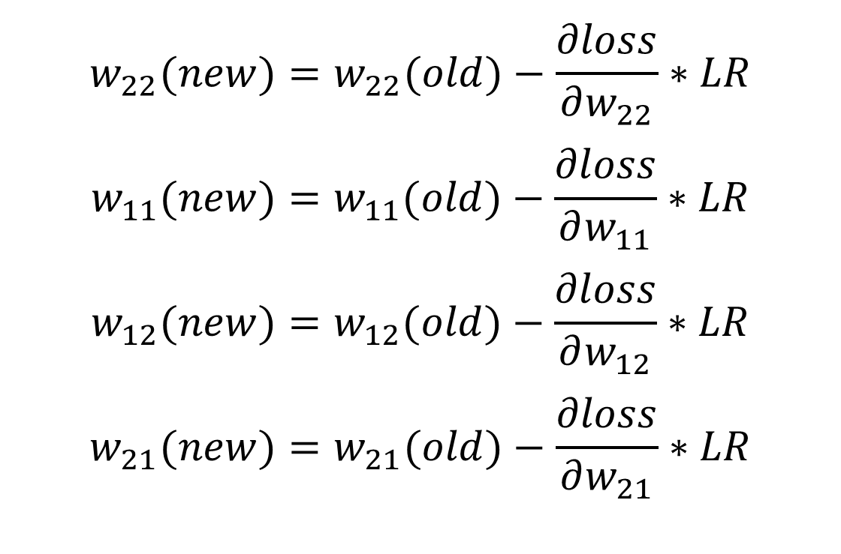
H₁
w₁₁
w₂₁
x₁
y
w₂₂
w₁₂
H₂
$$w_{22}(new)=w_{22}(old)−\frac{∂loss}{∂w_{22}}∗LR$$
$$w_{11}(new)=w_{11}(old)−\frac{∂loss}{∂w_{11}}∗LR$$
$$w_{12}(new)=w_{12}(old)−\frac{∂loss}{∂w_{12}}∗LR$$
$$w_{21}(new)=w_{21}(old)−\frac{∂loss}{∂w_{21}}∗LR$$

Slide 16
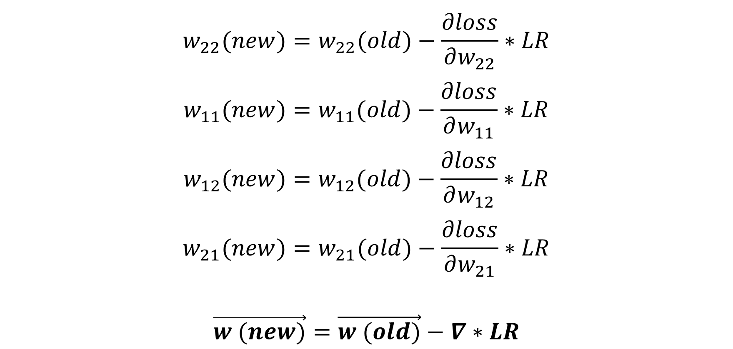
$$w_{22}(new)=w_{22}(old)−\frac{∂loss}{∂w_{22}}∗LR$$
$$w_{11}(new)=w_{11}(old)−\frac{∂loss}{∂w_{11}}∗LR$$
$$w_{12}(new)=w_{12}(old)−\frac{∂loss}{∂w_{12}}∗LR$$
$$w_{21}(new)=w_{21}(old)−\frac{∂loss}{∂w_{21}}∗LR$$
$$\vec{w (new)}=\vec{w (old)}−∇∗LR$$

Slide 17
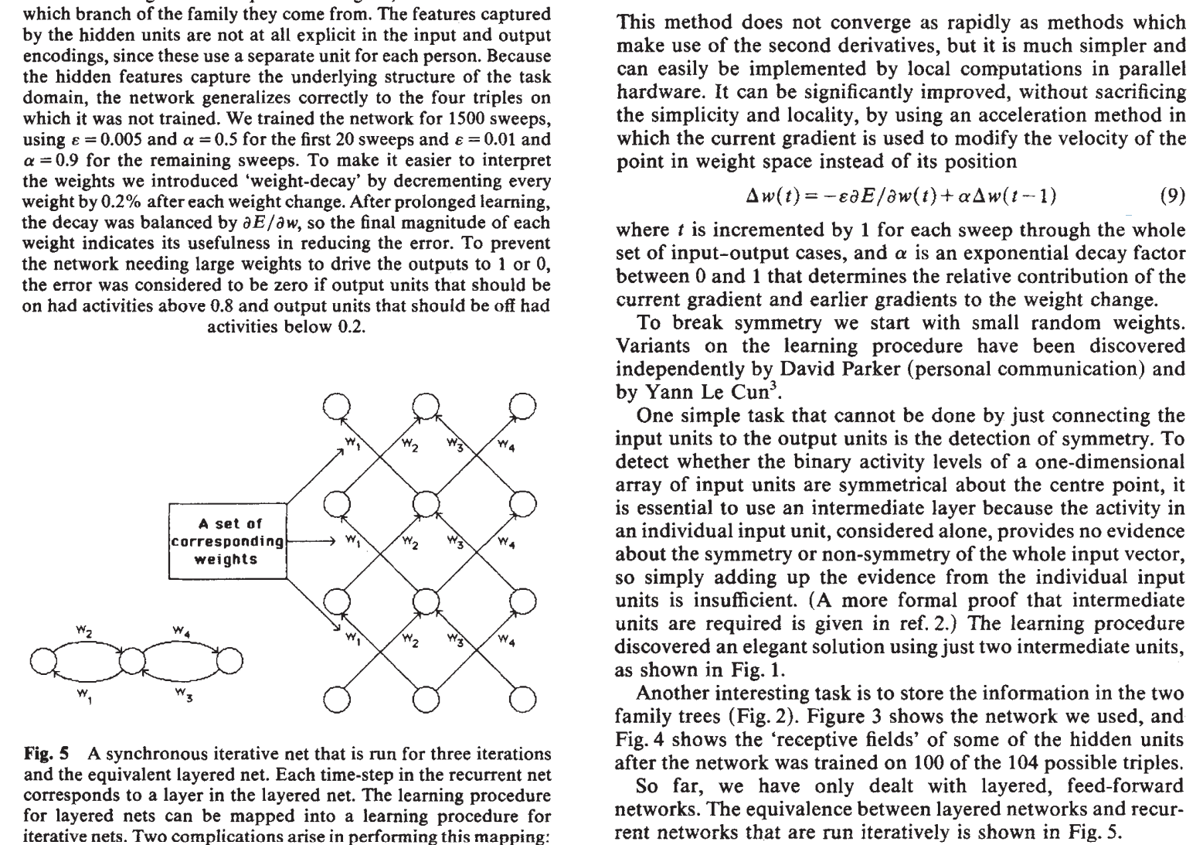
Rumelhart, D. E., Hinton, G. E., & Williams, R. J. (1986). Learning representations by back-propagating errors. nature, 323(6088), 533-536.

Slide 18
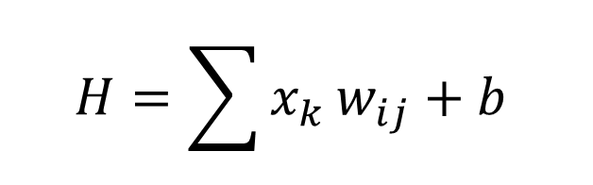
H₁
H
W₂₁
W₁₁
For each neuron H:
x₁
H₂
W₂₂
W₁₂
$$H=\sum{x_{k}}w_{ij}+b$$
y₁
x₂
y₂
w_{ij} is the weight
b is the bias
A DNN has millions of weights and biases
W_{ij}
H_{k}

Slide 19
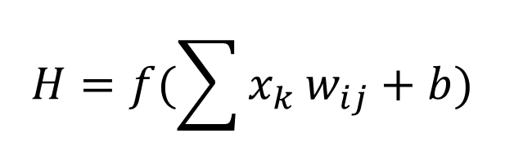
H₁
H
W₂₁
W₁₁
For each neuron H:
x₁
H₂
W₂₂
W₁₂
$$H=f(\sum{x_{k}}w_{ij}+b)$$
y₁
x₂
y₂
f is the activation function
w_{ij} is the weight
b is the bias
A DNN has millions of weights and biases
W_{ij}
H_{k}

Slide 20
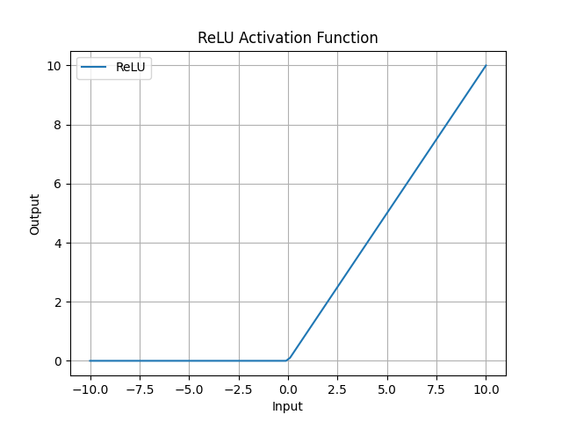

Slide 21
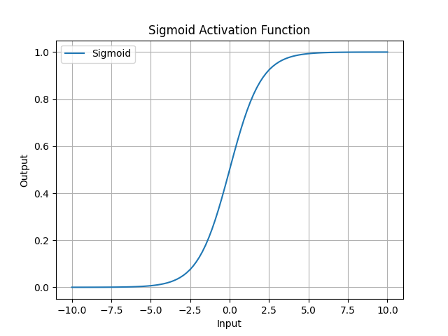

Slide 22
Output types
Regression
Classification
Feature extraction
Combination

Slide 23
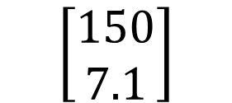
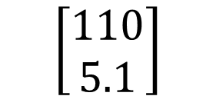


H₁
H
W₂₁
W₁₁
x₁
H₂
W₂₂
W₁₂
y₁
Weight (lbs)
$y_{pred}$
$y_{true}$
x₂
$$\left[\begin{aligned}110 \\ 5.1\end{aligned}\right]$$
$$\left[\begin{aligned}150 \\ 7.1\end{aligned}\right]$$
y₂
Height (feet)
W_{ij}
H_{k}

Slide 24
Regression loss
Mean absolute error
Mean square error
$$MAE=\frac{1}{n}|y_{pred}−y_{true}|$$
$$MSE=\frac{1}{n}{\left(y_{pred}−y_{true}\right)}^{2}$$

Slide 25
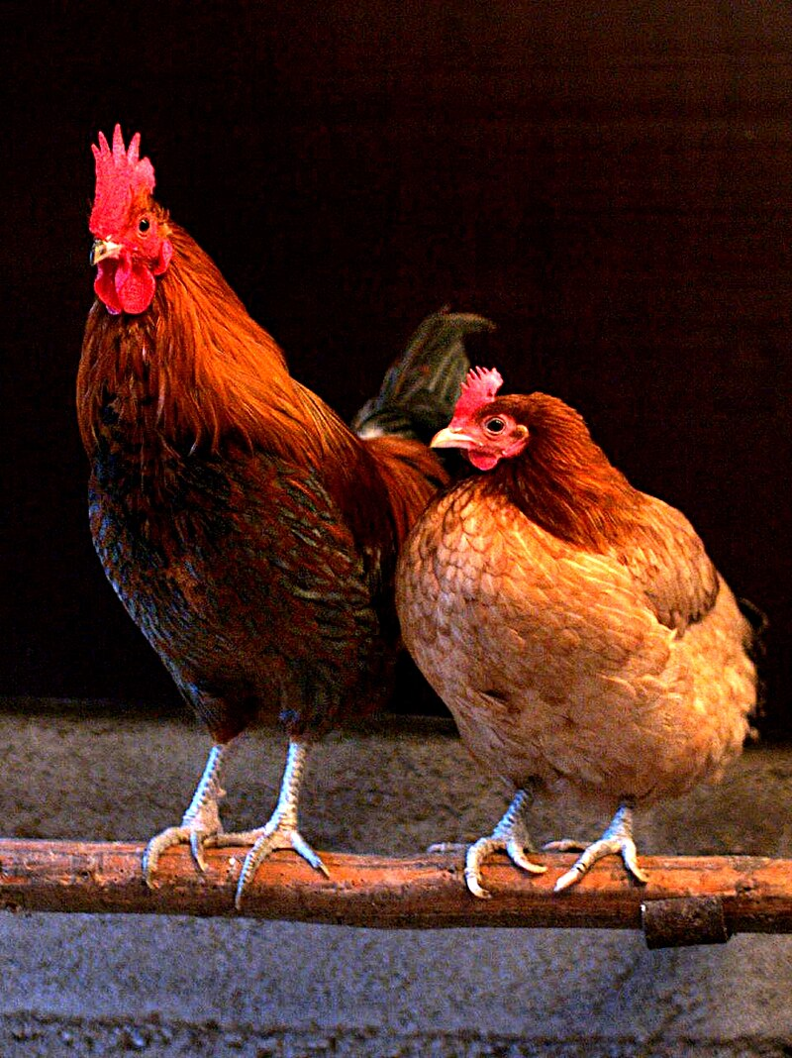
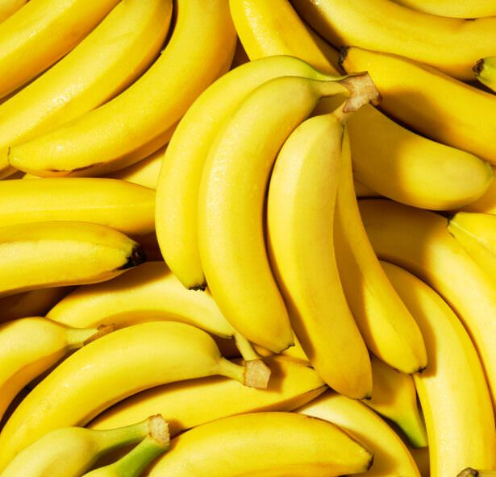
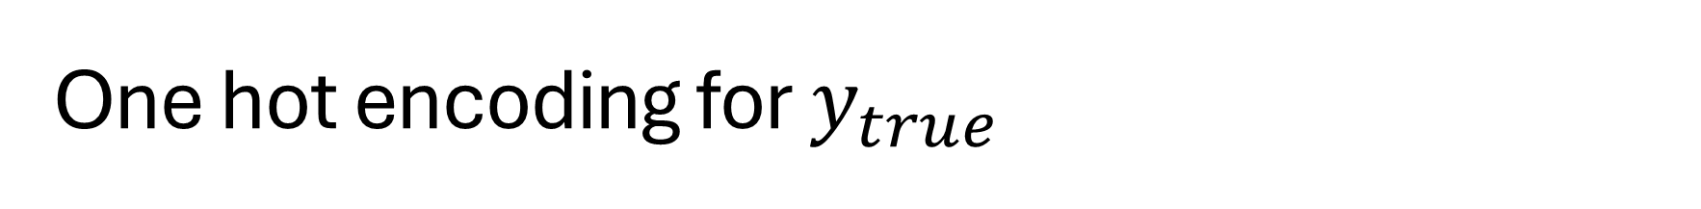


One hot encoding for $y_{true}$
$$\left[\begin{aligned}1 \\ 0\end{aligned}\right]$$
Chicken
Banana
$$\left[\begin{aligned}0 \\ 1\end{aligned}\right]$$

Slide 26
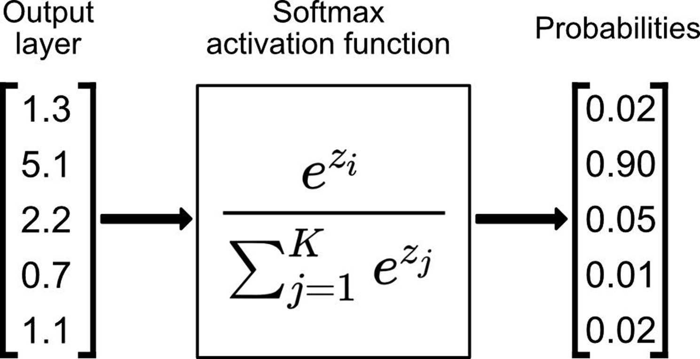
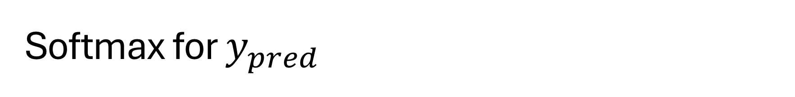
Softmax for $y_{pred}$

Slide 27

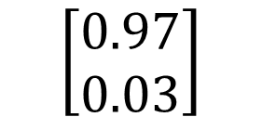


H₁
H
W₂₁
W₁₁
x₁
H₂
W₂₂
W₁₂
y₁
Chicken
$y_{pred}$
$y_{true}$
x₂
$$\left[\begin{aligned}0.97 \\ 0.03\end{aligned}\right]$$
$$\left[\begin{aligned}1 \\ 0\end{aligned}\right]$$
y₂
Banana
W_{ij}
H_{k}

Slide 28


H₁
H
W₂₁
W₁₁
$y_{pred}$
$y_{true}$
x₁
H₂
W₂₂
W₁₂
y₁
Recommend
Engaged
x₂
y₂
Not Recommend
Not Engaged
W_{ij}
H_{k}

Slide 29
Feature extraction
H₁
F
W₂₁
W₁₁
x₁
H₂
W₂₂
F
W₁₂
y₁
x₂
F
y₂
F
W_{ij}
H_{k}
F

Slide 30

Combination
H₁
H
W₂₁
W₁₁
x₁
H₂
W₂₂
W₁₂
y₁
x₂
$$loss=MSE+CE$$
y₂
W_{ij}
H_{k}

Slide 31
Cross entropy loss for classification
Binary cross entropy
After softmax
Multi class entropy
After softmax
$$BCE=−\sum{y_{true}∗\log\left(y_{pred}\right)+\left(1−y_{true}\right)∗log⁡(1−y_{pred})}$$
$$CE=−\sum{y_{true}∗\log\left(y_{pred}\right)}$$

Slide 32
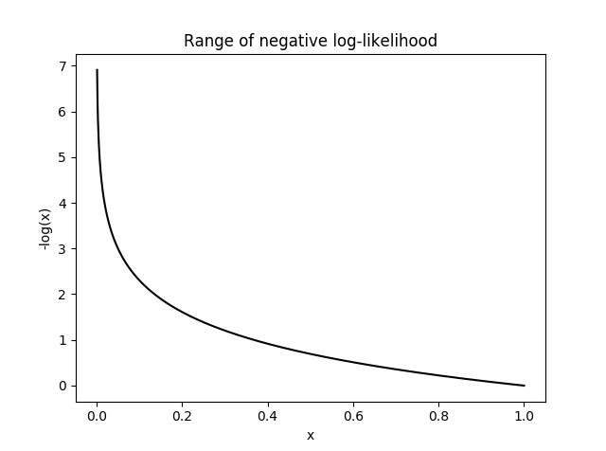

Slide 33
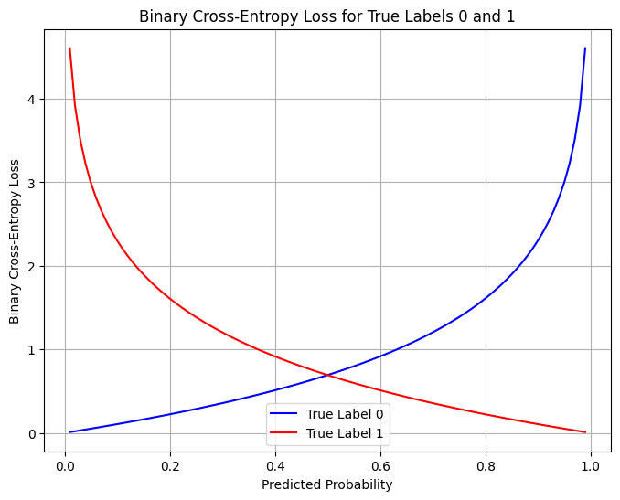

Slide 34


Weight update
H₁
H
W₂₁
W₁₁
x₁
H₂
W₂₂
W₁₂
Learn
Fit
Train
Back propagation
y_{1_true}
y₁
x₂
$$loss$$
y₂
y_{2_true}
W_{ij}
H_{k}
$$new \vec{w}=old \vec{w}−∇∗LR$$

Slide 35

Use the model
H₁
H
W₂₁
W₁₁
x₁
H₂
W₂₂
W₁₂
Forward pass
Inference
Test
Validation
Deployment
y₁
x₂
y₂
W_{ij}
H_{k}
$$NN\left(\vec{x}\right)=\vec{y}$$

Slide 36
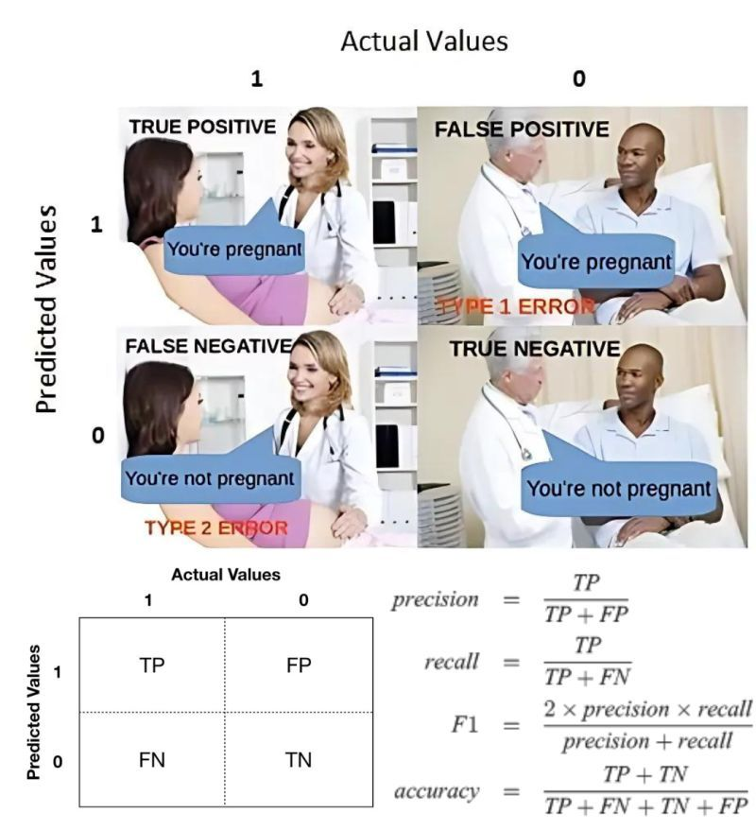
Image Credit: Linkedin.com

Slide 37
Underfitting
Overfitting
Loss
Validation
Training
0
Epoch

Slide 38
Metrics
Regression
MAE
MSE
Classification
Area under ROC
Confusion matrix
Recall
Precision
F1
Accuracy

Slide 39
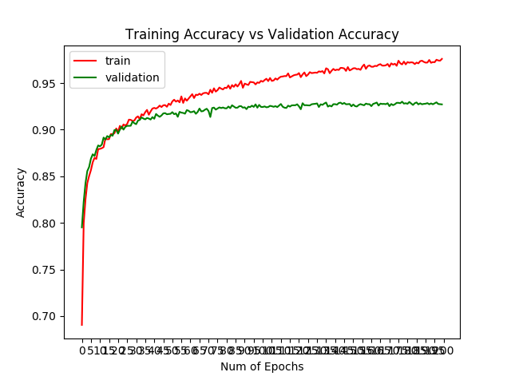

Slide 40
Excel machine learning

Slide 41
Excel machine learning
Partial derivatives
Chain rule/back propagation
https://github.com/TAMIDSpiyalong/Advanced-Concepts-in-Machine-Learning-for-Energy/blob/main/Lecure%201/Excel_Machine_Learning.pdf
Chapter 5.2
Chapter 7.1

Slide 42
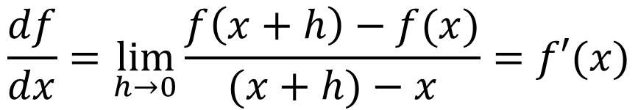
Derivative/slope for f(x)
“Mathematics for machine learning”, Chapter 5
Quiz
$$\frac{df}{dx}=\lim_{h→0}{\frac{f\left(x+h\right)−f(x)}{(x+h)−x}}=f′(x)$$

Slide 43

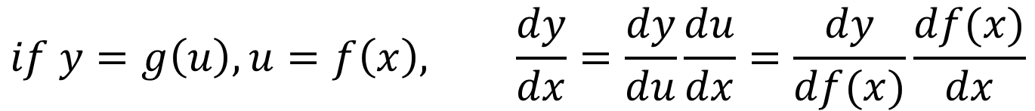

Differentiation Rules
$$\frac{dx^{n}}{dx}=nx^{n−1}$$
Power rule
Chain rule
Constant rule
$$if y=g\left(u\right), u=f\left(x\right), \frac{dy}{dx}=\frac{dy}{du}\frac{du}{dx}=\frac{dy}{df(x)}\frac{df(x)}{dx}$$
$$\frac{dc}{dx}=0$$

Slide 44

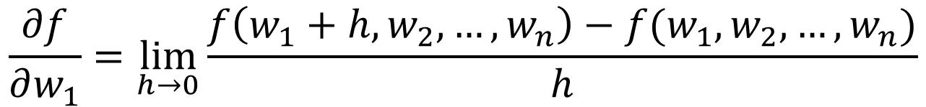
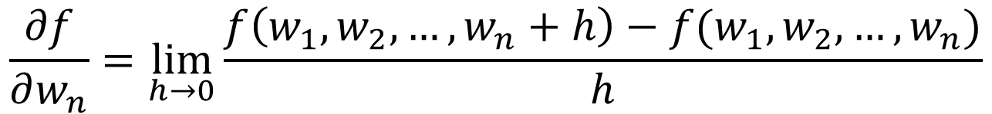
Partial derivatives (chapter 5.2)
For example: f(x)=f(w₁,w₂,…,w_{n})
$$\frac{∂f}{∂w_{1}}=\lim_{h→0}{\frac{f\left(w_{1}+h,w_{2},…,w_{n}\right)−f(w_{1},w_{2},…,w_{n})}{h}}$$
$$…$$
$$\frac{∂f}{∂w_{n}}=\lim_{h→0}{\frac{f\left(w_{1},w_{2},…,w_{n}+h\right)−f(w_{1},w_{2},…,w_{n})}{h}}$$

Slide 45
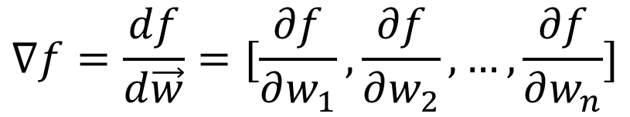
Gradient (chapter 5.3)
For example: f(x)=f(w₁,w₂,…,w_{n})
Quiz
$$∇f=\frac{df}{d\vec{w}}=[\frac{∂f}{∂w_{1}},\frac{∂f}{∂w_{2}},…,\frac{∂f}{∂w_{n}}]$$

Slide 46
Homework
See PDF
Try the Excel
Currently, there is no activation function. Could you add some?
Plot the prediction and results

Slide 47
Computing fundamentals and HPRC set up

Slide 48
Computing
Binary
Logic gates
Transistor
Half adder

Slide 49
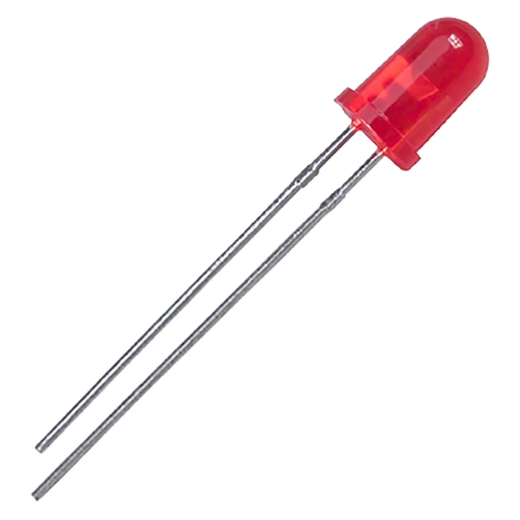













Binary Computers
High voltage = 1 (on); Low voltage = 0 (off)
ASCII (e.g., 01100001->”a”; 01110000->”p”)
2⁸ (8 bit). Modern computer 64 bit
Clock at 1 Hz takes 40 seconds to spell “apple”
Model computers have Gigahertz (10⁹)
“13”+”9”≠“22”
t | 1 | 2 | 3 | 4 | 5 | 6 | 7 | 8 | 9 | 10 | 11 | 12 | 13 | 14 | 15 | 16 | 17 | 18 | 19 | 20 | …
s | 0 | 1 | 1 | 0 | 0 | 0 | 0 | 1 | 0 | 1 | 1 | 1 | 0 | 0 | 0 | 0

Slide 50

Binary to decimal
Binary
Decimal
$$d_{n−1}…d_{2}d_{1}d_{0}$$
$$d_{0}∗2^{0}+d_{1}∗2^{1}+…+d_{n−1}∗2^{n−1}$$

Slide 51
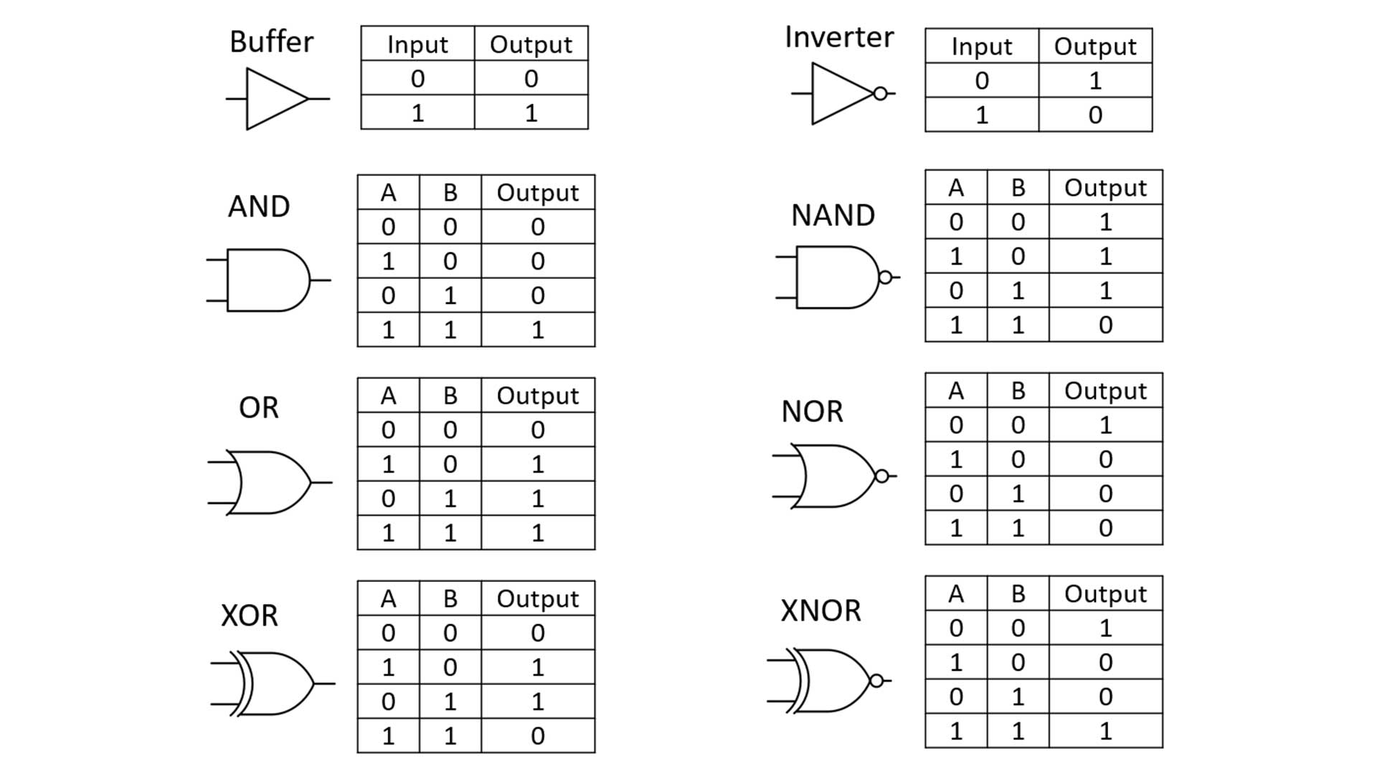






Slide 52
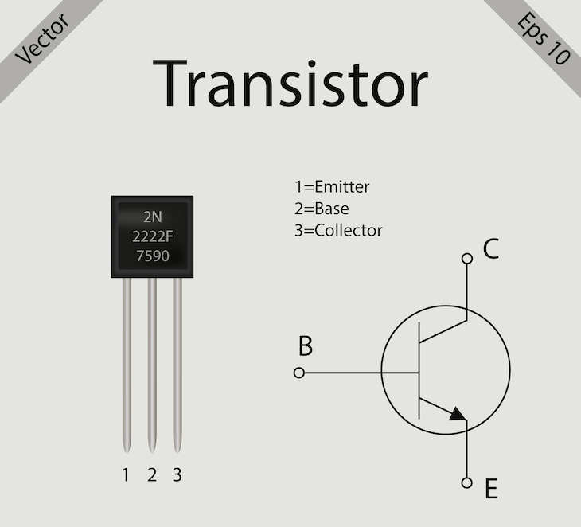
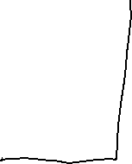
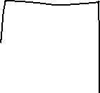


Slide 53
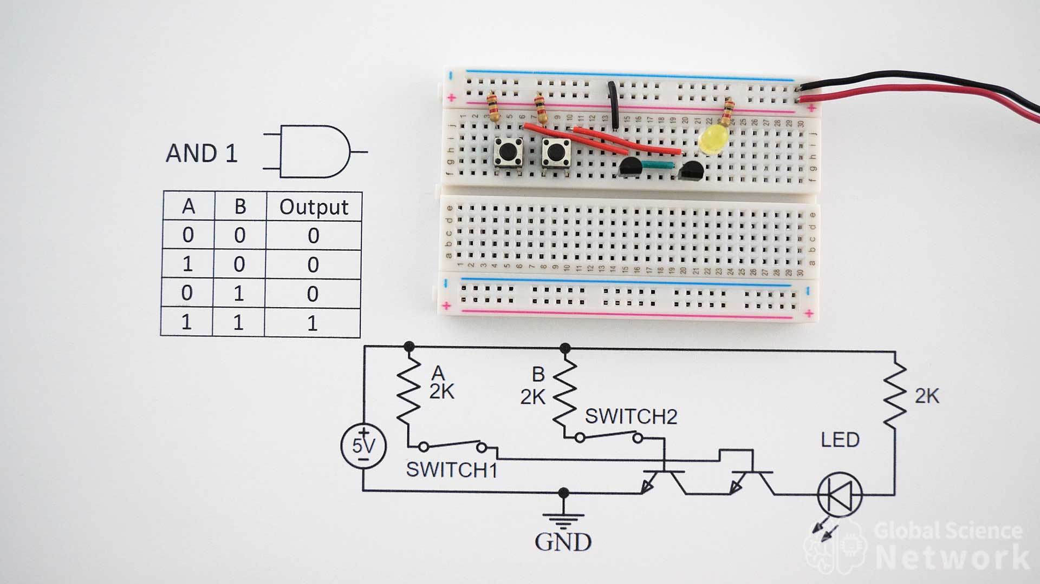

Slide 54
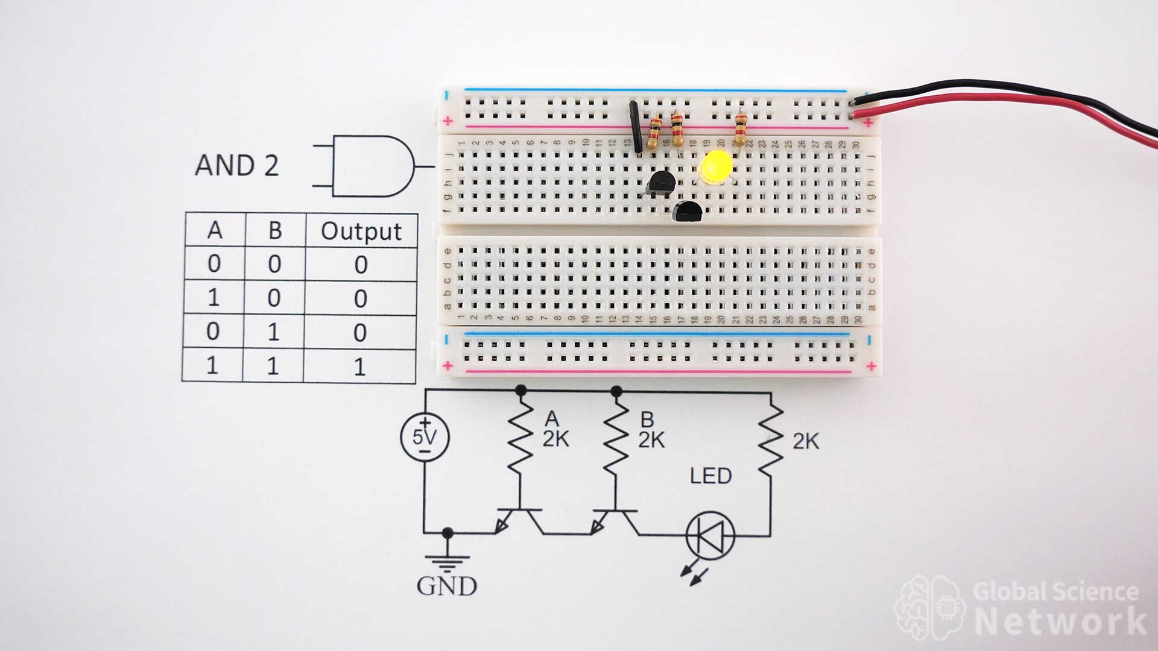




Slide 55
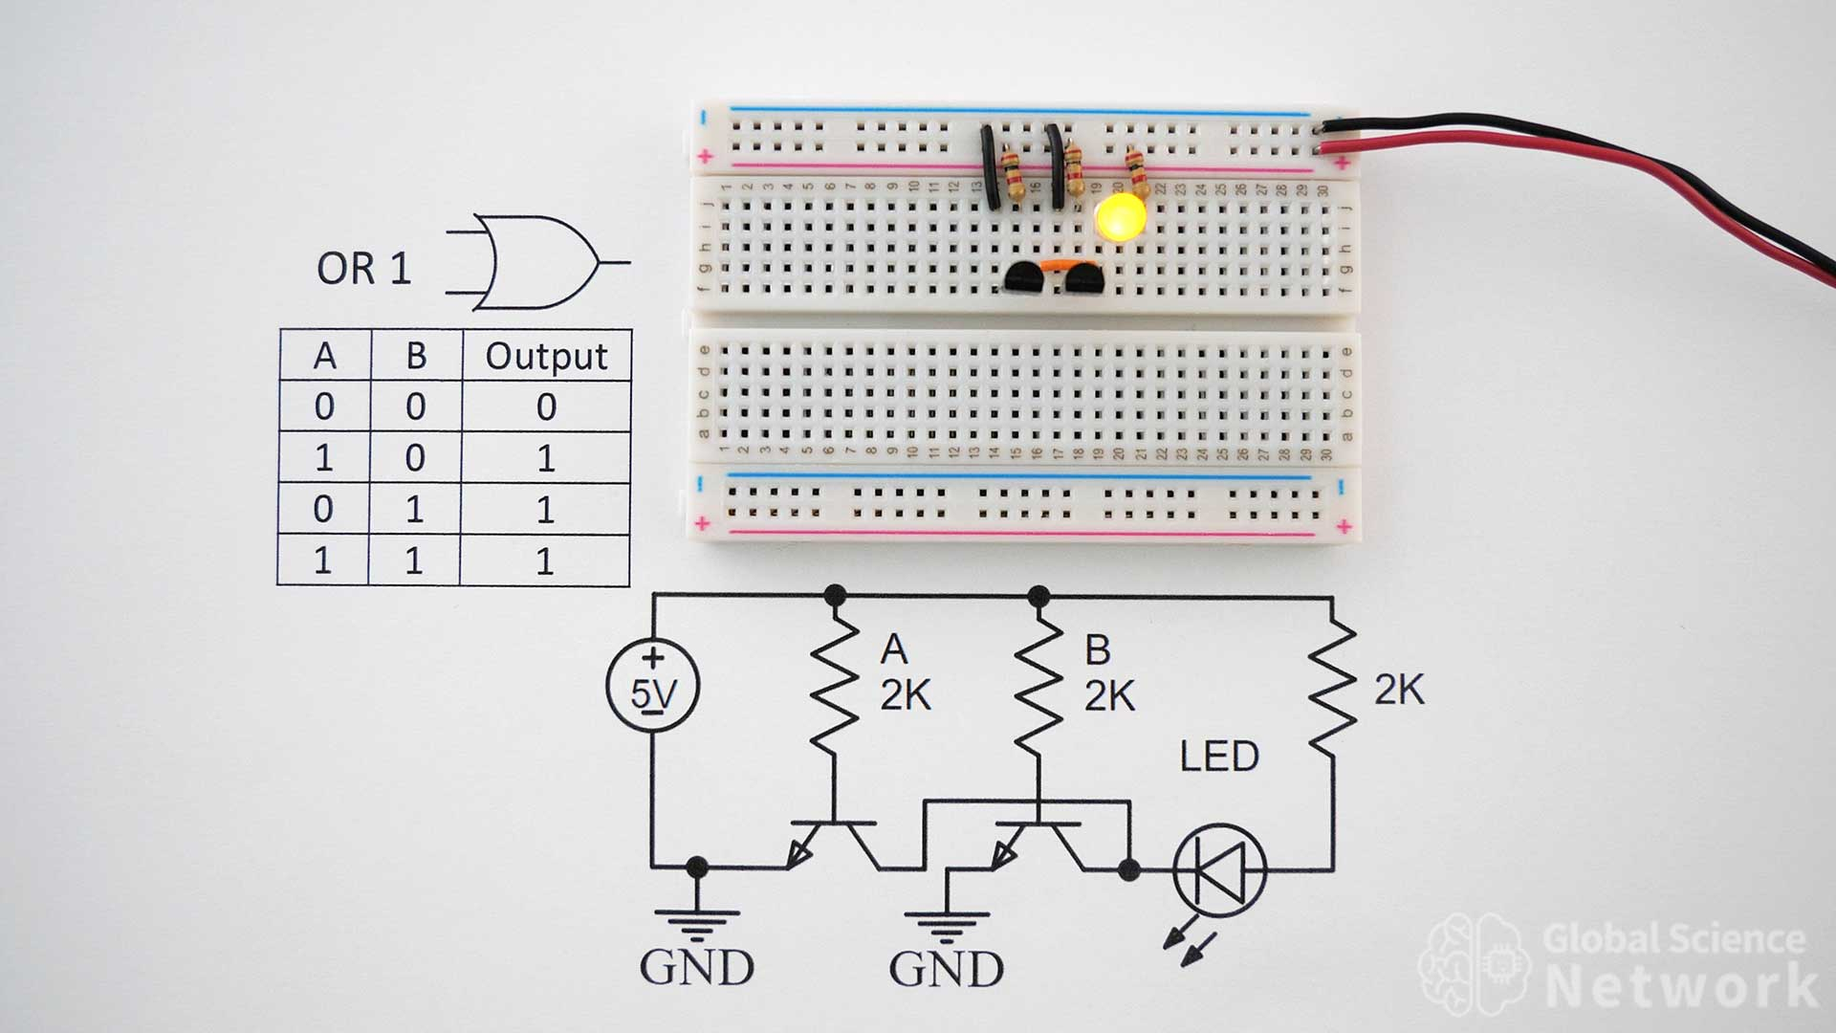
AND gate

Slide 56
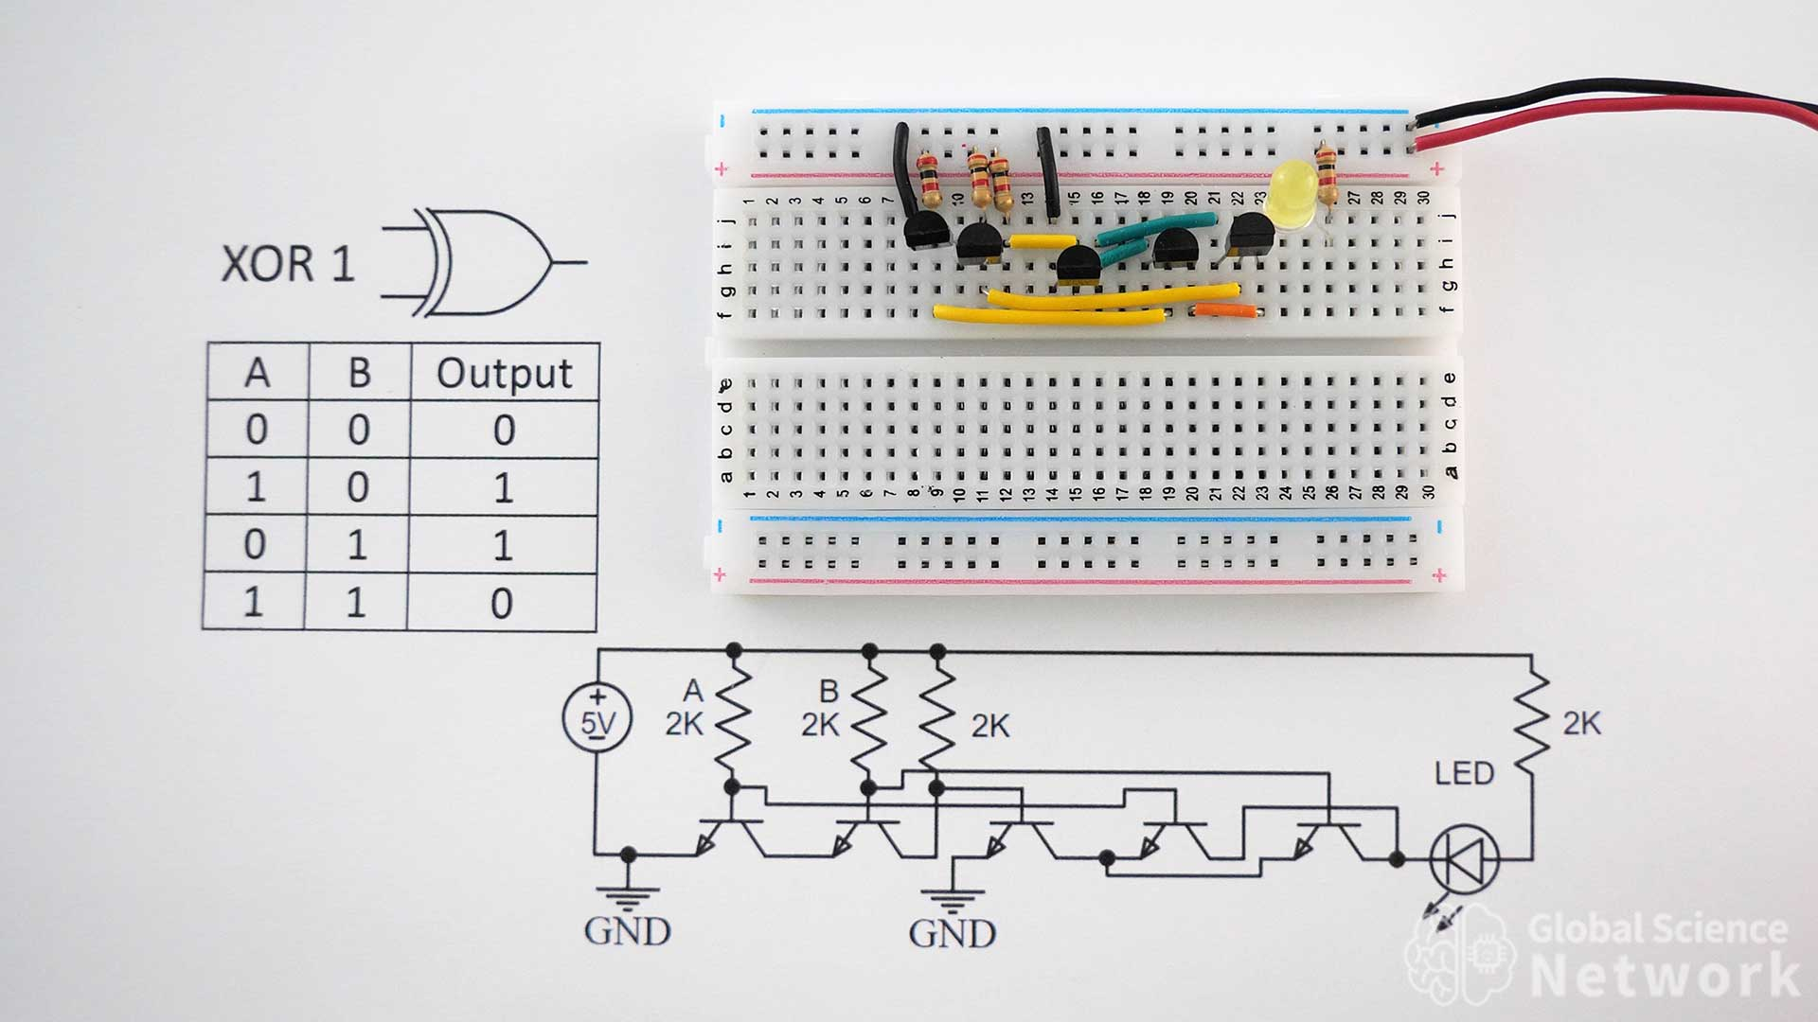

Slide 57
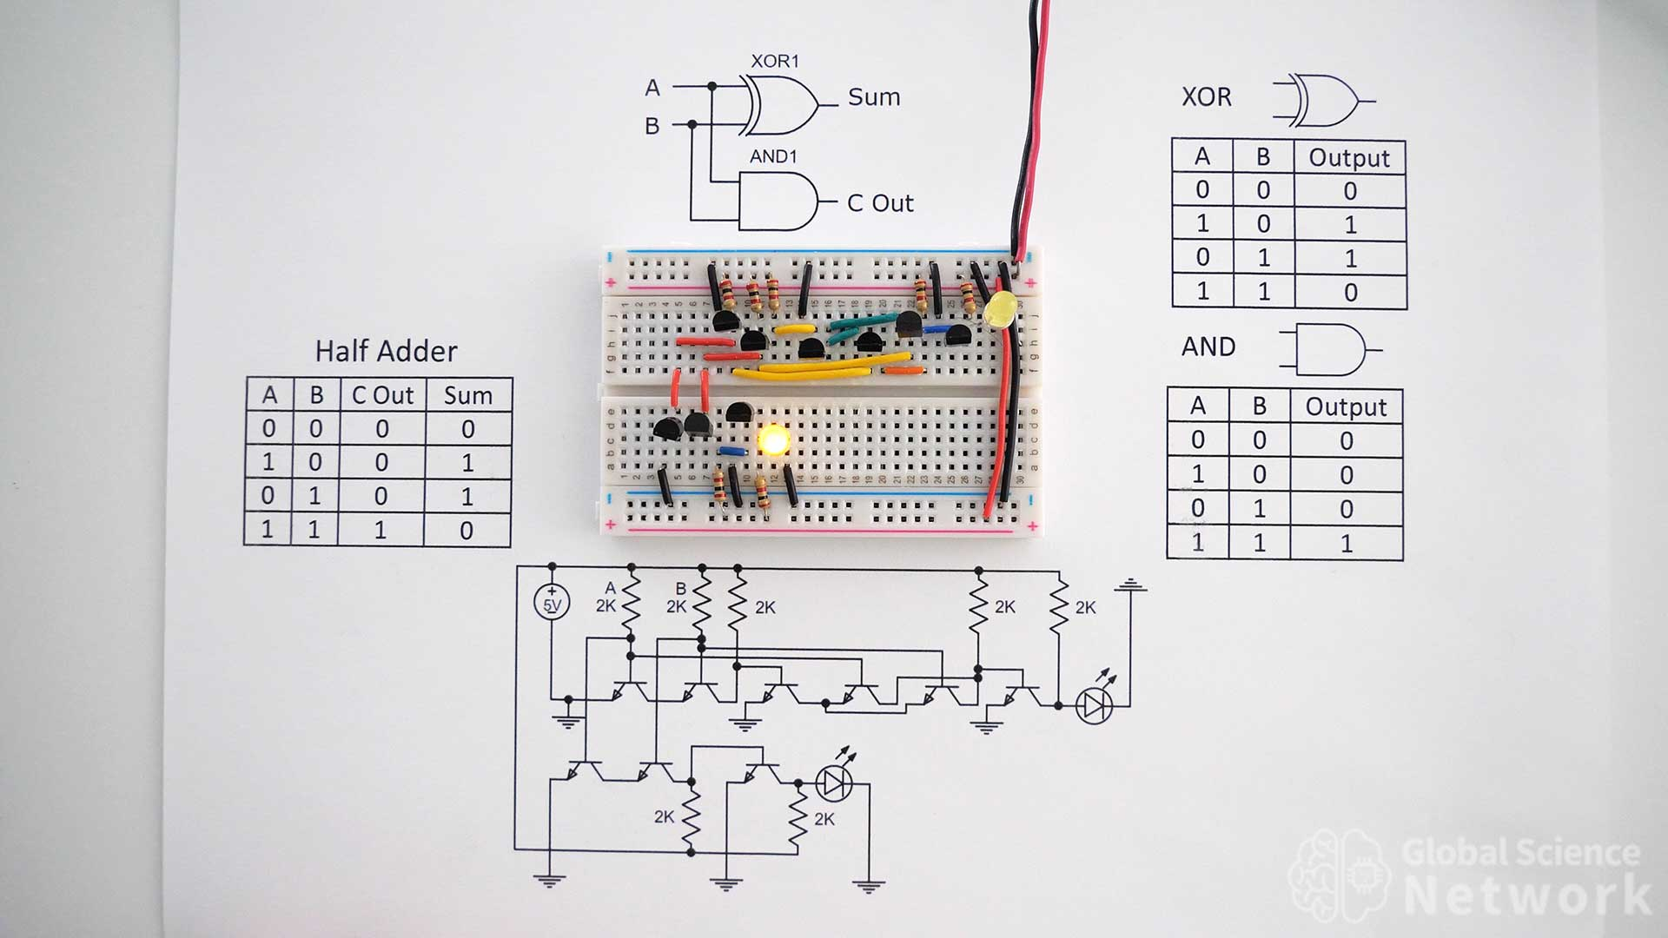

Slide 58
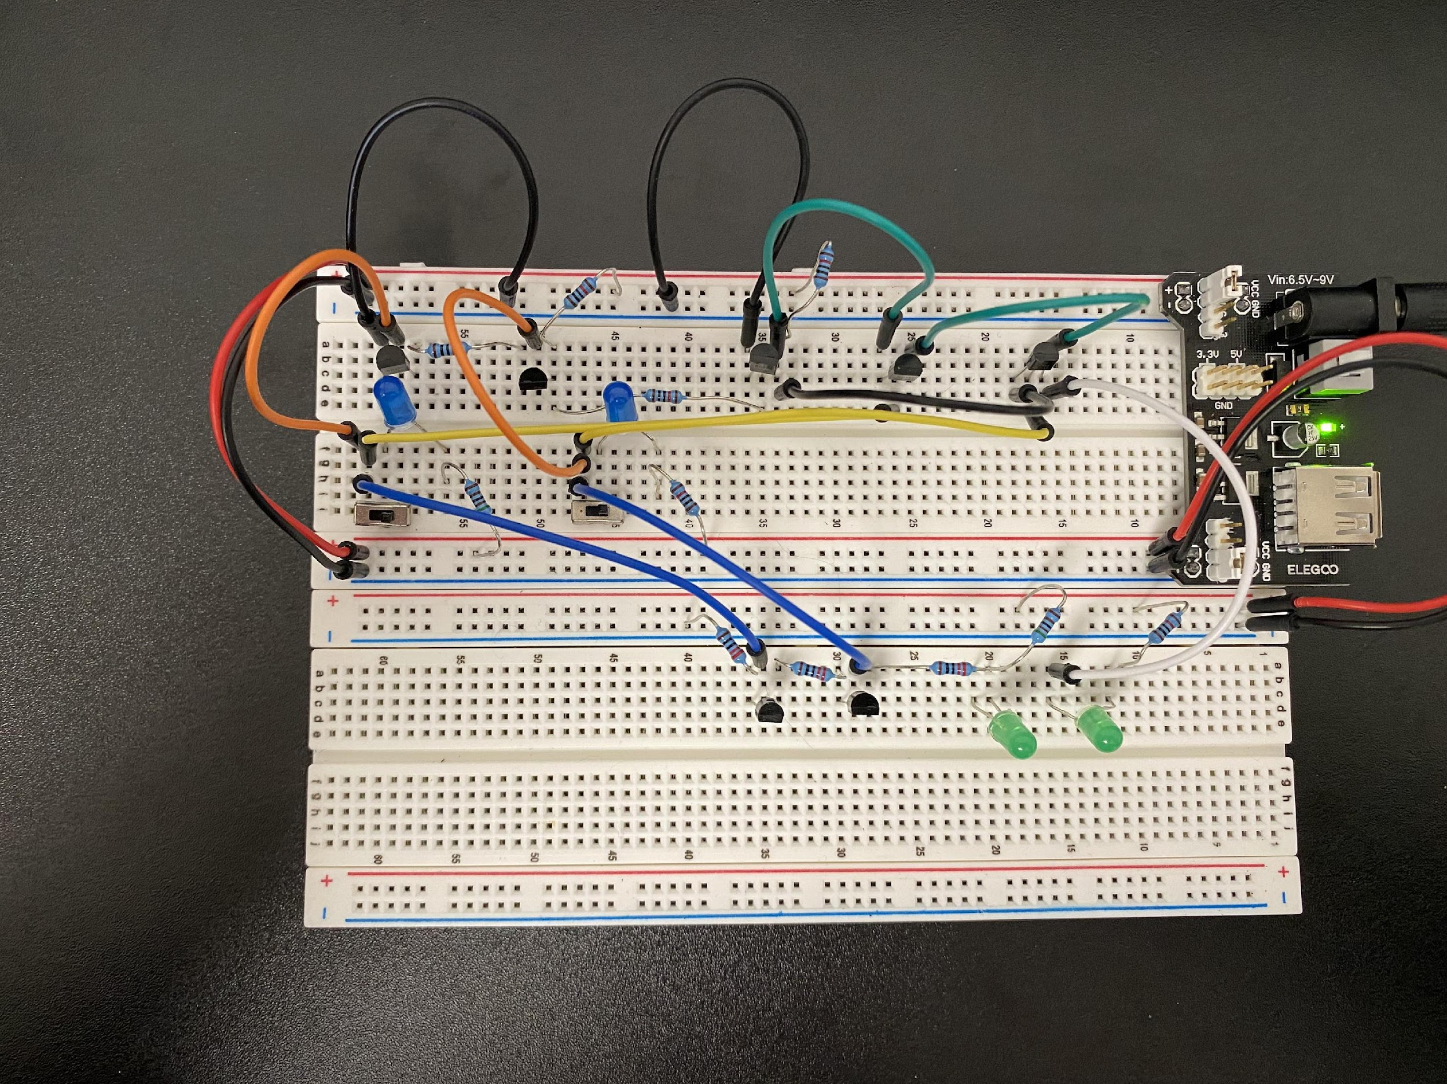

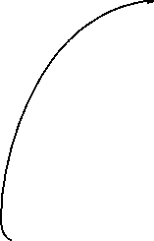


0+0=00

Slide 59
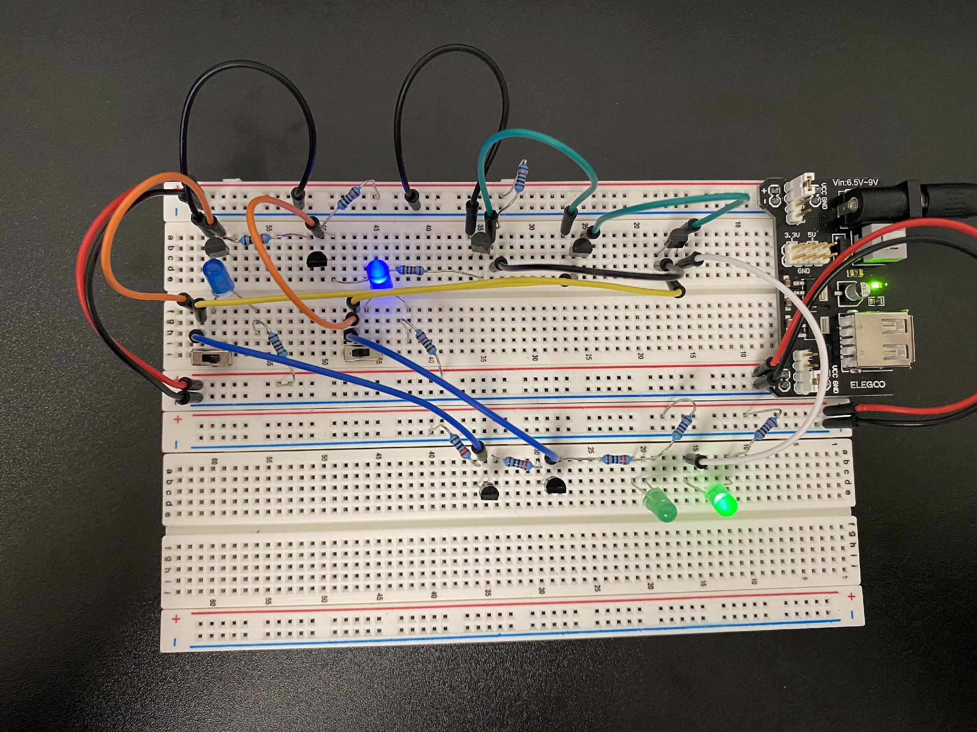
0+1=01

Slide 60
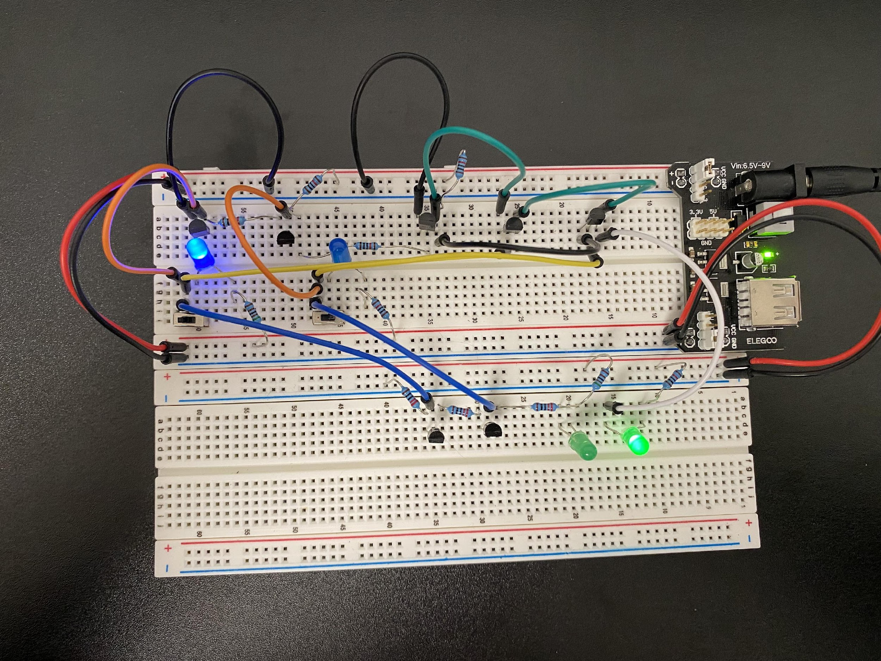
1+0=01

Slide 61
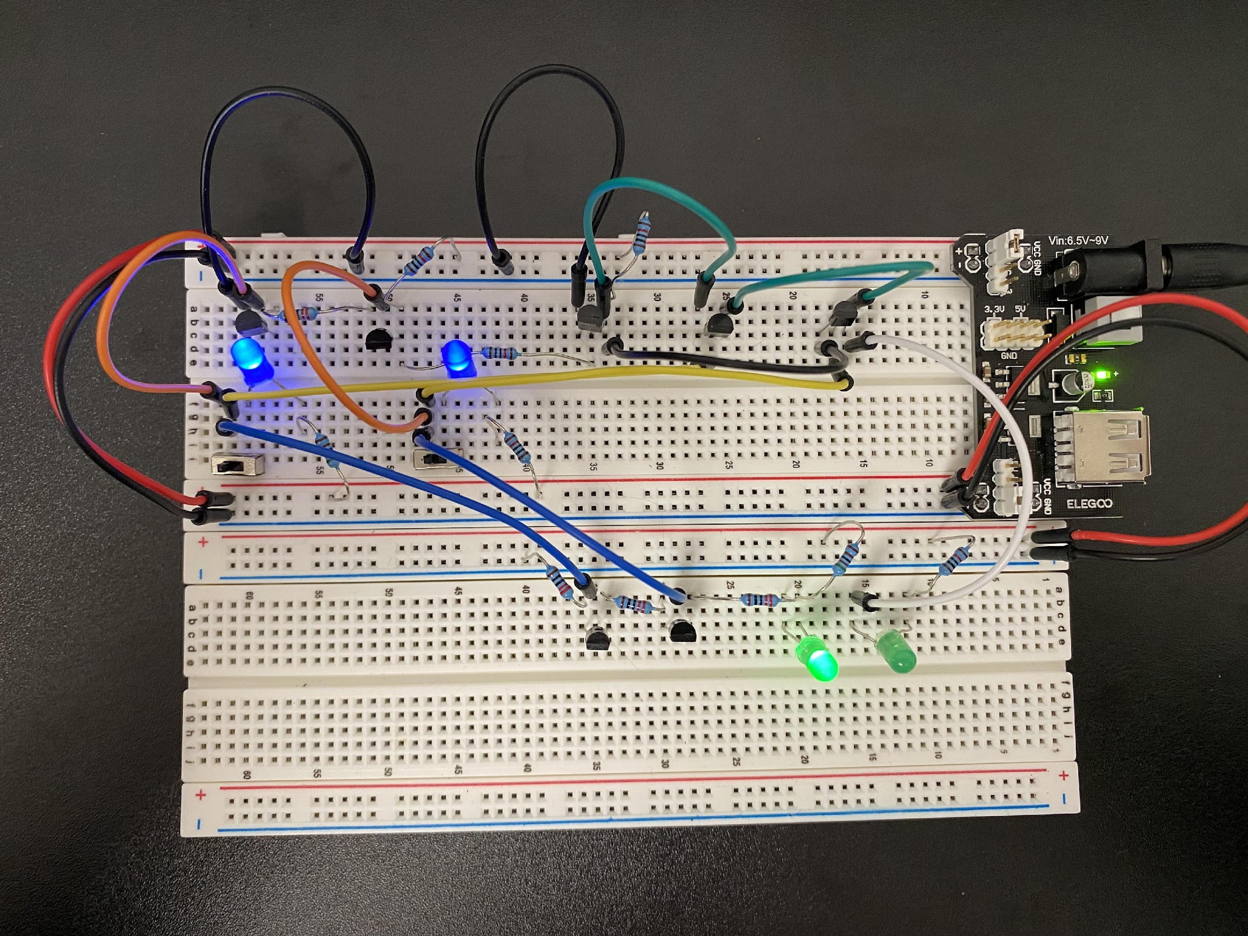
1+1=10

Slide 62
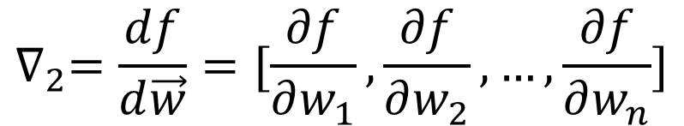
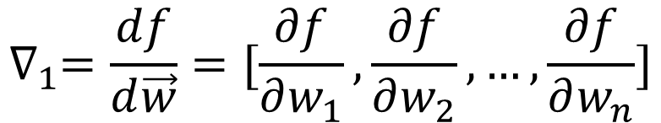
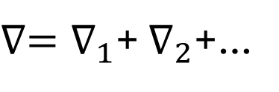
Batch
$$∇_{1}=\frac{df}{d\vec{w}}=[\frac{∂f}{∂w_{1}},\frac{∂f}{∂w_{2}},…,\frac{∂f}{∂w_{n}}]$$
Data pair 1
Data pair 2
…
Batch gradient
$$∇_{2}=\frac{df}{d\vec{w}}=[\frac{∂f}{∂w_{1}},\frac{∂f}{∂w_{2}},…,\frac{∂f}{∂w_{n}}]$$
…
$∇=∇_{1}$+ $∇_{2}$+…

Slide 63


Slide 64


Slide 65
HPRC Resources
HPRC libraries and Google Co-lab do not have the same versions of TensorFlow and PyTorch
GRACE
Get a sense of the AI hardware
Energy hungry

Slide 66
HPRC Account Application
https://hprc.tamu.edu/apply/
NetID: piyalong
Phone: 9792559203
Research Description: I am taking the 2026 ENGY 642. HPRC resources are required by the instructor to conduct energy-related research.
Apply for a basic account, 5000 computing hours

