Slide 1
Approximating APSP without Scaling: Equivalence of Approximate Min-Plus and Exact Min-Max
Authors: Karl Bringmann Marvin Künnemann Karol Węgrzycki
(Appeared in STOC 2019)

Slide 2
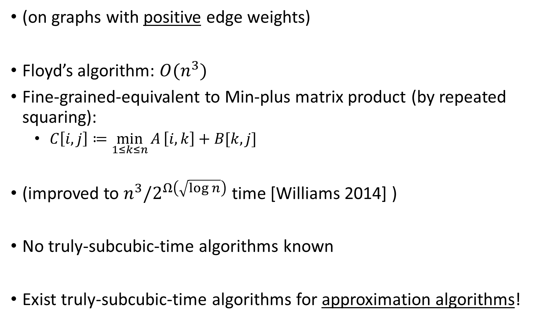
All-Pairs Shortest Path (APSP)
(on graphs with positive edge weights)
Floyd’s algorithm: $O(n^{3})$
Fine-grained-equivalent to Min-plus matrix product (by repeated squaring):
$C\left[i,j\right]≔\min_{1≤k≤n}{A}\left[i,k\right]+B[k,j]$
(improved to $n^{3}/2^{Ω\left(\sqrt{\log{n}}\right)}$ time [Williams 2014] )
No truly-subcubic-time algorithms known
Exist truly-subcubic-time algorithms for approximation algorithms!

Slide 3
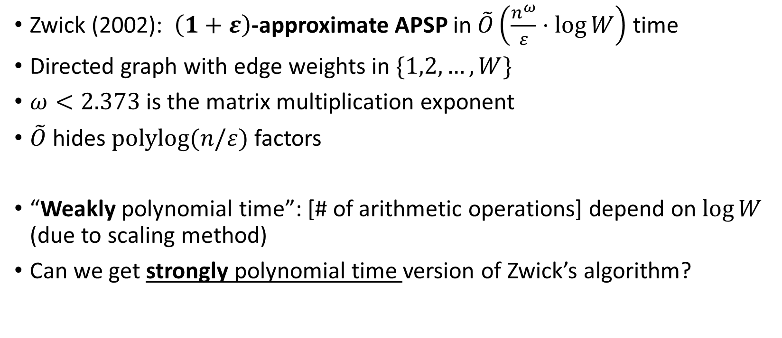
Zwick’s approximate APSP algorithm
Zwick (2002): $\left(1+ε\right)$-approximate APSP in $\tilde{O}\left(\frac{n^{ω}}{ε}⋅\log{W}\right)$ time
Directed graph with edge weights in $\{1,2,…,W\}$
$ω<2.373$ is the matrix multiplication exponent
$\tilde{O}$ hides $polylog(n/ε)$ factors
“Weakly polynomial time”: [# of arithmetic operations] depend on $\log{W}$ (due to scaling method)
Can we get strongly polynomial time version of Zwick’s algorithm?

Slide 4
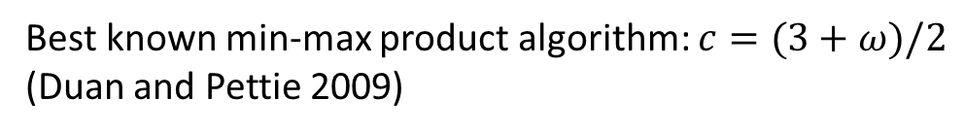
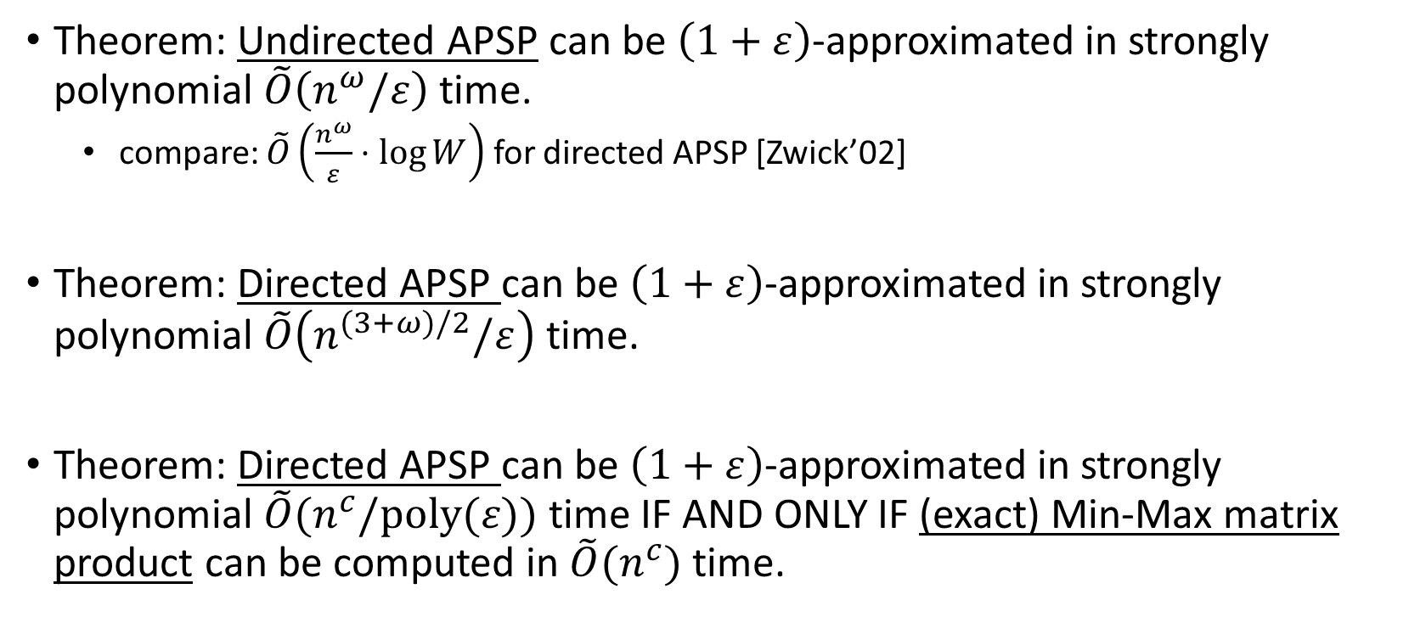
Main results in this paper [BKW’19]
Theorem: Undirected APSP can be $\left(1+ε\right)$-approximated in strongly polynomial $\tilde{O}\left(n^{ω}/ε\right)$ time.
compare: $\tilde{O}\left(\frac{n^{ω}}{ε}⋅\log{W}\right)$ for directed APSP [Zwick’02]
Theorem: Directed APSP can be $\left(1+ε\right)$-approximated in strongly polynomial $\tilde{O}\left(n^{(3+ω)/2}/ε\right)$ time.
Theorem: Directed APSP can be $\left(1+ε\right)$-approximated in strongly polynomial $\tilde{O}(n^{c}/poly(ε))$ time IF AND ONLY IF (exact) Min-Max matrix product can be computed in $\tilde{O}(n^{c})$ time.
Best known min-max product algorithm: $c=(3+ω)/2$ (Duan and Pettie 2009)
Assumption: in strongly polynomial approximation algorithms, assume the weights are stored as floating point numbers, and the usual floating point arithmetic operations cost unit time

Slide 5
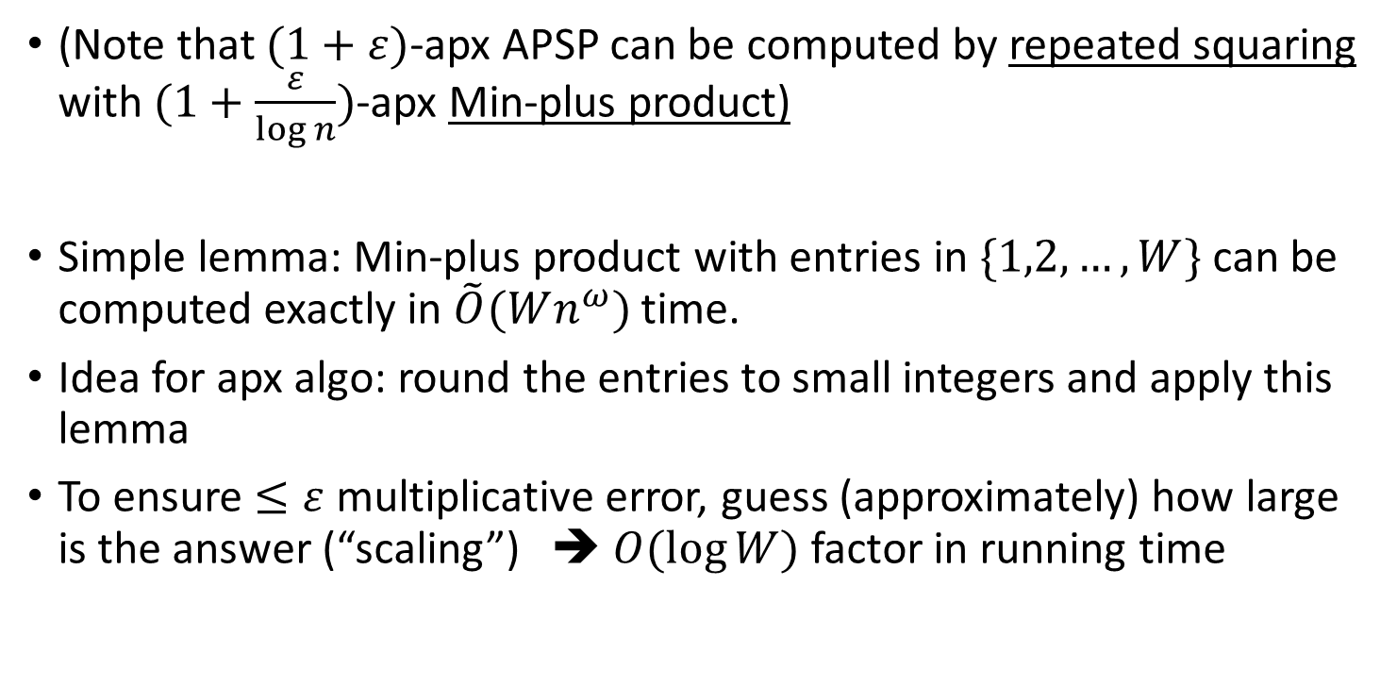

Zwick’s $\left(1+ε\right)$-apx Min-plus product via scaling
(Note that $(1+ε)$-apx APSP can be computed by repeated squaring with $(1+\frac{ε}{\log{n}})$-apx Min-plus product)
Simple lemma: Min-plus product with entries in $\{1,2,…,W\}$ can be computed exactly in $\tilde{O}(Wn^{ω})$ time.
Idea for apx algo: round the entries to small integers and apply this lemma
To ensure $≤ε$ multiplicative error, guess (approximately) how large is the answer (“scaling”) ➔ $O(\log{W})$ factor in running time

Slide 6
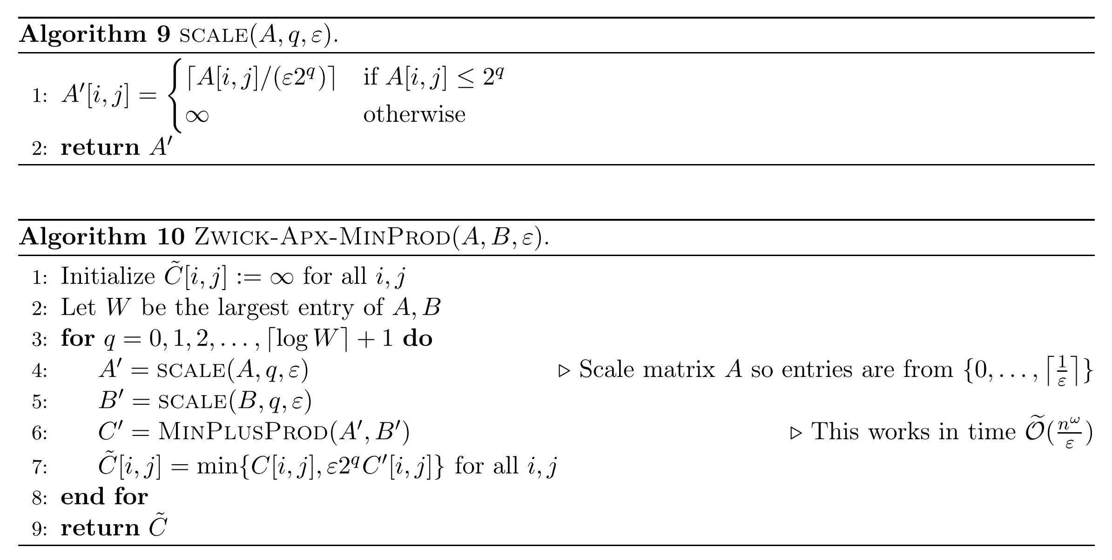

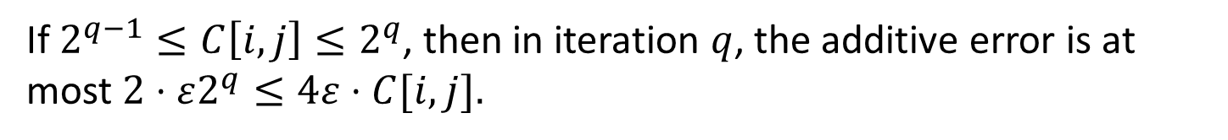
Zwick’s $\left(1+ε\right)$-apx Min-plus product via scaling
If $2^{q−1}≤C\left[i,j\right]≤2^{q}$, then in iteration $q$, the additive error is at most $2⋅ε2^{q}≤4ε⋅C[i,j].$

Slide 7
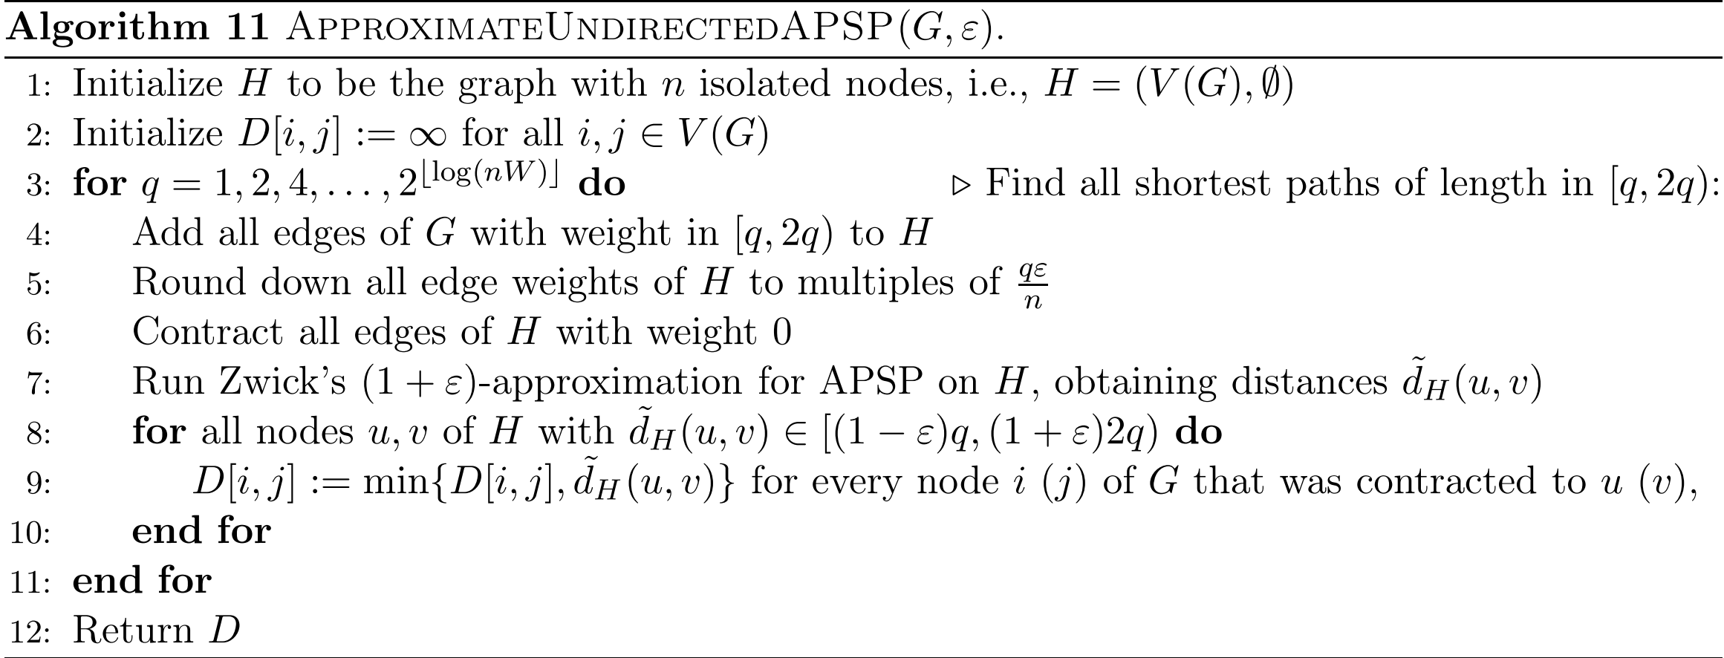


Strongly-polynomial undirected APSP
Idea: if the weight of edge $(i,j)$ is rounded down to zero, then contract them into a single node (valid because graph is undirected)
(improve time complexity by reducing the number of nodes)

Slide 8
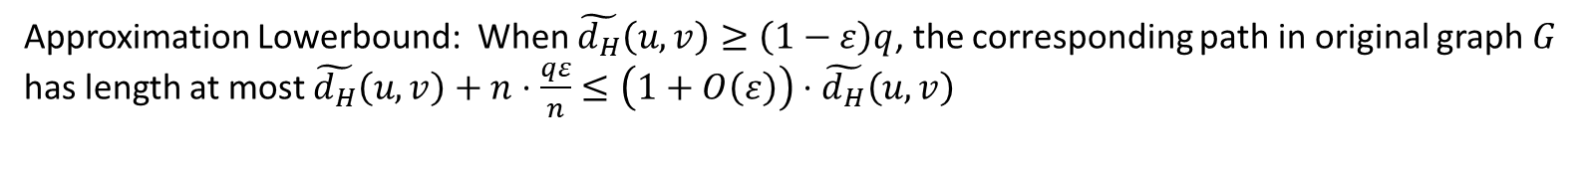
Correctness proof
Approximation Lowerbound: When $\tilde{d_{H}}\left(u,v\right)≥\left(1−ε\right)q$, the corresponding path in original graph $G$ has length at most $\tilde{d_{H}}\left(u,v\right)+n⋅\frac{qε}{n}≤\left(1+O\left(ε\right)\right)⋅\tilde{d_{H}}\left(u,v\right)$
Approximation upperbound: If the real distance $d_{G}\left(i,j\right)∈[q,2q)$, and in graph $H$ they are contracted to $u,v$ respectively, then $d_{H}\left(u,v\right)≤\left[q−qε, 2q\right)$ in graph $H$, and will be updated by Zwick’s algo.

Slide 9
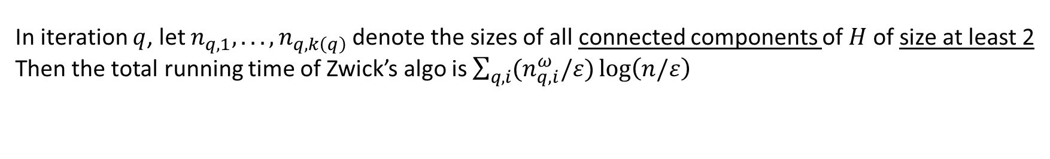
Running time
In iteration $q$, let $n_{q,1}, . . . , n_{q,k\left(q\right)}$denote the sizes of all connected components of $H$of size at least 2
Then the total running time of Zwick’s algo is $\sum_{q,i}{(n_{q,i}^{ω}/ε})\log\left(n/ε\right)$

Slide 10
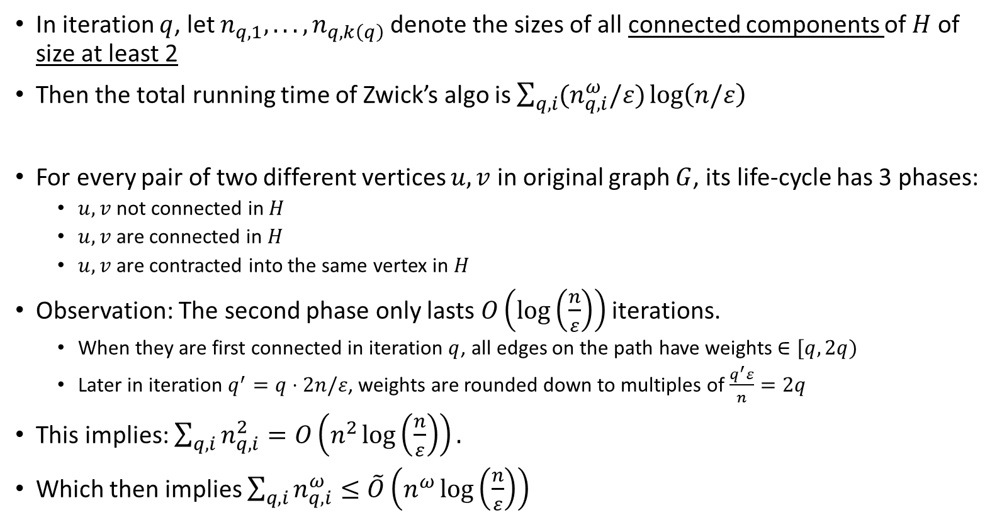
Running time
In iteration $q$, let $n_{q,1}, . . . , n_{q,k\left(q\right)}$denote the sizes of all connected components of $H$of size at least 2
Then the total running time of Zwick’s algo is $\sum_{q,i}{(n_{q,i}^{ω}/ε})\log\left(n/ε\right)$
For every pair of two different vertices $u,v$ in original graph $G$, its life-cycle has 3 phases:
$u,v$ not connected in $H$
$u,v$ are connected in $H$
$u,v$ are contracted into the same vertex in $H$
Observation: The second phase only lasts $O\left(\log\left(\frac{n}{ε}\right)\right)$ iterations.
When they are first connected in iteration $q$, all edges on the path have weights $∈[q,2q)$
Later in iteration $q^{′}=q⋅2n/ε$, weights are rounded down to multiples of $\frac{q^{′}ε}{n}=2q$
This implies: $\sum_{q,i}{n_{q,i}^{2}}=O\left(n^{2}\log\left(\frac{n}{ε}\right)\right).$
Which then implies $\sum_{q,i}{n_{q,i}^{ω}}≤\tilde{O}\left(n^{ω}\log\left(\frac{n}{ε}\right)\right)$

Slide 11
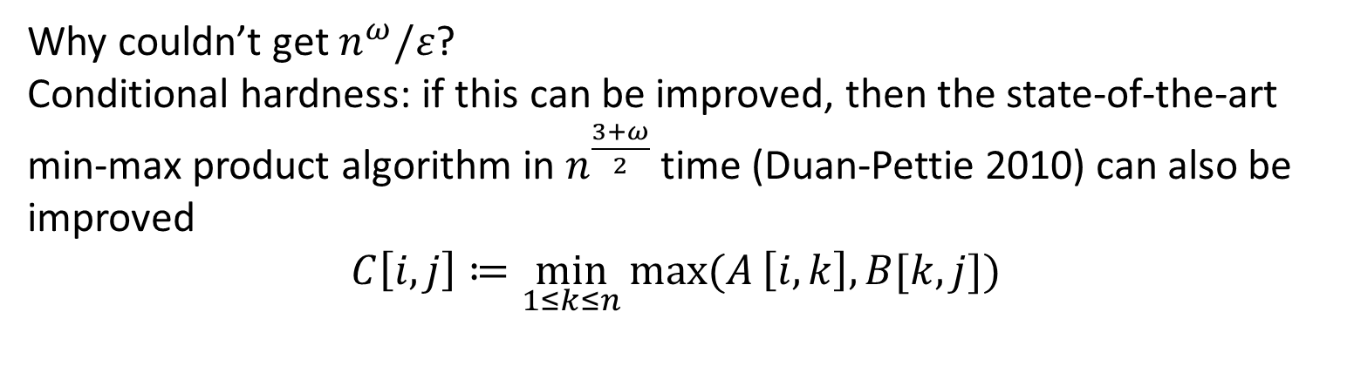
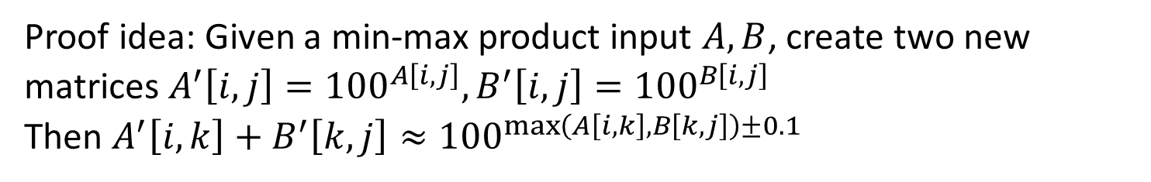
Strongly polynomial approx Min-plus product
$(1+ε)$-approximation in strongly polynomial $\tilde{O}\left(n^{(3+ω)/2}/ε\right)$ time
Why couldn’t get $n^{ω}/ε$?
Conditional hardness: if this can be improved, then the state-of-the-art min-max product algorithm in $n^{\frac{3+ω}{2}}$ time (Duan-Pettie 2010) can also be improved
$$C\left[i,j\right]≔\min_{1≤k≤n}{max⁡(A}\left[i,k\right],B[k,j])$$
Proof idea: Given a min-max product input $A,B$, create two new matrices $A^{′}\left[i,j\right]={100}^{A\left[i,j\right]}, B^{′}\left[i,j\right]={100}^{B\left[i,j\right]}$
Then $A^{′}\left[i,k\right]+B^{′}\left[k,j\right]≈{100}^{\max\left(A\left[i,k\right],B\left[k,j\right]\right)±0.1}$

Slide 12
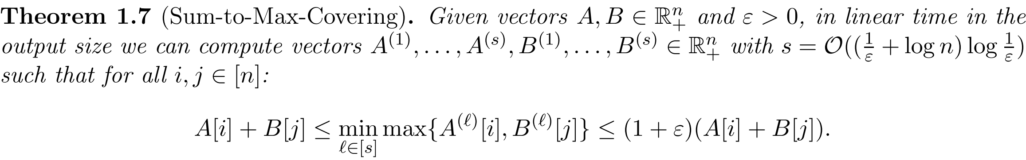

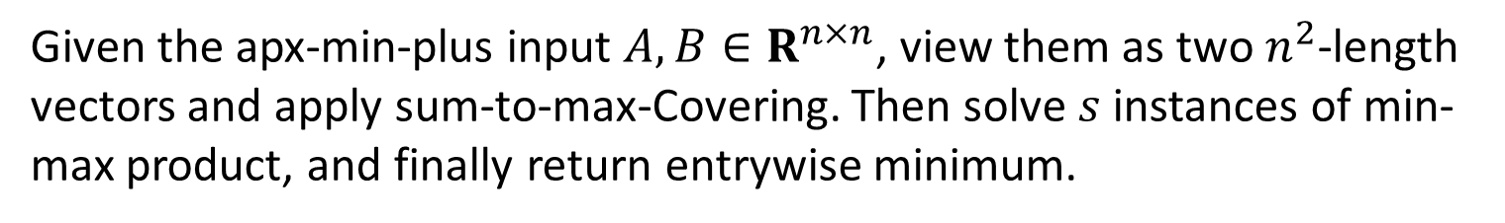
Strongly polynomial approx Min-plus product
Main technical tool: Sum-To-Max-Covering
This implies a $\left(1+ε\right)$-apx min-plus product algorithm in ${\tilde{O}(n}^{\frac{3+ω}{2}}/ε)$ time, by reducing to the min-max product problem:
Given the apx-min-plus input $A,B∈R^{n×n}$, view them as two $n^{2}$-length vectors and apply sum-to-max-Covering. Then solve $s$ instances of min-max product, and finally return entrywise minimum.

Slide 13

Sum-To-Max-Covering
Most technical part of the paper. Will only provide a sketch here.
Naïve approach:
enumerate $d$ and focus on all $i$ such that $A\left[i\right]≈{\left(1+ε\right)}^{d}$:
Define $A^{(d)}\left[i\right]=\left\{\begin{aligned}A[i] if A\left[i\right]∈[{\left(1+ε\right)}^{d−1},{\left(1+ε\right)}^{d}) \\ +∞ otherwise \end{aligned}\right.$
Note that $max\left({\left(1+ε\right)}^{d}+B\left[j\right], A^{(d)}\left[i\right]\right)$ is an $\left(1+ε\right)$-approximation of $A\left[i\right]+B[j]$
So we could simply define $B^{(d)}\left[j\right]={\left(1+ε\right)}^{d}+B[j]$
Issue: enumerating $d$ incurs $O(\log{W})$ factor……
Solution: each time take care of many $d$’s in parallel!

Slide 14
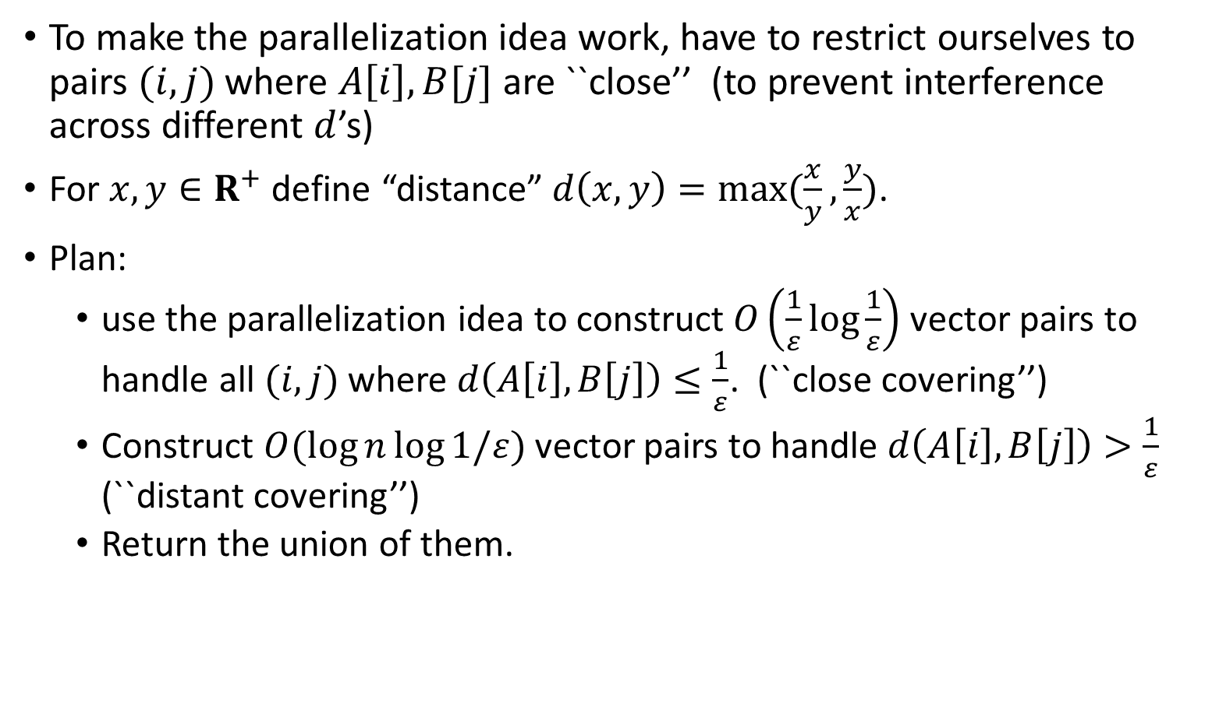
Sum-To-Max-Covering
To make the parallelization idea work, have to restrict ourselves to pairs $(i,j)$ where $A\left[i\right],B[j]$ are ``close’’ (to prevent interference across different $d$’s)
For $x,y∈R^{+}$ define “distance” $d\left(x,y\right)=max⁡(\frac{x}{y},\frac{y}{x})$.
Plan:
use the parallelization idea to construct $O\left(\frac{1}{ε}\log{\frac{1}{ε}}\right)$ vector pairs to handle all $(i,j)$ where $d\left(A\left[i\right],B\left[j\right]\right)≤\frac{1}{ε}$. (``close covering’’)
Construct $O(log{n}\log{1/ε})$ vector pairs to handle $d\left(A\left[i\right],B\left[j\right]\right)>\frac{1}{ε}$ (``distant covering’’)
Return the union of them.

Slide 15
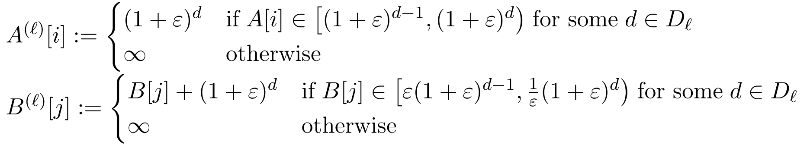
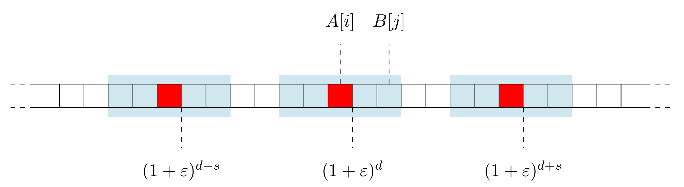

``Close covering’’
($d\left(x,y\right)=\max\left(\frac{x}{y},\frac{y}{x}\right).$ Want to handle $d\left(A\left[i\right],B\left[j\right]\right)≤\frac{1}{ε}$)
Pick large enough $s=Θ\left(\frac{1}{ε}\log{\frac{1}{ε}}\right)$. And each time focus on $A\left[i\right]≈{\left(1+ε\right)}^{d}$ for all $d∈D_{ℓ}≔ \{ℓ,ℓ+s,ℓ+2s,ℓ+3s,…\}$
Validity:

Slide 16
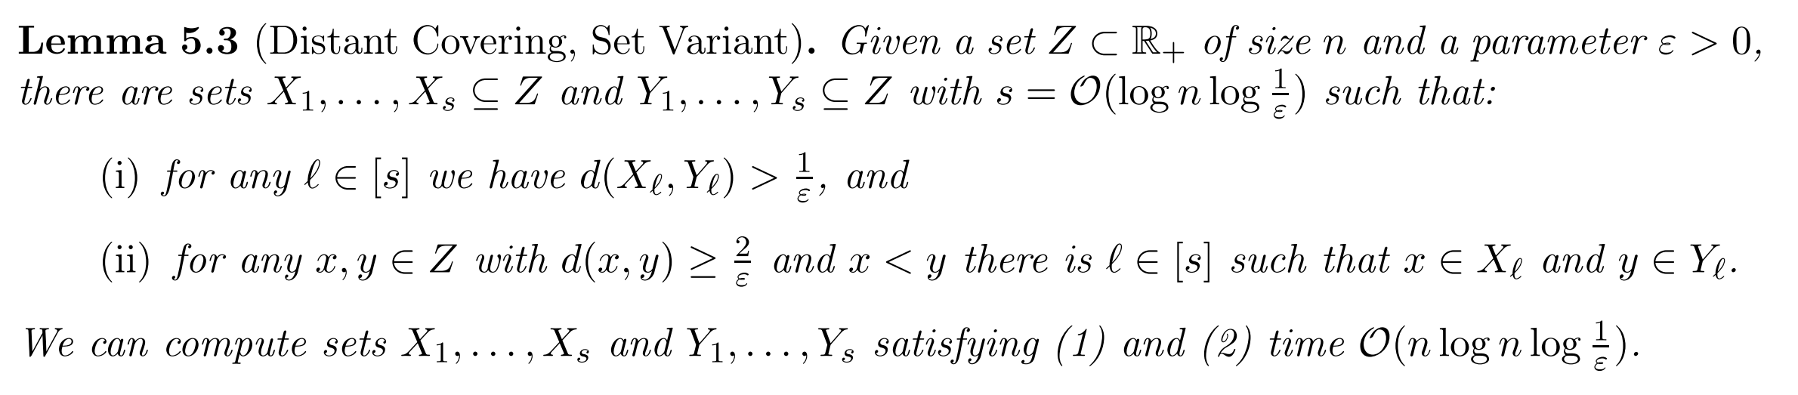

``Distant Covering’’
($d\left(x,y\right)=\max\left(\frac{x}{y},\frac{y}{x}\right).$ Want to handle $d\left(A\left[i\right],B\left[j\right]\right)>\frac{1}{ε}$)
In this case, $\max\left(A\left[i\right],B\left[j\right]\right)≈_{ε}A\left[i\right]+B[j]$.
Our constructed vectors will only include $A\left[i\right]$ (or $B[j]$) and $+∞$
The difficulty is how to ensure: for close pairs $A\left[i\right],B[j]$ we should not include both (i.e., at least one of them should be set to $+∞$)
Proof by some divide and conquer. Details omitted.

Slide 17
Thank you!

