Slide 1

The Directed Grid Theorem
Aeren

Slide 2
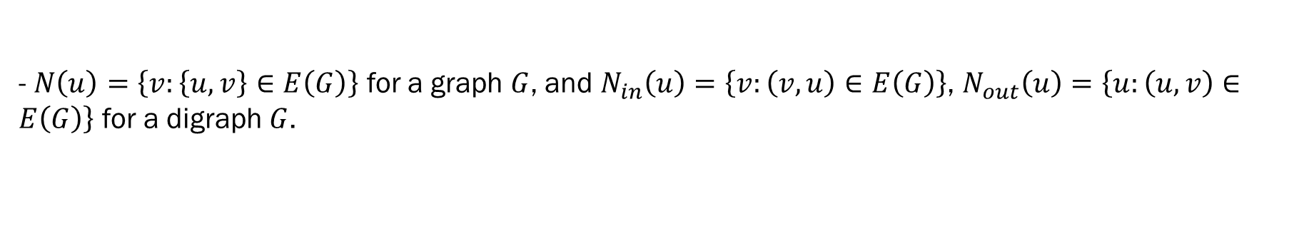
0. Notations
- Undirected and directed graphs will be denoted as graphs and digraphs, respectively.
- Every graph and digraph are finite and simple unless stated otherwise.
- For a graph(or a digraph) $G$, $V(G)$ denotes its vertex set and $E(G)$ its edge set.
- For an edge $e=\left(u,v\right)∈E\left(G\right)$ in a digraph $G$, $u$ and $v$ are tail and head of $e$ respectively. $e$ is said to be incident to $u$ and $v$.
- For an edge $e=\left(u,v\right)∈E\left(G\right)$ and paths $P_{1}$ ending at $u$ and $P_{2}$ in a digraph $G$, starting at $v$, $P_{1}eP_{2}$ denotes the combined path.
- $N\left(u\right)=\left\{v:\left\{u,v\right\}∈E\left(G\right)\right\}$ for a graph $G$, and $N_{in}\left(u\right)=\left\{v:\left(v,u\right)∈E\left(G\right)\right\}$, $N_{out}\left(u\right)=\left\{u:\left(u,v\right)∈E\left(G\right)\right\}$ for a digraph $G$.
- An abstract graph in a digraph $G$ is the graph obtained by ignoring the direction of edges.
- For an graph $G$, $G^{↔}$ denotes the biorientation of $G$, and $\overline{G}$ its completement.
- $K_{n}$ is the unique (up to isomorphism) complete graph with $n$ vertices.
- For a set $S$ and an integer $k$, ${\left[S\right]}^{=k}$ is the set of subsets of $S$ of size $k$. ${\left[S\right]}^{≤k},{\left[S\right]}^{<k}$, ${\left[S\right]}^{>k}$, ${\left[S\right]}^{≥k}$ are defined similarly.
- For a graph(or a digraph) $G$ and $S⊆V\left(G\right)$, $\left[S\right]$ denotes the induced subgraph.

Slide 3






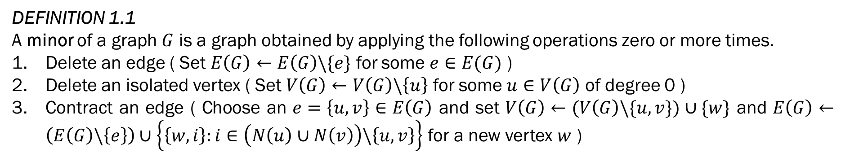







1. Prologue
DEFINITION 1.1
A minor of a graph $G$ is a graph obtained by applying the following operations zero or more times.
Delete an edge ( Set $E\left(G\right)←E\left(G\right)\backslash \{e\}$ for some $e∈E(G)$ )
Delete an isolated vertex ( Set $V\left(G\right)←V\left(G\right)\backslash \left\{u\right\}$ for some $u∈V\left(G\right)$ of degree 0 )
Contract an edge ( Choose an $e=\left\{u,v\right\}∈E\left(G\right)$ and set $V\left(G\right)←(V\left(G\right)\backslash \{u,v\})∪\{w\}$ and $E\left(G\right)←\left(E\left(G\right)\backslash \left\{e\right\}\right)∪\left\{\left\{w,i\right\}:i∈\left(N\left(u\right)∪N\left(v\right)\right)\backslash \left\{u,v\right\}\right\}$ for a new vertex $w$ )
$$;.$$
$$;.$$
$$;.$$
$$v$$
$$;.$$
$$e$$
$$w$$
$$;.$$
$$u$$
$$;.$$
$$;.$$
$$;.$$
$$;.$$

Slide 4
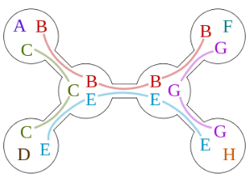
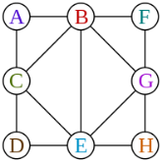
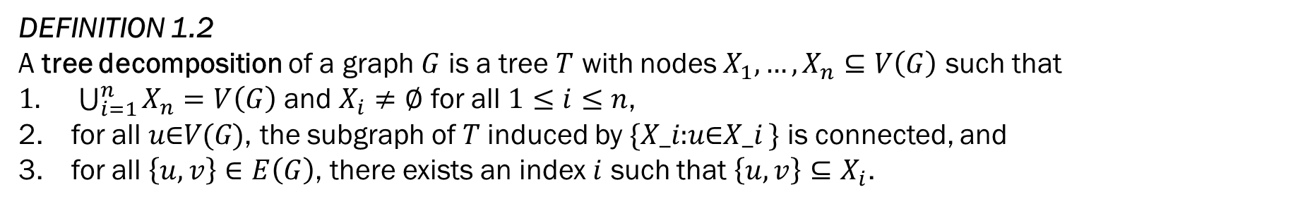
1. Prologue
DEFINITION 1.2
A tree decomposition of a graph $G$ is a tree $T$ with nodes $X_{1},…,X_{n}⊆V\left(G\right)$ such that
$\bigcup_{i=1}^{n}{X_{n}}=V\left(G\right)$ and $X_{i}≠∅$ for all $1≤i≤n$,
for all 𝑢∈𝑉(𝐺), the subgraph of 𝑇 induced by {𝑋_𝑖:𝑢∈𝑋_𝑖 } is connected, and
for all $\left\{u,v\right\}∈E\left(G\right)$, there exists an index $i$ such that $\left\{u,v\right\}⊆X_{i}$.

Slide 5
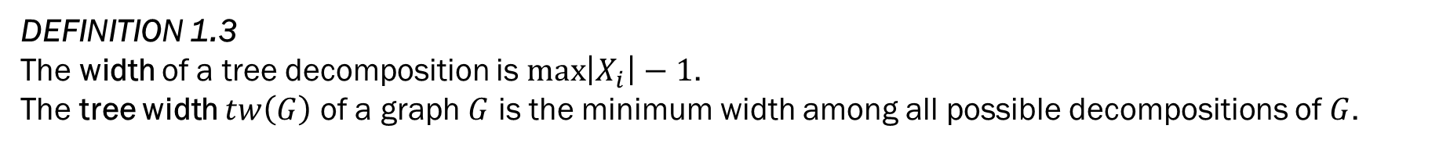
1. Prologue
DEFINITION 1.3
The width of a tree decomposition is $\max\left|X_{i}\right|−1$.
The tree width $tw\left(G\right)$ of a graph $G$ is the minimum width among all possible decompositions of $G$.
1
{1}
2
3
{1,2}
{1,3}
4
5
{2,4}
{2,5}

Slide 6
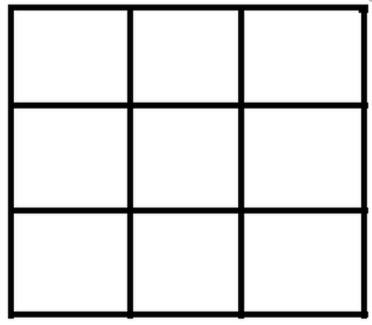
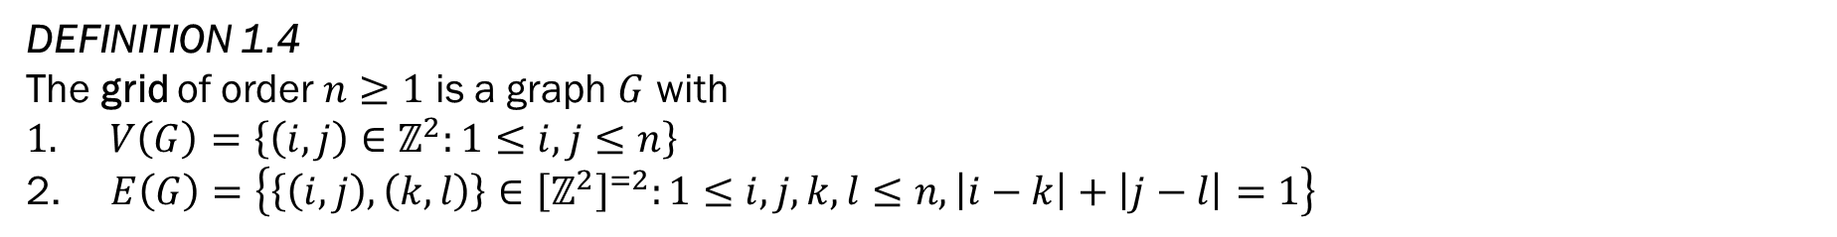
1. Prologue
DEFINITION 1.4
The grid of order $n≥1$ is a graph $G$ with
$V\left(G\right)=\left\{\left(i,j\right)∈ℤ^{2}:1≤i,j≤n\right\}$
$E\left(G\right)=\left\{\left\{\left(i,j\right),\left(k,l\right)\right\}∈{\left[ℤ^{2}\right]}^{=2}:1≤i,j,k,l≤n, \left|i−k\right|+\left|j−l\right|=1\right\}$
A grid of order 4

Slide 7
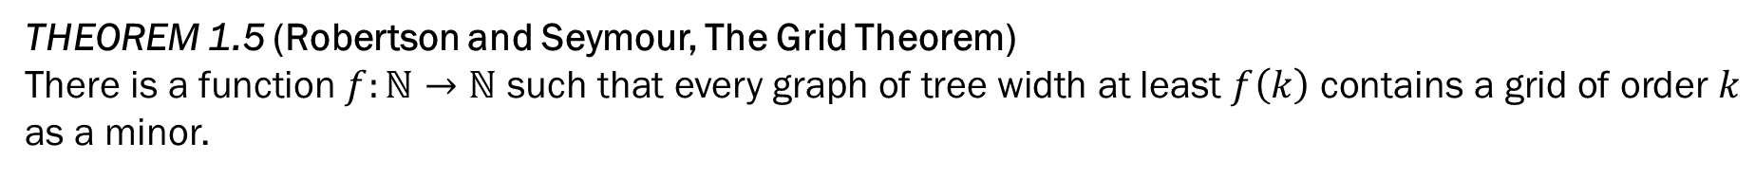
1. Prologue
THEOREM 1.5 (Robertson and Seymour, The Grid Theorem)
There is a function $f:ℕ→ℕ$ such that every graph of tree width at least $f\left(k\right)$ contains a grid of order $k$ as a minor.
“The grid theorem is important both for structural graph theory as well as for algorithmic applications. For instance, algorithmically it is the basis of an algorithm design principle called bidimensionality theory, which has been used to obtain many approximation algorithms, PTASs, subexponential algorithms and fixed-parameter algorithms on graph classes excluding a fixed minor. These include feedback vertex set, vertex cover, minimum maximal matching, face cover, a series of vertex-removal parameters, dominating set, edge dominating set, R-dominating set, connected dominating set, connected edge dominating
set, connected R-dominating set and unweighted TSP tour.”

Slide 8



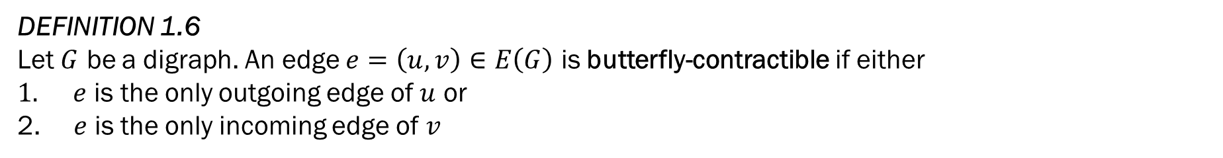





1. Prologue
DEFINITION 1.6
Let $G$ be a digraph. An edge $e=\left(u,v\right)∈E\left(G\right)$ is butterfly-contractible if either
$e$ is the only outgoing edge of $u$ or
$e$ is the only incoming edge of $v$
$$;.$$
$$;.$$
$$v$$
$$e$$
$$;.$$
$$u$$
$$;.$$
$$;.$$

Slide 9






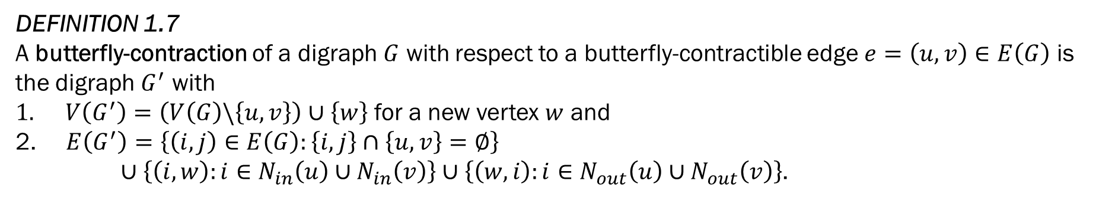







1. Prologue
DEFINITION 1.7
A butterfly-contraction of a digraph $G$ with respect to a butterfly-contractible edge $e=\left(u,v\right)∈E\left(G\right)$ is the digraph $G^{′}$ with
$V\left(G^{′}\right)=\left(V\left(G\right)\backslash \left\{u,v\right\}\right)∪\left\{w\right\}$ for a new vertex $w$ and
$E\left(G^{′}\right)=\left\{\left(i,j\right)∈E\left(G\right):\left\{i,j\right\}∩\left\{u,v\right\}=∅\right\}$
$∪\left\{\left(i,w\right):i∈N_{in}\left(u\right)∪N_{in}\left(v\right)\right\}∪\left\{\left(w,i\right):i∈N_{out}\left(u\right)∪N_{out}\left(v\right)\right\}$.
$$;.$$
$$;.$$
$$;.$$
$$v$$
$$;.$$
$$e$$
$$w$$
$$;.$$
$$u$$
$$;.$$
$$;.$$
$$;.$$
$$;.$$
DEFINITION 1.8
A butterfly-minor of a digraph $G$ is a digraph obtained from a subdigraph of $G$ by zero or more butterfly contractions.

Slide 10

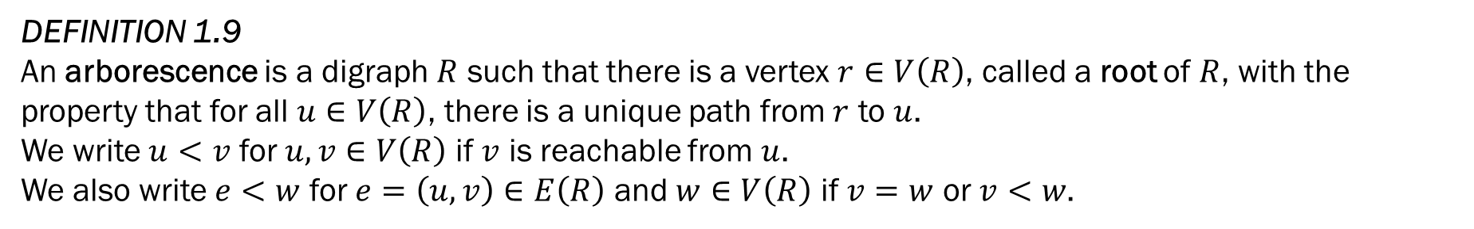

1. Prologue
DEFINITION 1.9
An arborescence is a digraph $R$ such that there is a vertex $r∈V\left(R\right)$, called a root of $R$, with the property that for all $u∈V\left(R\right)$, there is a unique path from $r$ to $u$.
We write $u<v$ for $u,v∈V\left(R\right)$ if $v$ is reachable from $u$.
We also write $e<w$ for $e=\left(u,v\right)∈E\left(R\right)$ and $w∈V\left(R\right)$ if $v=w$ or $v<w$.
$$r$$
$$r$$

Slide 11
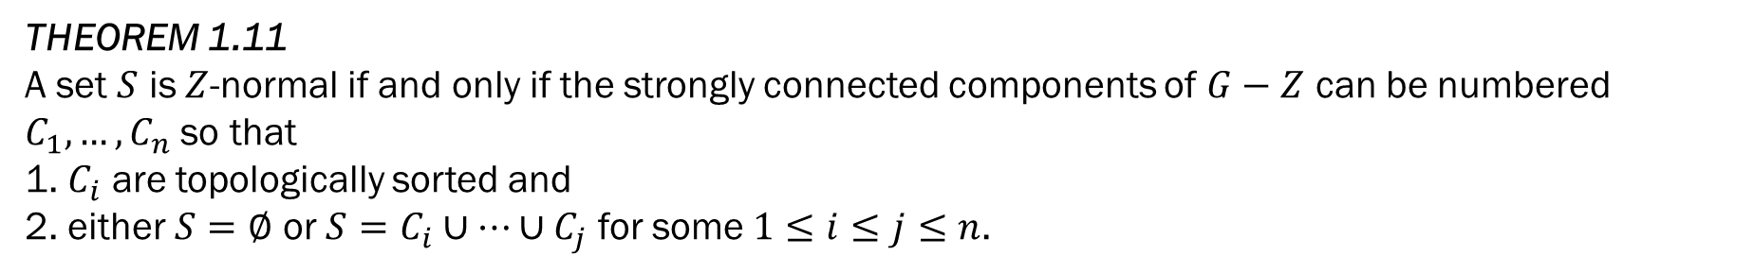
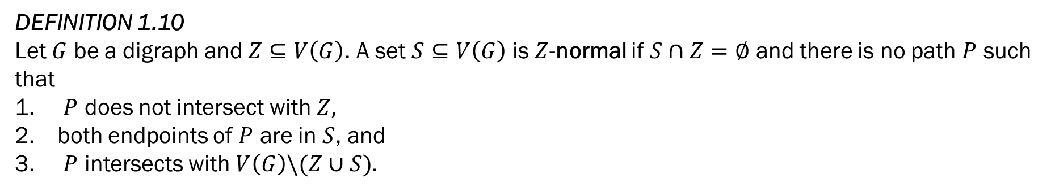
1. Prologue
DEFINITION 1.10
Let $G$ be a digraph and $Z⊆V\left(G\right)$. A set $S⊆V\left(G\right)$ is $Z$-normal if $S∩Z=∅$ and there is no path $P$ such that
$P$ does not intersect with $Z,$
both endpoints of $P$ are in $S$, and
$P$ intersects with $V\left(G\right)\backslash (Z∪S)$.
THEOREM 1.11
A set $S$ is $Z$-normal if and only if the strongly connected components of $G−Z$ can be numbered $C_{1},…,C_{n}$ so that
1. $C_{i}$ are topologically sorted and
2. either $S=∅$ or $S=C_{i}∪…∪C_{j}$ for some $1≤i≤j≤n$.

Slide 12
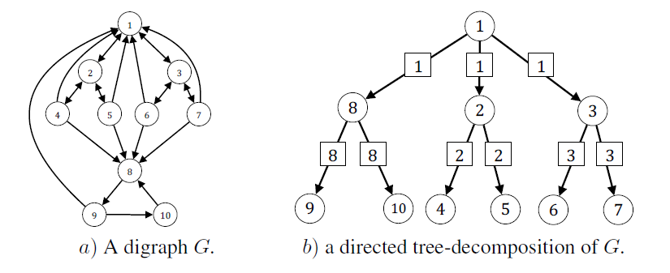
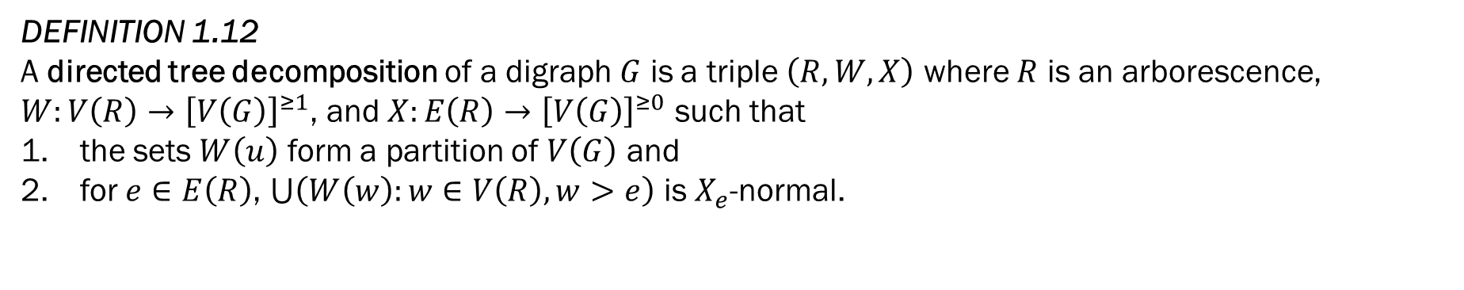
1. Prologue
DEFINITION 1.12
A directed tree decomposition of a digraph $G$ is a triple $\left(R,W,X\right)$ where $R$ is an arborescence, $W:V\left(R\right)→{\left[V\left(G\right)\right]}^{≥1}$, and $X:E\left(R\right)→{\left[V\left(G\right)\right]}^{≥0}$ such that
the sets $W\left(u\right)$ form a partition of $V\left(G\right)$ and
for $e∈E\left(R\right)$, $\bigcup{\left(W\left(w\right):w∈V\left(R\right), w>e\right)}$ is $X_{e}$-normal.

Slide 13
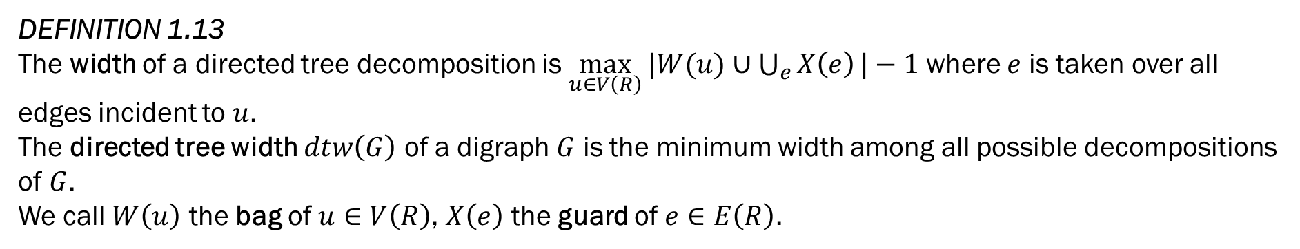
1. Prologue
DEFINITION 1.13
The width of a directed tree decomposition is $\max_{u∈V\left(R\right)}{|W(u)∪\bigcup_{e}{X\left(e\right)}|}−1$ where $e$ is taken over all edges incident to $u$.
The directed tree width $dtw\left(G\right)$ of a digraph $G$ is the minimum width among all possible decompositions of $G$.
We call $W\left(u\right)$ the bag of $u∈V\left(R\right)$, $X\left(e\right)$ the guard of $e∈E\left(R\right)$.

Slide 14
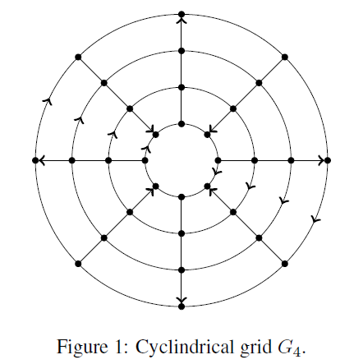
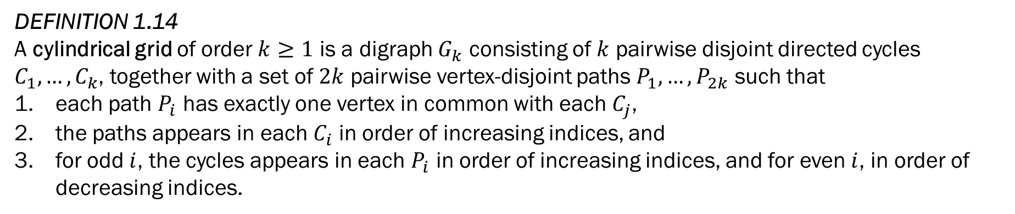
1. Prologue
DEFINITION 1.14
A cylindrical grid of order $k≥1$ is a digraph $G_{k}$ consisting of $k$ pairwise disjoint directed cycles $C_{1},…,C_{k}$, together with a set of $2k$ pairwise vertex-disjoint paths $P_{1}, …,P_{2k}$ such that
each path $P_{i}$ has exactly one vertex in common with each $C_{j}$,
the paths appears in each $C_{i}$ in order of increasing indices, and
for odd $i$, the cycles appears in each $P_{i}$ in order of increasing indices, and for even $i$, in order of decreasing indices.

Slide 15
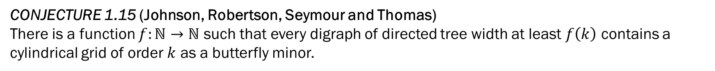
1. Prologue
CONJECTURE 1.15 (Johnson, Robertson, Seymour and Thomas)
There is a function $f:ℕ→ℕ$ such that every digraph of directed tree width at least $f\left(k\right)$ contains a cylindrical grid of order $k$ as a butterfly minor.

Slide 16
Overview of The Proof
Directed Tree Decomposition
Part 3
Bramble
Part 4
Web
Part 5
Fence
Part 6
Cylindrical Grid

Slide 17
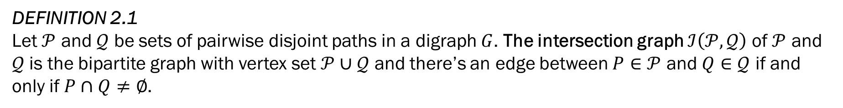
2. Preliminaries
DEFINITION 2.1 Let $𝒫$ and $𝒬$ be sets of pairwise disjoint paths in a digraph $G$. The intersection graph $ℐ\left(𝒫,𝒬\right)$ of $𝒫$ and $𝒬$ is the bipartite graph with vertex set $𝒫∪𝒬$ and there’s an edge between $P∈𝒫$ and $Q∈𝒬$ if and only if $P∩Q≠∅$.

Slide 18
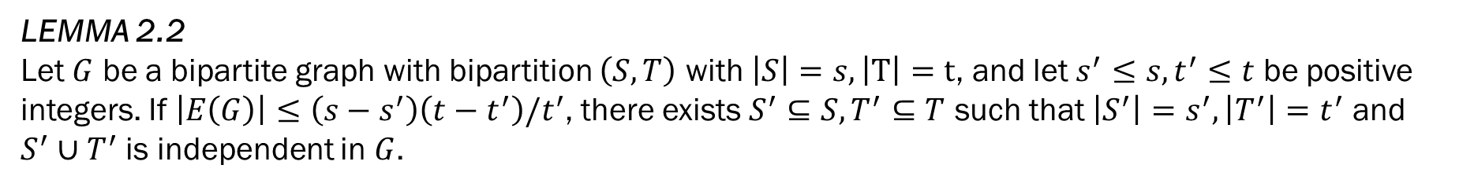
2. Preliminaries
LEMMA 2.2
Let $G$ be a bipartite graph with bipartition $\left(S,T\right)$ with $\left|S\right|=s, \left|T\right|=t$, and let $s^{′}≤s, t^{′}≤t$ be positive integers. If $\left|E\left(G\right)\right|≤\left(s−s^{′}\right)\left(t−t^{′}\right)/t^{′}$, there exists $S^{′}⊆S,T^{′}⊆T$ such that $\left|S^{′}\right|=s^{′},\left|T^{′}\right|=t^{′}$ and $S^{′}∪T^{′}$ is independent in $G$.
PROOF
Sort the elements in $T$ in increasing order by their degree and let $T^{′}$ be the set of the first $t^{′}$ vertices.
Their degree must be equal or lesser than $(s−s^{′})/t^{′}$ otherwise the number of edges generated by the remaining $t−t^{′}$ vertices exceeds $\left(s−s^{′}\right)\left(t−t^{′}\right)/t^{′}$
There are at most$\left(s−s^{′}\right)/t^{′}×t^{′}=s−s^{′}$ edges incident to $T^{′}$, and setting $S^{′}$ to be the set of $s^{′}$ vertices in $S$ not linked to $T^{′}$ completes the proof.

Slide 19
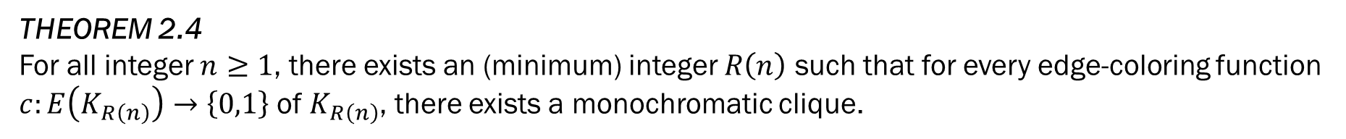
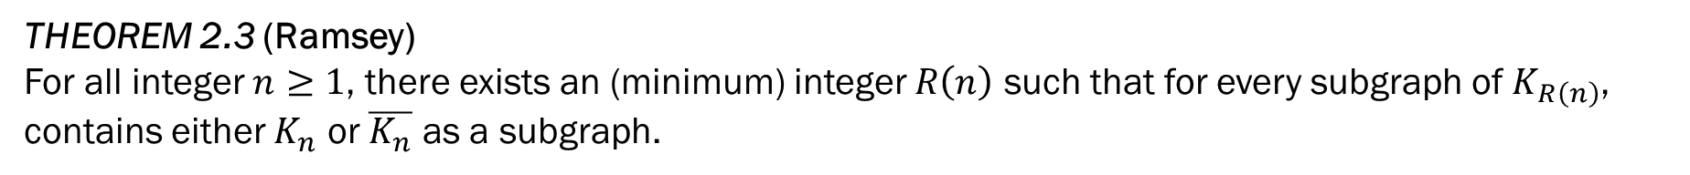
2. Preliminaries
THEOREM 2.3 (Ramsey)
For all integer $n≥1$, there exists an (minimum) integer $R\left(n\right)$ such that for every subgraph of $K_{R\left(n\right)}$, contains either $K_{n}$ or $\overline{K_{n}}$ as a subgraph.
THEOREM 2.4
For all integer $n≥1$, there exists an (minimum) integer $R\left(n\right)$ such that for every edge-coloring function $c:E\left(K_{R\left(n\right)}\right)→\left\{0,1\right\}$ of $K_{R\left(n\right)}$, there exists a monochromatic clique.

Slide 20
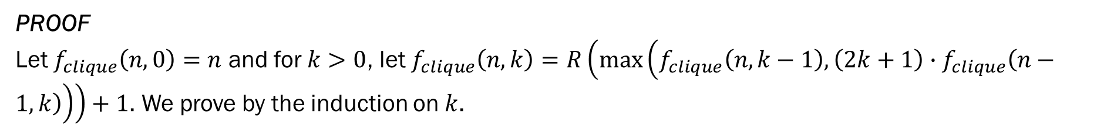
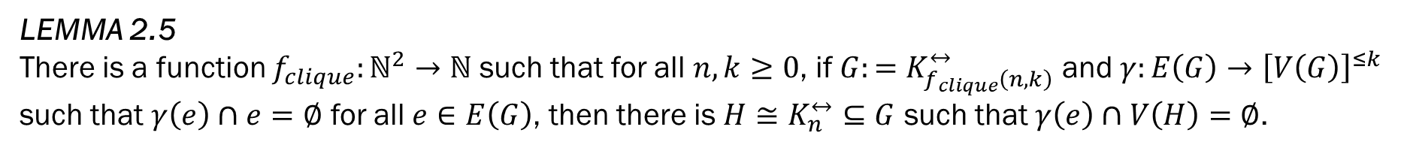
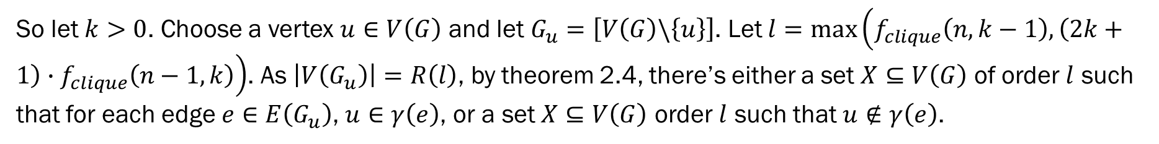
2. Preliminaries
LEMMA 2.5
There is a function $f_{clique}:ℕ^{2}→ℕ$ such that for all $n,k≥0$, if $G:=K_{f_{clique}\left(n,k\right)}^{↔}$ and $γ:E\left(G\right)→{\left[V\left(G\right)\right]}^{≤k}$ such that $γ\left(e\right)∩e=∅$ for all $e∈E\left(G\right)$, then there is $H≅K_{n}^{↔}⊆G$ such that $γ\left(e\right)∩V\left(H\right)=∅$.
PROOF
Let $f_{clique}\left(n,0\right)=n$ and for $k>0$, let $f_{clique}\left(n,k\right)=R\left(\max\left(f_{clique}\left(n,k−1\right),\left(2k+1\right)∙f_{clique}\left(n−1,k\right)\right)\right)+1$. We prove by the induction on $k$.
For $k=0$, the statement is trivial.
So let $k>0$. Choose a vertex $u∈V\left(G\right)$ and let $G_{u}=\left[V\left(G\right)\backslash \left\{u\right\}\right]$. Let $l=\max\left(f_{clique}\left(n,k−1\right),\left(2k+1\right)∙f_{clique}\left(n−1,k\right)\right)$. As $\left|V\left(G_{u}\right)\right|=R\left(l\right)$, by theorem 2.4, there’s either a set $X⊆V\left(G\right)$ of order $l$ such that for each edge $e∈E\left(G_{u}\right)$, $u∈γ\left(e\right)$, or a set $X⊆V\left(G\right)$ order $l$ such that $u∉γ\left(e\right)$.
In the first case, since $l≥f_{clique}\left(n,k−1\right)$, the induction hypotheses allows us to choose $X^{′}={\left[X\right]}^{=n}$ such that $γ\left(e\right)∩V\left(\left[X^{′}\right]\right)=∅$ for all $e∈E\left(\left[X^{′}\right]\right)$.

Slide 21
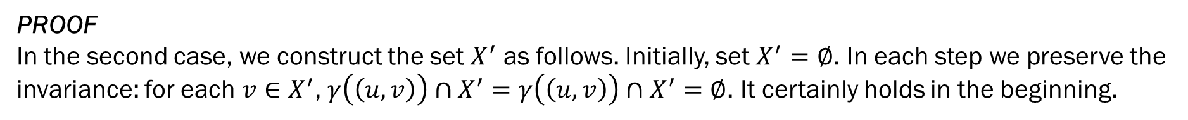
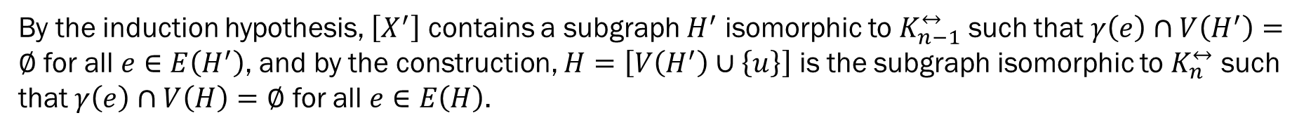
2. Preliminaries
LEMMA 2.5
There is a function $f_{clique}:ℕ^{2}→ℕ$ such that for all $n,k≥0$, if $G:=K_{f_{clique}\left(n,k\right)}^{↔}$ and $γ:E\left(G\right)→{\left[V\left(G\right)\right]}^{≤k}$ such that $γ\left(e\right)∩e=∅$ for all $e∈E\left(G\right)$, then there is $H≅K_{n}^{↔}⊆G$ such that $γ\left(e\right)∩V\left(H\right)=∅$.
PROOF
In the second case, we construct the set $X^{′}$ as follows. Initially, set $X^{′}=∅$. In each step we preserve the invariance: for each $v∈X^{′}$, $γ\left(\left(u,v\right)\right)∩X^{′}=γ\left(\left(u,v\right)\right)∩X^{′}=∅$. It certainly holds in the beginning.
While $X≠∅$, choose $v∈X$, add it to $X^{′}$, and remove $\left\{v\right\}∪γ\left(\left(u,v\right)\right)∪γ\left(\left(v,u\right)\right)$ from $X$. Since in each step, we remove $2k+1$ elements from $X$ at max, $\left|X^{′}\right|≥f_{clique}\left(n−1,k\right)$,
By the induction hypothesis, $\left[X^{′}\right]$ contains a subgraph $H^{′}$ isomorphic to $K_{n−1}^{↔}$ such that $γ\left(e\right)∩V\left(H^{′}\right)=∅$ for all $e∈E\left(H^{′}\right)$, and by the construction, $H=\left[V\left(H^{′}\right)∪\left\{u\right\}\right]$ is the subgraph isomorphic to $K_{n}^{↔}$ such that $γ\left(e\right)∩V\left(H\right)=∅$ for all $e∈E\left(H\right)$.

Slide 22
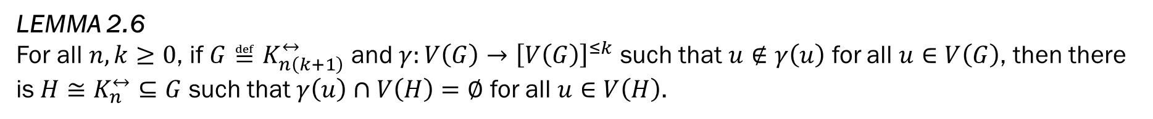
2. Preliminaries
LEMMA 2.6
For all $n,k≥0$, if $G≝K_{n\left(k+1\right)}^{↔}$ and $γ:V\left(G\right)→{\left[V\left(G\right)\right]}^{≤k}$ such that $u∉γ\left(u\right)$ for all $u∈V\left(G\right)$, then there is $H≅K_{n}^{↔}⊆G$ such that $γ\left(u\right)∩V\left(H\right)=∅$ for all $u∈V\left(H\right)$.
PROOF
Construct $H$ greedily. In each step, choose a vertex $u$ from $G$, add it to $H$, and delete $\left\{u\right\}∪γ\left(u\right)$ from $G$.

Slide 23
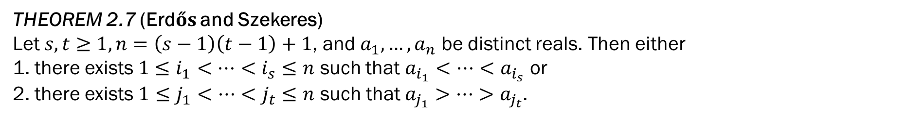
2. Preliminaries
THEOREM 2.7 (Erdős and Szekeres)
Let $s,t≥1, n=\left(s−1\right)\left(t−1\right)+1$, and $a_{1},…,a_{n}$ be distinct reals. Then either 1. there exists $1≤i_{1}<…<i_{s}≤n$ such that $a_{i_{1}}<…<a_{i_{s}}$ or 2. there exists $1≤j_{1}<…<j_{t}≤n$ such that $a_{j_{1}}>…>a_{j_{t}}$.

Slide 24
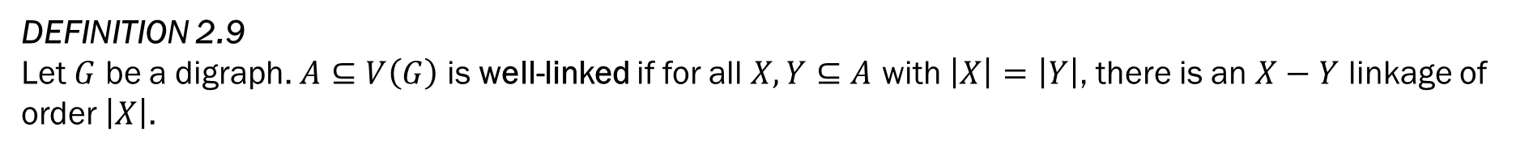
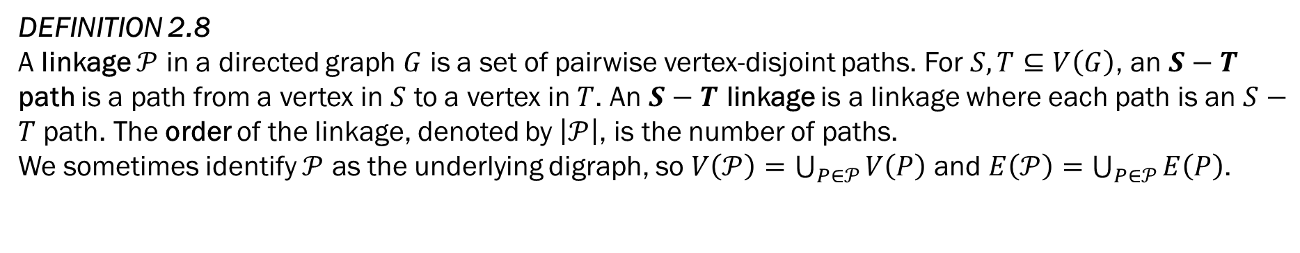
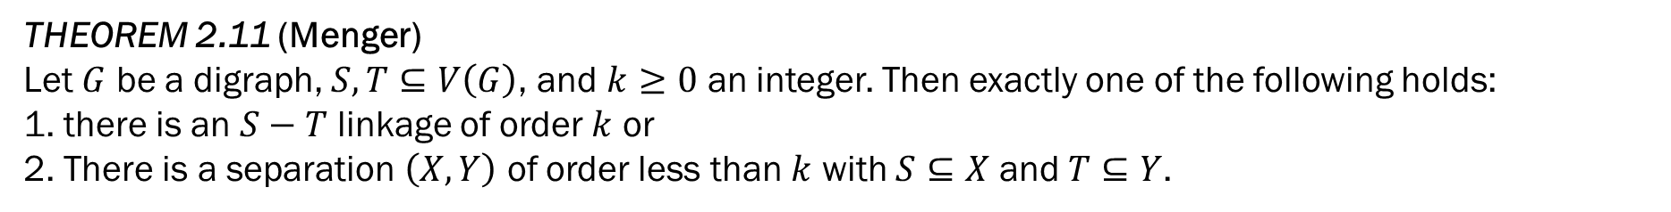
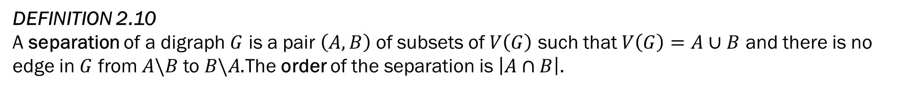
2. Preliminaries
DEFINITION 2.8
A linkage $𝒫$ in a directed graph $G$ is a set of pairwise vertex-disjoint paths. For $S,T⊆V\left(G\right)$, an $S−T$ path is a path from a vertex in $S$ to a vertex in $T$. An $S−T$ linkage is a linkage where each path is an $S−T$ path. The order of the linkage, denoted by $\left|𝒫\right|$, is the number of paths.
We sometimes identify $𝒫$ as the underlying digraph, so $V\left(𝒫\right)=\bigcup_{P∈𝒫}{V\left(P\right)}$ and $E\left(𝒫\right)=$ $\bigcup_{P∈𝒫}{E\left(P\right)}$.
DEFINITION 2.9
Let $G$ be a digraph. $A⊆V\left(G\right)$ is well-linked if for all $X,Y⊆A$ with $\left|X\right|=\left|Y\right|$, there is an $X−Y$ linkage of order $\left|X\right|$.
DEFINITION 2.10
A separation of a digraph $G$ is a pair $\left(A,B\right)$ of subsets of $V\left(G\right)$ such that $V\left(G\right)=A∪B$ and there is no edge in $G$ from $A\backslash B$ to $B\backslash A$.The order of the separation is $\left|A∩B\right|$.
THEOREM 2.11 (Menger)
Let $G$ be a digraph, $S,T⊆V\left(G\right)$, and $k≥0$ an integer. Then exactly one of the following holds:
1. there is an $S−T$ linkage of order $k$ or 2. There is a separation $\left(X,Y\right)$ of order less than $k$ with $S⊆X$ and $T⊆Y$.

Slide 25
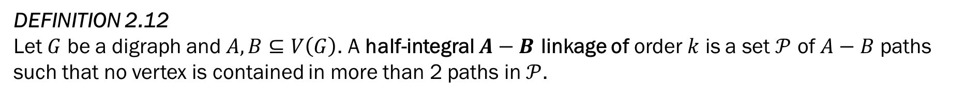
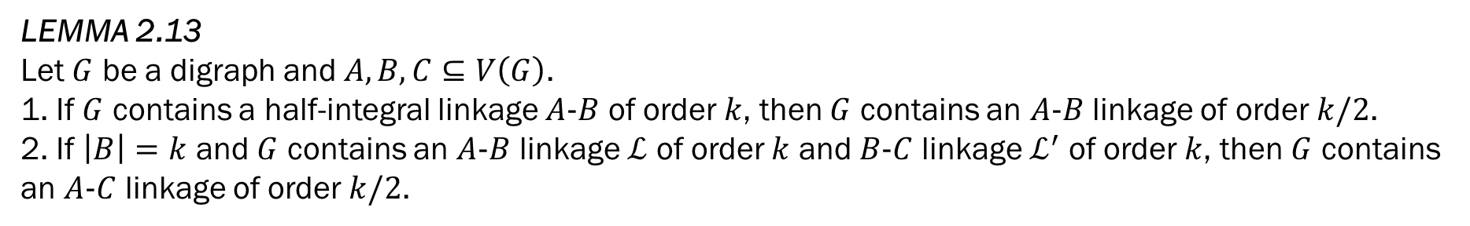
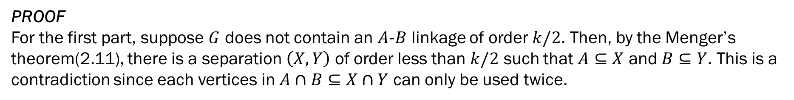
2. Preliminaries
DEFINITION 2.12
Let $G$ be a digraph and $A,B⊆V\left(G\right)$. A half-integral $A−B$ linkage of order $k$ is a set $𝒫$ of $A−B$ paths such that no vertex is contained in more than 2 paths in $𝒫$.
LEMMA 2.13
Let $G$ be a digraph and $A,B,C⊆V\left(G\right)$. 1. If $G$ contains a half-integral linkage $A−B$ of order $k$, then $G$ contains an $A−B$ linkage of order $k/2$.
2. If $\left|B\right|=k$ and $G$ contains an $A−B$ linkage $ℒ$ of order $k$ and $B−C$ linkage $ℒ^{′}$ of order $k$, then $G$ contains an $A−C$ linkage of order $k/2$.
PROOF
For the first part, suppose $G$ does not contain an $A−B$ linkage of order $k/2$. Then, by the Menger’s theorem(2.11), there is a separation $\left(X,Y\right)$ of order less than $k/2$ such that $A⊆X$ and $B⊆Y$. This is a contradiction since each vertices in $A∩B⊆X∩Y$ can only be used twice.
The second part follows from the first part as $ℒ$ and $ℒ^{′}$ can be combined onto a single half-integral $A−B$ linkage of order $k$.

Slide 26
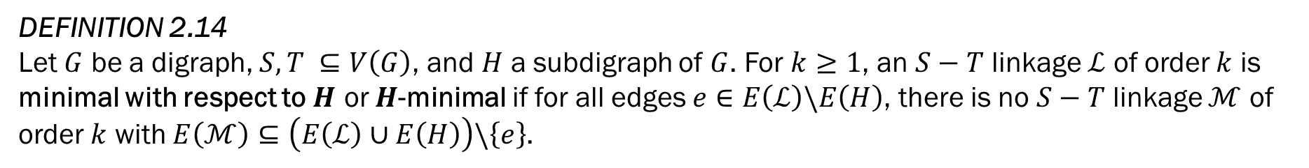
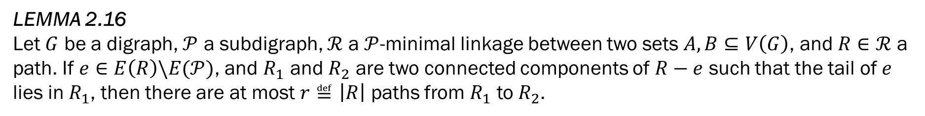
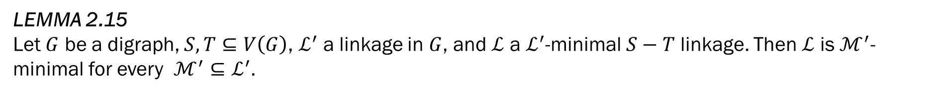
2. Preliminaries
DEFINITION 2.14
Let $G$ be a digraph, $S,T ⊆V\left(G\right)$, and $H$ a subdigraph of $G$. For $k≥1$, an $S−T$ linkage $ℒ$ of order $k$ is minimal with respect to $H$ or $H$-minimal if for all edges $e∈E\left(ℒ\right)\backslash E\left(H\right)$, there is no $S−T$ linkage $ℳ$ of order $k$ with $E\left(ℳ\right)⊆\left(E\left(ℒ\right)∪E\left(H\right)\right)\backslash \left\{e\right\}$.
LEMMA 2.15 Let $G$ be a digraph, $S,T⊆V\left(G\right)$, $ℒ^{′}$ a linkage in $G$, and $ℒ$ a $ℒ^{′}$-minimal $S−T$ linkage. Then $ℒ$ is $ℳ^{′}$-minimal for every $ℳ^{′}⊆ℒ^{′}$.
LEMMA 2.16 Let $G$ be a digraph, $𝒫$ a subdigraph, $ℛ$ a $𝒫$-minimal linkage between two sets $A,B⊆V\left(G\right)$, and $R∈ℛ$ a path. If $e∈E\left(R\right)\backslash E(𝒫)$, and $R_{1}$ and $R_{2}$ are two connected components of $R−e$ such that the tail of $e$ lies in $R_{1}$, then there are at most $r≝\left|R\right|$ paths from $R_{1}$ to $R_{2}$.

Slide 27
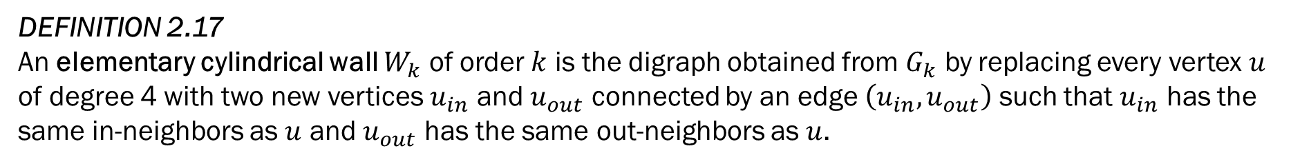
2. Preliminaries
DEFINITION 2.17 An elementary cylindrical wall $W_{k}$ of order $k$ is the digraph obtained from $G_{k}$ by replacing every vertex $u$ of degree 4 with two new vertices $u_{in}$ and $u_{out}$ connected by an edge $\left(u_{in},u_{out}\right)$ such that $u_{in}$ has the same in-neighbors as $u$ and $u_{out}$ has the same out-neighbors as $u$.
DEFINITION 2.18 A cylindrical wall of order $k$ is a subdivision of $W_{k}$.

Slide 28
Overview of The Proof
Directed Tree Decomposition
Part 3
Bramble
Part 4
Web
Part 5
Fence
Part 6
Cylindrical Grid

Slide 29


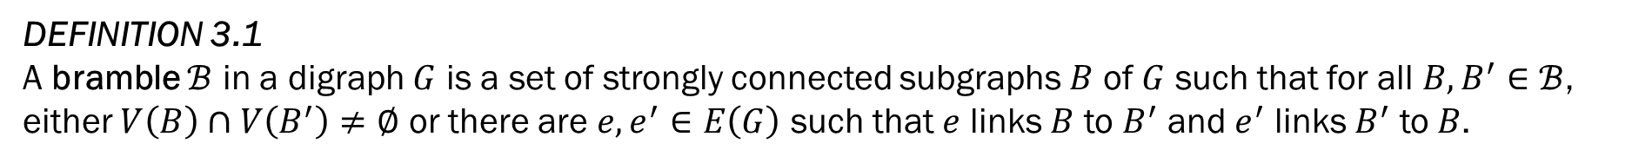

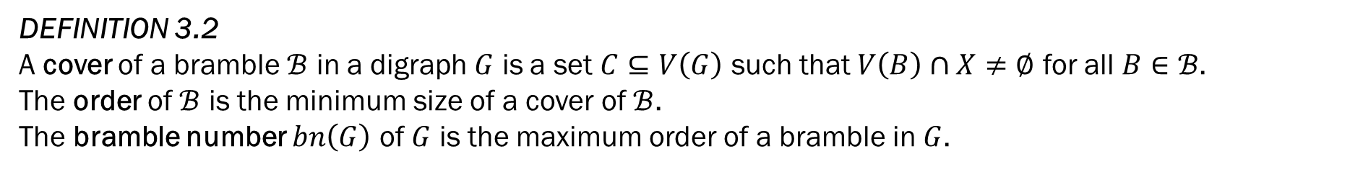




3. Directed Tree Decomposition $→$ Bramble
DEFINITION 3.1 A bramble $ℬ$ in a digraph $G$ is a set of strongly connected subgraphs $B$ of $G$ such that for all $B,B^{′}∈ℬ$, either $V\left(B\right)∩V\left(B^{′}\right)≠∅$ or there are $e,e^{′}∈E\left(G\right)$ such that $e$ links $B$ to $B^{′}$ and $e^{′}$ links $B^{′}$ to $B$.
$$B$$
$$B^{′}$$
$$B$$
$$B^{′}$$
$$e$$
$$u$$
$$e^{′}$$
DEFINITION 3.2 A cover of a bramble $ℬ$ in a digraph $G$ is a set $C⊆V\left(G\right)$ such that $V\left(B\right)∩X≠∅$ for all $B∈ℬ$.
The order of $ℬ$ is the minimum size of a cover of $ℬ$. The bramble number $bn\left(G\right)$ of $G$ is the maximum order of a bramble in $G$.

Slide 30
3. Directed Tree Decomposition $→$ Bramble
LEMMA 3.3 There are constants $c,c^{′}$ such that for all digraphs $G^{′}$, $bn\left(G\right)≤c∙dtw\left(G\right)≤c^{′}∙bn(G)$.
OUTLINE OF THE PROOF Can be proved by converting brambles into havens and back using $\left(3.2\right)$ here.

Slide 31
Overview of The Proof
Directed Tree Decomposition
Part 3
Bramble
Part 4
Web
Part 5
Fence
Part 6
Cylindrical Grid

Slide 32


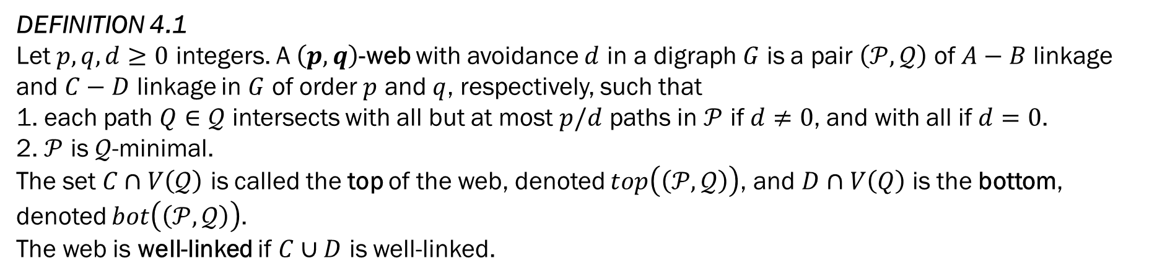


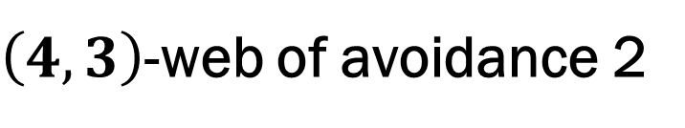


4. Bramble $→$Web
DEFINITION 4.1 Let $p,q,d≥0$ integers. A $\left(p,q\right)$-web with avoidance $d$ in a digraph $G$ is a pair $\left(𝒫,𝒬\right)$ of $A−B$ linkage and $C−D$ linkage in $G$ of order $p$ and $q$, respectively, such that
1. each path $Q∈𝒬$ intersects with all but at most $p/d$ paths in $𝒫$ if $d≠0$, and with all if $d=0$.
2. $𝒫$ is $𝒬$-minimal.
The set $C∩V\left(𝒬\right)$ is called the top of the web, denoted $top\left(\left(𝒫,𝒬\right)\right)$, and $D∩V\left(Q\right)$ is the bottom, denoted $bot\left(\left(𝒫,𝒬\right)\right)$.
The web is well-linked if $C∪D$ is well-linked.
$$𝓠$$
$$A$$
$$C$$
$$B$$
$$𝒫$$
$$D$$
$\left(4,3\right)$-web of avoidance 2

Slide 33
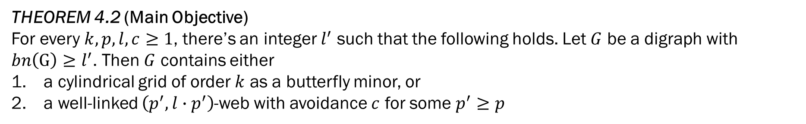
4. Bramble $→$Web
THEOREM 4.2 (Main Objective) For every $k,p,l,c≥1$, there’s an integer $l^{′}$ such that the following holds. Let $G$ be a digraph with $bn\left(G\right)≥l^{′}$. Then $G$ contains either
a cylindrical grid of order $k$ as a butterfly minor, or
a well-linked $\left(p^{′}, l∙p^{′}\right)$-web with avoidance $c$ for some $p^{′}≥p$

Slide 34



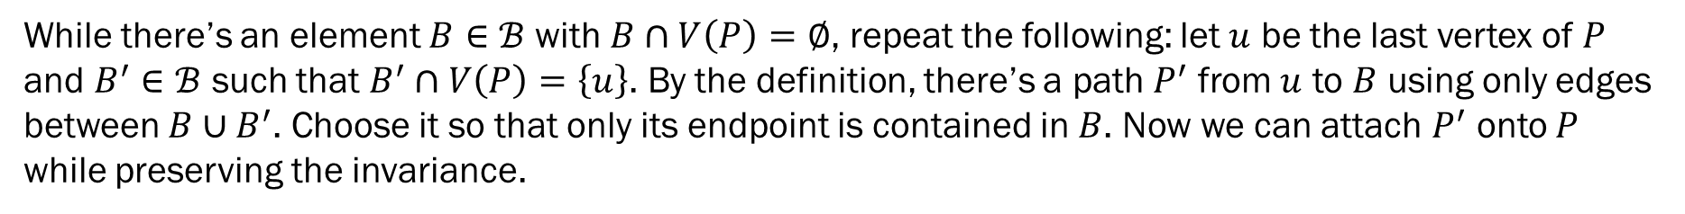





4. Bramble $→$Web
LEMMA 4.3 Let $ℬ$ be a bramble in a digraph $G$. Then there’s a path $P$ intersecting with every $B∈ℬ$.
PROOF We’ll inductively construct the path $P$.
Choose a vertex $u_{0}∈V\left(G\right)$ such that $u_{0}∈B_{0}$ for some $B_{0}∈ℬ$ and set $P=(u_{0})$
We maintain the following invariance throughout the construction: there is a bramble element $B∈ℬ$ such that $B∩V\left(P\right)=\left\{\left(the last vertex of P\right)\right\}$. It clearly holds initially.
While there’s an element $B∈ℬ$ with $B∩V\left(P\right)=∅$, repeat the following: let $u$ be the last vertex of $P$ and $B^{′}∈ℬ$ such that $B^{′}∩V\left(P\right)=\left\{u\right\}$. By the definition, there’s a path $P^{′}$ from $u$ to $B$ using only edges between $B∪B^{′}$. Choose it so that only its endpoint is contained in $B$. Now we can attach $P^{′}$ onto $P$ while preserving the invariance.
$$B_{2}$$
$$B_{0}$$
$$B_{1}$$
$$u_{2}$$
$$B_{3}$$
$$u_{0}$$
$$u_{1}$$
$$u_{3}$$

Slide 35


4. Bramble $→$Web
LEMMA 4.3 Let $ℬ$ be a bramble of order $k\left(k+2\right)$ in a digraph $G$ and $P$ a path intersecting with every $B∈ℬ$. Then there’s a well-linked set $A⊆V\left(P\right)$ of order $k$.
PROOF We first construct a sequence of subpaths $P_{1},…,P_{2k}$ of $P$ as follows.
Let $P_{1}$ be the minimal initial subpath of $P$ such that $ℬ_{1}≝\left\{B∈ℬ:V\left(B\right)∩V\left(P_{1}\right)≠∅\right\}$ is a bramble of order $\left\lfloor \frac{k+1}{2}\right\rfloor$. Now suppose $P_{1},…,P_{i}$ and $ℬ_{1},…,ℬ_{i}$ have already been constructed where $i<2k$. Let $u$ be the last vertex of $P_{i}$ and $v$ it’s successor in $P$. We define $P_{i+1}$ to be the minimal subpath of $P$ starting at $v$ such that $ℬ_{i+1}=\left\{B∈ℬ:B∩\bigcup_{l≤i}{V\left(P_{l}\right)}=∅ and B∩V\left(P_{i+1}\right)≠∅\right\}$ is of order$\left\lfloor \frac{k+1}{2}\right\rfloor$.
Let $a_{i}$ be the first vertex of $P_{2i}$ and $A≝\left\{a_{1},…,a_{k}\right\}$. We’ll show that $A$ is well-linked.
Let $X,Y⊆A$ with $\left|X\right|=\left|Y\right|$. W.l.o.g. we may assume that $V\left(X\right)∩V\left(Y\right)=∅$. By Menger’s theorem(2.11), it’s enough to show that for all set $S⊆V\left(G\right)$ of order less than $r$, there’s an $X−Y$ path in $G\backslash S$.

Slide 36

4. Bramble $→$Web
LEMMA 4.4 Let $ℬ$ be a bramble of order $k\left(k+2\right)$ in a digraph $G$ and $P=P\left(ℬ\right)$ a path intersecting with every $B∈ℬ$. Then there’s a well-linked set $A⊆V\left(P\right)$ of order $k$.
PROOF Let $X=\left\{a_{j_{1}},…,a_{j_{r}}\right\}$ and $Y=\left\{a_{i_{1}},…,a_{i_{r}}\right\}$. As $\left|S\right|<r$,

Slide 37

4. Bramble $→$Web
For the rest of the section 3, fix a digraph $G$ with $bn\left(G\right)>2kh(2kh+2)$ for some $k,h≥1$, a bramble $ℬ$ of maximum order, a path $P$ intersecting with every $B∈ℬ$, and a well-linked set $A⊆V\left(P\right)$ with $\left|A\right|=2kh$.
Split $P$ into subpaths $P_{1},…,P_{h}$ such that $P_{i}$ is the maximum initial subpath of $P\backslash \bigcup_{j<i}{P_{j}}$ containing $2k$ elements of $A$.
Let $A_{i}=V\left(P_{i}\right)∩A$. We split each $A_{i}$ into $A_{i}^{in}$ and $A_{i}^{out}$ of order $k$ such that each vertex in $A_{i}^{in}$ appears before $A_{i}^{out}$ in $P$.
Let $L_{i,j}$ be an $A_{i}^{out}−A_{j}^{in}$ linkage of order $k$ (which is guaranteed to exist by the well-linkedness of $A$).

Slide 38


4. Bramble $→$Web
DEFINITION 4.5 Let $G$ be a digraph and $l,p≥1$. An $l$-linked path system of order $p$ is a tuple of sequences $𝒮=\left(𝒫,ℒ,𝒜\right)$ where
$𝒫={\left(P_{i}\right)}_{1≤i≤p}$ is a sequence of pairwise vertex-disjoint paths in $G$,
$𝒜={\left(\left(A_{i}^{in},A_{i}^{out}\right)\right)}_{1≤i≤p}$ such that $A_{i}^{in},A_{i}^{out}$ are subsets of $V\left(P_{i}\right)$, of order $l$, all vertices of $A_{i}^{in}$ occurs before $A_{i}^{out}$ in $P_{i}$, the first vertex of $P_{i}$ belongs to $A_{i}^{in}$ and the last to $A_{i}^{out}$, and $A=\bigcup{\left(A_{i}^{in}∪A_{i}^{out}\right)}$ is a well-linked set in $G$, and
$ℒ={\left(L_{i,j}\right)}_{1≤i≠j≤p}$ such that $L_{i,j}$ is a linkage of order $l$ in $G$ from $A_{i}^{out}$ to $A_{j}^{in}$ for all $i≠j$.
A system $𝒮$ is clean if for all $i≠j$ and $Q∈L_{i,j}$, $Q∩P_{k}=∅$ for all $k≠i,j$.

Slide 39


4. Bramble $→$Web
LEMMA 4.6 Let $G$ be a digraph and $l,p≥1$. There is a function $f_{1}:ℕ^{2}→ℕ$ such that if $G$ contains a bramble of order $f_{1}\left(l,p\right)$ then it contains an $l$-linked path system of order $p$.
PROOF Follows from lemma 3.4.
LEMMA 4.7 Let $G$ be a digraph. There’s a function $f_{3}:ℕ^{4}→ℕ$ such that for all integers $l,p,k,c≥1$, if $G$ contains a bramble of order $f_{3}\left(l,p,k,c\right)$, then $G$ contains a clean $l$-linked path system of order $p$ or a well-linked $\left(p^{′},k∙p^{′}\right)$-web with avoidance $c$.

Slide 40


4. Bramble $→$Web
LEMMA 4.8 For every $k,p,l,c≥1$, there’s an integer $l^{′}$ such that the following holds. Let $𝒮$ be a clean $l^{′}$-linked path system of order $k$. Then either $G$ contains either
a cylindrical wall of order $k$ or
a well-linked $\left(p^{′},l∙p^{′}\right)$-web with avoidance $c$.
PROOF Let $K=k∙\left(k−1\right)$. We define a function $f:\left\{1,2,…,k\right\}→ℕ$ with $f\left(t\right)={\left(cKl\right)}^{K−t+1}p$ and set $l^{′}=f\left(1\right)$. For al $t$, we define $g\left(t\right)=\frac{f\left(t\right)}{k∙l}$.
Let $𝒮=\left(𝒫,ℒ,𝒜\right)$ be a clean $l^{′}$-linked path system of order $k$, where $𝒫=\left(P_{1},…,P_{k}\right)$, $ℒ={\left(L_{i,j}\right)}_{1≤i≠j≤k}$ and $𝒜={\left(A_{i}^{in},A_{i}^{out}\right)}_{1≤i≤k}$.
Fix an order of the pairs $\left\{\left(i,j\right):1≤i≠j≤k\right\}$. This yields the bijection $σ$ between $\left\{\left(i,j\right):1≤i≠j≤k\right\}$ and $\left\{1,2,…,k\right\}$.

Slide 41

4. Bramble $→$Web
LEMMA 4.8 For every $k,p,l,c≥1$, there’s an integer $l^{′}$ such that the following holds. Let $𝒮$ be a clean $l^{′}$-linked path system of order $k$. Then either $G$ contains either
a cylindrical wall of order $k$ or
a well-linked $\left(p^{′},l∙p^{′}\right)$-web with avoidance $c$.
PROOF We’ll inductively construct linkages $L_{i,j}^{r}$ where $r≤K$ such that
for all $i≠j$ such that $σ\left(i,j\right)<r$, $L_{i,j}^{r}$ contains a single path $P$ from $A_{i}^{out}$ to $A_{j}^{in}$ and $P$ does not share an internal vertex with any path in some $L_{s,t}^{r}$ with $\left\{s,t\right\}≠\left\{i,j\right\}$,
for $i≠j$ with $σ\left(i,j\right)=r$, we have $\left|L_{i,j}^{r}\right|=f\left(r\right)$
for all $q>r$, we have $\left|L_{σ^{−1}\left(q\right)}^{r}\right|=g\left(r\right)=\frac{f\left(r\right)}{K∙l}$ and $L_{σ^{−1}\left(q\right)}^{r}$ is $L_{σ^{−1}\left(r\right)}^{r}$-minimal.
For $r=1$, we choose a linkage $L_{σ^{−1}\left(1\right)}^{1}$ satisfying the second condition, and other linkages $L_{σ^{−1}\left(q\right)}^{ 1}$ satisfying the third condition for $q>1$.

Slide 42
4. Bramble $→$Web
LEMMA 4.8 For every $k,p,l,c≥1$, there’s an integer $l^{′}$ such that the following holds. Let $𝒮$ be a clean $l^{′}$-linked path system of order $k$. Then either $G$ contains either
a cylindrical wall of order $k$ or
a well-linked $\left(p^{′},l∙p^{′}\right)$-web with avoidance $c$.
PROOF Now suppose the linkages have already been defined for $r<K$. Let $\left(i,j\right)=σ^{−1}\left(r\right)$.
Suppose for all path $P∈L_{i,j}^{r}$, there are $i^{′},j^{′}$ with $σ\left(i^{′},j^{′}\right)>r$ such that $P$ intersects more than $\left(1−\frac{1}{c}\right)g\left(r\right)$ paths in $L_{i^{′},j^{′}}^{r}$.
As $\left|L_{i,j}^{r}\right|=f\left(r\right)=g\left(r\right)∙K∙l$, by the pigeon hole principle, there is a $q>r$ such that at least $\frac{f\left(r\right)}{K}=g\left(r\right)∙l$ paths in $L_{i,j}^{r}$ intersects all but at most $\frac{g\left(r\right)}{c}$ paths in $L_{σ^{−1}\left(q\right)}^{r}$.
Let $𝒬⊆L_{i,j}^{r}$ be the set of such paths. As a result, $\left(L_{σ^{−1}\left(q\right)}^{r},𝒬\right)$ forms a $\left(g\left(r\right),\frac{f\left(r\right)}{K}\right)$-web with avoidance $c$.
As $\frac{f\left(r\right)}{K}$=$g\left(r\right)∙l$ and the endpoints of the paths in $L_{i,j}^{r}$ are in the well-linked set $A_{s}^{out}∪A_{t}^{in}⊆A$ where $\left(s,t\right)=σ^{−1}\left(q\right)$, this yields the second possible outcome of the lemma.

Slide 43
4. Bramble $→$Web
LEMMA 4.8 For every $k,p,l,c≥1$, there’s an integer $l^{′}$ such that the following holds. Let $𝒮$ be a clean $l^{′}$-linked path system of order $k$. Then either $G$ contains either
a cylindrical wall of order $k$ or
a well-linked $\left(p^{′},l∙p^{′}\right)$-web with avoidance $c$.
PROOF Now assume that that is never the case throughout the construction.
So there’s a path $P∈L_{i,j}^{r}$ which, for all $q>r$, is disjoint to at least $\frac{g\left(r\right)}{c}$ paths in $L_{σ^{−1}\left(q\right)}^{r}$.
Define $L_{σ^{−1}\left(q\right)}^{r+1}=L_{σ^{−1}\left(q\right)}^{r}$ for all $q<r$, $L_{σ^{−1}\left(r\right)}^{r+1}=\left\{P\right\}$.
Let $\left(s,t\right)=σ^{−1}\left(r+1\right)$ and $L_{s,t}^{r+1}$ be an $A_{s}^{out}−A_{t}^{in}$ linkage of order $\frac{g\left(r\right)}{c}$ such that no path in $L_{s,t}^{r+1}$ intersects $P$ other than its endpoints. Such a linkage exists by the choice of $P$.
For each $q>r+1$ and $\left(s^{′},t^{′}\right)=σ^{−1}\left(q\right)$, choose an $A_{s^{′}}^{out}−A_{t^{′}}^{in}$ linkage $L_{s^{′},t^{′}}^{r+1}$ of order $g\left(r+1\right)=\frac{g\left(r\right)}{c∙K∙l}$ such that every path in it has no inner vertex in $P$ and which is $L_{s,t}^{r+1}$-minimal.

Slide 44

4. Bramble $→$Web
LEMMA 4.8 For every $k,p,l,c≥1$, there’s an integer $l^{′}$ such that the following holds. Let $𝒮$ be a clean $l^{′}$-linked path system of order $k$. Then either $G$ contains either
a cylindrical wall of order $k$ or
a well-linked $\left(p^{′},l∙p^{′}\right)$-web with avoidance $c$.
PROOF After eventually reaching $r=K$, we have paths $P_{1},…,P_{k}$ and between any two $P_{i},P_{j}$ with $i<j$, a path $L_{i,j}^{r}$. Furthermore, for all $\left(i,j\right)≠\left(i^{′},j^{′}\right)$ the linkages are pairwise vertex-disjoint except possibly at their endpoints. Now $\bigcup_{1≤i≤k}{P_{i}}∪\bigcup_{1≤i≠j≤k}{L_{i,j}^{′}}$ contains a cylindrical wall of order $k$.

Slide 45

4. Bramble $→$Web
LEMMA 4.9 Let $p^{′},q^{′},d$ be integers and $p≥\frac{d}{d−1}p^{′}$ and $q≥q^{′}\left({p \atop \frac{p}{d}}\right)$. If a digraph $G$ contains a $\left(p,q\right)$-web $\left(𝒫,𝒬\right)$ with avoidance $d$, then it contains a $\left(p^{′},q^{′}\right)$-web with avoidance $0$.

Slide 46
Overview of The Proof
Directed Tree Decomposition
Part 3
Bramble
Part 4
Web
Part 5
Fence
Part 6
Cylindrical Grid

Slide 47











5. Web $→$ Fence
DEFINITION 5.1 Let $p,q$ be integers. A $\left(p,q\right)$-fence in a digraph $G$ is a sequence $ℱ=\left(P_{1},…,P_{2p},Q_{1},…,Q_{q}\right)$ such that
$P_{1},…,P_{2p}$ are pairwise disjoint paths of $G$ and $\left\{Q_{1},…,Q_{q}\right\}$ is an $A−B$ linkage for two sets $A,B⊆V\left(G\right)$. We call $A$ the top, and $B$ the bottom, and denote each by $top\left(ℱ\right)$ and $bot\left(ℱ\right)$, respectively,
$P_{i}∩Q_{j}$ is a path for all $i$ and $j$,
For $1≤j≤q$, the paths $P_{1}∩Q_{j},…,P_{2p}∩Q_{j}$ appears in this order on $Q_{j}$, and the first vertex of $Q_{j}$ belongs to $P_{1}$ and the last to $P_{2p}$, and
For odd $i$, the paths $P_{i}∩Q_{1},…,P_{i}∩Q_{q}$ appears in this order on $P_{i}$, and in order of $P_{i}∩Q_{q},…,P_{i}∩Q_{1}$ for even $i$
A fence is well-linked if $A∪B$ is well-linked.
$$Q_{1}$$
$$Q_{2}$$
$$Q_{3}$$
$$A$$
$$P_{1}$$
$$P_{2}$$
$$P_{3}$$
$$P_{4}$$
$$B$$
$\left(2,3\right)$-fence

Slide 48

5. Web $→$ Fence
THEOREM 5.2 (Main Objective) For every $p,q≥1$, there’s an integer $p^{′}$ such that any digraph $G$ containing a well-linked $\left(p^{′},p^{′}\right)$-web contains a well-linked $\left(p,q\right)$-fence.

Slide 49

5. Web $→$ Fence
DEFINITION 5.3 An acyclic $\left(p,q\right)$-grid is a $\left(p,q\right)$-web $\left(𝒫=\left\{P_{1},…,P_{p}\right\},𝒬=\left\{Q_{1},…,Q_{q}\right\}\right)$ with avoidance $0$ such that
$P_{i}∩Q_{j}$ is a path $R_{ij}$ for all $i,j$,
for all $i$, the paths $R_{i1},…,R_{iq}$ are in order in $P_{i}$, and
for all $j$, the paths $R_{1j},…,R_{pj}$ are in order in $Q_{j}$.
The top and bottom of the acyclic grid is those of the underlying web.

Slide 50


5. Web $→$ Fence
LEMMA 5.4 For every integer $p≥1$, there is an integer $p^{′}≥1$ such that every digraph with an acyclic $\left(p^{′},p^{′}\right)$-grid has a $\left(p,q\right)$-fence such that the top and bottom of the fence are subsets of the top and bottom of the acyclic grid.

Slide 51

5. Web $→$ Fence
THEOREM 5.5 For all integers $t,d≥1$, there is an integer $p$ such that every digraph $G$ containing a well-linked $\left(p,p\right)$-web $\left(𝒫,𝒬\right)$ with avoidance $d$ contains a well-linked acyclic $\left(t,t\right)$-grid.

Slide 52

5. Web $→$ Fence
DEFINITION 5.6 Let $𝒬^{∗}$ be a linkage, $𝒬⊆𝒬^{∗}$ a sublinkage of order $q$, and $P$ a path intersecting every paths in $𝒬$.
Let $r≥0$. An edge $e∈E\left(P\right)\backslash E(𝒬^{∗})$ is $r$-splittable with respect to $𝒬$ and $𝒬^{∗}$ if there is a set $𝒬^{′}⊆𝒬$ of order $r$ such that for all $Q∈𝒬^{′}$, $Q$ intersects with both $P_{1}$ and $P_{2}$ where $P_{1}$ and $P_{2}$ are paths with $P=P_{1}eP_{2}$.
A subset $𝒬^{′}⊆𝒬$ of order $q^{′}$ is a segmentation of $P$ with respect to $𝒬^{∗}$ if there are edges $e_{1},…,e_{q^{′}−1}∈E\left(P\right)\backslash E\left(𝒬^{∗}\right)$ with $P=P_{1}e_{1}P_{2}…e_{q^{′}−1}P_{q^{′}}$ for suitable subpaths $P_{1},…,P_{q^{′}}$ such that $𝒬^{′}$ can be ordered as $\left(Q_{1},…,Q_{q^{′}}\right)$ such that $V\left(Q_{i}\right)∩V\left(P\right)⊆V\left(P_{i}\right)$.

Slide 53



5. Web $→$ Fence
DEFINITION 5.7 Let $𝒫$ and $𝒬^{∗}$ be linkages, $𝒬⊆𝒬^{∗}$ a sublinkage of order $q$, and $r≥0$.
An $r$-split of $\left(𝒫,𝒬\right)$ of order $q^{′}$ with respect to $𝒬^{∗}$ is a pair $\left(𝒫^{′},𝒬^{′}\right)$ of linkages of order $r$ and $q$ with $𝒬^{′}⊆𝒬$ such that $𝒫^{′}$ can be ordered $\left(P_{1},…,P_{r}\right)$ in a way that there is a path $P∈𝒫$ and edges $e_{1},…,e_{r−1}∈E\left(P\right)\backslash E(𝒬^{∗})$ with $P=P_{1}e_{1}P_{2}…e_{r−1}P_{r}$ and every $Q∈𝒬^{′}$ can be segmented into subpaths $Q_{1},…,Q_{r}$ such that $Q=Q_{1}e_{1}^{′}Q_{2}…e_{r−1}^{′}Q_{r}$ and $V\left(Q\right)∩V\left(P_{i}\right)⊆V\left(Q_{i}\right)$.
An $r$-segmentation of order $q^{′}$ with respect to $Q^{∗}$ is a pair $\left(𝒫^{′},𝒬^{′}\right)$, where $𝒫^{′}$ is a linkage of order $r$, $𝒬^{′}⊆𝒬$ is a linkage of order $q^{′}$ such that $𝒬^{′}$ is a segmentation of every path $P_{i}$ into segments $P_{1}^{i}e_{1}P_{2}^{i}…e_{q^{′}−1}P_{q^{′}}^{i}$ and for all $Q∈𝒬^{′}$ and all $i≠j$, if $Q$ intersects $P_{i}$ in segment $P_{l}^{i}$ for some $l$, then $Q$ intersects $P_{j}$ in segment $P_{l}^{j}$.
An $r$-split $\left(𝒫,𝒬\right)$ and $r$-segmentation $\left(𝒫,𝒬\right)$ are well-linked if the set of start and endpoints of the paths in $𝒬$ is a well-linked set.
6-split of order 7
2-segmentation of order 7

Slide 54

5. Web $→$ Fence
REMARK 5.8 When $𝒫$ only contains a path $P$, we allow writing the $r$-split $\left(𝒫,𝒬\right)$ as $\left(P,𝒬\right)$.
Furthermore, as the order $r$-split is important, we’ll often write $\left(\left(P_{1},…,P_{r}\right),𝒬^{′}\right)$.

Slide 55



5. Web $→$ Fence
LEMMA 5.9 Let $r, s ≥ 0$. Let $𝒬^{∗}$ be a linkage and let $𝒬⊆𝒬^{∗}$ be a sublinkage of order $q$. Let $P$ be a path intersecting every path in $𝒬$. If $q≥r∙s$ then $P$ contains an $r$-splittable edge with respect to $𝒬$ and $𝒬^{∗}$ or there is an $s$-segmentation $𝒬^{′}⊆𝒬$ with respect to $𝒬^{∗}$.
PROOF It’s enough to show for $q=r∙s$. Let $𝒬=\left(Q_{1},…,Q_{r∙s}\right)$. For $1≤j≤r∙s$, let $F_{j}$ be the minimal subpath of $P$ that includes $V\left(P∩Q_{j}\right)$.
If some edge $e∈E\left(P\right)\backslash E\left(𝒬^{∗}\right)$ belongs to $F_{j}$ for at least $r$ values of $j$, then $e$ is $r$-splittable.
Otherwise, every edge in $E\left(P\right)\backslash E(𝒬^{∗})$ occurs in $F_{j}$ fewer than $r$ values of $j$, and therefore, there are $s$ values of $j$, say $j_{1},…,j_{s}$ such that $F_{j_{1}},…,F_{j_{s}}$ are pairwise disjoint. Thus $Q_{j_{1}},…,Q_{j_{s}}$ is an $s$-segmentation of $P$.

Slide 56

5. Web $→$ Fence
COROLLARY 5.10 Let $G$ be a digraph, $𝒬^{∗}$ a linkage in $G$, $𝒬⊆𝒬^{∗}$ a sublinkage of order $q$, $P$ a path in $G$ intersecting every path in $𝒬$, and $c≥0$ such that for all edge $e∈E\left(P\right)\backslash E(𝒬^{∗})$, there are no $c$ pairwise vertex-disjoint paths in $G$ from $P_{1}$ to $P_{2}$ where $P=P_{1}eP_{2}$. Then for all $x,y≥0$, if $q≥\left(x+c\right)y$,
there is a $y$-segmentation $𝒬^{′}⊆𝒬$ of $P$ with respect to $𝒬^{∗}$ or
a $2$-split $\left(\left(P_{1},P_{2}\right),𝒬\right)$ of $\left(P,𝒬\right)$ order $x$ with respect to $𝒬^{∗}$
PROOF By lemma 5.9, there is a $y$-segmentation of $P$ or an $\left(x+c\right)$-splittable edge $e∈E\left(P\right)\backslash E\left(𝒬^{∗}\right)$. In the second case, let $P=P_{1}eP_{2}$ and $𝒬^{′}⊆𝒬$ of order $\left(x+c\right)$ witnessing that $e$ is $\left(x+c\right)$-splittable.
As there are less than $c$ disjoint paths from $P_{1}$ to $P_{2}$, at most $c$ of the paths in $𝒬^{′}$ intersects $P_{1}$ before $P_{2}$.
Therefore, there’s a set $𝒬^{′′}⊆𝒬^{′}$ of order $x$ such that for all $Q∈𝒬^{′′}$, the last vertex of $V\left(P_{2}∩Q\right)$ occurs before the first vertex of $V\left(P_{1}∩Q\right)$. Hence, $\left(\left(P_{1},P_{2}\right),𝒬\right)$ is a $2$-split of $\left(P,𝒬\right)$.

Slide 57

5. Web $→$ Fence
DEFINITION 5.11
Let $p,q,c≥0$ be integers and $𝒬^{∗}$ a linkage. A $\left(p,q\right)$-web with linkedness $c$ with respect to $𝓠^{∗}$ in a digraph $G$ consists of an $A−B$ linkage $𝒫=\left\{P_{1},..,P_{p}\right\}$ and $C−D$ linkage $𝒬=\left\{Q_{1},..,Q_{q}\right\}$ such that
for all $i$, $Q_{i}$ intersects every path $P∈𝒫$ and
for all $P∈𝒫$ and every $e∈E\left(P\right)\backslash E\left(𝒬^{∗}\right)$, there are at most $c$ disjoint paths from $P_{1}$ to $P_{2}$ where $P_{1}$ and $P_{2}$ are subpaths of $P$ such that $P=P_{1}eP_{2}$.
The set $C∩V\left(𝒬\right)$ is called the top of the web, denoted $top\left(\left(𝒫,𝒬\right)\right)$, and $D∩V\left(𝒬\right)$ is the bottom $bot\left(\left(𝒫,𝒬\right)\right)$. The web $\left(𝒫,𝒬\right)$ is well-linked if $C∪D$ is well-linked.

Slide 58

5. Web $→$ Fence
LEMMA 5.12
For all $p,q,r,s,c≥0$, and all $x,y≥0$ with $p≥x$, there is a number $q^{′}={\left(pq\left(q+c\right)\right)}^{2^{\left(x−1\right)y+1}}$ such that if $G$ contains a $\left(p,q^{′}\right)$-web $𝒲=\left(𝒫,𝒬\right)$ with linkedness $c$, then $G$ either contains
a $y$-split $\left(𝒫^{′},𝒬^{′}\right)$ of $\left(𝒫,𝒬\right)$ of order $q$,
or an $x$-segmentation $\left(𝒫^{′},𝒬^{′}\right)$ of $\left(𝒫,𝒬\right)$ of order $q$.
Furthermore, if $𝒲$ is well-linked, then so is $\left(𝒫^{′},𝒬^{′}\right)$ (in both cases)

Slide 59

5. Web $→$ Fence
DEFINITION 5.13
A $\left(p,q\right)$-pseudo fence is a pair $\left(𝒫=\left(P_{1},…,P_{2p}\right),𝒬\right)$ of pairwise disjoint paths, where $\left|𝒬\right|=q$, such that each $Q∈𝒬$ can be divided into segments $Q_{1},…,Q_{2p}$ occurring in this order in $Q$ such that for all $i$, $P_{i}$ intersects with each $Q∈𝒬$ in $Q_{i}$ and nowhere else. Furthermore, for all $1≤i≤p$, there is an edge $e_{i}$ connecting the endpoint of $P_{2i}$ to the startpoint of $P_{2i−1}$.
REMAKR 5.14
Let $\left(𝒫^{′},𝒬^{′}\right)$ be a $y$-split of order $q$ of some pair $\left(𝒫,𝒬\right)$ of linkages. Then $\left(𝒫^{′},𝒬^{′}\right)$ form a $\left(y,q\right)$-pseudo fence.

Slide 60

5. Web $→$ Fence
LEMMA 5.15
There’s a function $f:ℕ→ℕ$ with the following property. Let $𝒫$ be a linkage and $R$ a path intersecting every path in $𝒫$. For all $k≥0$, if $\left|𝒫\right|≥f\left(k\right)$ then there’s a sequence $\left(P_{1},…,P_{k}\right)$ of distinct paths $P_{1},…,P_{k}∈𝒫$ such that for all $1≤i<k$, $R$ contains a subpath $R_{i}$ from a vertex in $P_{i}$ to a vertex in $P_{i+1}$ which is internally vertex disjoint from $\bigcup_{1≤i≤k}{P_{i}}$.
Furthermore, the sequence can be chosen either in a way that
the first vertex of $\bigcup_{1≤i≤k}{P_{i}}$ on $R$ is contained in $V\left(P_{1}\right)$ or
such that the last vertex of $\bigcup_{1≤i≤k}{P_{i}}$ on $R$ is contained in $V\left(P_{k}\right)$.

Slide 61


5. Web $→$ Fence
LEMMA 5.16 (Split Case of Lemma 5.12)
Let $f$ be the function on lemma 5.15. For all $k≥0$, $q≥f\left(k\right)$, and $p≥\left(\begin{matrix}q \\ k\end{matrix}\right)k!k^{2}$, if $G$ contains a $p$-split $\left(𝒮_{split},𝒬\right)$ of order $q$, then $G$ contains an acyclic $\left(k,k\right)$-grid $\left(𝒫^{′},𝒬^{′}\right)$. Furthermore, $𝒬^{′}⊆𝒬$ and for every path $P^{′}∈𝒫^{′}$, every subpath $S$ of $P^{′}$ with both endpoints on a path in $𝒬^{′}$ but internally vertex disjoint from $𝒬^{′}$ is also a subpath of a path in $𝒫$. Finally, if $\left(𝒮_{split},𝒬\right)$ is well-linked, so is $\left(𝒫^{′},𝒬^{′}\right)$.
LEMMA 5.17 (Segmentation Case of Lemma 5.12)
Let $f$ be the function defined on lemma 5.15. Let $t$ be an integer and $q≥\left(\begin{matrix}f\left(3t\right) \\ 3t\end{matrix}\right)∙12t^{2}$ and $r≥f\left(3t\right)∙q!$. If $G$ contains an $r$-segmentation $\left(𝒮_{seg},𝒬\right)$ of order $q$, then $G$ contains an acyclic $\left(t,t\right)$-grid $W^{′}=\left(𝒫^{′},𝒬^{′}\right)$ such that $𝒫^{′}⊆𝒮_{seg}$. Furthermore, if the set of start and end vertices of $𝒬$ is well-linked, then so is $W^{′}$. More precisely, the set of start and end vertices of $𝒬^{′}$ are subsets of the start and end vertices of $𝒬$.
Finally, the grid $\left(𝒫^{′},𝒬^{′}\right)$ can be chosen so that one (but not both) of the following properties is satisfied. Let $𝒫^{′}=\left(P_{1},…,P_{t}\right)$ be an ordering of $𝒫^{′}$ in order in which they occur on the paths $𝒬^{′}$ of the grid.
For every $Q∈𝒬^{′}$, the first path $P∈𝒫$ hit by $Q$ is $P_{1}$.
For every $Q∈𝒬^{′}$, the last path $P∈𝒫$ hit by $Q$ is $P_{t}$.

Slide 62
5. Web $→$ Fence
THEOREM 5.5 For all integers $t,d≥1$, there is an integer $p$ such that every digraph $G$ containing a well-linked $\left(p,p\right)$-web $\left(𝒫,𝒬\right)$ with avoidance $d$ contains a well-linked acyclic $\left(t,t\right)$-grid.
PROOF
Let $t,d$ be integers and let a $\left(p,p\right)$-web of avoidance $d$ in a digraph $G$ be given.
By the lemma 4.9, it contains a $\left(p_{1},q_{1}\right)$-web with avoidance $0$ as long as $p≥\max\left(\frac{d}{d−1}p_{1},q_{1}\left({p \atop \frac{p}{d}}\right)\right)$.
As noted before, any such $\left(p_{1},q_{1}\right)$-web is a $\left(p_{1},q_{1}\right)$-web with linkedness $p_{1}$.
By lemma 5.12, if $p_{1}=p_{2}$, $q_{1}≥{\left(p_{2}q_{2}\left(q_{2}+p_{1}\right)\right)}^{2^{\left(x−1\right)y+!}}$, $x=p_{2}$, and $y=f\left(3t\right)q2!$, then $G$ contains a $p_{2}$-split of order $q_{2}$ or a $f\left(3t\right)q_{2}!$-segmentation of order $q_{2}$.

Slide 63

5. Web $→$ Fence
THEOREM 5.5 For all integers $t,d≥1$, there is an integer $p$ such that every digraph $G$ containing a well-linked $\left(p,p\right)$-web $\left(𝒫,𝒬\right)$ with avoidance $d$ contains a well-linked acyclic $\left(t,t\right)$-grid.
PROOF
In the first case, if $q_{2}≥f(t)$ and $p_{2}≥\left({q_{2} \atop t}\right)t!t^{2}$, where $f$ is the function on lemma 5.15, then lemma 5.16 implies that $G$ contains an acyclic well-linked $(t,t)$-grid.
In the second case, if $q_{2}≥ \left({f\left(3t\right) \atop 3t}\right)12t^{2}$, then lemma 5.17 implies that $G$ contains an acyclic well-linked $(t,t)$-grid.
Clearly, for any $t≥0$, we can choose the numbers $p,p_{1},p_{2},x,y$ so that all the inequalities above are satisfied, which concludes the proof.

Slide 64
Overview of The Proof
Directed Tree Decomposition
Part 3
Bramble
Part 4
Web
Part 5
Fence
Part 6
Cylindrical Grid

Slide 65

6. Fence $→$ Cylindrical Grid
DEFINITION 6.1
Let $\left(𝒫,𝒬\right)$ be a fence. A $\left(𝓟,𝓠\right)$-bottom-up linkage is a linkage $ℛ$ from $bot\left(𝒫,𝒬\right)$ to $top\left(𝒫,𝒬\right)$. It is called minimal $\left(𝓟,𝓠\right)$-bottom-up linkage if $ℛ$ is $\left(𝒫,𝒬\right)$-minimal.

Slide 66


6. Fence $→$ Cylindrical Grid
THEOREM 6.2 (Main Objective)
Let $G$ be a digraph. For every $k≥1$, there are integers $p,r≥1$ such that if $G$ contains a $\left(p,p\right)$-fence $ℱ$ and an $ℱ$-bottom-up linkage $ℛ$ of order $r$, then $G$ contains a cylindrical grid of order $k$ as a butterfly minor.
OUTLINE OF THE PROOF
We follow the paths in $ℛ$ from the bottom of $ℱ$ to its top and somewhere along the way we’ll find a cylindrical grid, either because
$ℛ$ avoids a sufficiently large subfence,
it contains subpaths that “jump” over large fractions of the fence, or
$ℛ$ and $𝒬$ intersect in a way that they generate a cylindrical grid locally.

Slide 67
Overview of The Proof
Directed Tree Decomposition
Part 3
Bramble
Part 4
Web
Part 5
Fence
Part 6
Cylindrical Grid

Slide 68



7. Epilogue
THEOREM 7.1
There is a function $f:ℕ→ℕ$ such that every digraph of directed tree width at least $f\left(k\right)$ contains a cylindrical grid of order $k$ as a butterfly minor.
THEOREM 7.2
There is a function $f:ℕ→ℕ$ such that for any digraph $G$ and a fixed constant $k$, in polynomial time, we can obtain either
a cylindrical grid of order $k$ as a butterfly minor, or
a directed tree decomposition of width at most $f\left(k\right)$.
PROOF
First conclusion follows from the proof, and the second conclusion follows from the result in this which states that there’s a polynomial time algorithm to to construct a directed tree decomposition of a given graph $G$ with width $3l$ if $G$ has directed tree width at most $l$.

