Slide 1
CSCE 313 Threading and Synchronization (Due: 3/31/19 Sunday at 11:59pm)
Wei Zhang

Slide 2

PA2 (Revisited)
ECG_ch1
Client
ECG Data
ECG File Request
New Channel Creation
Data server
ECG_ch2
Communication
channel
PA4 extends PA2 by including multi-threading for better performance. Let’s revisit PA2 briefly
We design the inter-process system where a client process and a server process communicate with each other for biomedical data management.
The server maintains the electrocardiogram (ECG) data points of 15 patients suffering from various cardiac diseases.
A client (1) receives ECG Data Points, (2) receives ECG Files and (3) requests New Channel Creation through a control channel

Slide 3
PA2 (Revisited) : (1) Requesting Data Points
Client
datamsg
Data server
Control Channel
data point
The server is in a “infinite" loop
// See “common.h”
// different types of messages
enum MESSAGE_TYPE {DATA_MSG, FILE_MSG, NEWCHANNEL_MSG, QUIT_MSG, UNKNOWN_MSG};
// message requesting a data point
class datamsg{
public:
MESSAGE_TYPE mtype;
int person;
double seconds;
int ecgno;
datamsg (int _person, double _seconds, int _eno){
mtype = DATA_MSG, person = _person, seconds = _seconds, ecgno = _eno;
}
};
Send a request message (i.e. datamsg) including message type (e.g. DATA_MSG), patient ID (e.g. 2), time in seconds (e.g. 0.008), ECG record (e.g. 1)
Intends to get the first ECG data point sampled at the time stamp, 0.008 sec from patient 2.
Use a write function of a control channel
Receive a response (double data) from a server
Use a read function of a control channel

Slide 4
PA2 (Revisited) : (2) Requesting Files
filemsg
Client
Data server
Control Channel
File length / partitioned file data
The server is in a “infinite" loop
// See “common.h”
// different types of messages
enum MESSAGE_TYPE {DATA_MSG, FILE_MSG, NEWCHANNEL_MSG, QUIT_MSG, UNKNOWN_MSG};
// message requesting a file
class filemsg{
public:
MESSAGE_TYPE mtype;
__int64_t offset;
int length;
filemsg (__int64_t _offset, int _length){
mtype = FILE_MSG, offset = _offset, length = _length;
}
};
Communication 1:
Send a request message (i.e. filemsg) including message type (e.g. FILE_MSG), offset (0), length (0)
Receive a file length from a server → determine # of subsequent requests to read a file
Communication 2:
Send a request message (i.e. filemsg) including message type (e.g. FILE_MSG), offset (#), length (e.g. MAX_MESSAGE)
Receive a partitioned data of a file from a server
Recreate a file by storing every partitioned data at the right position (The file should be same as the original file kept by a server)

Slide 5
PA2 (Revisited) : (3) New Channel Creation
Client
NEWCHANNEL_MSG
Data server
Control Channel
new channel name
The server is in a “infinite" loop
// See “common.h”
// different types of messages
enum MESSAGE_TYPE {DATA_MSG, FILE_MSG, NEWCHANNEL_MSG, QUIT_MSG, UNKNOWN_MSG};
Send a request message including message type (e.g. NEWCHANNEL_MSG) only
We do not need any class for this message since the request message needs the message type only
Receive a new channel name from a server
Do you remember that a client create a channel instance by using the channel name, “control” to join the control channel created by a server?
Likewise, a server creates a new channel and send the channel name to a client.
A client will instantiate the channel by using the channel name to join the channel created by a server.
A client won’t use the new channel in PA2 but will use them in the later PAs studying multi-threads.

Slide 6
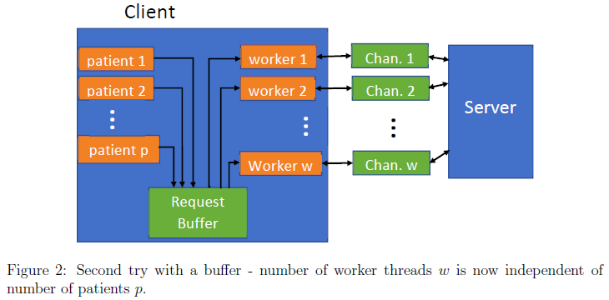
Overview
All these threads such as patient threads and worker threads must be running simultaneously.
The patient threads generate requests to the request buffer.
Each worker thread pops a request from the request buffer, sends it to the server, collects the response.
A thread in the server side communicates with a worker thread via each data channel.
Your task: Implement bounded buffer and client
Modify BoundedBuffer.h, BoundedBuffer.cpp, Histogram.cpp and client.cpp
The server side implementation is already complete, meaning that you do not need to change it.

Slide 7
Key Challenges (Buffer)
Thread-Safeness
Simultaneous access from the producers (i.e., patient threads) and consumers (i.e., worker threads) would lead to race condition.
Support “bounded” buffer
“overflow” happens when the patient threads are much faster than the worker threads.
“underflow” can happen under the opposite case.

Slide 8
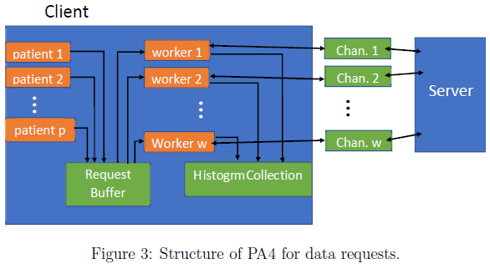
Client Requesting Data Points
A patient thread performs two tasks;
generates datamsgs based on the number of requests specified by a user (See -n flag)
stores them in the request buffer
The worker thread performs four tasks;
reads a datamsg from the request buffer.
sends it to a server over a data channel
receives the response from sever through a data channel
puts the response in the patient’s histogram.
There is a histogram per patient that keeps track of that patient’s statistics.
Another Challenge: Note that multiple worker threads would potentially update the same histogram at the same time leading to another race condition, which must be avoided by using mutual exclusion. That is, you need to modify a given histogram class

Slide 9
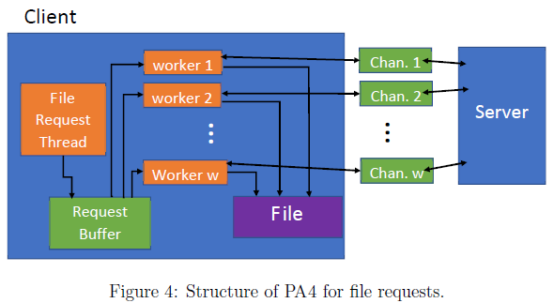
Client Requesting Files
A file request thread performs three tasks;
requests the size of the file using a special filemsg through a control channel like PA2.
generates all request messages (filemsgs) for requesting different chunks of the file
pushes them to the request buffer unlike PA2
Each worker thread performs three tasks;
sends the request message through a data channel
receives a chunk of the file through a data channel
writes the received chunk to a file
Another Challenge: Note that you must make your worker threads robust enough so that they do not corrupt the file when they are writing to it simultaneously. How?
Notes:
instead of

Slide 10
Channel
Bidirectional inter-process communication
Not a standard concept, implemented with two unidirectional pipes
See FIFORequestChannel.h and FIFORequestChannel.cpp for detail
write
read
A
B
read
write

Slide 11
Data Channel
We first need a single control channel (Done in PA2)
Then, we can create multiple data channels by sending new thread commands to control channel
One data channel per worker thread
See client.cpp for detail
FIFORequestChannel *chan = new FIFORequestChannel("control", FIFORequestChannel::CLIENT_SIDE);
std::string s = chan->send_request("newchannel");
MESSAGE_TYPE m = NEWCHANNEL_MSG;
chan->cwrite ((char*) &m, sizeof(MESSAGE_TYPE));
string s = chan->cread();
FIFORequestChannel *workerChannel = new FIFORequestChannel(s, RequestChannel::CLIENT_SIDE);
Notes:
Server Side also has a control channel. Since it uses the same name, “control”, it can communicate with a client side

Slide 12
PA2 vs PA4
 | PA2 | PA4
Multi-Threading | No | Yes
Control Channel | Yes | Yes
Data Channel per worker thread | No | Yes
Thread-Safe Bounded Buffer | No | Yes

Slide 13
Implementation Issues
How to implement multiple threads?
Use Posix library
pthread_create/pthread_join
Use a compound type (e.g. class) to pass some necessary information to each thread
E.g. Worker threads needs to use a BoundedBuffer pointer and a FIFORequestChannel pointer
How to implement thread-safe bounded buffer?
Use a lock to support the thread-safe buffer
Use a lock and condition variables for bounded buffer
Refer to a lecture note, L11. Synchronization

Slide 14
Thread-Safe Buffer
Thread safe
Multiple threads can work on the buffer
Use a lock to control concurrency
Only one thread can work on the queue at a time
SafeBuffer::push(data) {
lock
Q.push(data);
unlock
}
SafeBuffer::pop() {
lock
data = Q.pop();
unlock
return data;
}

Slide 15
Bounded Buffer
string BoundedBuffer::pop(){
pthread_mutex_lock(&mtx);
while(buffer.size()==0){
pthread_cond_wait(&cond,&mtx);
}
// now consume
data = Q.pop();
// send signal to Producer(s)
pthread_cond_signal(&cond2);
pthread_mutex_unlock(&mtx);
return data;
}
string BoundedBuffer::push(){
pthread_mutex_lock(&mtx);
??????? (We will discuss this during lab time)
pthread_mutex_unlock(&mtx);
}
Extension from Thread-safe buffer. (See your lecture note)
Idea:
The queue size S is bounded by K.
When S = K, producers (i.e. thread calling push function) must wait for consumers (i.e. thread calling pop function)
when S = 0, consumers must wait for producers
Use Condition Variables to control the queue size

Slide 16
How to implement threads?
int main() {
THREAD_ARGS ta;
int data = 0;
ta.datap = &data;
int n = 10000;
ta.n = n;
int nthreads = 50;
pthread_t tids[nthreads];
for (int i = 0; i < nthreads, i++)
pthread_create(&tids[i], 0, THREAD_FUNCTION, &ta);
for (int i = 0; i < nthreads, i++)
pthread_join(tids[i], 0);
cout << "Output is: " << data << "Expected: “;
cout << nthreads * n << endl;
}
class THREAD_ARGS {
public:
int n;
int *datap;
};
void* THREAD_FUNCTION(void* arg) {
THREAD_ARGS *ta = (THREAD_ARGS*)arg;
for (int i = 0; i < ta->n; i++) {
*(ta->datap) = *(ta->datap) + 1;
}
}
Note that this example from your lecture note has a race condition. This is only for giving you an example of creating/joining threads

Slide 17
PSEUDO-Code for thread functions
We will discuss some details about how to design patient/worker thread functions during Lab time

Slide 18
From this slide, TAs may use different slides

Slide 19
Password for Online Attendance
5 + 3 = 28
9 + 1 = 810
8 + 6 = 214
5 + 4 = 19
7 + 3 = ? (Password)

