Slide 1


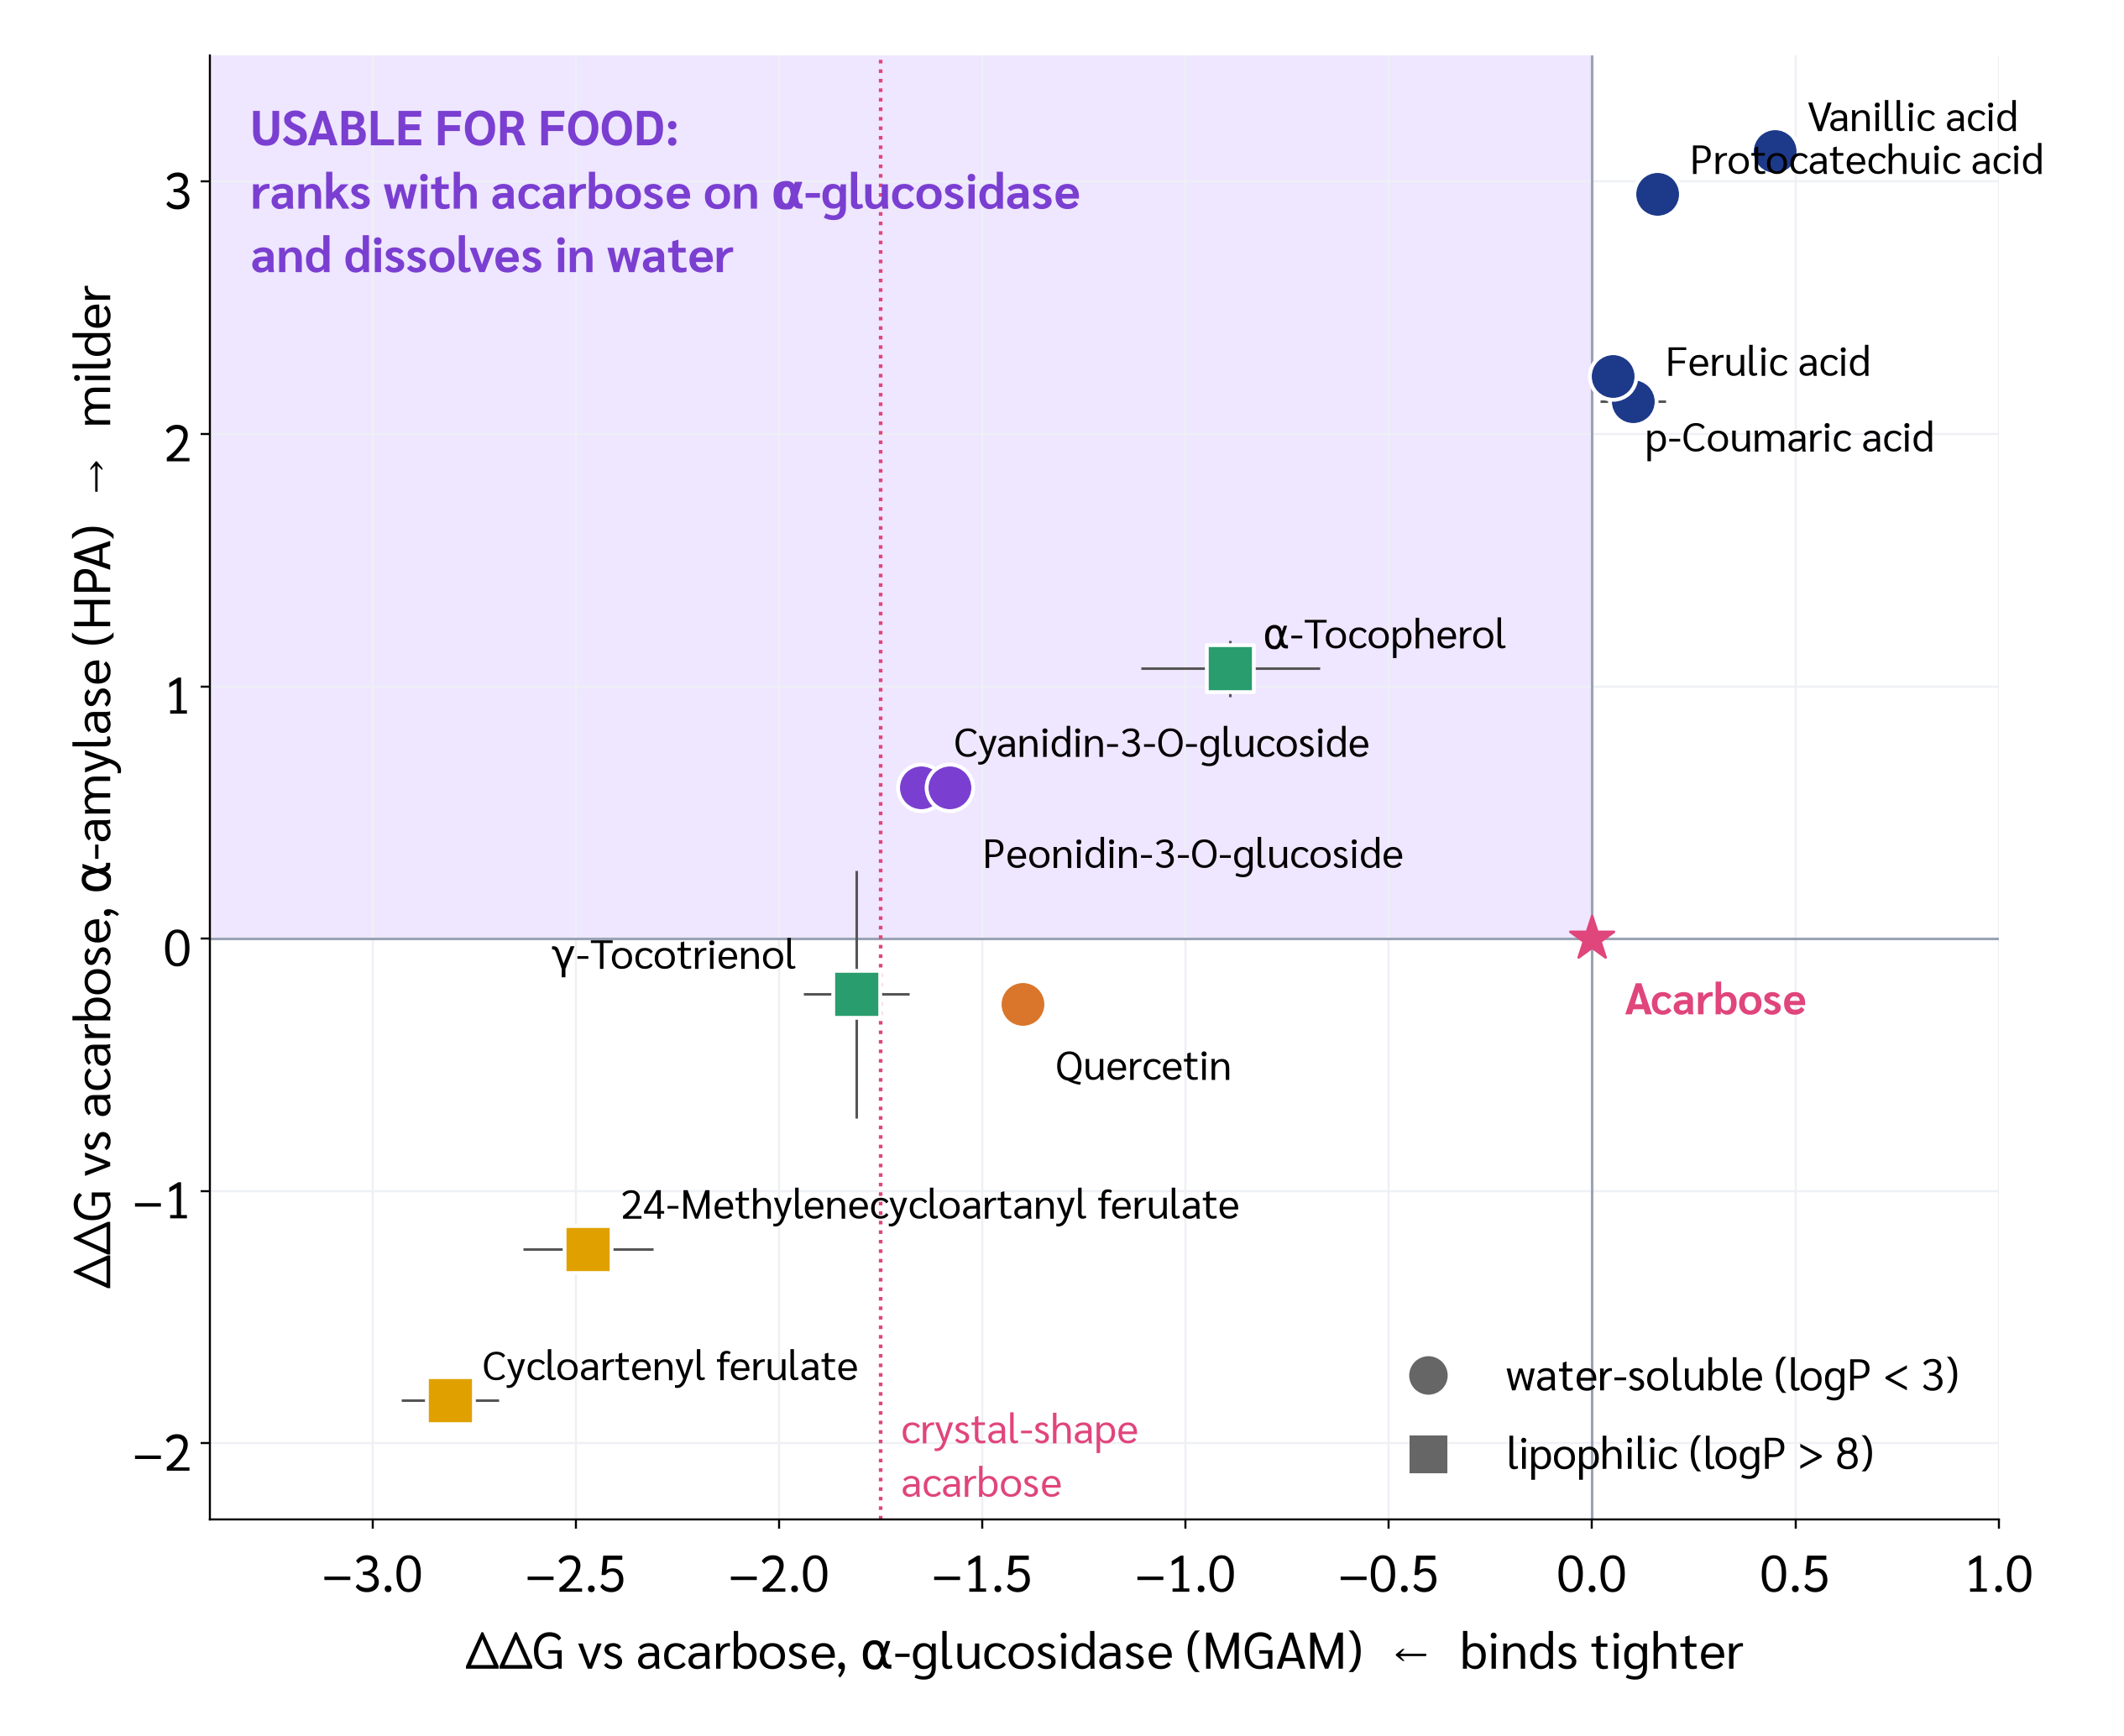
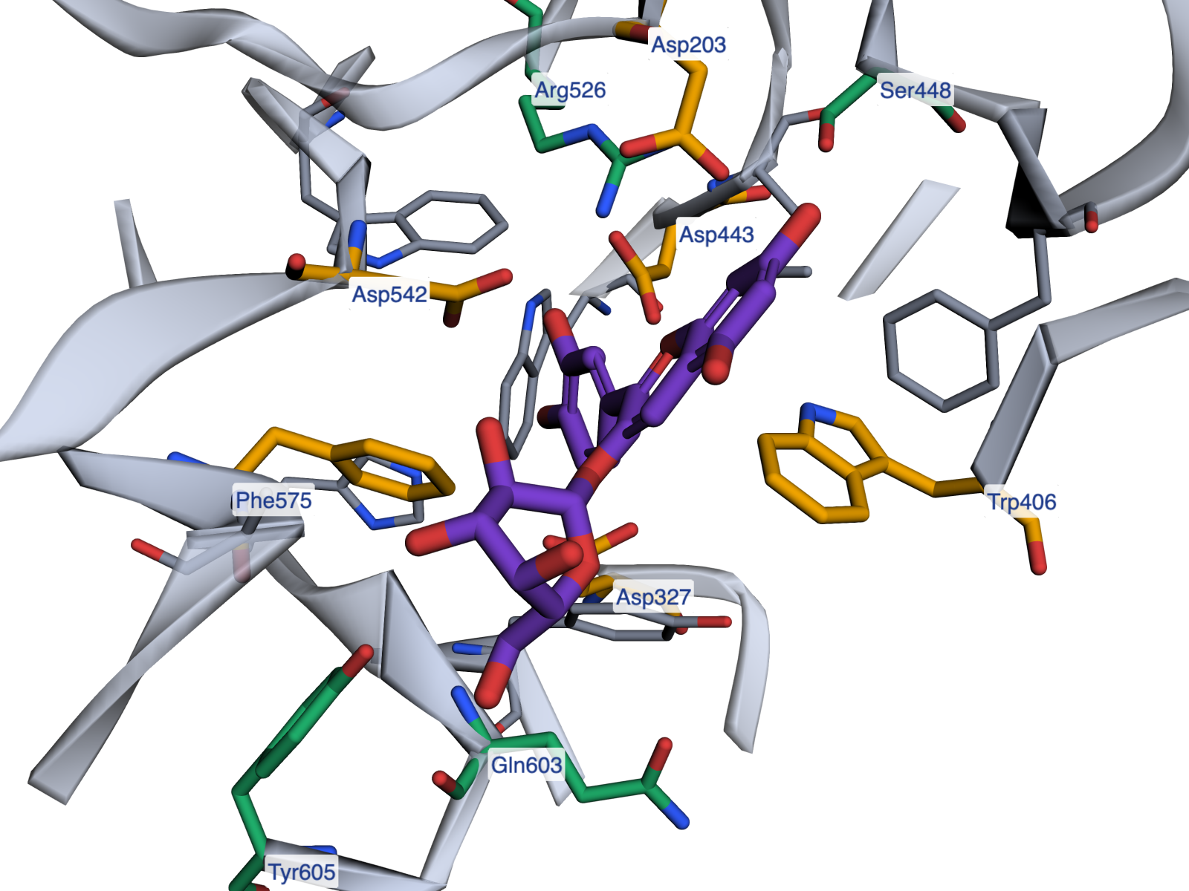
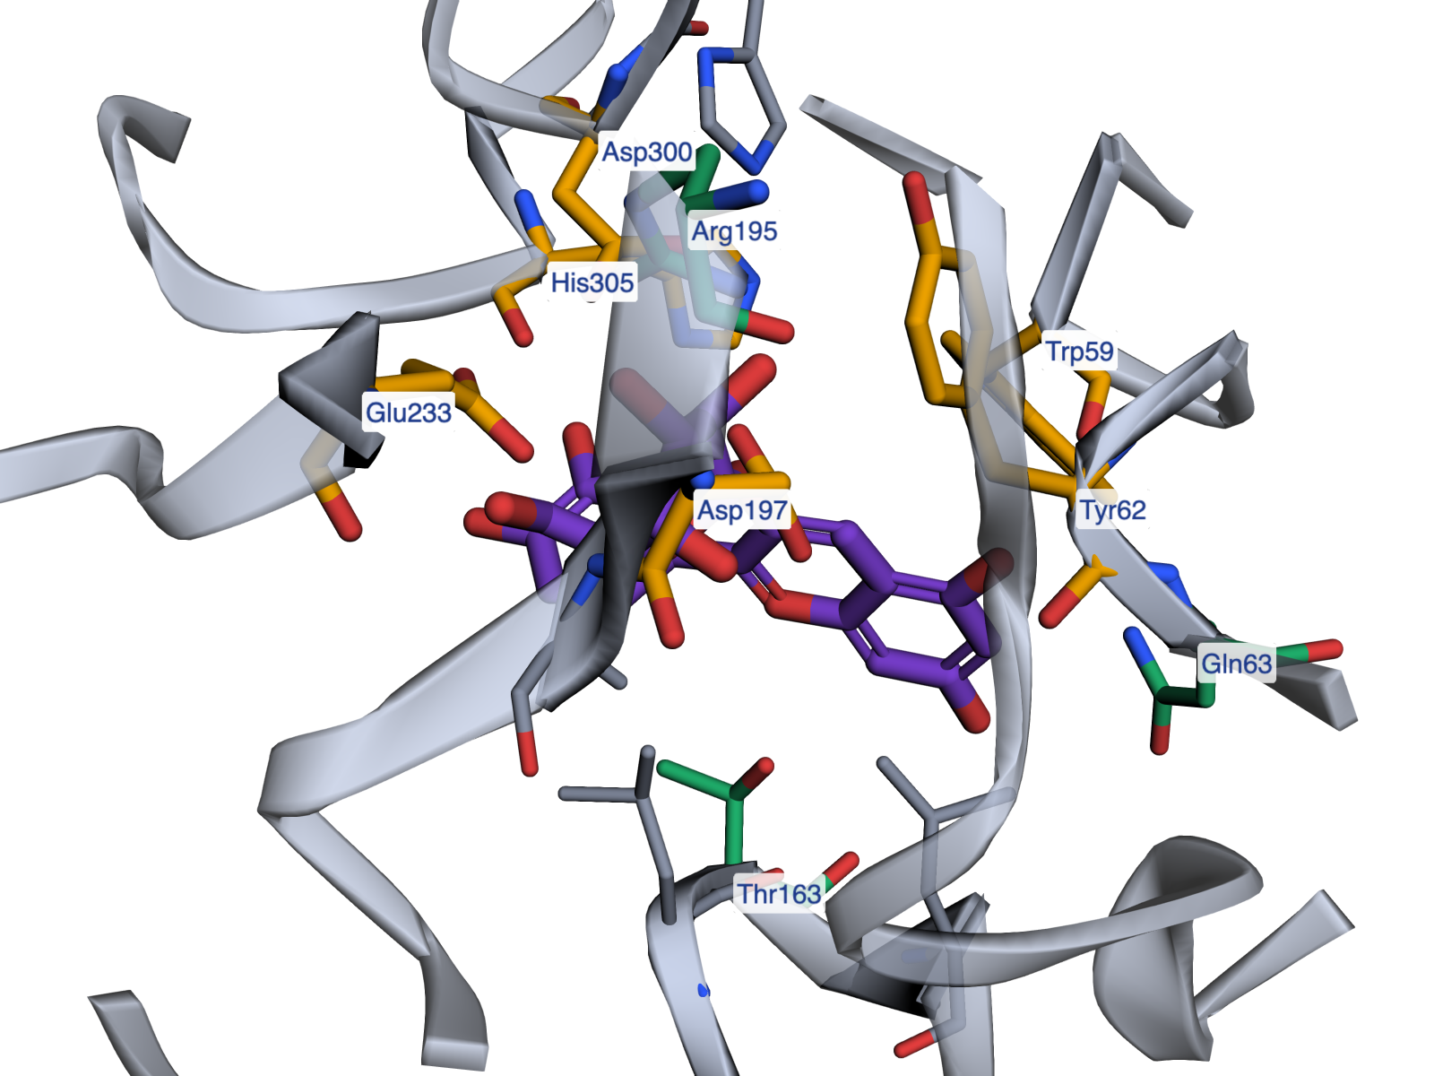

50
–Year Journey of INMU
Real World Impact in Food and Nutrition
11 – 12 February 2027
DOCKING-BASED PRIORITISATION OF RICEBERRY BRAN CONSTITUENTS AGAINST HUMAN α-GLUCOSIDASE AND α-AMYLASE FOR BY-PRODUCT VALORISATION
Puttitada Pruetchayakul*
Bodindecha (Sing Singhaseni) School, Bangkok, Thailand
A BY-PRODUCT WORTH MINING
THE QUESTION
Starch becomes glucose via pancreatic α-amylase and intestinal α-glucosidase. Acarbose slows both, but is poorly tolerated (flatulence 74% vs 29% on placebo, US label).
Riceberry bran is a low-value by-product of Thai rice milling. Pigmented-rice anthocyanins are already known from in vitro work to inhibit both enzymes (Akkarachiyasit et al., 2010).
Bran carries many candidates at once, and a food ingredient must also dissolve where the enzymes are. These have never been compared on the human enzymes.
Riceberry bran, a low-value by-product of Thai rice mills, carries anthocyanins, γ-oryzanol, vitamin E and phenolic acids.
Which fraction should a food project extract and assay first? That is the question this screen answers.
11 bran constituents ranked on both human enzymes, scoring predicted binding and solubility together
MATERIALS AND METHODS
1 Targets
Human MGAM (PDB 2QMJ, 1.9 Å) and pancreatic α-amylase (PDB 3BAJ, 2.1 Å), both crystallised with acarbose
2 Protein prep
PDBFixer: waters and ions removed, missing atoms and hydrogens added at pH 7.4; Meeko PDBQT
3 Ligands
12 structures from PubChem; RDKit ETKDG + MMFF94 optimisation; Meeko
4 Docking
AutoDock Vina 1.2.7 in the acarbose site, exhaustiveness 16, 3 independent seeds (78 runs)
5 Analysis
ΔΔG vs acarbose; contacts ≤ 4 Å and H-bonds ≤ 3.5 Å per residue; ligand efficiency; score–size regression; logP
Protocol validation: acarbose re-docked from a randomised start returned to its MGAM crystal pose in every run (RMSD 2.04–2.06 Å, n = 3).
RESULTS · RANKING THE BRAN
Fig. 2 Cyanidin-3-O-glucoside (purple) in α-glucosidase (left) and α-amylase (right). Gold = catalytic residues, green = hydrogen-bond partners.
The tightest binder is not the usable one
γ−Oryzanol esters topped the ranking (cycloartenyl ferulate −8.87 / −10.52 kcal/mol), but with logP > 10 they will not dissolve in the gut lumen, and they sit in the bran's oil fraction.
Anthocyanins are the only soluble front-runners
Cyanidin−3−O−glucoside (−7.71 / −8.09) and peonidin−3−O−glucoside (−7.64 / −8.09) ranked next, hydrogen-bonded the catalytic acids Asp443/Asp542 and Asp197/Glu233, and were the only high-ranking compounds with logP < 0.7.
Size inflates the score, so efficiency was scored too
Across the panel the predicted affinity rose with molecular size (Pearson r = 0.73, p = 0.007 on MGAM; r = 0.88, p = 0.0002 on HPA). Per heavy atom the anthocyanins bind more efficiently than the γ-oryzanol esters (0.24 vs 0.20 kcal/mol/atom on MGAM) and than acarbose (0.14).
Fig. 1 Each constituent placed against acarbose on both enzymes (ΔΔG, mean of 3 seeds). Circles dissolve in water, squares do not. The shaded area marks where a usable food candidate would sit.
FROM SCREEN TO PRODUCT
① Take this fraction
The acidified aqueous extract of fresh Riceberry bran — the anthocyanin-bearing fraction.
Not whole bran, not the oil fraction: the γ-oryzanol that ranks highest sits in the oil and will not dissolve.
Bran must be fresh; it turns rancid within weeks.
② Prove it on the bench
Two-enzyme IC₅₀, not one. Run α-glucosidase and α-amylase assays side by side against acarbose.
Report a selectivity index (IC₅₀ amylase ÷ IC₅₀ glucosidase) so potency and selectivity are measured, not inferred.
Quantify anthocyanin by pH-differential (520/700 nm) as cyanidin-3-glucoside equivalents.
③ Build it into food
Anthocyanins survive acid and short heat, not long baking. The prototype is a no-added-sugar jelly drink: pH 3.2–3.5, 80 °C for 1 min, hot-filled.
Three extract levels (20/30/40%), 9-point hedonic test, n ≥ 30.
Label claims stay factual: no health claim without FDA approval.
CONCLUSION
Scoring binding together with solubility changes which molecule a food project should chase. The highest-scoring constituents of Riceberry bran, the γ-oryzanol esters, cannot dissolve where the enzymes work; the anthocyanins rank just below them and are the only front-runners that can.
This turns a rice-mill by-product into one defined fraction to extract and one assay that would settle it, instead of a vague claim about rice bran being healthy.
What this cannot tell you. Docking ranks predicted binding, not inhibitory potency or selectivity; differences below ~1 kcal/mol sit inside the scoring error. Prior in vitro work established that these anthocyanins do inhibit both enzymes, and the two-enzyme IC₅₀ comparison above is what would rank them. No health claim is made here.
Rotate the binding sites in 3D
Structures PDB 2QMJ (Sim et al., J Mol Biol 2008) and 3BAJ (Maurus et al., Biochemistry 2008). Software AutoDock Vina 1.2.7 (Eberhardt et al., JCIM 2021); Meeko; RDKit; PDBFixer. Ligands from PubChem. Prior in vitro data Akkarachiyasit et al., Int J Mol Sci 2010;11:3387. Acarbose tolerability US prescribing information. All scripts and raw results via the QR link.
*Corresponding author: Puttitada Pruetchayakul (graciepiewppiew@gmail.com)
Website: https://inmu.mahidol.ac.th/50th
E-mail: inmu50th@gmail.com
LINE: @inmu50th

