Slide 1
Multi Stack Densely Convolved Long Short Term Memory

Slide 2
Structure of the Network

Slide 8

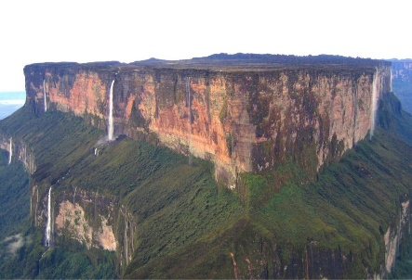
Pros and Cons compared with a pure LSTM stacked network
Pros:
Higher Accuracy;
Faster Convergence;
The Convolutional Layer can be easily parallelized when training on GPU cluster, while LSTM is strictly sequential. So the training of VC-LSTM should be faster with GPU clusters.
Cons:
Higher Requirements on Parameter Tuning;
Easier to Trap in Non-optimized Local Minima(having a steeper energy graph);
More complex in back propagation process;
How do we know this?
Pure LSTM Stack
VC-LSTM Stack

Slide 9
Possible Applications
Forensic Recognition on Second Dataset;
Neural Machine Translation with Local Attention;
Semantic Analysis;
Speech Recognition;
And any other interesting fields dealing with sequential data;
more computational resource is needed~~

