Slide 1
How to use…
[matrixProfile, profileIndex, motifIndex, discordIndex] = interactiveMatrixProfile(data, subLen);
Input
data: input time series
subLen: subsequence length
Output
matrixProfile: the approximated matrix profile when stopped or complete
profileIndex: the approximated matrix profile index when stopped or complete
motifIndex: the detected motif index when stopped or complete (3x2 cell)
discordIndex: vector contains the discord’s index when stop or complete
1st motif | 1st motif’s NN within certain radius
2nd motif | 2nd motif’s NN within certain radius
3rd motif | 3rd motif’s NN within certain radius

Slide 2
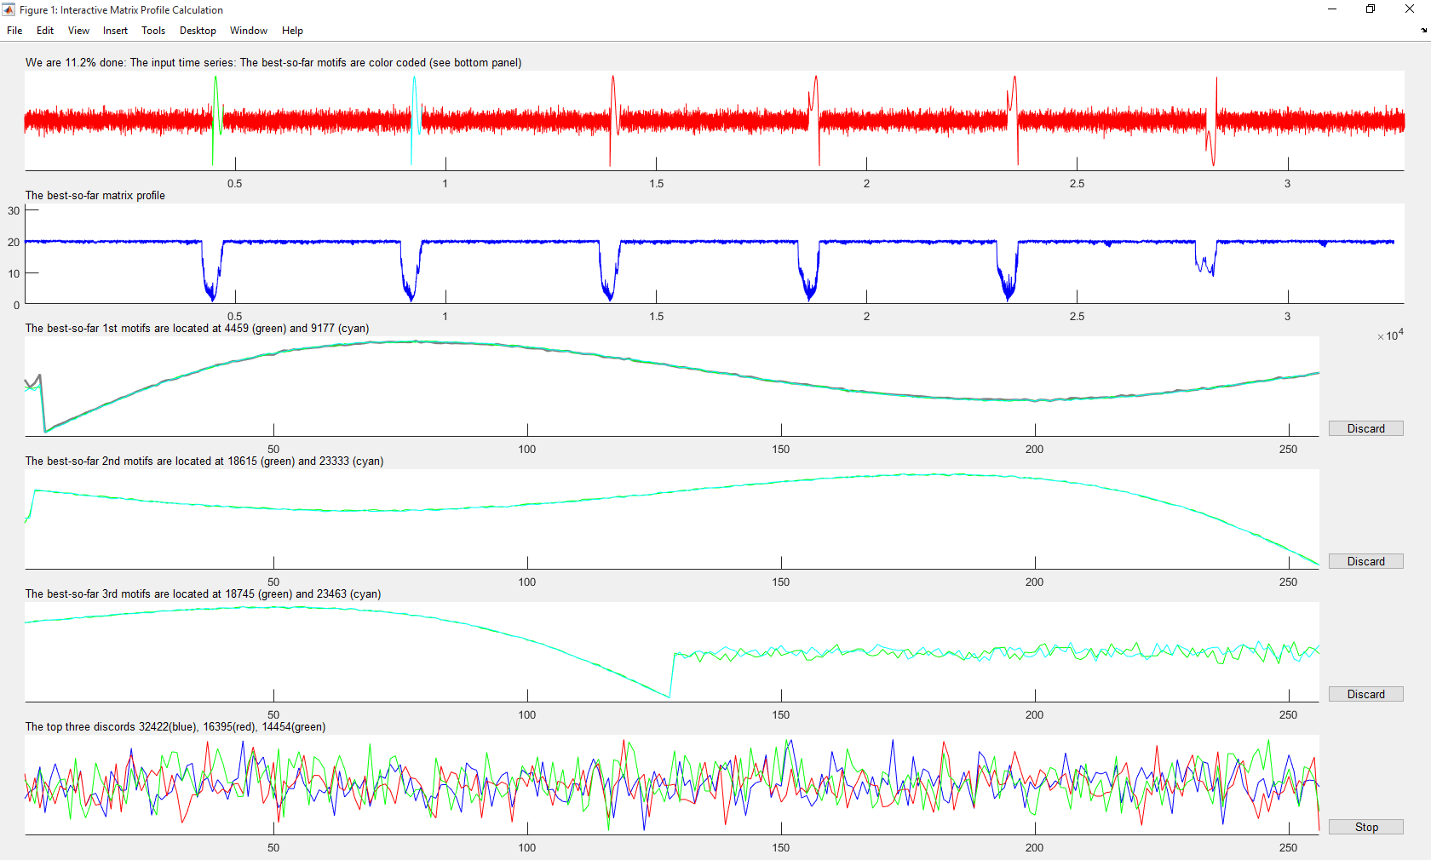
If this motif is not of interest to you, click discard, to force the tool to find another motif
Here stop means stop the entire tool, and return all the patterns.

Slide 3
If you set a subsequence length that was too long, there simply would not be enough data to make three sets of motifs and three discords!
So the subsequence length must be less than 1/20 the length of the time series length.

Slide 4
We have to impose a maximum number on subsequences that can appear in a single motif (we chose ten).
Otherwise, having three different motifs would not be defined for certain pathological datasets. For example, a pure sine wave.

Slide 5
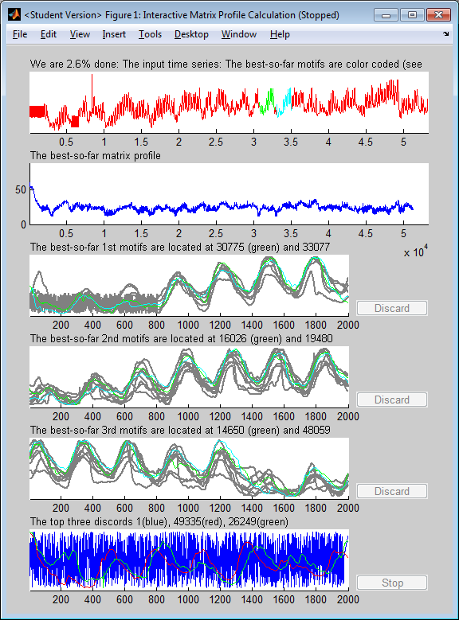
It actually converged at about 1%, I could not click fast enough ;-)
To my eye, these results make sense.
The three motifs are three variations on a theme.
800 datapoints of noise or low amplitude, then four cycles
Weak cycles in the beginning, that get progressively more pronounced
Five full strong cycles, that then (around 1400) fade
The first discord is just the high frequency noise at the beginning of the data. The second two have cycles, but are clearly different to normal motifs.
However, you might say that motif ‘1’ and ‘2’ are really the same, and should be merged, which begs the question, how did we define them in the first place (next slide…………)
Here is the entire code you need to run this
load dataset % Load the data
TAG = data(140000:5:end,7); % Pull out a section of TAG 7 to examine
subLen = 2000; % Choose the pattern length we are interested in
[matrixProfile, profileIndex, motifIndex, discordIndex] = interactiveMatrixProfile(TAG, subLen);

Slide 6
a. Creating an equivalent of the parameter that enabled the user to specify the similarity between instances of a motifs within a cluster (done. I did this a very sensible way, but there might be other ways)
Below I explain how I did this.
There might be other ways, but every other way I can think of, seems to be vulnerable to a pathologic dataset that would make it give strange results.
----
First, we have to set a parameter, R (range). Must be greater than or equal to 1.0, I made it 3.0 for all the slides today.
When the motif tool finds the best pair A and B (here the pair at 30775 and 33077), we measure the Euclidean distance between them;
Dist = EuclideanDistance (A,B )
Now we search the full time series, for any other patterns that are
Within R*Dist of A
or
Within R*Dist of B
All such patterns are part of the motif (these are the gray time series in the window).
The second motif panel is searching for motifs, excluding anything in the first panel.
The third motif panel is searching for motifs, excluding anything in the two panels.

Slide 7
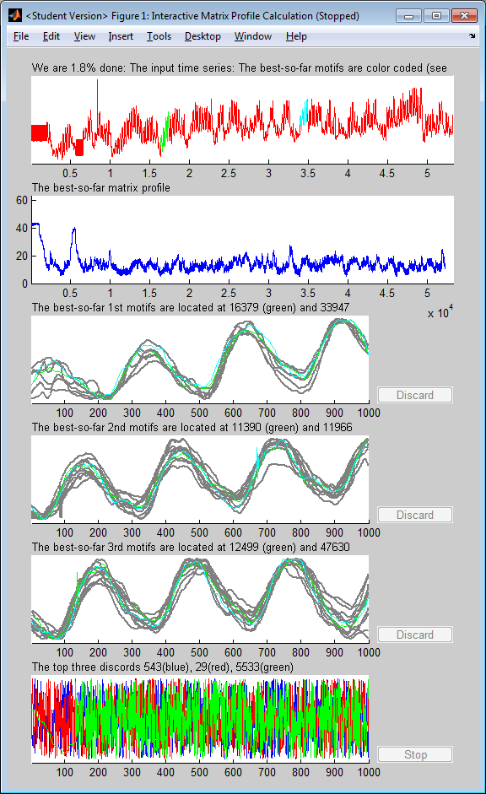
Just for fun, I repeated the experiment in the last slide, but halved the subsequence length
The three motifs are three variations on a theme. This makes sense, there is only one high-level pattern in the data. However it nicely seems to find subtle sub-motifs
8 degree ascending slope
4 degree ascending slope
Constant slope
8 degrees
4 degrees
0 degrees
Here is the entire code you need to run this
load dataset % Load the data
TAG = data(140000:5:end,7); % Pull out a section of TAG 7 to examine
subLen = 1000; % Choose the pattern length we are interested in
[matrixProfile, profileIndex, motifIndex, discordIndex] = interactiveMatrixProfile(TAG, subLen);

Slide 8
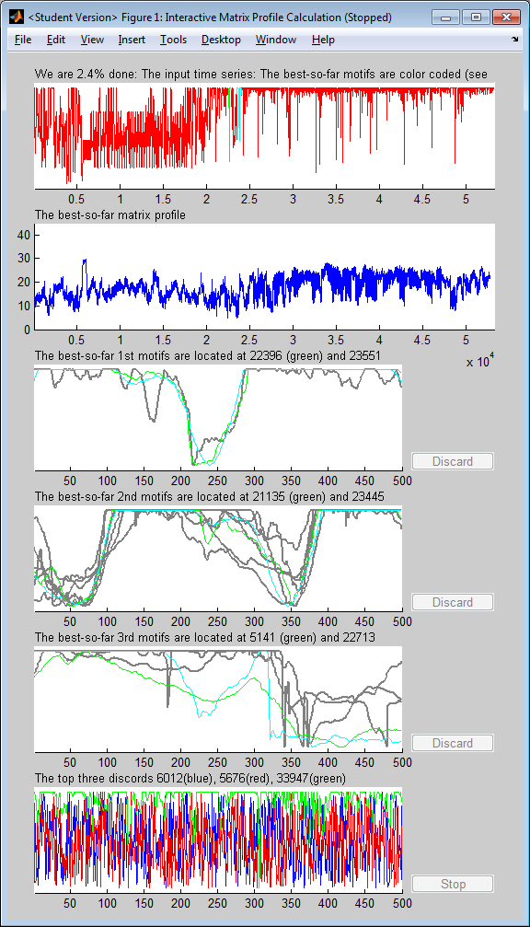
The tool seems quite robust to very noisy data, here discovering two motifs that seem ‘real’ to me, in spite of the fact that they are not “perfect”, and there is a lot of noise.
{close to random}

Slide 9
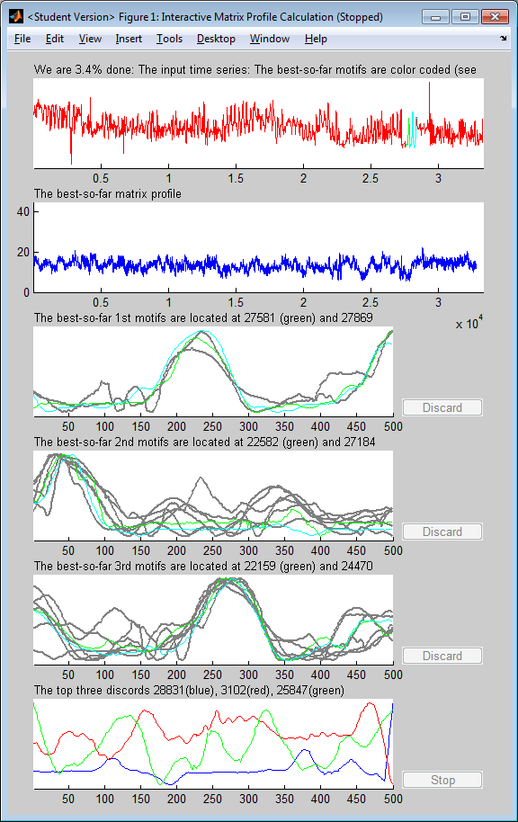
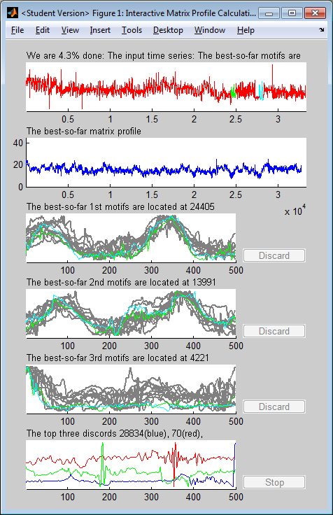
Here are two identical experiments, except I first smoothed the data for the leftmost one.
It is clear (and not surprising) that smoothing helps a little.

Slide 10
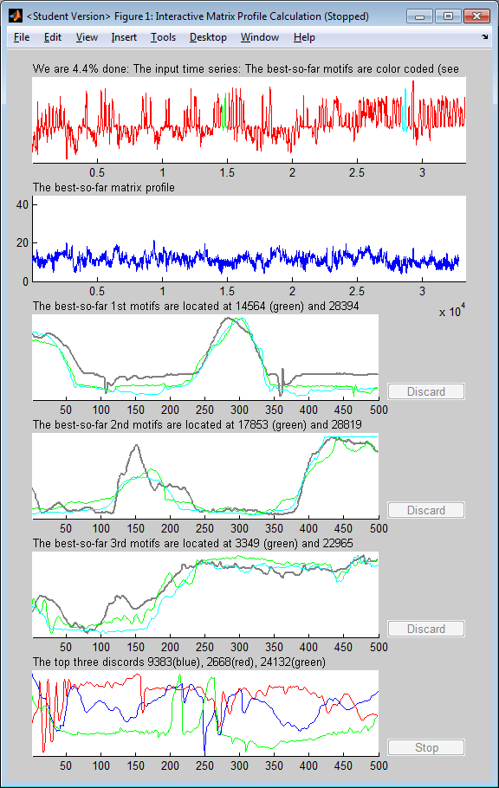
(no comments here, just another example)

