Slide 1
Gender Classification from Facial Images
Team : Queen
Subha Karanam, 201430043
Dushyant Goel, 201401011
Appidi Abhinav, 201431218

Slide 2
Problem Statement
Identification of Gender from facial images of people is done by using 3 different methods. The methods chosen are :
Using EigenFaces Method
Using Fisherfaces Method
Using Set Classification (for unaligned facial images)

Slide 3
Introduction
A gender classification method has many potential applications such as human identification, smart computer-human interface, computer vision approach for monitoring people, passive demographic data collection, etc. The methods chosen here deal with frontal facial images with inherent variations in the image formation process.
The database that is being used for this project is the Frontal Face dataset from Caltech(also called Caltech Faces). This dataset contains 450 images of 27 people with variations in lighting, expressions, backgrounds etc. It has 278 male images and 172 female images
Some challenges faced will be the variations in the dataset taken like illumination, change in camera angle, head pose, expressions, facial hair, background etc.

Slide 4
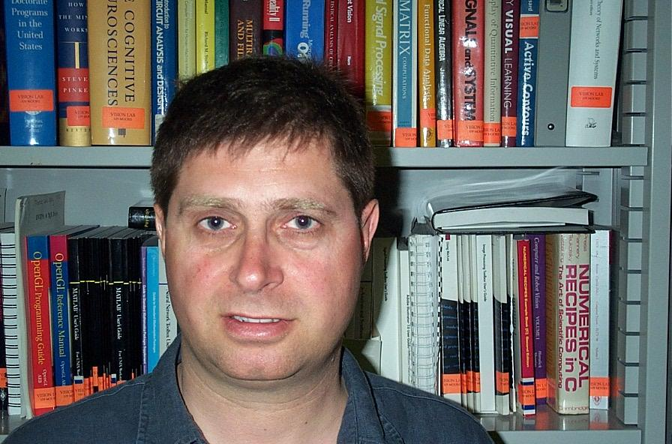
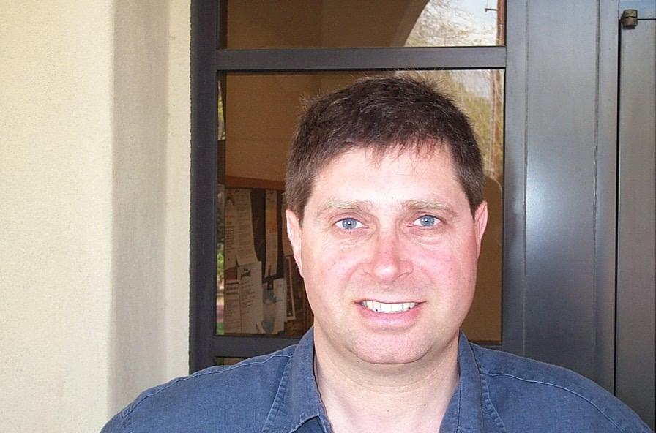
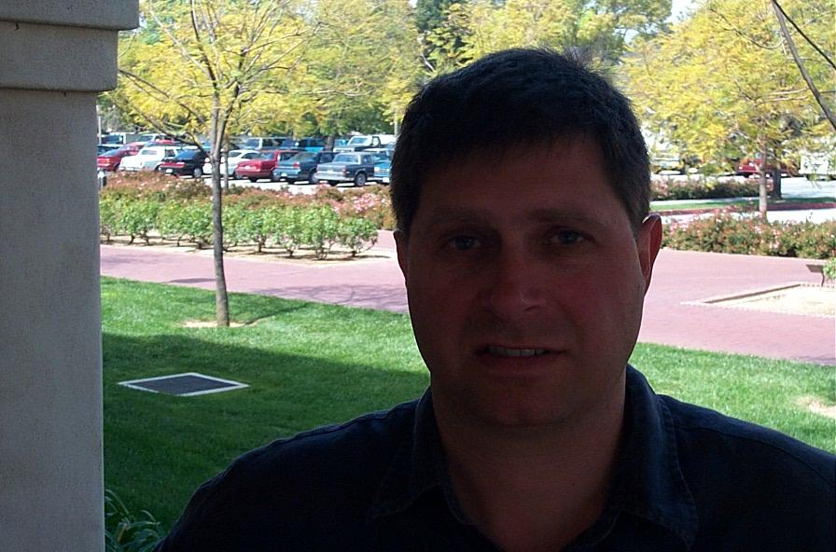
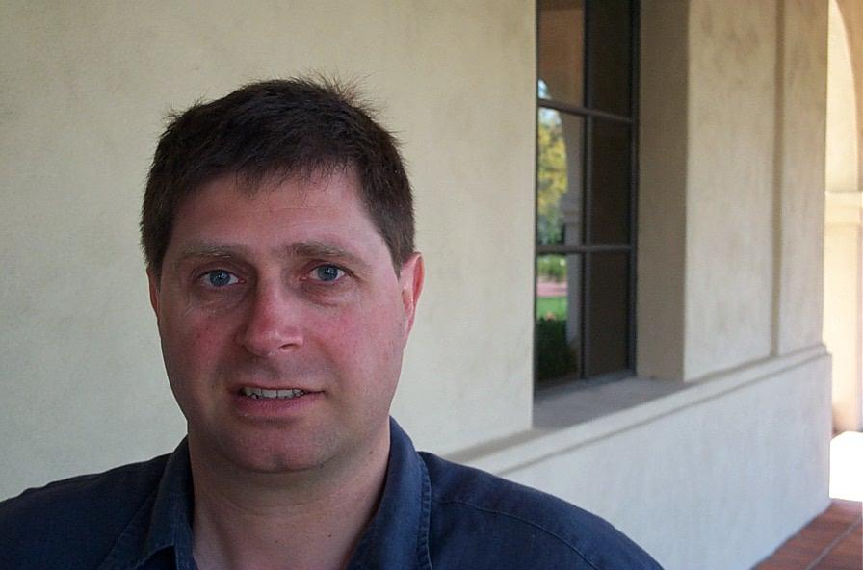
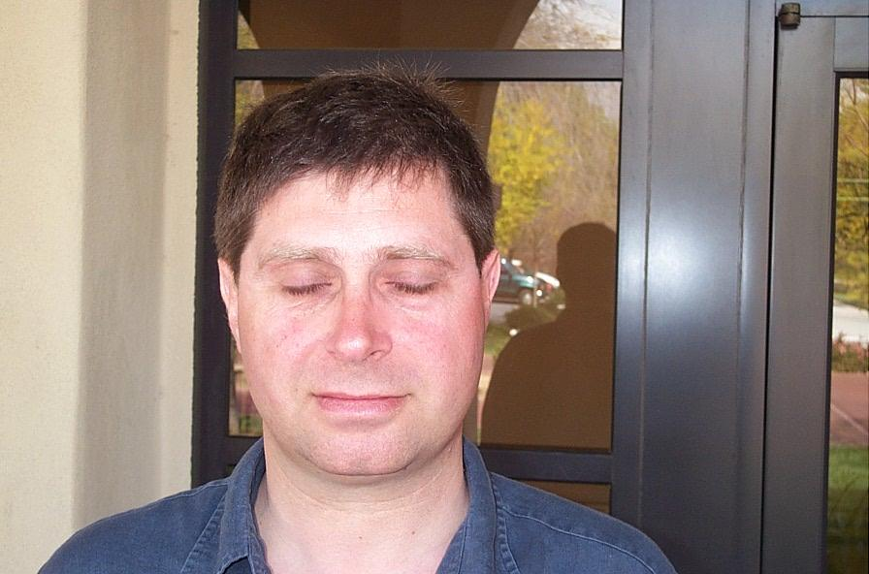
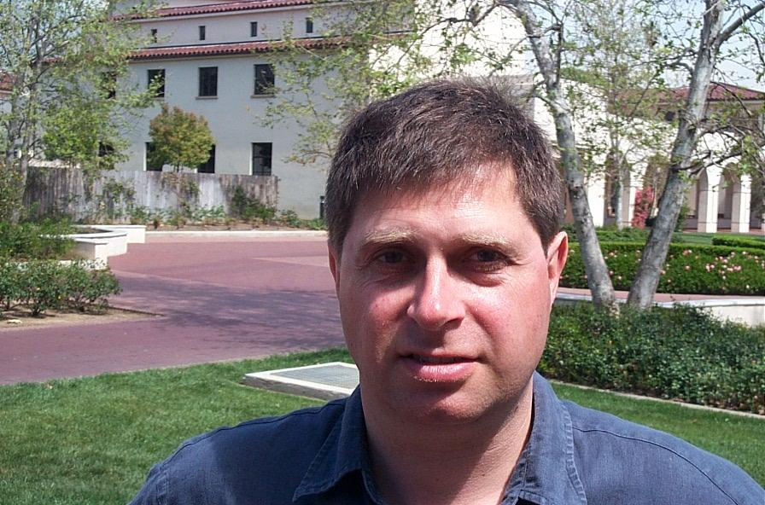
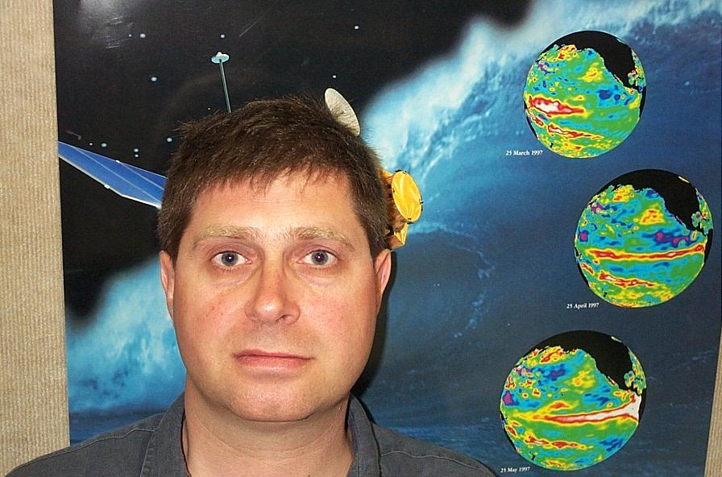
An example showing that all variations in image are considered in processing the algorithm.

Slide 5
Method 1 : Using EigenFaces
*This method can also detect faces in an image.
From a total of 450 images(278M and 172F), 400(250M and 150F) images are being used as training data and the rest(50) are testing data(28M and 22F).
Step 1 : The training dataset is loaded and the mean of the grayscale version of the images is taken.
Step 2 : A new dataset is formed by normalising the original dataset with the mean.(Subtracting mean from original). The mean of this new dataset will be zero.

Slide 6
Method : (PCA)
Step 3 : Then we have calculated the covariance of the matrix.
Step 4 : Then calculate the eigenvalues and eigenvectors of the covariance matrix.
Step 5 : Last step of PCA is to select the components(choosing the first k large values among all eigenvalues) and forming a feature vector.
→ Objective of PCA is to reduce the high dimensional training data set into lower dimensional space by finding the Eigenfaces also known as the Principal Components.

Slide 7
Procedure followed :
We have training dataset with total of P images of size NxM.
Calculated the mean(μ) of that face vectors. (size = NxM).
Next step is to get normalised images(Lm)(subtract mean from each image vector) (size = NxM).
Now we compute the covariance matrix C which is of NMxNM.
Where D = [L1,L2,L3, . . . Lm]’ (size = NMxM).
5. Next step is to find the eigenvalues and eigenvectors of the matrix C or DD’ .
Let eigenvectors of covariance matrix is Ui.

Slide 8
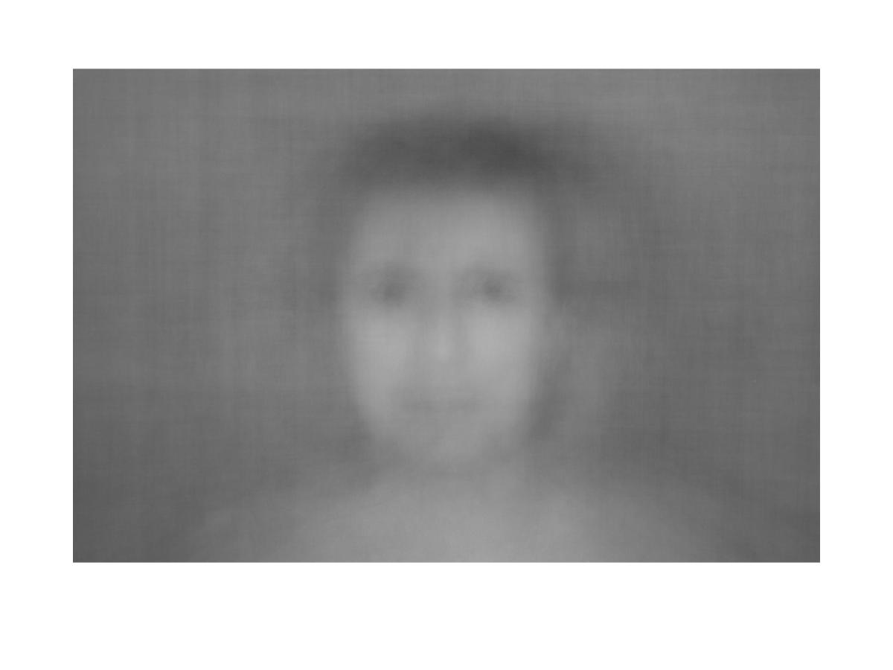
Mean Faces
250 male faces were used for training dataset and mean image is calculated,

Slide 9
Continuing . .
We have DD’ of dimensions NMxNM (here, we have NxM = 592x896 -> NM = 530432), which is practically not possible to compute the eigenvectors of this size.
So, instead of finding eigenvectors of DD’ , we calculate the eigenvectors of matrix D’D.which is of size MxM.
Let Vi is the eigenvectors for this D’D. So, D’DVi = Si.Vi (where s_i is an eigenvalues).
We know DD’ and D’D have same eigenvalues but their eigenvectors are different.

Slide 10
Eigenvalues of DD’ = D’D ??
D’DVi = SiVi
→ DD’.DVi = Si.DVi
→ CDVi = SiDVi
→ CUi = SiDUi.
It means Ui is equal to DVi. So, the DD’ and D’D have the same eigenvalues but there eigenvectors are different and are related by Ui = DVi.

Slide 11
Continuing . .
After computing the eigenvectors we need to select the K eigenvectors whose eigenvalues are larger.
So as we have K eigenvectors, this selected K eigenvectors are used for representing the whole dataset.

Slide 12
Testing
For recognition of any unknown face image(test image), we first need to convert the given image into its normalised form(subtract calculated mean from given image -> size = NxM).
Then it is converted into its linear form ie., into NMx1 size image vector.
We then project this on all the selected components. Then we need to calculate the distance by using Eucildean distance (can use Mahalanobis distance, but error is high in that), and the calculated image which is minimised is the equivalent image of the given input image.
We can set a threshold value, accordingly we can identify that given image.

Slide 13
Method 2 : Using Fisherfaces(LDA)
It is assumed that there are 3 classes of images(male, female and ambiguous) and the data in each class is normally distributed denoted by N(𝝁_{i}, 𝚺_{i}) with mean 𝝁_{i} , covariance 𝚺_{i} and probability density function fi(x|μi,Σi). GIven their class Prior probabilities, test samples are classified by comparing log-likelihoods.
Step 1 : The training dataset is normalised by calculating mean and subtracting the mean from from each image.
Step 2 : Two types of matrices are needed to be calculated from the training data. One is a within-class scatter matrix(S_{w}) which denotes the differences in images in each class. And the second one is the between-class scatter(S_{b}) matrix which denotes the differences between the classes.

Slide 14
Continuing . .
S_{w} = ∑^{C}_{j=1}∑^{nj}_{i=1}(x_{ij}−μ_{j})(x_{ij}−μ_{j})^{T}, where x_{ij} is the i^{th} sample of the j^{th} class, n_{j} is the number of samples in the j^{th} class and C is the number of classes.
S_{b} = ∑^{C}_{j=1}(μ_{j}−μ)(μ_{j}−μ)^{T} , where μ_{j} is the mean of the data in the j_{th} class, μ is the mean of all classes and C is the number of classes.
Step 3 : Now we create a basis, V for a subspace such that S_{w} is minimized and S_{b} is maximised. V will be a matrix whose columns v_{i} will be the basis vectors for the mentioned subspace. The matrix V can be found by (VS_{b}V^{T})/(VS_{w}V^{T}).

Slide 15
Continuing . .
The solution for the aforementioned equation will be the eigen generalization :
S_{b}V = S_{w}VE
So, V will be the matrix of eigenvectors and E will be a diagonal matrix consisting of eigenvalues. The eigenvectors corresponding to nonzero eigenvalues will be the Fisherfaces.
Step 4 : An image is taken from the test data and is normalised using the mean of the training data.

Slide 16
Step 5 : We choose a V so as to maximise (VS_{b}V^{T})/(VS_{w}V^{T}). And the test image is then projected onto the subspace with basis V.
Step 6 : A simple Linear Discriminant Function is applied now to differentiate between the classes. This can be done because the variation between the classes has been maximised and the variation in the data in each class has been minimised.

Slide 17
Bibliography
Database : http://www.vision.caltech.edu/html-files/archive.html
http://ethesis.nitrkl.ac.in/6482/1/212CS1097-2.pdf
http://www.scholarpedia.org/article/Fisherfaces

Slide 18
Where we are
Done
We have implemented the Eigenfaces method for gender classification. The classifier was trained using 150 male and 150 female images from public CalTech data set.
We have finished reading theory for Fischerfaces method.
Doing
In process of implementing fischer face.
To Do
Unaligned facial images by set classification.
Notes:
:) :P

