Slide 1

Automated Obstacle Detection and Speed Controlling System

Slide 2

Presented By
Chowdhury Ullas (ID: 17-35528-3, Roll: 18)
Raihan MD Hemel (ID: 17-33607-1, Roll: 04)
Tania Rahman (ID: 17-33841-1, Roll: 07)
Nowrin Muhaimin Shailee (ID: 18-37259-1, Roll: 30)
Rahman, Md. Ashiqur (ID: 17-35477-3, Roll: 15)
Md Refatul Islam (ID: 18-37818-2, Roll: 33)
Ragib, Azmaill Damil (ID: 17-35503-3, Roll: 17)
Mohammed Afridul Haque (ID: 18-38794-3, Roll: 43)
Anwar Hossain (ID: 17-35487-3, Roll: 16)

Slide 3
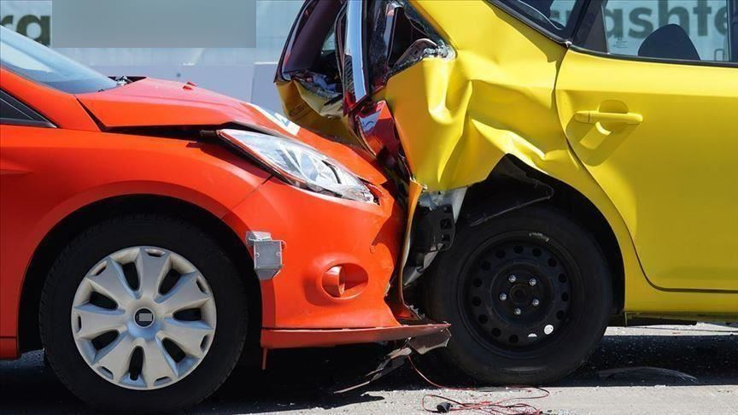
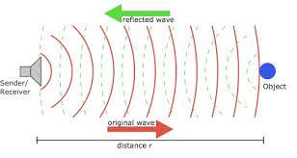
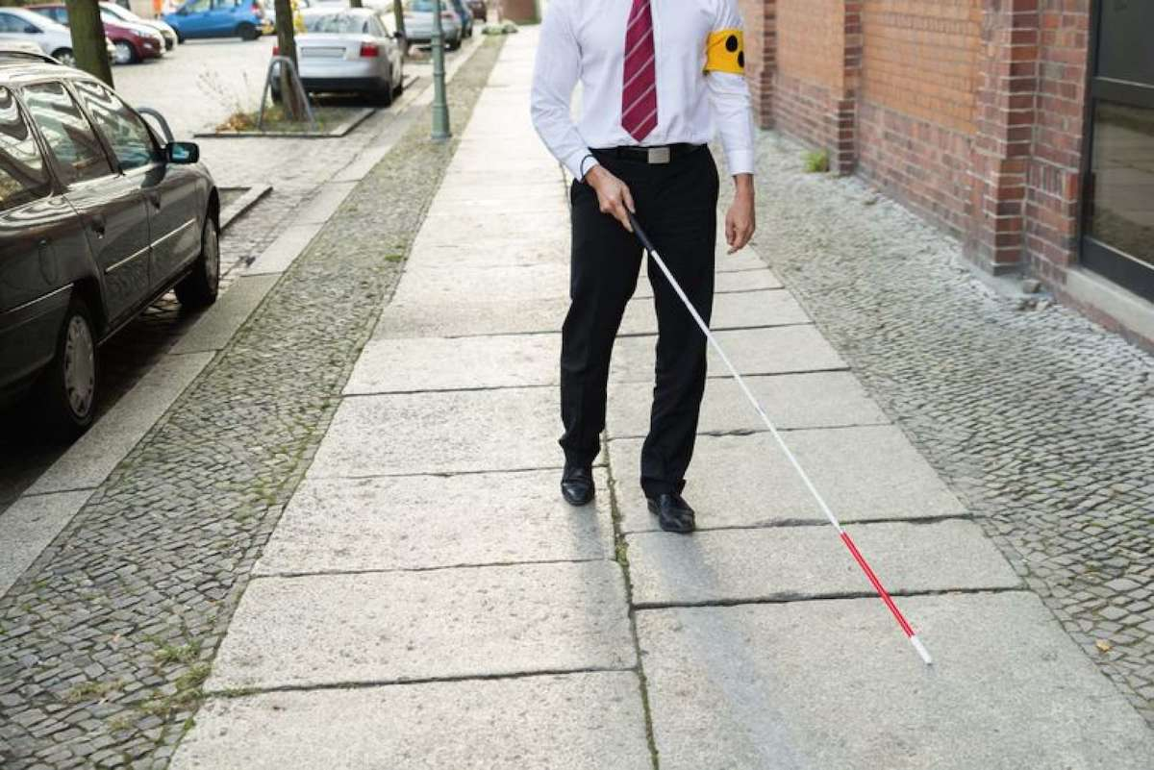
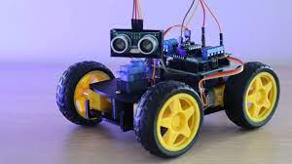
Main PURPOSE
Avoid unwanted accident on road.
To avoid Vehicle Crash.
To warn the visually impaired users.

Slide 4
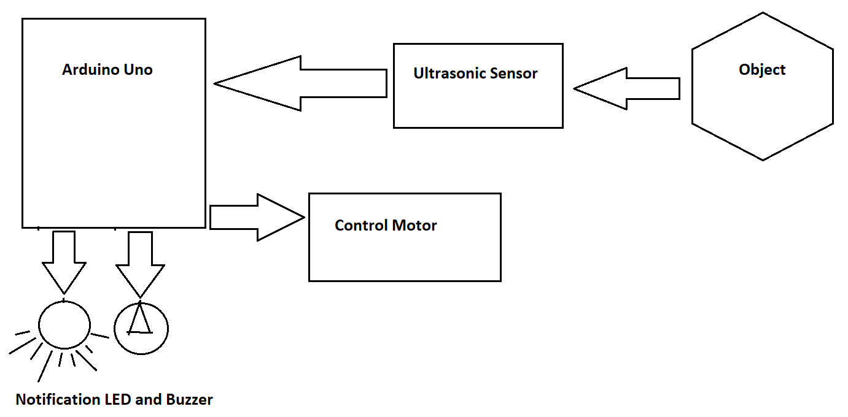
Block Diagram of the Project

Slide 5
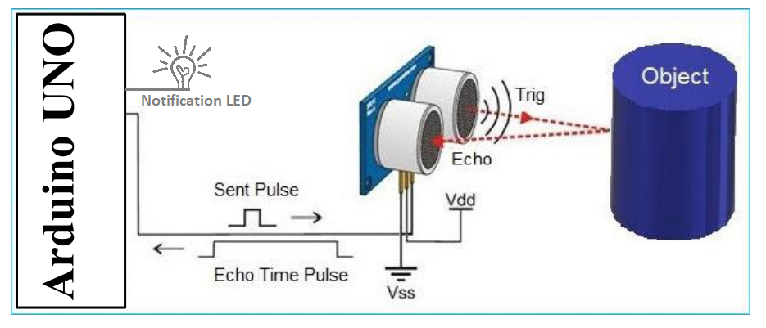
Ultrasonic Sensor Overview

Slide 6
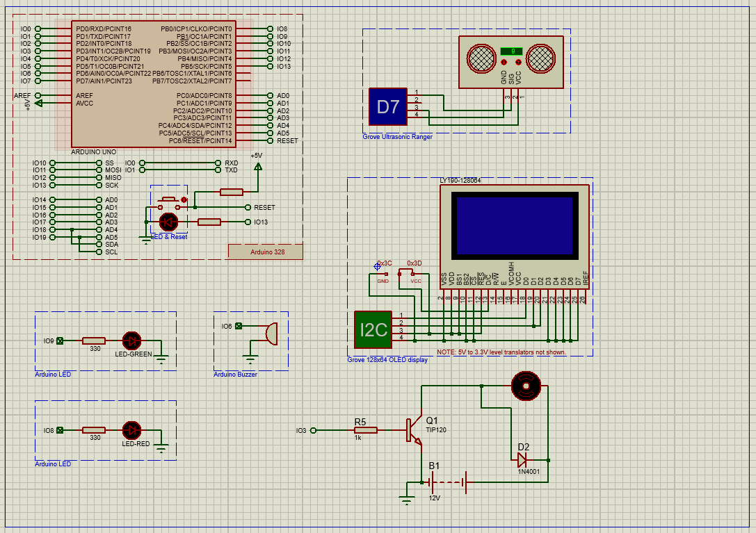
Circuit Design

Slide 7
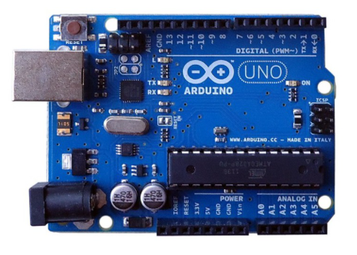
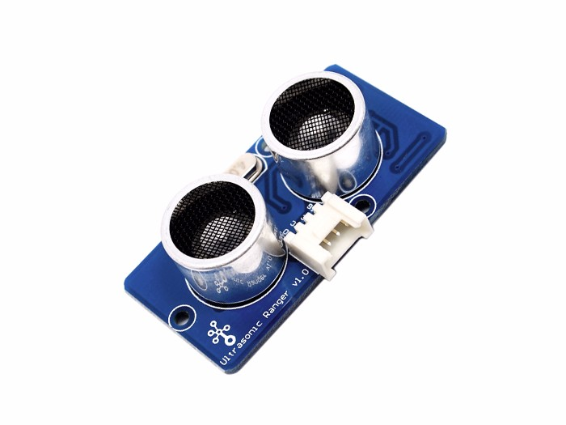
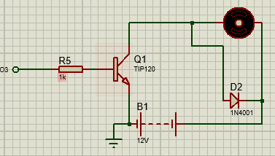
Component Details
Arduino UNO:
An electronics platform based on easy-to-use hardware and software.
Capable of reads inputs from sonar sensors, gas sensors, temperature sensors etc.
Control the board by sending set of instructions.
Arduino UNO
Grove Ultrasonic Ranger:
Non-contact distance measurement module.
Using IO trigger for at least 10us high level signal, the Module automatically sends eight 40 kHz and detect whether there is a pulse signal back.
Use to obtain distance message in cm or inch.
Ultrasonic sensor
DC motor:
One simple DC motor used to control the speed of the vehicle or the system.
Works by turning electricity into motion.
Also used 1N4001 Diode, TIP120 Transistor, Resister and a Battery for dc voltage source to activate the motor.
DC Motor

Slide 8
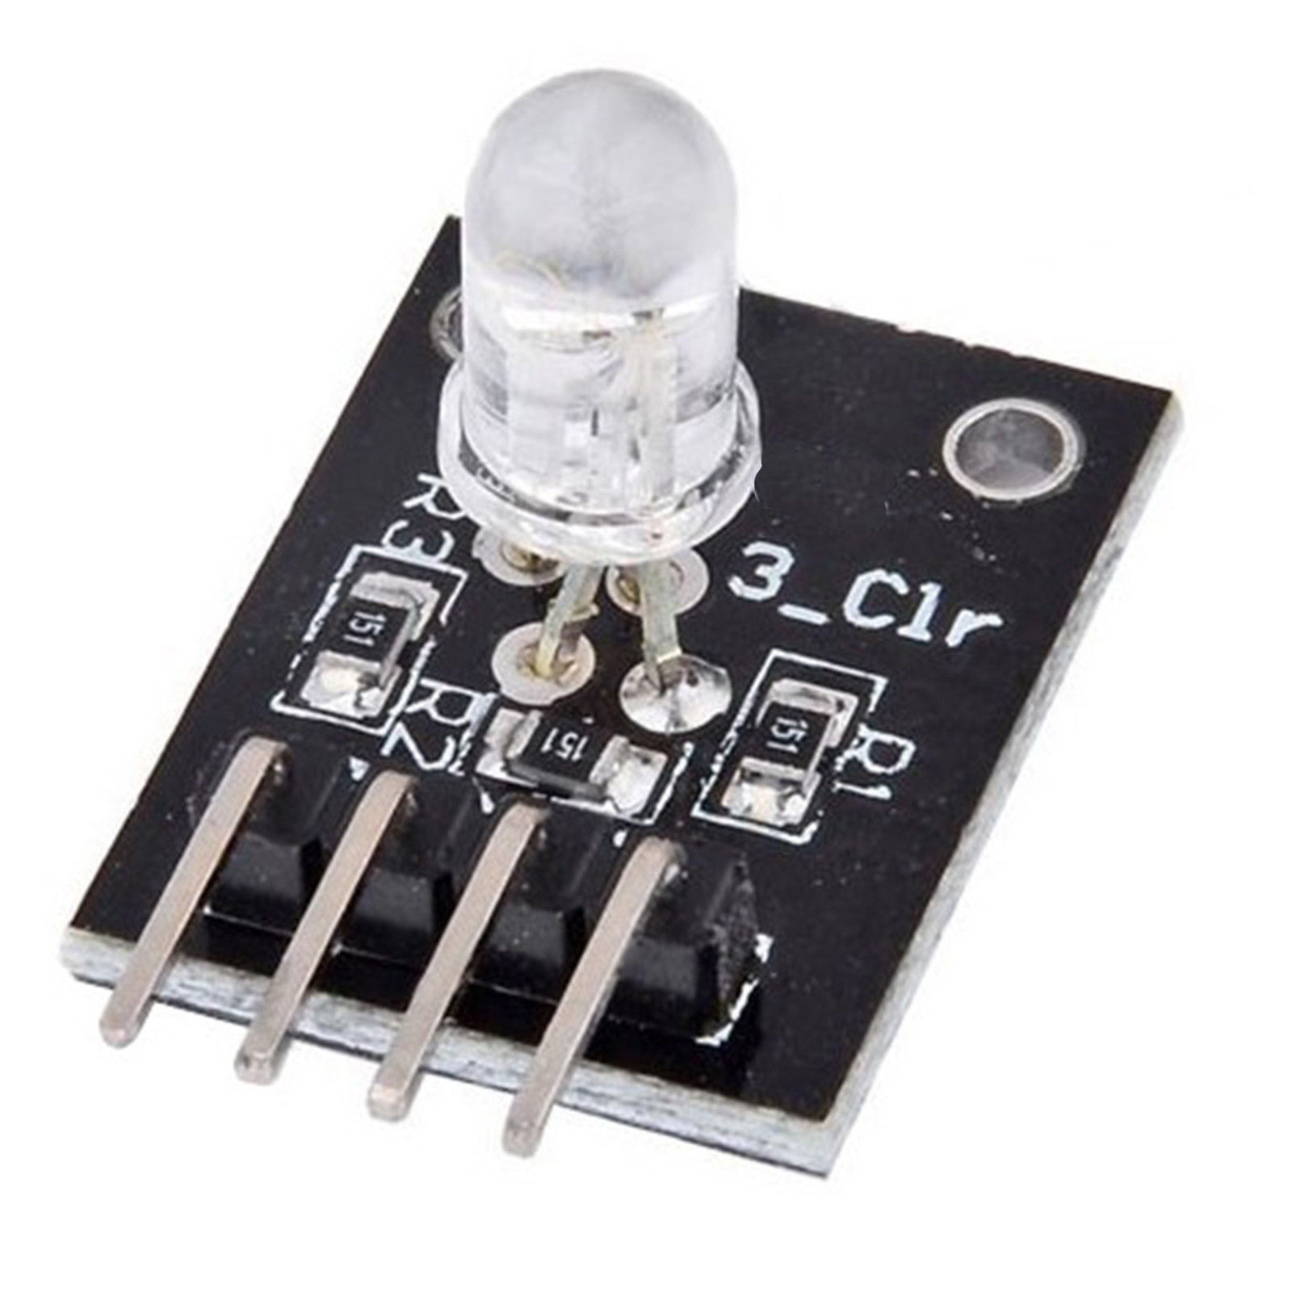
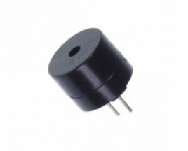
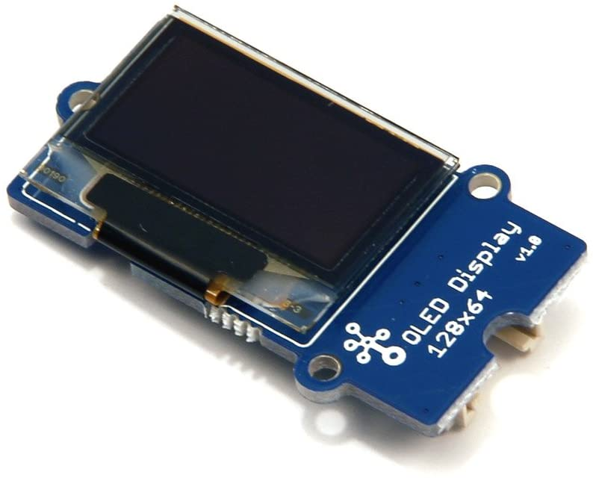
Component Details
LED Breakout Board :
Used for notification light when the obstacle detected.
LED light with a resistor.
Used red and green led for different conditions.
LED
Buzzer:
Used for notification sound.
It makes sound through vibration.
Grove OLED Display:
OLED monochrome 128×64 matrix display module.
Used for show a notification message with distance.
Buzzer
OLED display

Slide 9
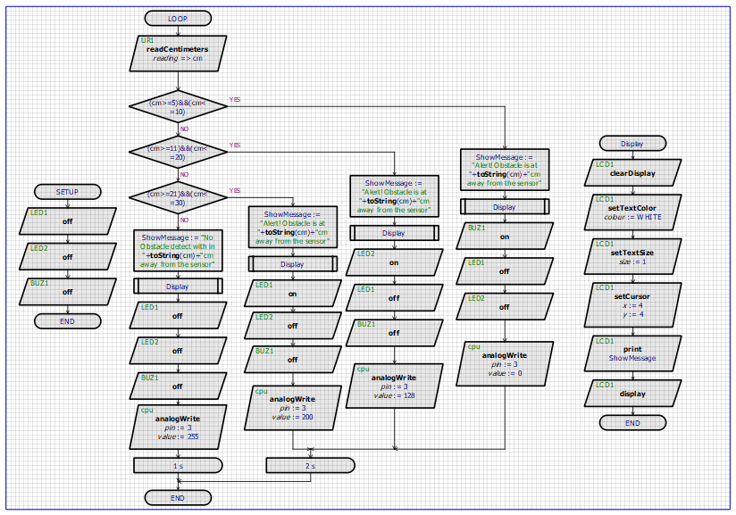
Project Workflow

Slide 10
Conditions
If distance_cm between 5 to 10 cm turn on the Buzzer, Motor Speed: 0 (Off).
If distance_cm between 11 to 20 cm turn on Red LED, Motor Speed: 128 (Half speed)
If distance_cm between 21 to 30 cm turn on Green LED, Motor Speed: 200 (Little bit slower).
If distance_cm is above 30 cm turn off all the LED and Buzzer, Motor Speed: 255 (Full speed).

Slide 11
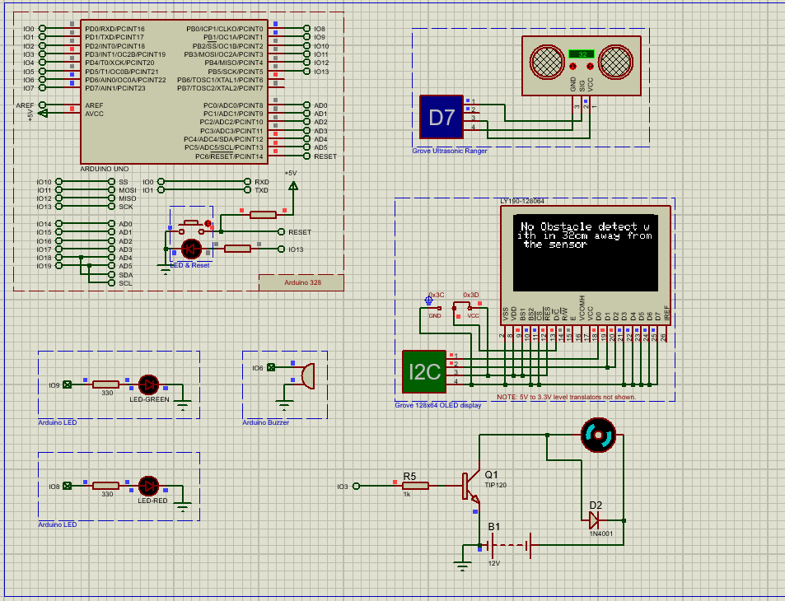
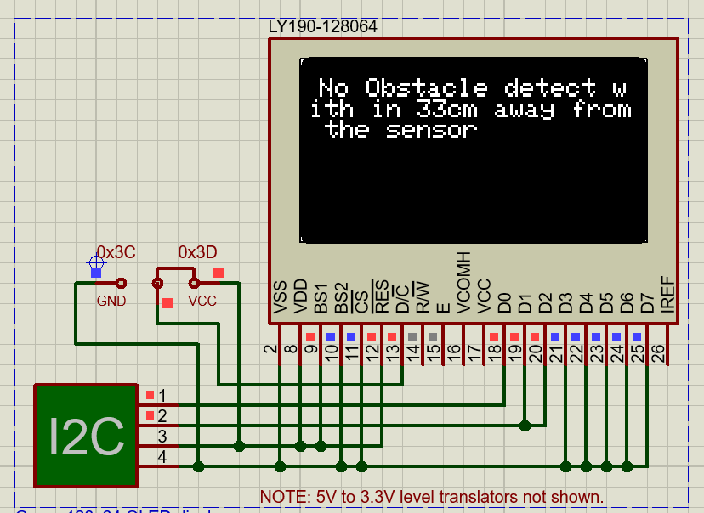
Results
Test 1:
When the distance of an obstacle is above 30 cm.

Slide 12
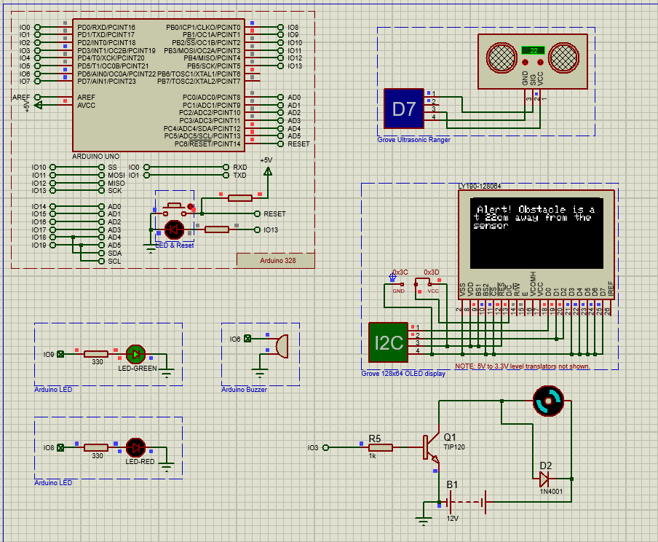

Results
Test 2:
When the distance of an obstacle is between 21 to 30 cm.

Slide 13
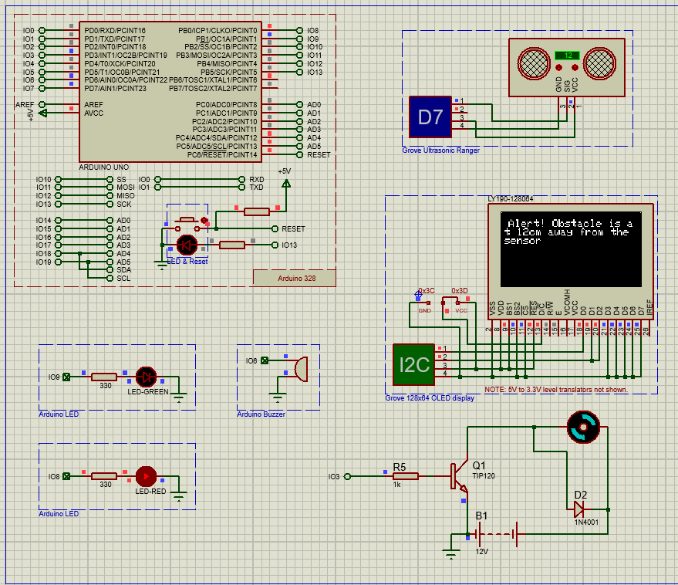
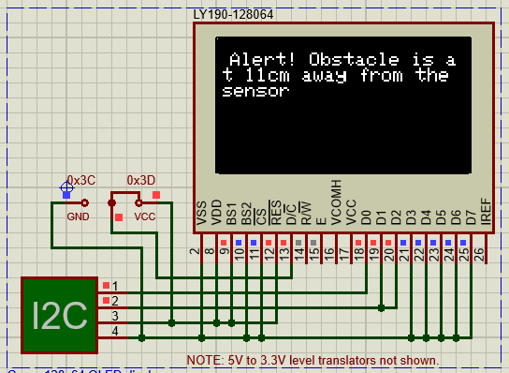
Results
Test 3:
When the distance of an obstacle is between 11 to 20 cm.

Slide 14
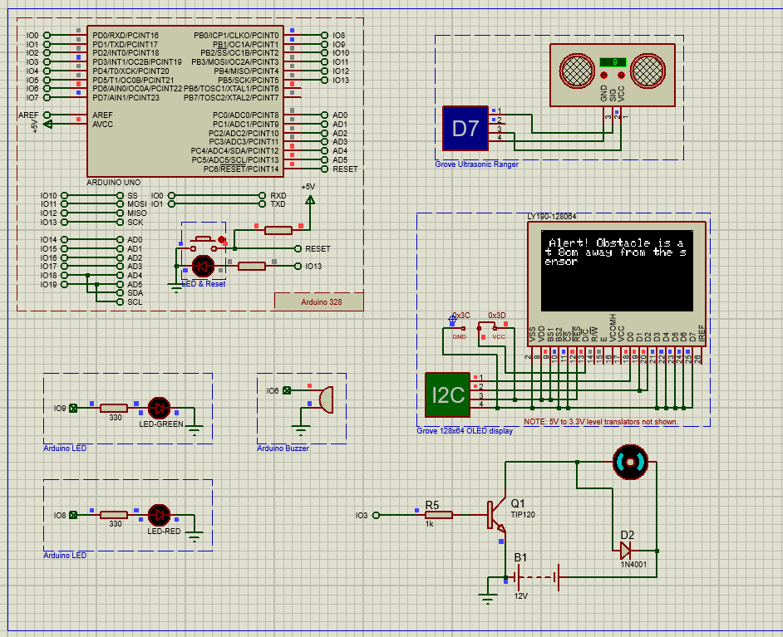
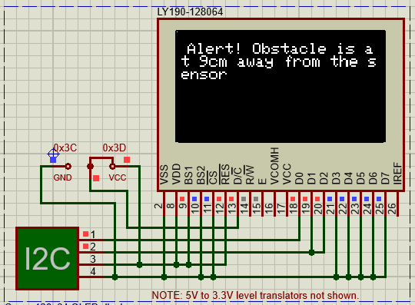
Results
Test 4:
When the distance of an obstacle is between 5 to 10 cm.

Slide 15
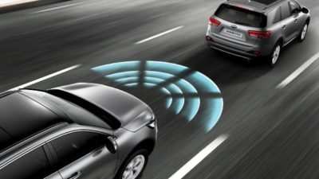
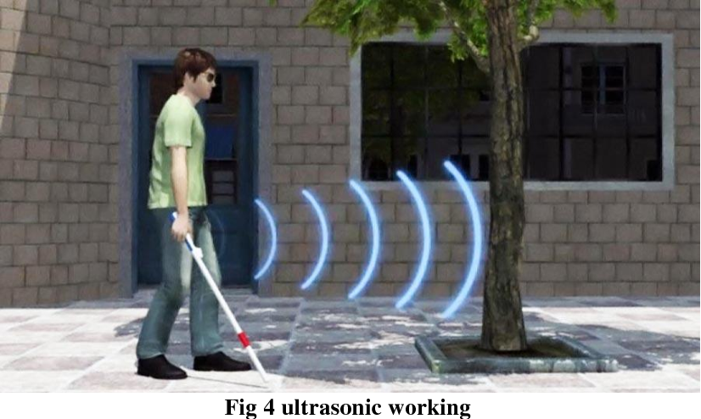
Environmental and Society Impact
Use this system in automated speed control vehicles, robots, and smart blind sticks to stop any unwanted accidents on the road.
Small robots can use this system to avoid any objects in real-time.
For blind stickers this system is a very good option as it helps the person to know from a certain distance that there is an object by giving them a buzz or an audio signal.
This is an environment friendly device which is suitable and beneficial for the betterment of humankind.

Slide 16
Project Finance
Component Name | No of item | Price/piece (tk)
Arduino Uno | 1 | 400
OLED display | 1 | 370
LED Red Breakout Board | 1 | 5
LED Green Breakout Board | 1 | 5
Buzzer | 1 | 20
DC Motor | 1 | 520
1N4001 Diode | 1 | 2
TIP120 Transistor | 1 | 16
Battery | 1 | 400
Resister | 1 | 2
Total: | 10 | 1740

Slide 17


ADVANTAGES
Enhanced life security.
Save time with automated tasks.
Easy to use
Cost efficient.

Slide 18

Limitations
Limited testing distance or limited detection range.
Unsuitable placement of any component can cause system failure.
Damage of sensor can provide faulty result which might be harmful for users.

Slide 19
Conclusion
In this project the system with Ultrasonic sensor is easy to implement with very low cost. But it has some limitations also. So with proper implementation and maintenance this system can make our life more efficient.

Slide 20
Thank You!

