Slide 1
Context-Free Languages are not closed under intersection by: Tanisha, Natasha, Ritu, Liam

Slide 2
Context
COMP 382 ON1 Assignment 2
Topic 1: Demonstrate that the set of context-free languages is not closed over the operation of intersection. Use {a^{n} b^{n} c^{n} | n ≥ 0} is not context free.
By: Liam Maarhuis 300143581, Ritu Randhawa 300204724, Tanisha Ahuja 300205289, Natasha Maundu 300202882

Slide 3
introduction
In this assignment, we demonstrate that the set of context-free languages is not closed under the operation of intersection.
We prove this by showing that the language L = {a^{n} b^{n} c^{n} | n ≥ 0} is not context-free, but can be expressed as the intersection of two context-free languages.

Slide 4
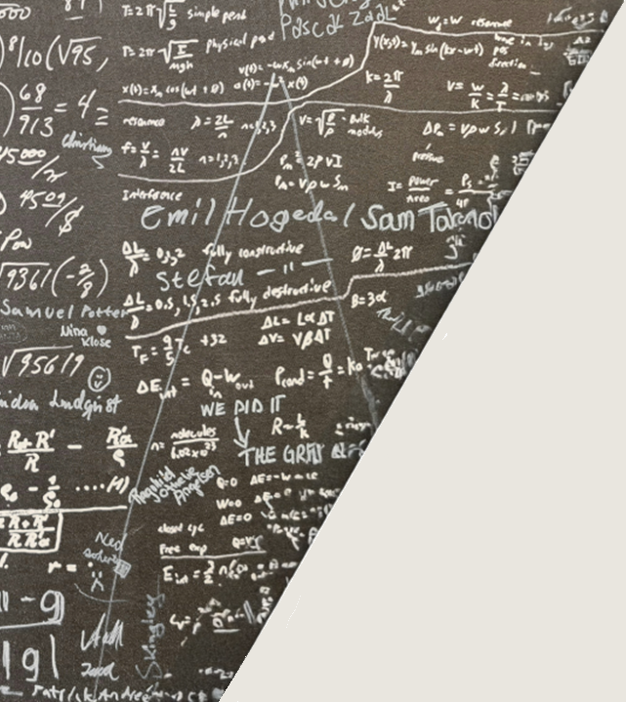
Construction of Two Context-Free Languages

Slide 5
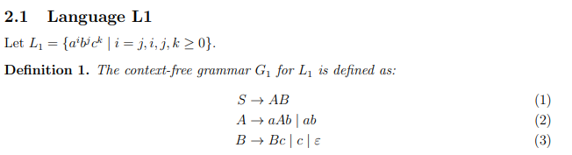
Language one
The nonterminal A generates strings of the form a^{n} b^{n} for n ≥ 1, and B generates strings of the form c^{k} for k ≥ 0.
Therefore, L₁ contains all strings where the number of a’s equals the number of b’s, followed by any number of c’s.

Slide 6
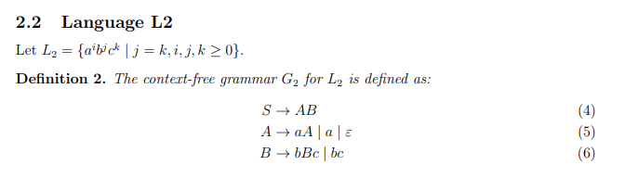
Language two
The nonterminal A generates strings of the form a^{i} for i ≥ 0, and B generates strings of the form b^{n} c^{n} for n ≥ 1.
Therefore, L₂ contains all strings with any number of a’s followed by equal numbers of b’s and c’s.

Slide 7
Intersection of L1 and L2

Slide 8
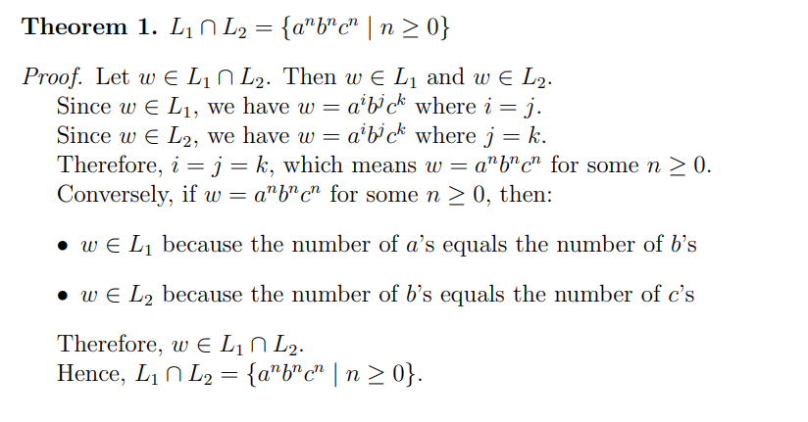
Intersection of L1 and L2

Slide 9
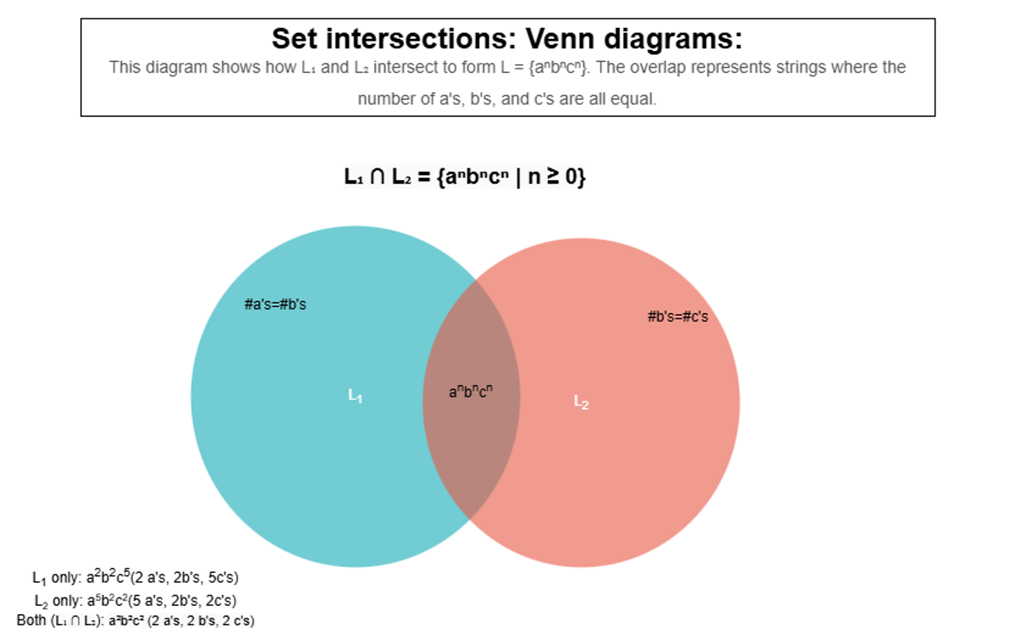

Slide 10
Proof that L is not Context-Free

Slide 11
Proof that L is not context-Free
Theorem 2. The language L = {a^{n} b^{n} c^{n} | n ≥ 0} is not context-free.
Proof. We prove this by contradiction using the pumping lemma for context-free languages.
Lemma 1 (Pumping Lemma for Context-Free Languages). If L is a context-free language, then there exists a constant p > 0 such that for any string s ∈ L with |s| ≥ p, we can write s = uvwxy where:
|vwx| ≤ p
|vx| ≥ 1
For all i ≥ 0, uv^{i}wx^{i}y ∈ L
Assume, for the sake of contradiction, that L is context-free. Let p be the pumping length guaranteed by the pumping lemma. Consider the string s = a^{p}b^{p}c^{p}. Since s ∈ L and |s| = 3p ≥ p, the pumping lemma applies.
By the pumping lemma, we can write s = uvwxy where conditions (i), (ii), and (iii) hold. We analyze all possible cases for the position of the substring vwx:

Slide 12
Market overview
Case | Proofs
1 | vwx contains only a’s. Then v = a^{k} and x = a^{m} for some k, m ≥ 0 with k + m ≥ 1. Pumping up with i = 2, we get uv²wx²y = a^{p+k+m} b^{p}c^{p} . This string has more a’s than b’s or c’s, so it is not in L.
2 | vwx contains only b’s. Then v = b^{k} and x = b^{m} for some k, m ≥ 0 with k + m ≥ 1. Pumping up with i = 2, we get uv²wx²y = a^{p}b^{p+k+m}c^{p}. This string has more b’s than a’s or c’s, so it is not in L.
3 | vwx contains only c’s. Then v = c^{k} and x = c^{m} for some k, m ≥ 0 with k + m ≥ 1. Pumping up with i = 2, we get uv²wx²y = a^{p}b^{p}c^{p+k+m}. This string has more c’s than a’s or b’s, so it is not in L.
4 | vwx spans across a’s and b’s. Since |vwx| ≤ p, the substring vwx cannot span all three types of symbols. Pumping will create an imbalance between the number of a’s and b’s on one side, and c’s on the other side, so the resulting string is not in L
5 | vwx spans across b’s and c’s. Similar to Case 4, since |vwx| ≤ p, pumping will create an imbalance between the number of b’s and c’s on one side, and a’s on the other side, so the resulting string is not in L.

Slide 13
Proof that L is not context-Free
In all cases, pumping leads to a string that is not in L, which contradicts condition (iii) of the pumping lemma.
Therefore, our assumption that L is context-free must be false. Hence, L = { a^{n}b^{n}c^{n} | n ≥ 0 } is not context-free.

Slide 14
Conclusion

Slide 15
Conclusion
We have successfully demonstrated that:
We constructed two context-free languages L₁ and L₂.
We showed that L₁ ∩ L₂ = { a^{n}b^{n}c^{n} | n ≥ 0 }.
We proved that {a^{n}b^{n}c^{n} | n ≥ 0} is not context-free using the pumping lemma. Therefore, the set of context-free languages is not closed under the operation of intersection.

Slide 16
Code demo

Slide 17
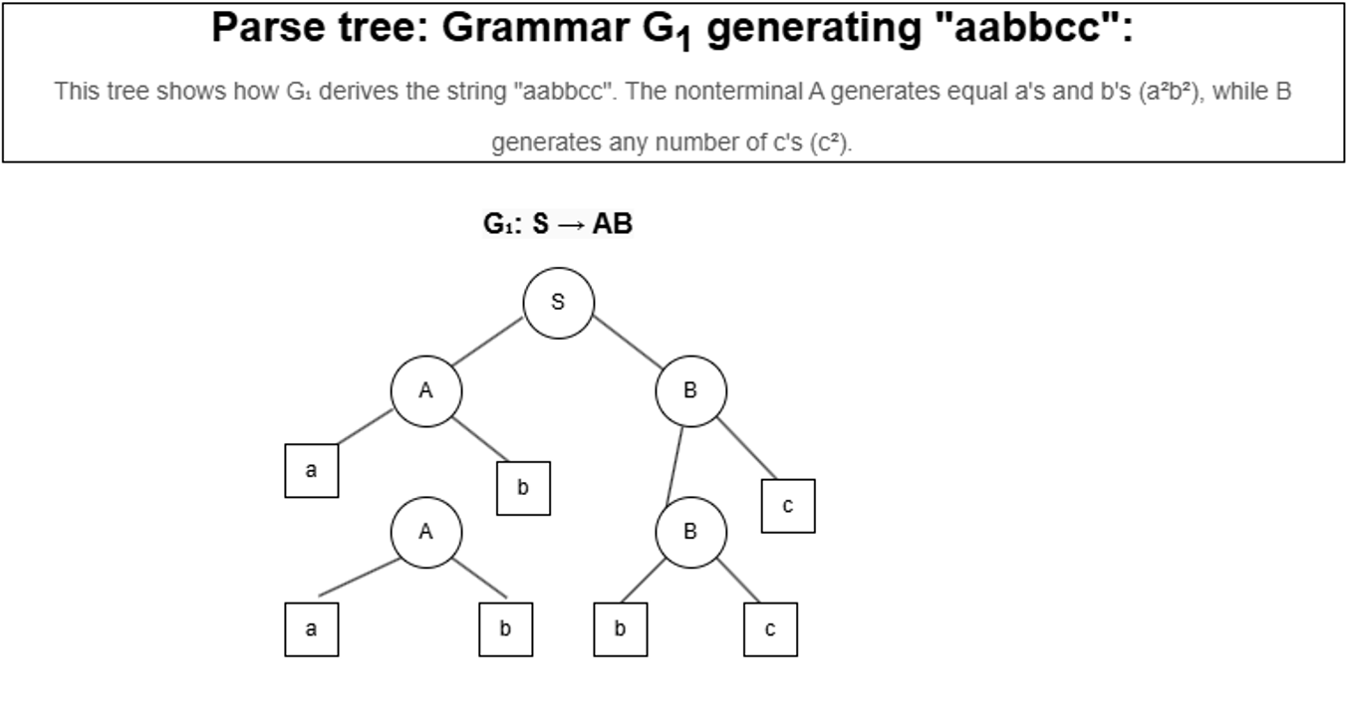

Slide 18
References
Hopcroft, J. E., Motwani, R., & Ullman, J. D. (2006). Introduction to Automata Theory, Languages, and Computation (3rd ed.). Addison-Wesley.
Sipser, M. (2012). Introduction to the Theory of Computation (3rd ed.). Cengage Learning.
GitHub - TANISHAAHUJA/comp-382assignment2
Git

Slide 19

Thank you

