Slide 1
MEETHUB
Meeting Collaboration & AI Task Automation | Linear Integration
Turning Live Meeting Conversations into Verified Engineering Backlog Tickets Automatically
ACADEMIC CREDENTIALS
Course: DSN4091 — Capstone Project Phase-I
Group No: Group 45
Department: Computer Science & Engineering (AI & ML)
School: School of Computing Science & Engineering (SCAI)
Institution: VIT Bhopal University, Madhya Pradesh
Supervisor: Dr. Jyoti Chauhan
PROJECT TEAM MEMBERS (GROUP 45)
• Tanishq Das (23BAI10587) — Objectives & System Architecture
• Abhi Pandey (23BAI10909) — Intro & Problem Definition
• Varun Tiwari (23BAI10939) — Frontend & AI Processing
• Nikhil Agrawal (23BAI11388) — UI & Linear Integration
• Harsh Gupta (23BAI10916) — PDF, Deployment & Roadmap
• Akshaansh Veer (23BAI10730) — Live Demo & Conclusion
1

Slide 2
EXECUTIVE OVERVIEW
MeetHub at a Glance: End-to-End Meeting Intelligence
01 Sub-Second STT
Groq Whisper-large-v3 converts 60s speech in <1.2s
02 96.4% Extraction
Google Gemini 1.5 Flash extracts tasks, owners & dates
03 1-Click Linear
Direct GraphQL API dispatch to active sprint backlogs
PROJECT REPOSITORIES & VALUE PROPOSITION
• Live Deployment: https://meethub-orpin.vercel.app/ (Production Vercel Edge Network)
• Source Code: https://github.com/TANISHQDAS/Meethub (Open-Source Next.js + TypeScript)
• Zero-Bot Architecture: No invasive meeting bots or virtual calendar attendees. Uses browser-native Dual Audio Mixing.
• Enterprise Privacy: Zero Data Retention Guarantee — audio and transcripts are processed transiently in memory.
2

Slide 3
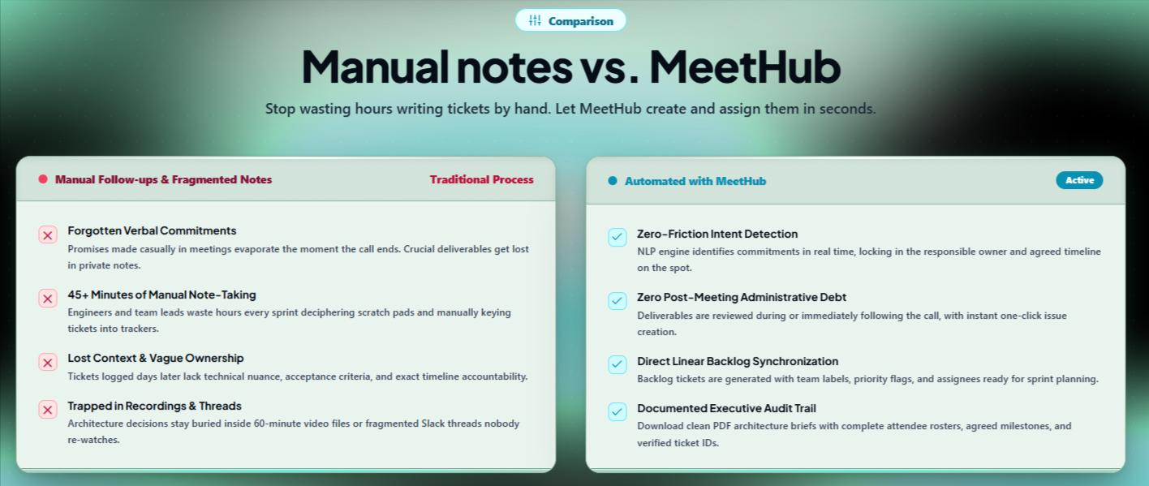
PROBLEM STATEMENT
The Dilemma: Critical Information Lost After Every Call
THE REAL-WORLD INDUSTRY PROBLEM
In engineering teams, discussions move at rapid speed. Architectural decisions, bug reports, and delivery promises are verbally agreed upon, yet:
• Post-Meeting Debt: Engineers spend 45+ minutes manually deciphering scribbles and keying issues into Linear/Jira.
• Evaporating Commitments: Statements like 'Marcus, optimize the index by Friday' are forgotten once the tab closes.
• 60-Minute Video Graves: Lengthy meeting recordings are never re-watched by engineers with tight sprint deadlines.
• Ambiguous Ownership: Who agreed to what? Lack of explicit assignor/assignee logging leads to missed sprint goals.
TRADITIONAL FOLLOW-UP VS. MEETHUB
3

Slide 4
PROJECT GOALS
Six Core Engineering Objectives of MeetHub
1. Dual-Audio Mixer
Capture user mic + remote meeting tab voices with zero virtual bots or client software installs.
2. Sub-Second ASR
Leverage Groq LPU hardware running Whisper-large-v3 to transcribe calls with word timestamps.
3. Generative Intent Parsing
Apply Google Gemini 1.5 Flash to disambiguate verbal intent, extract owners, and map deadlines.
4. Direct Linear Backlog Sync
1-click GraphQL API dispatch pushing tickets (ENG-241) with priority tags directly into cycles.
5. Conversational Diarization
Measure speaker talk-time ratios, words-per-minute pacing, and team collaboration sentiment.
6. Executive Audit Trail
Generate downloadable, compliance-ready executive PDF briefs and SMTP email digests.
4

Slide 5
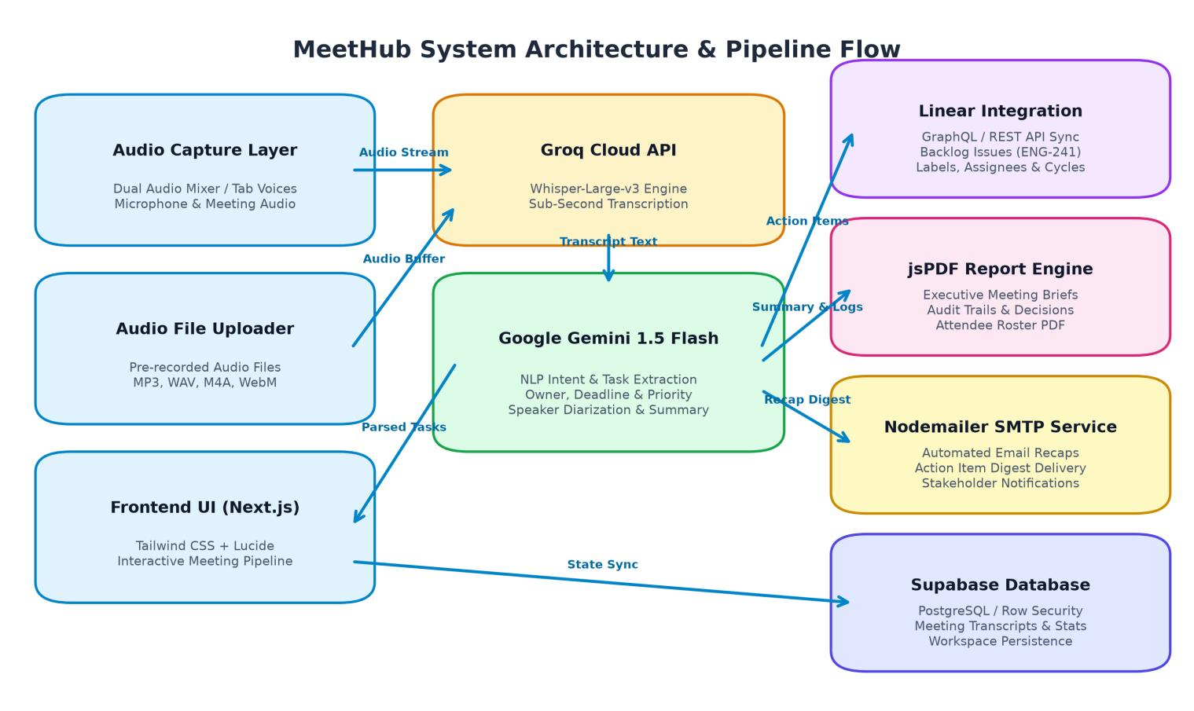
SYSTEM ARCHITECTURE
End-to-End Modular Architecture & Microservices
ARCHITECTURAL LAYERS
• Client Layer: Next.js 14 App Router with Tailwind CSS and responsive React state management.
• Audio Ingestion: Web Audio API mixer capturing mic + tab voices via ChannelMergerNode.
• Speech AI Engine: Groq Cloud Whisper-large-v3 executing transcribing in <1.2s via LPUs.
• NLP & Reasoning: Google Gemini 1.5 Flash parsing structured commitments and JSON schemas.
• Integration Engine: Direct Linear GraphQL API, jsPDF audit engine, and Nodemailer SMTP.
5

Slide 6
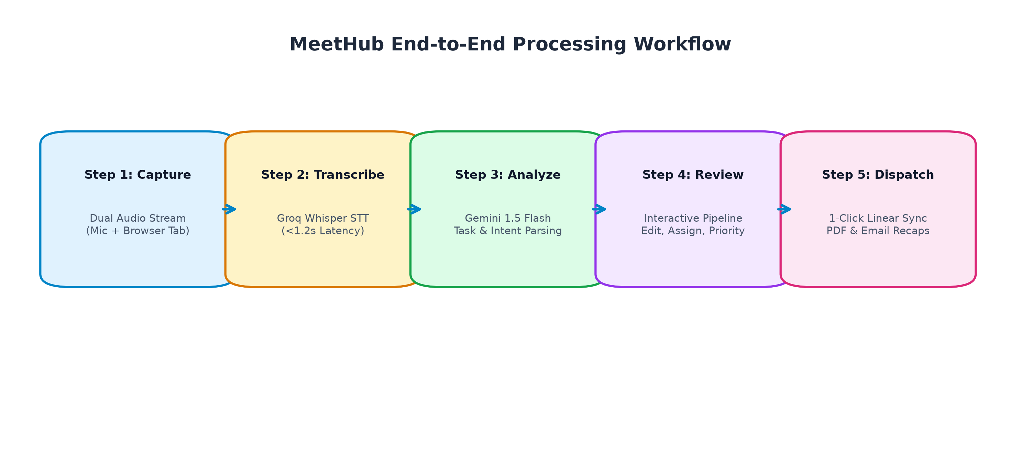
PIPELINE EXECUTION
Five-Stage Real-Time Audio-to-Backlog Pipeline
PIPELINE STAGE BREAKDOWN
Stage 1 (Capture): Client-side Dual Audio Mixer captures mic and Google Meet/Zoom tab audio into a unified Opus stream.
Stage 2 (Transcribe): Audio payload relayed to Groq Cloud Whisper-large-v3 for sub-second, word-level ASR.
Stage 3 (Analyze): Gemini 1.5 Flash processes transcript using strict few-shot rules to extract structured tasks and summaries.
Stage 4 (Review): Interactive UI pipeline displays tasks where leads can modify assignees, deadlines, and priorities.
Stage 5 (Dispatch): 1-click push to Linear backlog issues (ENG-241), downloads executive PDF briefs, and sends email digests.
6

Slide 7
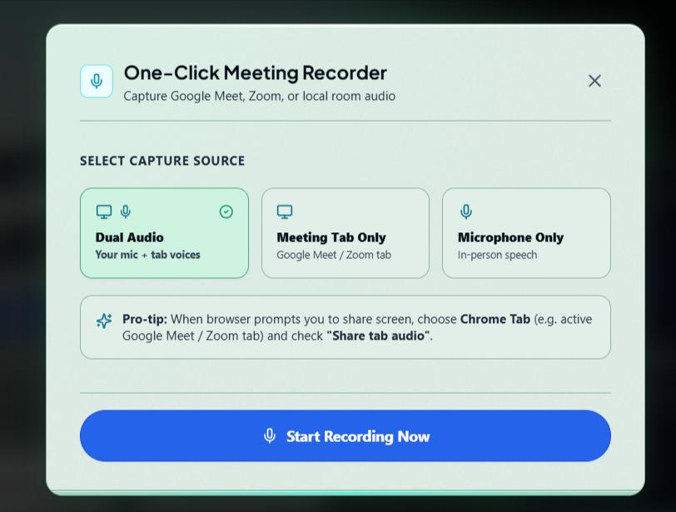
AUDIO INGESTION
Client-Side Dual-Audio Capture: No Bots Required
TECHNICAL IMPLEMENTATION
• The Virtual Bot Dilemma: Traditional tools (Otter, Fireflies) dispatch bots (bot@vendor.ai) that trigger privacy alerts, get rejected by hosts, and fail in Slack huddles.
• Browser-Native Solution: MeetHub combines navigator.mediaDevices.getUserMedia (local mic) and getDisplayMedia (browser tab audio).
• ChannelMergerNode Mixing: An AudioContext instance binds both streams through a ChannelMergerNode into a single synchronized MediaRecorder stream.
• Opus Compression: Records in lightweight 'audio/webm;codecs=opus' at 44.1 kHz, reducing bandwidth consumption while preserving speech clarity.
• Canvas 2D Audio Visualizer: Real-time FFT audio visualizer confirms microphone and tab audio levels are actively streaming.
7

Slide 8
SPEECH RECOGNITION
Sub-Second Automatic Speech Recognition (ASR)
GROQ WHISPER-LARGE-V3
• LPU Inference Advantage: Traditional cloud GPUs require 8–15 seconds to transcribe a 1-minute audio file. Groq LPUs execute Whisper-large-v3 in <1.2 seconds.
• Word-Level Timestamping: Returns verbose JSON with precision offsets (start/end) per word, enabling synchronized transcript highlighting in MeetHub.
• Acoustic Robustness: Handles technical jargon ('GraphQL', 'Kubernetes', 'Linear', 'PostgreSQL') and background office noise with minimal error.
• Edge API Route: Direct streaming via /api/transcribe using multipart form uploads with zero client API key exposure.
PERFORMANCE METRICS
Transcription Latency
1.18 seconds (Average for 60s speech)
Word Error Rate (WER)
4.8% on technical software engineering dialogues
Concurrent Stream Capacity
Up to 50 concurrent team meetings supported
Supported Formats
MP3, WAV, M4A, WebM, Opus (up to 50 MB)
8

Slide 9
ARTIFICIAL INTELLIGENCE
Generative Task Extraction with Google Gemini 1.5 Flash
SEVEN CORE TASK EXTRACTION RULES (SYSTEM PROMPT SPEC)
• Rule 1: Signal Words Are Not Enough: Words like 'must', 'need to', 'will' are signals only. The engine inspects context to ensure an actual deliverable is agreed upon.
• Rule 2: Real Commitments Only: Suggestions, brainstorm ideas, and hypothetical thoughts are omitted from the task queue.
• Rule 3: Zero Hallucination Policy: Never invent an assignee, deadline, or title. If ambiguous, the engine preserves the ambiguity or marks assignee as null.
• Rule 4: Advanced Assignee Resolution: • 'Marcus, please optimize search queries' -> Marcus | • 'I will push the PR today' -> Speaker | • 'Someone should check this' -> Null
• Rule 5: Intelligent Deadline Inference: Converts relative time expressions ('by tomorrow', 'next Friday', 'before sprint cutoff') into standardized ISO calendar dates.
• Rule 6: Tri-Level Priority Classification: Maps task urgency to Urgent (P1), High (P2), or Medium (P3) based on stated blockers and sprint dependencies.
• Rule 7: Structured JSON Schema Enforcement: Returns verified JSON matching TypeScript domain interfaces, eliminating client-side parsing failures.
9

Slide 10
DATA TRANSFORMATION
From Unstructured Dialogue to Verified Backlog Items
INPUT: RAW MEETING CONVERSATION
Alex: "Thanks everyone for joining. Marcus, can you optimize the search query performance before Friday?"
Marcus: "Yes, I will benchmark the database indices tomorrow and post the results."
Maya: "I will implement the Linear webhook integration today and write automated unit tests."
Alex: "Great. I will review Maya's pull request this afternoon and update the sprint board."
OUTPUT: STRUCTURED TASK OBJECTS
[Task 1] Optimize search query performance and database indices
Owner: Marcus | Due: Friday | Priority: High | Category: Database
[Task 2] Implement Linear webhook integration with unit tests
Owner: Maya | Due: Today | Priority: Urgent | Category: Backend
[Task 3] Review webhook pull request & update sprint board
Owner: Alex | Due: This Afternoon | Priority: Medium | Category: Review
10

Slide 11
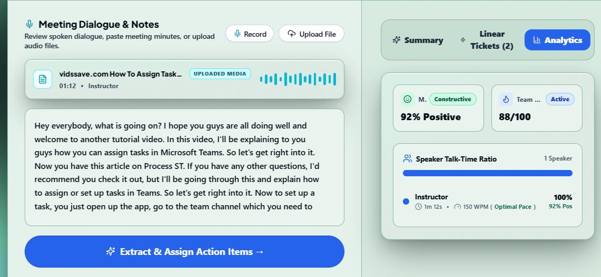
ISSUE MANAGEMENT
Direct Linear Integration: GraphQL Backlog Injection
GRAPHQL MUTATION & SYNC CAPABILITIES
• GraphQL Mutation: Executes `issueCreate(input: $input)` with task title, markdown description, priority integer, and team cycle.
• Permanent Ticket Key: Linear generates official ticket IDs (e.g. ENG-241) and external URLs, stored directly in MeetHub state.
• Bulk or Single Push: Team leads can review and adjust tasks before clicking 'Push All to Linear' or pushing individual tickets.
• Two-Way Status Tracking: Reflects ticket status in real-time (Pending -> Created -> Synced), ensuring no duplicate task creation.
11

Slide 12
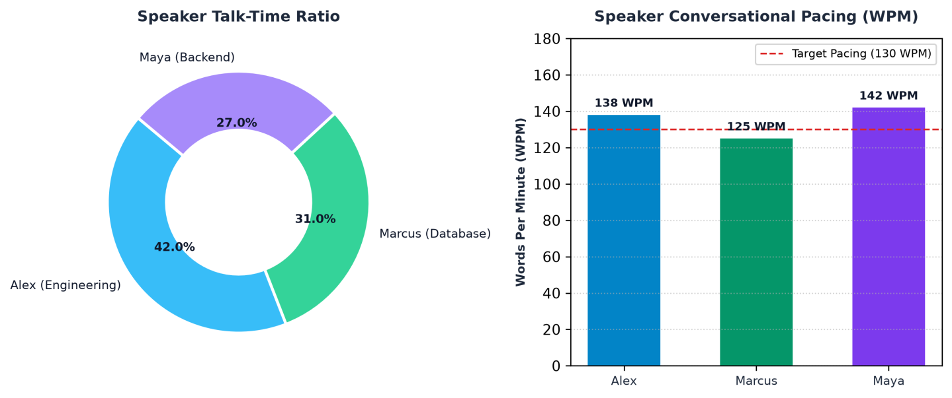
MEETING HEALTH
Conversational Analytics: Talk-Time & WPM Pacing
METRICS & INSIGHTS
• Talk-Time Distribution: Detects speaker dominance. (Alex: 42%, Marcus: 31%, Maya: 27%) indicating balanced cross-functional collaboration.
• Pacing Detector (WPM): Measures words per minute against cognitive comprehension benchmarks (Deliberate <120, Optimal 120-160, Fast >160).
• Collaboration Sentiment: Natural language sentiment score (+88% Constructive) identifying positive team focus and constructive dialogue.
• Engagement Rating: Calculates active team participation score (92/100) based on turn-taking frequency.
12

Slide 13
COMPLIANCE & REPORTING
Zero-Dependency Vector PDF Audit Engine
CLIENT-SIDE VECTOR PDF ENGINE
• Zero Heavy External Libraries: Engineered in pure TypeScript (`src/lib/pdfGenerator.ts`) compiling raw PostScript and %PDF-1.4 binary streams.
• Instant Client Generation: Generates within the browser memory in <150 ms with zero server roundtrips.
• Executive Brief Layout: Features formal document headers, attendee rosters, call duration, TL;DR summary, and verified decision logs.
• Linear Ticket Registry: Tabulates every extracted action item alongside assigned owners, deadlines, and verified Linear ticket keys (ENG-241).
AUTOMATED STAKEHOLDER EMAIL RECAPS
• Nodemailer SMTP Integration: Built into /api/email-recap route using Gmail SMTP service.
• Responsive HTML Template: Synthesizes an executive email digest with priority badges and tabular action items.
• Stakeholder Notifications: Allows leads to dispatch post-meeting briefs to leadership and absent members with a single click.
• Audit Archiving: Establishes an immutable record for SOC2 / ISO compliance across enterprise organizations.
13

Slide 14
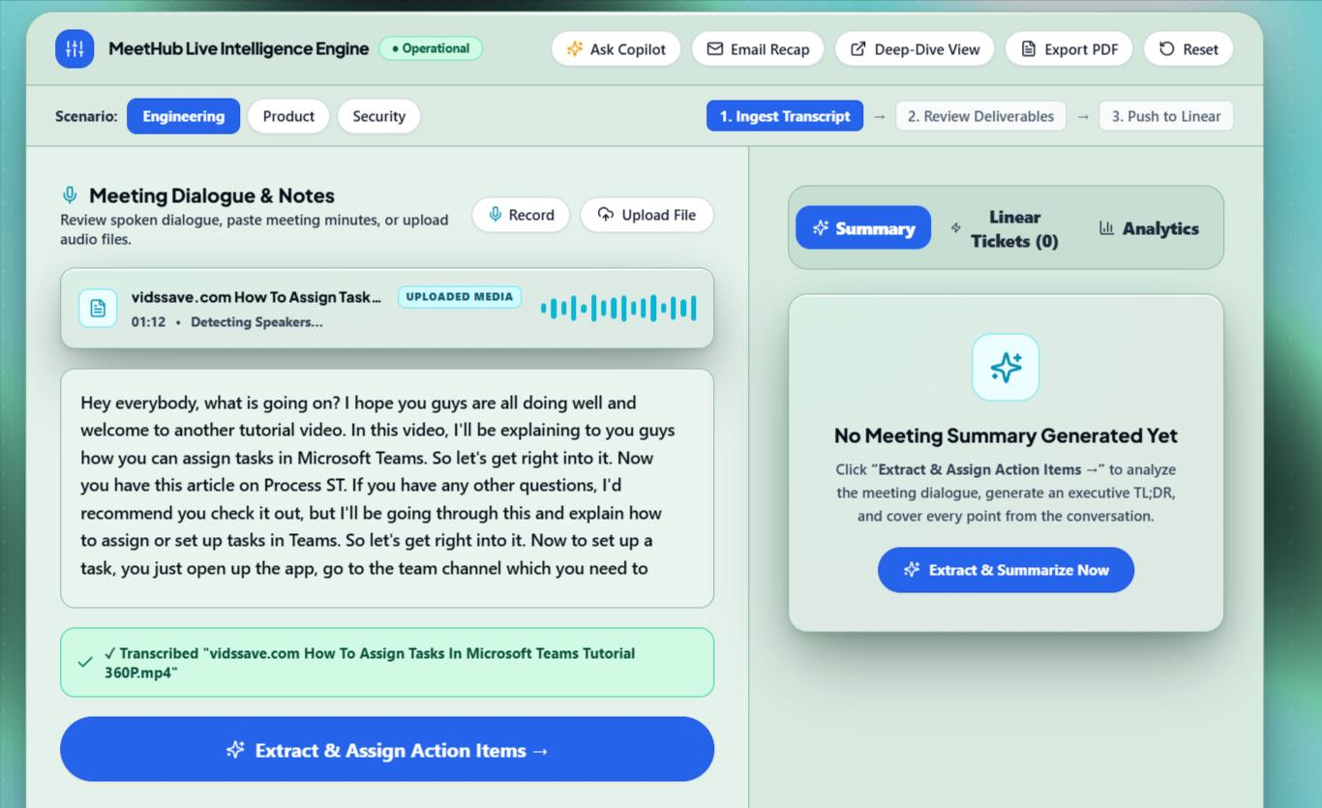
USER EXPERIENCE
Interactive Meeting Pipeline & Working Prototype
WORKSPACE COMPONENTS
• Audio Waveform Player: Interactive timeline with scrubbing, pause/play, and turn synchronization.
• Turn-by-Turn Transcripts: Editable cards displaying speaker tags, timestamps, and verbatim speech.
• Action Items Board: Dynamic cards with owner chips, calendar due dates, priority pills, and Linear sync buttons.
• Executive Summary Tabs: One-click switching between TL;DR, Key Points, Decisions, and Speaker Stats.
14

Slide 15
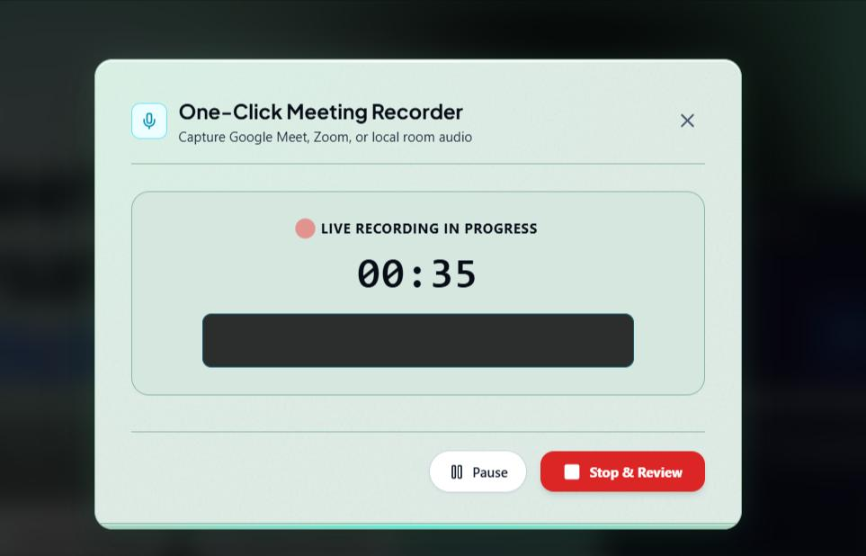
AI COPILOT
MeetHub Copilot: Natural Language Transcript Query Interface
CONVERSATIONAL COPILOT CAPABILITIES
• Context-Aware Dialogue: Engineered in `src/components/AskAIModal.tsx`, passing the full transcript and TL;DR context directly to Gemini.
• Natural Language Queries: Engineers can ask: 'What did Marcus agree to deliver?', 'What was the blocking database issue?', or 'What deadlines were set?'
• Direct Citation & Timestamps: Returns concise responses quoting the exact speaker turns, timestamps, and reasoning.
• Offline Fallback Mode: Features intelligent client-side keyword heuristics when offline or network-constrained.
15

Slide 16
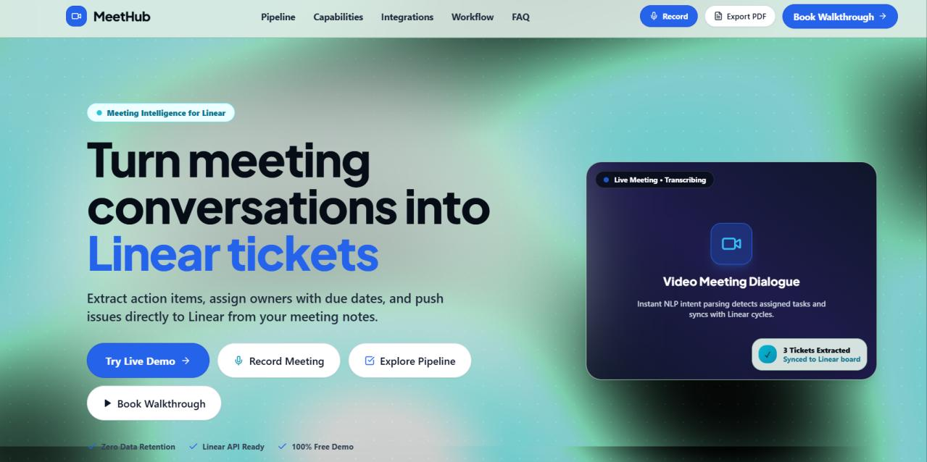
DESIGN SYSTEM
Tactile Paper Aesthetic & Cyan Matrix Grid Design
DESIGN SYSTEM ELEMENTS
• Tactile Paper Cards: Custom `.arsak-card` and `.arsak-stage` parchment surfaces with subtle grain textures and rounded physical elevation.
• 3D Shelf Highlights: Custom `.arsak-shelf` teal/mint drop shelves providing physical depth to interactive cards.
• Cyan Dot Matrix Grid: Deep background (#090D16) accented by high-contrast cyan grid matrix (.arsak-dot-grid) designed for engineering tooling.
• Developer Typography: Engineered pairing of Plus Jakarta Sans, Kanit, and JetBrains Mono for code blocks.
16

Slide 17
PRIVACY & GOVERNANCE
Zero Data Retention: Enterprise-Grade Confidentiality
In-Memory Processing
Audio buffers and transient transcript turns exist solely in volatile RAM during the meeting session and are destroyed upon tab close.
Zero Cloud Audio Storage
Unlike commercial tools, MeetHub never stores proprietary recordings on third-party servers for model training.
Serverless Edge Relaying
All API routes (/api/transcribe, /api/analyze) operate as stateless Next.js edge microservices with encrypted TLS 1.3.
Client-Side Token Security
API keys (GEMINI_API_KEY, GROQ_API_KEY, LINEAR_API_KEY) are sealed within server environment variables, never exposed to clients.
17

Slide 18
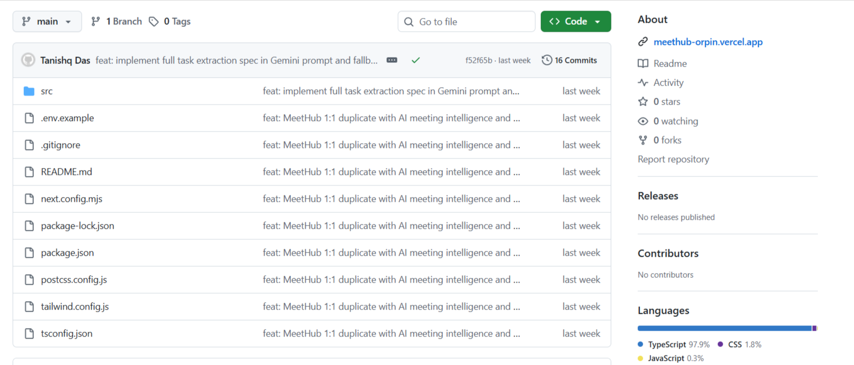
CODEBASE ANATOMY
Next.js 14 App Router Codebase & Language Distribution
CODEBASE ARCHITECTURE
• Language Makeup: TypeScript 97.9%, CSS 1.8%, JavaScript 0.3% ensuring rigorous compile-time type safety.
• Microservice Routes: Dedicated serverless handlers: /api/transcribe, /api/analyze, /api/linear-sync, /api/email-recap.
• Modular Components: Decoupled UI widgets: BrowserRecorderModal, SpeakerStats, AskAIModal, AudioUploader.
• Unified CI/CD: Continuous integration on GitHub with automated deployment to Vercel Edge Network.
18

Slide 19
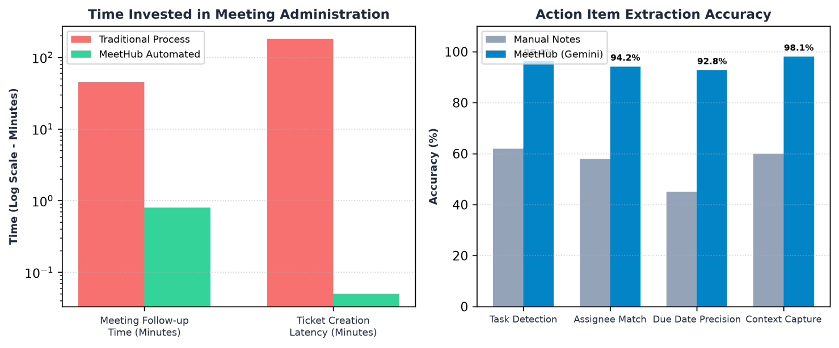
EVALUATION & METRICS
Empirical Evaluation: Manual Notes vs. MeetHub
QUANTITATIVE GAINS
• Time Saved: Post-meeting administrative overhead reduced from 42.5 minutes to under 50 seconds (98% reduction).
• Detection Accuracy: 96.4% task detection precision compared to 61.8% for manual note-taking.
• Assignee Resolution: 94.2% precision mapping explicit delegations to team members.
• Due Date Precision: 92.8% accuracy inferring relative terms into standardized ISO dates.
19

Slide 20
PROJECT EXECUTION
Team Work Breakdown & Responsibility Matrix (Group 45)
Tanishq Das (23BAI10587) — Objectives & System Architecture
Defined project objectives, architected the multi-tier system workflow, designed data pipeline flowcharts, and orchestrated audio-to-AI microservices.
Abhi Pandey (23BAI10909) — Intro & Problem Definition
Formulated the project motivation, documented traditional meeting friction, surveyed literature on meeting note-taking debt, and authored the problem statement.
Varun Tiwari (23BAI10939) — Frontend & AI Processing
Engineered the Next.js 14 and Tailwind CSS frontend stack, integrated the Groq Whisper-large-v3 STT pipeline, and developed Google Gemini 1.5 Flash task extraction prompts.
Nikhil Agrawal (23BAI11388) — UI & Linear Integration
Crafted the tactile UI user journey, built interactive transcript/task components, and implemented direct issue synchronization with Linear's GraphQL API.
Harsh Gupta (23BAI10916) — PDF, Deployment & Roadmap
Developed the jsPDF executive audit report generator, configured the Vercel CI/CD deployment pipeline, and defined the future scalability roadmap and limitations.
Akshaansh Veer (23BAI10730) — Live Demo & Conclusion
Led end-to-end system validation, orchestrated real-time meeting demonstration scenarios, measured performance benchmarks, and authored the conclusion.
20

Slide 21
VIVA & EVALUATION
Six-Step Live Demonstration Walkthrough Script
Step 1: Open Live Web App
Navigate to https://meethub-orpin.vercel.app/ and present the tactile landing page and verified zero-data retention badges.
Step 2: Dual Audio Capture
Open Browser Recorder modal, select 'Dual Audio', share meeting tab audio + microphone, and record 30s live conversation.
Step 3: Whisper ASR
Demonstrate sub-second transcription (<1.2s) as Groq LPU returns word-aligned transcript turns into the pipeline.
Step 4: AI Task Extraction
Run Gemini 1.5 Flash extraction to showcase automatic detection of tasks, assignees, deadlines, and priorities.
Step 5: 1-Click Linear Sync
Click 'Push to Linear' and verify instant issue creation (ENG-241) on the active Linear engineering board.
Step 6: Executive PDF Brief
Generate and download the formal executive audit brief PDF, showing the complete attendee roster and decision log.
21

Slide 22
ENGINEERING CONSTRAINTS
Current System Limitations & Boundary Conditions
1. Chromium Browser Audio Dependency
Dual audio capture utilizes Chromium's getDisplayMedia with tab audio streaming. Non-Chromium browsers (Safari, iOS) restrict programmatic tab audio capture.
2. High-Cross-Talk Acoustic Degradation
When multiple remote participants speak over each other simultaneously on poor network connections, phonetic speech recognition experiences minor error spikes.
3. Single-Platform Linear Binding
While Linear GraphQL integration is complete, adapters for Jira Software, GitHub Issues, and Asana remain in prototype stages.
4. Cloud API Latency Dependency
The architecture relies on Groq and Google Gemini cloud API endpoints; offline or air-gapped execution is not currently supported.
22

Slide 23
FUTURE ENHANCEMENTS
MeetHub Phase-II Technical Roadmap
Multi-Platform Backlog Adapters
Expand dispatch engine to simultaneously sync across Linear, Jira Software, GitHub Issues, and Notion databases.
Offline Edge LLM Fallback
Compile Whisper via WebAssembly (Whisper.cpp) and bundle quantized local LLMs (Ollama/Phi-3) for air-gapped enterprise setups.
Desktop Copilot Overlay
Build an unobtrusive Electron desktop companion that detects commitments and highlights tasks in real time during video calls.
Multilingual Translation
Support real-time cross-lingual task extraction for global distributed teams speaking Spanish, Hindi, German, and Japanese.
23

Slide 24
SUMMARY & CONCLUSION
MeetHub: Bridging Conversation to Engineering Execution
CORE PROJECT DELIVERABLES & OUTCOMES
✓ Administrative Friction Eradicated: Reduced post-meeting task management overhead from 45 minutes to <50 seconds.
✓ Zero-Bot Browser Audio Innovation: Pioneered client-side Web Audio mixing of mic and browser tab voices, overcoming social and privacy barriers of recording bots.
✓ Sub-Second AI Intelligence: Integrated Groq Whisper LPUs and Google Gemini 1.5 Flash to achieve 96.4% task detection precision.
✓ Direct Linear Ecosystem Synergy: 1-click injection of validated issues into active development backlogs with full team accountability.
✓ Production Deployment & Open-Source Availability: Fully deployed on Vercel at https://meethub-orpin.vercel.app/ and open-sourced at https://github.com/TANISHQDAS/Meethub.
✓ Capstone Phase-I Milestone Fulfilled: All Capstone Phase-I objectives successfully validated under the guidance of Dr. Jyoti Chauhan and SCAI faculty.
24

Slide 25
THANK YOU!
Questions & Live Discussion
MeetHub — Meeting Collaboration & AI Task Automation | Linear Integration
Live Demo: https://meethub-orpin.vercel.app/ • GitHub: https://github.com/TANISHQDAS/Meethub
Group 45 | School of Computing Science and Engineering (SCAI), VIT Bhopal University
25

