Slide 1



OPTIMIZING HOSPITALITY: DATA-DRIVEN INSIGHTS INTO INDIA'S HOTEL ECONOMY
by Tanmay Kadwe

Slide 2

EXECUTIVE SUMMARY
This project focuses on:
Analyzing hotel price patterns across Tier-1 cities
Understanding customer rating behavior
Evaluating the relationship between price and customer satisfaction
Identifying top-performing hotels within each city
Delivering actionable insights through Power BI dashboards

Slide 3
BUSINESS OBJECTIVES
Key Business Questions:
How are hotel prices distributed within and across cities?
Do higher-priced hotels consistently receive higher ratings?
Which cities offer better value-for-money hotels?
Which hotels perform best in terms of ratings and reviews?
Goal:
Enable data-driven decision-making for travelers, hotel owners, and travel platforms.

Slide 4
DATA OVERVIEW
Data Source:
Hotel data collected using a Chrome web scraping extension
Dataset Details:
8 Tier-1 cities
~150 hotels per city
Combined into a single consolidated dataset
Key Columns:
Hotel Name
City
Price
Rating
Number of Reviews

Slide 5
METHODOLOGY
End-to-End Analytics Approach:
Data collection (city-wise scraping)
Data cleaning & preprocessing (Excel + Python)
Exploratory Data Analysis (Python)
Feature validation & data type corrections
Interactive dashboard development (Power BI)

Slide 6
DATA CLEANING & PREPROCESSING
Key Steps Performed:
Removed duplicate hotel records
Handled missing and inconsistent values
Standardized price, rating, and review data types
Ensured consistent city naming
Validated numeric ranges for accuracy

Slide 7
EXPLORATORY DATA ANALYSIS (EDA)
EDA Conducted Using Python:
Price distribution analysis
Rating distribution analysis
Price vs Rating relationship
City-wise comparison of hotel metrics
Purpose:
Use EDA insights to design meaningful dashboard visuals.

Slide 8
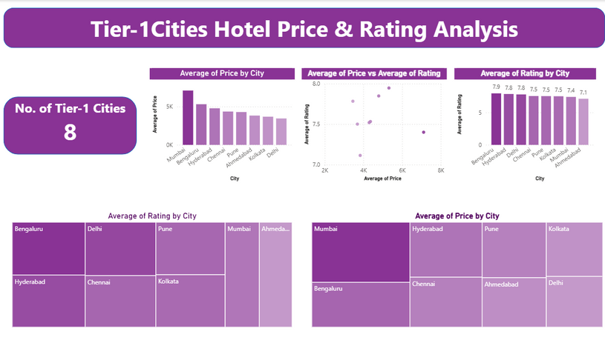
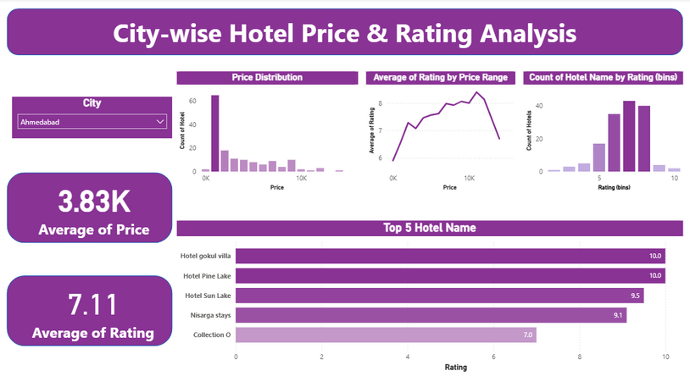
DASHBOARDS DEVELOPED
Dashboard 1: Cross-City Comparison
Average price by city
Average rating by city
Price vs Rating relationship
City-level KPI comparison
Dashboard 2: City-Level Analysis
Price distribution (Histogram)
Rating composition (%)
Price vs Rating scatter plot
Top 5 hotels of selected city

Slide 9
KEY INSIGHTS
Higher price does not consistently lead to higher ratings
Ratings are concentrated between 7–8 across cities
Mid-priced hotels often outperform premium hotels
Review volume improves rating reliability

Slide 10
BUSINESS RECOMMENDATIONS
For Hotel Owners:
Align pricing with customer-perceived value
Improve service quality to justify premium pricing
Encourage customer reviews to build trust
For Travel Platforms:
Highlight value-for-money hotels
Improve filtering based on price and rating combinations
For Travelers:
Focus on ratings and reviews rather than price alone

Slide 11
LIMITATIONS
Dataset represents a sample of hotels, not the entire city market
Prices may vary based on season and availability
Ratings are subjective and influenced by review volume

Slide 12
CONCLUSION
Delivered a complete hotel analytics solution
Combined web scraping, Python-based EDA, and Power BI dashboards
Identified pricing inefficiencies and value-for-money insights
Provided actionable recommendations for multiple stakeholders

Slide 13
THANK
YOU
Any Questions?

