Slide 1












ANDROID DEVELOPMENT-MEETUP APP
BY TANMOY MAZUMDAR

Slide 2
Here there would the meet Up icon

Slide 3
INTRODUCTION TO MAIN PROJECT
Meet Up is an app which connects you with other people al over the world having common interests
It is a fast ,secure and reable and free to use.

Slide 4
TOOLS AND TECHNOLOGIES USED
Android Studio
JAVA Language as a backend language
XML for front end
Firebase Storage and real-time database.
Firebase Authentication and Firebase cloud messaging.

Slide 5
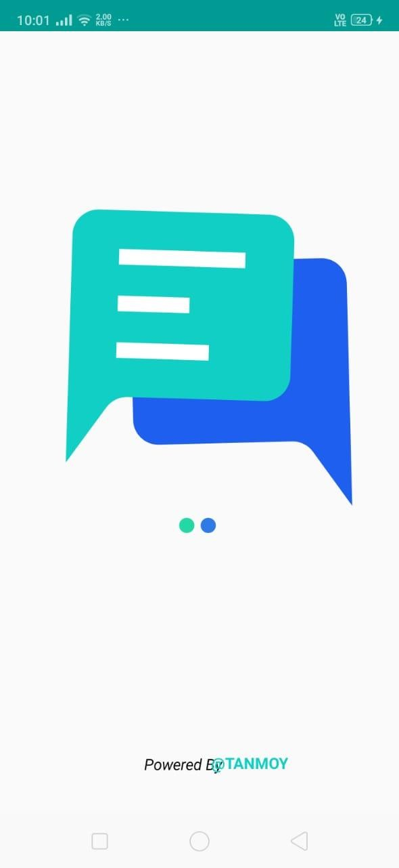
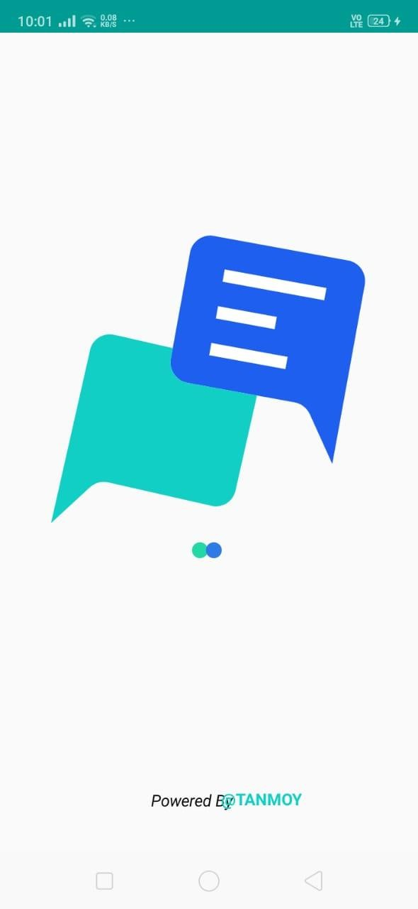
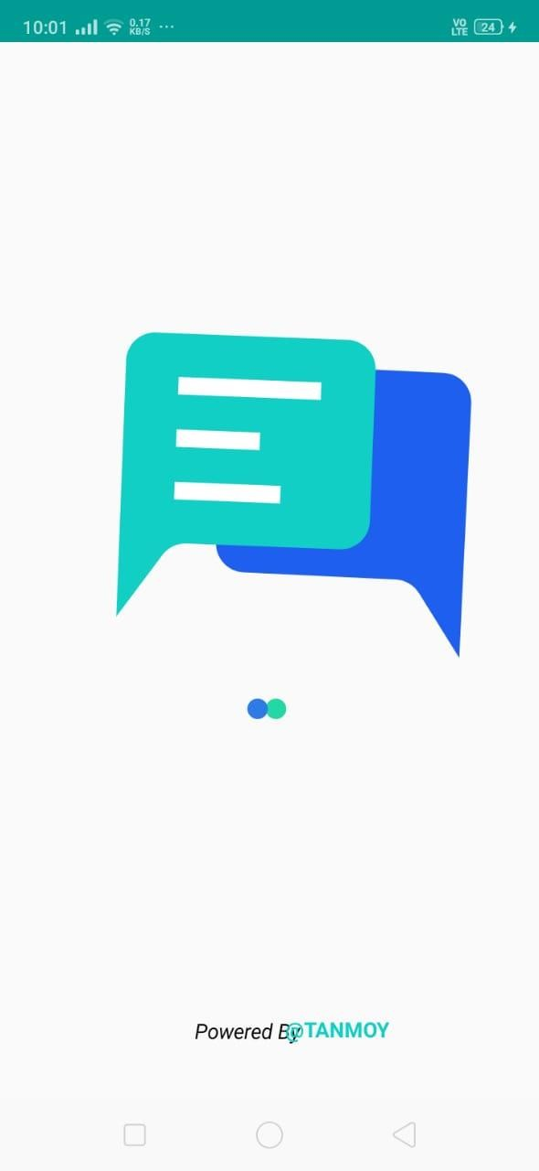
FLOW OF MEET UP APP
ANIMATED SPLASHSCREEN

Slide 6
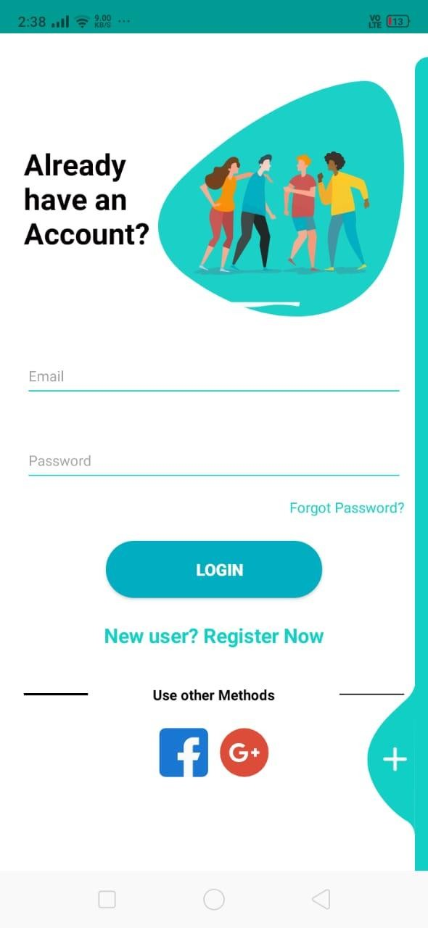
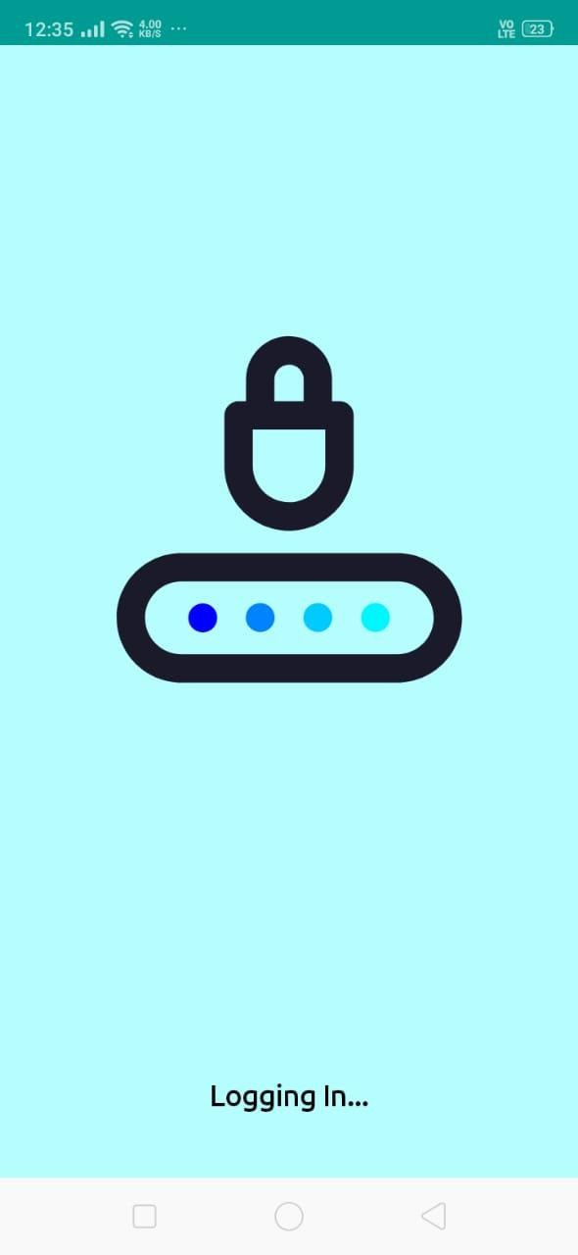
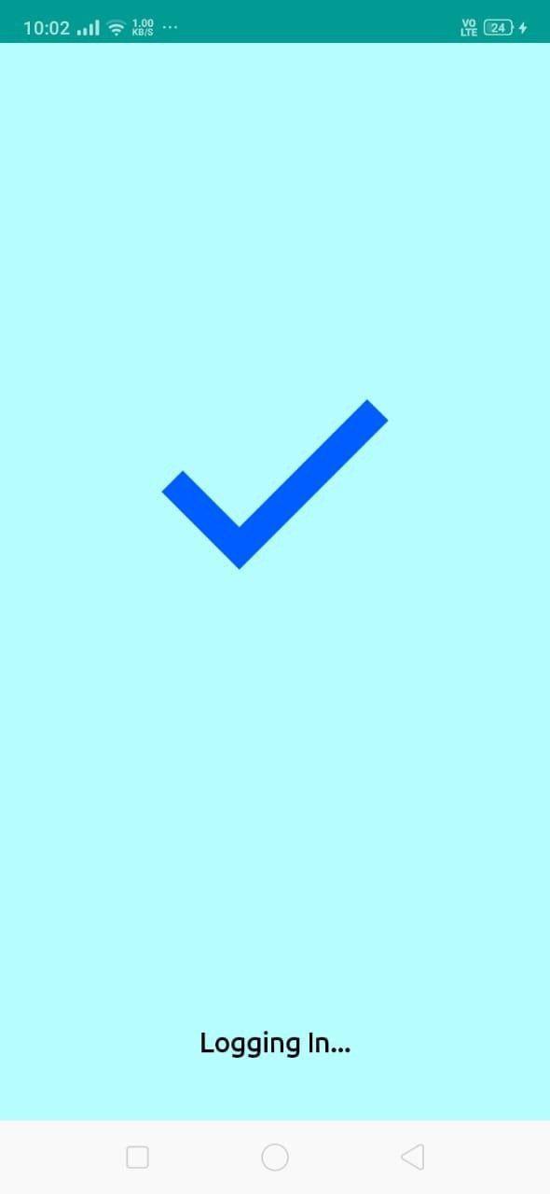
LOGIN SCREEN

Slide 7
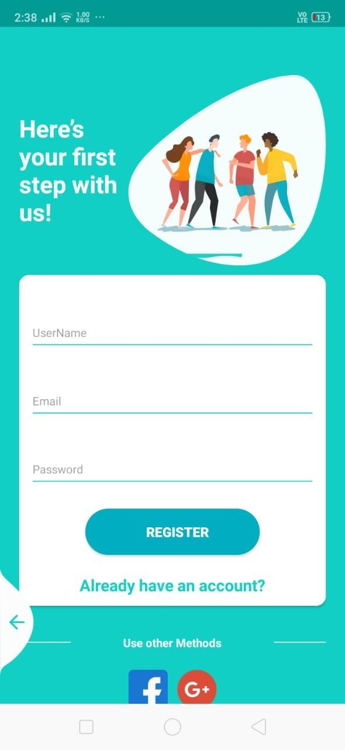
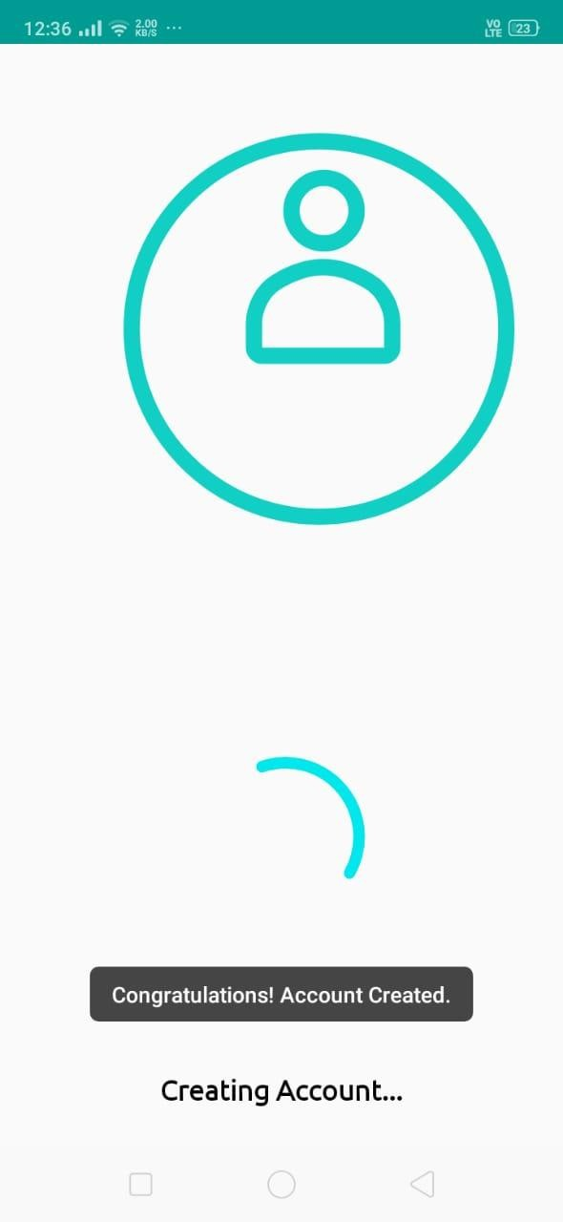
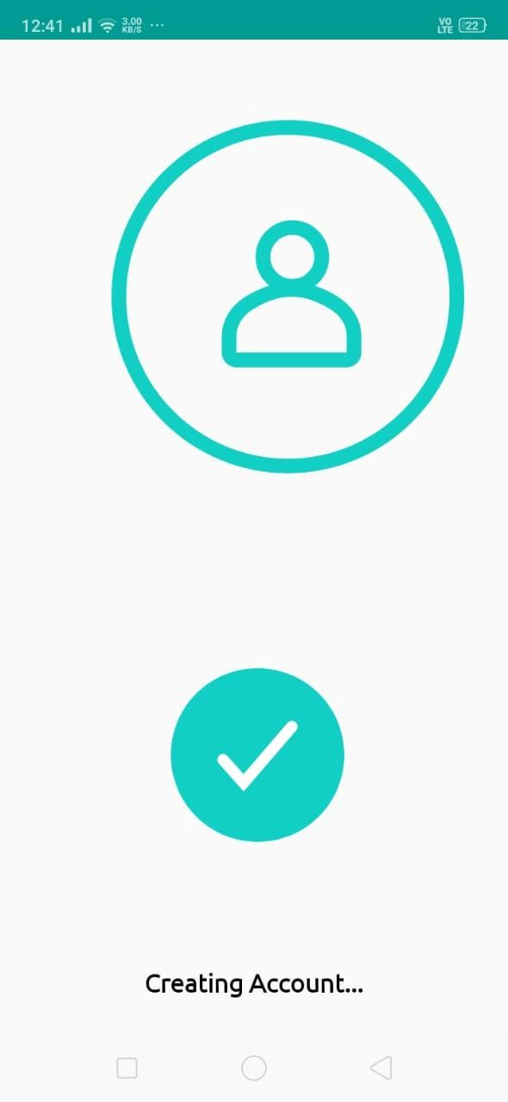
SIGN UP SCREEN

Slide 8
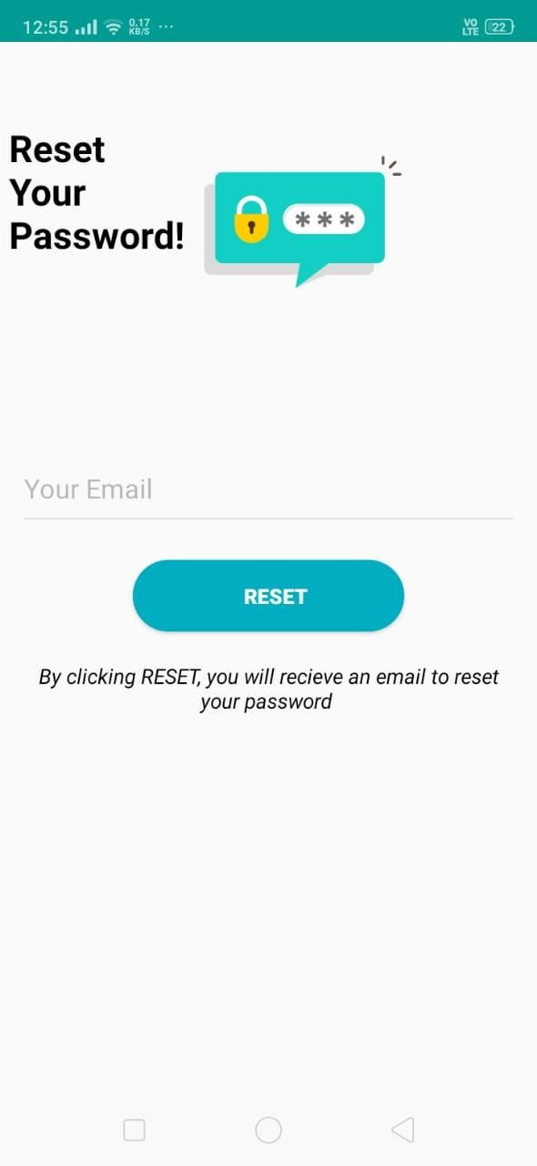
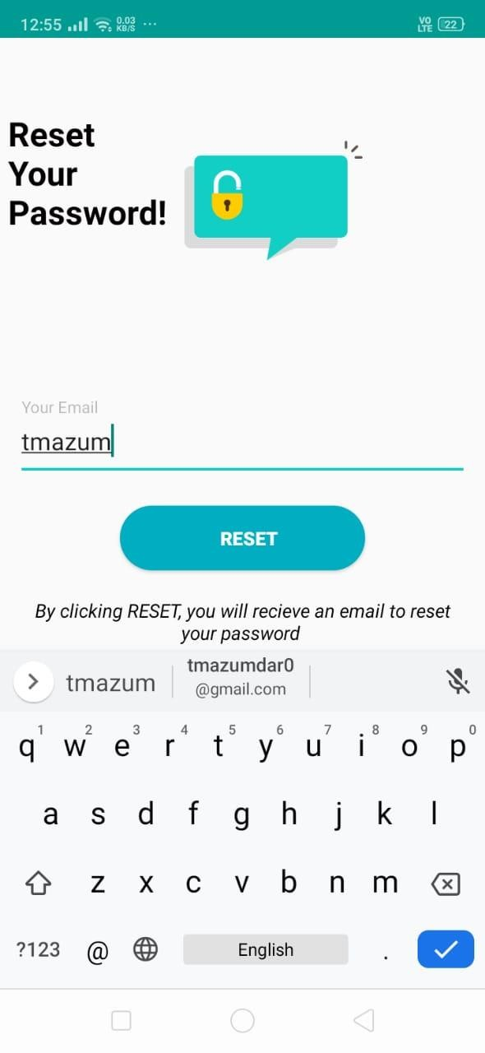
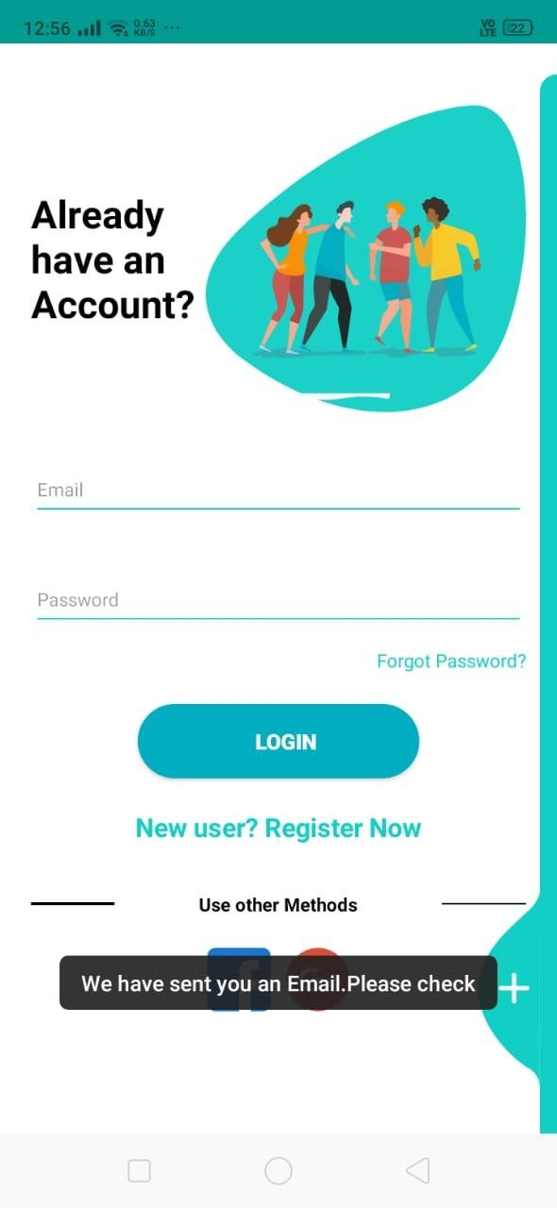
RESET PASSWORD SCREEN

Slide 9
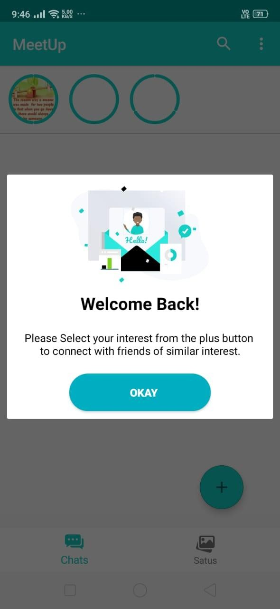
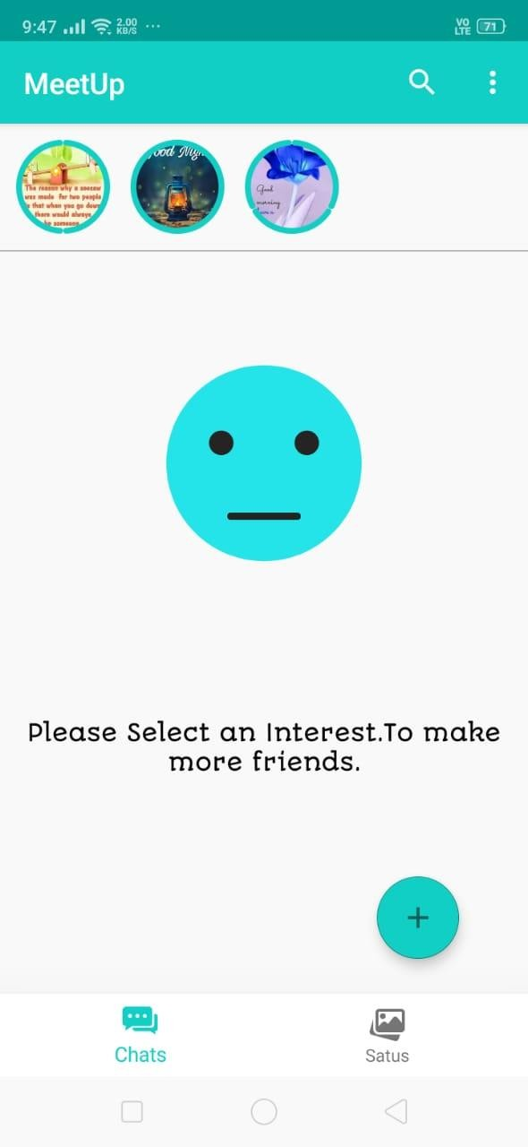
HOME SCREEN

Slide 10
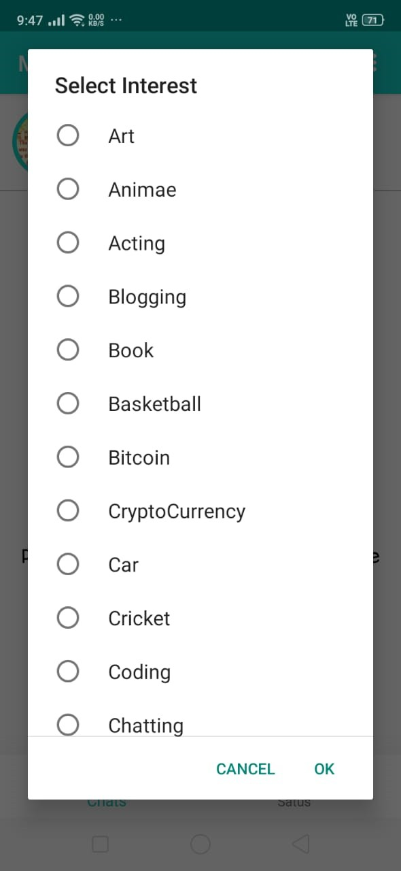
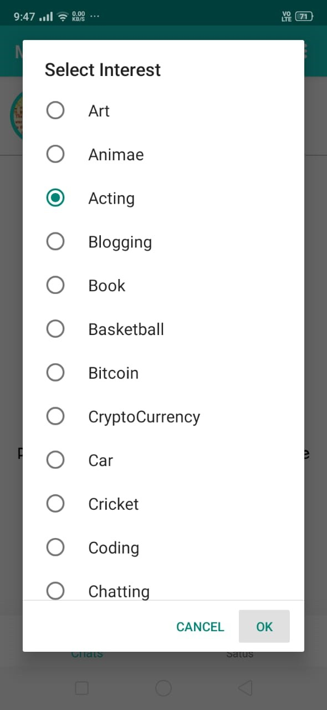
SELECTION OF INTEREST

Slide 11
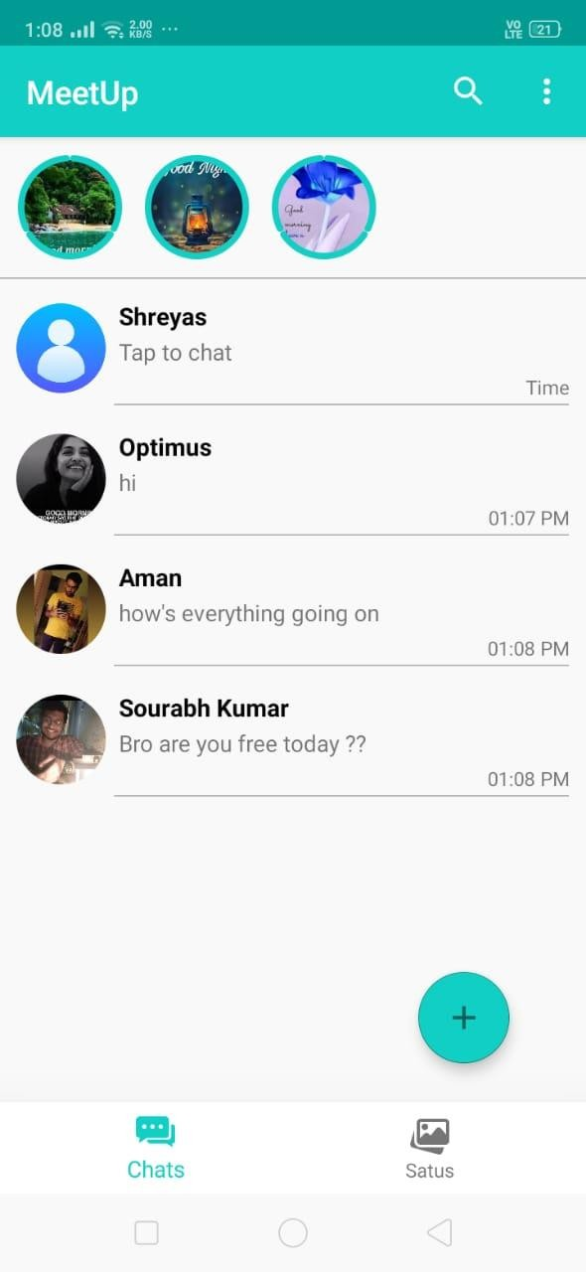
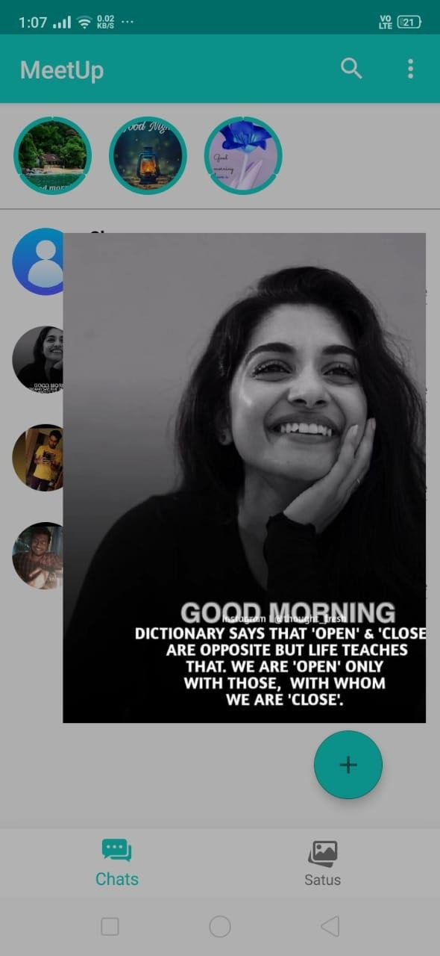
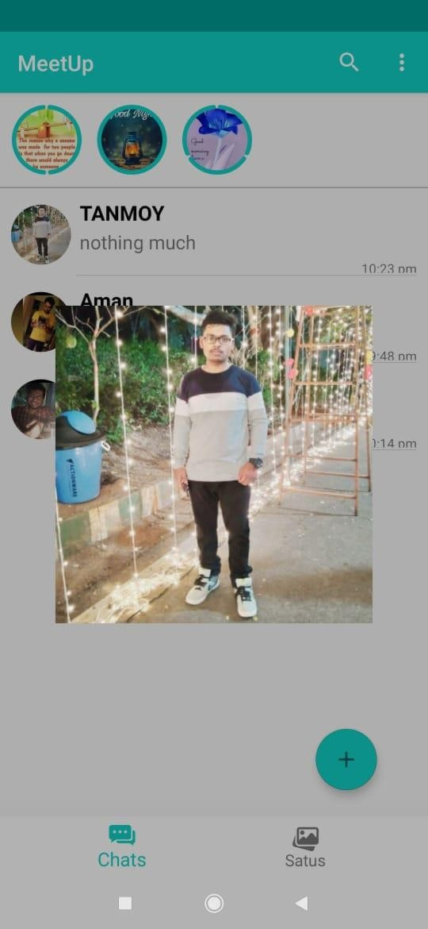
HOME SCREEN AFTER AN INTEREST
IS ELECTED

Slide 12
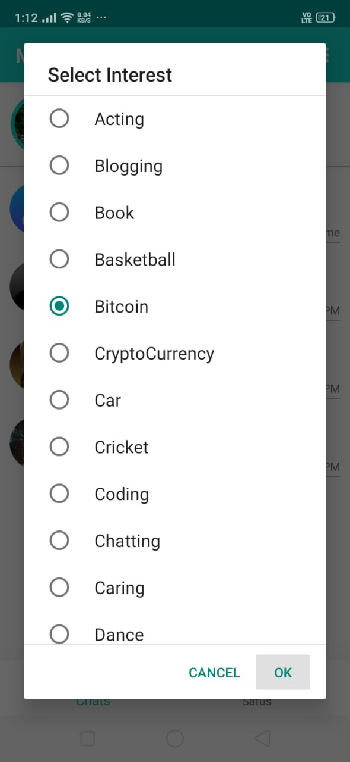
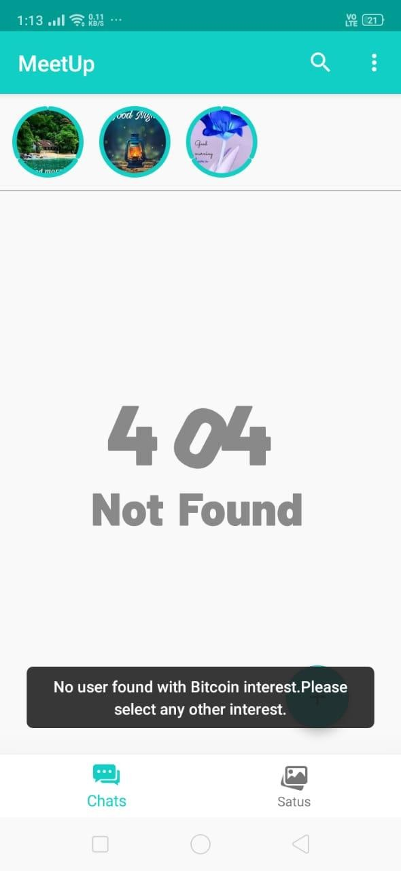
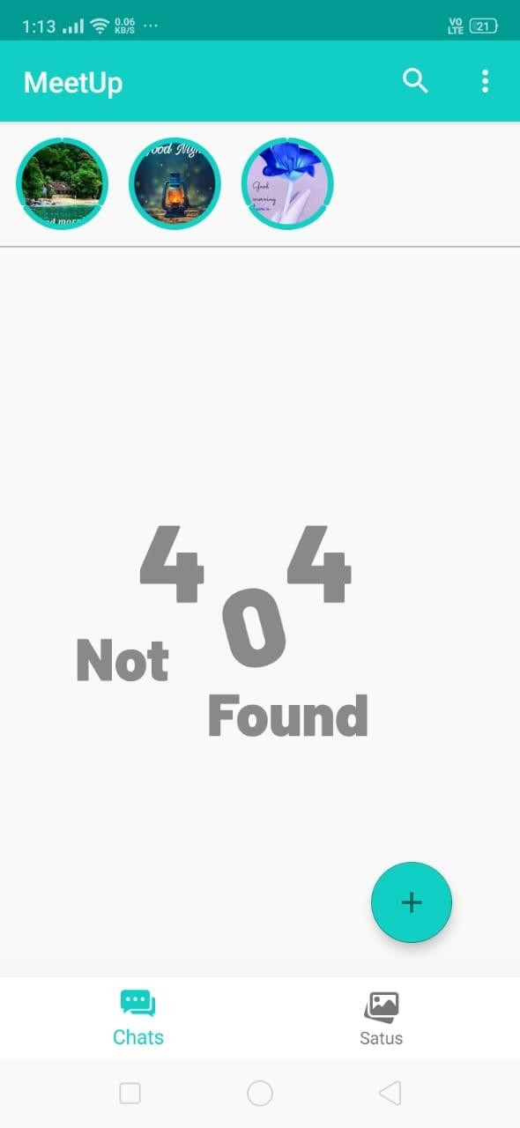
HOME SCREEN AFTER AN INTEREST
IS ELECTED AND NO USER FOUND

Slide 13
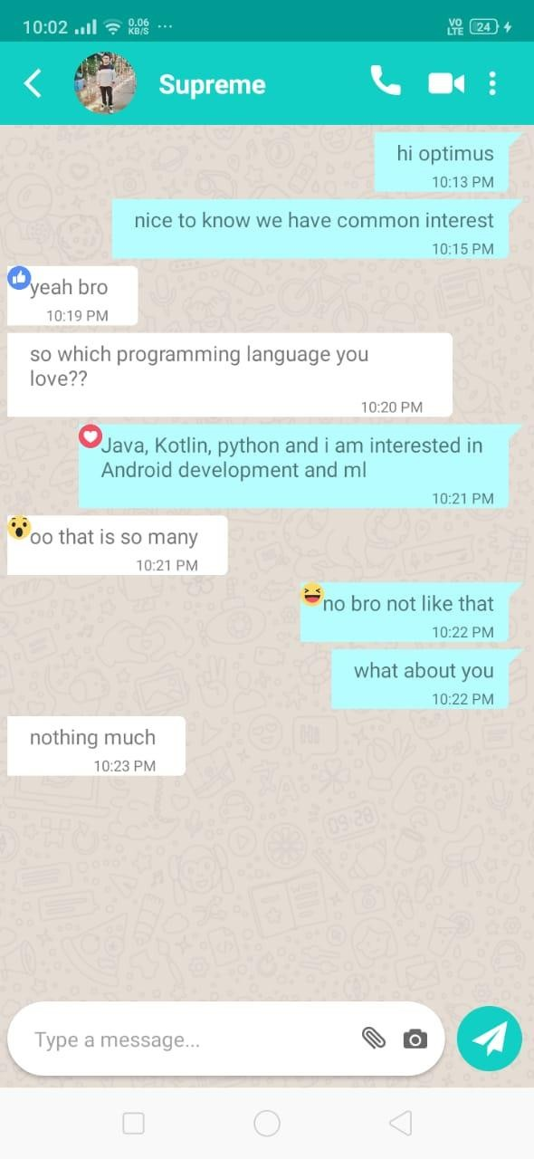
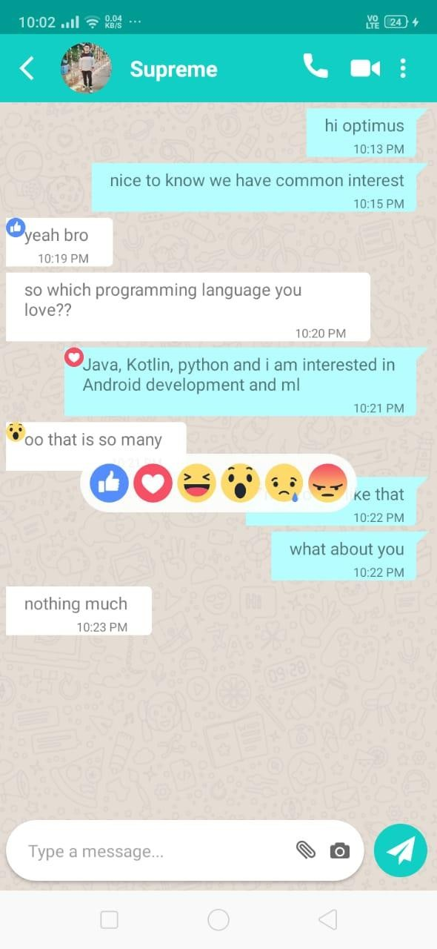
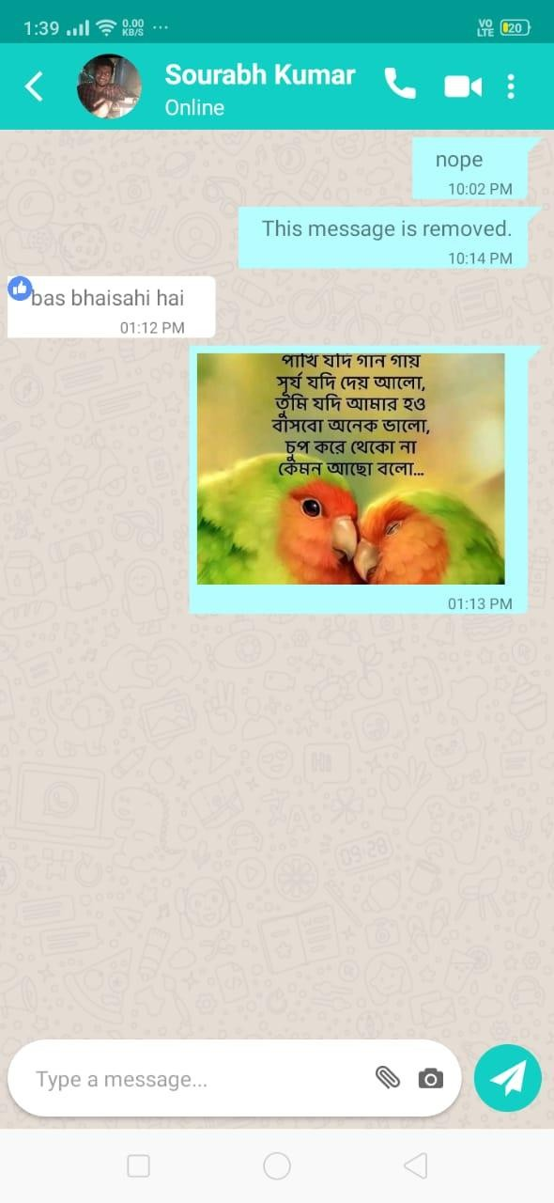
CHAT ACTIVITY

Slide 14
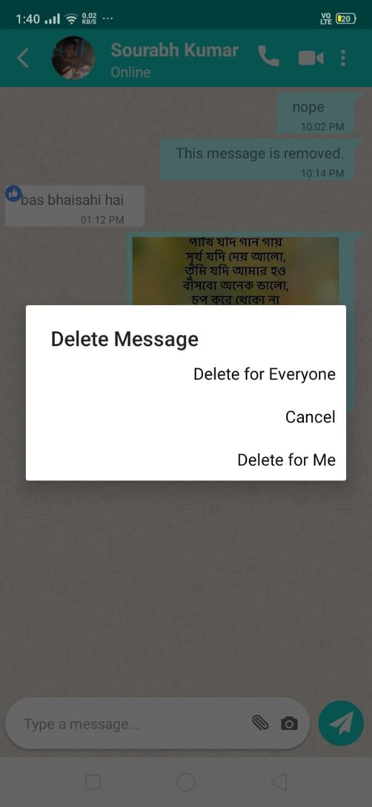
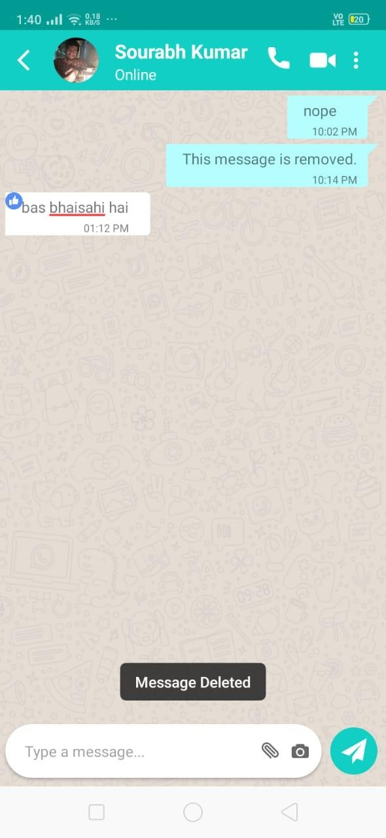
CHAT ACTIVITY DELETE FOR ME

Slide 15
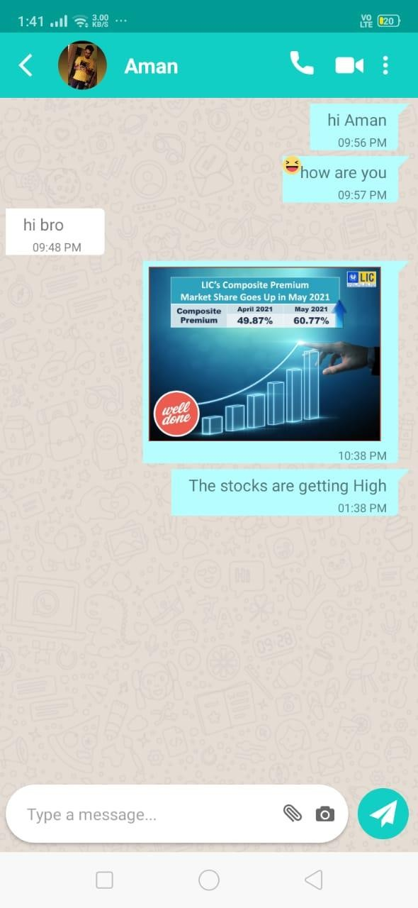
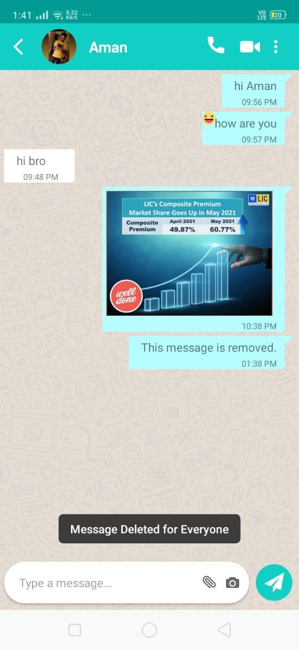
CHAT ACTIVITY DELETE FOR EVERYONE

Slide 16
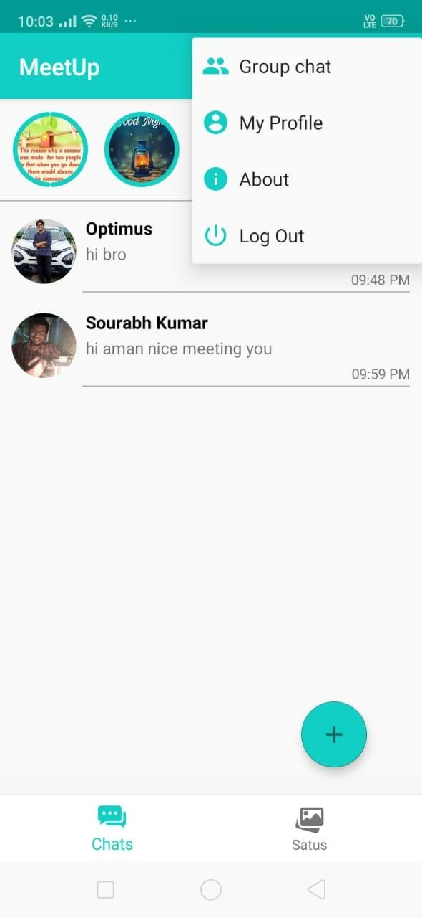
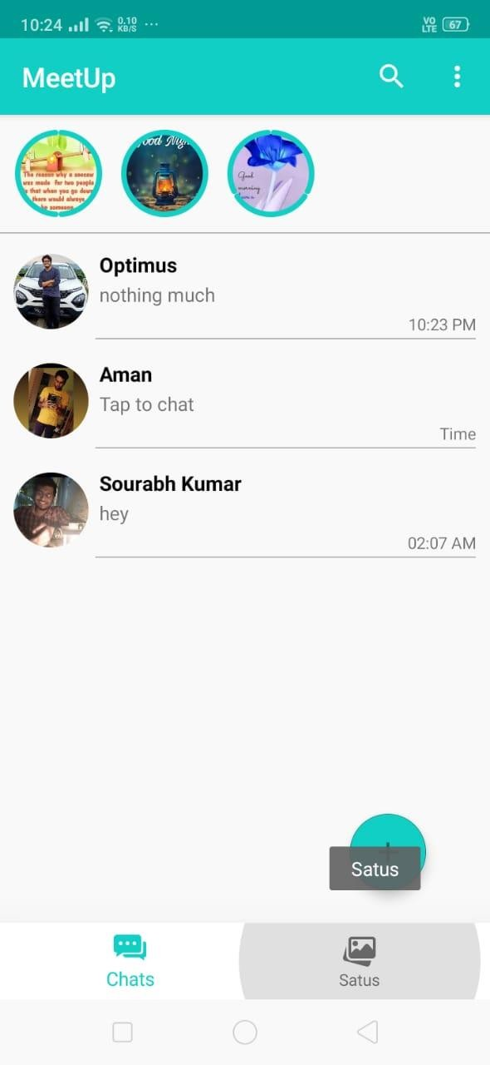
MENU SCREEN SCREEN

Slide 17
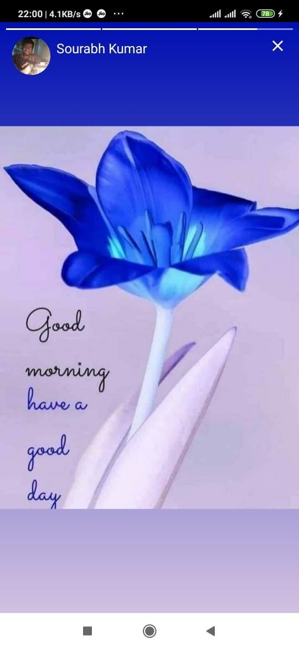

TOP STATUS SCREEN

Slide 18
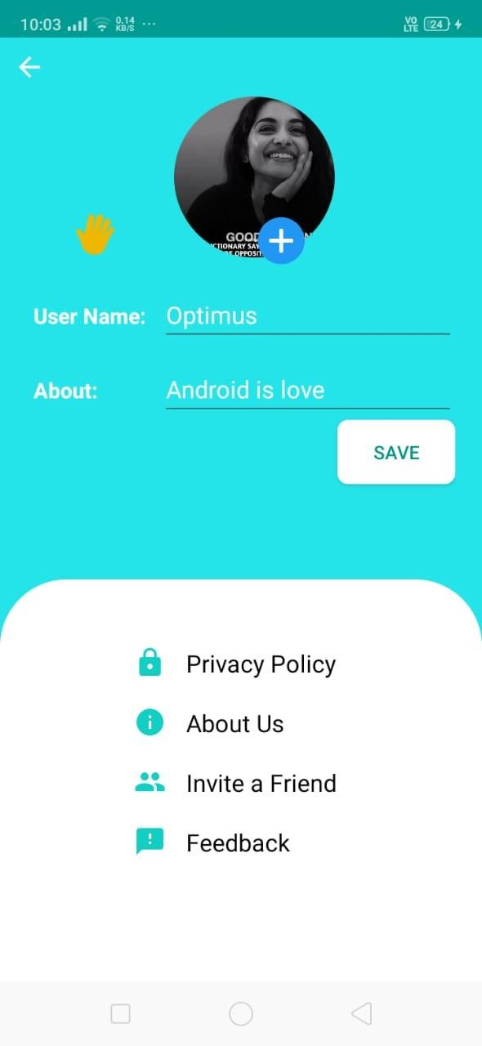
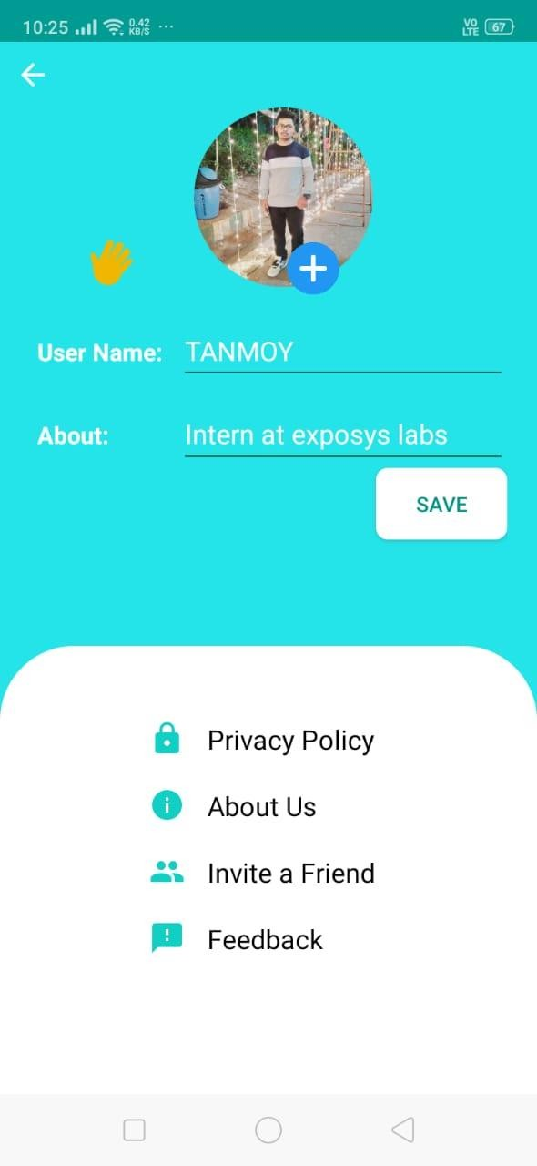
MY PROFILE SCREEN

Slide 19
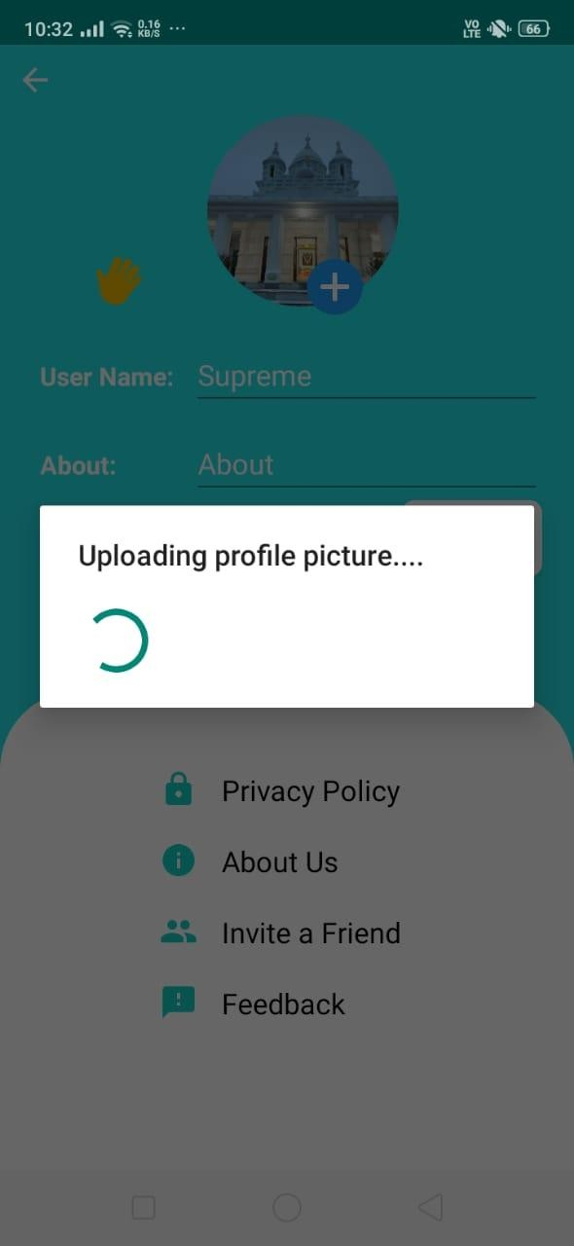
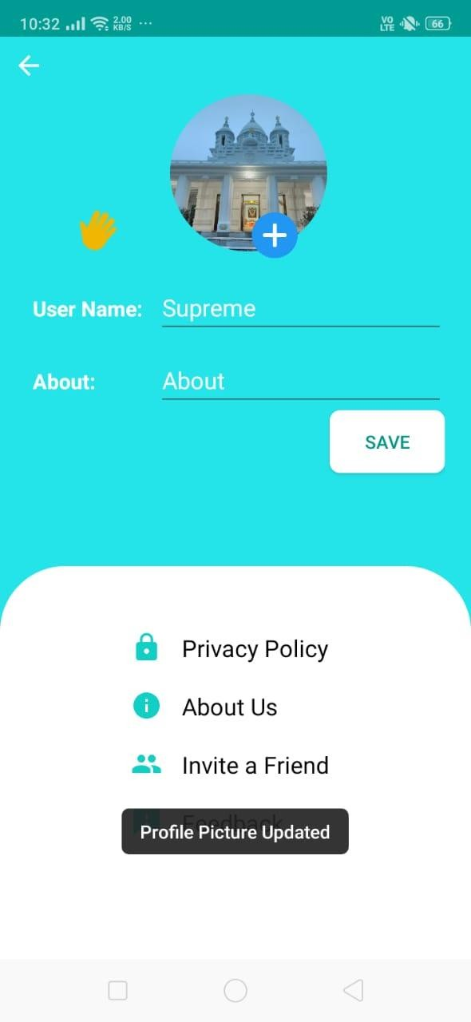
UPDATING MY PROFILE

Slide 20
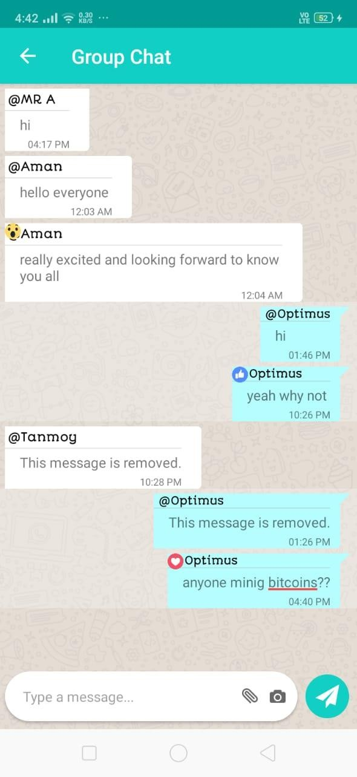
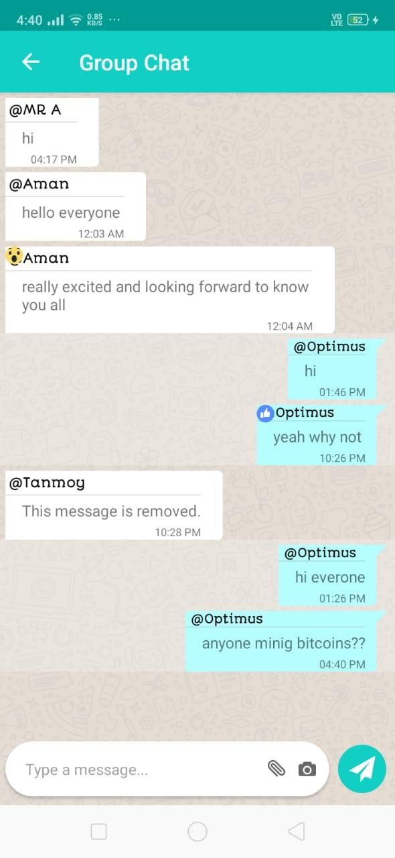
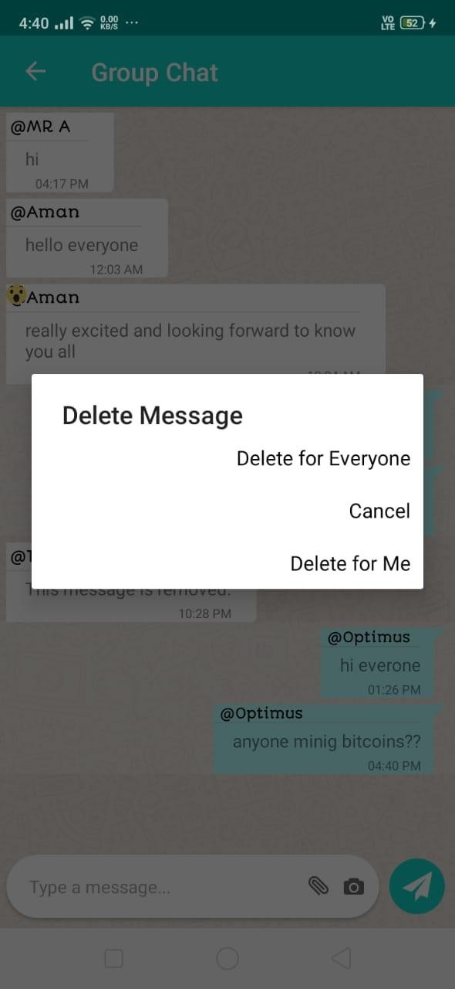
GROUP CHAT SCREEN

Slide 21
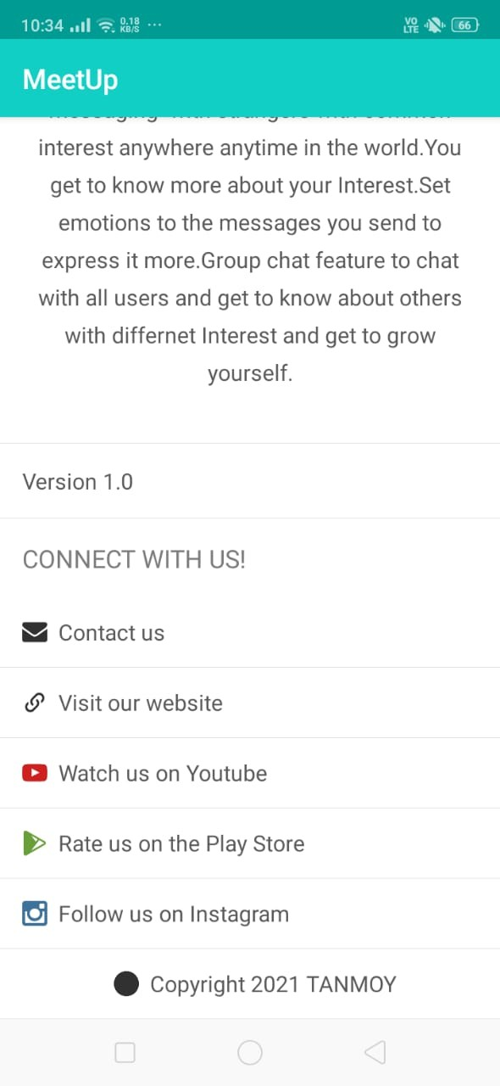
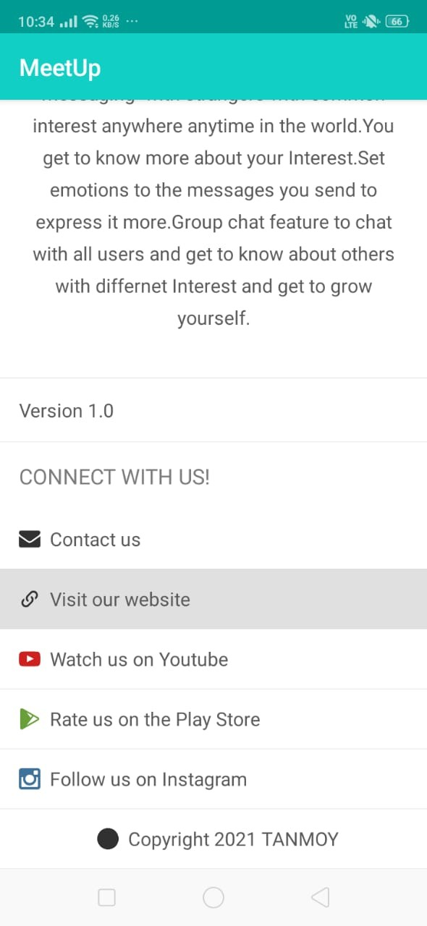
ABOUT US SCREEN

Slide 22
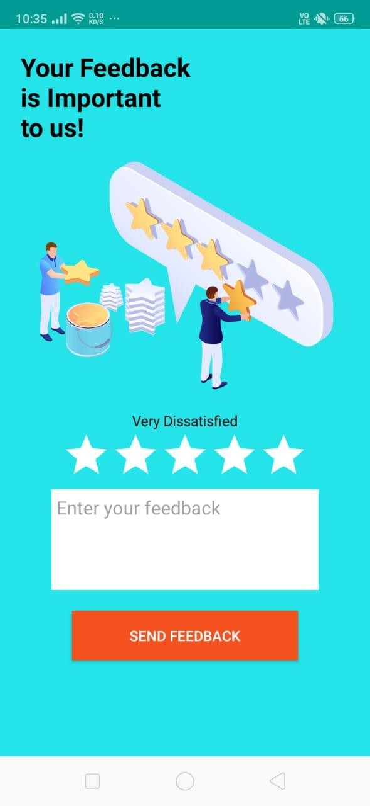
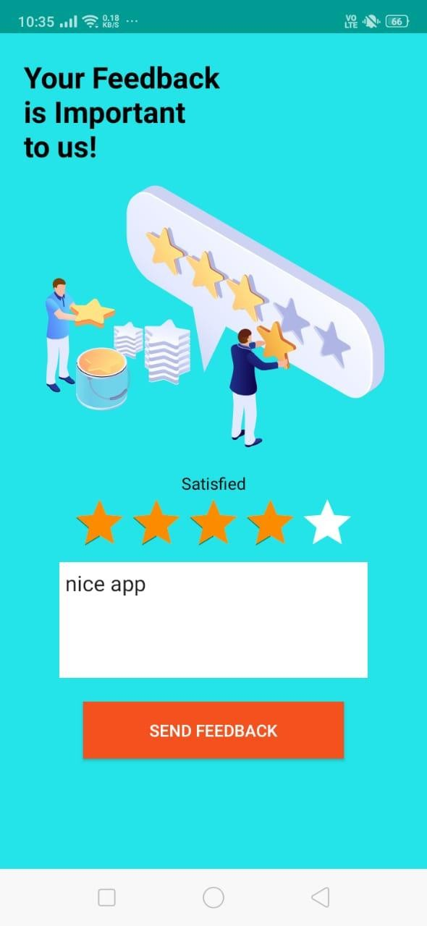
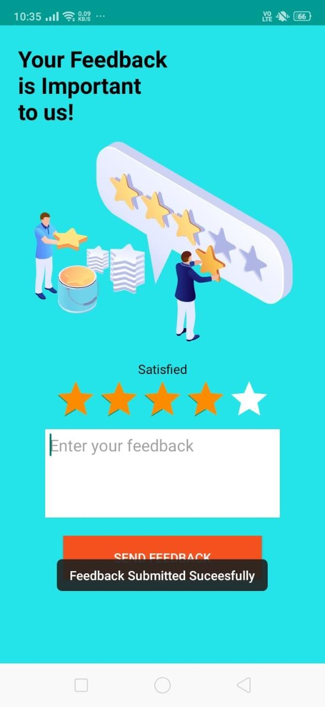
FEEDBACK SCREEN

Slide 23
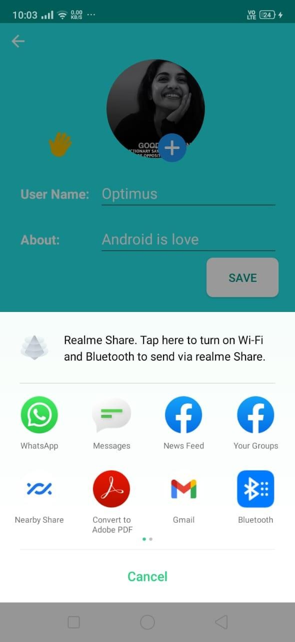
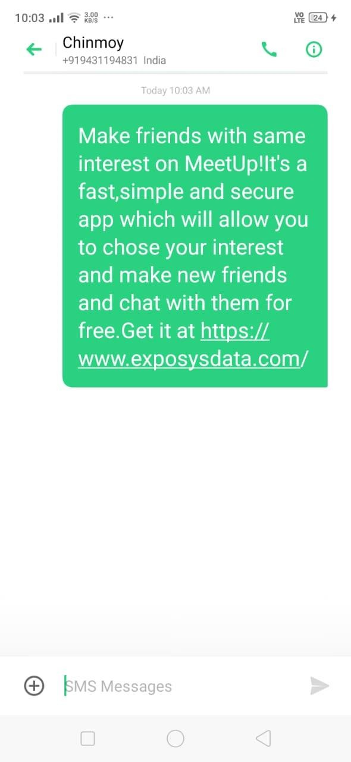
INVITE FRIEND SCREEN

Slide 24
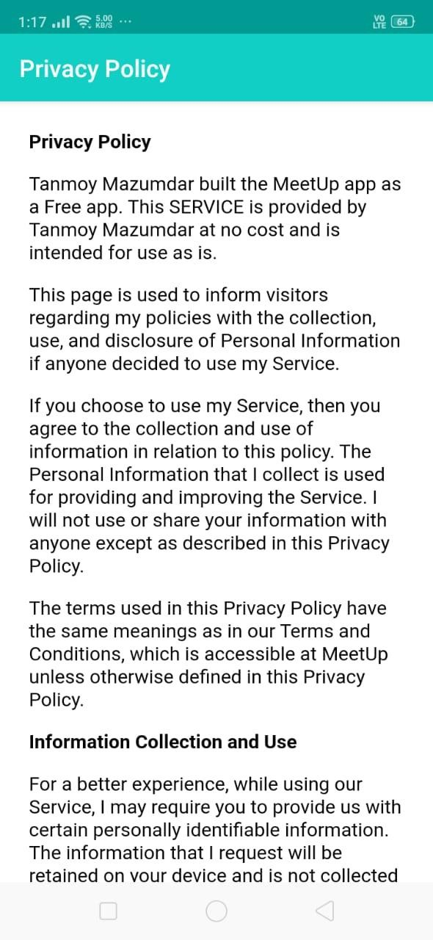
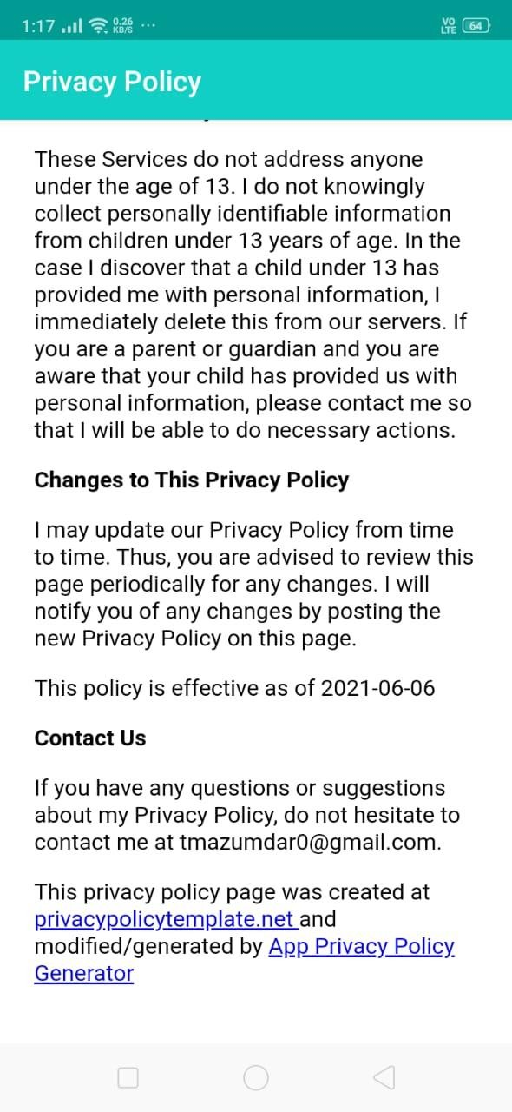
PRIVACY POLICY SCREEN

Slide 25
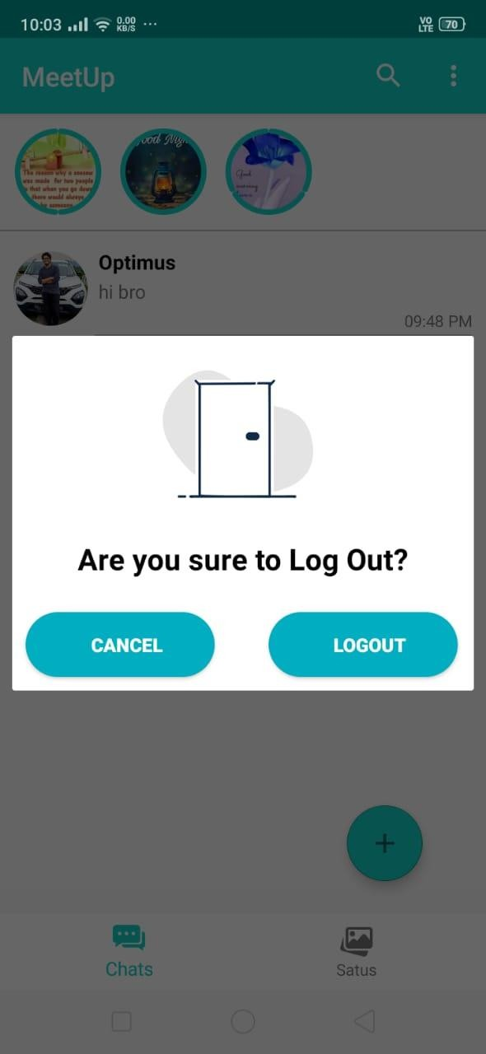
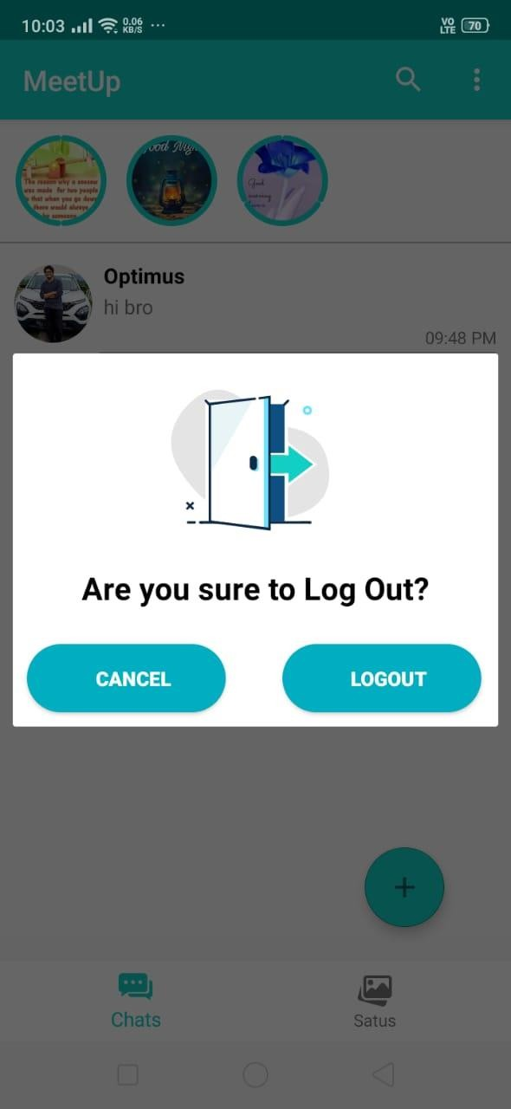
SCREEN
LOGOUT

Slide 26
CONCLUSION
In our project work, the attempt to make friends or to know other person with same interest has been made. In this project few difficulties have been faced while making this stil there is always a scope for improvement and we have decided to come up with more features so that the users are always satisfied of what they are using.

Slide 27
THANK YOU
FROM:
TANMOY MAZUMDAR

