Slide 1
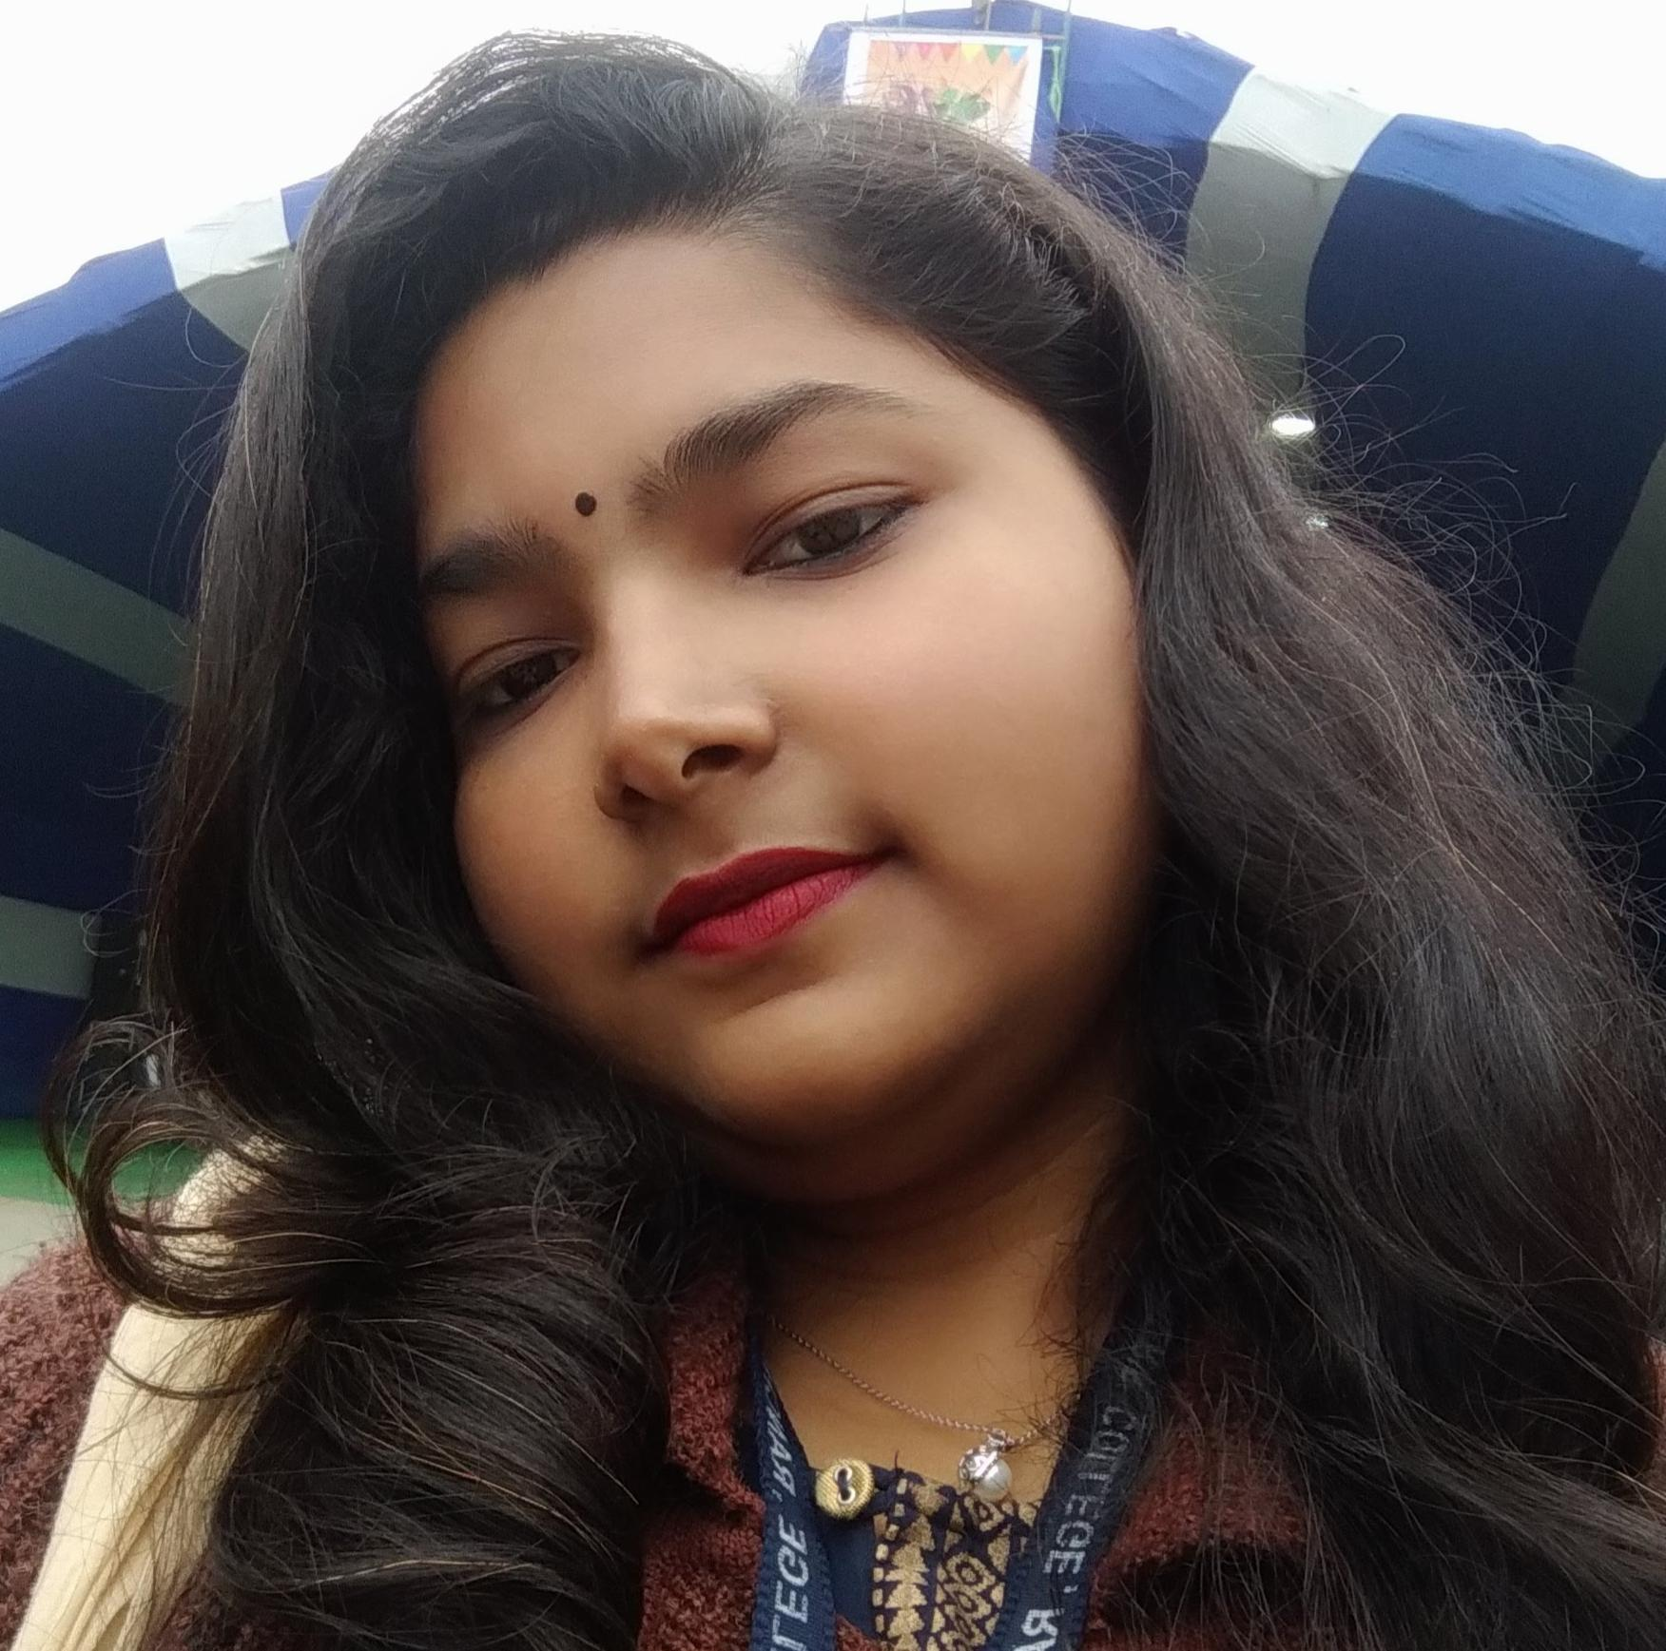


Tannu Kumari
Analyst/Software Engineer
Master of Computer Application :2018-2021
Skills Java 8 /J2EE
Spring Boot
Spring MVC
JPA CRUD
Bootstrap
React
Database
SQL database – MySQL
Web Technologies
HTML5
CSS3
JavaScript
Add-ons
GitHub
Postman
Additional Details
Leadership
Responsible
Team work
Quick Learner
Active Listner
Mumbai
tannu.kumari@capgemini.com
+91 8709722892
A4
Proficient in JAVA and OOPs concepts.
Hands on experience in creating Web Application with Spring boot , Java, Rest API, React.
Hands on experience in developing web pages using HTML5, CSS3, Object Oriented Programming, JSON, XML. Good understanding of Document Object Model (DOM) and DOM Functions.
Proficient in creating Web Application in React with Authentication with routing.
Experience in creating documentation with swagger and unit testing using JUnit and Mockito.
Employee Management System
Completed end to end case study of Employee Management System . along with API Gateway, Swagger,Postman, responsive UI with HTML5, CSS, Bootstrap and React used as User Interface.
.

