Slide 1
Smart Water Bottle
TANSixu SUSTECH
LIANGHongrui UESTC

Slide 2
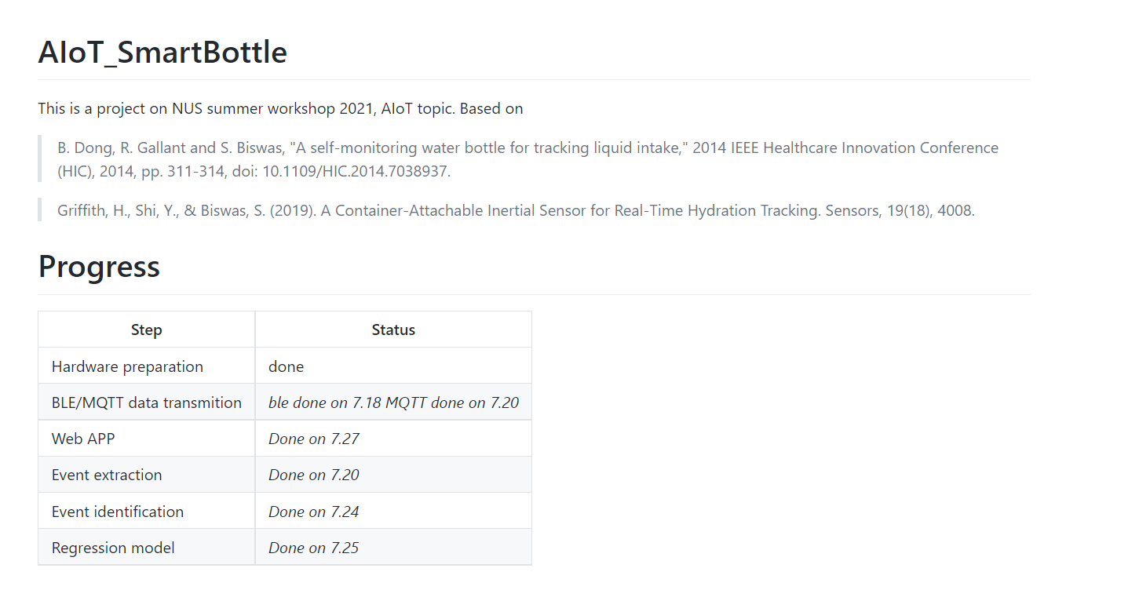

Slide 3
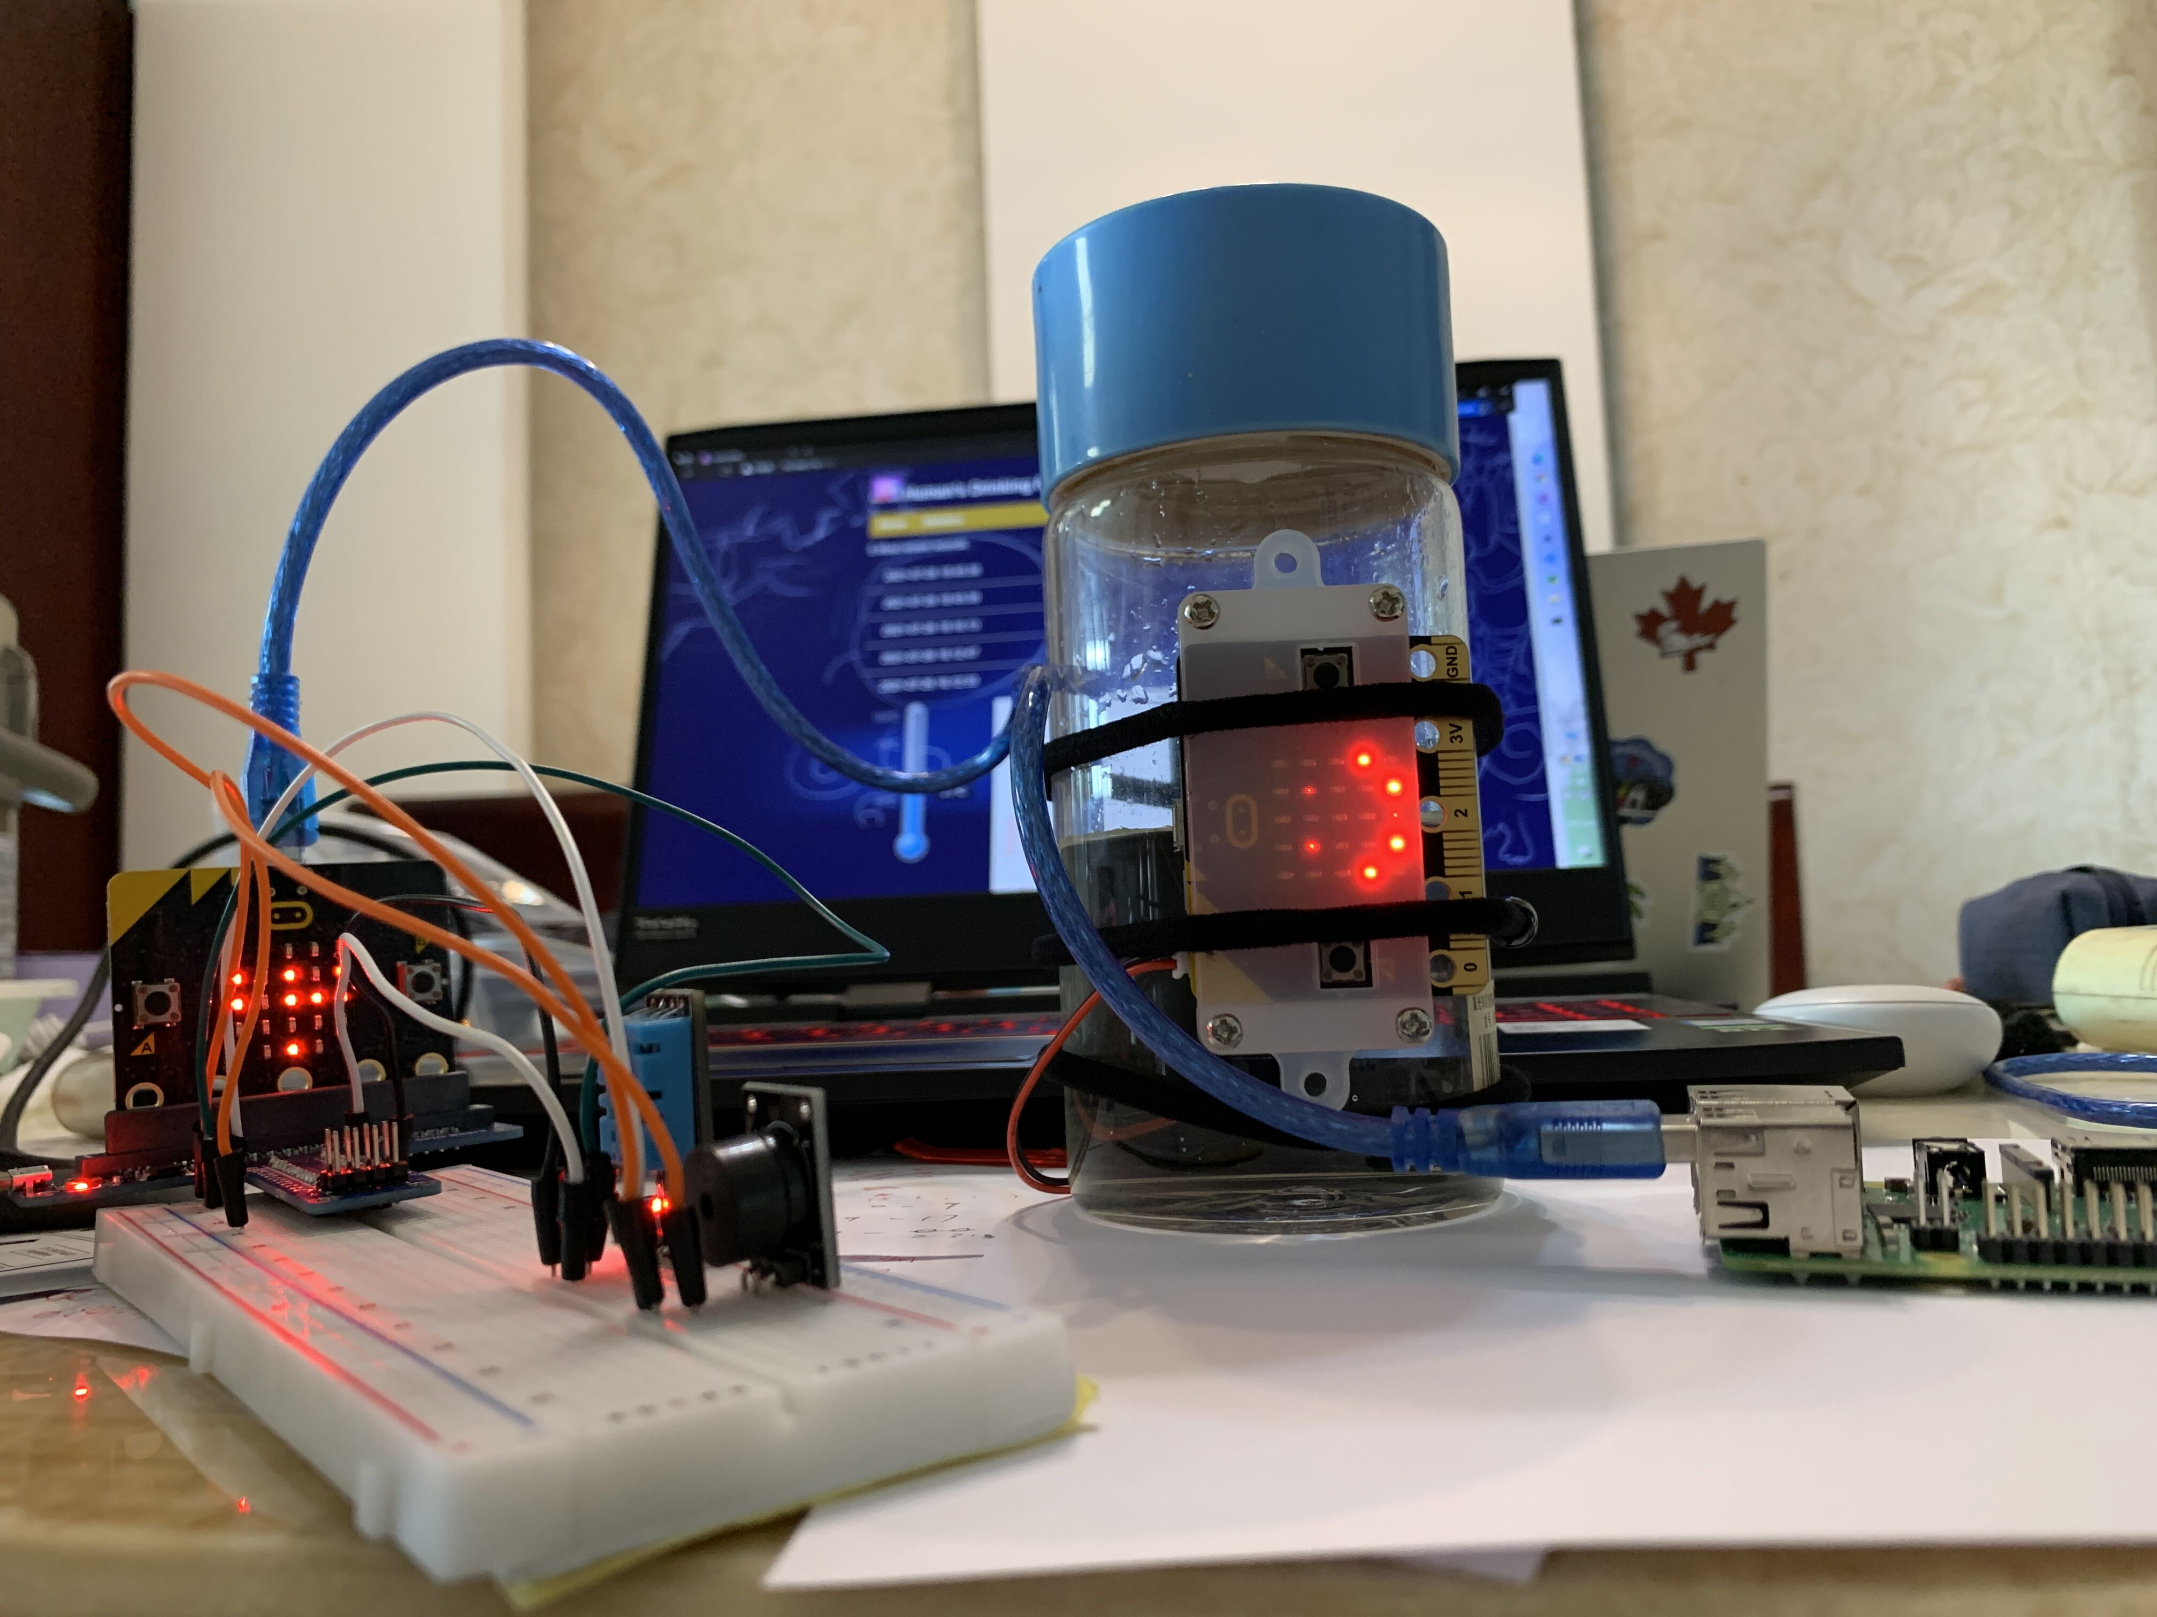
1. Accuracy 2. Portable 3. Healthy 4. User-friendly

Slide 4
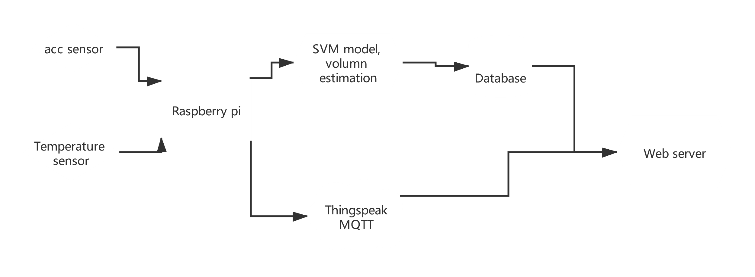

Slide 5
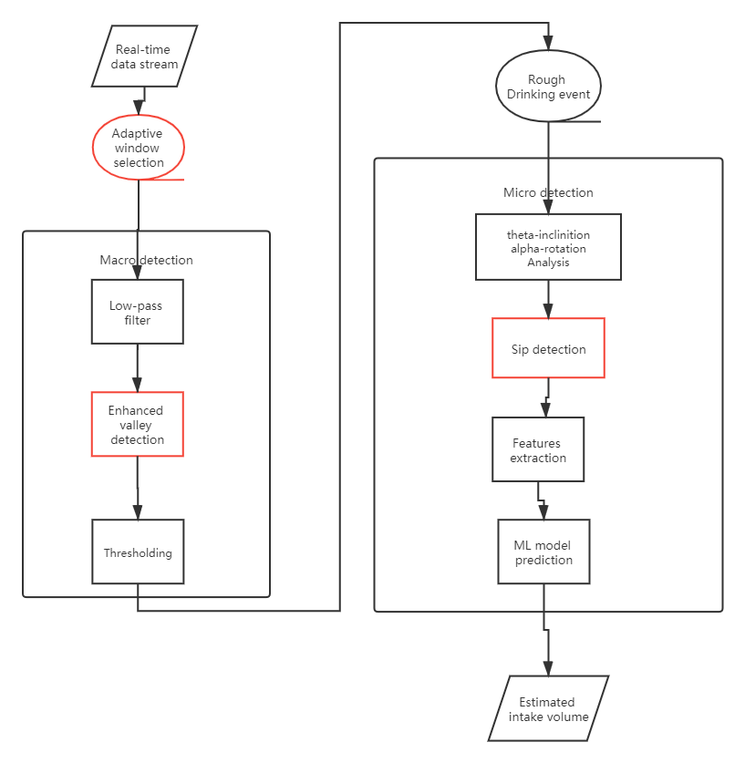

Slide 6
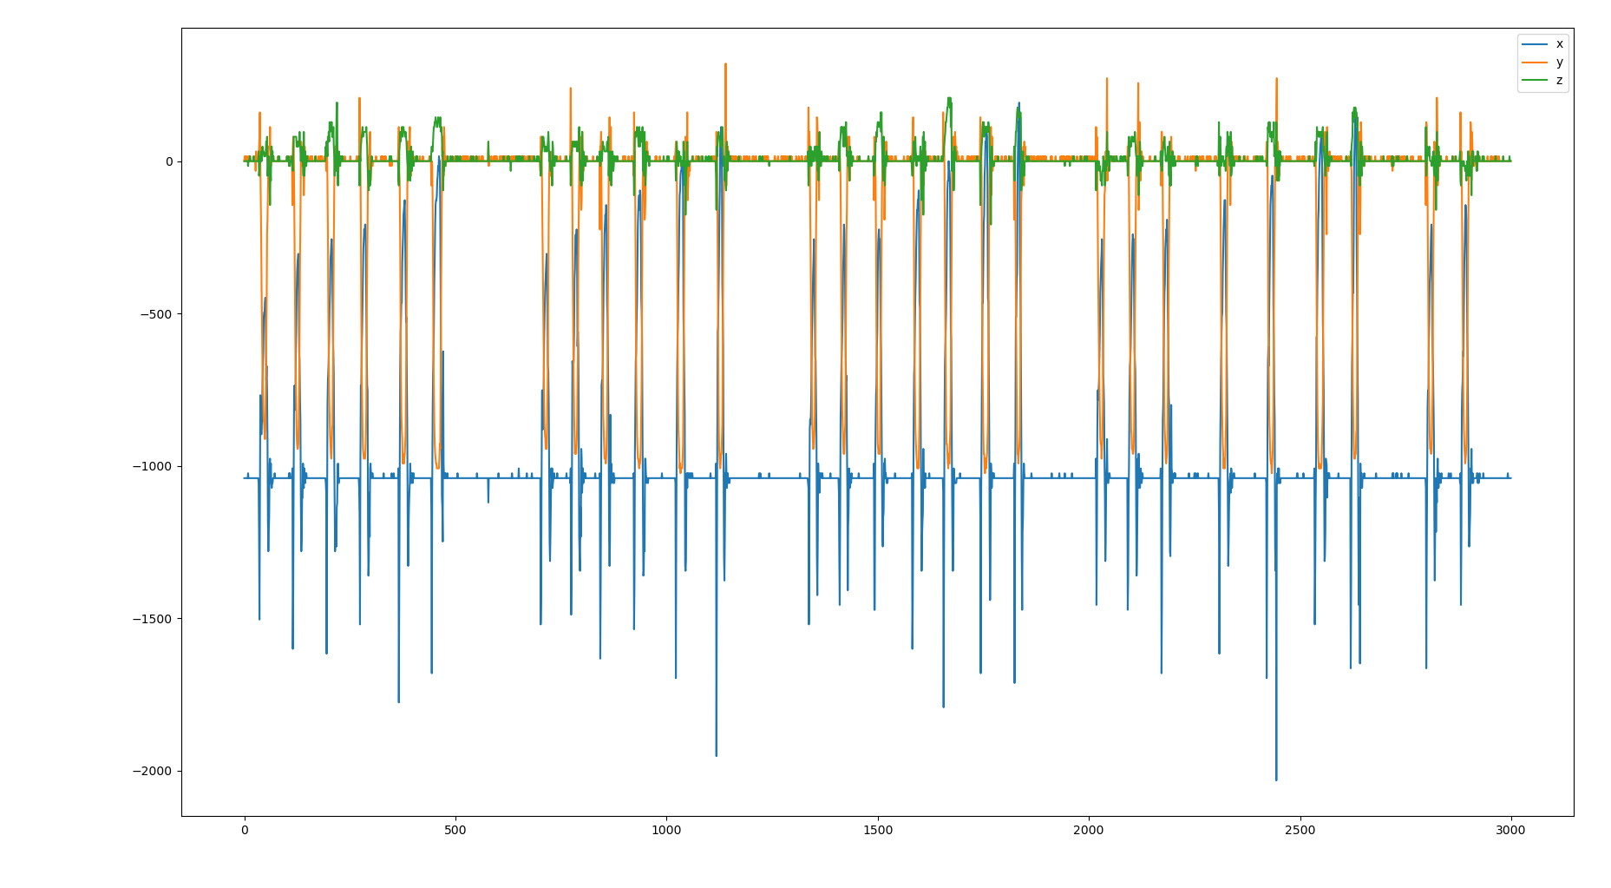

Slide 7
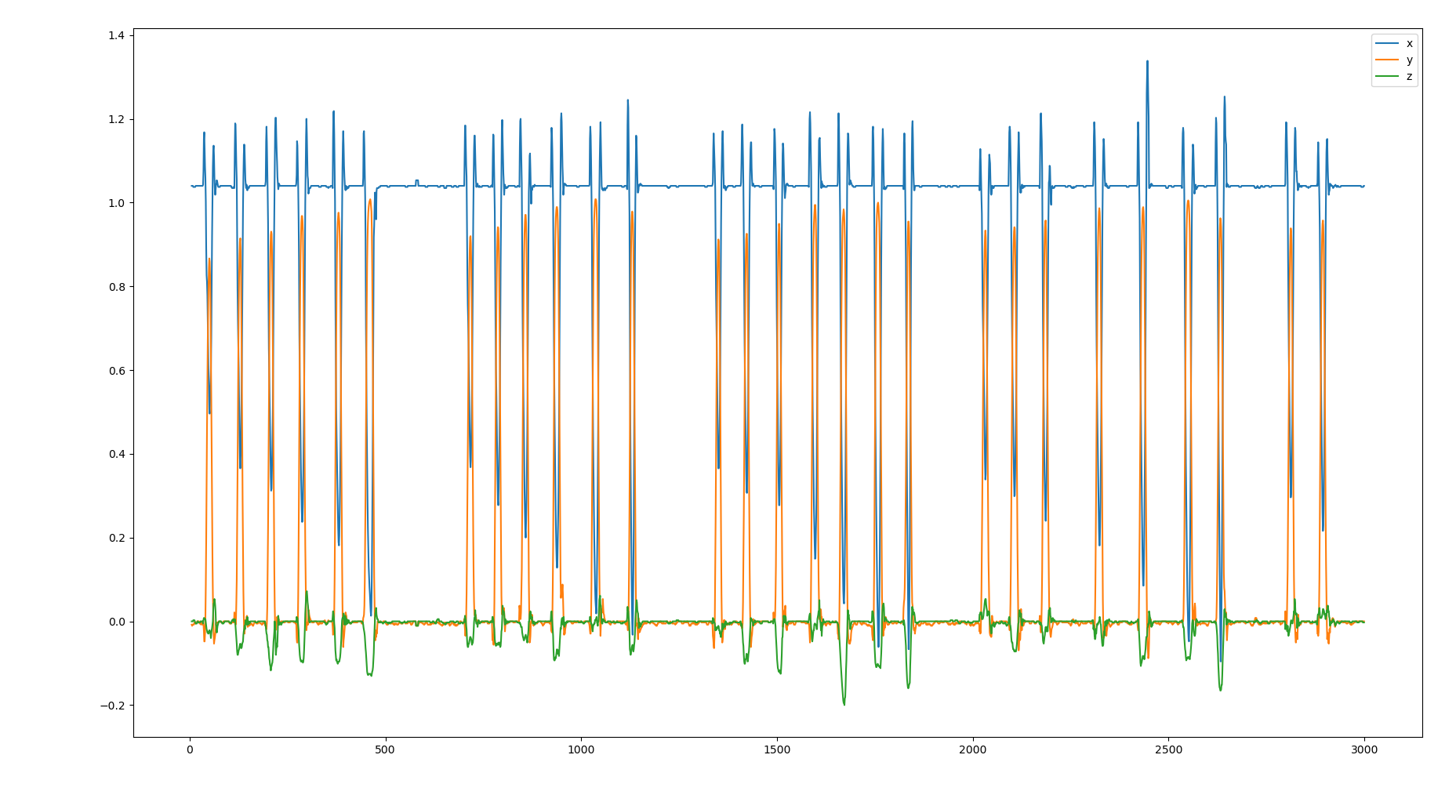

Slide 8
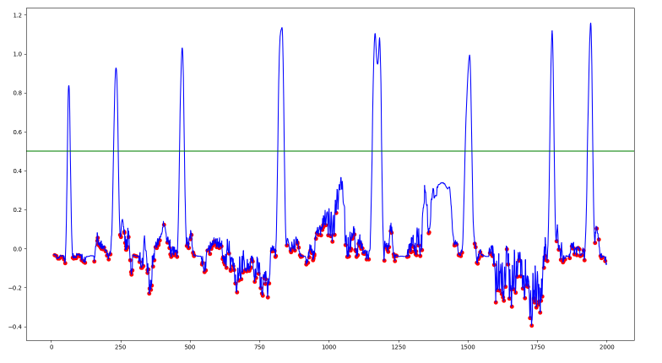

Slide 10
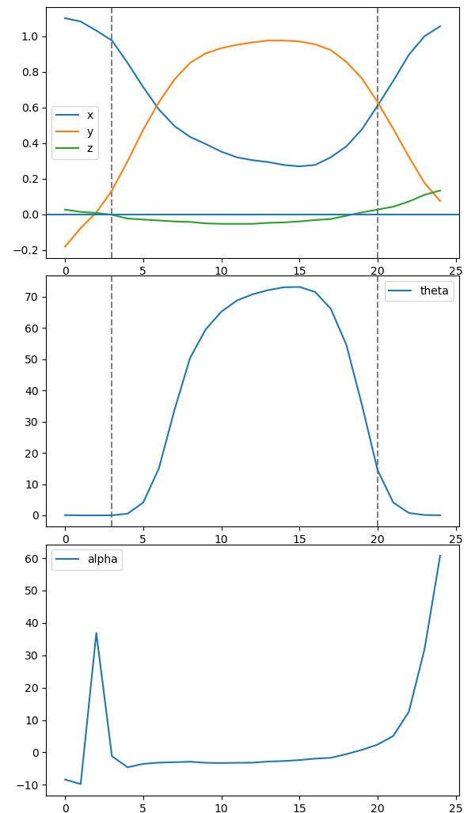
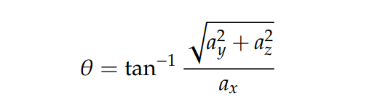
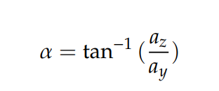
Lift
Sip
Place

Slide 11
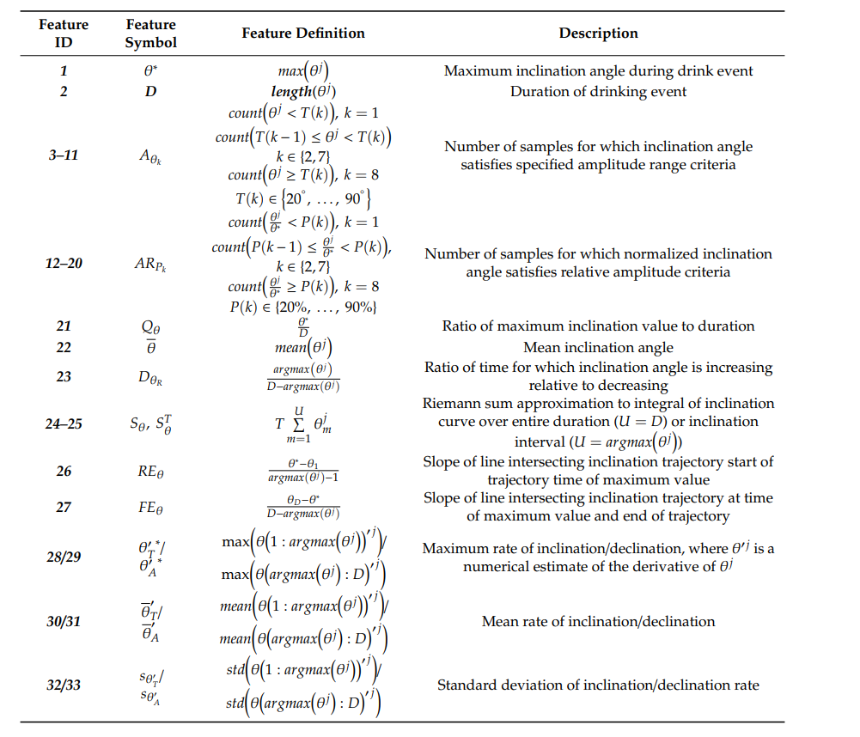

Slide 13
Our Extension
Adaptive real-time window selection
Enhanced valley detection
Modified sip detection

Slide 14
Demo

Slide 15
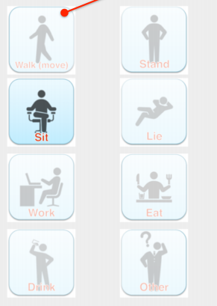
Future work
FluidMeter: Gauging the Human Daily Fluid Intake Using Smartwatches

Slide 16
Reference
B. Dong, R. Gallant and S. Biswas, "A self-monitoring water bottle for tracking liquid intake," 2014 IEEE Healthcare Innovation Conference (HIC), 2014, pp. 311-314, doi: 10.1109/HIC.2014.7038937.
Griffith, H., Shi, Y., & Biswas, S. (2019). A Container-Attachable Inertial Sensor for Real-Time Hydration Tracking. Sensors, 19(18), 4008.

Slide 17
Special Thanks to Prof. TAN Wee Kek and our family

Slide 18
Q & A

