Slide 1
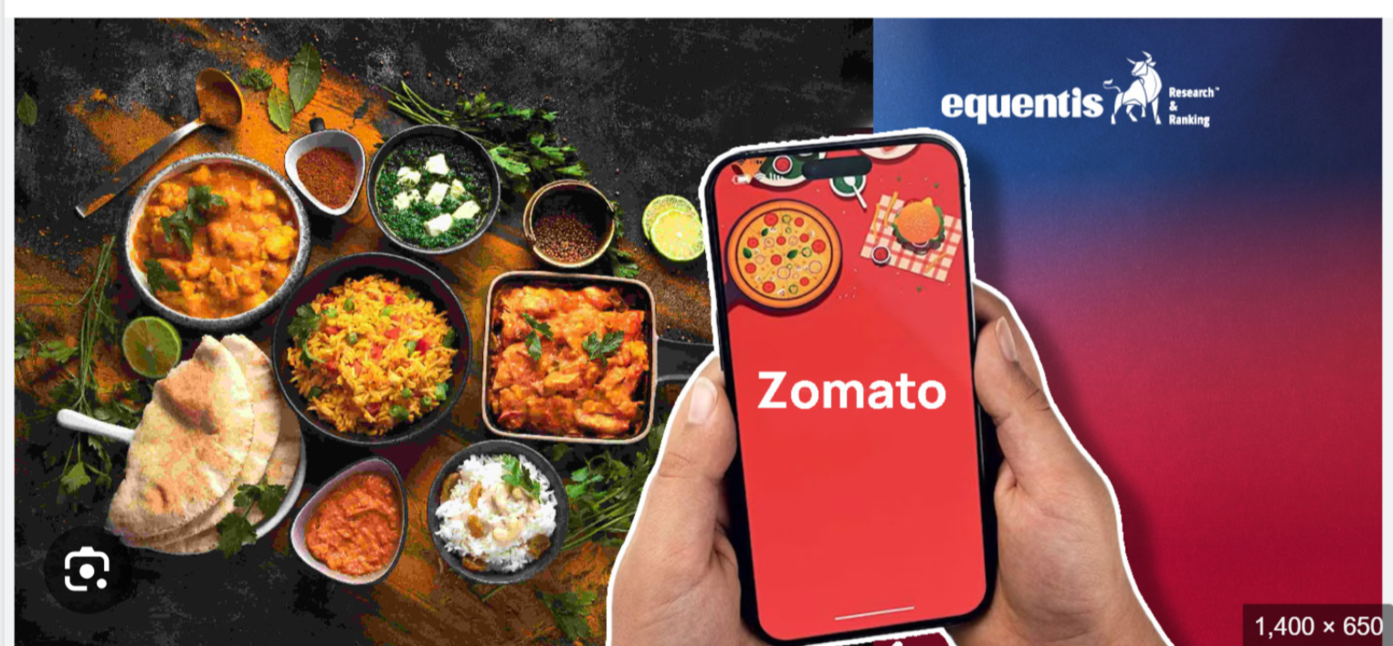
Zomato python project

Slide 2
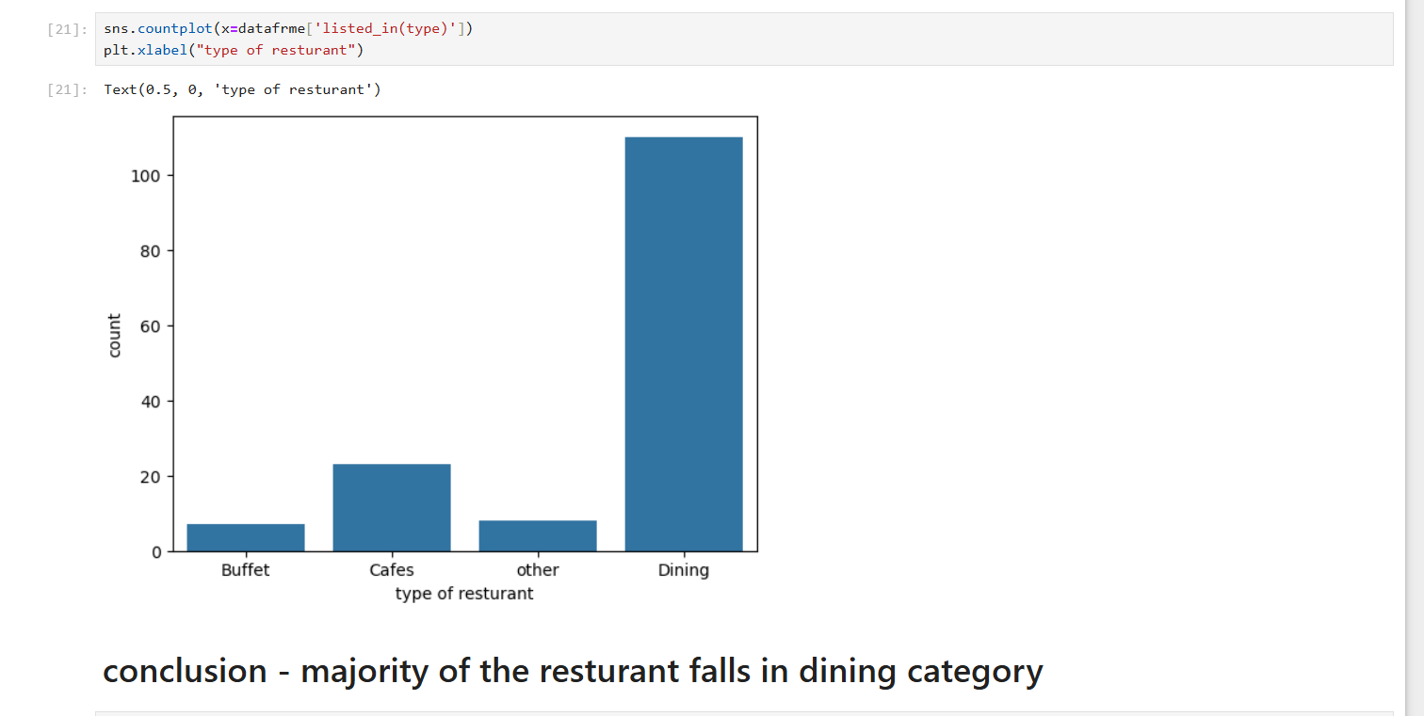
1. What type of restaurant do the majority of customers order from?
Zomato

Slide 3
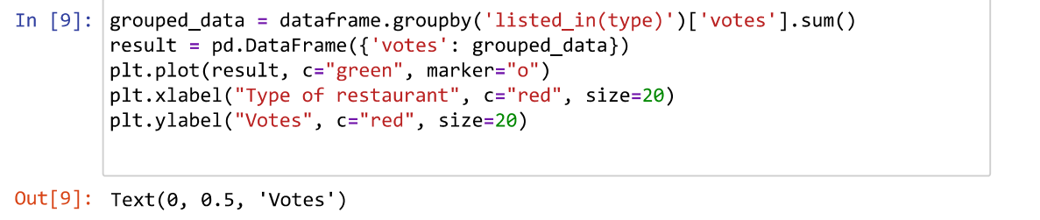
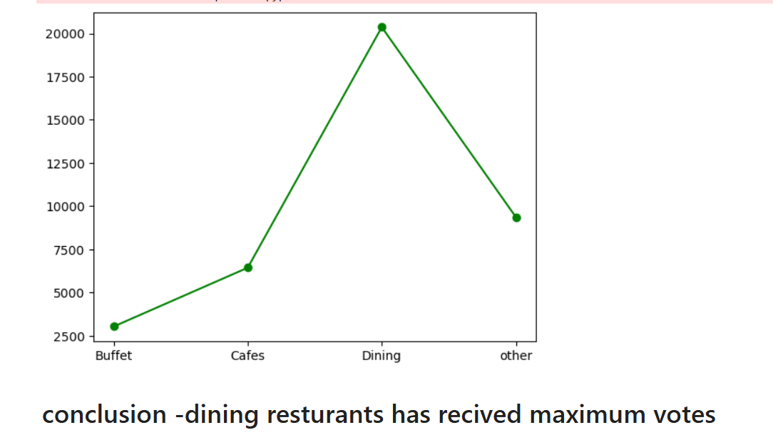
2. How many votes has each type of restaurant received from customers?

Slide 4
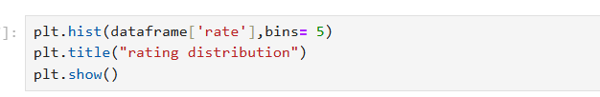
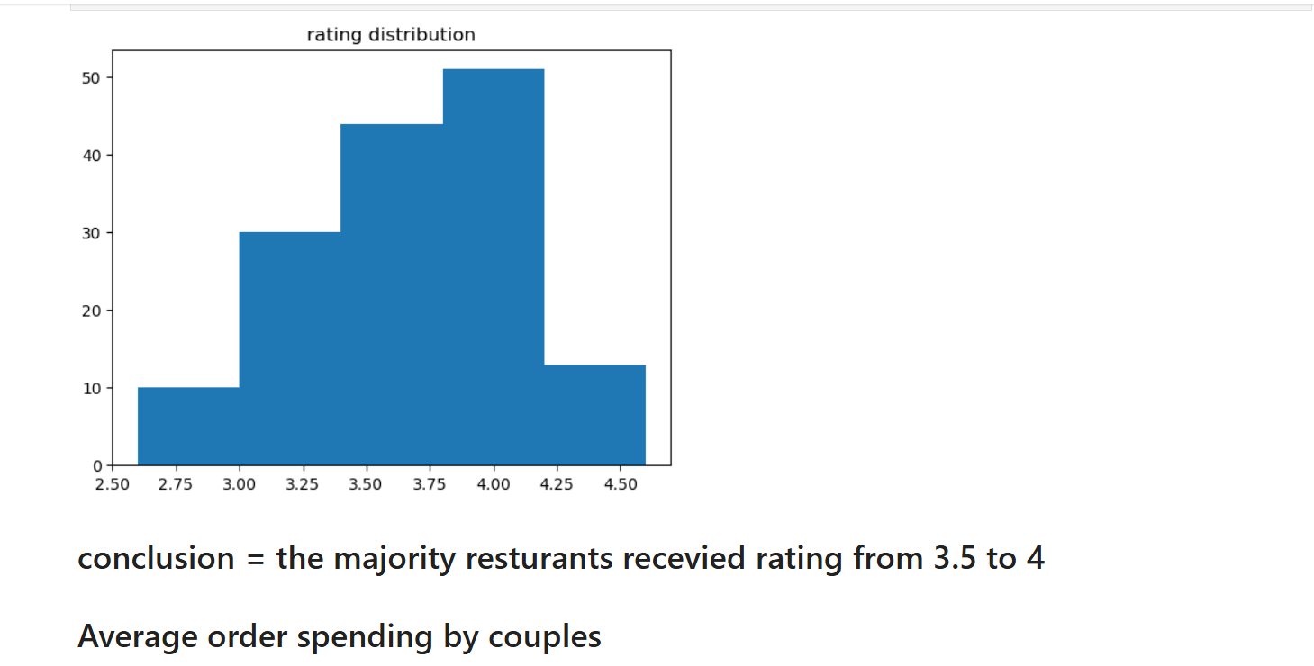
3. What are the ratings that the majority of restaurants have received?

Slide 5
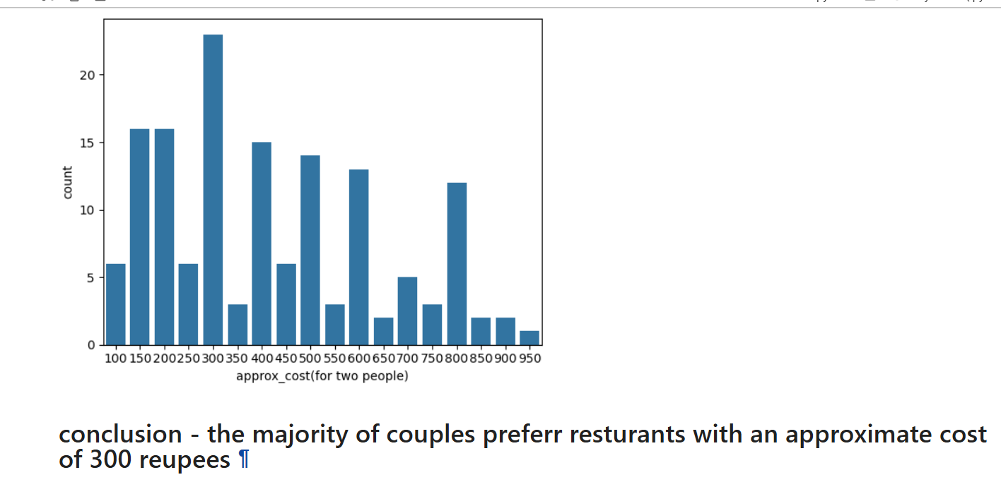
4. Zomato has observed that most couples order most of their food online. What is their average spending on each order?

Slide 6
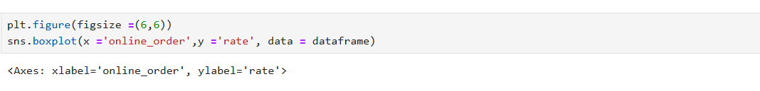
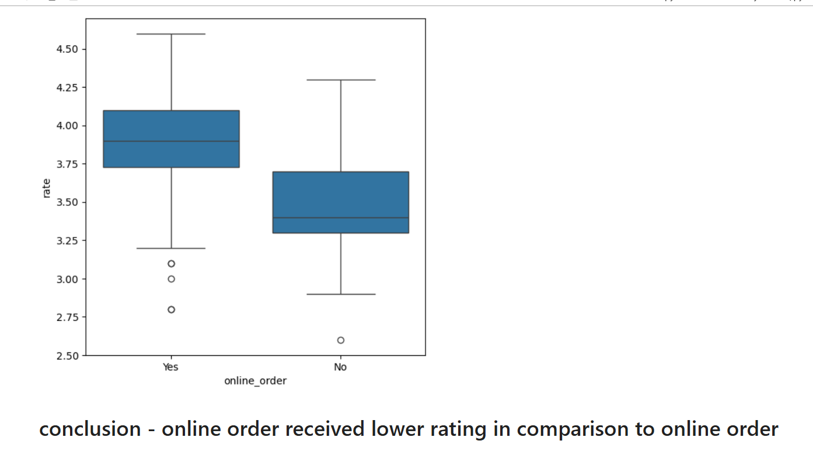
5. Which mode (online or offline) has received the maximum rating?S

Slide 7
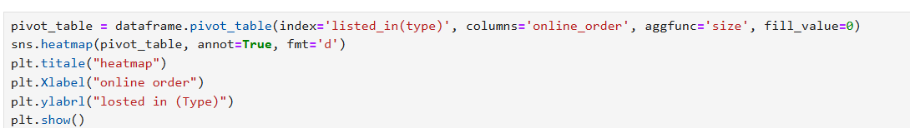
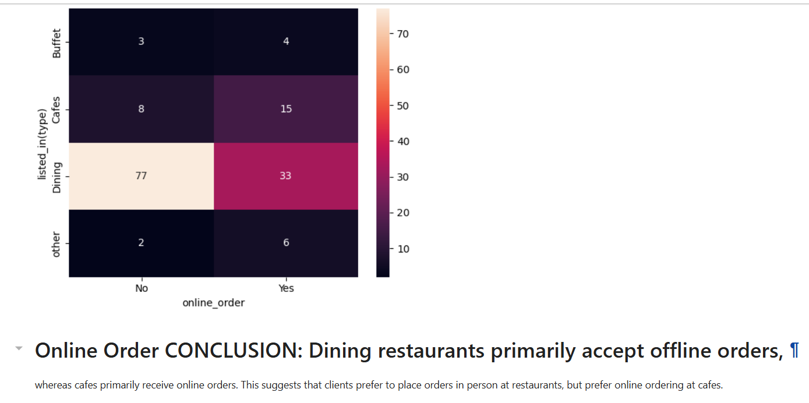
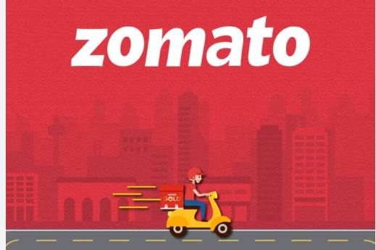
6. Which type of restaurant received more offline orders, so that Zomato can provide customers with some good offers?

